Slide 1
SVHN Image Classification
Using Convolutional Neural Networks (CNN)
Topic 2 Group Assignment · Deep Learning
91.88%
Best Test Accuracy
Yunnan University · 2026
ROY SUDIPTA

Slide 2
Presentation Agenda
01
Problem Statement
02
Dataset Overview
03
Why CNN?
04
CNN Architecture
05
Data Preprocessing
06
Training Setup
07
Code Highlights
08
Results & Analysis
09
Challenges & Solutions
10
Conclusion & Future Work

Slide 3
Problem Statement: SVHN Digit Recognition
What is SVHN?
Why harder than MNIST?
Street View House Numbers — real-world images from Google Street View
32×32 pixel colour (RGB) images of house number digits
10 classes: digits 0 through 9
Published by Stanford University (Netzer et al., 2011)
Far more challenging than MNIST: natural noise, clutter, colour variation, variable lighting
RGB colour — 3 channels vs 1
Real background clutter
Variable lighting & blur
Multiple digits may be visible
Natural class imbalance
Project Goal
Build a CNN from scratch to classify digits 0–9 with > 90% accuracy. No pre-trained weights or transfer learning — all feature extraction learned from the data.

Slide 4
Dataset Overview: SVHN
73,257
26,032
10
32×32
Training Images
Test Images
Classes (0–9)
Image Size (RGB)
Key Dataset Properties
Property | Detail
Format | MATLAB .mat file, loaded via torchvision API directly — no manual parsing needed
Label mapping | Raw dataset assigns label 10 to digit '0' — mapped to 0 in preprocessing code
Class distribution | Approximately balanced across digits 0–9; digit '1' slightly over-represented (natural frequency in street addresses)
Extra set | 531,131 additional images available but not used — we use only the standard train/test split
Preprocessing | Normalise to [−1,1]; random crop and flip for training; ToTensor + normalise only for test

Slide 5
Why Convolutional Neural Networks?
Traditional ML
Fully Connected NN
CNN ✓ (Our Approach)
Manual feature engineering required
Does not exploit spatial structure
Fails on pixel-level variations
Cannot share weights spatially
Poor scalability to higher resolution
Treats pixels as independent features
No spatial awareness whatsoever
Huge parameter count for images
Poor generalisation to new images
Computationally prohibitive
Automatic feature extraction
Exploits 2D spatial structure
Weight sharing = fewer parameters
Translation invariance via pooling
Hierarchical feature learning
CNN Key Advantage: One filter slides across the ENTIRE image — learning one edge detector works everywhere! (weight sharing)

Slide 6
CNN Architecture — SVHN_CNN
Input
32×32×3
Conv1
3→32
BN+ReLU
Pool
16×16×32
Conv2
32→64
BN+ReLU
Pool
8×8×64
Conv3
64→128
BN+ReLU
Pool
4×4×128
Flatten
2048
FC+BN
ReLU+Drop
256
Output
10 classes
3×3 Kernels
32→64→128 Filters
Same receptive field as 5×5 but fewer parameters and more non-linearity (VGGNet principle). Used throughout all conv layers.
Classic doubling schedule. As spatial size halves (via MaxPool), depth doubles — total information capacity stays roughly constant.
Padding = 1 (same)
~780K Parameters
Preserves spatial dimensions: (32 - 3 + 2) / 1 + 1 = 32. No information loss at borders during convolution.
Compact enough to train on a single GPU, large enough for strong representational capacity on SVHN.

Slide 7
Data Preprocessing & Augmentation
①
Random Crop (Train only)
②
Random Horizontal Flip (Train only)
Pad image by 4px each side → randomly crop back to 32×32. Creates positional variation — teaches translation invariance without distortion.
50% probability flip. Increases dataset diversity and teaches stroke-orientation robustness. Applied only during training.
③
ToTensor
④
Normalise to [−1, 1]
Convert PIL image to PyTorch tensor. Scales pixel values from [0, 255] to [0.0, 1.0] automatically.
Mean=[0.5, 0.5, 0.5], Std=[0.5, 0.5, 0.5] per channel. Centers distribution around zero for faster gradient convergence.
Test set: ToTensor + Normalise only — no augmentation applied, so evaluation is unbiased

Slide 8
Training Setup & Hyperparameters
Hyperparameter | Value | Justification
Batch Size | 64 | Balances GPU memory and gradient quality
Learning Rate | 0.001 | Adam default; effective for deep networks
Epochs | 15 | Model converged — no further gain observed
Optimiser | Adam | Adaptive per-parameter learning rates
Weight Decay | 1×10⁻⁴ | L2 regularisation — prevents large weights
Loss Function | CrossEntropyLoss | Standard for multi-class classification
LR Scheduler | ReduceLROnPlateau | Halves LR when test accuracy plateaus (patience=2)
Dropout | p = 0.5 | 50% neuron dropout in fully connected layers

Slide 9
Code Highlight: Model Definition
class SVHN_CNN(nn.Module):
def __init__(self, num_classes=10):
super().__init__()
# Block 1: 32×32×3 → 16×16×32
self.conv1 = nn.Conv2d(3, 32, kernel_size=3, padding=1)
self.bn1 = nn.BatchNorm2d(32)
self.relu1 = nn.ReLU(inplace=True)
self.pool1 = nn.MaxPool2d(2, 2) # halve spatial dims
# Block 2: 16×16×32 → 8×8×64
self.conv2 = nn.Conv2d(32, 64, kernel_size=3, padding=1)
self.bn2 = nn.BatchNorm2d(64)
# ... (same pattern) ...
# Block 3: 8×8×64 → 4×4×128
# Fully connected
self.fc1 = nn.Linear(128*4*4, 256) # flatten: 2048→256
self.drop1 = nn.Dropout(0.5)
self.fc2 = nn.Linear(256, 128)
self.fc3 = nn.Linear(128, 10) # → 10 digit classes
kernel_size=3, padding=1
"Same" padding — preserves 32×32 spatial dimensions
BatchNorm2d
Normalises activations per batch; accelerates convergence 2×
MaxPool2d(2,2)
Halves H and W — 32→16→8→4 across 3 blocks
Dropout(0.5)
Zeros 50% of FC neurons during training — prevents co-adaptation
fc3: 128→10
Final logits, one per digit class; CrossEntropyLoss applies softmax

Slide 10
Code Highlight: Training Loop
def train_one_epoch(model, loader,
optimizer, criterion, device):
model.train() # enable Dropout, BN train mode
total_loss, correct = 0.0, 0
for images, labels in loader:
images = images.to(device)
labels = labels.to(device)
optimizer.zero_grad() # clear old gradients
outputs = model(images) # forward pass
loss = criterion(outputs, labels)
loss.backward() # backpropagation
optimizer.step() # update weights θ
# track running loss and accuracy
total_loss += loss.item() * images.size(0)
correct += (outputs.argmax(1)==labels).sum()
return total_loss/len(loader.dataset),
correct/len(loader.dataset)
①
model.train()
Enables Dropout (masks 50% of neurons) and BatchNorm uses batch statistics — not running averages.
②
zero_grad()
PyTorch accumulates gradients by default. Clearing each step prevents errors from prior batches.
③
loss.backward()
Computes gradients for all parameters via chain rule (backpropagation through all layers).
④
optimizer.step()
Updates parameters: θ ← θ − lr · ∇L(θ). Adam adapts lr per parameter automatically.

Slide 11
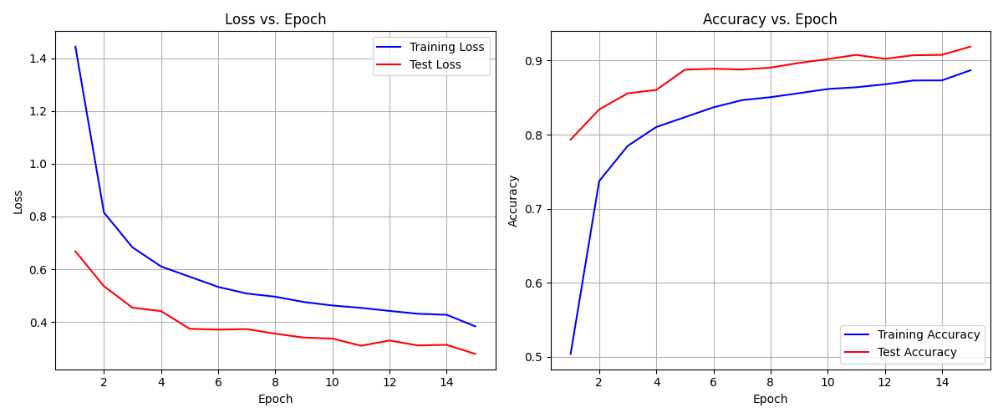
Results: Loss & Accuracy Curves (15 Epochs)
Key Observations: Sharp loss drop in first 5 epochs. Test loss converges to 0.279 (better than training loss due to Dropout). No overfitting — test loss tracks training loss throughout. Test accuracy consistently leads training accuracy because Dropout masks neurons during training but not at evaluation.

Slide 12
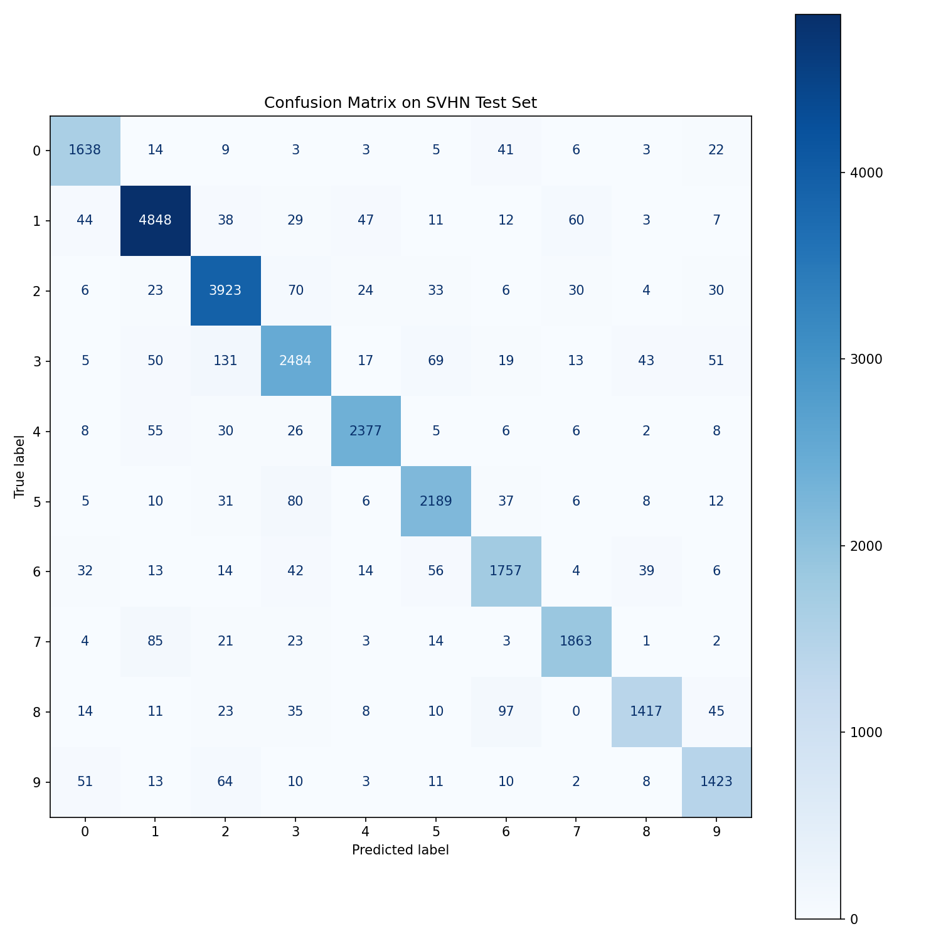
Results: Confusion Matrix on SVHN Test Set (26,032 samples)
Analysis
Diagonal dominance shows strong classification across all 10 classes
Digit 1 has the highest true count (4,848) — most common in the dataset
Digit 3 shows most off-diagonal confusion — mainly confused with 2 and 5
Digit 8 shows confusion with 6 (similar loops at this resolution)
Digit 9 often confused with 4 and 6 (stroke similarity)
Overall accuracy: 91.88% — strong for a custom model from scratch

Slide 13
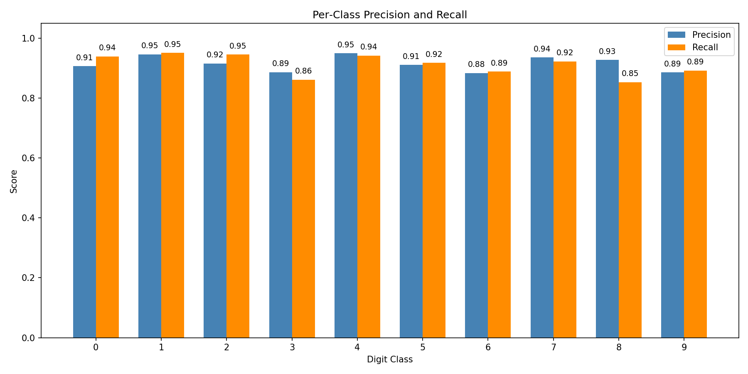
Results: Per-Class Precision & Recall
Best precision: Digit 4 (0.95) | Best recall: Digits 1 & 2 (0.95)
Lowest recall: Digit 8 (0.85) — confusion mainly with 6 and 3
Most classes achieve 0.88–0.95 precision and 0.86–0.95 recall — consistent performance

Slide 14
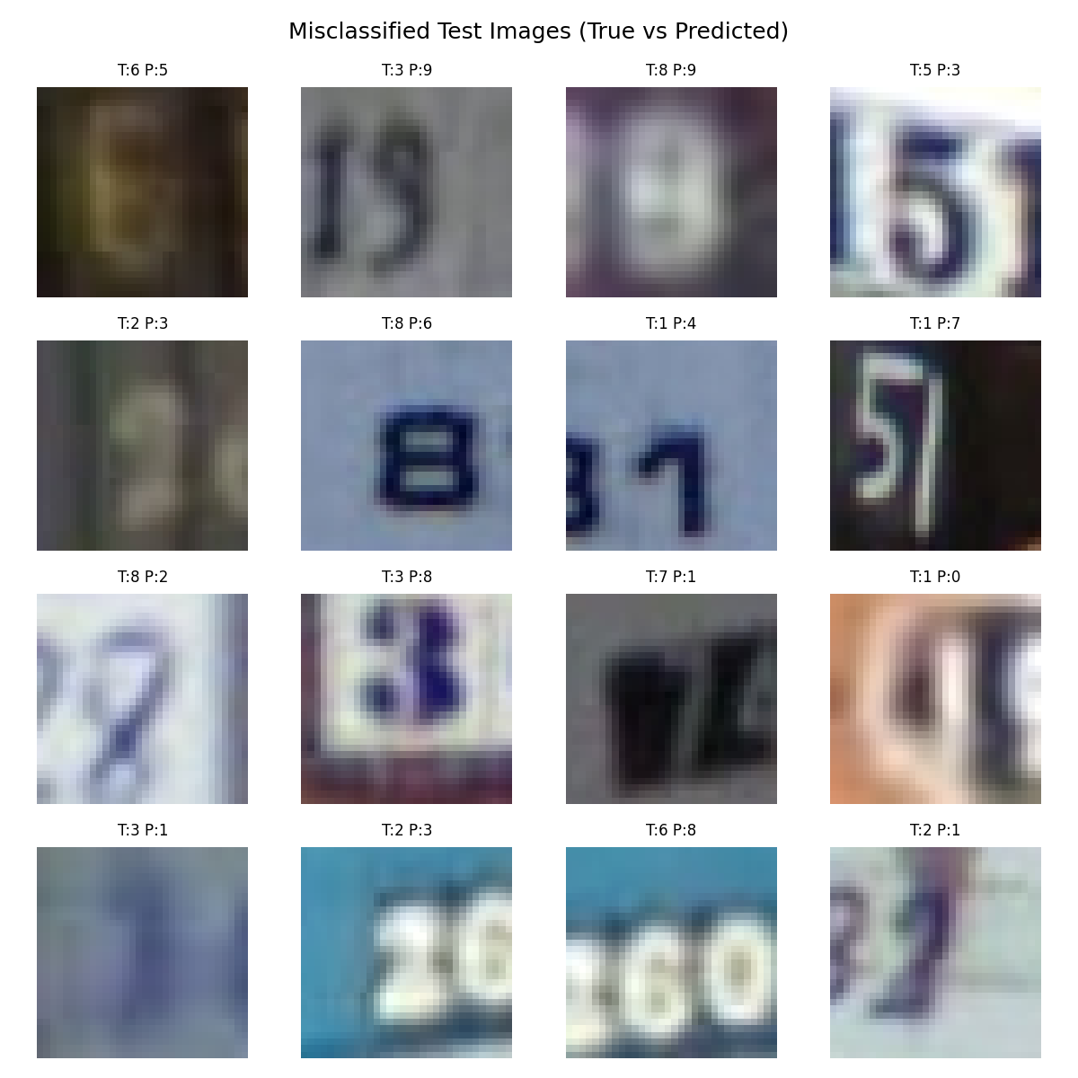
Results: Misclassified Test Images
Error Pattern Analysis
T = True label, P = Predicted label shown above each image
6↔9: Rotationally similar at 32×32 resolution — most common confusion
3↔8: Similar closed-loop structure in the lower half
1↔7: Similar vertical stroke — especially in italic/styled fonts
Background clutter causes some errors — digit region is ambiguous
Multi-digit images: model focuses on wrong digit in the crop
Most errors involve visually ambiguous pairs — not random noise

Slide 15
Discussion & Result Interpretation
Why Test Acc > Train Acc?
Dropout(0.5) masks 50% of neurons during training — artificially suppresses the training metric. During eval(), Dropout is OFF — full model capacity is used. This is the expected behaviour with Dropout regularisation.
Why Accuracy Plateaus After Epoch 10?
Model has extracted most useful information from the current architecture and augmentation strategy. ReduceLROnPlateau reduced the learning rate — the model stabilised rather than getting stuck. Deeper networks or more augmentation would be needed for further gains.
Why No Overfitting?
Dropout(0.5) provides strong regularisation in FC layers. BatchNorm acts as an implicit regulariser by normalising activations. L2 weight decay (1×10⁻⁴) prevents large weight values. Data augmentation increased effective dataset diversity.

Slide 16
Challenges & Solutions
Early Overfitting
⚠ Problem → ✓ Added Dropout(0.5) + L2 weight decay (1e-4) → test loss stabilised throughout training
Slow Convergence (No BN)
⚠ Problem → ✓ Added BatchNorm after every layer → 2× faster convergence; more stable gradient flow
Windows Multiprocessing
⚠ Problem → ✓ Set num_workers=0 in DataLoader → eliminated OS-level deadlock in training
LR Too High at Later Epochs
⚠ Problem → ✓ ReduceLROnPlateau scheduler → automatic LR halving on plateau; oscillation eliminated
Choosing Kernel Size
⚠ Problem → ✓ 3×3 preferred: same receptive field as 5×5 but fewer parameters and more non-linearity

Slide 17
Conclusion
91.88%
15
0.279
~780K
Best Test Accuracy
Training Epochs
Final Test Loss
Trainable Params
Architecture
Regularisation
Three conv blocks with doubling filter depth (32→64→128) capture low-to-high level features. 3×3 kernels with same padding preserve spatial information.
BatchNorm + Dropout(0.5) + L2 weight decay work together. Near-zero overfitting on 73,000 samples confirms they complement each other.
Optimisation
Augmentation
Adam with ReduceLROnPlateau gave stable, fast convergence. The scheduler prevented oscillation in later epochs while still allowing improvement.
Random cropping and horizontal flipping contributed to the gap between training accuracy (88.69%) and test accuracy (91.88%).

Slide 18
Future Work & Improvements
Deeper Architecture (ResNet-style)
Residual connections allow training 20+ layer networks without vanishing gradients. Expected accuracy gain: ~95%+ from the current 91.88%.
Advanced Augmentation
Colour jitter, rotation, Cutout, MixUp — increases effective dataset diversity and improves generalisation on unseen lighting/background conditions.
Ensemble Methods
Train 5 different model seeds, average predictions. Typically adds 1–2% accuracy with no architecture changes — low cost, reliable gain.
Transfer Learning
Fine-tune ImageNet-pretrained ResNet-18 as starting point. Pre-learned low-level features (edges, textures) dramatically accelerate training.
Attention Mechanisms
Add SE blocks or CBAM spatial attention to help the model focus on the most discriminative digit regions — ignores background clutter better.

Slide 19
Thank You!
91.88%
15 Epochs
CNN
0 Pre-training
Best Accuracy
Training
Architecture
From Scratch

