Slide 1

Department of Electrical Engineering

Slide 2

Awards won by the faculty members
ASEM DUO-Belgium/Wallonia-Brussels mobility fellowship-2022
INAE Young Engineer Award-2022
IETE-IRSI (83) Young Scientist Award-2022
Japan Society for the Promotion of Science (JSPS)
Materials Research Society of India (MRSI) Medal-2018
IETE Technomedia Award 2018 for Young Women in Engineering
IETE-Prof SVC Aiya Memorial Award by IETE-2018, 2021.
World’s Top 2% Scientists and many more…………

Slide 3
Faculty

Slide 4
Students graduated

Slide 5
Publications: Journals
Publications: Conferences

Slide 6
Total no. of projects: 95
Project count
Total amount: ₹ 37.4379 crore
From Outreach grants
(SPARC, GIAN):
₹ 0.89159 crore

Slide 7
Placement Data

Slide 8
Core
Non-Core
Non-Core
Average placed/registered percentage
in review period: 69.55%
Core
Average placed/registered percentage
in review period: 34.44%

Slide 10

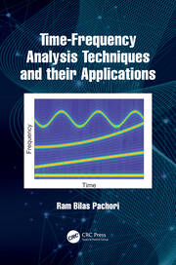
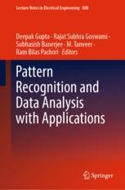

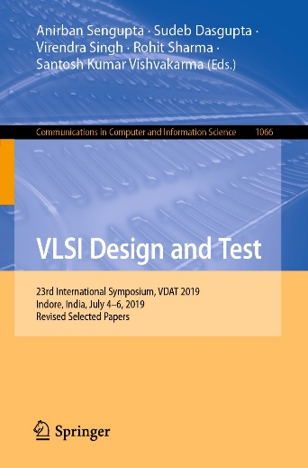

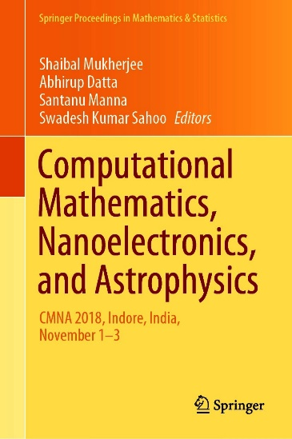


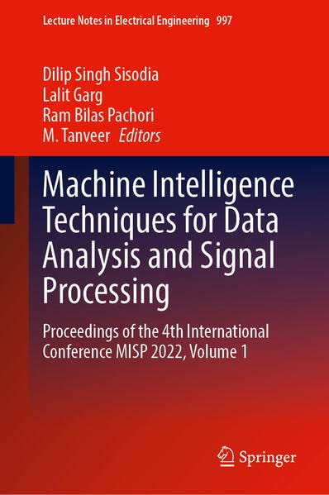
Books by faculty

