Slide 1
DLT Series
Kristian Brock

Slide 2
Intro
Bullet 1
Bullet 2
Bullet 3

Slide 3
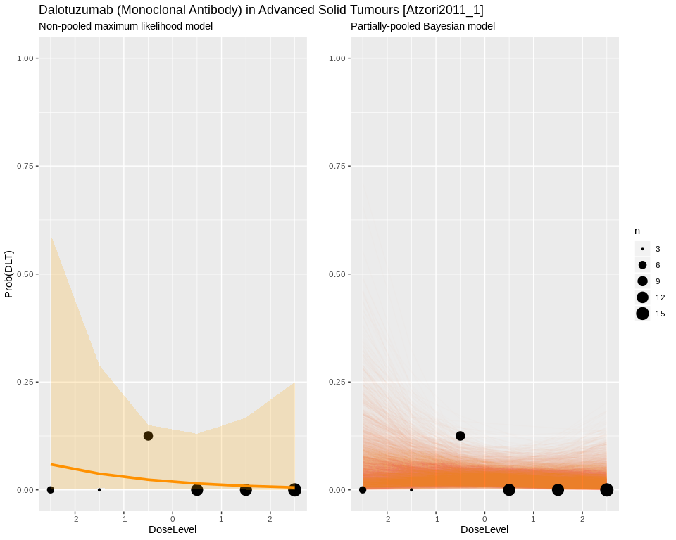

Slide 4
