Slide 1

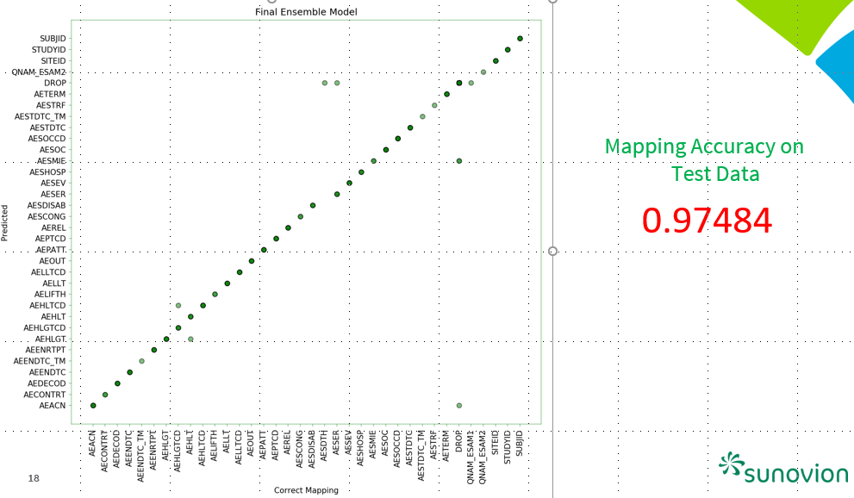
Machine Learning Project Sub-team
SDTM Mapping
Project initiated based on the positive outcome of the POC presented at CDISC US Interchange 2018
weighting scheme for word-variable matrices
neural network language model
Purpose
To explore and develop the SDTM mapping algorithms using NLP, ML, and NN.
To publish whitepaper on SDTM mapping
Notes:
The figure shows the promising performance of the NLP/ML based ensemble model on completely new 3 studies from the POC. x-axis = target ($Y$) and y-axis = output ($\hat{Y}$)
This project, SDTM Mapping will explore more efficient and high performing SDTM mapping algorithms through NLP, ML, and NN on a few selected domains. We planned to publish a whitepaper on methodology and the performance of the algorithms.

