Slide 1
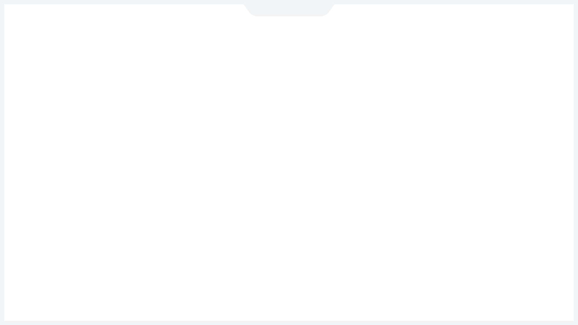





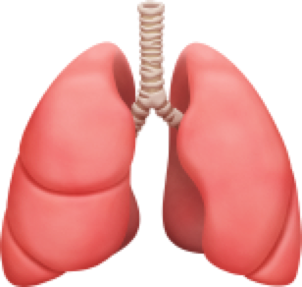

Emoji for the Medical Community
Massachusetts General Hospital
Lab of Computer Science
Assistant Professor
Harvard Medical School
Department of Internal Medicine
Department of Emergency medicine
Shuhan He, MD

Slide 2




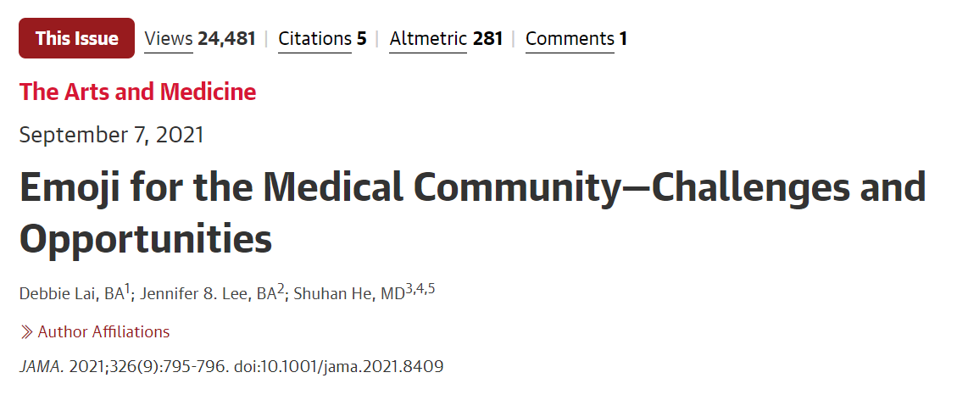
Emoji have significant medical importance
Shuhan He, MD
2

Slide 3
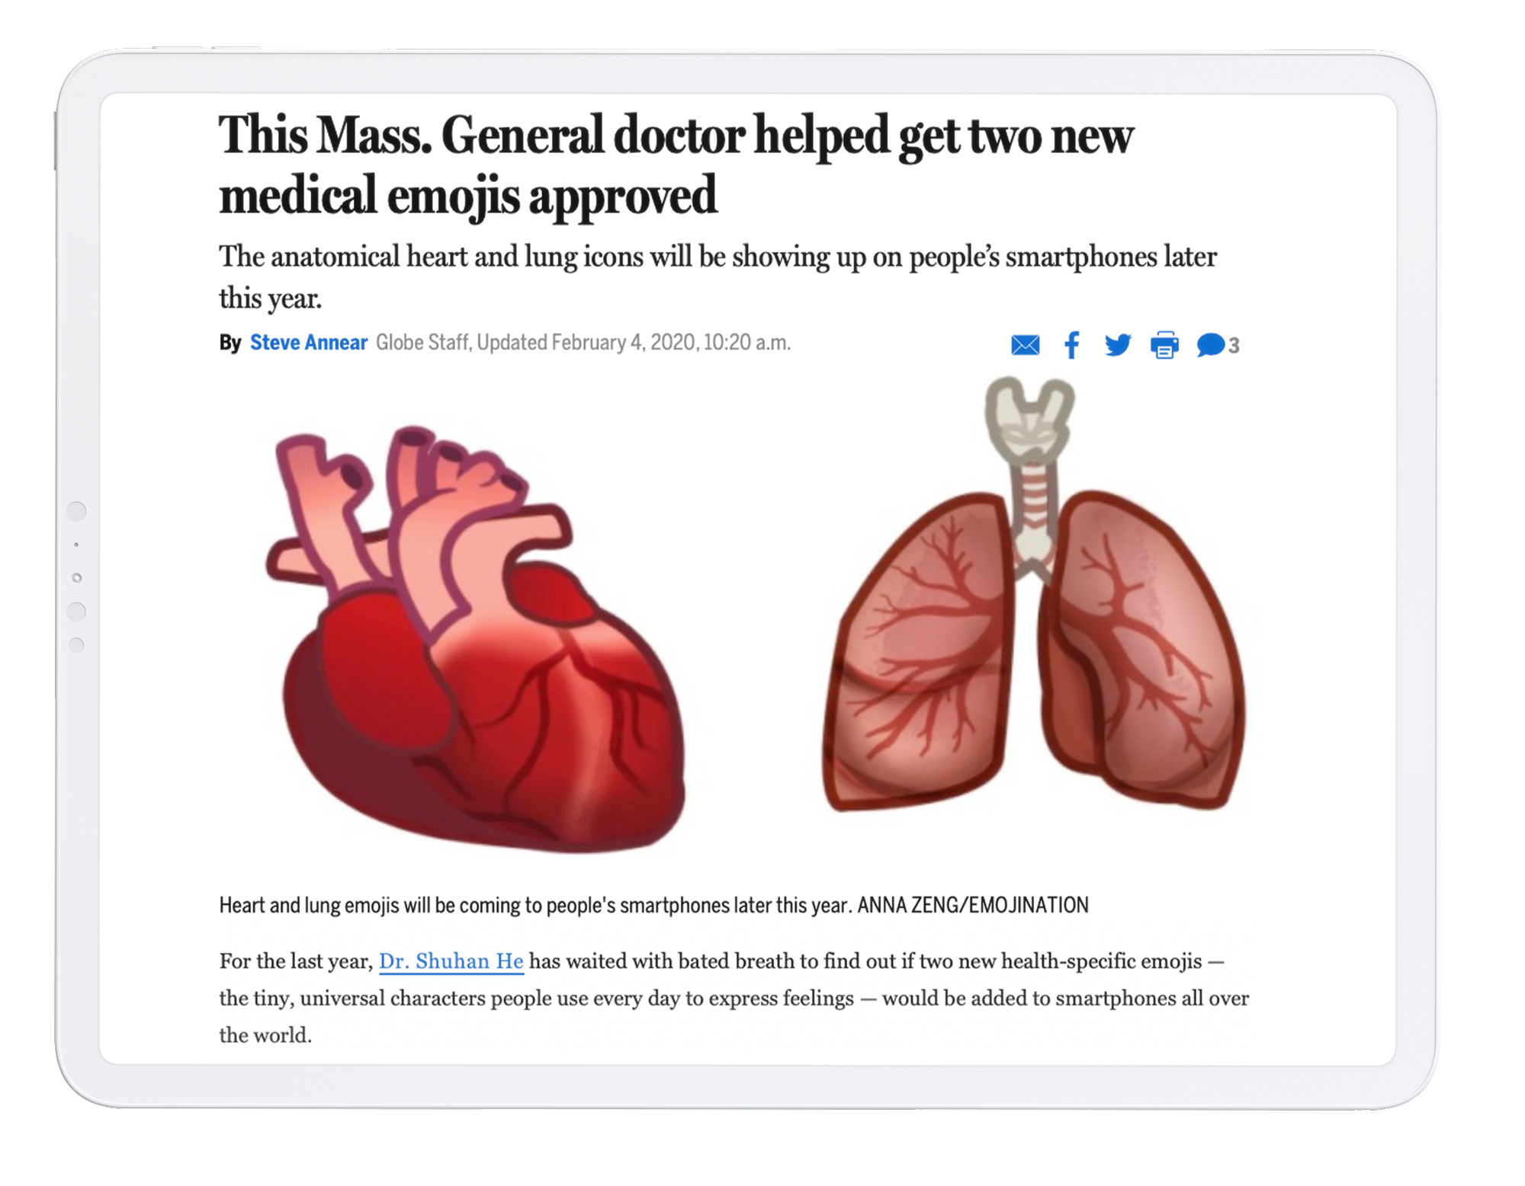

2019
Shuhan He, MD

Slide 4




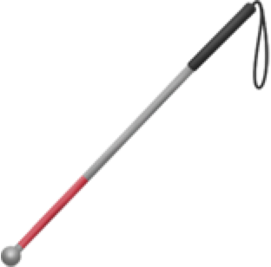
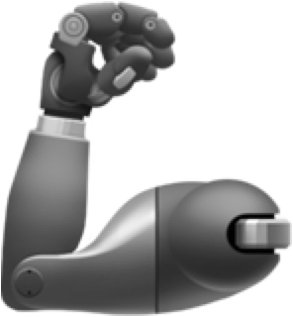

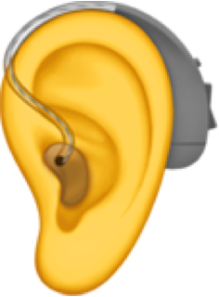






Existing Emoji
💉
Shuhan He, MD
4

Slide 5
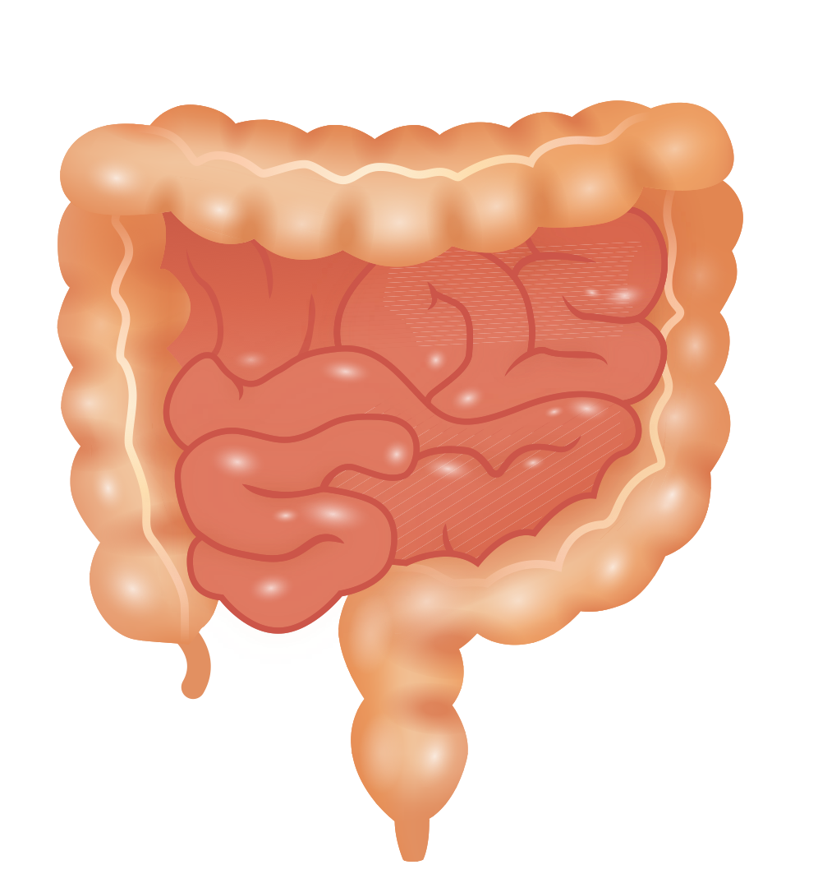
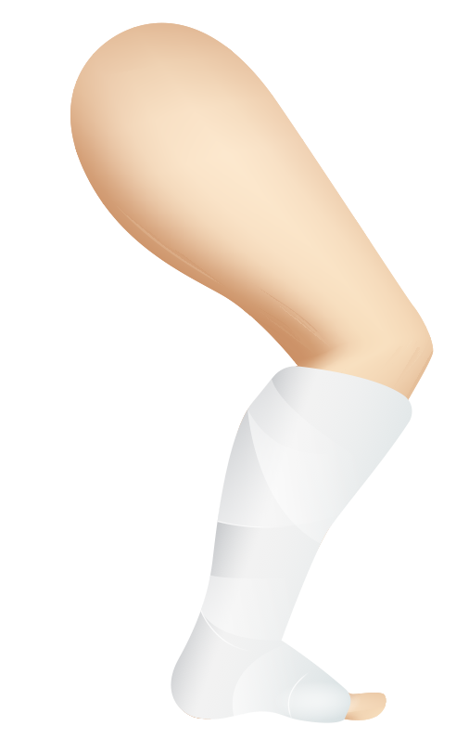
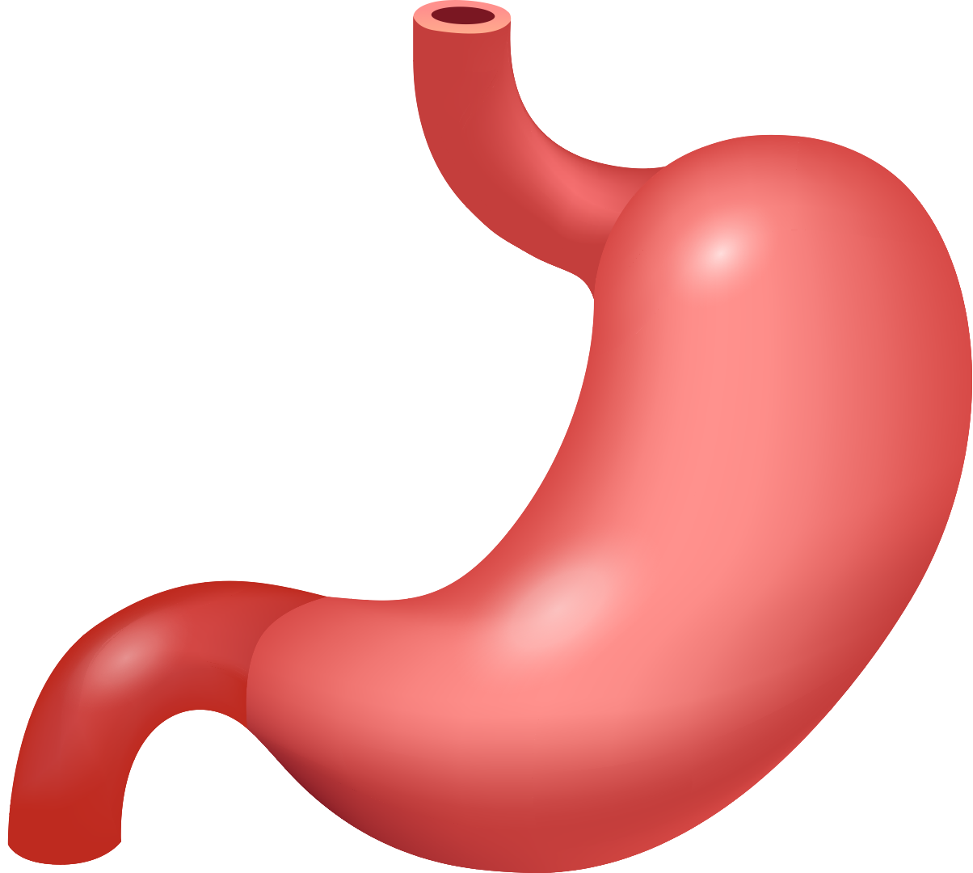
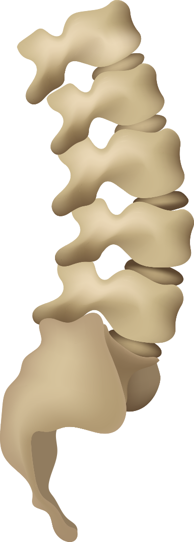
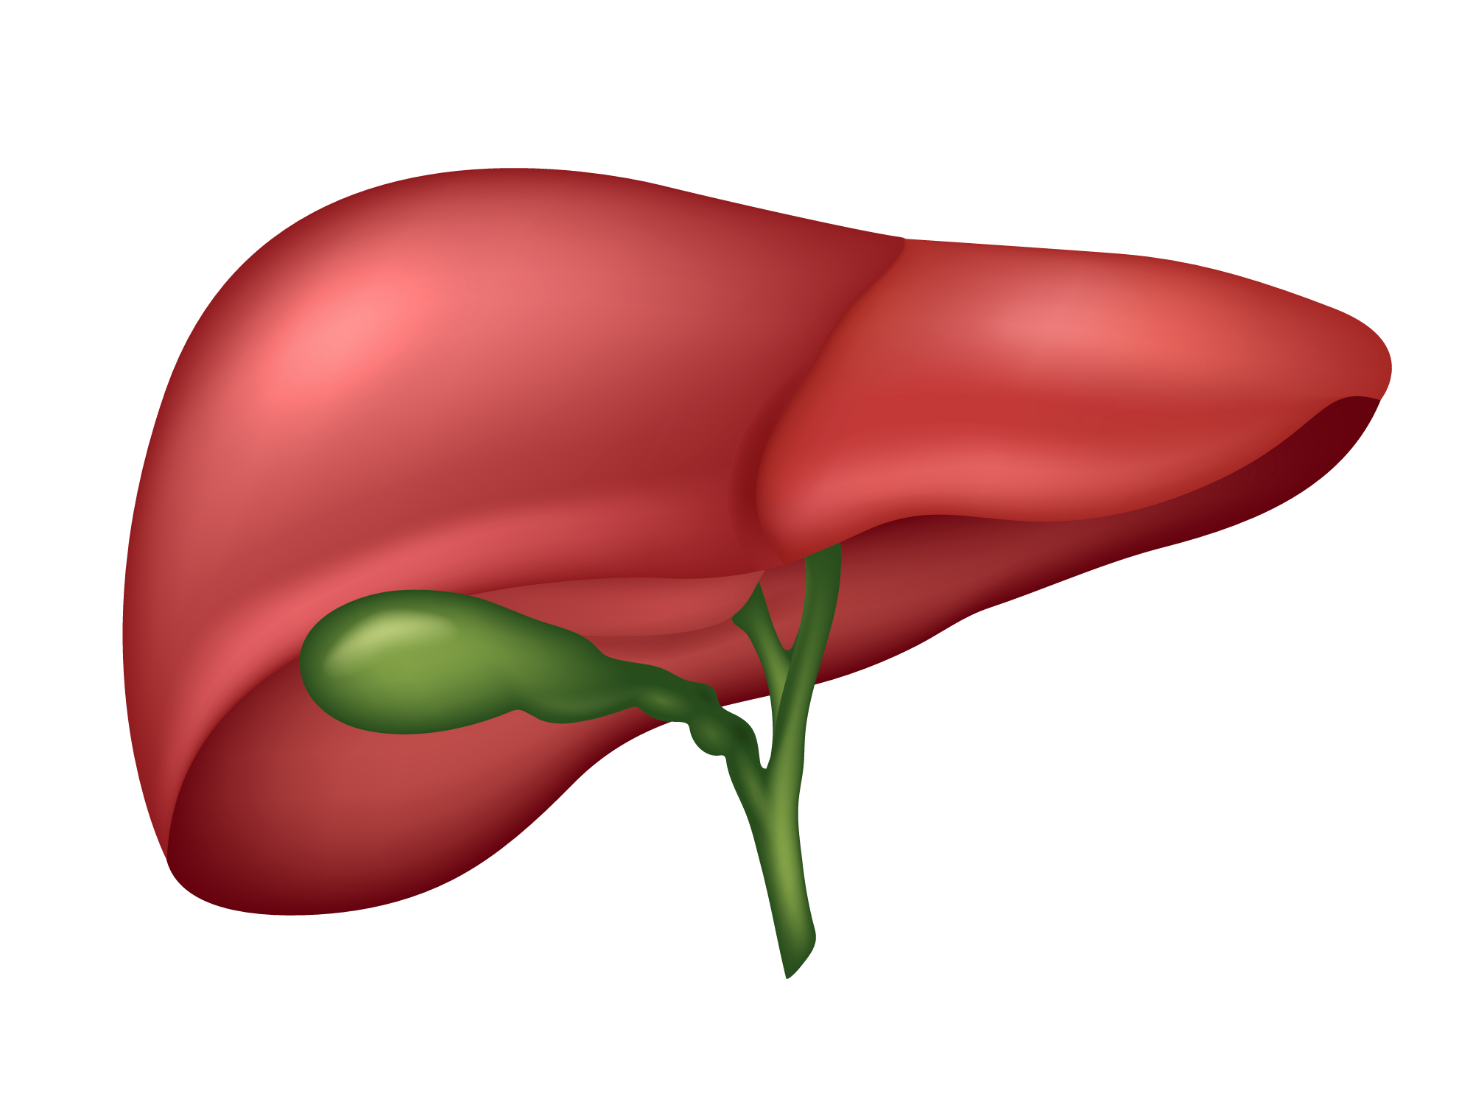
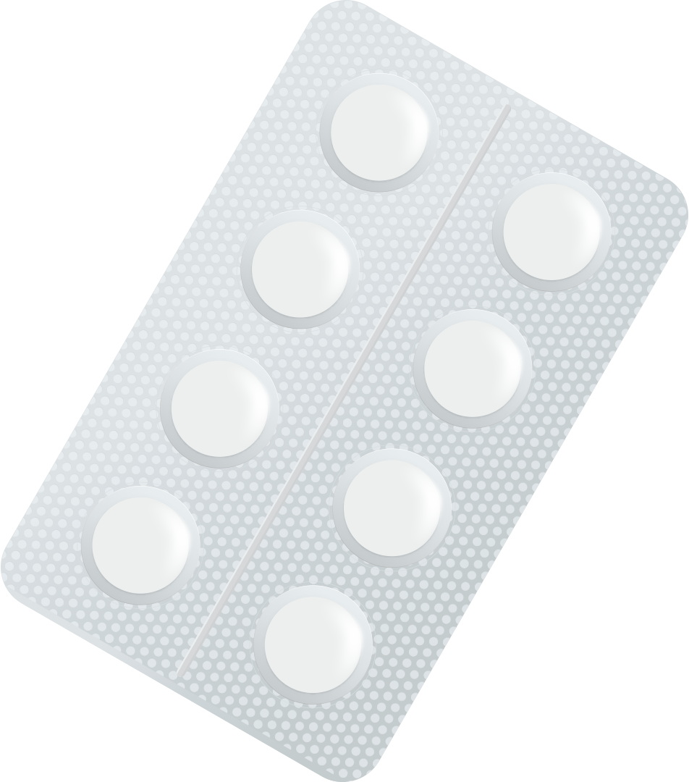
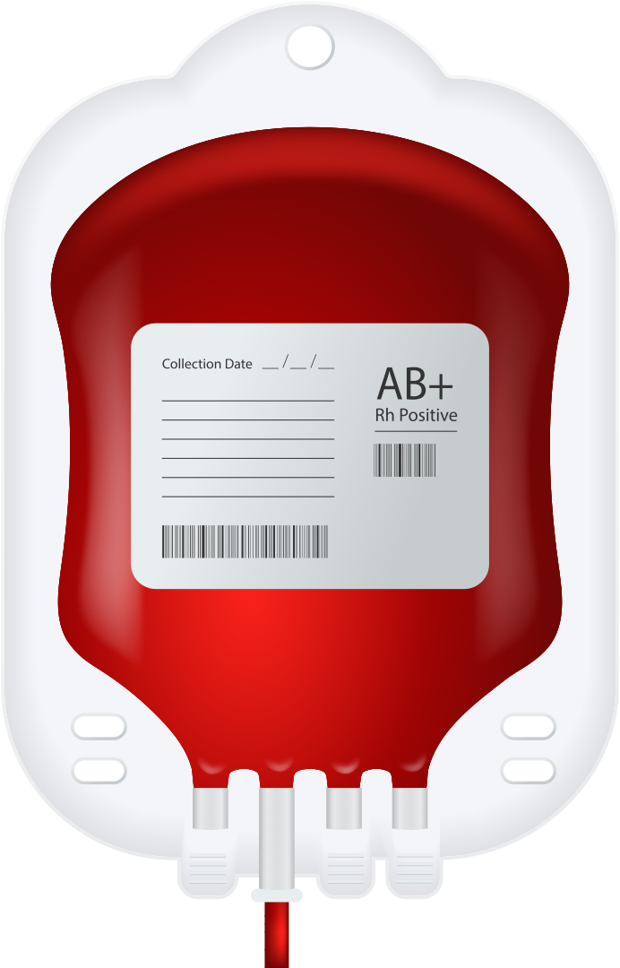
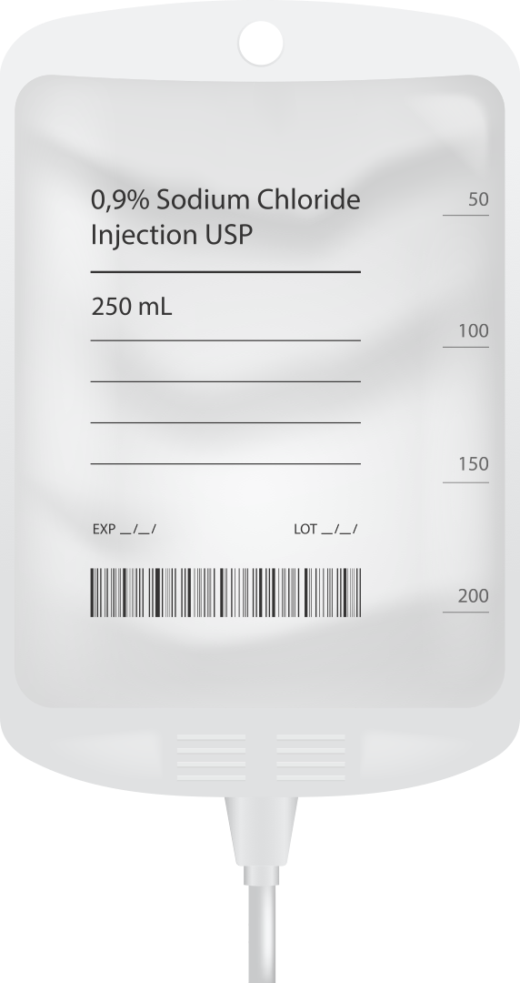
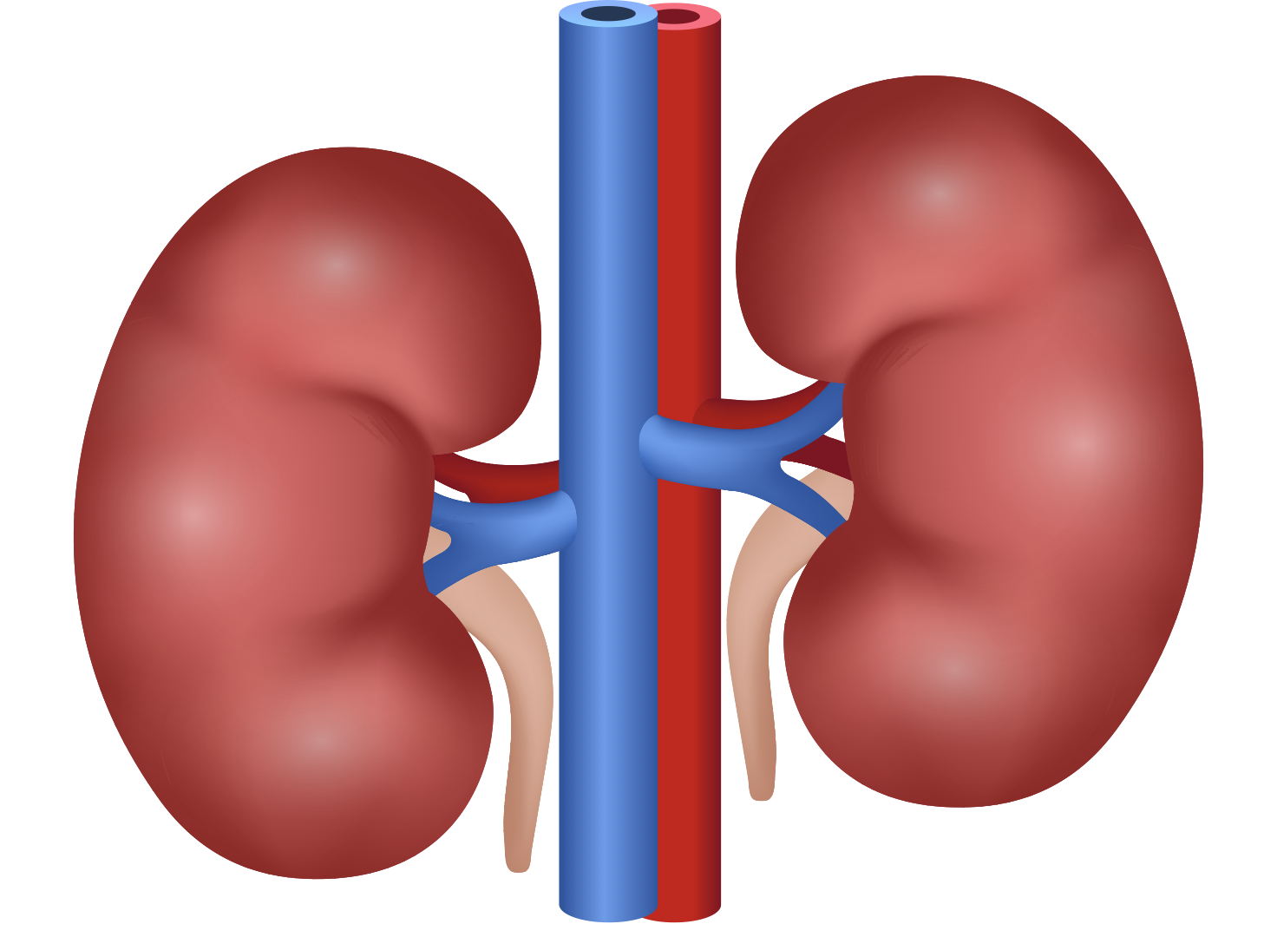
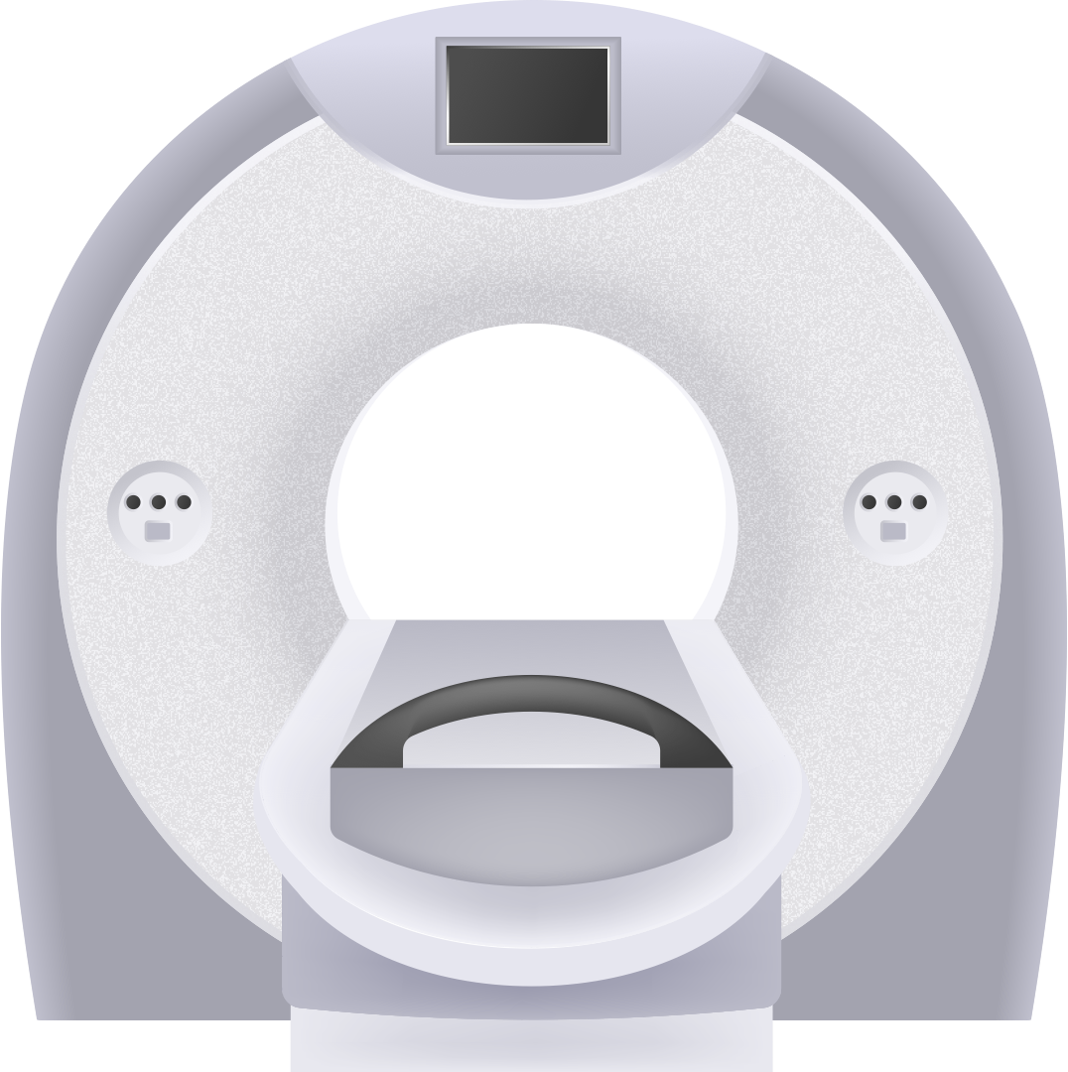

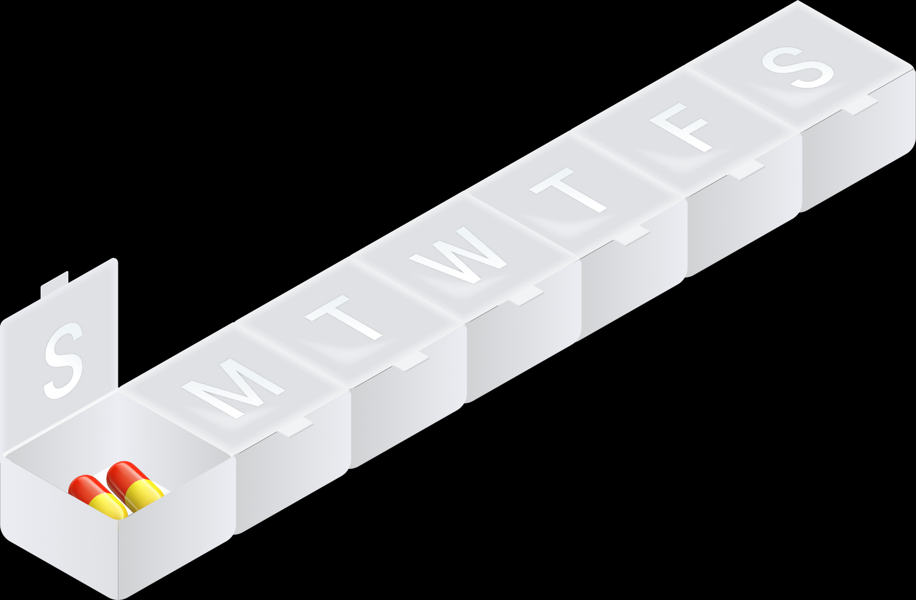
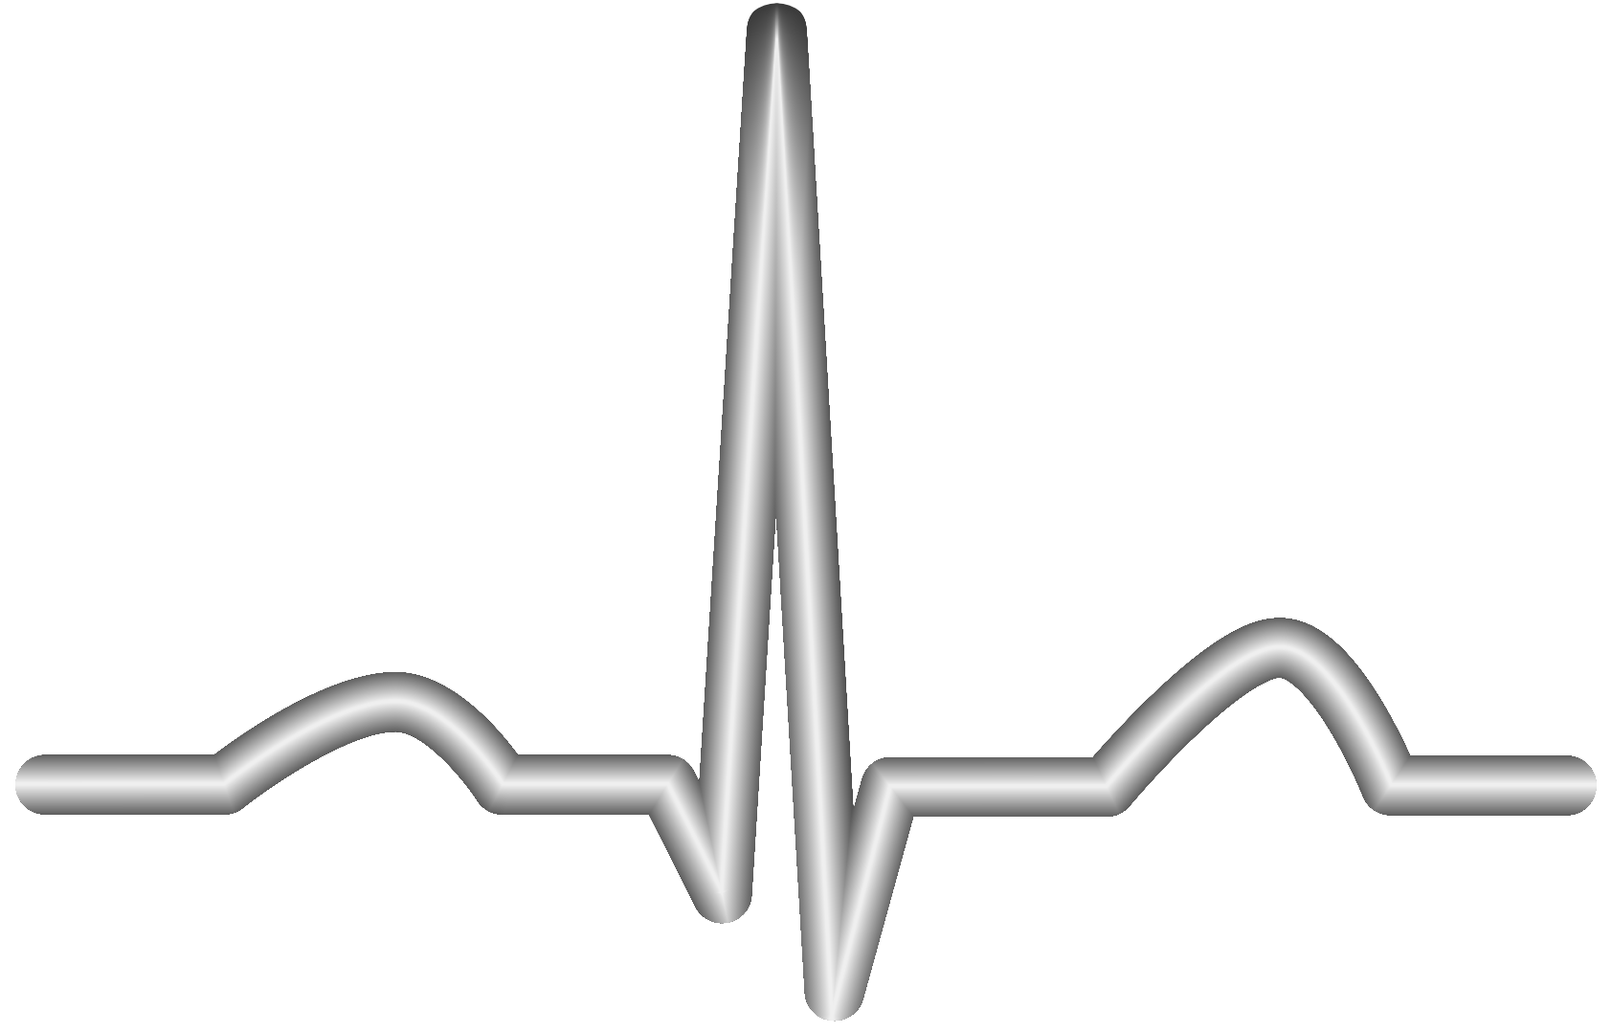

Our New Candidates
Shuhan He, MD
5

Slide 6
Every resubmission reset the clock
Unicode bars a declined emoji from re-review for four years, counted from the decline.
2019
2020
2021
2022
2024
2026
Heart + lungs
submitted
Both ship in
Emoji 13.0
First wave declined;
JAMA makes the case
Kidney, stomach,
liver declined
Spine, intestines,
ECG declined
Window shuts
July 31
Clear to file now 8 concepts
Unclear 3 concepts
Barred 3 concepts
White blood cell · Pill pack · Pill box
Blood bag · Leg cast · IV bag
CT scan · Weight scale
Kidney · Stomach · Liver
Spine · Intestines · ECG
Last declined in the 2021 cycle. The four-year bar has lapsed.
Submitted July 2022, declined that November. From the decline, the bar lifts Nov 2026 — after the window shuts. From submission, they clear by 12, 3 and 1 day.
Submitted days after the 2024 window opened, declined that cycle. The bar lifts around Nov 2028.
Shuhan He, MD
Unicode publishes submission dates, not decline dates; declines issue at cycle end, submitters notified by Nov 30. Sources: unicode.org/emoji/emoji-proposals-status.html · unicode.org/emoji/proposals.html

Slide 7
Where emoji decisions get made
The subcommittee recommends. The Technical Committee votes. Microsoft votes in that room.
Proposal
Emoji Standard &
Research WG
Unicode Technical
Committee
Release + fonts
Anyone may file
during the window
formerly the Emoji
Subcommittee (ESC)
recommends only
holds the vote
Full = 1 · Supporting = ½
Unicode version, then
Segoe UI Emoji ships it
Microsoft's standing in the Consortium
The 2026 cycle
— Full member. One of the few tiers that carries a UTC vote.
Opened
April 2, 2026
— Board seat. Vishal Chowdhary, VP of Science, Microsoft 365 Copilot.
Closes
July 31, 2026
— Vendor. Segoe UI Emoji puts the glyph on every Windows device.
Decisions
by Nov 30, 2026
Declined emoji: four-year bar
Shuhan He, MD
unicode.org/consortium/utc.html · unicode.org/consortium/directors.html · unicode.org/emoji/proposals.html

Slide 8
Request
Shuhan He, MD
8

