Slide 1
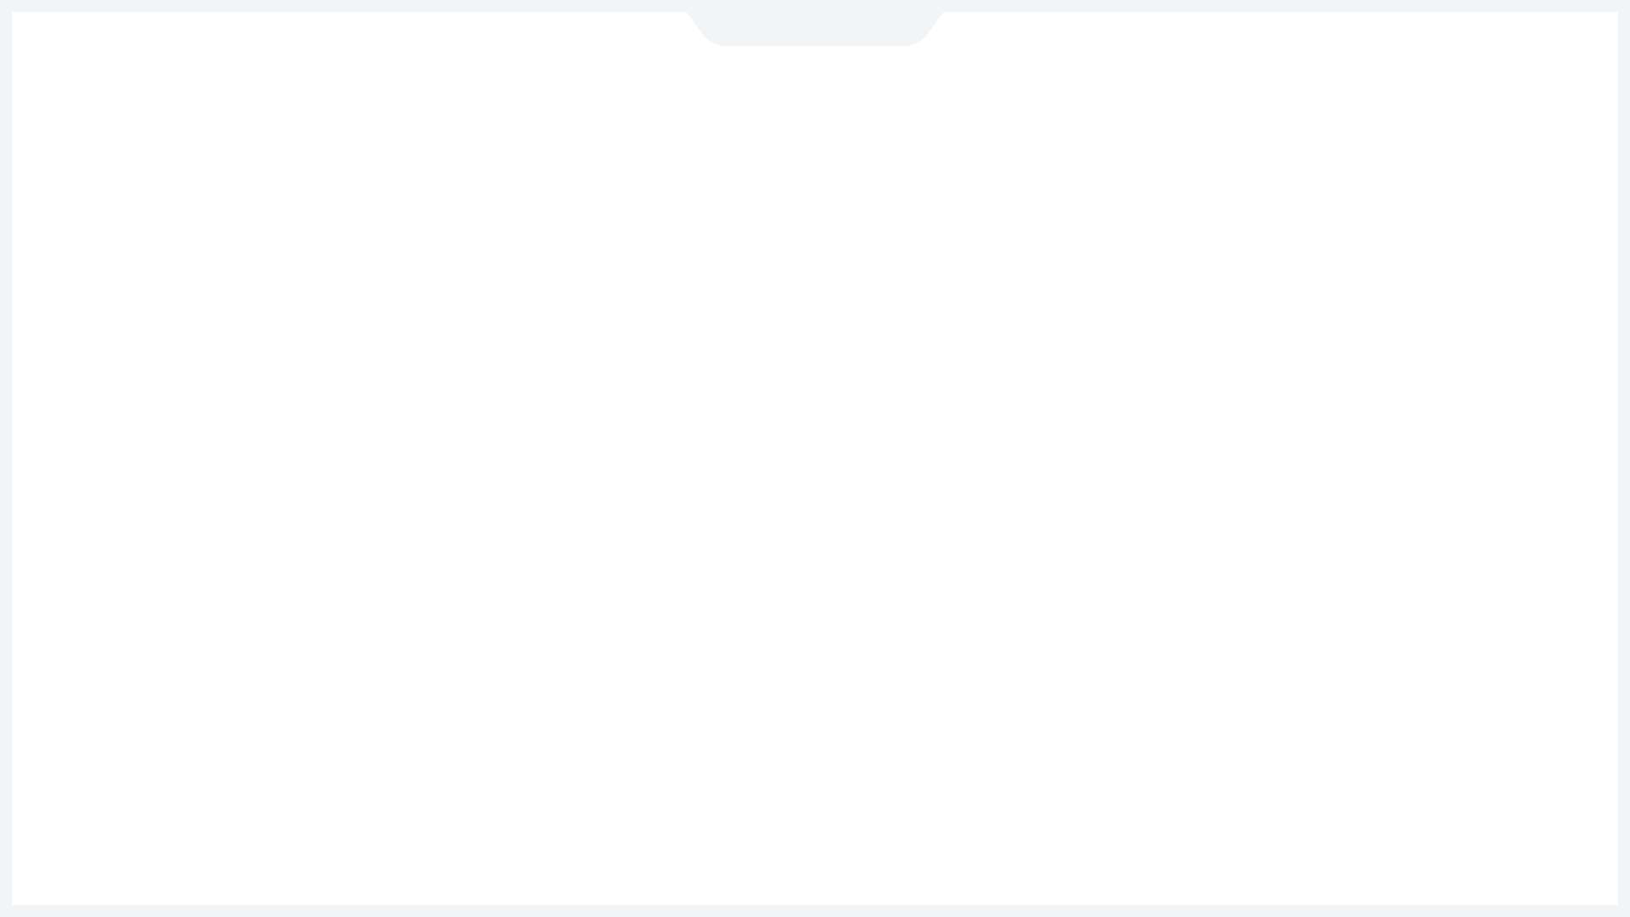





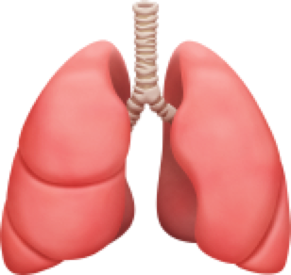

Emoji for the Medical Community
Massachusetts General Hospital
Lab of Computer Science
Assistant Professor
Harvard Medical School
Department of Internal Medicine
Department of Emergency medicine
Shuhan He, MD

Slide 2



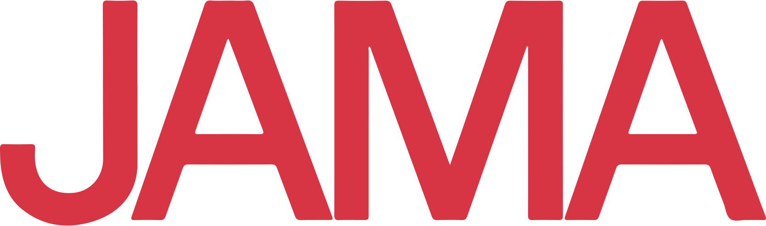
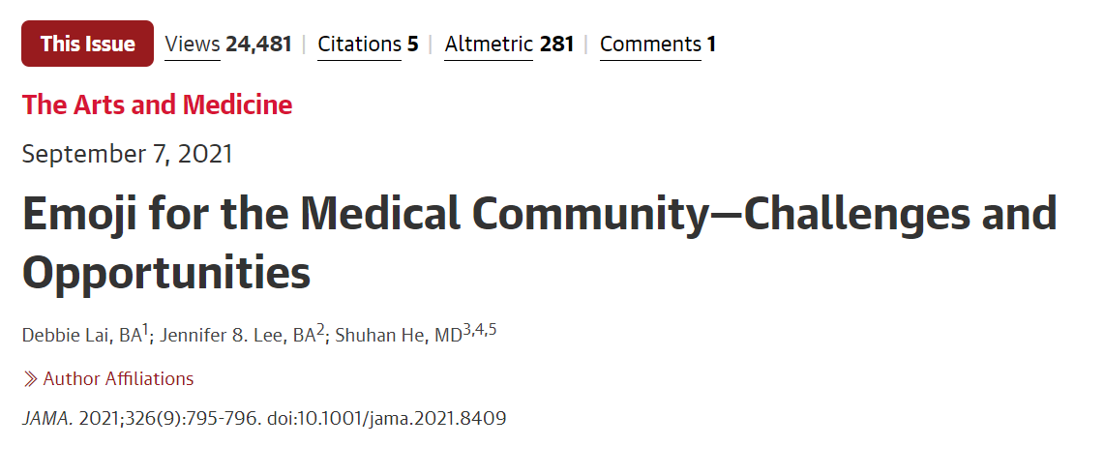
Emoji have significant medical importance
Shuhan He, MD
2

Slide 3
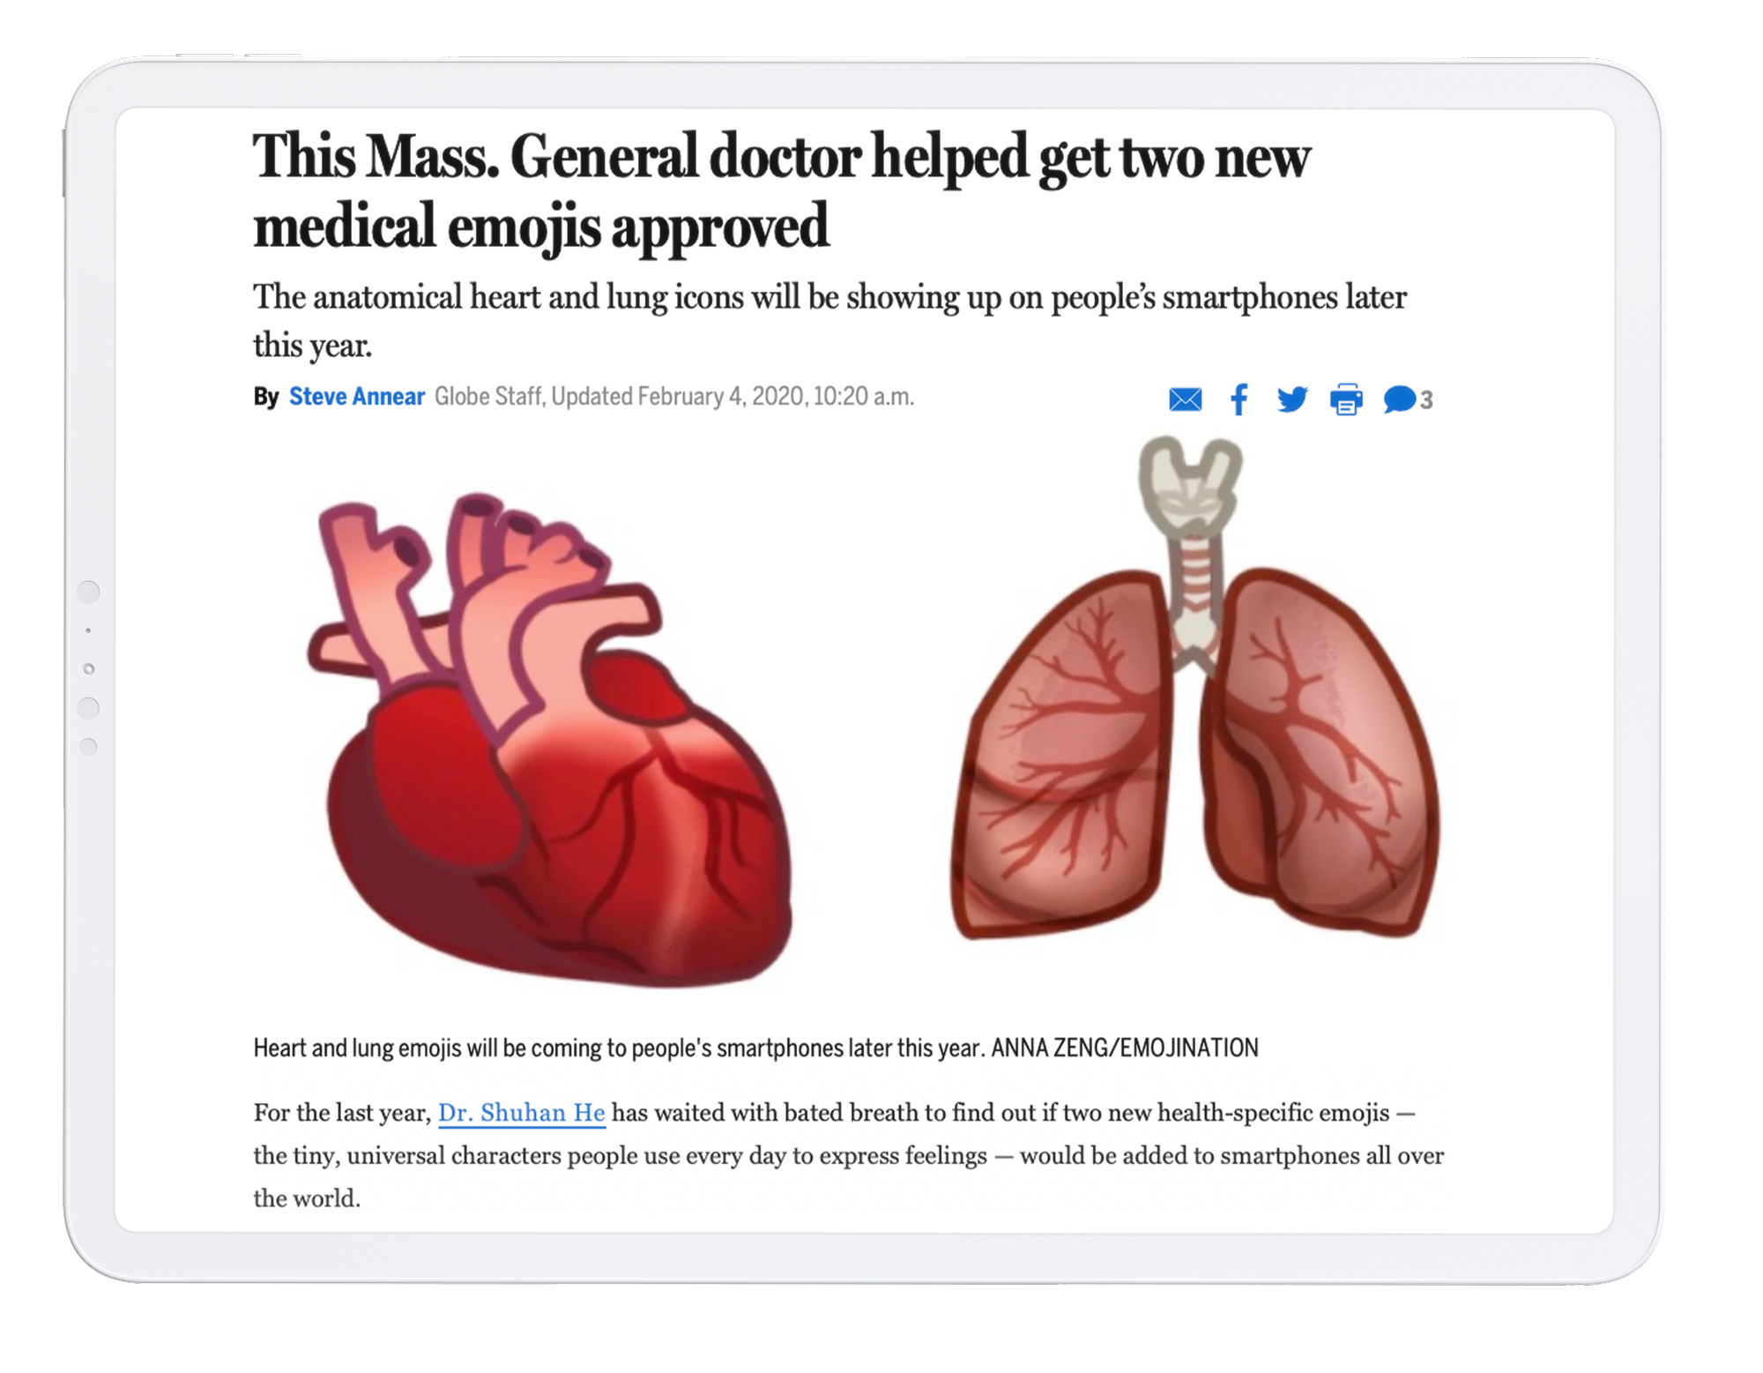

2019
Shuhan He, MD

Slide 4




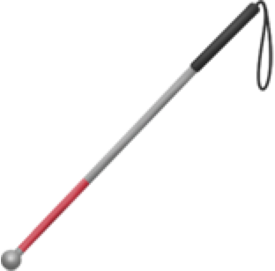
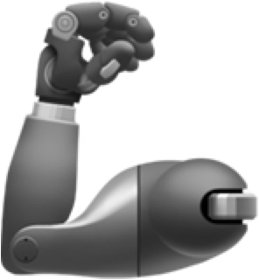
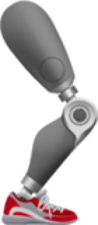
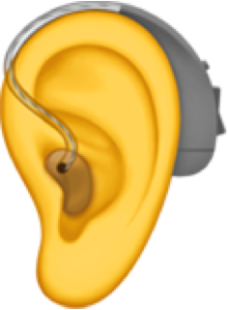






Existing Emoji
💉
Shuhan He, MD
4

Slide 5
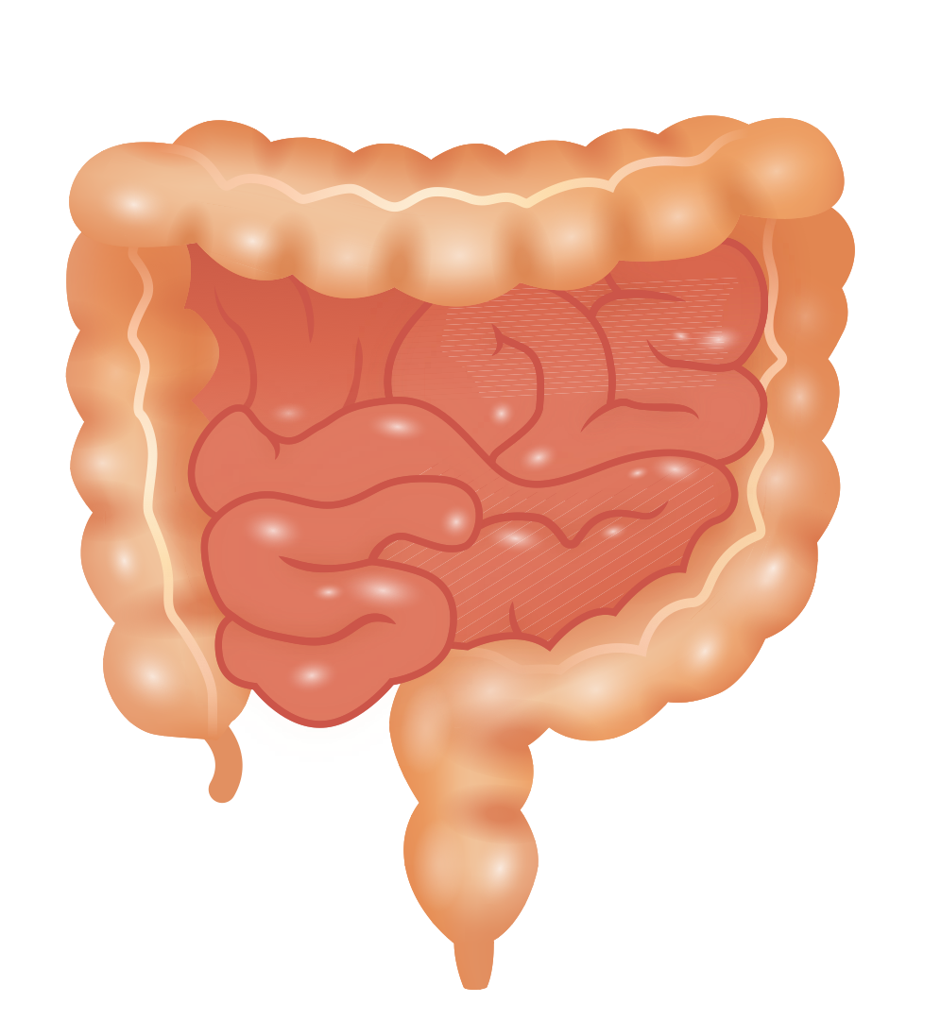
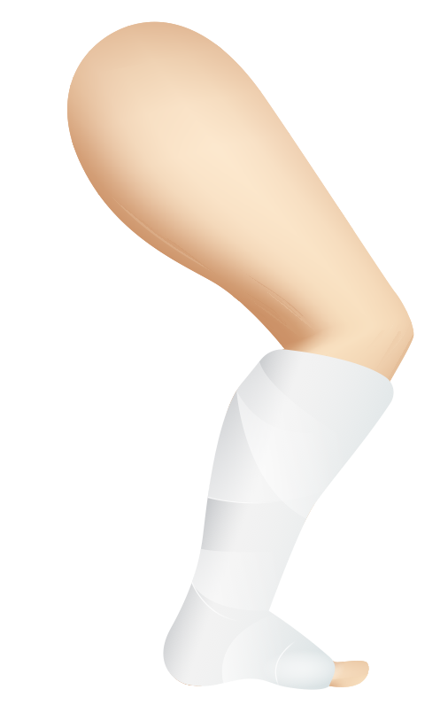
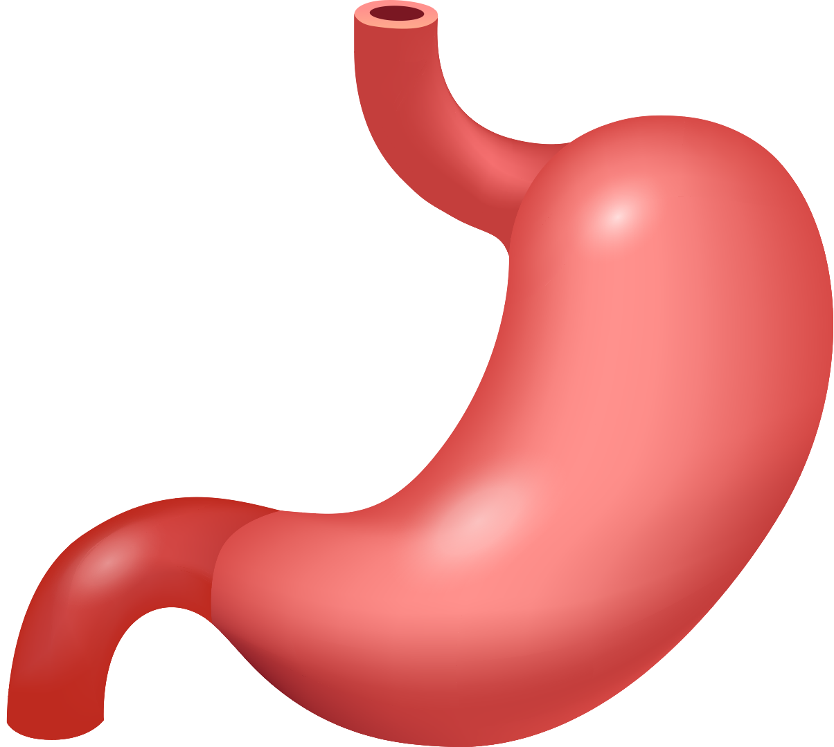
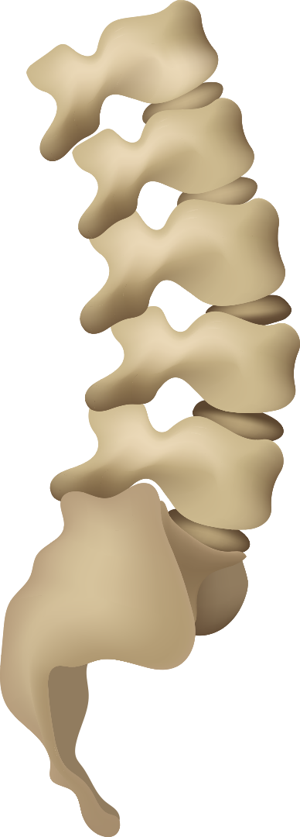
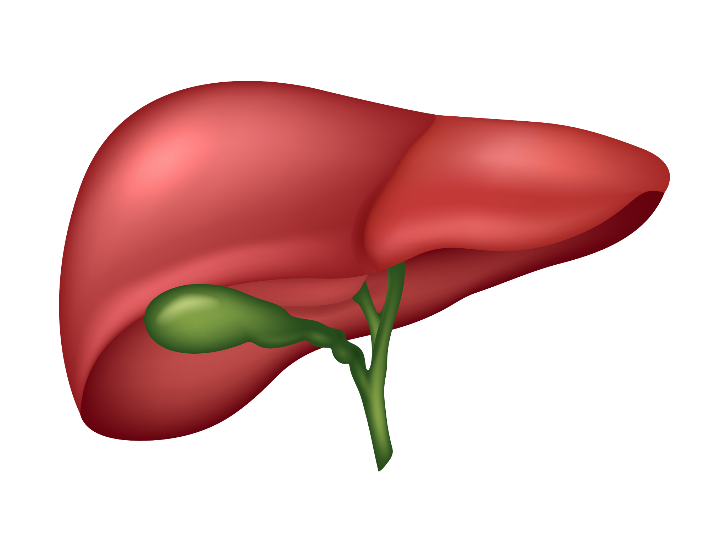
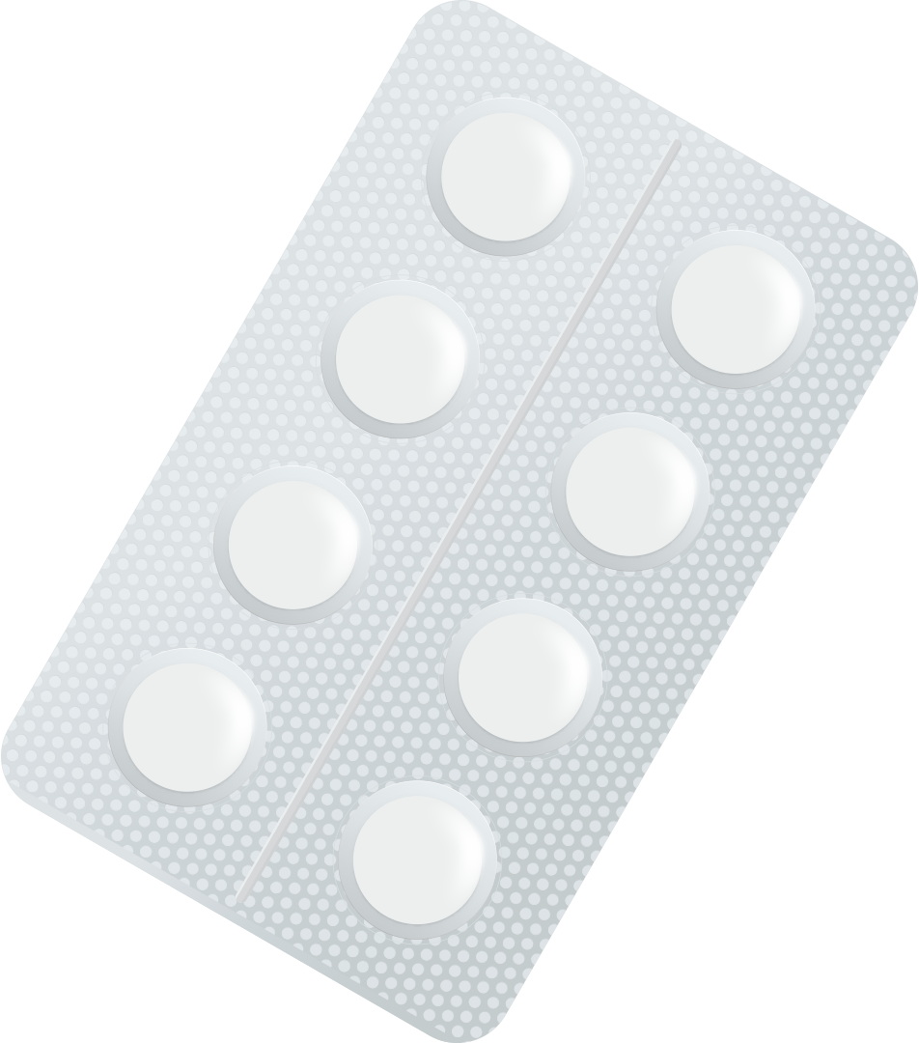
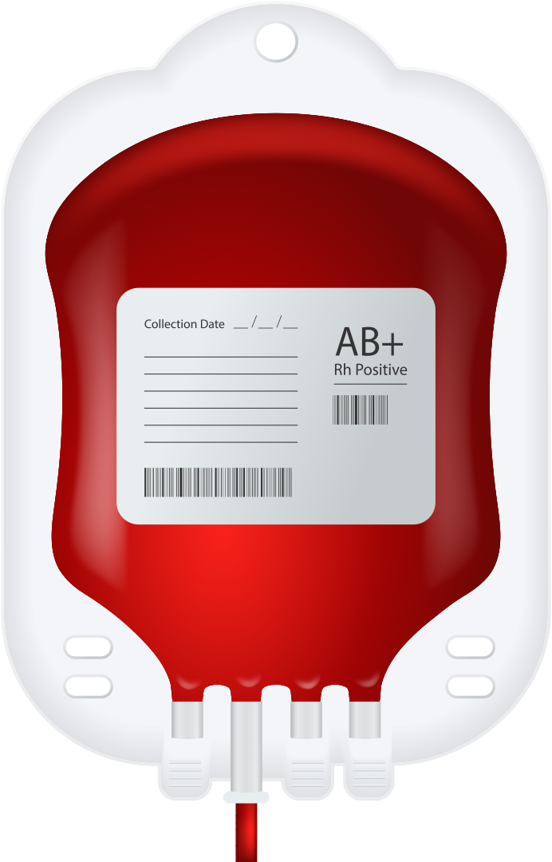
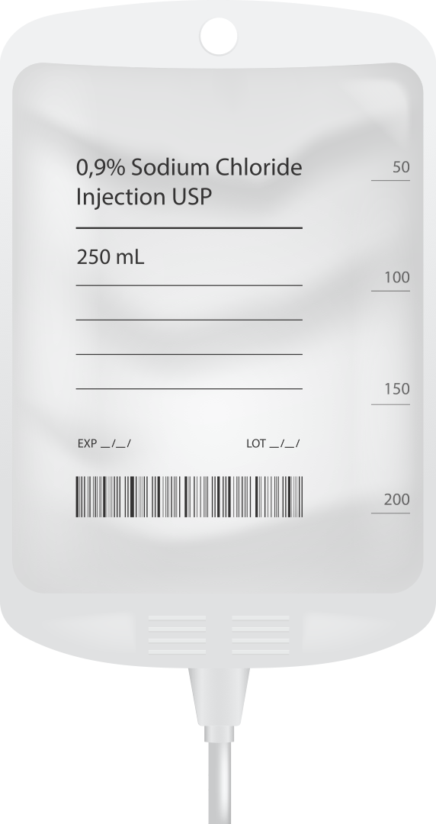
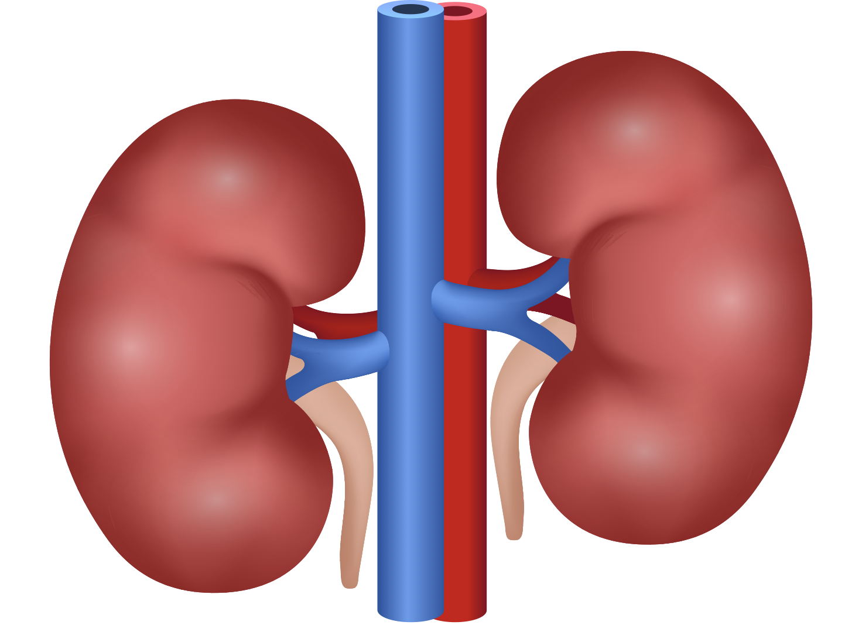
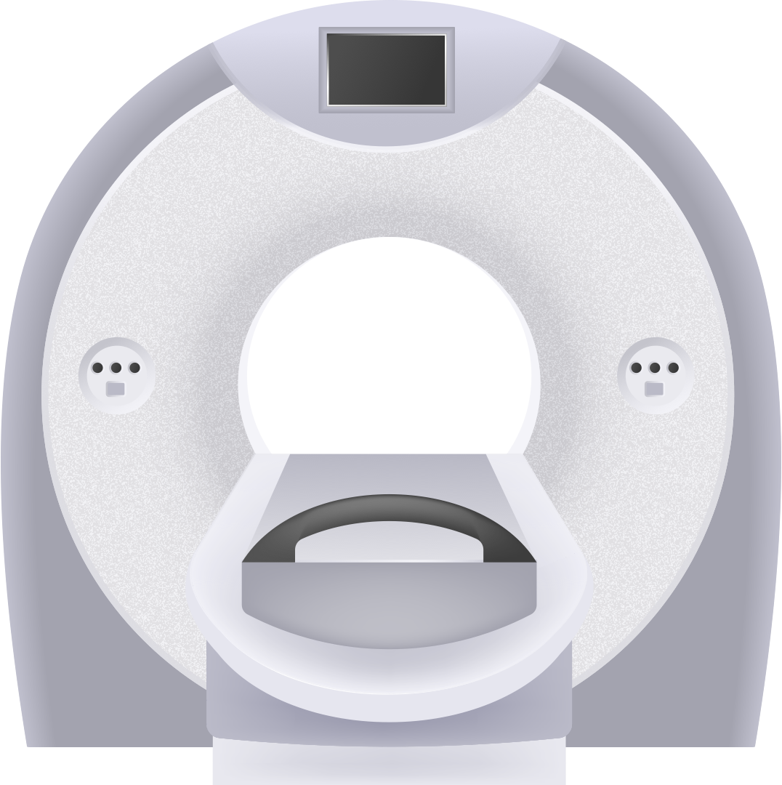
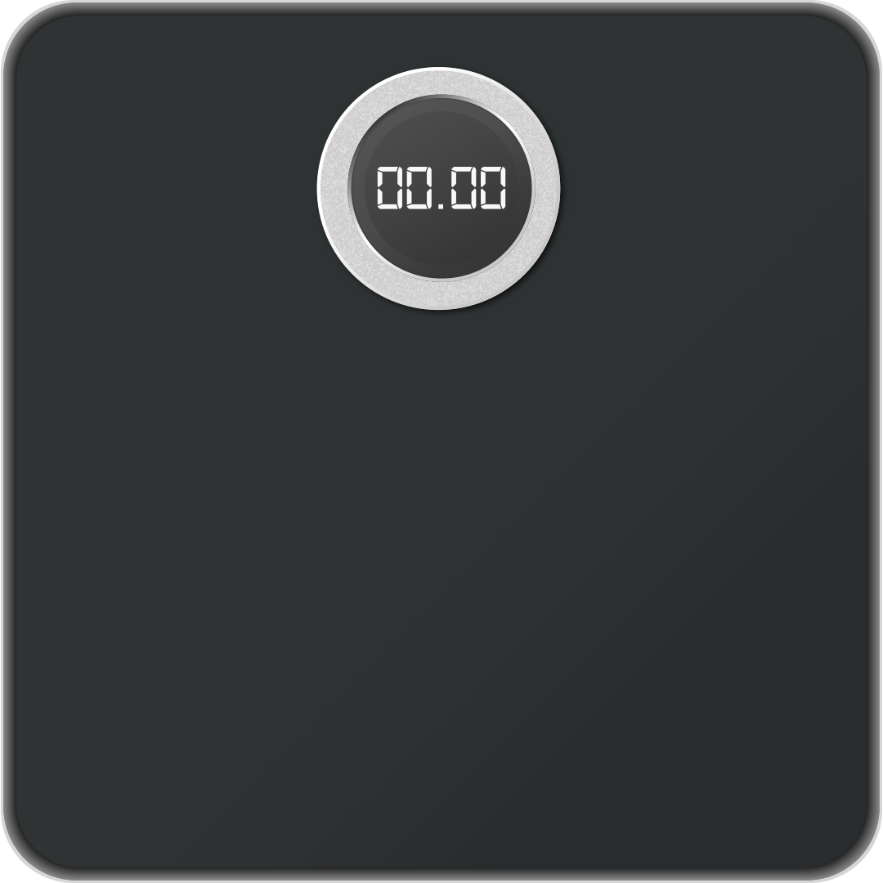
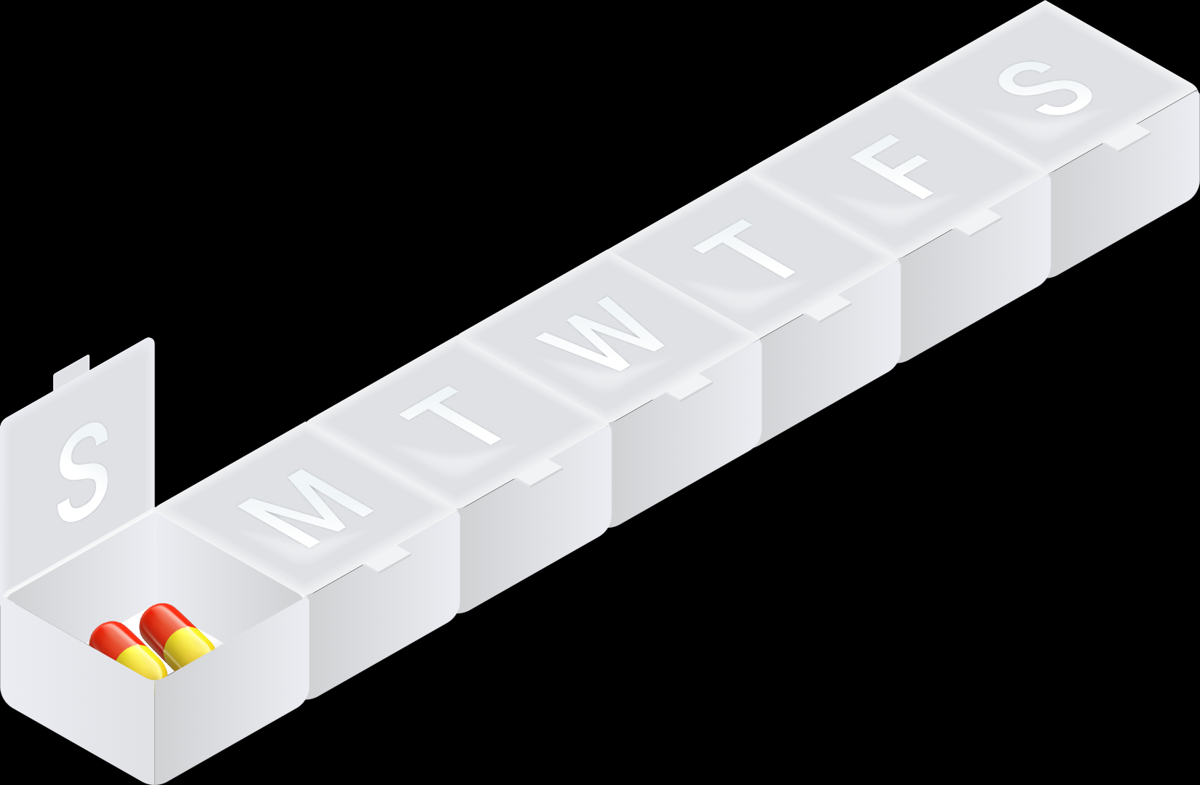


Our New Candidates
Shuhan He, MD
5

Slide 6
Every resubmission reset the clock
Unicode bars a declined emoji from re-review for four years, counted from the decline.
2019
2020
2021
2022
2024
2026
Heart + lungs
submitted
Both ship in
Emoji 13.0
First wave declined;
JAMA makes the case
Kidney, stomach,
liver declined
Spine, intestines,
ECG declined
Window shuts
July 31
Clear to file now 8 concepts
3 concepts
Barred 3 concepts
White blood cell · Pill pack · Pill box
Blood bag · Leg cast · IV bag
CT scan · Weight scale
Kidney · Stomach · Liver
Spine · Intestines · ECG
Last declined in the 2021 cycle. The four-year bar has lapsed.
Submitted July 2022, declined that November. From the decline, the bar lifts Nov 2026 — after the window shuts. From submission, they clear by 12, 3 and 1 day.
Submitted days after the 2024 window opened, declined that cycle. The bar lifts around Nov 2028.
Shuhan He, MD
Unicode publishes submission dates, not decline dates; declines issue at cycle end, submitters notified by Nov 30. Sources: unicode.org/emoji/emoji-proposals-status.html · unicode.org/emoji/proposals.html

Slide 7
Inside the Unicode Consortium
Microsoft sits on the board and votes in the UTC. Emoji sits one level below the UTC.
Unicode Consortium
Board of
Directors
CLDR Technical
Committee
Unicode Technical
Committee
ICU Technical
Committee
Editorial
Committee
Microsoft holds a seat
locale data
Microsoft votes here
ICU libraries
publications
working groups recommend; the UTC votes
Emoji Standard &
Research WG
Script Encoding
WG
CJK & Unihan
WG
Properties &
Algorithms WG
Editorial
WG
our proposal is read here
new scripts
Han characters
character properties
specification text
Microsoft's vote sits one level above the working group that reads our proposal.
Full member = 1 UTC vote (Supporting = ½; associate, liaison and individual members do not vote) · board seat: Vishal Chowdhary · ships Segoe UI Emoji
Shuhan He, MD
unicode.org/consortium/consort.html · unicode.org/consortium/utc.html · unicode.org/consortium/directors.html

Slide 8
Whole sets get through
When a member company carries them. Apple did exactly this for accessibility in 2018.
Apple's accessibility set
Plan International UK + NHS Blood and Transplant
Drop of blood, Emoji 12.0 (2019). Their narrower
“period pants” proposal was declined first.
L2/18-080 · Submitter: Apple Inc. · March 2018
— One curated set across four categories, built with the American Council of the Blind, the Cerebral Palsy Foundation and the National Association of the Deaf.
Tinder + Emojination
— Nine concepts shipped in Emoji 12.0 (2019): guide dog, service dog, probing cane, both wheelchairs, ear with hearing aid, deaf person, mechanical arm and leg.
71 holding-hands combinations, Emoji 12.1 (2019).
Emojination's founder later vice-chaired the subcommittee.
“This is not meant to be a comprehensive list of all possible depictions of disabilities, but to provide an initial starting point.”
Google
Gender-inclusive designs across ~53 human emoji.
L2/19-078 (2019).
Unicode declines taxonomies, not sets.
“The goal is iconic representation of large categories, not completeness in the sense of filling out the categories of a scientific or taxonomic classification system.” Fourteen organs read as a taxonomy. A curated set, carried by a member, reads as Apple 2018.
Shuhan He, MD
unicode.org/L2/L2018/18080-accessibility-emoji.pdf · unicode.org/emoji/proposals.html

Slide 10
How Apple did it
L2/18-080 answered Unicode's selection factors one by one, under a heading titled “Counterarguments to Factors for Exclusion.”
Frequency
“the most compelling factor for this proposal is not frequency of use of each character, but the desire to be inclusive in representation.”
Then filed the Google Trends data anyway, reproducibly: “each data item was obtained using a new private browser window.”
Breaking new
ground
“Other than the wheelchair symbol, there are currently no emoji that can be used to depict various forms of disability.”
Image
distinctiveness
“the image of a hearing aid would not be sufficiently distinctive at emoji scale; it needs to be shown with an ear in order to establish its identity.”
Argued manual and motorized wheelchairs must be separate characters, not one.
Open-ended
“we don't expect such discussion to lead to proposals for a large number of additions beyond the current proposal.”
The exclusion factor that a fourteen-organ set trips. Apple answered it before it was asked.
Partners
“Developed in collaboration with … American Council of the Blind, the Cerebral Palsy Foundation and the National Association of the Deaf.”
Apple argued Unicode's factors, in Unicode's order, in Unicode's words.
Our packets led with medical importance and supporter credibility. Unicode lists neither as a selection factor. Nine of Apple's concepts shipped in Emoji 12.0 (2019).
Shuhan He, MD
All quotes verbatim: unicode.org/L2/L2018/18080-accessibility-emoji.pdf · factors: unicode.org/emoji/proposals.html

Slide 11
Request
Shuhan He, MD
11

