Slide 1

BriskStream: Scaling Data Stream Processing on Shared-Memory Multicore Architectures
Shuhao Zhang^{*1}, Jiong He², Amelie Chi Zhou³, Bingsheng He¹
1
2
3
*Work done while as research trainee at SAP Singapore.
Notes:
Good afternoon, thanks for coming to my talk. I’m going to present my recent work on data stream processing system with NUMA awareness.
My name is Shuhao, and this a joint work with Jiong He, Amelie Chi Zhou and BingSheng He.

Slide 2
Outline
Motivation
Performance Model
Algorithm Design
Experimental Results
Notes:
I will start with motivation of this work.
Then, I will briefly discuss the performance model and algorithm design of the concerned optimization problem
Finally, I will go through a few experimental results.

Slide 3



Importance of Data Stream Processing
Data stream processing (DSP) has attracted much attention for real-time analysis applications, e.g., stock market monitoring and IoT (Internet of Things).
Many DSP systems (DSPSs) have been proposed recently.
…
Apache Storm
Twitter Heron
Apache Flink
Notes:
There is an increasing demand for handling real-time data streams, such as stock market monitoring and IoT (Internet of Things).
Many data stream processing (DSP) systems have been proposed such as Apache Storm, Twitter Heron and Apache Flink and so on.

Slide 4
DSPS on Modern Hardware
Multicore architectures are attractive platform for DSPSs.
However, fully exploiting its computation power can be challenging.
Saber, SIGMOD’16
StreamBox, ATC’17
…
BriskStream, SIGMOD’19
CPU+GPU
Out-of-order arrival
NUMA-aware
Notes:
Multicore architectures have attracted many researches including DSPSs.
Fully exploiting its computation power can be challenging.

Slide 5
Pipelined processing with message passing
Parser
Split
Count
Sink
Word-count (WC) application
Input tuples
Notes:
A streaming application is represented by a graph,
where nodes in the graph represent operators, and edges【click】 represent the data dependency between operators.【click】Each operator executes independently and continuously perform fetch, process and output operations in a pipelining way.

Slide 6
Execution plan optimization
(a) Logical view of WC.
(b) One example execution plan of WC. Three CPU sockets are used.
Each operator can be scaled to multiple instances (called replicas).
Each replica can be independently scheduled.
Given a NUMA machine (limited HW resources), how can we maximize throughput of stream application by operator replication and placement optimization?
Notes:
The left figure shows the logical view of WC
What is the optimal replication?
What is the optimal way to allocate each replica instance?

Slide 7
Zoom into the current system design
Producer
e.g., Splitter
Consumer
e.g., Counter
1
2
3
4
Pass value
queue
Pass reference
Memory
x
Step x
Socket 0
Socket x?
Relative location affects the processing behavior of consumer.
Each operator (except Spout) is a consumer of its upstream operator.
Notes:
Let us first zoom into the system design of most common DSPSs.
This figure explains how the message passing between operators are achieved in a shared memory environment.
[Click] In this example, there are two operators, which are denoted as producer and consumer.
[Click] The producer first writes its output data to the local memory
and [Click] emits a tuple containing a reference to the output data to its output queue
[Click] The consumer fetches from the corresponding queue to obtain the tuple and
then [Click] accesses the data by the reference.
Now we see it is obvious that the data fetch of consumer will be much faster if it is allocated in the same socket of producer than if it is allocated in other sockets.

Slide 8
Outline
Motivation
Performance Model
Algorithm Design
Experimental Results
Notes:
Now, I will first discuss the performance model of RLAS.

Slide 9


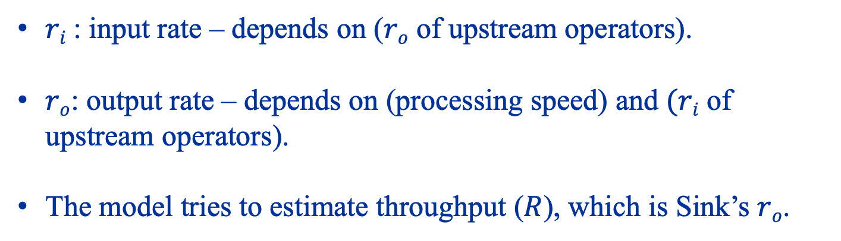

The Performance Model
…
Bolt
Sink
$$Throughput (R)$$
Bolt
$$ri$$
$$ro$$
$ri$: input rate – depends on ($ro$ of upstream operators).
$ro$: output rate – depends on (processing speed) and $(ri$ of upstream operators).
The model tries to estimate throughput ($R$), which is Sink’s $ro$.
Notes:
Let me use ri and ro to denote input and output rate of each operator.
Then,
r_{o} is related to its processing speed as well as its input rate.
r_{i} is related to output rate of upstream operators.

Slide 10
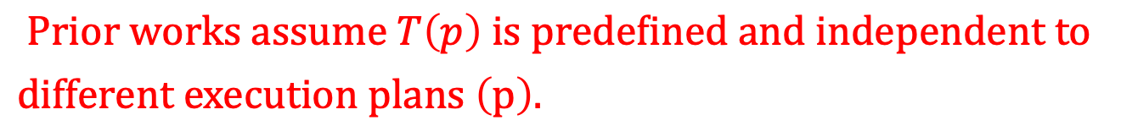
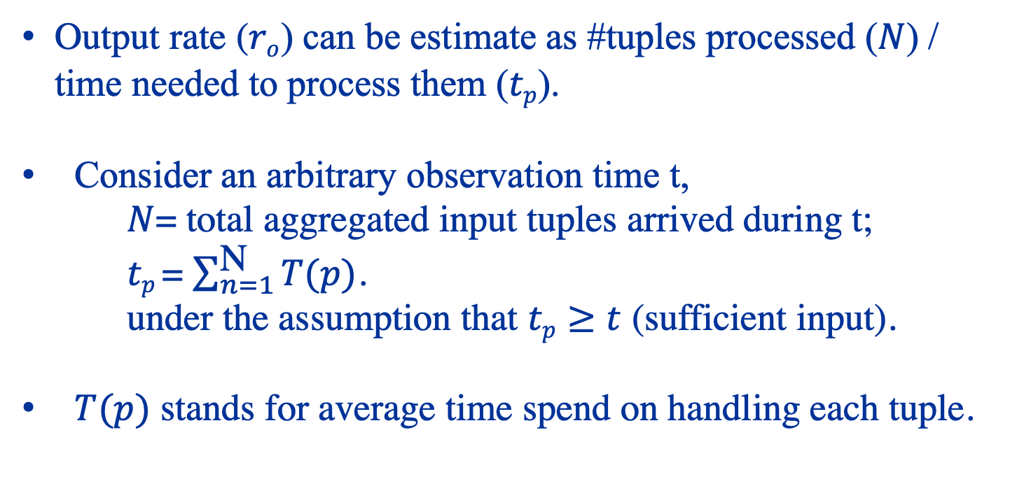
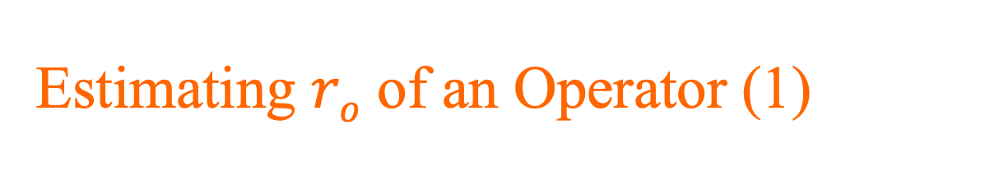
Estimating $ro$ of an Operator (1)
Output rate ($ro$) can be estimate as #tuples processed ($N$) / time needed to process them ($tp$).
Consider an arbitrary observation time t,
$N$= total aggregated input tuples arrived during t;
$tp$= $\sum_{n=1}^{\text{N}}{T(p)}$.
under the assumption that $tp≥t$ (sufficient input).
$T(p)$ stands for average time spend on handling each tuple.
$$Prior works assume T\left(p\right) is predefined and independent to$$
$different execution plans \left(p\right).$
Notes:
$Intitively, ro$ can be estimate as number of tuples processed / time needed to process them.
Then, consider an arbitrary observation time t,
N is the aggregated inputs from all producers during t, and tp is the aggregated execution time for processing all tuples by that operator.
Capital TP stands for average time spend on each tuple, and it is varying on different execution plans.

Slide 11
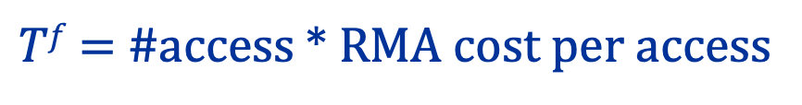
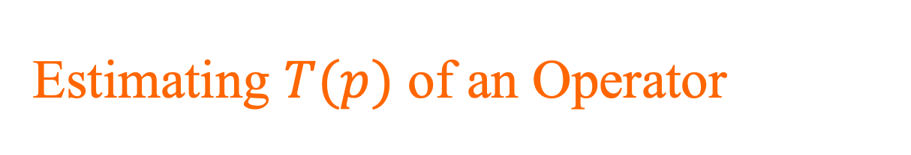
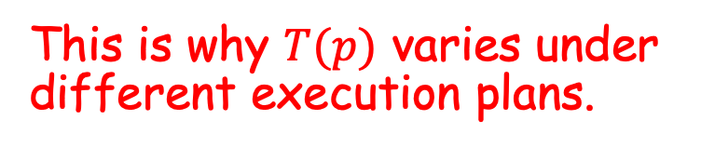
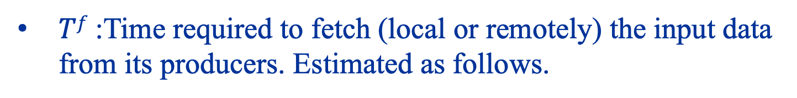
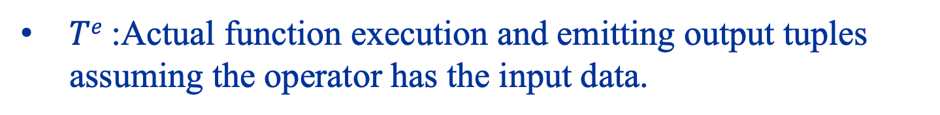
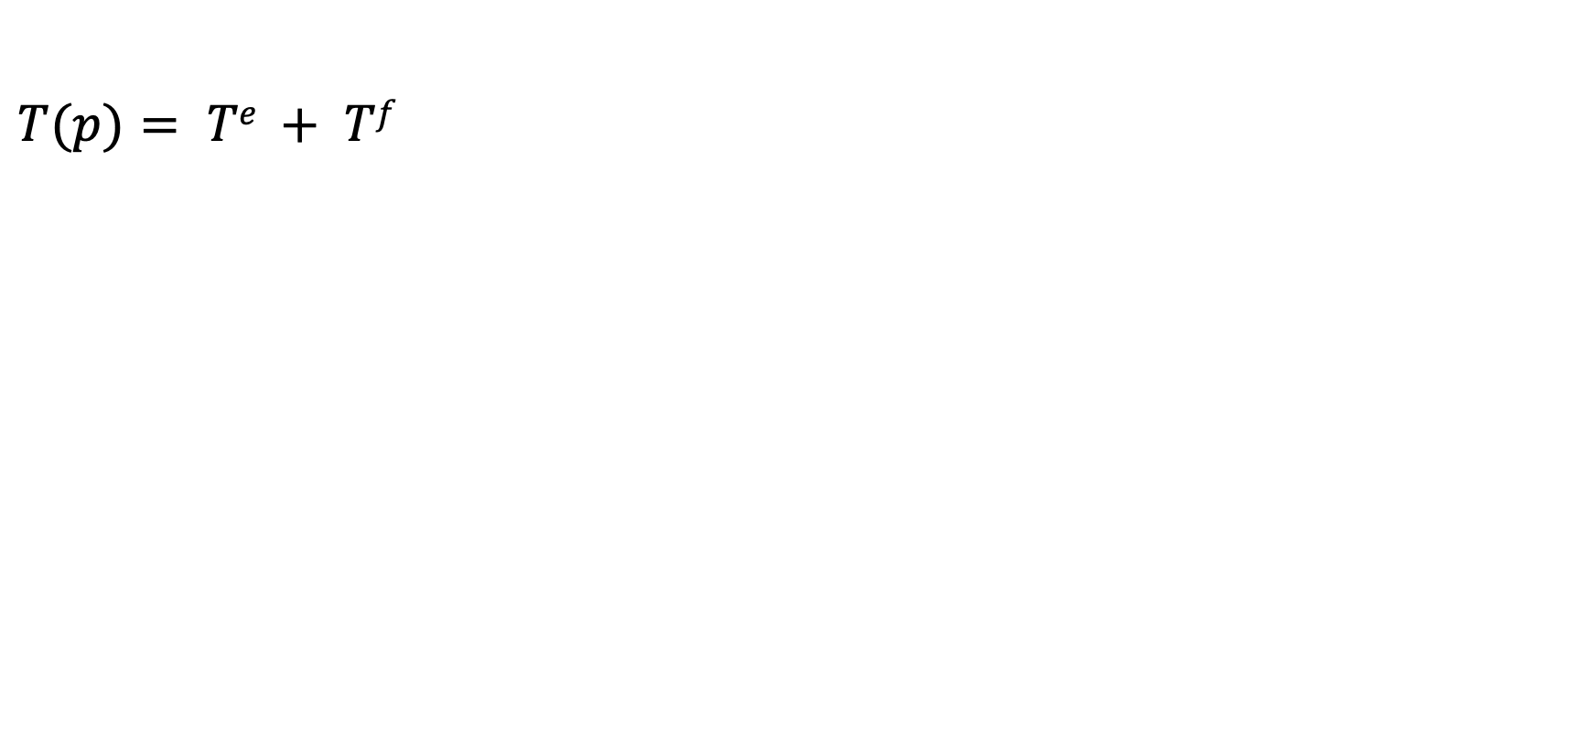
Estimating $T(p)$ of an Operator
$$T(p)= Te + Tf$$
$Te$:Actual function execution and emitting output tuples assuming the operator has the input data.
$Tf$:Time required to fetch (local or remotely) the input data from its producers. Estimated as follows.
$Tf$= #access * RMA cost per access
This is why $T(p)$ varies under different execution plans.
Notes:
Captial T(p) can be divided into two disjoint components.
Te stands for the time spend in actual function execution and emitting output tuples assuming the operator has the input data.
Specifically, we estimate the cross socket communication cost based on the total size of data transfer N bytes per input tuple, cache line size S and the worst case memory access latency (L(i, j)) that operator and its producer allocated (i != j).

Slide 12
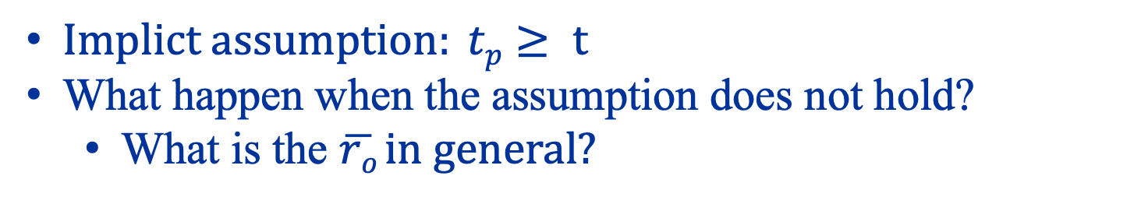
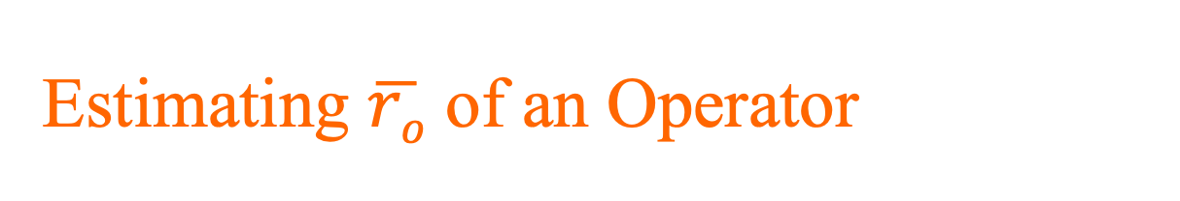
Estimating $\overline{ro}$ of an Operator
$Implict assumption: tp≥ t$
What happen when the assumption does not hold?
  What is the $\overline{ro} in general?$
Notes:
We have just discussed how to model capital T(P) to solve equation 1, but there is one thing left to discuss.
Note that equation 1 essentially make an implicit assumption that there are always sufficient input tuples to process and the operator is always busy processing them.
In other words, tp is larger than t.
What happen when the assumption does not hold?

Slide 13
Bottleneck Operators
An operator can have only two possible conditions under a given execution plan.
Operator being over-supplied is essentially the bottleneck.
Under-supplied
Over-supplied (or just fulfilled)
Output rate is only determined by its input rate
Output rate is determined by its input rate and processing speed
Notes:
An operator can have only two possible conditions under a given execution plan.
Under-supplied or over-supplied.

Slide 14
Outline
Motivation
Performance Model
Algorithm Design
Experimental Results
Notes:
Now, we can proceed to discuss algorithm design of solving RLAS.

Slide 15
RLAS Overview
RLAS optimization
= Repeat {Scaling Optimization + Placement Optimization}.
The key idea to optimize streaming application is to remove bottlenecks.
Notes:
The key idea to optimize streaming application is to remove bottlenecks.
To achieve that, RLAS optimization is an iterative process composing two components: Scaling Optimization and Placement Optimization.

Slide 16
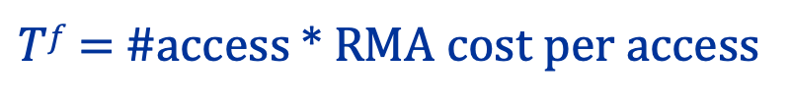
Solving RLAS is Tricky
Stochasticity is introduced into the problem.
  Objective value (e.g., throughput) or weight (e.g., resource demand) of each operator is no longer constant.
The placement decisions may conflict with each other and ordering is introduced into the problem.
$Tf$= #access * RMA cost per access
We proposed a branch and bound based approach to solve the concerned optimization problem.
Notes:
However, relative-location awareness makes the optimization problem much harder to solve.
For two main reasons.
Stochasticity is introduced into the problem as the objective value (e.g., throughput) or weight (e.g., resource demand) of each operator is variable and depends on all previous decisions.
Additionally, the placement decisions may conflict with each other and ordering is introduced into the problem.
Checkout the algorithm detail in our paper.

Slide 17
Branch and Bound Solution Overview
B&B systematically enumerates a tree of candidate solutions, based on a bounding function.
Bounding function: operators remaining scheduled are free to collocate with all of its producers.
The searching space is still too large, and heuristics have to be applied.
  Collocation heuristic
  Best-fit & Redundant-elimination heuristic
  Compress graph
Please checkout our paper for the detailed algorithms

Slide 18
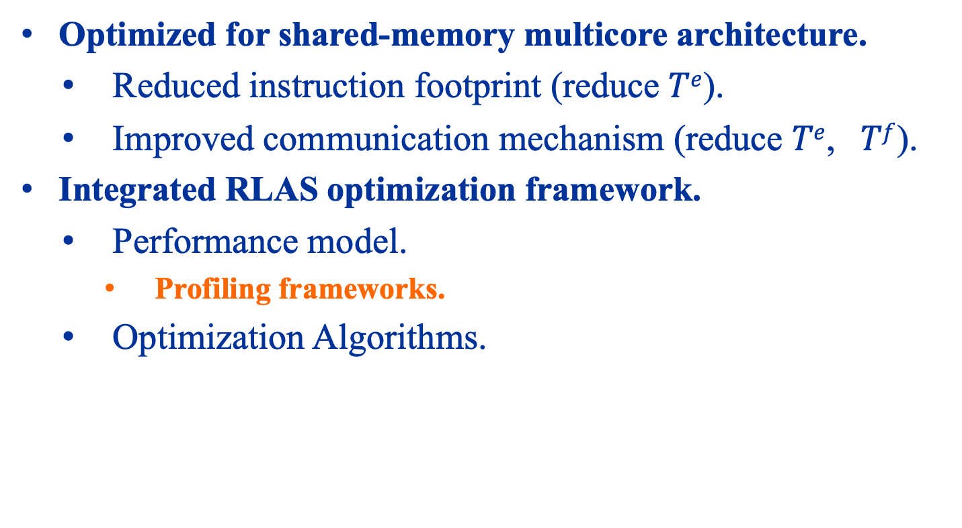
BriskStream Implementation
Optimized for shared-memory multicore architecture.
  Reduced instruction footprint (reduce $Te$).
  Improved communication mechanism (reduce $Te$, $Tf$).
Integrated RLAS optimization framework.
  Performance model.
    Profiling frameworks.
  Optimization Algorithms.
Please checkout the implementation detail in https://github.com/ShuhaoZhangTony/briskstream
Notes:
Based on RLAS optimization framework, we built a new DSP system from scratch, called BriskStream.

Slide 19
Outline
Motivation
Performance Model
Algorithm Design
Experimental Results
144 cores (w/o HT)
Notes:
Now, we proceed to discuss some experimental results.
The following experiments are primarily conducted on the shown 8 sockets machine with 144 cores without HT.

Slide 20
Why not assume fixed T(P)?
RLAS stands for our optimization scheme.
RLAS_fix ignores relative-location-aware.
（1） RLAS_fix(L) assumes RMA overhead always present, and underutilize HW resources
（2）RLAS_fix(U) ignores RMA overhead completely, and mislead optimization process to involve severely interference
Notes:
We use this figure demonstrate the importance of considering relative location awareness.
（1） RLAS_fix(L) assumes RMA overhead always present
over-estimates resource demand
underutilize resources
（2）RLAS_fix(U) ignores RMA overhead completely
under-estimates resource demand
mislead optimization process to involve severely interference

Slide 21
Why do we need a model?
Random plans hurt the performance in a high probability due to the huge optimization space.
Notes:
We use this figure demonstrate the importance of model-guided optimization. It shows the results of monte-carol simulation of 1000 randomly generated plans, none can achieve the same performance of our optimized plan.

Slide 22
Why not simple heuristics? (1)
OS: No explicit placement optimization
FF: Greedily minimize cross-operator traffic.
RR: Greedily balance workloads among CPU sockets.
Heuristic approaches commonly used in distributed environment
either oversubscribe a few CPU sockets (FF)
or unnecessarily involve RMA overhead (RR).
Notes:
We use this figure demonstrate the problem of relying on simple heuristics.

Slide 23
Why not simple heuristics? (2)
Generally worse
Server A
Server B
Heuristic approach requires tedious tuning process to determine the suitable usage of HW resource.
Notes:
We use a different server to repeat the same heuristic study, and we keep the same input loads.
The figure shows that the maximum achievable system capacity of Server B is larger.
As a result, RLAS choose not to use all CPU sockets in Server B to achieve maximum throughput under the given ingest rate.

Slide 24
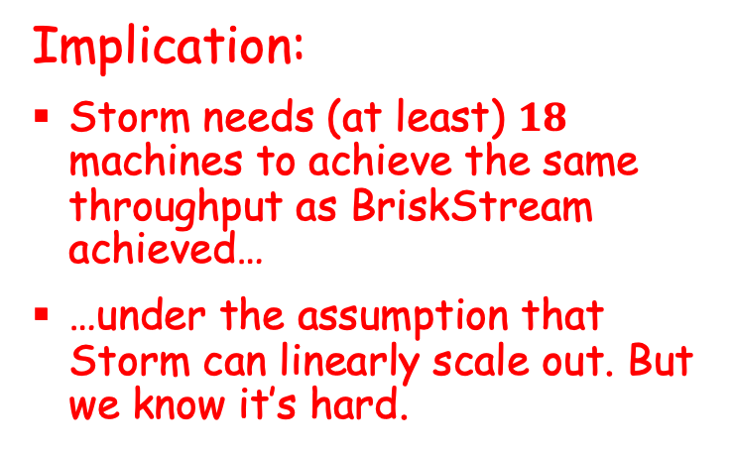
Evaluation of Execution Efficiency
Implication:
Storm needs (at least) $18$ machines to achieve the same throughput as BriskStream achieved…
…under the assumption that Storm can linearly scale out. But we know it’s hard.

Slide 25
Evaluation of Scalability
(1) BriskStream scales much better than Storm and Flink on multi-socket servers.
(2) Unable to linearly scaleup due to significant increase of RMA overhead cross CPU trays.
Linear Road Benchmark
Tray 1
Tray 2

Slide 26
Execution Time Breakdown
（1） T^{e} is significantly reduced to only 5 ∼ 24% of that of Storm.
（2） RMA overhead, as a result of improving efficiency of other components, becomes a critical issue to optimize.
Notes:
Execute: time spend in function execution (T^{e}).
Others: e.g., context switching.
RMA: time spend in remote memory access (T^{f}).

Slide 27
How about other Single-node Optimized DSPS?
It shows a much poorer performance than BriskStream for its different design focus:
  providing ordering guarantee (bears heavy locking overhead).
471.2
on 1 socket(soc.)
2soc.
4soc.
8soc.
Notes:
Streambox is a recently proposed multicore optimized stream processing system with morsel-driven like system design. Due to the difference in testing machine, we were unable to reproduce the exact results of original StreamBox. However, the scalability trend is still consistent with their original paper.
Nevertheless, it shows a much poorer performance due to its different design focus.

Slide 28
How about other Single-node Optimized DSPS?
StreamBox (w/o ordering guarantee) still leads to sub-optimality under large core count due to its greedy nature for addressing NUMA effect.
Nevertheless, we foresee an interesting future work to employ morsel-driven execution into BriskStream.
471.2
on 1 socket(soc.)
2soc.
4soc.
8soc.
Notes:
The current solution relys on heurstic.
It remains a open question how to better optimize morsel-driven like execution model in addressing NUMA effect.
An interesting future work is to investigate the possibility of composing morsel-driven like execution model into BriskStream.
This may be equivalent to include operator fusion technique (check out appendix of our paper).

Slide 29
Recap
BriskStream scales stream computation towards hundred of cores under NUMA effect even without the tedious tuning process.
We demonstrated that relative-location awareness (or varying processing capability awareness) is the key to address NUMA effect in optimizing stream computation on modern multicore architectures.

Slide 30
Acknowledgement
This work is supported by a MoE AcRF Tier 2 grant (MOE2017-T2-1-122) and an NUS startup grant in Singapore.
Jiong He is supported by the National Research Foundation, Prime Ministers Office, Singapore under its Campus for Research Excellence and Technological Enterprise (CREATE) programme.
Chi Zhou’s work is partially supported by the National Natural Science Foundation of China under Grant 61802260 and the Guangdong Natural Science Foundation under Grant 2018A030310440.
Notes:
We acknowledge the funding received from varies parties.

Slide 31
Q&A
Thank you
shuhao.zhang@comp.nus.edu.sg
END
https://github.com/ShuhaoZhangTony/briskstream
Notes:
We have open-sourced our system.
It is still under heavily active development, so expect more bug-fixing and new features adding.

Slide 32
State-of-the-art
Operator replication and placement optimization is a classical topic.
  But commonly assume a fixed (vs. dependent) processing behavior of each operator/replica.
NUMA-aware query optimization.
  Different system model (ad-hoc vs. continuous).
  Usually different optimization goals (load-balancing vs. throughput).
  Based on simple heuristics (greedy vs. model-guided).
Notes:
We then review the literature and we found that
Despite that there are many useful techniques on approaching operator replication and placement optimization. They run into suboptimal in our context. Because they commonly assume the processing behavior of each operator/replica is fixed, independent to where it is allocated.
2) There are also a number of works on improving NUMA-awareness on data management systems. But, they often have different optimization goals such as minimizing resource consumption, better load balancing, and often relys on simple heuristics, which can easily result in suboptimal.

Slide 33
RLAS Optimization
RLAS optimization framework:
  relative-location aware,
  model-guided,
  maximizing throughput for streaming application.
Notes:
We propose RLAS optimization framework.
It is a model-guided, relative-location aware, maximizing throughput optimization scheme for streaming application.

Slide 34
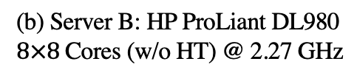
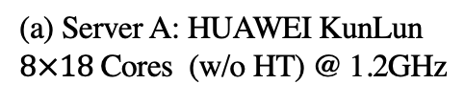
NUMA Servers
(a) Server A: HUAWEI KunLun
$8×18$Cores (w/o HT) @ 1.2GHz
(b) Server B: HP ProLiant DL980
$8×8$Cores (w/o HT) @ 2.27 GHz
Different NUMA topology
Notes:
Modern machines scale to multiple sockets with non- uniform-memory-access (NUMA) architecture. Each socket has its own “local" memory and is connected to other sockets remotely. Therefore, access latency and bandwidth vary depending on whether a core in a socket is accessing “local" or “remote" memory. Such NUMA effect requires ones to carefully align the communication patterns accordingly to get good performance.
[Click] This figure shows the NUMA topology of our servers.

