Slide 1
Big Data Systems on Future Hardware
Bingsheng He
NUS Computing
http://www.comp.nus.edu.sg/~hebs/

Slide 2
Outline
Why Hardware Matters?
Challenges & Experiences
On-going Projects
Summary

Slide 3
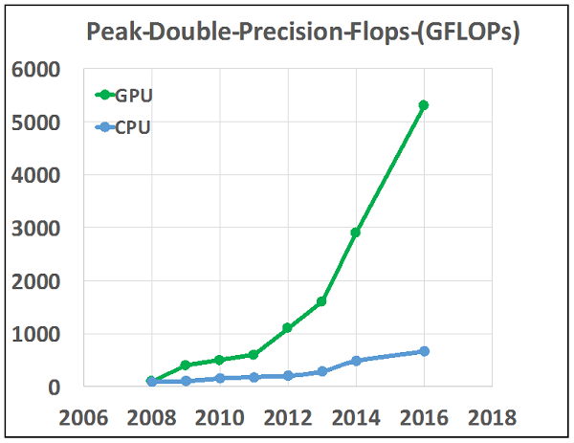
Why HW Matters: Processors
Source: https://www.hpcwire.com/2016/08/23/2016-important-year-hpc-two-decades/

Slide 4
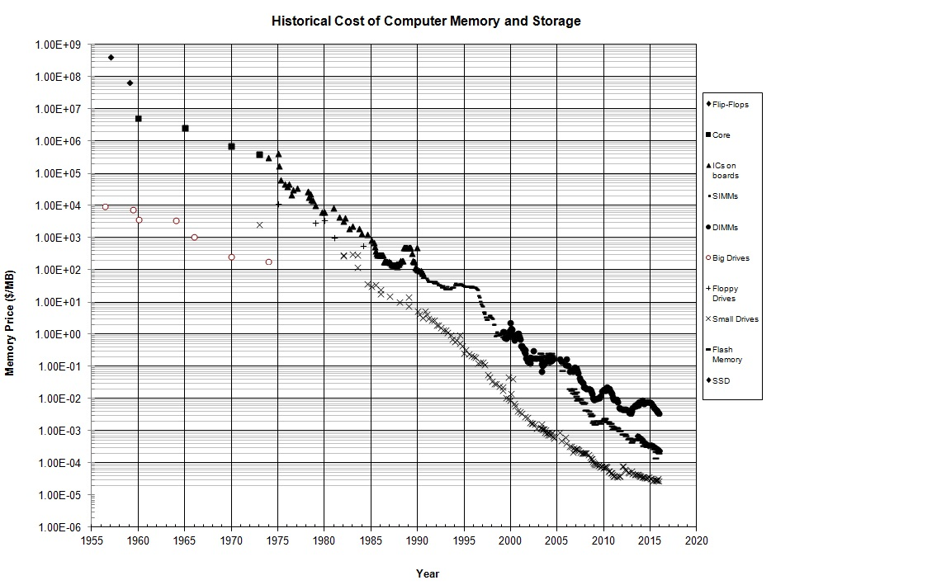
Why HW Matters: Memory and Storage
Source: hblok.net/storage

Slide 5
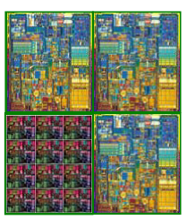
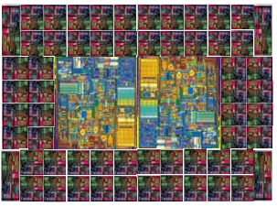
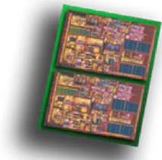
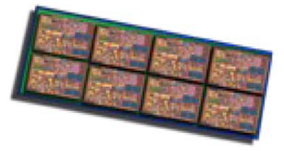
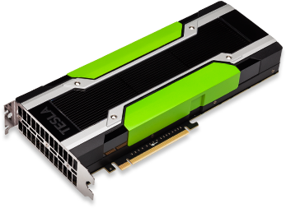
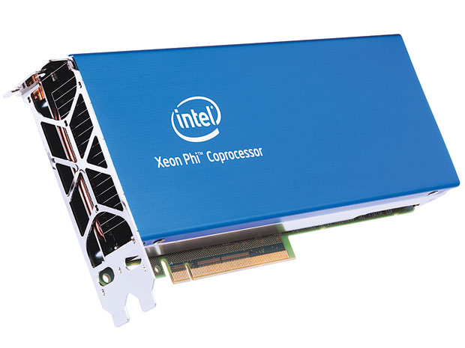
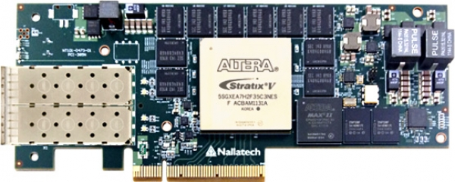
Emerging HPC Hardware: Parallelism and Heterogeneity
Towards many cores
From CPU to accelerators (co-processors)
>>
>>
>>
Dual cores
Multi-core array
Scalar plus many cores
Many-core array
GPU
Xeon Phi
FPGA
Figures are adopted from Intel, NVIDIA and Altera.
Notes:
Parallelism and heterogeneity is the key trend for hardware architectures.
For CPUs, we have seen the transition from dual cores to multi-cores. In Intel’s roadmap, we will see many-cores in different forms in the very near future.
The other trend is that accelerators (or coprocessors) are becoming more and more popular. GPU, Xeon Phi and FPGA and etc. They have been used the massive scale including supercomputer and cloud.
Dual core (Symmetric multithreading)
Multi-core array (CMP with ~10 cores)
Scalar plus many core for highly threaded workloads
Many-core array (CMP with 10s-100s low power cores, Scalar cores, Capable of TFLOPS+, Full System-on-Chip)

Slide 6
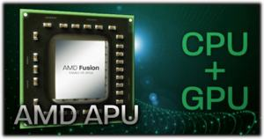
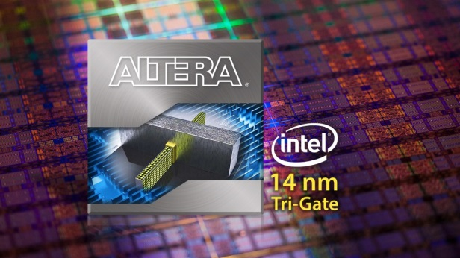
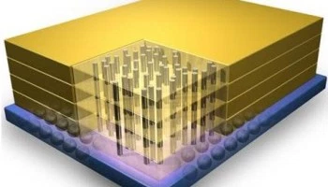
Emerging HPC Hardware: Parallelism and Heterogeneity (Cont’)
Towards tightly coupled heterogeneous systems
High bandwidth memory (HBM)
…
AMD APU
Intel-Altera Heterogeneous Accelerators
Figures are adopted from AMD, Intel and Altera.
Notes:
The other recent trend is more tightly coupled heterogeneous systems. The examples include AMD APU (i.e., CPU+GPU into one chip), and CPU+FPGA into one chip.
All those architectures are significantly different from CPU. We need to have new system design and implementations on those architectures.
Heterogeneous Architecture Research Platform (HARP) program, which will provide faculty with computer systems containing Intel microprocessors and an Altera Stratix® V FPGA module that incorporates Intel® QuickAssist Technology in order to spur research in programming tools, operating systems, and innovative applications for accelerator-based computing systems.
Memory
Big-memory system
NVRAM

Slide 7
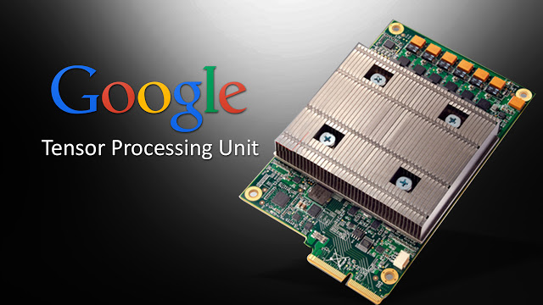
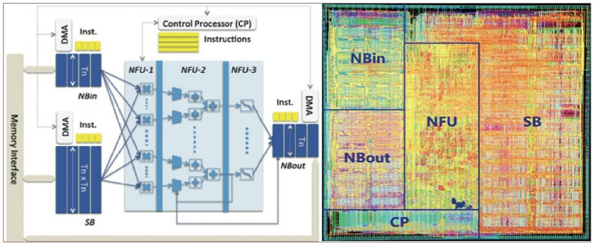
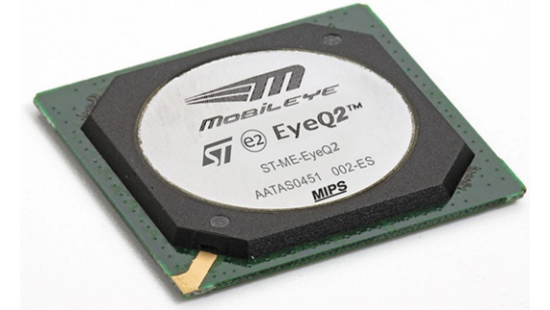
Emerging HPC Hardware: Generalization vs. Specialization
AI chips
Graph accelerators
…

Slide 8

Future Hardware
Processors
  1, 000 cores
  Heterogeneous/specialized hardware (FPGA/ASIC)
Disk is dead, NVRAM is disk, DRAM is cache, Locality is still the King.
  NVRAM/3D stacking
  “Tape is Dead, Disk is Tape, Flash is Disk, RAM Locality is King” by Jim Gray
Cluster as a personal supercomputer
  Fast and cheaper interconnects
  (e.g., Infiniband)

Slide 9
When Big Data Meets Emerging Hardware
System issues:
Emerging hardware
architectures
Performance
Programmability
Energy consumption
User interfaces
…
Our solution:
Hardware-software codesign
(Emerging) data-intensive
applications
Notes:
My research has focused on the interplay between HPC and big data.
We are particularly interested in the system issues such as performance, programmability, energy consumption etc when HPC meets big data.
Our vision is: pervasive HPC for big data. Anyone can leverage HPC for taming the big data challenges anytime and anywhere.

Slide 10
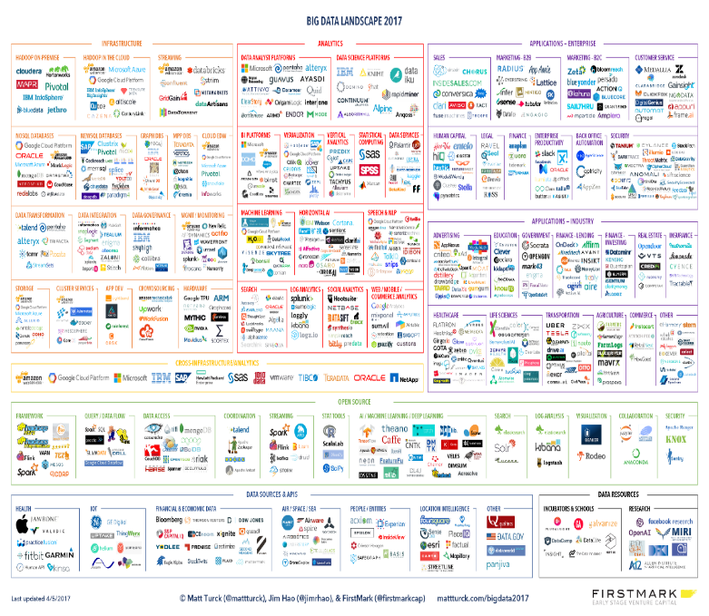

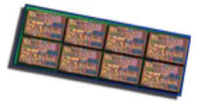

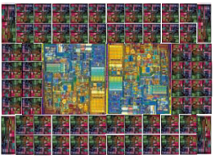
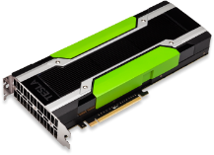


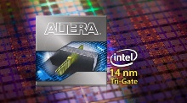
When Big Data Meets Emerging Hardware (Con’t)
Architecture-aware optimizations: how to make our software systems fully optimize for the hardware?
New hardware: how can new applications drive the design of new hardware?
New systems/applications: can superb hardware power enable new systems/applications?

Slide 11
Outline
Why Hardware Matters?
Challenges & Experiences
On-going Projects
Summary

Slide 12
Challenges & Experiences
Challenge #1: HW is simply one side of the coin; SW is the other side.
Challenge #2: The leap from prototype to production.
Challenge #3: Millions of lines of legacy code.
Challenge #4: Generalization vs. Specialization

Slide 13
Challenge #1: HW is simply one side of the coin; SW is the other side.
Parallel algorithmic design
  Revisit existing parallel algorithm and develop new algorithm.
  Running a large task in parallel vs. running many small tasks in parallel
Hardware features
  GPU: shared memory, cache, constant memory etc.
  FPGA: local memory, pipeline, pipe etc.
Architecture-aware software system design can make a big difference.

Slide 14
Our Experiences in GPGPU-based Data Management Systems
CUDA was released in Feb. 2007
GPUQP (GDB) published in SIGMOD 2008 (“best papers”)
Mars (GPU-based MapReduce) published in PACT 2008 (2nd top cited paper in PACT)*
Mars has been extended to AMD GPU and Hadoop (TPDS10)
OmniDB: relational database on coupled CPU/GPU architectures (VLDB’13/14/15, SIGMOD 16, VLDB’13 demo,…)
Medusa: GPU-based graph processing (TPDS13/14, VLDB13 best demo, CloudCom13)
Transaction executions on GDB (VLDB11)
GDB supports compressed column-based processing (VLDB10)
Example speedup over CPU:
OLAP: 2-7X (vs. one CPU)
OLTP: 4-10X (vs. one CPU)
Graph: 5.5X (vs. two CPUs)
Notes:
http://arnetminer.org/conference/pact-124.html
Thanks to my advisor, colleagues, and students.
In the past years, we have developed a number of interesting data management systems on the GPU. We are among the first batch of researchers in using CUDA. CUDA is a programming framework for GPU.
We have developed the first relational query processor, GDB, and published it in SIGMOD 2008. it was one of the best papers of the year. GPU programming is a challenging task, and writing a correct and efficient program is still a difficult problem. At 2008, we have developed a number of optimized primitives. Based on the primitives as building blocks, we further developed GDB in a layered manner.
To support more flexible data analytics on the GPU, we developed Mars (the mapreduce on the GPU). It is the 2nd top cited papers in the PACT. Later, we extend Mars to cluster and cloud setting.
In VLDB 2010, we have developed a compressed column store on GPU. Query processing can be directly performed on the compressed data. That is a kill two birds with one stone approach. Firstly, compression can reduce the data transfer on PCI-e. Secondly, direct query processing on compressed data can improve the memory bandwidth utilization within the GPU.
In VLDB 2011, we have developed OLTP, online transaction processing on the GPU. Compared with the previous work and studies in other groups, OLTP is challenging due to the concurrency control and updates. I have proposed an optimized grouping approach to execute many transactions at the same time. We have taken care of concurrency control, branch divergence etc.
Later, we have developed Medusa: a GPU-based graph processing framework on the GPU. The challenging part of Medusa is on how to support irregular data structures and irregular accesses on the GPU.
More recently, we have developed OmniDB on coupled CPU/GPU architectures. By removing PCI-e bus, the coupled architectures have enabled various optimization opportunities in query co-processing.
In the following, I will present more details on Medusa and OmniDB.

Slide 15
Challenge #2: The leap from prototype to production
Many research papers demonstrate that the speedup of GPU/FPGA can reach 10-100X.
Still, GPU/FPGA has rather limited adoptions in production environments (although increasingly more).
Why?
  Hardware: power supply budget, space, costs,…
  Software: software maintenance, reliability, manpower expertise, sharing, virtualization ….
  Workload: deep learning, database …
Besides algorithmic innovation, various system aspects have to be addressed.

Slide 16
Experiences in Addressing Practical Issues of GPU Computing
PCI-e bus via data compressions
  Database compressions on column-based databases [VLDB2010]
Concurrent kernel executions
  Resource complementary kernel co-scheduling [TPDS 2014]
GPU virtualizations
  Gaming virtualization [USENIX ATC 2016]
Minimizing data flow overhead among processors
  Pipeline execution [SIGMOD 2016]

Slide 17
Performance, or Perf per $, or Perf per Joule?
Kai Zhang^, Jiayu Hu, Bingsheng He, Bei Hua. DIDO: Dynamic Pipelines for In-Memory Key-Value Stores on Coupled CPU-GPU Architectures. ICDE 2017.

Slide 18
Challenge #3: Millions of lines of legacy code
Our legacy software systems are monsters
  National labs have MPI programs of millions of code lines.
  Google’s Internet services spans some 2 billion lines of code.
  Microsoft’s Windows operating system has around 50 million lines.
  Other younger ones: Hadoop 2millions, Spark 0.9 million, MySQL 2.7 millions…
The reality is, “write once, reuse till many many times”.
The research on automatic parallel optimizer is dead.
(Semi-)Automated tools are needed to resolve the pain points.

Slide 19
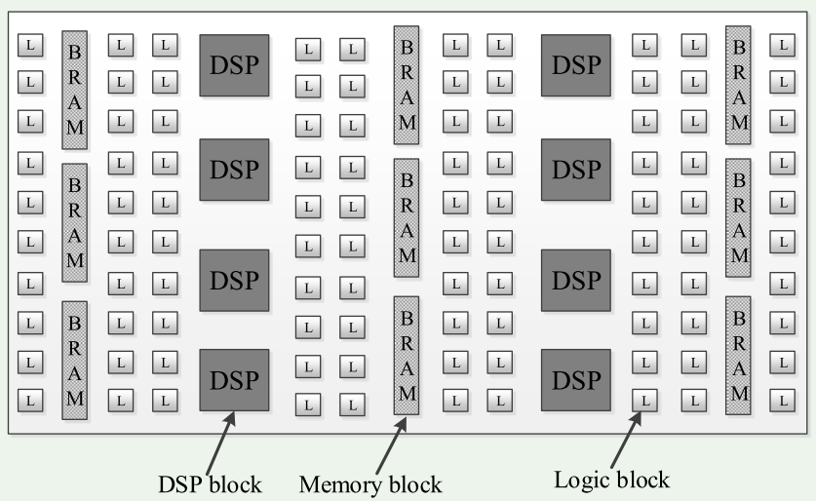
“Architectural Evolution” of FPGA (Field Programmable Gate Arrays)
Hardware centric
Users need to program with low-level hardware description languages. ☹

Slide 20
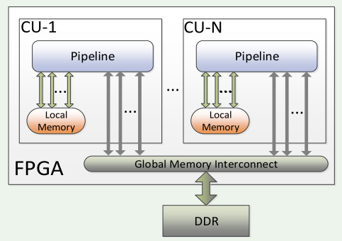
“Architectural Evolution” of FPGAs: From OpenCL’s Perspective
Software centric → FPGA is viewed as a parallel architecture.
Users can program with OpenCL. ☺

Slide 21
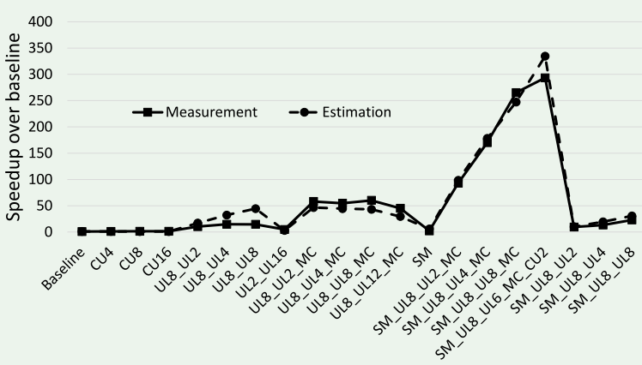
Our Experiences on FPGA
The example: K-Means
Applying different combinations of optimization leads to huge performance
differences → Tools for optimizations are needed.

Slide 22
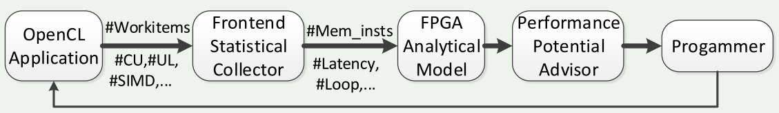
Our Solution: Static and Dynamic Program Analysis
We propose a performance analysis framework to assist programmers to optimize the OpenCL program on FPGA
  Static statistical collection on the corresponding LLVM IR code.
  Dynamic proﬁling of the OpenCL application execution.
  FPGA analytical model predicts the performance of OpenCL application.
  The performance advisor digests the model information and provides the four potential metrics to understand the performance bottleneck.
Details in “Zeke Wang^, Bingsheng He, Wei Zhang, Shunning Jiang. A Performance Analysis Framework for Optimizing OpenCL Applications on FPGAs. HPCA 2016”

Slide 23
Challenge #4: Generalization vs. Specialization
Specialized hardware
  “SQL in Silicon” (in Oracle SPARC M7 processor)
  Google TPU for deep learning
Specialized software
  System call overhead for memcached
  Layers of abstractions in OS (e.g., for NVRAM)
A compromise is possible (but difficult to find the optimal cut between generalization and specialization).

Slide 24
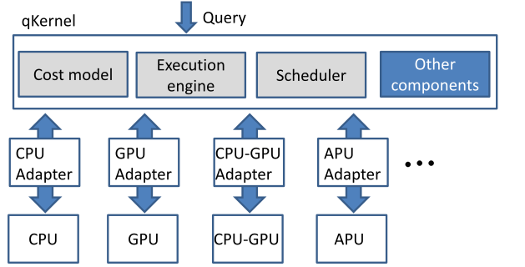
SW Portability vs. Specialization
OmniDB: General Engine Design + Adapter to Specific Architecture
Shuhao Zhang*, Jiong He*, Bingsheng He, Mian Lu. OmniDB: Towards Portable and Efficient Query Processing on Parallel CPU/GPU Architectures. International Conference on Very Large Data Bases (VLDB) 2013. (also published in Proceedings of the VLDB Endowment, Volume 6 Issue 10, August 2013, pages = {1—4}, system demonstration).

Slide 25
Outline
Why Hardware Matters?
Challenges & Experiences
On-going Projects
Summary

Slide 26
On-going Projects
High performance graph databases
  Goal: a graph database that can outperform Neo4j by 10+times.
Network Function Virtualization (NFV)
  Goal: a cost-effective solution to replace specialized network devices.

Slide 27
Network Function Virtualization
Basic trend: supporting network functions shifting from specialized hardware to software.
Huawei predicts, in 3-5 years, CPU + GPU will satisfy the computational requirement for telecom equipment.
Challenges:
  Massive network flows
  Low latency
  Flexible deployment

Slide 28
GPU-Accelerated NFVs?
GPU advantage over specialized hardware
  Comparable speed
  Low cost
However,
  Low GPU Utilization (Each VM has no enough traffic to fully utilize GPUs)→ GPU virtualization is still an open research problem.
  Unpredictable Latency
  Lots of development effort

Slide 29
Poseidon: Use Remote API to Virtualize GPUs in NFV
NF:
— Abstraction: Reduces development effort
— Framework: Handle network I/O, and
communicate with the Core
User NF
User NF
…
Abstraction
Abstraction
Framework
Framework
Switch
Scheduler
Manager
NIC
GPU
Core:
— Switch: Handle network I/O
— Scheduler: Schedule GPU for execution
— Manager: Launch GPU kernels

Slide 30
Preliminary Results
Our system can significantly improve the performance of GPU sharing.

Slide 31
Outline
Why Hardware Matters?
Challenges & Experiences
On-going Projects
Summary

Slide 32
Summary
(Database) systems on emerging hardware continue to be a challenging and exciting research area.
Our experiences demonstrate the system insights as well as open challenges of building big data systems on future architectures.
Hardware and software co-design might be the key for the success of this battle.

Slide 33
Thank you!
More about Xtra Computing Group:
http://www.comp.nus.edu.sg/~hebs/
Notes:
I am fortunate to work with colleagues, staffs and students.

