Slide 1

Towards Concurrent Stateful Stream Processing on Multicore Processors
Shuhao Zhang
co-author: Yingjun Wu (AWS), Fengzhang (Renmin University of China), Bingsheng He
Xtra Computing Group
lead by Prof. Bingsheng He
Notes:
Hello everyone, I’m shuhao, I’m going to present my very recent work on designing new system to support concurrent stateful stream processing on multicores.
This work was done when I was a phd student at NUS Xtra Computing Group, lead by professor Bingsheng He.

Slide 2
Data Stream Processing Systems
[Available] Fast stream processing on large-scale multicore architectures
  E.g., BriskStream¹, StreamBox², Grizzly³
[Inadequate] Support of consistent stateful stream processing
BriskStream: Scaling Data Stream Processing on Shared-Memory Multicore Architectures, SIGMOD’19
StreamBox: Modern Stream Processing on a Multicore Machine, ATC’19
Grizzly: Efficient Stream Processing Through Adaptive Query Compilation, SIGMOD’20
2
Notes:
Recent efforts have demonstrated ultra-fast stream processing on large-scale multicore architectures.
[click] However, one weakness of today’s systems is the inadequate support of consistent stateful stream processing.
What do I mean by that?

Slide 3
Outline
Motivation
State-of-the-art
Our Approach
Experimental Results
3
Notes:
let me illustrate it with an example.

Slide 4
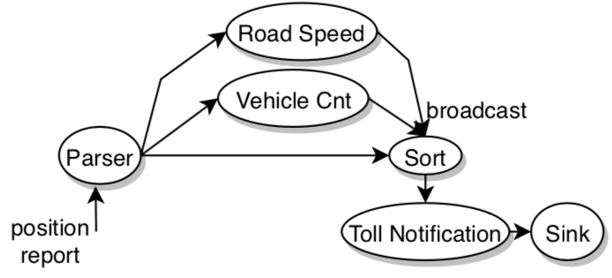
Motivation Example
Road congestion status is shared among different streaming operators
  Its consistency needs to be preserved
Toll Processing: computes toll based on the road congestion status
-- consistent stateful stream processing
road congestion status
4
Notes:
Let’s consider the toll processing query, which aims at computing toll of each vehicle based on the current road congestion status.
In the figure, each cycle denotes a stream operator and the edge denotes the data flow among operators.
[click] Position report of each vehicle is continuously passed into the application.
[click] Road Speed and Vehicle Cnt maintain and update road congestion status of different road segments.
[click] Toll notification computes “toll” of each vehicle depends on road congestion status.
[click You may now notice that road congestion status is shared intuitively among different streaming operators.
[click] Consistent stateful stream processing requires such shared states to be maintained consistently.

Slide 5
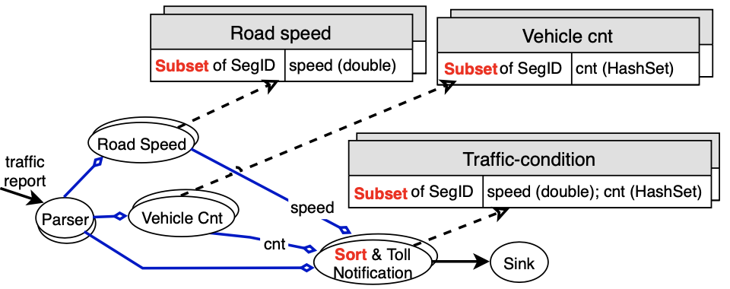
The Current Common System Design
disjoint subset
operator parallelism
  Common designs:
    Pipelined processing with message passing
    On-demand data parallelism
5
Notes:
Let’s now take a look how most existing systems handle it.
[click] Let’s recall the common designs of stream system including pipelined processing with message passing and on-demand data parallelism.
That means,
[click] each operator may be replicated into multiple instances, or called executors and running concurrently.
Then, [click] to ensure consistency of the logically shared application state, developers often apply key-based stream partition so that each operator instance only maintain a disjoint subset of application states.
In the next slides, I will show you the limitation of this approach.

Slide 6
Key-based Stream Partition
Road 1
executor₁
No Conflict!☺
AYE
Road1
copy
Road 2
Pay extra penalty if road1 is empty!
PIE
executor₂
Road2
Road1
Can not efficiently handle general case
6
Notes:
Suppose there are two concurrent running executors, one for handling reports of road 1, and the other for handling position reports of road 2.
In this way, each executor only maintains either [click] road 1 status or [click] road 2 status and [click] there’s no conflict among them.
[click] Now, suppose the processing of reports of road 2 also reference to status of road 1. For example, charge driver on road 2 higher if road 1 is empty.
[click] To achieve that, we have to either broadcast the status of road 1 from executor1 to executor 2 or, replicate reports of road 1 to executor 2 as well and maintain a replicate state of road 1 there.
Obviously, both approaches are very costly involving synchronization and extra communication overhead.
[click] So, key-based stream partition cannot efficiently handle such cases.

Slide 7
Lock-based State Sharing
Road1
executor₁
AYE
Road1,2,3…
Road 2
PIE
executor₂
Lead to poor performance
7
Notes:
An alternative is to let different executors to share states.
In this example, both executors can read or write to status of different roads.
However, it may cause state inconsistency as they may concurrently read and write to the same state.
Current solution rely on [click] locks, where only one instance is allowed to acquire the lock, which
[click] leads to poor performance.

Slide 8
Access Ordering
A toll should based on exactly current road condition, otherwise..
8
Notes:
Besides the issue of potential state access conflict, we also need to guarantee access ordering,
For example, A toll should based on exactly current road condition.
Otherwise, think about you are charged more of today simply because there were more serious road congestions yesterday, which makes nonsense.

Slide 9
Access Ordering
  Common workaround:
    Buffer and sort
Lead to poor performance
9
Notes:
Today, existing systems often achieve access ordering by using
[click] buffering and sorting, which is again
[click] obviously problematic.
So, how can we better handle it?

Slide 10
Outline
Motivation
State-of-the-art
Our Approach
Experimental Results
10
Notes:
Let’s now review the state-of-the-art.

Slide 11
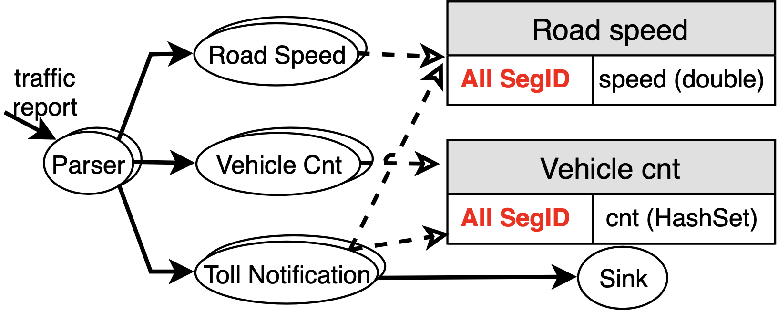
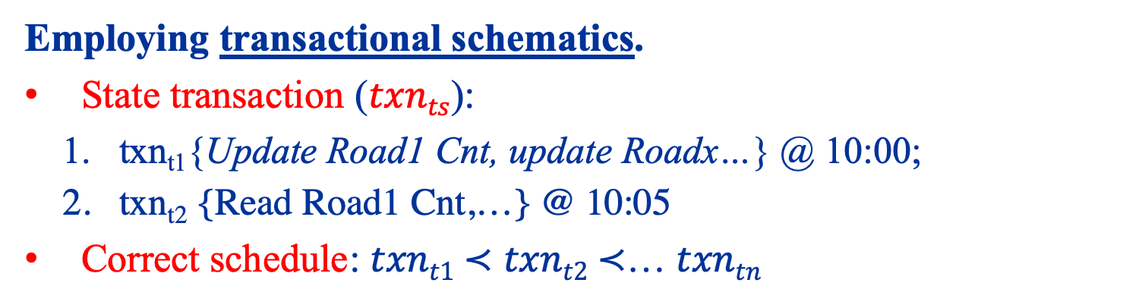
Consistent Stateful Stream Processing
  Employing transactional schematics.
  State transaction ($txnts$):
    txn_{t1}{Update Road1 Cnt, update Roadx…} @ 10:00;
    txn_{t2} {Read Road1 Cnt,…} @ 10:05
  Correct schedule: $txnt1$ $≺$ $txnt2$ $≺$… $txntn$
11
Notes:
Several prior works proposed to employ transactional schematics on managing shared states.
So, here all operators and their executors are allowed to access shared table of records and
[click] the state access is modelled as transactions.
[click] For example, at 10 am, there is one update to the count of unique vehicle on road 1;
[click] 5 mins later, there is a read to the count of road 1 to compute the toll.
[click[ A correct schedule must ensure all state accesses are performed as if they are executed sequentially according to their timestamp, this ensures the status being read is up-to-date.

Slide 12
Existing Solutions Revisited
What if we use existing design[1]?
Severe lock contention
A new solution for scaling concurrent state access is needed!
[1] S-Store: Streaming Meets Transaction Processing, VLDB’15
12
Notes:
Unfortunately, prior solutions explored very limited parallelism opportunities.
This figure shows the results of using an existing partition-based approach on handling the toll processing query.
[click] As the number of cores used increases, the overhead of accessing shared states quickly dominates other operations due to
[click] serious lock contention.
[click] Therefore, we need a new solution for scaling concurrent state access in the stream system.

Slide 13
Outline
Motivation
State-of-the-art
Our Approach:
  TStream (An extension of BriskStream[2])
Experimental Results
[2] BriskStream: Scaling Data Stream Processing on Shared-Memory Multicore Architectures, SIGMOD’19
13
Notes:
We build a new stream processing system called TStream to handle concurrent stateful stream processing on modern multicores.
In the following, I will discuss how we design the system.

Slide 14
Design Overview
Design 1) Dual-Mode Scheduling
  Exposing Parallelism
Design 2) Dynamic Restructuring Execution
  Exploiting Parallelism.
Up to 4.8 times higher throughput with similar or even lower processing latency!
14
Notes:
We introduce two designs to our system
[click] First, the dual-mode scheduling design aims at exposing parallelism opportunities to the system.
[click] Second, the dynamic restructuring execution design aims at exploiting the parallelism opportunities.
Put them together, our system achieves up to 4.8 times higher throughput with similar or even lower processing latency compare to the state-of-the-art.

Slide 15
Design1) Dual-Mode Scheduling
PreProcess
Initial process on an input event
StateAccess
Access to shared states
PostProcess
Process on an input event with reference to obtained state values
State access is often the bottleneck.
It unnecessarily blocks all subsequent processes.
Let’s postpone it.
15
Notes:
We abstract the process of one input event as three steps.
[click] the preprocess step is for performing some initial process on the input event, for example, filtering,
[click] state access for accessing shared application states. For example, read to the road congestion status.
and
[click] post-process for performing other process that depends on state access results. For example, computes the toll
Under existing algorithms, these three steps are performed contiguously in one thread.
However, state access is often the bottleneck, and it unnecessarily blocks all subsequent processes.
[click] We hence decouple the process of it to be evaluated later.

Slide 16
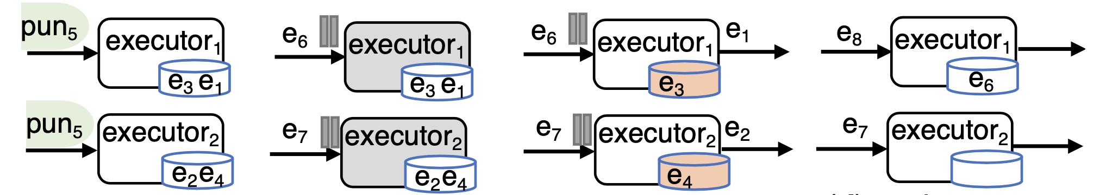
Design 1) Dual-Mode Scheduling
(a)PreProcess
(b)StateAccess
(c)PostProcess
(d)PreProcess
Compute Mode
State Access Mode
Compute Mode
Pros: Enlarging inter-event parallelism opportunities.
Cons: Need to handle ``on-the-fly” events.
16
Notes:
Let me illustrate it with an example, where we consider two executors running concurrently.
Each executor process input events without handling the state access requests.
[click] after a while, it pause the handling of further input events, and start to actually evaluate the postponed state transactions.
[click] next, when postponed state transactions are fully processed, the operators can start the post-process step.
[click] finially, operators are resumed to process further input events.
[click] Now you can see there are two modes, a compute mode and a state access mode.
These two modes are switched to each other periodically controlled by punction signals.
The advantage of this type of design is that it enlarges inter-event parallelism opportunists. As you can imaging, multiple state transactions from multiple events are going to be evaluated as a batch.
The disadvantage is that it needs to handle ``on-the-fly” events to ensure processing correctness. Please find the detail in our paper to see how we handle it.

Slide 17

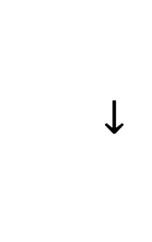
Design 2) Dynamic Restructuring Execution
For each state transaction:
  Dynamically decompose and regroup operations to avoid conflict before actual parallel evaluation is applied.
e₃
e₁
e₂
executor₁
executor₂
txn_{t1}: {O₁, O₂}
txn₂: {O₃}
txn_{t1}
txn_{t2}
O₁ : Read of Road 1
O₂ : Update to Road 2
O₃ : Read of Road 2
O₃
$$→$$
Operation chains:
…
O₁
O₂
: A thread
Road 1
Road 2
17
Notes:
As state transaction process turns out to be a performance bottleneck, we propose a fine-grained parallelism approach to speed up the processing of postponed state transactions.
[click] The key idea is to decompose each state transaction into atomic operations and regroup them to avoid conflict before actual parallel evaluation is applied.
[click] In this example, executor 1 decomposes transaction t1 into operations O1 and O2; and executor 2 decomposes transaction t2 into operation O3,
[click[ where operation 1 stands for read of road 1, operation 2 stands for update to road 2 and operation 3 strands for read of road 2.
[click] Those operations will in inserted into the so-called operation chains data structure
[click] where operations in each chain target at the same application state and they are automatically sorted according to their timestamps.
[click] subsequently, when all transactions are decomposed and inserted into those operations chains, we can evaluate those operations chains in parallel without any state access conflict.

Slide 18
Outline
Motivation
State-of-the-art
Our Approach
Experimental Results
18
Notes:
I’ll jump to experimental results.

Slide 19
Benchmark Workloads
Four applications:
  Grep Sum (GS); Streaming Ledger (SL); Online Bidding (OB); Toll Processing (TP).
Diverse characteristics:
  Varying compute/state access ratio
  Varying state transaction types: read-only, write-only
  Varying data dependencies
  Varying multi-partition transactions
Experiments conducted on a 4-socket Intel Xeon E7- 4820 server with 128 GB DRAM.
19
Notes:
We use four applications in experiments including grep sum, streaming ledger, online bidding, and toll processing.
[click] They cover different runtime characteristics such as
[click] varying compute/state access ratio.
[click] different types of state transactions such as read-only, write-only.
[click] different data dependencies in the workload, where data dependency stands for, for example,
[click] different ratio of multi-partition transactions.
[click] we conduct the experiment on a 4-socket intel xeon server.

Slide 20
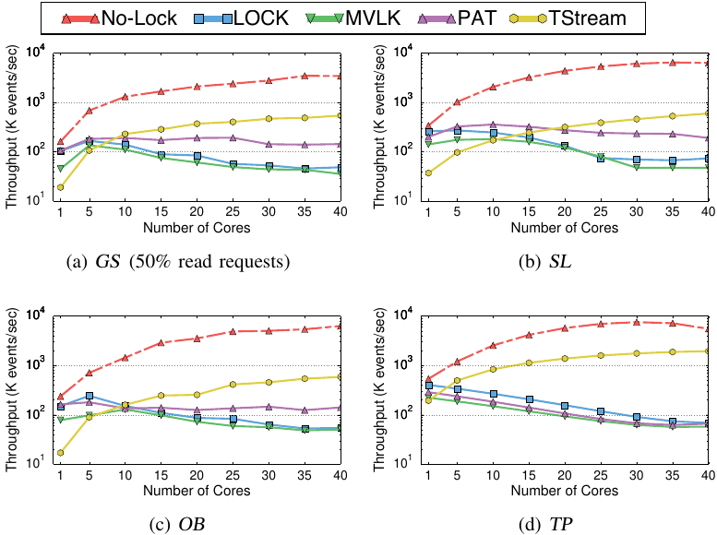
Overall Performance Comparison
(i) In general, TStream performs well at large core counts.
(ii) TStream performs slightly better when data dependency is heavily presented (SL).
(iii) Large room for further improvement.
20
Notes:
We implement all state-of-the-art solutions in the same system including
[click] Lock based,
[click] multiversion lock based,
[click] partition based, which is essentially S-Store scheme.
[click] In addition, we compare our solution with no consistency guarantee by removing locks from LOCK scheme, which represents the performance upper bound of the system.
Let's see the overall performance comparison.
There are three major observations.
[click] First, TStream significantly outperforms other consistent guarantee schemes at large core counts.
[click] Second, It still performs slightly better when data dependency is heavily presented.
[click] Finally, we need to note that there is still large room for further improvement as indicated by the no-lock scheme.

Slide 21
Recap
[Key Designs] 1) dual-mode scheduling, 2) transaction restructuring
[Results] TStream performs constantly better than prior solutions under varying workloads.
https://github.com/Xtra-Computing/briskstream/tree/TStream
21
Notes:
Now, let’s do a recap.
[click] TStream adopts an non-conventional dual mode scheduling and transaction restructuring execution strategy for scaling consistent stateful stream processing on multicores.
[click] We demonstrated that TStream performs constantly better than prior solutions.

Slide 22


Current Work
Next Generation IoT Data Management Platform
(lead by Prof. Volker Markl)
visit us @ www.nebula.stream
Twitter@nebulastream
Thank you!
shuhao.zhang@tu-berlin.de
22
Notes:
The arising Internet of Things (IoT) are adding further pressure on current stream processing systems.
I’m now a postdoc in the team of NebulaStream at TU berlin, where we are building the next generation IoT data Management Platform leading by professor Volker markl.
There are many exciting open questions remain to be solved, stay tuned.
[click] if you have further question, do not hesitate to contact me! Thank you.

Slide 23
Competitor Schemes
Ordering-lock-based approach (LOCK).
Multi-versioning-based approach (MVLK).
Static-partition-based approach (PAT).
  S-Store
No Consistency Guarantee (No-Lock).
  Remove locks from LOCK scheme.
  Represent the performance upper bound.
23
Notes:
We implement all state-of-the-art solutions in the same system.
[click] Lock based,
[click] multiversion lock based,
[click] partition based, which is essentially S-Store scheme.
[click] In addition, we compare our solution with no consistency guarantee by
[click] removing locks from LOCK scheme, which
[click] represents the performance upper bound of the system.

Slide 24
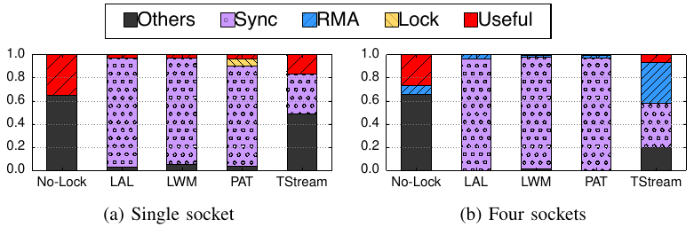
Runtime Breakdown
(a) No-Lock scheme spends more than 60% in others mainly due to index look up.
(b) Synchronization overhead dominates in all prior solutions regardless of NUMA effect.
(c) TStream involves high RMA overhead.
NUMA-aware optimization detailed in our paper.
24
Notes:
Here, I show a detailed execution time breakdown during transaction processing comparing different algorithms.
[click] Useful stands for actual time in transaction processing;
[click] Lock stands for time spend due to lock insertion;
[click] Sync stands for synchronization time due to ordering waiting or punctuation interval;
[click] RMA stands for remote memory access overhead;
[click] Others stands for all other overhead such as indexing look up, context switching.
There are three major observations.
[click] First, No-lock scheme spends more than 60% of the time in others mainly due to index look up. we defer it as future work and focus on concurrency control in this work.
[click] Second, synchronization overhead dominates in all prior solutions regardless of the NUMA effect.
[click] Third, TStream has an unavoidable data shuffling operation during transaction decomposition, which involves high NUMA overhead. We apply multiple NUMA-aware optimization techniques, detailed in our paper.

Slide 25
No free lunch
Currently, TStream has its drawback on efficiently handling transaction abort.
  E.g., one that leaves the average speed of a road to become negative.
Stay tuned for future work
25
Notes:
Stream transactions may need to be aborted. E.g., one that leaves the average speed of a road to become negative.
Currently, TStream has its drawback on efficiently handling transaction abort.
It’s hard to efficiently abort one transaction that is decomposed and partially evaluated.

