Slide 1
Big Data Systems on Future Hardware
Bingsheng He
NUS Computing
http://www.comp.nus.edu.sg/~hebs/

Slide 2
Learning Outcome
After this lecture, you should know about
  Why Hardware Matters?
  Challenges & experiences in hardware-conscious research
  Some example case studies
  Future research directions

Slide 3
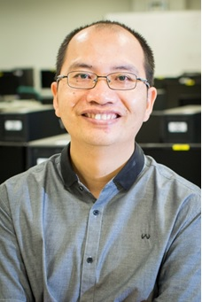
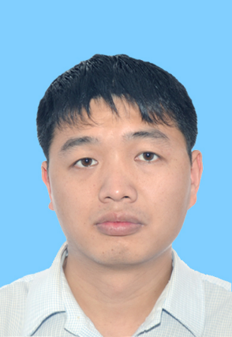
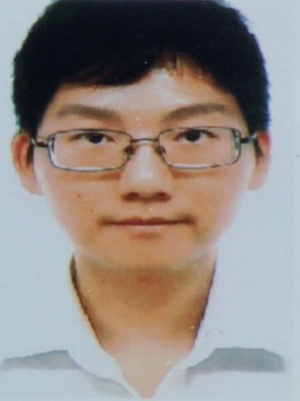
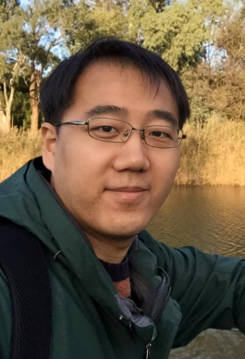
Lecturers
Dr. Bingsheng He
Dr. Cheng Liu
Mr. Shuhao Zhang
Mr. Xuntao Cheng

Slide 4
Agenda
Jan 10, morning:
  An overview [Dr. Bingsheng He, 1 hour and 30 min]
  Data processing on FPGA [Dr. Cheng Liu, 1 hour and 30 min]
Jan 10, afternoon:
  DSP on multi-core processors [Mr. Shuhao Zhang, 1 hour and 30 min].
  Relational databases on many-core processors [Mr. Xuntao Cheng, 1 hour and 30 min]
  Q&A [Dr. Bingsheng He, 30 min]

Slide 5
Welcome to NUS SoC Graduate Student Tutorials!
More about Xtra Computing Group:
http://www.comp.nus.edu.sg/~hebs/
Notes:
I am fortunate to work with colleagues, staffs and students.

