Slide 1
System Optimizations and Performance Tuning for New Generation FPGAs
Bingsheng He
NUS Computing
http://www.comp.nus.edu.sg/~hebs/
Notes:
Good morning, everyone! My name is Zeke Wang, and I come from NTU, Singapore. Today I’ll present our paper about A Performance Analysis Framework for Optimizing OpenCL Applications on FPGAs.

Slide 2
Learning Outcomes
After this lecture, you should be able to understand
  FPGA is an emerging hardware accelerator, which can be challenging for programming.
  System optimization and performance tuning is very important for the system performance on FPGA.
  More R&D efforts have to be put in systems, applications and tools for FPGAs.

Slide 3
Outline
Background
  FPGA
  OpenCL SDK for FPGAs
A Performance Analysis Framework
Case Study: Database Systems
Conclusion
Notes:
Here is the outline of our paper.
First, we will talk about the background and motivations; Second, we will talk about the design; Third, the experiment is discussed; Fourth, the summary is presented.

Slide 4
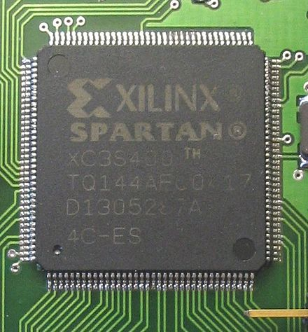
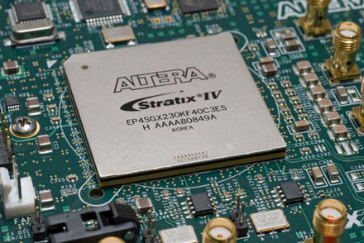
What is FPGA?
Wiki: A field-programmable gate array (FPGA) is an integrated circuit designed to be configured by a customer or a designer after manufacturing – hence "field-programmable".

Slide 5
Advantages of FPGA
Fine-grained hardware parallelism
  Simultaneously process data
  Bit-level computing
The power of dedicated circuits
  Custom for each application (without the limitation of Von Neumann architecture)
  Higher performance/watt ratio→ energy efficient.
Real time processing
  Latency is usually predictable

Slide 6
Many Applications
An FPGA can be used to solve any problem which is computable.
  This is trivially proven by the fact FPGA can be used to implement a soft microprocessor.
Specific applications of FPGAs include software-defined radio, ASIC prototyping, medical imaging, computer vision, speech recognition, cryptography, and a growing range of other areas.
Another trend on the usage of FPGAs is hardware acceleration, where one can use the FPGA to accelerate certain parts of an algorithm.

Slide 7
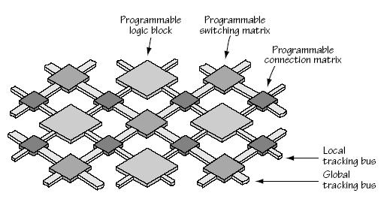
Basic Hardware Resources in FPGA
FPGA Fabric
Logic Block
LUT (Look Up Table): implement logic functions
REG (Flip-Flops): clocked storage elements.
Interconnection & switch: switch matrix/switch box

Slide 8
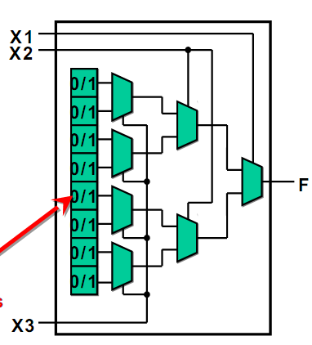
LUT in FPGA
Example: 3-input LUT
  Multiplexer
  Configuration memory (SRAM)
  Filling content in SRAM
  (programming)
1
0
Configuration memory (SRAM)
$$F=x1.x2.x3+\overline{x1}.x2.x3+…+\overline{x1}.\overline{x2}.\overline{x3}$$

Slide 9
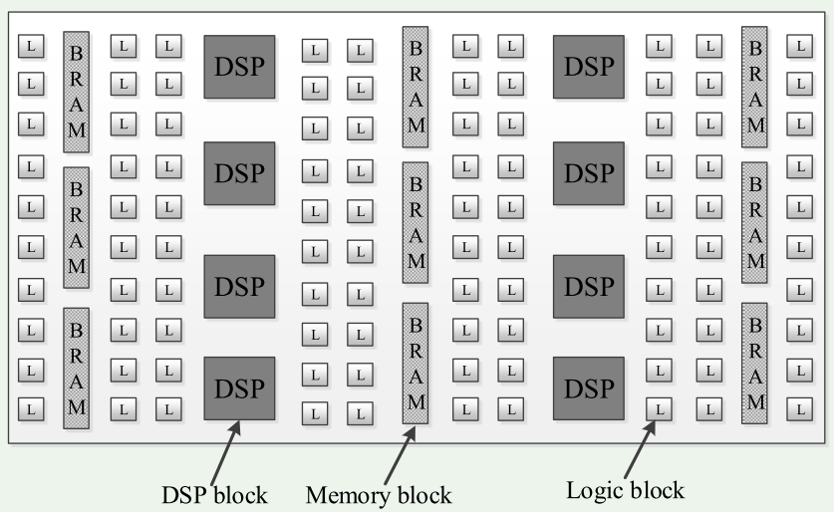
“Architectural Evolution” of FPGA (Field Programmable Gate Arrays)
Hardware-centric → fine-grained parallelism
Users need to program with hardware description languages ☹
Notes:
Originally, the FPGA has distributed resource features, such as logic blocks, DSP blocks and memory blocks.
From the hardware centric point of view, FPGA can be used to achieve fine-grained parallelism. In particular, we can implement bit-level computation on FPGAs.
However, users need to program FPGA with low-level hardware description languages, for example Verilog. Since HDL is cycle-sensitive and error-prone, generally good knowledge of hardware design detail and hand-on experiences are required to guarantee a successful design on FPGA.

Slide 10
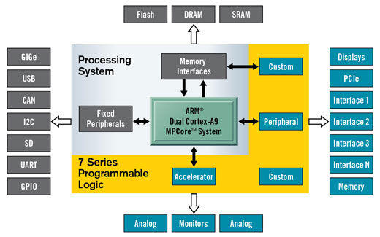
Towards More Powerful FPGAs
General-purpose processors
More interfaces
A Xilinx Zynq-7000 All Programmable System on a Chip.

Slide 11
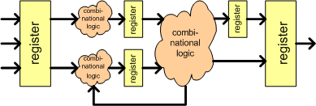
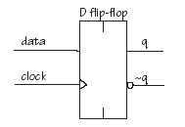

Programming FPGA with Verilog
Design for each register at each cycle.
Combinational logic must meet timing (in one cycle)
Inputs
New Output
every clock edge
Clock
Register
Cycles

Slide 12

High Level Synthesis (HLS)
Generates register-transfer level (RTL) description from behavioral specification (e.g., C, OpenCL), in an automatic or semi-automatic way.
The user can just focus on the high-level program.

Slide 13
HLS Taxonomy

Slide 14
What is OpenCL?
OpenCL stands for Open Computing Language
OpenCL has been developed for heterogeneous system with a host-accelerator model of program execution.
Intel plans to use OpenCL to program its CPU-FPGA heterogeneous system.
Notes:
So what is OpenCL? OpenCL stands for Open Computing Language
OpenCL has been developed for heterogeneous computing environments with a host-accelerator execution model. For example, CPU runs the host code and GPU/FPGA runs the kernel code.
OpenCL has been used by many companies. For example, Intel plans to use OpenCL to program its CPU-FPGA heterogeneous system.

Slide 15
OpenCL
The user only needs to program with OpenCL, leaving the tedious details to the OpenCL SDK.

Slide 16
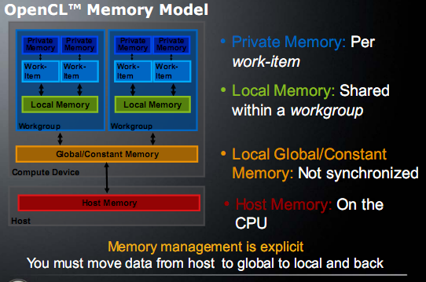
OpenCL
From: http://dna.cs.byu.edu/CS484/lectures/opencl-20training.pdf

Slide 17
“Architectural Evolution” of FPGAs: From OpenCL’s Perspective
DSP blocks, memory blocks, and logic blocks
Memory blocks
External DDR
Software-centric → FPGA as a parallel architecture.
Users can program with OpenCL. ☺
Notes:
Fortunately, the FPGA community is undergoing significant change to address the programmability issues.
In particular, FPGA vendors such as Altera have started to develop OpenCL SDKs for a much better programmability on FPGAs.
From the software centric point of view, the FPGA is viewed as a parallel architecture.
And users can program FPGA with OpenCL to use computing ability of FPGAs, not HDL.
From OpenCL’s perspective, the global memory is implemented with external DDR.
Local memory is implemented with memory blocks, and pipeline is implemented with dsp blocks, memory blocks and logic blocks.

Slide 18
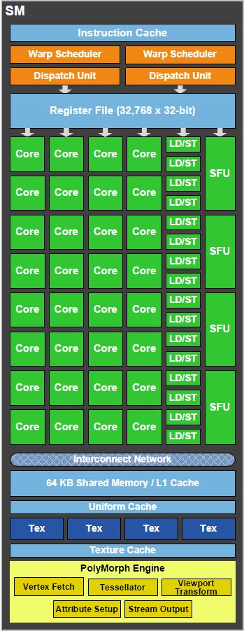
OpenCL on GPU
__kernel void vectorAdd (global int *A, *B, *C, *D, *E, *F)
{
int gid = get_global_id(0);
A[gid] = B[gid] + C[gid];
D[gid] = E[gid] + F[gid];
}
Sufficient threads are required to utilize cores.
0
1
2
3
D=E+F
D=E+F
D=E+F
D=E+F
Both add insns can share the computing cores.
0
1
2
3
A=B+C
A=B+C
A=B+C
A=B+C
core_0
core_1
core_2
core_3
Notes:
Since the OpenCL is originally designed for GPU, it is necessary to compare OpenCL on GPU and OpenCL on FPGA. First, we talk about OpenCL on GPU.
Take the simple vector addition kernel for example. Each parallel thread is associated with an ID (get global id(0)). The global id indicates the subset of data that each thread operates on.
There are two add instructions in the OpenCL kernel.
When the OpenCL code runs on GPU, the first add instruction will go into the core’s pipeline at the first cycle, and the second add instruction at the second cycle
So our first observation here is that both add instructions can share the pipeline of each computing core, based on Von Neumann architecture.
The second observation is that sufficient threads are required to fully utilize the computing ability of cores. For example, there are four cores here, if only 2 threads are active on the OpenCL code, the cores are definitely under-utilized.

Slide 19
OpenCL on FPGA
__kernel void vectorAdd (global int *A, *B, *C, *D, *E, *F)
{
int gid = get_global_id(0);
A[gid] = B[gid] + C[gid];
D[gid] = E[gid] + F[gid];
}
Enough threads are required
to fully utilize custom pipelines.
A=B+C
D=E+F
3
2
1
0
FPGA
Instructions mean real circuits on FPGA
→ Pipeline parallelism.
Notes:
Next, we talk about OpenCL on FPGA.
Take the previous vector addition kernel for example. Each add instruction has its own custom circuit on FPGA. And its throughput is one addition per cycle.
So our first observation here is that Instructions mean real circuits on FPGA.
On FPGA, one thread will flow into the custom pipelines at one cycle. If there is only one thread active on the FPGA, one addition unit is always idle.
So the second observation here is that sufficient threads are required to fully utilize custom pipelines.
So to sum up, GPU only requires sufficient threads to utilize its computing ability, while FPGA requires not only sufficient threads, but also instructions.

Slide 20
Impact of attributes
__kernel void vectorAdd_int(__global int *A, *B, *C, *D, *E, *F)
{
int gid = get_global_id(0);
#pragma unroll 8
for (int j = 0; j < 8; j++)
A[(gid<<3)+j] = B[(gid<<3)+j] + C[(gid<<3)+j];
D[gid] = E[gid] + F[gid];
}
For GPU: larger code size, less dependency between instructions.
Instructions (with attributes) mean real circuits on FPGA.
For FPGA: 8x real circuits for addition instruction, 8 additions per cycle.
A=B+C
A=B+C
A=B+C
A=B+C
A=B+C
A=B+C
A=B+C
A=B+C
D=E+F
Notes:
Since we can specify the attributions on the OpenCL code, it is necessary to compare the impact of attribute on GPU and on FPGA.
We also take the previous vector addition kernel for example.
We try to add the loop unrolling attribute on the loop. In particular, the loop is unrolled by 8 times.
What is the impact this attribute on GPU, it can achieve less dependency between addition instructions at the cost of larger code size.
However, when the code runs on FPGA, the add instruction can have eight addition circuit units, not just one. So the throughput becomes 8 additions per cycle.
Therefore, there is significantly different about attributes between GPU and FPGA.
So our observation here is that instructions with optimizations mean real circuits on FPGAs.

Slide 21
Outline
Background
  FPGA
  OpenCL SDK for FPGAs
A Performance Analysis Framework
Case Study: Database Systems
Conclusion
Notes:
Here is the outline of our paper.
First, we will talk about the background and motivations; Second, we will talk about the design; Third, the experiment is discussed; Fourth, the summary is presented.

Slide 22

Motivating Questions
OpenCL has improved the programmability of new generation FPGAs.
Good programmability does NOT necessarily mean good performance.
How can we tune the performance of an OpenCL program on FPGAs?

Slide 23
Impact of Optimization Combinations
SM
MC
PM
100+
Optimization combinations
UL
SIMD
CU
Different optimization combinations can significantly affect performance.
Local Memory (SM), Memory Coalescing (MC), Private Memory (PM),
Loop Unrolling (UL), Kernel Vectorization (SIMD), Kernel Pipeline Replication (CU)
Notes:
There are six basic optimization methods for OpenCL on FPGA, SM MC, UL, PM, SIMD and CU. So there are more than 100 optimizations applied on the input kernel.
And optimization combinations can have significantly performance impact. For example, the SM+UL can have more than 100 times performance speedup over the baseline.

Slide 24
Challenge from Long Synthesis Time
☹
FPGA Bitstream
OpenCL Code
2-4 hours
It takes too much time to evaluate all the optimization combinations on real FPGAs.
A tool for estimating optimization optimizations for OpenCL kernel is needed.
Notes:
To make things worse, each optimization combination requires hours to compile (from OpenCL to FPGA bit-stream).
So we cannot choose to evaluate all the optimization combinations on real FPGAs, since it requires hundreds of hours to evaluate.
A tool for evaluate optimizations for the input OpenCL kernel is needed and then the hundred-hours synthesis time can be eliminated.

Slide 25
Our Solution: A Performance Analysis Framework
We propose a performance analysis framework to provide performance guidance on FPGA
  Frontend Collector: Obtain necessary OpenCL information (LLVM IR) about each basic block
  Analytical model: Estimate the performance of the OpenCL kernel and generate model output
  Performance Potential Advisor: Convert program analysis information into user-friendly metrics
#WI, #CU,
#SIMD
Frontend
Statistical Collector
#Cycle, #Mem_insts,
#Mem_burst,
#Mem_bytes, Trip
FPGA
Analytical
Model
Performance
Potential
Advisor
OpenCL
Kernel
Model
output
Programmer
Manual tuning
Notes:
Based on the previous FPGA execution model, we propose an FPGA-specific performance analysis framework to provide performance guidance on FPGA.
The proposed performance analysis framework has three components: frontend collector, analytical model and performance potential advisor.
First, the OpenCL kernel with the necessary attributes is passed to the frontend statistical collector, which is used to obtain OpenCL kernel information about each basic block.
Second, the information from each basic block is passed to the FPGA analytical model, which will generate necessary model output.
Third, the model output is passed to the performance potential advisor, which is used to generate performance metrics.
Finally, the programmer gets the performance potential metrics and then identify the bottleneck of the input OpenCL kernel with the input attributes. Therefore, the programmer can further optimize the input OpenCL kernel in order to reduce the value of performance potential metrics.

Slide 26
OpenCL Compiler on FPGA
OpenCL code
LLVM IR
Verilog
Too high-level, hard to capture all the cases
Fixed intermediate instructions,
Plenty of static analysis tools
Too low-level,
large HDL code size
Our performance analysis framework is based on LLVM IR.
Notes:
Now we talk about the OpenCL complier, which is based on an LLVM compiler infrastructure.
The first step is convert OpenCL code to an intermediate representation (IR). The second step is to convert the IR to HDL code.
Since we want to analyze the performance of input OpenCL code, we need to choose one step to analyze.
If the direct OpenCL code is chosen, it is too high-level and hard to capture all the cases because they are too flexible.
If the Verilog code is chosen, it is too low level and its generated HDL code size is too large, so it is hard to map the Verilog code back to the OpenCL code. For example, 20-line OpenCL code can have more than 10 thousands lines of Verilog code.
However, LLVM IR has fixed number of intermediate instructions and LLVM framework has plenty of static analysis tools.
So our performance analysis framework is based on LLVM IR.

Slide 27
LLVM IR View of OpenCL Kernel
__kernel void vectorAdd (__global int *A, *B, *C, *D, *E, *F)
{
int gid = get_global_id(0);
for (int j = 0; j < 128; j++)
A[(gid<<7)+j] = B[(gid<<7)+j] + C[(gid<<7)+j];
for (int k = 0; k < 16; k++)
D[(gid<<4)+k] = E[(gid<<4)+k] + F[(gid<<4)+k];
}
Basic block: a group of instructions in a contiguous sequence.
Notes:
To illustrate the IR, take the OpenCL kernel for example.
First, we need to talk about one important concept basic block.
a basic block contains a group of instructions in a contiguous sequence.
So the OpenCL kernel has four basic blocks. The get thread ID instruction belongs to the first basic block, the first loop belongs to the second basic block and the second loop belongs to the third basic block.

Slide 28
Basic Block → Heterogeneous core
core_0
A basic block == a core
Cores run concurrently
core_1
core_2
Keeping the load balance among cores is critical.
core_3
Notes:
Now we talk about the FPGA execution model, we also take the previous vector addition kernel for example.
Each basic block behaves like a separate core. However, each core contains different pipeline circuit.
So they are heterogeneous core, not homogeneous core like the one in the multi-core CPU.
With sufficient threads existing in the OpenCL kernel, all the basic blocks run simultaneously .
So the performance of an OpenCL kernel is determined the slowest core (basic block).
Keeping the load balance among basic blocks is critical.
“Von Neumann architectures were elegant and have served us well, but if you think about something like the human brain, there is no single pipeline to execute instruction after instruction; we have one part for language processing, another for motor control, and so on. These are highly specialized circuits. If you think about Von Neumann architectures as well, executing something simple such as add has many steps—retrieve, decode, rename, schedule, execute and write back—there are usually five to ten steps, depending on what you want to do and this pipeline is not efficient.”

Slide 29
Frontend Collector
  Standard inputs:
  Frequency and resource utilizations of logic block, memory block, DSP block (from compilation report).
  Memory width and memory channels (from vendor).
  Number of input work items (from host code).
Static inputs of basic block with UL and SIMD (LLVM::BasicBlock):
  Memory instructions, average memory bytes and burst length.
  Critical path for computing instructions.
Run-time Inputs (LLVM:: LoopInfo):
  Loop hierarchy.
  Trip counter for each loop (Run same OpenCL code on GPU).
Notes:
Frontend Collector has three inputs.
First, standard inputs contains Frequency and resource utilizations of logic block, memory block, DSP block (they are from compilation report).
Memory width and memory channels (from vendor). Number of input work items (from host code).
Second, we develop one LLVM pass to collect the static input. In particular, we collect information from memory side and computation side. For the memory side, we collect the Memory instructions, average memory bytes and burst length. For the computation side, we collect the critical path for computing instructions. The challenge part here is that we take into consideration the impact of UL and SIMD.
Third, we develop one LLVM pass, based on LLVM::LoopInfo, to collect the run-time input. In particular, we identify the loop hierarchy of the input kernel and we run the code on GPU to determine the trip counter for each loop in case it is necessary.

Slide 30
Performance Analytical Model
CS
C_0
L0
C_1
C_2
L2
B_0
B_1
B_2
B_3
B_4
B_5
B_6
B_7
Our model follows a down-up approach.
B_0--B_7: Basic blocks of the kernel (leaf nodes)
C_0--C_2: LLVM non-leaf nodes
Cs : Cycles to execute the input kernel on FPGA
Notes:
Now I will talk about how to estimate the clock cycles Cs required by the input kernel.
Our analytical model follows a down-up approach. In particular, we begin with the evaluation of basic blocks, then father nodes of basic blocks, until to the root node Cs.
B_0:: B_3 belongs to the first loop C_0, with trip counter L0. B_5:: B_7 belongs to the second loop C_2, with trip counter L2.
B_4 belongs to C_1. The OpenCL kernel has two loops.
When non_leaf nodes C_0: C_2 are computed, we can compute the root node Cs.

Slide 31

Evaluation of Basic Block
Ck
$$C_{k}=Max({Comp}_{k}, {Mem}_{k})$$
Compk
Memk
Compk : Computation cycles of the basic block k
Memk : Memory cycles of the basic block k
Each basic block has its own computing pipeline.
All the basic blocks share the memory bandwidth.
Notes:
Now we begin with the evaluation of basic block.
C_k is computed as the maximum value of Computing cycles Compk and memory cycles Memk. The details about evaluating Compk and Memk are shown in our paper.
The first observation here is that each basic block has its own computing pipeline.
The second observation is that all the basic blocks share the memory bandwidth. So we need to carefully organize the memory instructions.

Slide 32
Evaluation of C_0
CS
C_0
L0
C_1
C_2
B_0
B_1
B_2
B_3
B_4
B_5
B_6
B_7
Notes:
In this slides, we will talk about how to evaluate C_0, which has four leaf child nodes B_0-B_3. And C_0 belongs to the for-loop type, with the trip counter L0.

Slide 33
Evaluation of C_0
C_0
L0 = 5
B_0
B_1
B_2
B_3
Unbalanced, B_1 is the bottleneck!
B_0
B_1
B_2
B_3
B_0
B_1
B_2
B_3
B_0
B_1
B_2
B_3
B_0
B_1
B_2
B_3
B_0
B_1
B_2
B_3
C_0 = B_0 + 5*B_1 + B_2 + B_3
Notes:
When the loop trip counter is equal to 5, how many cycles are required for C_0?
We can see that C_0 is equal to B_0 + 5B_1 + B_2 +B_3
Our observation here is that B_1 is the bottleneck, and unbalance exists between these four basic blocks.

Slide 34
Performance Potential Advisor
B_{comp}: high → FPGA resource still available.
B_{mem}: high → low global memory bandwidth utilization.
B_{balance}: high → unbalancing among basic blocks.
B_{itpp}: high → more threads required to fully utilize pipeline.

Slide 35
Experimental Setup
Platform:
  Terasic’s DE5-Net board: 4GB 2-bank DDR3 and Altera Stratix V A7, with Altera OpenCL SDK version 14.0 (now Intel).
  Connected to the host with PCI-e bus
Application | Data Size
Matrix Multiplication (MM) | 2048*2048 matrices
K-Means, K=128, 8 features (KM) | 32M points
Word Count (WC) | 1500MB text file
Similarity Scope (SS) | 8000 files each with 8000 features
Notes:
Our experiment is based on terasic’s de5 FPGA board. And we use four application to evaluate our performance analytical framework.

Slide 36
Analytical Model Evaluation (MM)
350X over baseline
Our estimation can capture the performance trend of 18 optimization combinations.
Notes:
Our framework has two parts. First, we talk about the evaluation of analytical model. We use MM for example.
Our Estimation can capture the performance trend of 18 optimization combinations.
The optimal optimization combination can achieve 350X performance speedup over the baseline. You may be interested in how to find it?

Slide 37
Code Tuning Steps (MM)
The tuning rule: Each step aims to decrease the metric with largest value.
Notes:
Now we talk about second part of our framework: code tuning steps.
When we use our tool to analyse the baseline implementation, we can see the B_mem is very high, wo we employ SM to reduce B_mem.
We also pass the SM implementation to our tool and find that SM implementation suffers from large B_inbalance, so the performance speedup is not significant.
Then we employ UL to the SM implementation. So SM_UL have significant performance speedup over the baseline since B_mem and B_balance are low now.
We can see that we still have the available FPGA resources, so we employ SIMD to further improve the performance and then the highest performance speedup can be achieved.
We need to stop optimization process here since there is no FPGA resources available.

Slide 38
Comparison with Altera OpenCL SDK
Speedup over baseline | MM | KM | WC | SS
Altera -O3 approach | 0.7 | 4.4 | 0.93 | 1
Our framework | 362.4 | 293.4 | 11.4 | 9.4
Notes:
We compare the performance of the OpenCL program 1) with the optimization guided by our framework, and 2) with the Altera SDK resource driven optimizations (“-O3 approach", “aoc -O3" command, with default maximum_logic_utilization=85%). In particular, we apply these two optimization frameworks to the four baseline implementations (MM, KM, WC and SS). The experimental result shows that the implementations optimized by our framework over the baselines can achieve significantly higher speedups than the Altera SDK resource driven optimizations, as shown in Table.

Slide 39
Summary
Tuning OpenCL code on FPGAs is still an open problem, since FPGA is significantly different from GPU.
We use static and dynamic analysis to develop an performance analytical framework.
Our framework can guide the programmer to effectively tune the code on FPGA.

Slide 40
Outline
Background
  FPGA
  OpenCL SDK for FPGAs
A Performance Analysis Framework
Case Study: Database Systems
Conclusion
Notes:
Here is the outline of our paper.
First, we will talk about the background and motivations; Second, we will talk about the design; Third, the experiment is discussed; Fourth, the summary is presented.

Slide 41
Problem
OmniDB [1]: State-of-the-art OpenCL-based query processor on CPU/GPU.
  Kernel-based execution
  Common optimization methods
  Cost-based approach to schedule
How OmniDB performs on OpenCL-based FPGAs?
[1] Shuhao Zhang and et al. OmniDB: Towards Portable and Efficient Query Processing on Parallel CPU/GPU Architectures, VLDB’13.
Notes:
On one hand, we have OpenCL to program FPGA; on the other hand, OpenCL-based design and implementation for relational databases have been emerging on CPUs/GPUs. For example, OmniDB.
OmniDB is OpenCL-based database query processing running on CPU/GPU. It is obvious that OmniDB can achieve good performance on CPU/GPU.
It has two properties. First, it belongs to the layered design and kernel-based execution. Second, it contains one cost model to schedule the computing tasks among CPUs and GPUs.
One natural question is that how OmniDB performs on OpenCL-based FPGAs. We try to run OmniDB on FPGA.
It has serious performance problems on FPGA because of the architecture differences between CPU/GPU and FPGA.

Slide 42
Challenge (Large Exploration Space)
A single SQL query can have many possible query execution plans on FPGAs.
  Each query has multiple operators, and each operator consists of multiple OpenCL kernels.
  Each OpenCL kernel can have different FPGA-specific optimization combinations.
We also consider another dimension of using multiple FPGA images.
Notes:
The first challenge comes from the large exploration space. For each single SQL query, it can have many implementations. In particular, each query has multiple operators, and each operator can consist of multiple OpenCL kernels, each kernel has multiple FPGA-specific optimization combinations.
To make the things worse, we also consider another dimension of using multiple FPGA images.

Slide 43
Observation
There is an FPGA-specific trade-off between the following two factors.
  Optimization combination for each kernel
  Reconfiguration overhead
More aggregative optimizations for each kernel ☺ →
More resources for each kernel ☺ →
More resources for the entire query →
More FPGA images ☹ →
Higher FPGA reconfiguration overhead ☹
Notes:
Now I will talk about the FPGA-specific trade-off between the two dimensions: optimization combination and reconfiguration overhead.
In general, More aggregative optimizations for each kernel will cost More resources for the kernel. Then, More resources are required for the entire query . In particular, more FPGA images are required and higher FPGA reconfiguration overhead appears.

Slide 44
Impact of Optimization Combination
Time and resource utilization of scanLargeArrays kernel (@prefix scan) with 128M tuples
More aggregative optimizations →
More resource utilization →
Higher performance
Notes:
Now I talk about the other observation, about the impact of optimization combination.
Let me use the scanLargeArrays kernel with 128M input tuples for example. The figure shows the relationship between (time, resource utilization) and optimization combination.
X-axis is the optimization combination, Y axis is the resource utilization and resource utilization.
Our observation here is that more aggregative optimization means more resource utilization and then higher performance.

Slide 45
FPGA Reconfiguration Overhead
According to Altera, FPGA reconfiguration overhead contains three sources.
  Transfer the active contents (memory footprint) from FPGA memory to host memory via PCIe (roughly 2GB/s)
  Fully reconfigure the FPGA (roughly 1914.6ms).
  Transfer the active contents from host memory to FPGA memory via PCIe (roughly 2GB/s)
FPGA reconfiguration overhead is significant in the current FPGA board.
Notes:
Next, we talk about the other observation about the FPGA reconfiguration overhead.
According to Altera, FPGA reconfiguration overhead contains three sources. The first part is the time taken to transfer the active contents (memory footprint) from FPGA memory to host memory via PCIe. The seond part is the time taken to reconfigure the FPGA. The third part is the time to transfer the active contents from host memory between FPGA memory
The reason why to transfer the data between FPGA memory and host memory is that the FPGA reconfiguration will corrupt the FPGA DDR contents.

Slide 46
Our Approach
Query processor: accelerated with FPGA-specific optimizations
FPGA-specific cost model: to determine the optimal query plan for the input query
Notes:
Our approach contains two parts. The first part is to accelerate query processor with FPGA-specific optimization methods. The second part contains one FPGA-specific cost model to determine the optimal query plan for the input query.

Slide 47
Query Processor (Operator Kernel Level)
The layered design of query processor contains four operators (constituting the SQL query).
  Selection (5 operator kernels)
  Order-by (2 operator kernels)
  Grouping and Aggregation (7 operator kernels)
  Join (2 operator kernels)
Notes:
We adopt the implementation of the query processor from OmniDB, which contains 4 operators. And the 4 operators can form any SQL query. Each operator contains several kernels to implement.
For the detailed description, please read our paper.
The selection operator contains 5 kernels, order-by contains 2 kernels, grouping and aggregation contains 7 kernels. Join contains 2 kernels.

Slide 48
Operator Kernel
Adopt the implementation of operator kernel from OmniDB, which has already explored the common optimizations
  Thread Parallelism (TP)
  Shared Memory (SM)
  Memory coalescing (MC)
Mainly focuses on FPGA-specific optimizations
  Compute units (CU)
  Kernel Vectorization (SIMD)
Notes:
We adopt the implementation of primitives from OmniDB, which has already explored the optimizations, thread parallelism, shared memory and memory coalescing. Our paper mainly focuses on the FPGA-specific optimizations.

Slide 49
FPGA-specific Cost Model
We propose an FPGA-specific cost model to determine the optimal query plan for the input query.
The cost model follows the layered design.
  Unit Cost (for each operator kernel)
  Optimal query plan generation (dynamic programming based approach)
A dynamic programming based approach
Notes:
In order to generate the optimal query plan for the input query, our approach is to use an FPGA-specific cost model. The cost model follows the layer design and contains two components, unit cost and optimal query plan generation.

Slide 50
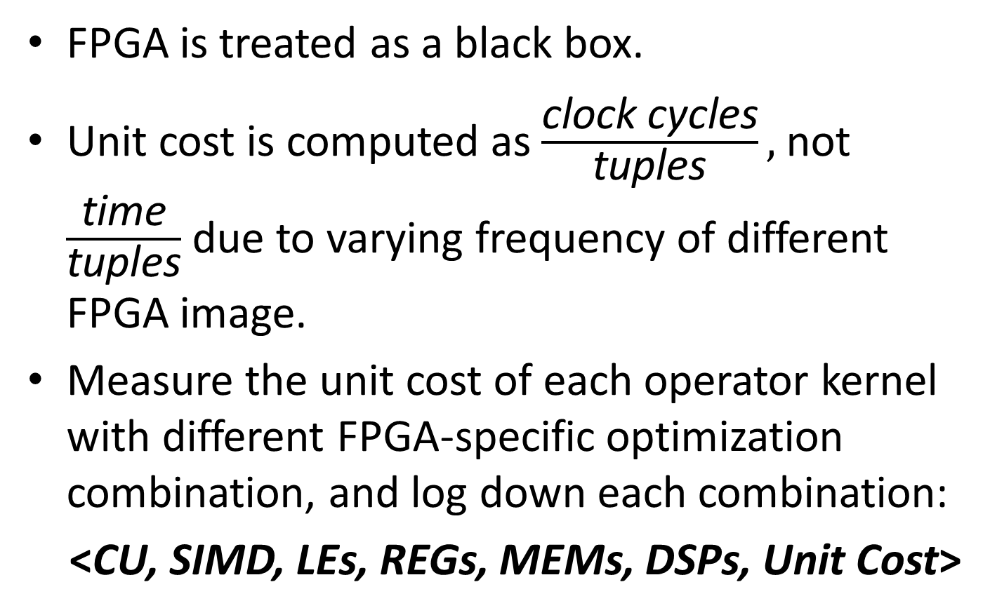
Unit Cost for Each Operator Kernel
FPGA is treated as a black box.
Unit cost is computed as$\frac{\text{clock} \text{cycles}}{\text{tuples}},$not $\frac{\text{time}}{\text{tuples}}$ due to varying frequency of different FPGA image.
Measure the unit cost of each operator kernel with different FPGA-specific optimization combination, and log down each combination:
<CU, SIMD, LEs, REGs, MEMs, DSPs, Unit Cost>
Notes:
FPGA is treated as a black box and the unit cost is supposed to be the number of total clock cycles divided by the number of tuples in the input relation. We do not use the elapsed time because the frequency varies with the FPGA image.
we measure the unit cost of each operator kernel with different FPGA-specific optimization combinations and the corresponding resource utilizations and unit costs.

Slide 51
Experimental Setup
Platform:
  Terasic’s DE5-Net board: Altera Stratix V A7 and 4GB 2-bank DDR3
  PCI-e 2.0 (X8)
  Altera OpenCL SDK version 14.0
Workloads:
  Four queries (Q1, Q2, Q3 and Q4)
  Tuple format: <key, payload>. Both keys and payloads are 4-bytes.
We use Q3 for example.
Notes:
We conduct the experiment on Terasic’s DE5-Net board. We evaluate four queries.
The input data is a relation (i.e., table) with the tuple format of <key, payload>, in the format of column databases. Both keys and payloads are 4-byte. We use Q3 for example.

Slide 52
Details of Q3
SQL query:
  SELECT S.key, SUM(S.payload) FROM S WHERE Lo ≤ S.paylaod ≤ Hi GROUP BY S.key
Q3: 12 operator kernels
Notes:
We show the details of Q3. And the right figure shows the corresponding kernels to implement the Q3. We can see that Q3 contain 12 operator kernels.
For the next slides, we will show the corresponding execution plan with the different size of Table S.

Slide 53
Generation of Execution Plans
Execution plan 1
FPGA image | LUTs | REGs | RAMs | DSPs | Freq.
Estimated | 151460 | 339134 | 2175 | 42 | 198
Measured | 154509 | 283131 | 1973 | 34 | 233
Execution Plan 2
FPGA image 1 | LUTs | REGs | RAMs | DSPs | Freq.
Estimated 1 | 187738 | 349051 | 2416 | 72 | 182M
Measured 1 | 184082 | 334093 | 2342 | 72 | 192.5M
FPGA image 2 | LUTs | REGs | RAMs | DSPs | Freq.
Estimated 2 | 179428 | 331045 | 2538 | 0 | 163M
Measured 2 | 134629 | 346087 | 2421 | 0 | 182M
FPGA image 3 | LUTs | REGs | RAMs | DSPs | Freq.
Estimated 3 | 155187 | 294559 | 1950 | 90 | 223M
Measured 3 | 171434 | 348651 | 2112 | 90 | 203M
Our cost model can roughly predict the resource utilization and frequency of each FPGA image.
Notes:
For different table size, our cost model recommends two execution plans.
The observation here is that our cost model can roughly predict the resource utilization and frequency of each FPGA image. Next we show the evaluation of Q3.

Slide 54
Break-even Point for Execution Plans
1: execution plan 1
2: execution plan 2
Measured: real FPGA
Estimated: cost model
Break-even point
Our cost model can roughly predict the performance for each execution plan.
Our cost model can recommend the optimal execution plan for different table sizes.
Notes:
From the figure x axis is the table size, y axis is elapsed time for Q3.
In the figure, 1 means the execution plan 1 and 2 means the execution plan 2.
Measured means the time when running on FPGA, Estimated means the time predicted by our cost model.
The first observation here is that our cost model can roughly predict the performance for each execution plan.
The second observation is that our cost model can predict the break-even point for Q3 and our cost model can recommend the optimal execution plan for different table sizes.

Slide 55
Comparison with OmniDB on FPGA
One FPGA image
OmniDB: one FPGA image without FPGA-specific optimizations
FPGA reconfiguration overhead > Benefit from the reduced execution time (more aggregative optimizations for each involved kernel.
Notes:
This slide shows that comparison with OmniDB on FPGA. The OmniDB means the implementation using one FPGA image without FPGA-specific optimizations.
When table size is less than 16M, only one FPGA image is used ,then the speedup is limited. There are two reasons. First, The FPGA reconfiguration overhead > the benefit from the reduced execution time. Second, Optimization level is limited for each operator kernel in one FPGA image.

Slide 56
Comparison with OmniDB on FPGA
Three FPGA images
OmniDB: one FPGA image without FPGA-specific optimizations
FPGA reconfiguration overhead < Benefit from the reduced execution time
Notes:
When table size is less than 16M, only one FPGA image is used ,then the speedup is limited. When the table size becomes larger, three FPGA images are used, and then the performance speedup becomes larger. And larger input table size will have higher performance speedup. The reason is that The FPGA reconfiguration overhead < the benefit from the reduced execution time which comes from more aggregative optimizations for each involved kernel.

Slide 57
Outline
Background
  FPGA
  OpenCL SDK for FPGAs
A Performance Analysis Framework
Case Study: Database Systems
Conclusion
Notes:
Here is the outline of our paper.
First, we will talk about the background and motivations; Second, we will talk about the design; Third, the experiment is discussed; Fourth, the summary is presented.

Slide 58
Conclusions
The OpenCL support in new generation FPGAs has brought significant technical challenges and opportunities.
Our performance analysis tool and case study demonstrate the importance of system optimizations and performance tunings.
Hardware and software co-design can enable many interesting systems and applications.

Slide 59

Future Work
Can FPGA be used for deep learning and achieve the same performance as GPU?

Slide 60
State-of-the-art of Deep Learning
GPUs are de facto hardware for deep learning.
A lot of deep learning systems have been developed and deployed.
  Tensorflow, Caffee, Theano, SINGA…
Problems of current solutions:
  GPUs are expensive, especially in large-scale deployment.

Slide 61
GPUs are Costly
Hardware cost
  One P100 costs more than 5000 USD
Energy consumption
  The TDP of P100 is 300W.
  Idle power
Other related costs
  Cooling
  Server space and density
Consider a medium size data center with 5000 machines…
Question: Can we develop a new architecture that can deliver similar
(if not better) performance but with much lower cost?

Slide 62
One Possible (feasible) Answer is FPGA
FPGA
  Low power (<50W), very low idle power.
  Dense deployment
  The hardware cost is elastic to hardware volume. It is more cost effective for large-scale deployment.
  Low latency
Other benefits
  Compared with GPU, FPGA can achieve very low latency
  Very flexible in hardware integration (e.g., network)
  Next-generation Intel CPU (coupled CPU+FPGA design)
Who are using it?
  Amazon EC2 F1
  Microsoft data center
  Baidu data center
  …
We are trying… Stay tuned ☺

Slide 63
As a Data Scientist, Do I Need to Learn/Use FPGA?
Maybe, yes…
  HPC is important for deep learning and big data.
  FPGA is also good for specialized systems (e.g., “deep learning chips”)
  FPGA is used many robotics systems.
Maybe, no…
  Many (supposedly great) HW architectures did not survive.
  Hire HW engineers to do it for me ☺ ☺ ☺

Slide 64
References
Zeke Wangˆ, Johns Paul*, Hui Yan Cheahˆ, Bingsheng He and Wei Zhang. Accelerating Database Query Processing on OpenCL-based FPGAs. FPL 2016: International Conference on Field Programmable Logic and Applications.
Zeke Wang^, Bingsheng He, Wei Zhang, Shunning Jiang. A Performance Analysis Framework for Optimizing OpenCL Applications on FPGAs. HPCA 2016: IEEE International Symposium on High Performance Computer Architecture [53/240=22%]
Zeke Wang^, Bingsheng He, Wei Zhang. A Study of Data Partitioning on OpenCL-based FPGA. FPL 2015: International Conference on Field Programmable Logic and Applications. [Top-quality papers of FPL 2015]
Zeke Wang^, Shuhao Zhang*, Bingsheng He, Wei Zhang. Melia: A MapReduce Framework on OpenCL-based FPGAs. IEEE TPDS: IEEE Transactions on Parallel and Distributed System (TPDS) Volume ??, Number ?, April 2015, pp. ???-???.

