Slide 1



Revisiting the Design of Data Stream Processing Systems on Multi-Core Processors
Shuhao Zhang^{1,2}, Bingsheng He¹, Daniel Dahlmeier², Amelie Chi Zhou³, Thomas Heinze²
1
2
3
Notes:
Good afternoon, thanks for coming. I’m going to present my recent work on data stream processing system.
My name is Shuhao, and this a joint work with BingSheng from NUS, Daniel and Thomas from SAP, Amelie from Inria.

Slide 2
Outline
Background.
Profiling study of DSP systems on modern multi-core processors.
A new DSP system designed for modern multi-core processors.
Notes:
I will first introduce some background information, follow by a profiling study on existing data stream processing systems on multi-core processors.
Finally, I will briefly talk about my on-going work.

Slide 3
Outline
Background.
  Multi-core processors
  DSP systems
Profiling study of DSP systems on modern multi-core processors.
A new DSP system designed for modern multi-core processors.

Slide 4
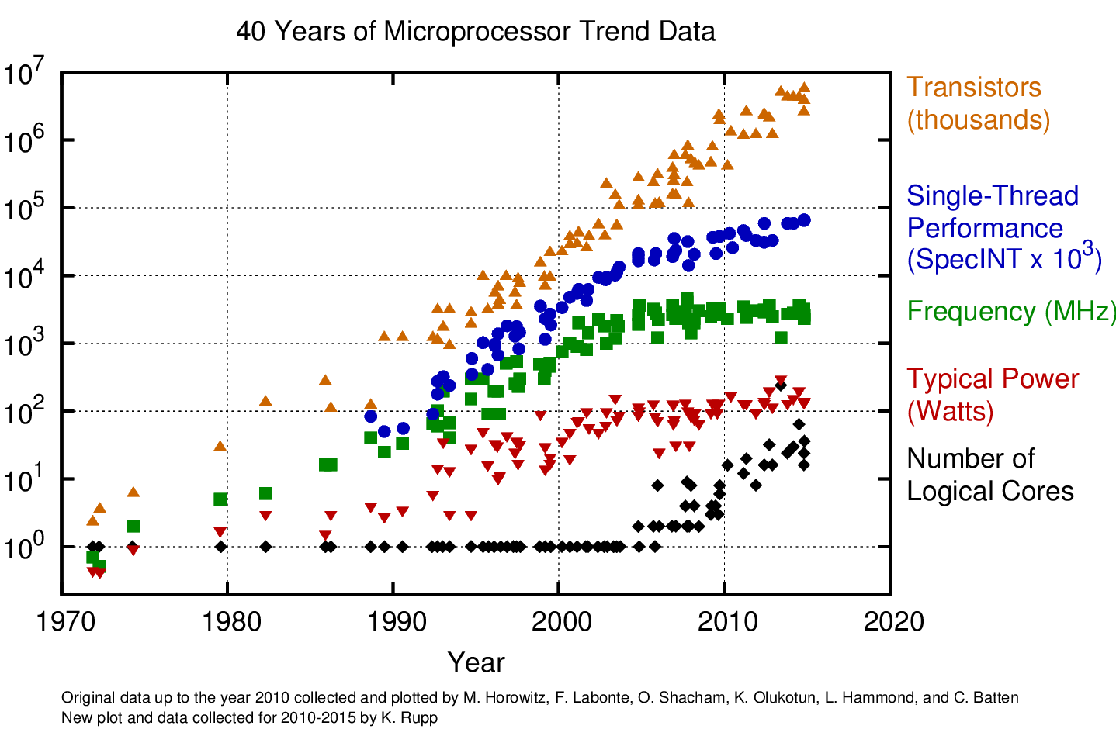
The trend of CPU development
Transistors is still rapidly increasing.
Number of logical cores is also increasing fast.
Other metrics are slowing down.
We are now at the multi-core era.
Notes:
CPU had evolved many generations, and there are three trends.
First, transistors per CPU is still rapidly increasing.
Second, number of logical cores is also increasing fast.
Third, other metrics are slowing down. In particular, single-thread performance has little improvement for years.
We are now at the multi-core era.

Slide 5
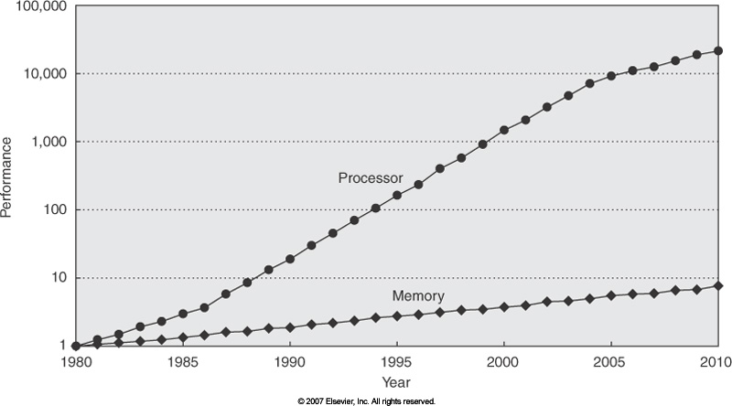
The speed gap between memory and CPU is widening
Over 1000x
Notes:
On the other hand, the improvement on memory is less significant compared to CPU, and results in significant performance gap between them.

Slide 6
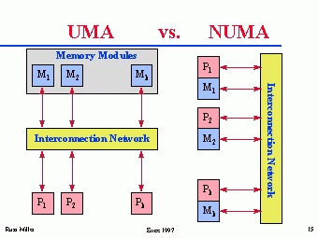
From UMA to NUMA
UMA (Uniform Memory Access):
  access time to a memory location is independent of which processor makes the request or which memory chip contains the transferred data.
  Issues: power and scalability
NUMA(Non-Uniform Memory Access):
  a processor can access its own local memory faster than non-local memory.
  Main-stream architectures
Notes:
Depending how the processors access memory, we have two kinds of architectures. Modern multi-core processors generally adopts non-uniform memory access architecture. You may wonder why.
(Click) As I have just mentioned, CPU cores are getting more and more (from 1 core, 2 core to dozens of cores and even hundreds of cores in a single machine), and the speed gap between CPU and memory is bigger and bigger.
There is an increasing competition among CPU cores to access the same piece of memory, and limits the number of CPU cores a machine can support.
(Click) Thus, the hardware architectures add multiple CPUs into the same board, and each CPU has its own local memory to reduce the potential conflict among CPU cores. The communication between CPU sockets are supported by additional channels such as quick path interface.

Slide 7
An overview of one of the state-of-the-art NUMA server
NUMA topology
The overview of the execution components of the processor
Notes:
This is one type of NUMA server with only four CPU sockets forming a ring, and you can see the CPU access its own memory with much higher bandwidth.
Furthermore, I want to show here that not only the connections among CPU sockets become complex, the CPU itself is also getting more and more complicated with deep execution pipeline.

Slide 8
Scale-up architecture is complex
DRAM
(128 GB)
Socket 0
(8 Cores)
Socket 1
(8 Cores)
Non-uniform memory access (NUMA) brings performance issues
Complex memory subsystem and deep execution pipelines
Instruction Fetch Units
16 GB/S
DRAM
(128 GB)
Instruction Length Decoder (ILD)
Socket 0
(8 Cores)
Socket 1
(8 Cores)
Front end
ITLB
L1-I cache
Instruction Queue (IQ)
51.2 GB/S
Memory
Instruction Decoders
1.5k
D-ICache
L2 cache
Instruction Decode Queue (IDQ)
LLC cache
There is a lack of detailed studies on profiling the aforementioned common design aspects of DSP systems on scale-up architectures.
Renamer
Back end
L1-D cache
Scheduler
DTLB
Execution Core
Retirement
Notes:
Modern machine scales to multiple sockets.
[Click] Subsequently, non-uniform memory access brings performance issues to data management systems.
[Click] Even a single CPU socket is getting more and more complex.
[Click] Specifically, more CPU cores are being put on the same die, and the on-chip cache hierarchies are getting larger, deeper, and more complex.
[Click] and the execution involves deep and complex execution pipelines,
[Click] which can be divided into front-end and back-end.
[Click] However, there is a lack of detailed studies on profiling the aforementioned common design aspects of DSP systems on such scale-up architectures.

Slide 9
NUMA servers
Glue-less NUMA architecture from HUAWEI (288 cores and 8 TB of memory)
Glue-assist NUMA architecture from HP (128 cores and 2 TB of memory)
Notes:
There is no standard NUMA system, but different configurations exist in nowadays market.
We show here two eight-sockets NUMA servers with totally different architectures.
The more and more complicated hardware challenges software optimization.

Slide 10



Importance of data stream processing
Data stream processing (DSP) has attracted much attention for real-time analysis applications, e.g., stock market monitoring and IoT (Internet of Things).
Many DSP systems have been proposed recently.
…
Apache Storm
Twitter Heron
Apache Flink
Notes:
After introduce the hardware, let’s now turn to the software side, and this talk focuses on data stream processing.
There is an increasing demand for handling real-time data streams, such as stock market monitoring and IoT (Internet of Things).
Many data stream processing (DSP) systems have been proposed such as Apache Storm, Twitter Heron and Apache Flink and so on.

Slide 11
Some representative stream processing applications/areas
Complex event processing.
  Identify composite (complex) event consists of a series of primitive events in real-time manner. For example, stock market monitoring.
Real-time Machine Learning.
  Integrate Apache Storm and R to perform real-time data mining task. For example, make real-time decision on which ad to display [http://events.linuxfoundation.org/sites/events/files/slides/StormR.pdf].
Internet of Things (IoT).
Notes:
There are many stream processing applications, and here are three representatives.

Slide 12


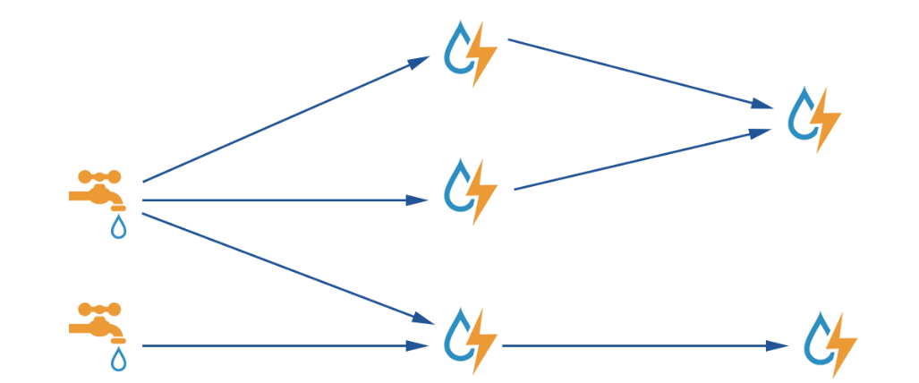
A concert example: NaviSite, Event Log Monitoring
log messages
Queue
Queue
Thousands of servers
RabbitMQ
STORM
Notes:
This is a real-life example of using data stream processing system.
We send log messages from thousands of servers into a RabbitMQ cluster and then use Storm to check each message against a set of regular expressions.

Slide 13
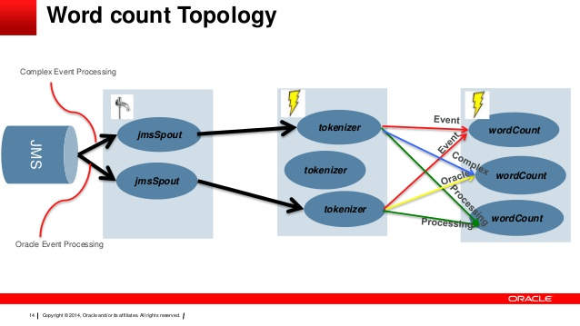
Storm 101: A Word Count Example
Notes:
Spout, bolt.
http://storm.apache.org/releases/1.1.0/Tutorial.html

Slide 14
Outline
Background.
Profiling study of DSP systems on modern multi-core processors.
  Published work in ICDE’2017
A new DSP system designed for modern multi-core processors.
Notes:
Now, I will introduce a project on profiling state-of-the-art DSP systems on modern multi-core processors.

Slide 15
Common designs of recent DSP systems
Existing systems mainly focus on scaling out using a cluster of commodity machines.
Three common design aspects
    Pipelined processing with message passing
    On-demand data parallelism
    JVM based implementation
  In this paper, we study the three design aspects on scale-up architectures (i.e., multi-socket multi-core architectures).
Notes:
[click] Recent DSP systems are mostly aimed at scaling out using a cluster of commodity machines, That is, they are designed for distributed environment, and they pay little attention on optimizing their performance on a single machine.
[click] Further, they are mostly built around a number of key designs including a) pipelined processing with message passing, b) on-demand data parallelism, and c) JVM based implementation.
In this paper, we study the three design aspects on scale-up architectures (i.e., multi-socket multi-core architectures).
In the following slides, we are going to explain each design in detail.

Slide 16
Design aspect 1: Pipelined processing with message passing
Data Source
Split
Count
Sink
Word-count application
Input tuples
Notes:
A streaming application is represented by a graph,
Where
1 nodes in the graph represent operators, and
2 edges represent the data dependency between operators.
3 Each operator executes independently and continuously perform fetch, process and output operations in a pipelining way.

Slide 17
Design aspect 1: Pipelined processing with message passing
Producer
Consumer
1
2
3
4
Pass value
queue
Pass reference
Memory
x
Step x
Socket 0
Socket 1
Notes:
Let me explain how the message passing between operators are achieved in most modern DSP systems in a shared memory environment.
[Click] In this example, there are two operators, which are denoted as producer and consumer.
[Click] The producer first writes its output data to the local memory
and [Click] emits a tuple containing a reference to the output data to its output queue
[Click] The consumer fetches from the corresponding queue to obtain the tuple and
then [Click] accesses the data by the reference.
[Click] When they are scheduled to different sockets, this data fetch comes with remote memory access overhead.

Slide 18
Design aspect 2: On-demand data parallelism
Modern DSP systems such as Storm and Flink are also designed to support data parallelism.
Word-count application
Data Source
Split
Count
Sink
Notes:
[Click] Modern DSP systems such as Storm and Flink are also designed to support data parallelism.
The actual execution of an operator is carried out by one or more physical threads, which are referred as executors.
[Click] In this example, split operator is carried out by three split executors.
[Click] The output stream of each operator is partitioned before passing downstream
[Click] The way of partition stream is specified by grouping strategies such as shuffle grouping, which equally distribute streams, and fields grouping, which distribute tuples according to keys in the tuple.

Slide 19
Design aspect 3: JVM based implementation
Many DSP systems are implemented with JVM-based programming languages (i.e., Closure, Java, and Scala).
We examine three aspects of JVM runtime.
    Data reference
    Method table
    Garbage collection (GC)
  Since previous studies demonstrate considerate runtime overhead of those components, we study their performance impact on DSP systems.
Notes:
Many DSP systems are implemented with JVM-based programming languages (i.e., Closure, Java, and Scala), and their execution relies on JVM.
[Click] We consider three aspects of JVM primarily, including
data reference,
method table and
garbage collection.

Slide 20
Goals & Contributions
Goals
    Identify the common design aspects of modern DSP systems and to understand how those designs interact with modern processors
    Develop some hardware and software approaches to resolving the bottleneck
Contributions
    We design a micro-benchmark covering a wide range of applications.
    We conduct detailed profiling study on two state-of-the-art DSP systems.
    We design optimization techniques to solve the identified performance issues.
Notes:
There are two major goals,
first, we want to identify the common design aspects of modern DSP systems and to understand how those designs interact with modern processors.
Second, we want to develop some hardware and software approaches to resolving the bottleneck.
[Click] Our contributions can be summarized as follows:
[Click] We design a micro-benchmark covering a wide range of applications;
[Click] We conduct detailed profiling studies on two state-of-the-art DSP systems on multi-socket multi-core processors, and identify common performance issues;
[Click] We design optimization techniques to solve the identified performance issues.

Slide 21
Benchmark design
There has been no standard benchmark for DSP systems, especially on scale-up architectures.
We design our benchmark according to the four criteria proposed by Jim Gray [1].
    Relevance
    Portability
    Scalability
    Simplicity
1: J. Gray, Benchmark Handbook: For Database and Transaction Processing Systems. San Francisco, CA, USA: Morgan Kaufmann Publishers Inc., 1992.
Notes:
There has been no standard benchmark for DSP systems, especially on scale-up architectures.
[Click] Hence, we design our micro benchmark with seven streaming applications according to the four criteria proposed by Jim Gray including relevance, portability, scalability and Simplicity.

Slide 22
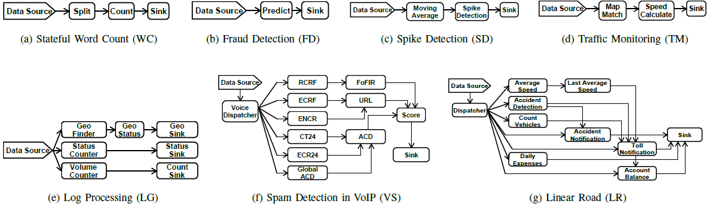
Benchmark
a) Relevance: Cover a wide range of CPU and memory bandwidth consumption
d) Simplicity: Choose the applications with simplicity in mind
c) Scalability: Include different data sizes
b) Portability: Describe the high level functionality of each application
https://github.com/shzhang1/ProfilingStudy
Notes:
We briefly describe how the micro-benchmark achieves the four criteria.
[Click] First, the applications covers a wide range of memory and computational behaviors, as well as different application complexities.
For example, TM has high CPU and memory bandwidth consumption.
[Click] Second, we describe the high level functionality of each application, and they can be easily
applied to other DSP systems;
[Click] Third, the benchmark includes different data sizes;
[Click] Finally, we choose the applications with simplicity in mind so that the benchmark is understandable.

Slide 23
Profiling Outline
Scalability on varying number of CPU cores
Execution time breakdown of overall execution
Study the impact of common designs
Notes:
Here’s the outline of our profiling experiments.
We first show the scalability test results on varying number of CPU cores.
Then, we show the execution time breakdown of execution on a single socket.
Finally, we go through the study on the impact of each design aspects.

Slide 24
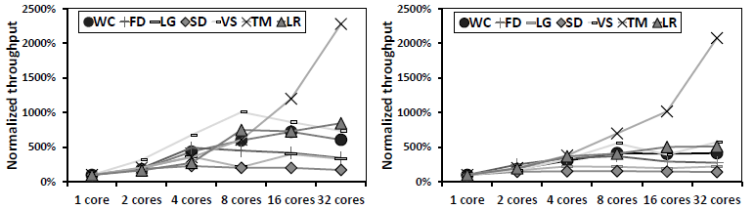
Scalability on varying number of cores/sockets
(2sockets)
(4sockets)
(2sockets)
(4sockets)
(a) Storm
(b) Flink
Scale poorly on multiple sockets
Scale well on a single socket
Overhead > Additional resource benefits
Notes:
These two figures show the normalized throughput of running different applications with varying number of cores/sockets on Storm and Flink, respectively.
The performance results are normalized to their throughputs on a single core.
We have the following observations.
[Click] Firstly, on a single socket, most of the applications scale well with the increasing number of CPU cores for both Storm and Flink.
[Click] Secondly, most applications perform not better or even worse on multiple sockets than on a single socket.
[Click] Multiple sockets essentially brings more resources but also additional overhead of remote memory access. Applications scale poorly or become even worse due to the greater negative impact of overhead.

Slide 25
Profiling Outline
Scalability on varying number of CPU cores
Execution time breakdown of overall execution
Study the impact of common designs
Notes:
Here’s the outline of our profiling experiments.
We first show the scalability test results on varying number of CPU cores.
Then, we show the execution time breakdown of execution on a single socket.
Finally, we go through the study on the impact of each design aspects.

Slide 26
Are there any problems when running on a single socket?
Processor stalls
(a) Storm
(b) Flink
70% of the execution times are spent in processor stalls.
Notes:
It seems that both DSP systems scale well on a single socket, but [Click] we find about 70% of their execution times are spent in processor stalls as shown in these figures.

Slide 27
Are there any problems when running on a single socket?
(a) Storm
(b) Flink
Front-end stalls is a major bottleneck.
Notes:
Front-end stalls is a major bottleneck.

Slide 28
Profiling Outline
Scalability on varying number of CPU cores
Execution time breakdown of overall execution
Study the impact of common designs
    Pipelined processing with message passing
    On-demand data parallelism
    JVM based implementation

Slide 29
Impact of pipelined and data parallel processing model
The design of supporting both pipelined and data parallel processing results in a very complex massively parallel threading model.
This threading model poorly utilizes instruction cache.
(a) Storm
(b) Flink
Notes:
[Click] The design of supporting both pipelined and data parallel processing results in a very complex massively parallel threading model in DSP systems.
[Click] The high front-end stalls are mainly caused by this threading model, which causes frequent instruction cache miss.
[Click] The figures further illustrate the breakdown on front stalls, where I-cache miss stalls are I-Decoding stalls dominate front-end stalls, and I-Decoding stalls are caused by frequent instruction cache misses.

Slide 30
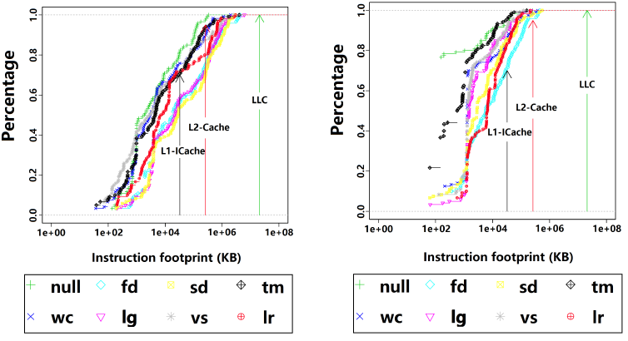
Instruction footprint between two consecutive invocations of the same function
(i) Common range of their instruction footprints is between 1KB to 10MB and 1KB to 1MB
(ii) 50~70% and 20~40% of the instruction footprints are larger than the L1-ICache
(a) Storm
(b) Flink
Notes:
This figure further illustrates the cumulative density function of the instruction footprints on a log scale, which stands for the percentage that instruction footprint is no larger than a certain number of distinct instructions.
There are two major observations:
First, the common range of their instruction footprints during execution are between 1KB to 10MB and 1KB to 1MB on Storm and Flink, respectively.
Second, the cross-over points of L1-ICache line and different CDF curves are between 0.3~0.5 for Storm and 0.6~0.8 for Flink.
It means, around 50~70% and 20~40% of the instruction footprints between two consecutive calls to the same functions are larger than the L1-ICache in Storm and Flink, respectively.
This explains why the instruction cache miss issue is so serious.

Slide 31

Impact of message passing and stream partitioning
Message passing between operators scheduled to different sockets comes with remote memory access (RMA).
RMA overhead prevents DSP systems from scaling well on multi-socket processors.
Table: LLC miss stalls when running Storm with four CPU sockets
Up to 24% of the total execution time are wasted due to remote memory access
Notes:
The main problem of scaling DSP systems on multi-socket processors is the high remote memory access overhead due to the heavy pipelined message passing design.
[Click] This table shows the LLC miss stalls for executing different applications on Storm on four sockets.
[Click] Up to 24% of the total execution time are wasted due to remote memory access

Slide 32
Key Findings (recap)
Large instruction footprint between two consecutive invocations of the same function causes significant L1-Icache misses.
The current message passing design overlooks NUMA effect and results in serious performance degradation due to significant remote memory access overhead.
Notes:
Now, let’s do a recap.

Slide 33
Towards more efficient DSP systems
Non-blocking tuple batching
  Goal: to reduce instruction cache misses
  Batch and only batch tuples that can be batched
NUMA-aware executor placement
  Goal: to reduce remote memory accesses
  Relies on solving the min-cut graph partition problem on the executor graph
Notes:
We present our initial attempt at addressing the aforementioned performance issues.
[Click] non-blocking tuple batching to reduce instruction cache misses,
[Click] the main idea of non-blocking tuple batching is to batch and only batch tuples that can be batched.
[Click] NUMA-aware executor placement to reduce remote memory accesses.
[Click] the main idea of NUMA-aware executor placement is to convert it into a min-cut graph partition problem.

Slide 34
Evaluate combining both techniques on Storm
Our optimizations can significantly improve Storm (up to 3.2x).
Notes:
Finally, this figure shows the evaluation results on Storm by combining both techniques, and the batch size is set to 8.
【click】Our techniques improves throughput by up to 3.2 times on four sockets.
Although our techniques improves the performance significantly, it still has space to linear scale up.

Slide 35
Profiling study summary
There is a lack of detailed analysis on the common design aspects of modern DSP systems when running on modern multi-socket multi-core processors.
We have designed micro-benchmark, conducted extensive evaluations based on two state-of-the-art DSP systems, and identified several common performance issues.
We have designed two optimization techniques to address the found performance issues and demonstrated promising performance improvements
Notes:
【click】There is a lack of detailed analysis on the common design aspects of modern DSP systems when running on modern multi-socket multi-core processors
【click】We design micro-benchmark and conducted extensive evaluations based on two state-of-the-art DSP systems and identify several common performance issues
【click】We present two optimization techniques to address the found performance issues and demonstrate promising performance improvements

Slide 36
Outline
Background.
Profiling study of DSP systems on modern multi-core processors.
A new DSP system designed for modern multi-core processors.
  On-going work

Slide 37
BriskStream: NUMA-aware Data Stream Processing
A quick glance of my recent work

Slide 38
The need of a ``scale-up” DSP system
Applications tend to more complex, expressed as larger diameter graph structure.
  Cross machines communication is often the performance killer, especially considering latency.
Modern multi-core processors have demonstrated superior performance.
  Hundreds of cores and terabytes of memory are available in a single instance.
Notes:
We have witness two trends that drive us to rethink the design of DSP systems.
First…
Second..
Recently, a few DSP systems designed from ground up towards scale-up are proposed. However, none of them are NUMA-aware.

Slide 39
Data Stream Processing on NUMA servers
An application is expressed as a directed acyclic graph (DAG).
  Pipeline execution: each vertex corresponds to one operator, which executes independently and edge indicates message passing between operators.
  Data parallel execution: each operator may be replicated to increase throughput.
Count
Split
Parser
Count
Split
Count

Slide 40
Optimize Data Stream Processing on NUMA servers
We need to determine both the level of operator replication and the placement of operators to optimize the execution (e.g., maximize throughput).
Count
Split
Parser
Count
？
Split
Count
？
CPU0
CPU1

Slide 41
Message passing
Count
Split
Parser
Count
Split
Count
Producer
Consumer
1
2
3
4
Pass value
queue
Pass reference
Memory
x
Step x
Socket 0
Socket 1
Notes:
Let’s see how a tuple is transmitted in a shared memory environment.
When they are scheduled to different sockets, this data fetch comes with remote memory access overhead.

Slide 42
Relative location matters
Sit together in the same CPU socket with its producer
1-hop away from its producer
Notes:
As a motivation study, we show here the time of processing one tuple of an operator when it is either local or remotely allocated to its producers.
We can see that the processing time of each operator is up to 42\% higher when it is remotely allocated to its producer.

Slide 43
Insufficiency of existing approaches
NUMA is between UMA and distributed environment.
  Cross site (i.e., cross sockets) communication cost can be significantly reduced thanks to shared-memory optimizations.
    -> traffic-minimization heuristics fall short.
  But, it still creates differences among accessing cost to different CPU sockets.
    -> the optimization needs to be NUMA-aware to ensure optimality.
We propose a novel NUMA-aware optimization framework for DSP systems.

Slide 44
Replication and Location Aware Scheduling
Notes:
The contribution mainly consists of a novel NUMA-aware streaming model and a branch and bound based algorithm that solves the resulting optimization problem. This figure gives the overview of our optimizations procedure.

Slide 45
Backup Slides

Slide 46
Impact of JVM runtime environment
The overhead of JVM runtime contains two major and moderate components.
    The frequent pointer referencing during tuple transmission and the frequent method table search stress TLB.
    The overhead of GC in running streaming applications (1~3%) is insignificant.
Enable huge page optimizations to further reduce the TLB overhead.
Notes:
The overhead of JVM runtime contains two major and moderate components.
【Click】First, the frequent pointer referencing during tuple transmission and the frequent method table search stress TLB (stalls account for 5~10% and 3~8%).
【Click】Second, the overhead of GC in running streaming applications (1~3%) is insignificant.
[Click] It suggests that we can enable huge page optimizations to reduce the TLB overhead when running DSP systems on multi-core processors.

Slide 47
Non-blocking tuple batching
Notes:
Recall that in the original design, each tuple are executed independently and transmitted one by one.

Slide 48
Non-blocking tuple batching
Re-generating the hash value of the keys in each tuple, and combines whenever possible
Notes:
The idea of tuple batching is to combine multiple tuples into one, and hence the executor works on multiple tuples after a single fetch.
【click】This batching is initiated at Data source, and performs at each executor. Say, once the split receives multiple tuples in a batch from data source, it will process on them and potentially generate multiple outputs correspondingly, which are going to be batched and transmitted further downstream.
However, tuples aimed at different consumers may be grouped together, which results in wrong final results.
【click】Our solution to this problem is re-generating the hash value of the keys in each tuple, and combines whenever possible. The larger the targeted batch size, the higher chances that more tuples are combined.

Slide 49
Evaluate non-blocking tuple batching on Storm on a single socket
(a) Throughput
(b) Latency per output
trade-off between the throughput and latency
Notes:
This figure illustrates the normalized throughput and latency of Storm with tuple batching optimization for different applications on a single socket.
As expected, tuple batching significantly increase performance of most applications, and larger initial batch sizes enables greater opportunities of batching more tuples together.
However, with tuple batching, the processing latency of each tuple may be increased as they are not emitted until all tuples in the same batch are processed.
The figure on the right shows the normalized average latency per output tuple under different batch sizes. Comparing both figures, we observe a clear trade-off between the throughput and latency. Meanwhile, our non-blocking tuple batching scheme preservers a sublinear increase in process latency for most applications, which is due to the much-improved performance and no explicit buffering delay.

Slide 50
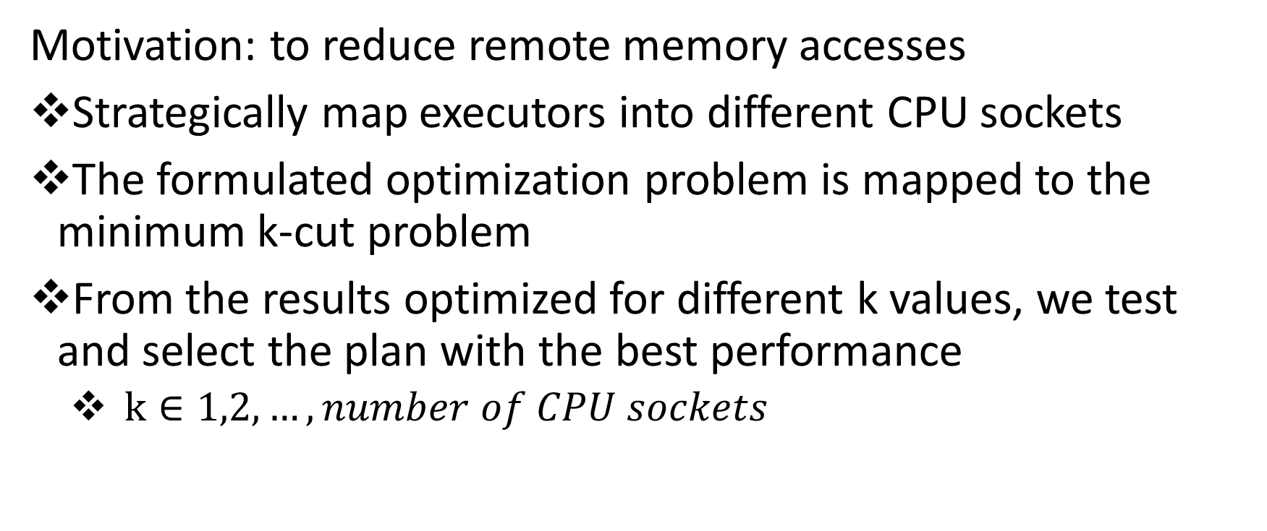
NUMA-Aware Executor Placement
Motivation: to reduce remote memory accesses
Strategically map executors into different CPU sockets
The formulated optimization problem is mapped to the minimum k-cut problem
From the results optimized for different k values, we test and select the plan with the best performance
  $k∈1,2,…,number of CPU sockets$
Notes:
To let DSP systems to scale on multiple sockets, the executors in a topology should be placed in an NUMA-aware manner, so that remote memory access overhead can be reduced.
We strategically map executors into different sockets. The formulated optimization problem is mapped to the minimum k-cut problem, where k stands for how many sockets we are going to use.

Slide 51
Evaluation NUMA-aware executor placement on Storm
Improve up to 32% on four sockets
Notes:
This figure shows the effectiveness of the NUMA-aware executor placement.
Results are normalized to four sockets without optimization.
【click】The placement strategy improves the throughput of all applications by up to 32%

Slide 52
Impact of message passing and stream partitioning
Up to 3 times difference
Number of threads of MapMatcher bolt in TM
The current design of data parallelism has overlooked the NUMA effect
Notes:
Furthermore, the current design of data parallelism creates serious process speed unbalance due to the NUMA effect.
【Click】We take traffic-monitoring application as an example to further study the impact of the current design of stream partitioning under the NUMA effect.
【Click】When the threads of MapMatcher bolt is configured to be 56, we observe up to 3 times of difference in average execution latency among them.

