Slide 1

Notes:
Good morning, everyone. Welcome to Large Language Model Inference Systems. In the next two hours, we will follow one user request all the way from text, to tokens, to model execution, and finally to a production serving stack. The central idea of this course is simple: an inference service is not just a model running once. It is an online, stateful system that must organize many requests, preserve intermediate state, use hardware efficiently, and produce evidence that its optimizations really work.
I am Shuhao Zhang from Huazhong University of Science and Technology. You do not need prior experience building an inference engine. We will begin with one concrete prompt, derive the important model operations, and then connect them to scheduling, KV cache, heterogeneous hardware, and benchmarking.
By the end, you should be able to explain not only what an inference engine does, but why its main design decisions exist.
Let us begin with the user experience.

Slide 2

Notes:
Consider one ordinary chatbot question. From the user's perspective, the interaction is very small. The user types a question, waits for the first word, watches tokens stream out, and decides very quickly whether the service feels responsive.
The system sees a much longer sequence of work. It validates and tokenizes the request. It places the request in a queue with requests from other users. It runs a prefill phase that processes the prompt and creates KV cache. It then runs many decode iterations, streams each selected token, and finally recycles the memory.
The important sentence at the bottom is our first systems claim: LLM serving is an online stateful system. It is online because requests arrive over time and users observe latency. It is stateful because every unfinished request carries tokens, KV cache, scheduling status, and execution progress.
Keep this one request in mind. We will repeatedly return to it.

Slide 3

Notes:
Here is the structure of the course. The first half lasts fifty-five minutes. We start from tokens, attention, and Transformer blocks. We then explain autoregressive generation, the prefill and decode phases, the complete request lifecycle, and the metrics visible to users.
After a ten-minute break, the second half also lasts fifty-five minutes. We move inside the serving engine: iteration-level scheduling, continuous batching, KV paging, state ownership, long context, RAG, mixture-of-experts models, agents, heterogeneous accelerators, and performance evidence.
The guiding thread is written at the bottom: follow the tensor, follow the request, follow the state, and verify the evidence. When a system design becomes confusing, ask four questions. What data is moving? Which request owns it? Which state must survive? What measurement supports the claim?
We will finish the first half at slide thirty-one, take the break on slide thirty-two, and finish the course at slide sixty-six.

Slide 4

Notes:
This deck is designed to be self-contained. Definitions appear before we use them. Worked examples show the assumptions, the arithmetic, and the conclusion. Each checkpoint is followed by an answer key. Performance claims are paired with the measurements needed to support them. The final slides synthesize the course and provide a reading path.
That means you should not need a separate handout to follow the argument. When a formula appears, we will interpret it in plain language. When a diagram appears, we will identify the objects, the direction of control, and the consequence for the system.
There is also a teaching contract here. I may add personal examples, and you may ask questions, but no missing explanation or exercise answer needs to be invented during the class.
With that expectation set, let us look at the whole serving system before opening the model.

Slide 5

Notes:
This picture is the map for the entire course. Across the top is the request path: application, API, queue, scheduler, executor, and output stream. A request enters from the application, becomes a structured API call, waits in a queue, is selected by the scheduler, runs on an executor, and streams tokens back.
Below that path are three horizontal lanes. The policy lane decides admission, batching, and priority. The state lane remembers KV pages, sessions, and tool results. The evidence lane measures time to first token, time per output token, and tail latency.
The feedback arrow on the right is important. Measurements should change policy. If tail latency rises, the system may need a different admission rule, batch size, or cache policy.
Many important optimizations therefore do not live inside one kernel. They live at control points: queueing, batching, caching, memory movement, and validation.
Now we are ready to enter the model side.

Slide 6

Notes:
The first part builds the model-side foundation. We will move from text to tokens, from tokens to vectors, from vectors through attention and Transformer blocks, and from the final hidden state to one selected next token.
The purpose is not to reproduce every detail of model training. Our purpose is to understand the shapes, dependencies, and repeated work that an inference engine must serve.
Pay special attention to two facts. First, prompt positions can be processed together because they are already known. Second, generated tokens depend on earlier generated tokens, so generation becomes a loop over time.
Those two facts will later explain the prefill and decode phases. Let us start with the smallest possible prompt.

Slide 7
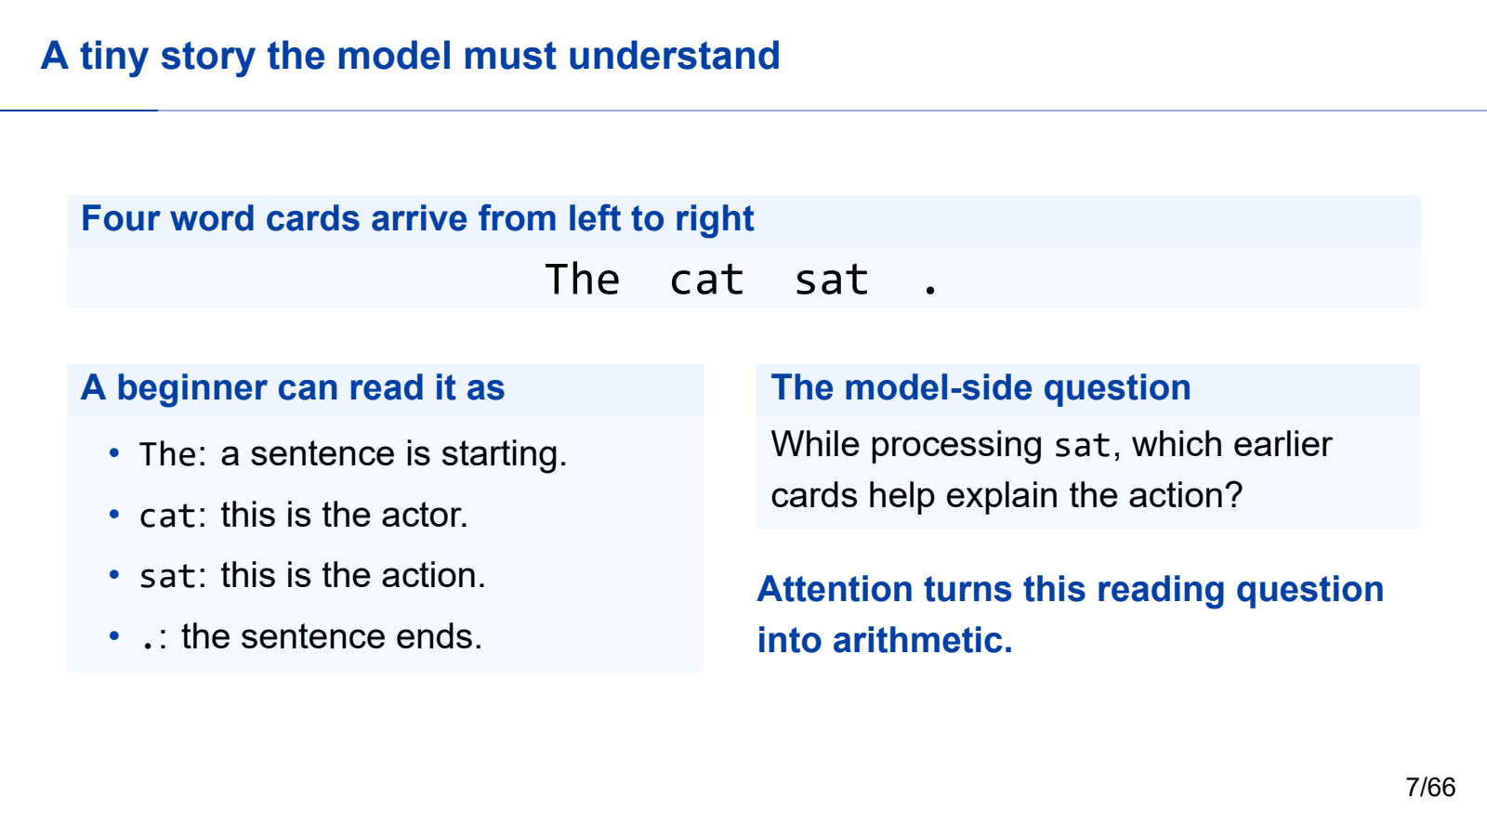
Notes:
Let us make attention concrete with one tiny sentence: “The cat sat.” Imagine that the words arrive as four cards, one after another. The first card, “The,” tells us that a noun phrase is beginning. The second card, “cat,” gives us an actor. The third card, “sat,” gives us an action. The final period tells us the sentence is complete.
Now freeze the story when the model reaches “sat.” A beginner can ask a very natural question: which of the earlier cards help explain this action? “Cat” matters because it tells us who sat. “The” contributes a little context. The future period should not be visible yet.
Attention converts exactly that reading question into arithmetic. Over the next few slides, we will keep the same four cards on the table. We will turn them into tokens, compare one query with several keys, hide the future, divide a one-hundred-percent relevance budget, and finally mix the useful information together.

Slide 8
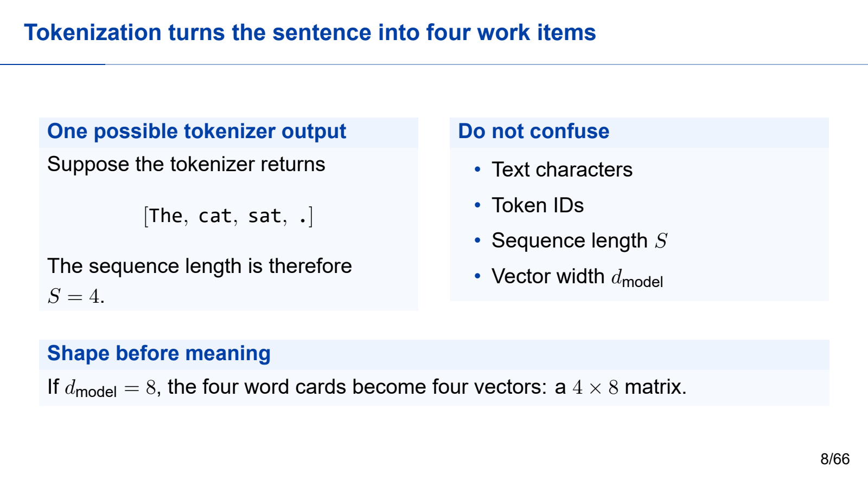
Notes:
Before the model can reason about the sentence, the tokenizer turns text into work items called tokens. A token is not guaranteed to be a whole word. It may be a word, part of a word, punctuation, or even a byte-level fragment. In this deliberately simple example, however, the four visible pieces become four tokens: “The,” “cat,” “sat,” and the period.
Think of four index cards moving onto a conveyor belt. Each card receives a numerical barcode called an embedding. If our toy model has a hidden width of eight, every card gets eight numbers, so the input is a four-by-eight matrix. The numbers are not a dictionary definition that a human wrote. They are learned coordinates that help the model represent useful patterns.
This distinction matters for systems work. The sequence length tells us how many cards are present. The hidden width tells us how much state each card carries. Those two dimensions drive both memory traffic and compute.

Slide 9
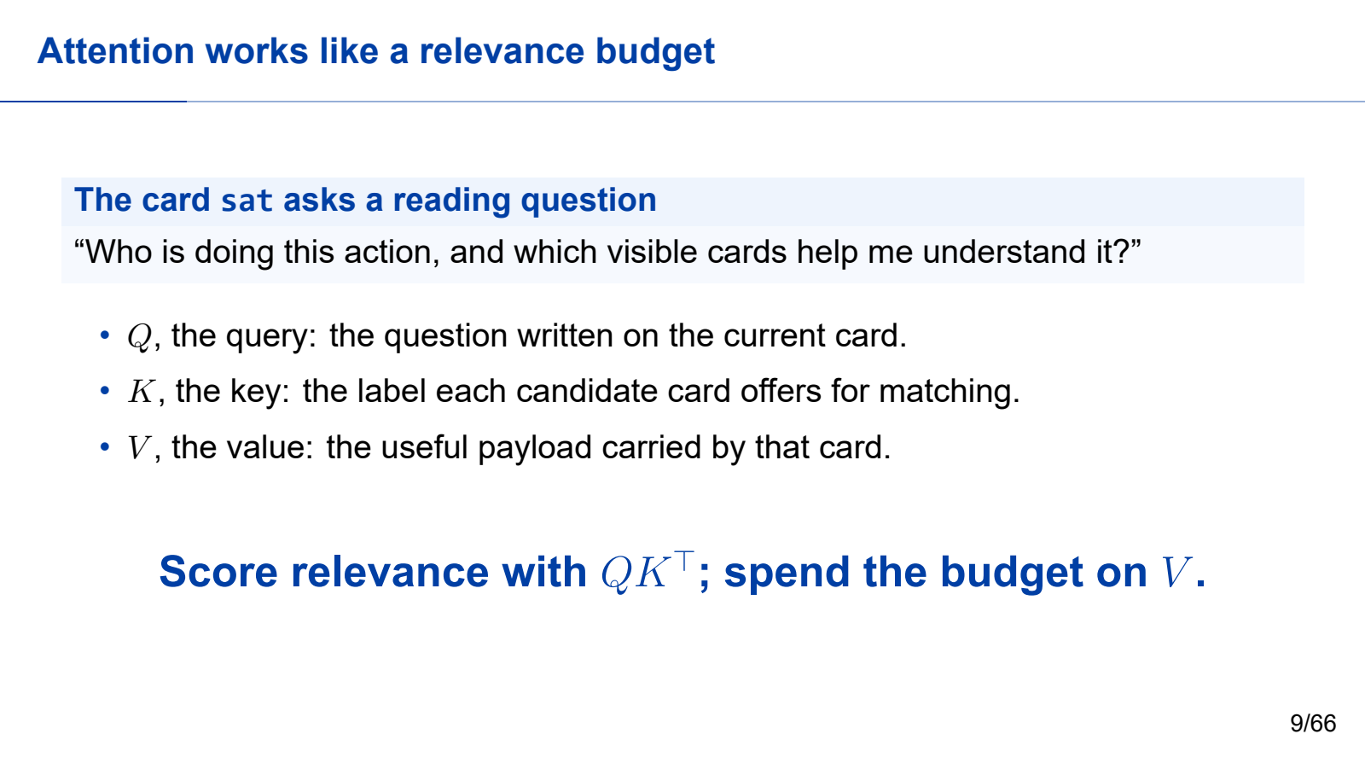
Notes:
Attention is easiest to understand as a relevance budget. When the model is processing the card “sat,” that position asks a question: which cards contain information that is useful to me right now?
The query is the question carried by the current position. The keys are labels that advertise what each position can help with. The values are the actual payloads that will be collected if a position receives attention.
For our sentence, the query at “sat” is roughly asking, “Who is performing this action, and what action state should I preserve?” The key at “cat” can match the actor part of that question. The key at “sat” can match the action part. After comparing the query with the keys, the model spends its relevance budget on the corresponding values.
This budget is over positions in the existing sequence. It is not yet a probability distribution over possible next words. That comes later, after many layers and the final vocabulary projection.

Slide 10
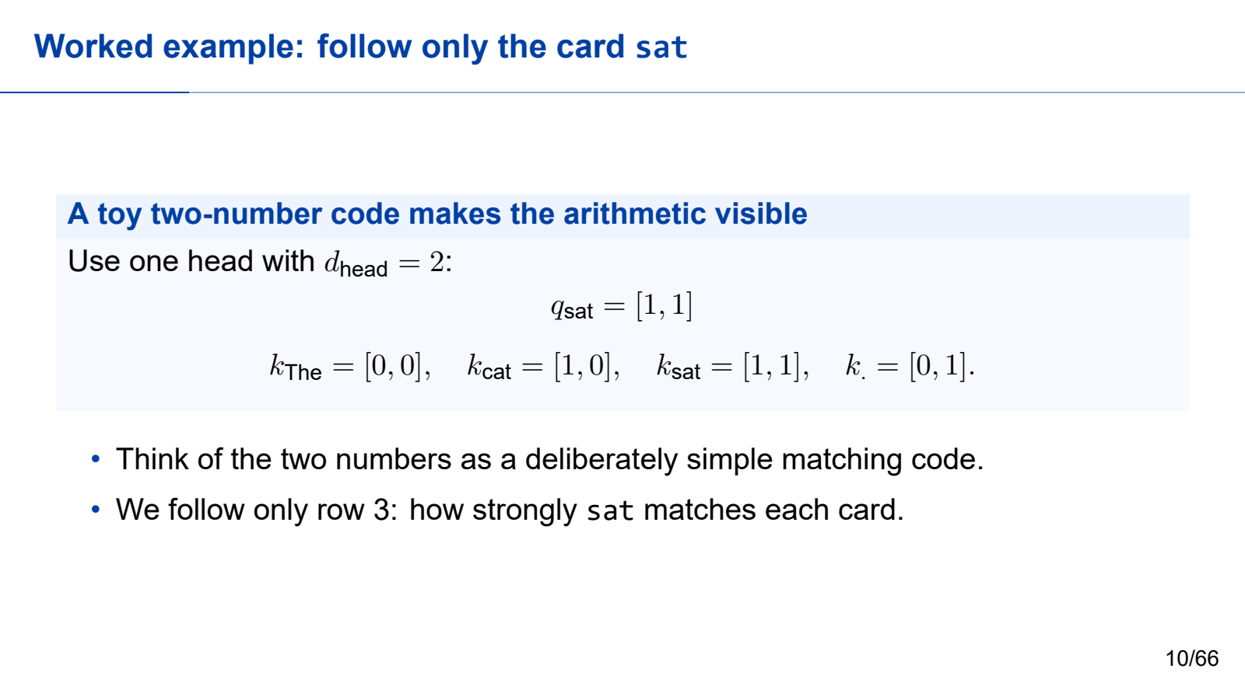
Notes:
We will use tiny two-number vectors so that every calculation fits on the slide. These numbers are invented for teaching. A real model learns much larger vectors from data, but the mechanism is the same.
Follow only the row for the position “sat.” Its query is the vector one, one. The key for “The” is zero, zero. The key for “cat” is one, zero. The key for “sat” is one, one. The future period has key zero, one.
You can picture the query as a two-part checklist. One coordinate looks for an actor clue, and the other looks for an action clue. The card “cat” matches the first part. The card “sat” matches both parts. The period happens to match one part, but it is in the future, so the causal rule will remove it before probabilities are formed.
For now, the important move is simple: one current query is compared with every candidate key.

Slide 11
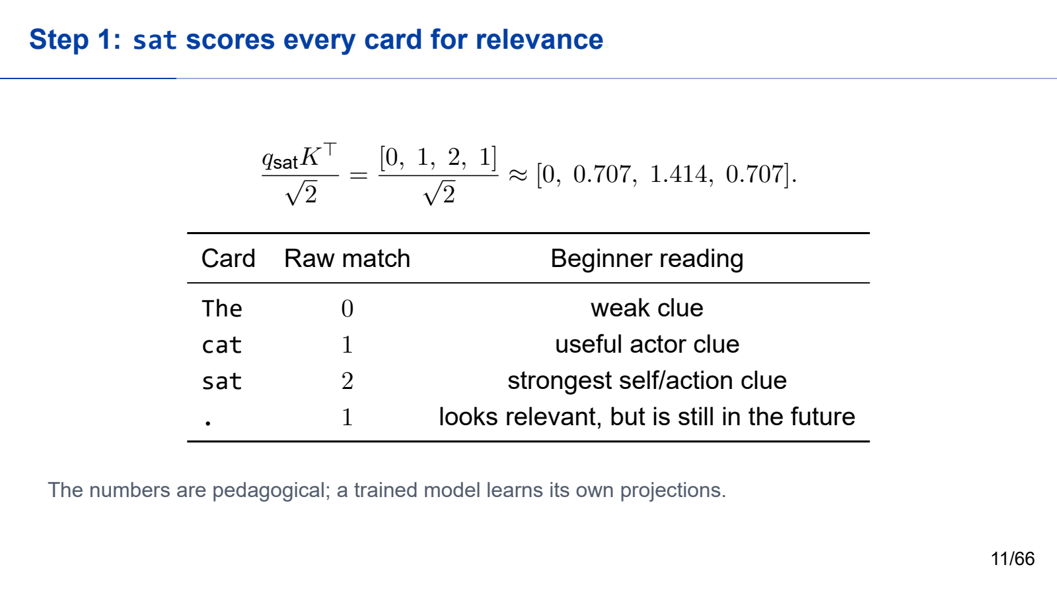
Notes:
Now we compute similarity with dot products. The query at “sat” is one, one.
Against the key for “The,” the dot product is zero. Against “cat,” it is one. Against “sat,” it is two. Against the period, it is one. We divide every result by the square root of two, because the key dimension is two. That gives approximately zero, zero point seven zero seven, one point four one four, and zero point seven zero seven.
Read the table as a relevance ranking before rules are applied. “The” is a weak match. “Cat” is useful because it identifies the actor. “Sat” is the strongest match because the current position carries the action itself. The period also looks somewhat relevant numerically, but it has not happened yet.
Scaling by the square root keeps dot products from becoming excessively large as vectors get wider. It helps softmax remain numerically and statistically well behaved.

Slide 12
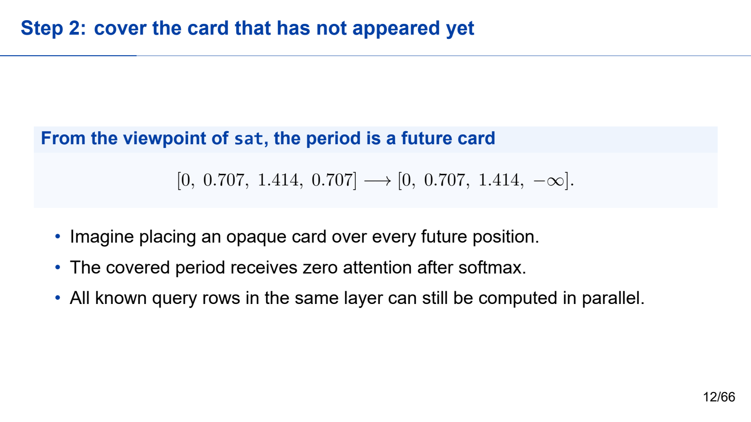
Notes:
The model is generating left to right, so the position “sat” is not allowed to peek at the future period. Imagine placing an opaque card over that final column. The arithmetic version of that cover is the causal mask.
Before masking, the four scores are approximately zero, zero point seven zero seven, one point four one four, and zero point seven zero seven. We replace the future score with negative infinity. After softmax, negative infinity becomes exactly zero probability. The period receives none of the attention budget.
This rule prevents information leakage during training and preserves autoregressive generation during inference. Notice that masking does not force the whole prompt to run one token at a time. For a known prompt, all query rows can still be computed in parallel. Each row simply has a different boundary that hides later positions.
The mask changes what each position may see, not whether the GPU may process many positions together.

Slide 13
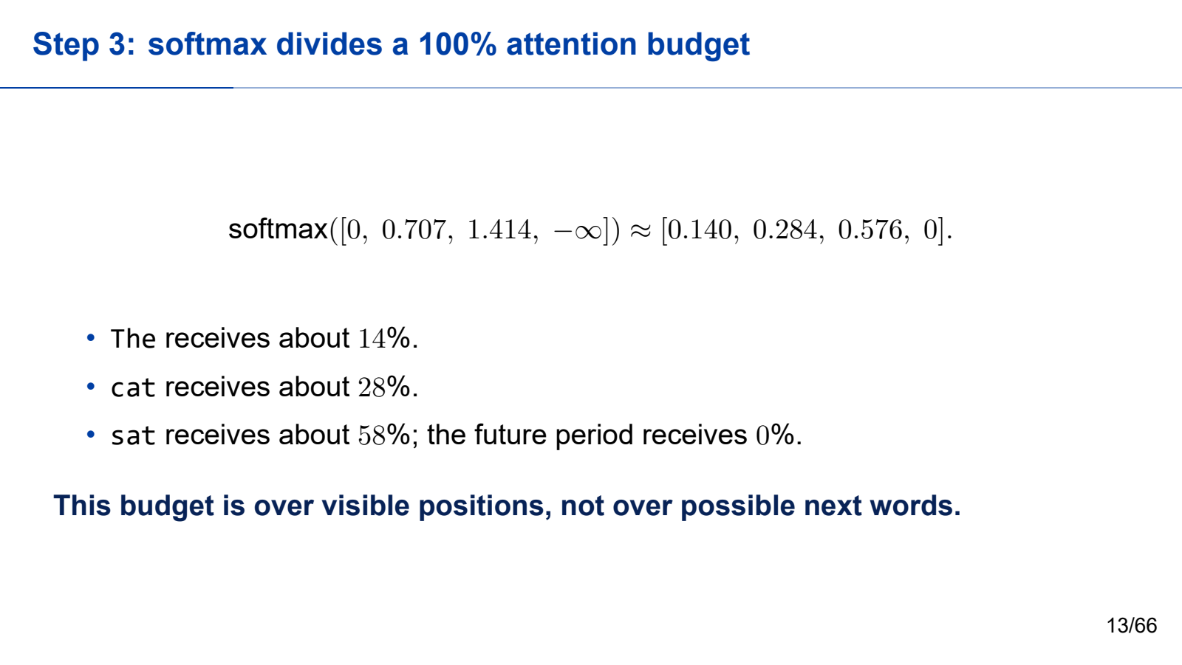
Notes:
Softmax now converts the allowed scores into a one-hundred-percent relevance budget. For our “sat” row, the approximate weights are fourteen percent for “The,” twenty-eight percent for “cat,” fifty-eight percent for “sat,” and zero percent for the future period.
The exact numbers are less important than the pattern. A higher score receives more of the budget. Every visible position receives a nonnegative share, and all shares add up to one. The mask guarantees that a forbidden future position receives zero.
This gives us an intuitive reading. The model keeps a little broad context from “The.” It spends a meaningful share on “cat” because that token supplies the actor. It spends the largest share on “sat” because the current action is central to the representation.
Again, these are attention weights over token positions. They do not mean there is a fifty-eight-percent chance that the next word will be “sat.”

Slide 14
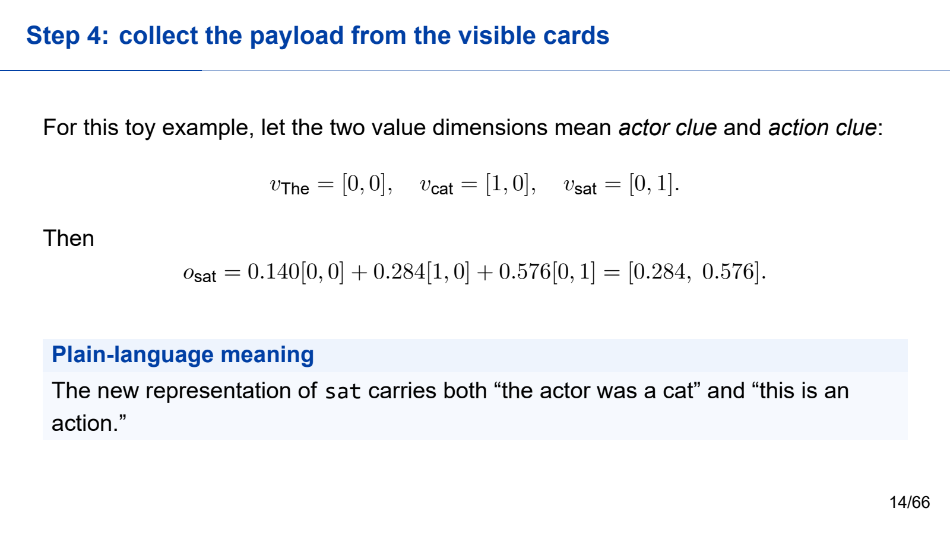
Notes:
The final step is to collect the payloads stored in the values. In our toy example, let the first value coordinate mean “actor clue” and the second mean “action clue.” Give “The” the value zero, zero. Give “cat” the value one, zero. Give “sat” the value zero, one.
We multiply each value by its attention weight and add the results. Fourteen percent of zero, zero contributes nothing. Twenty-eight percent of one, zero contributes an actor signal. Fifty-eight percent of zero, one contributes an action signal. The mixed output is approximately zero point two eight four, zero point five seven six.
So the representation at “sat” now carries both ideas: the actor was the cat, and the current token expresses an action. A real model uses many learned dimensions rather than two named axes, and it repeats this operation across many heads and layers. The toy story simply makes the mechanism visible.

Slide 15

Notes:
Multi-head attention repeats the same procedure several times with different learned projections.
Each head has its own Q, K, and V projections. Different heads can learn different positional or semantic relationships. Their outputs are concatenated and projected back to the model width.
The shape example uses batch size two, sequence length four, model width eight, and two heads. The input shape is two by four by eight. Splitting into two heads gives a head dimension of four. Q, K, and V therefore have shape two by two by four by four. After attention and concatenation, the result returns to two by four by eight.
This shape restoration is important because the next operation expects the same model width. It also lets residual connections add the input back to the output.

Slide 16

Notes:
A Transformer block preserves the main tensor shape. First, normalization prepares the representation. Attention mixes information along the sequence dimension. A residual connection adds the original path. The multilayer perceptron expands and contracts the feature dimension. A second residual connection completes the block.
For our example, the input is two by four by eight and the block output is still two by four by eight. This shape invariant allows many blocks to be stacked.
From a systems perspective, attention and the MLP have different computation and memory patterns. The residual paths also require tensors to remain available. During inference, the runtime must execute these operations repeatedly while handling variable sequence lengths and batch membership.
After the final block, the model must choose a next token.

Slide 17

Notes:
After the final Transformer block, we take the hidden state at the final active position of each sequence. The language-model head maps that d-model-dimensional vector to one score for every vocabulary token. These scores are called logits.
Logits are unnormalized. Temperature, top-k, top-p, or another decoding rule changes how a token is selected. The selected token is appended to the sequence.
Only one next token is selected per active sequence at a decode step. Different sequences may choose different tokens and finish at different times.
This is where the model computation becomes an online loop. The selected token changes the input for the next step, so the next token cannot be finalized before the current one has been selected.

Slide 18

Notes:
Autoregressive generation repeats five steps. Process the known context. Produce logits for the next position. Select one token. Append that token. Repeat until a stop condition is reached.
The stop condition may be an end-of-sequence token, a maximum length, or an application rule.
The system consequence at the bottom explains the serving architecture. Prompt positions are known together, so prompt processing can expose substantial parallelism. Output tokens are causally dependent across time, so decode repeats a smaller operation many times.
This creates the prefill and decode split. Prefill processes the prompt and creates the first KV state. Decode consumes that state and extends it one step at a time.
Before moving to serving, let us check the model-side reasoning.

Slide 19

Notes:
Please take two minutes to answer these four questions. You may write short phrases rather than full sentences.
First: why do four token positions produce a four-by-four attention score matrix? Second: what does the causal mask remove? Third: why is attention output a weighted sum of value vectors rather than a vocabulary probability? Fourth: why does generation need a repeated loop?
After two minutes, compare your answers with the person next to you for another two minutes. Try to produce one explanation that a non-specialist could understand.
We will now compare your explanation with the explicit answer key. Do not worry if your wording is different; we are checking the causal structure, not memorizing one sentence.

Slide 20

Notes:
Here is the answer key.
One: four query positions are compared with four key positions, so the score table contains four times four entries.
Two: the causal mask removes attention from each position to future positions. The current position and earlier positions remain visible.
Three: attention weights select and mix value vectors. Vocabulary probabilities appear later, after the final hidden state is projected to logits.
Four: the selected next token becomes part of the input for the following token. Generation must therefore repeat until an end token, a length limit, or another stop rule.
These four statements are the model-side foundation for the rest of the course. We now connect them to a user-visible service.

Slide 21

Notes:
The second part of the first half connects autoregressive generation to serving behavior.
We will translate model operations into a request lifecycle. We will distinguish training systems from inference systems. We will separate prefill from decode. We will define throughput, time to first token, time per output token, and tail latency.
The goal is to stop treating the model as a single function call. A service must accept online arrivals, organize mixed-length requests, preserve state between decode steps, stream partial output, and meet user-facing objectives.
Let us begin by asking how changes in models have changed the service around them.

Slide 22

Notes:
Models changed in several directions: longer context, mixture-of-experts layers, multimodal input, and tool-using agents. Services changed too: chat APIs, enterprise assistants, scientific agents, and multi-tenant platforms.
As a result, the metrics also changed. We care about first-token delay, tail latency, cost per request, and service-level-objective satisfaction, not only raw throughput.
The takeaway is important: a good model can still become a bad product if the serving system is slow, unstable, or too expensive.
Serving engineering therefore asks a different question from model evaluation. It asks whether the model can be delivered under realistic arrivals, resource limits, and latency objectives.
The next slide shows why one attractive throughput number is not enough.

Slide 23

Notes:
Compare Server A and Server B. Server A has high average throughput and large batches, but some users wait a long time before receiving the first token. Server B has slightly lower throughput, smaller waiting time, and more requests that meet the latency target.
Which server is better? The answer depends on the objective. For an offline batch job, Server A may be preferable. For an interactive assistant, Server B may provide better service.
This example separates throughput from goodput. Throughput counts completed work. Goodput counts useful work that also satisfies the service objective.
The broader lesson is that averages can hide pain. A serving result should report throughput together with first-token latency, token-to-token latency, and tail behavior.

Slide 24

Notes:
Training and inference both run the same model family, but their systems constraints differ.
Training usually uses large, stable batches. The objective is time to train and scaling efficiency. Parameters, gradients, and optimizer state dominate persistent state. The control point is often the step or micro-batch.
Inference serving receives online arrivals with mixed request lengths. The objectives include time to first token, time per output token, tail latency, service-level objectives, and cost. Persistent state includes KV cache, queues, sessions, and logs. Control occurs at the request, iteration, and token levels.
The working view at the bottom is our conclusion: inference serving behaves like a stateful online service, not a static model call.
That difference determines what we must inspect when evaluating an inference system.

Slide 25

Notes:
We will use four recurring checks.
First: how are requests organized? Look at queueing, batching, priorities, and service objectives.
Second: how is state managed? Look at KV allocation, reuse, migration, ownership, and eviction.
Third: which execution path is used? Look at kernels, graph replay, accelerator backends, and fallbacks.
Fourth: what evidence supports the result? Look at workload, baseline, metadata, and metrics.
These four checks correspond to the labels at the bottom: request, state, execution, and evidence.
Whenever you read a serving paper, inspect a benchmark, or debug a regression, ask all four questions. A claim that answers only one of them is usually incomplete.
Now let us trace one request through the service.

Slide 26

Notes:
A request moves through six stages.
One: the API receives the prompt and generation parameters. Two: the tokenizer converts text into token identifiers. Three: the scheduler admits the request into a waiting queue. Four: prefill processes the prompt and creates the first KV cache. Five: decode repeatedly generates new tokens. Six: the server streams output and releases resources.
This lifecycle is useful because every performance claim should name the stage it changes. A faster tokenizer does not automatically reduce decode latency. A better scheduler may reduce queueing without changing kernel speed. A cache policy may reduce prefill work but increase memory pressure.
By naming the stage and the resource, we can explain where a benefit comes from and where its cost moves.

Slide 27

Notes:
Read this diagram from left to right. The request passes through API, tokenization, queue, prefill, decode, and streaming.
Below the main path is KV cache state. Prefill creates it. Every decode iteration appends to it. Finishing releases it.
The orange line marks the time-to-first-token path. It includes queueing and prefill before the first token can be emitted. The cyan line marks the decode stream after the first token.
This explains why one request can have a good first-token time but uneven streaming, or a slow first token followed by smooth output.
The two phases use different shapes and expose different bottlenecks, so they often need different optimization strategies.

Slide 28

Notes:
Prefill reads the whole prompt. It is relatively compute intensive, determines first-token latency, and becomes expensive with long context and retrieval-augmented generation.
Decode generates one or a few tokens per iteration. Each step is smaller, but it repeats many times. Decode depends on KV cache remaining available and is sensitive to scheduling jitter.
The point at the bottom is the conclusion: prefill and decode expose different bottlenecks and need different optimization paths.
An optimization that helps prefill may not help decode. For example, prefix reuse can remove repeated prompt work, while continuous batching may improve decode utilization.
When reporting performance, separate the two phases instead of hiding them inside one average.

Slide 29

Notes:
Consider a request with a six-hundred-token prompt and a one-hundred-twenty-token output.
Prefill is one relatively heavy pass over the six hundred prompt tokens. Decode is one hundred twenty smaller iterations, each extending the sequence and updating KV state.
The timeline on the right makes the asymmetry visible. Prefill happens once. Decode repeats over time.
The user experiences both. The wait before the first token reflects queueing and prefill. The smoothness of the output stream reflects decode scheduling, KV residency, batch changes, and backpressure.
This is why “request latency” should not be treated as one indivisible number. We need metrics that identify the part of the experience that changed.

Slide 30

Notes:
Here are the main service metrics.
TTFT means time to first token. It is strongly affected by queueing and prefill.
TPOT, or time per output token, and ITL, or inter-token latency, describe decode-step behavior.
Throughput counts tokens or requests per second, but can hide tail latency.
Goodput counts useful work completed under a latency target.
P95 and P99 describe tail latency and matter under multi-tenant or bursty workloads.
The metric set at the bottom is the practical rule: report throughput, latency, tail behavior, and configuration together. Without the configuration and workload, the numbers cannot be interpreted or reproduced.

Slide 31

Notes:
Before the first token, time is spent in queueing and admission, tokenization and validation, prefill, and any allocation or graph-path selection.
After the first token, time is spent in repeated decode iterations, batch reshaping, KV-page lookup and residency, and stream backpressure.
The same request contributes to different bottlenecks at different times. This is the final idea of the first half.
If time to first token is poor, investigate queueing and prefill first. If token streaming is uneven, investigate decode scheduling, KV state, and backpressure. If P99 is poor while the mean looks good, investigate bursts, long requests, and resource contention.
We will now take a ten-minute break. When we return, we will open the scheduler and KV manager.

Slide 32

Notes:
We will take a ten-minute break here.
Please return when the timer reaches ten minutes. In the second half, we will use three objects repeatedly: the candidate requests, the token budget, and the free KV blocks.
If you want one question to think about during the break, use this one: when several requests compete for limited compute and memory, what information should the scheduler consider before choosing the next batch?

Slide 33

Notes:
Welcome back. The second half begins with scheduling and state management.
We will move from request-level scheduling to iteration-level scheduling and continuous batching. Then we will quantify KV-cache capacity, explain logical and physical state, examine paging and sharing, and make one explicit scheduling decision under two resource constraints.
The central idea is that the scheduler is not choosing only which request runs next. It is also deciding which state remains resident, which state can be reused, and which work may need to be recomputed.
Let us begin with the basic scheduling tension.

Slide 34

Notes:
Online serving must continuously organize requests with very different lengths into efficient batches.
Larger batches can improve device utilization. But larger batches can also increase waiting time for new users. Long requests keep KV state alive across many iterations. Short requests still need low waiting time when long requests are active.
This creates a multi-objective problem. The scheduler must respect hard resource limits while balancing throughput, first-token latency, token-to-token latency, fairness, and service objectives.
The important phrase is continuously organize. The batch cannot be chosen once and left unchanged, because requests arrive, finish, and consume different amounts of state over time.

Slide 35

Notes:
There are three useful scheduling granularities.
Request-level scheduling is simple, but it has poor ability to insert new work while a long generation is running.
Iteration-level scheduling rebuilds the active batch after each decode round. This enables new requests to enter and finished requests to leave, but it requires careful state tracking and KV management.
Token-level scheduling offers maximum flexibility, but the metadata and synchronization overhead can become large.
The Orca-style intuition at the bottom is the key: move the scheduling decision from the request boundary to the generation-iteration boundary.
The next slide shows what that looks like over several iterations.

Slide 36

Notes:
Each row represents one decode iteration. At iteration zero, requests A through E are active. At the next boundary, batch membership can change. A new request may enter, a finished request may leave, and the remaining requests continue with their own state.
This is continuous batching. The engine does not wait for the whole original batch to finish before admitting new work.
The benefit is better utilization and lower waiting time. The price is state management. Every active request must preserve its token history, KV-page mapping, finish status, sampling configuration, and execution progress across changing batches.
Iteration boundaries therefore become control points where the scheduler and KV manager cooperate.

Slide 37

Notes:
Let us solve a scheduling example. This iteration has two hard limits: a token budget of eight and three free KV blocks.
Request A needs four tokens and two blocks. Request B needs three tokens and one block. Request C needs five tokens and three blocks.
The question is not which pair has the smallest total or which pair arrived first. The first question is feasibility: which pairs fit both budgets at the same time?
Take thirty seconds and calculate A plus B, A plus C, and B plus C.
Now let us check every candidate pair explicitly.

Slide 38

Notes:
A plus B uses seven tokens and three blocks, so it is feasible.
A plus C uses nine tokens and five blocks, so it exceeds both budgets.
B plus C uses eight tokens and four blocks. The token budget fits, but the KV-block budget does not.
Therefore A plus B is the only feasible pair.
This example separates constraints from policy. Hard constraints define the feasible set. Priority, fairness, deadlines, or service objectives choose among feasible options. A scheduler that ignores memory can select a batch that fits compute but cannot allocate its KV state.
Next we quantify why KV capacity becomes such a central constraint.

Slide 39

Notes:
KV cache grows with context length and concurrency. It must remain available across many decode iterations. It limits effective batch size. It turns every active request into a stateful object. Once prefix reuse is enabled, it can also become a shared resource.
The sentence at the bottom is worth emphasizing: KV cache is not an implementation detail. It is a first-class system resource.
Compute can be available while memory is full. A request can be logically ready while its KV pages are not resident. A shared prefix can save prefill work but complicate ownership and release.
We will now calculate KV bytes per token so that this resource pressure is concrete.

Slide 40

Notes:
Assume thirty-two layers, eight KV heads, head dimension one hundred twenty-eight, and FP16 values using two bytes each.
KV bytes per token equal two times the number of layers times the number of KV heads times the head dimension times the bytes per value. The first factor of two accounts for one key and one value.
Substituting the numbers gives one hundred thirty-one thousand seventy-two bytes, or one hundred twenty-eight KiB per token.
One hundred new tokens therefore add approximately twelve point five MiB for one request. Multiply that by many concurrent requests and long contexts, and KV capacity can dominate admission and batch size.
The exact number changes with architecture and precision, but the method is the same.

Slide 41

Notes:
Now suppose the logical block size is sixteen tokens and the sequence contains forty tokens.
Tokens one through sixteen fill block zero. Tokens seventeen through thirty-two fill block one. Tokens thirty-three through forty require block two.
Forty divided by sixteen rounds up to three blocks. Three blocks provide forty-eight slots, so eight slots are unused.
Paging avoids the requirement for one contiguous forty-token allocation. However, capacity still grows in block-sized units, so the last block may contain internal fragmentation.
This small example explains why block size is a trade-off. Smaller blocks reduce wasted slots but increase mapping and metadata overhead. Larger blocks reduce metadata but may waste more capacity.

Slide 42

Notes:
Logical request state and physical KV state are different.
The example request moves from waiting, to running, to preempted, back to running, and finally to finished. Logical state records tokens, phase, and progress. Physical state records devices, blocks, addresses, and in-flight operations.
After preemption, the same logical tokens may resume on different physical blocks. That is why the request cannot simply store one permanent device pointer.
Release is safe only after ownership, references, and asynchronous use are resolved. A request may be logically finished while a device operation is still reading its state.
Separating logical and physical state makes migration, preemption, and multi-level storage possible.

Slide 43

Notes:
Suppose requests R seventeen and R eighteen share prefix block P three. The reference count is initially two.
If R seventeen is cancelled, the count drops to one. P three cannot return to the free list because R eighteen still reads it.
When R eighteen finishes, the count drops to zero. Even then, the block is reclaimed only after in-flight device reads complete.
The sentence at the bottom separates two mechanisms. Reference counting handles logical sharing. A device event or fence handles asynchronous completion.
Without both, the runtime risks use-after-free errors, corrupted outputs, or premature reuse of memory that an accelerator still accesses.

Slide 44

Notes:
The top row is the logical sequence, divided into logical blocks. The bottom row is the physical KV pool. The arrows show that logical blocks can map to non-contiguous physical pages.
This is the core PagedAttention-style idea. The request sees an ordered logical sequence, while the memory manager is free to place blocks in available physical locations.
The system effect is broader than fragmentation reduction. Paging supports dynamic batching and creates handles for prefix reuse, migration, offload, and multi-level KV storage.
The cost is additional mapping state and lookup logic. The scheduler and executor must agree on the current page table for every active request.

Slide 45

Notes:
The runtime can keep, reuse, move, or evict state.
Keeping state avoids recomputation but occupies memory and limits new batches. Reusing state saves prefill work but requires matching, validation, and ownership checks. Moving state releases device memory but adds transfer latency and coordination. Evicting state admits urgent work but may cause recomputation later.
The local benefit is never the whole story. Every state decision has a system cost.
The scheduling view at the bottom is our conclusion: the scheduler is no longer choosing only which request runs next. It is also choosing which state remains valuable.
Let us test that reasoning with one checkpoint.

Slide 46

Notes:
Here is the checkpoint. The token budget is ten and there are four free blocks. Request D needs six tokens and two blocks. E needs four tokens and two blocks. F needs three tokens and three blocks.
Please do four things. List all feasible pairs. Decide what to do if F has the oldest deadline. Name one metric that could become worse. Finally, name the event fields needed to explain the decision later.
Take ninety seconds. Separate feasibility, policy, expected effect, and evidence.
Now compare your reasoning with the answer key.

Slide 47

Notes:
D plus E uses ten tokens and four blocks, so it is feasible. D plus F uses nine tokens and five blocks. E plus F uses seven tokens and five blocks. Both pairs containing F exceed the four-block limit.
If F has the oldest deadline, no feasible pair contains F. The scheduler can run F alone or free at least one block before pairing it.
Running F alone may reduce instantaneous throughput. Delaying F may worsen its deadline-miss rate or tail latency.
To explain the decision later, record candidate identifiers, token and block demand, budgets, free blocks, ages or deadlines, the selected set, rejection reasons, and resulting latency.
This is the full chain: feasibility first, policy second, effect third, and evidence throughout.

Slide 48

Notes:
Part four expands the workload beyond a simple dense-model request.
Long context and retrieval increase prefill and KV pressure. Mixture-of-experts models introduce dynamic routing and expert residency. Agents turn one request into a multi-step workflow with tool results and session state. Heterogeneous accelerators change graph execution, kernels, precision, and communication paths.
The goal is not to list every modern feature. The goal is to see how each feature changes the control surface of the serving system.
We begin with a nearly full memory pool and one urgent request.

Slide 49

Notes:
The device memory is almost full and a high-priority request arrives.
Option one is to keep all KV state and reject or delay the new request. Option two is to preempt one request and keep its KV elsewhere. Option three is to drop KV state and recompute it later.
None of these options is universally best. The decision depends on transfer cost, recomputation cost, request priority, expected remaining length, and the value of the existing state.
This is why scheduling now includes a state-utility decision. The runtime is choosing not only who runs, but which intermediate state deserves scarce memory.

Slide 50

Notes:
Longer prompts amplify prefill cost and KV size. Retrieval-augmented generation makes input length and overlap more variable. Similar documents may create reuse opportunities, but the benefit depends on matching cost, memory pressure, and latency targets.
Consider a university assistant that answers one hundred questions using the same handbook. Blindly recomputing the handbook prefix wastes prefill work. Reuse may help, but only if the reused segment matches the model, parameters, version, permissions, and semantic boundary.
Long context therefore changes both compute and state management. It increases the value of reuse while also increasing the cost of keeping state resident.

Slide 51

Notes:
In a mixture-of-experts model, each token may activate different experts, and the expert load can change from token to token.
The system must handle load imbalance, expert-parallel communication, expert offloading and residency, and dynamic expert-to-device mapping.
The small diagram shows that routing can change between decode steps. A heavily used expert at one step may not be heavily used at the next.
This creates a conflict. High-performance graph replay prefers stable shapes, addresses, and execution paths. MoE routing introduces dynamic expert selection and communication.
Serving an MoE model efficiently is therefore not only a kernel problem. It is also a routing, placement, communication, and scheduling problem.

Slide 52

Notes:
An agent request is a workflow rather than one sequence.
The example moves through planning, search, reading, a tool call, and an answer. Shared memory, tool results, and session state connect the steps.
This creates intermediate state outside the ordinary KV cache. Some state may be reused across steps. Some state must be isolated between users. Some state may need expiration, versioning, or permission checks.
Scheduling now spans the workflow. A tool call may pause model execution. A later model call may resume with new context. The system must decide what state to keep during the pause and how to account for the workflow's total latency and cost.
Next we return to performance fundamentals.

Slide 53

Notes:
Two kernels can perform the same number of floating-point operations and still have very different latency.
Both kernels perform one GFLOP. Kernel A reads sixty-four MiB from high-bandwidth memory. Kernel B reads sixteen MiB.
Arithmetic intensity is operations divided by bytes moved. Kernel A has about fourteen point nine FLOPs per byte. Kernel B has about fifty-nine point six, four times higher.
Under a bandwidth bottleneck, Kernel B has a much lower memory-time bound. This is why FLOP count alone does not determine kernel time or end-to-end latency.
Always ask how much data moves, from where, and whether the operation is compute-bound or memory-bound.

Slide 54

Notes:
Suppose an optimized kernel becomes twice as fast, but that kernel accounts for only forty percent of total request time. The remaining sixty percent is unchanged.
The new normalized time is zero point six plus zero point four divided by two, which equals zero point eight. The end-to-end speedup is therefore one divided by zero point eight, or one point two five times.
This is Amdahl's-law reasoning. A local speedup answers whether the mechanism worked. End-to-end speedup answers whether the user benefited. A new profile checks whether the bottleneck moved.
Never present a two-times kernel improvement as a two-times service improvement unless the optimized region truly dominates the full path.

Slide 55

Notes:
Cross-platform correctness begins with a contract.
The GPU and NPU output fragments shown here are close but not bitwise identical. The maximum absolute difference is zero point zero zero two.
We compare that difference with a tolerance declared before the experiment for this data type and operator. We also test masking, boundary shapes, fallback paths, and multi-step state updates separately.
The conclusion is that portability means equivalent semantics and observable behavior, not necessarily bitwise identity.
A performance comparison is meaningless if the two systems are not computing the same function under the same contract. Correctness checks therefore come before speed claims.

Slide 56
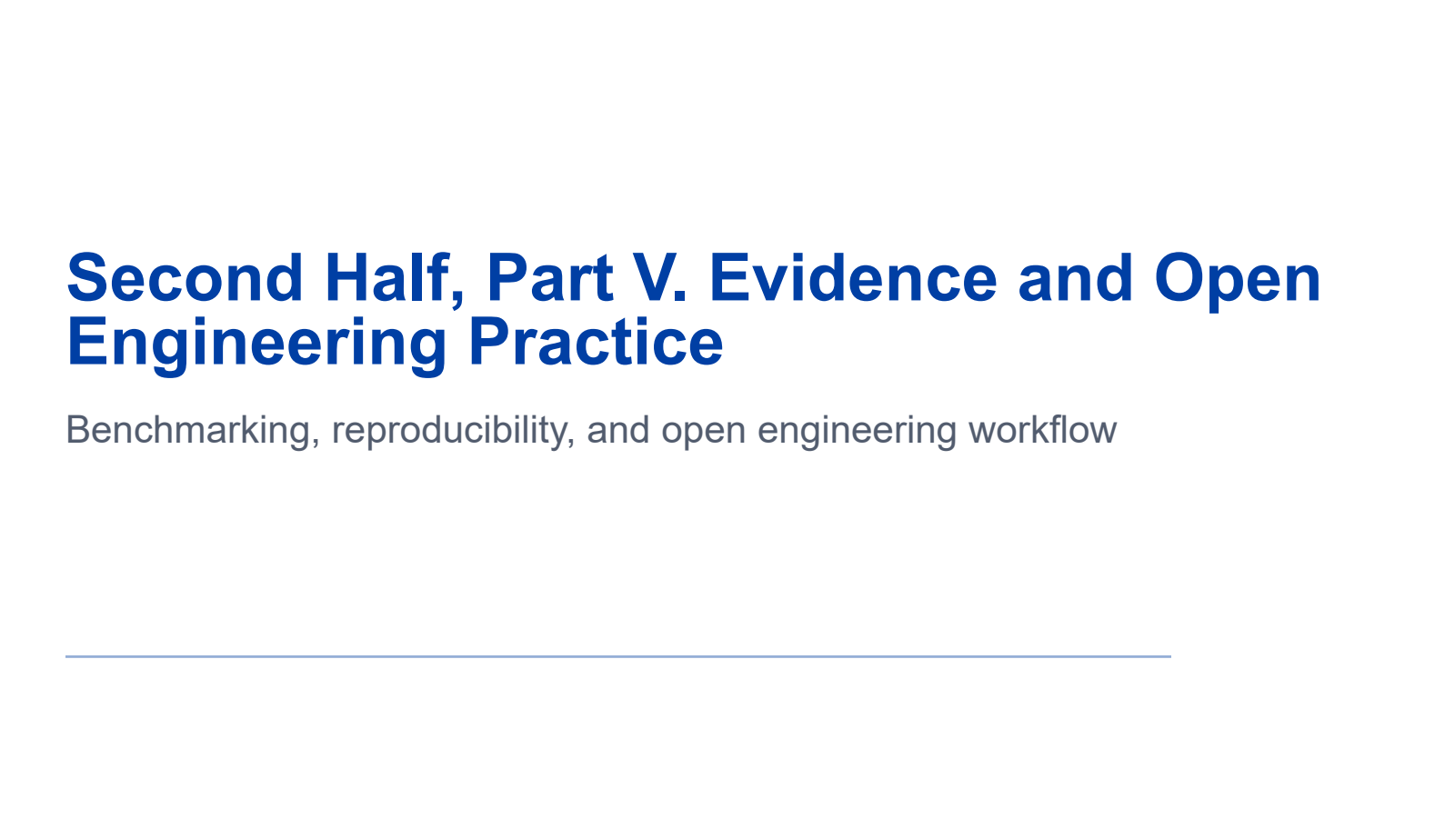
Notes:
The final technical part is about evidence and open engineering practice.
We will examine why benchmark evidence is fragile, what metadata a credible result needs, how to run a controlled A/B comparison, why a microbenchmark gain must not be inflated into a system claim, and how to move from an observation to a reproducible engineering result.
The guiding question is simple: what would another engineer need in order to reproduce, interpret, and challenge this claim?

Slide 57

Notes:
Benchmark evidence is fragile because apparently identical labels can hide different experiments.
The workload name may be the same while token distributions differ. The model name may be the same while precision or parallelism differs. The code path may be the same while backend defaults differ. Throughput may be the same while tail latency is very different. A benchmark may omit essential metadata.
The sentence at the bottom defines a benchmark as an evidence chain: workload, setup, baseline, and metrics.
If one link is missing, the result may be impossible to interpret or reproduce. A benchmark is not just a command and one number.

Slide 58

Notes:
A credible result records six categories.
For code, record the repository, commit, pull request, and dependency versions. For the model, record model identifier, data type, quantization, and parallel strategy. For hardware, record device type, card count, driver, and runtime stack.
For service configuration, record maximum length, graph or eager mode, and cache or offload settings. For workload, record input and output lengths, concurrency, arrival process, and data source. For metrics, record time to first token, time per output token, tail latency, throughput, goodput, and memory usage.
This metadata is not administrative overhead. It defines the experiment.

Slide 59

Notes:
A controlled A/B test begins with a narrow hypothesis: a fused kernel lowers operator latency for one fixed shape.
Hold the model, shape, data type, hardware, version, stream, and timing boundary constant. Warm up both paths. Then measure each path thirty times.
The baseline median is twelve point four milliseconds and P95 is thirteen point one. The fused median is ten point two and P95 is ten point eight. The median speedup is about one point two two times.
Reporting a distribution matters because one run may be affected by warm-up, synchronization, or noise. The hypothesis is supported at the operator level under this fixed condition.

Slide 60

Notes:
Now measure the complete request on the same workload. Latency changes from one hundred milliseconds to ninety-six milliseconds.
The system speedup is one hundred divided by ninety-six, or about one point zero four two times. That is roughly a four point two percent improvement.
Both statements are true: the operator improved by one point two two times, and the user-visible request improved by about four point two percent. They have different scopes.
Profile data explains the gap by showing the optimized operator's share of total time.
Report both results with clear labels. Do not turn a microbenchmark gain into a system claim.

Slide 61

Notes:
This is the evidence loop.
Begin with an observation, such as a latency regression. Form a hypothesis about the expected cause. Design a benchmark with complete metadata. Attribute the result using profiles or traces. Produce a patch or a benchmark record. Then rerun and compare.
The arrow returning from the patch to the benchmark matters. Engineering evidence is maintained through reruns, not created once and forgotten.
The conclusion at the bottom is that a performance claim becomes useful only after the baseline, workload, configuration, and code path are recorded and rerun.
Now we will apply this structure to one final trace.

Slide 62

Notes:
The trace reports P99 latency of one point eight seconds. Queueing contributes one point one seconds, prefill zero point four, the first decode step zero point two, and the network zero point one.
The fact is that queueing accounts for about sixty-one percent of the measured P99 path.
The inference is that admission or capacity pressure may dominate. This is not yet proven; it is a hypothesis suggested by the trace.
The decision is to record candidate sets, budgets, free blocks, and request ages. The next test compares the current policy with an aging-aware policy on a fixed workload.
This separates fact, inference, decision, and experiment. Use the same separation whenever you diagnose a serving problem.

Slide 63

Notes:
Here are the six concepts to remember.
Attention matches with Q K transpose and mixes visible value vectors. Autoregression means one selected token unlocks the next generation step. Prefill and decode have different shapes, timing, and bottlenecks. Scheduling and KV management connect dynamic batches to persistent request state. Heterogeneous execution means hardware differences reshape the viable path. Evidence means every claim is bounded by matched workloads and complete metadata.
If you retain only one sentence, retain this one: an LLM inference engine is a control system for dynamic requests and valuable intermediate state, and its success must be demonstrated end to end.

Slide 64

Notes:
This reading list follows the same progression as the course.
Attention Is All You Need provides the Transformer foundation. Orca explains iteration-level scheduling for generative models. The vLLM and PagedAttention work explains block-based KV memory management. SGLang studies efficient execution of structured language-model programs. LMCache, CacheBlend, Hydragen, and related work explore KV reuse and sharing. The vLLM-HUST and vLLM-Ascend-HUST projects provide practice on heterogeneous serving platforms.
When reading, use three questions. Which control point changed? Which new state was introduced or managed? What end-to-end value was demonstrated?
That reading method helps distinguish a mechanism from a complete systems result.

Slide 65

Notes:
Let us close the argument.
LLM inference systems build a verifiable service loop across dynamic requests, complex intermediate state, and heterogeneous execution paths.
Scheduling absorbs dynamic load. KV cache determines memory pressure and reuse opportunities. Heterogeneous hardware reshapes the execution path. Benchmarking decides whether the performance story is trustworthy.
The model supplies the computation, but the serving system determines how users experience it. A strong design therefore connects model dependencies, request policy, state ownership, execution behavior, and evidence.
That completes the two-hour course. On the final slide, I will open the floor for questions.

Slide 66

Notes:
Thank you for your attention.
We have followed one request from text and tokens, through attention and autoregressive generation, into prefill, decode, scheduling, KV paging, modern workloads, heterogeneous execution, and reproducible evidence.
I am happy to take questions. You may ask about any layer of the stack: model computation, request scheduling, KV-cache design, accelerator adaptation, performance measurement, or possible research directions.
If there are no immediate questions, ask the audience: which control point in an inference system would you most like to inspect or improve, and what evidence would convince you that the change worked?

