Slide 1
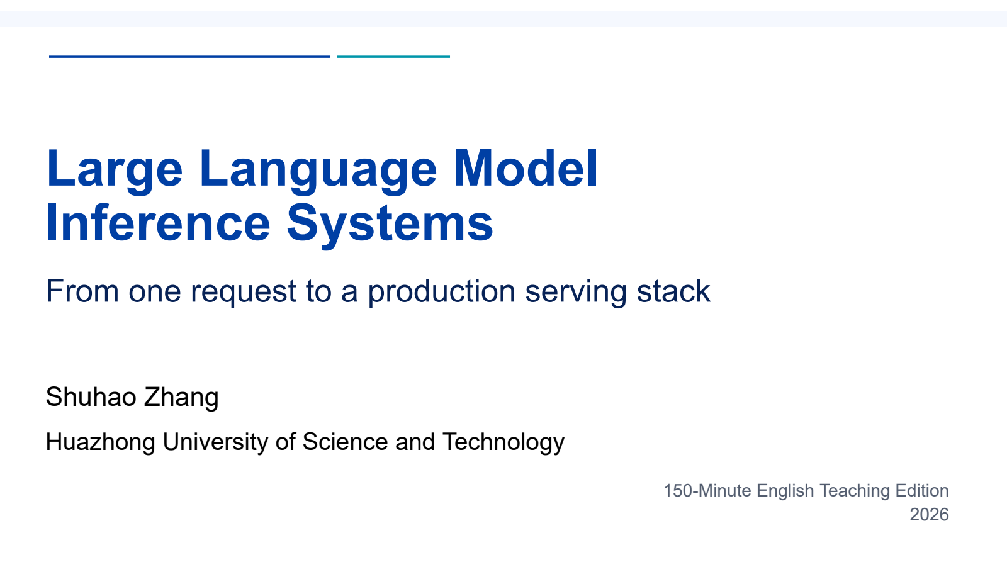
Notes:
First half: model to request. Keep the cumulative first-half teaching time within 70 minutes.
All required teaching content is visible on the slide. Use the worked steps and answer keys as written; personal examples are optional.
[Sources]
- Self-authored Beamer source: llm_inference_systems.tex
- Vaswani et al., "Attention Is All You Need," NeurIPS 2017.
- Yu et al., "Orca: A Distributed Serving System for Transformer-Based Generative Models," OSDI 2022.
- Kwon et al., "Efficient Memory Management for Large Language Model Serving with PagedAttention," SOSP 2023.
[/Sources]

Slide 2

Notes:
First half: model to request. Keep the cumulative first-half teaching time within 70 minutes.
All required teaching content is visible on the slide. Use the worked steps and answer keys as written; personal examples are optional.
[Sources]
- Self-authored Beamer source: llm_inference_systems.tex
- Vaswani et al., "Attention Is All You Need," NeurIPS 2017.
- Yu et al., "Orca: A Distributed Serving System for Transformer-Based Generative Models," OSDI 2022.
- Kwon et al., "Efficient Memory Management for Large Language Model Serving with PagedAttention," SOSP 2023.
[/Sources]

Slide 3
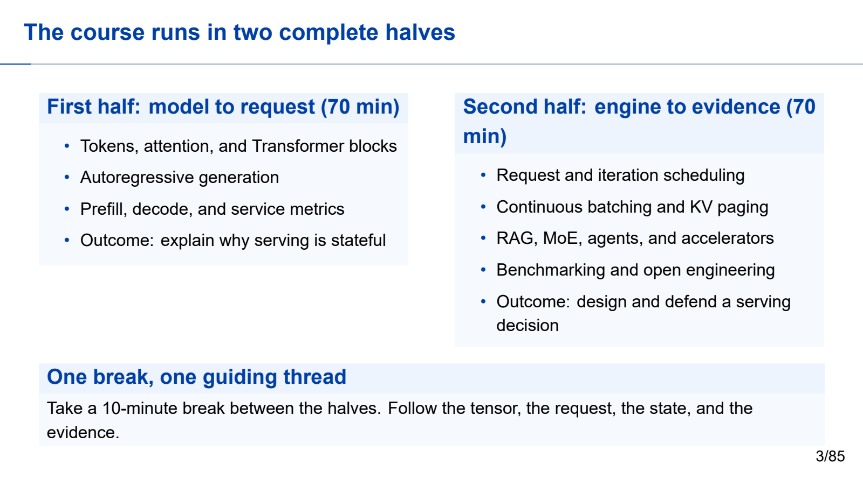
Notes:
First half: model to request. Keep the cumulative first-half teaching time within 70 minutes.
All required teaching content is visible on the slide. Use the worked steps and answer keys as written; personal examples are optional.
[Sources]
- Self-authored Beamer source: llm_inference_systems.tex
- Vaswani et al., "Attention Is All You Need," NeurIPS 2017.
- Yu et al., "Orca: A Distributed Serving System for Transformer-Based Generative Models," OSDI 2022.
- Kwon et al., "Efficient Memory Management for Large Language Model Serving with PagedAttention," SOSP 2023.
[/Sources]

Slide 4
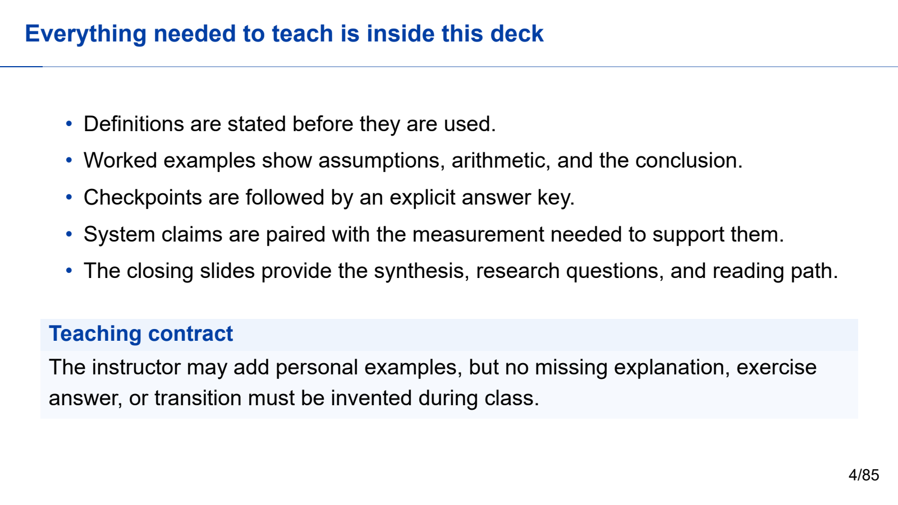
Notes:
First half: model to request. Keep the cumulative first-half teaching time within 70 minutes.
All required teaching content is visible on the slide. Use the worked steps and answer keys as written; personal examples are optional.
[Sources]
- Self-authored Beamer source: llm_inference_systems.tex
- Vaswani et al., "Attention Is All You Need," NeurIPS 2017.
- Yu et al., "Orca: A Distributed Serving System for Transformer-Based Generative Models," OSDI 2022.
- Kwon et al., "Efficient Memory Management for Large Language Model Serving with PagedAttention," SOSP 2023.
[/Sources]

Slide 5

Notes:
First half: model to request. Keep the cumulative first-half teaching time within 70 minutes.
All required teaching content is visible on the slide. Use the worked steps and answer keys as written; personal examples are optional.
[Sources]
- Self-authored Beamer source: llm_inference_systems.tex
- Vaswani et al., "Attention Is All You Need," NeurIPS 2017.
- Yu et al., "Orca: A Distributed Serving System for Transformer-Based Generative Models," OSDI 2022.
- Kwon et al., "Efficient Memory Management for Large Language Model Serving with PagedAttention," SOSP 2023.
[/Sources]

Slide 6

Notes:
First half: model to request. Keep the cumulative first-half teaching time within 70 minutes.
All required teaching content is visible on the slide. Use the worked steps and answer keys as written; personal examples are optional.
[Sources]
- Self-authored Beamer source: llm_inference_systems.tex
- Vaswani et al., "Attention Is All You Need," NeurIPS 2017.
- Yu et al., "Orca: A Distributed Serving System for Transformer-Based Generative Models," OSDI 2022.
- Kwon et al., "Efficient Memory Management for Large Language Model Serving with PagedAttention," SOSP 2023.
[/Sources]

Slide 7

Notes:
First half: model to request. Keep the cumulative first-half teaching time within 70 minutes.
All required teaching content is visible on the slide. Use the worked steps and answer keys as written; personal examples are optional.
[Sources]
- Self-authored Beamer source: llm_inference_systems.tex
- Vaswani et al., "Attention Is All You Need," NeurIPS 2017.
- Yu et al., "Orca: A Distributed Serving System for Transformer-Based Generative Models," OSDI 2022.
- Kwon et al., "Efficient Memory Management for Large Language Model Serving with PagedAttention," SOSP 2023.
[/Sources]

Slide 8

Notes:
First half: model to request. Keep the cumulative first-half teaching time within 70 minutes.
All required teaching content is visible on the slide. Use the worked steps and answer keys as written; personal examples are optional.
[Sources]
- Self-authored Beamer source: llm_inference_systems.tex
- Vaswani et al., "Attention Is All You Need," NeurIPS 2017.
- Yu et al., "Orca: A Distributed Serving System for Transformer-Based Generative Models," OSDI 2022.
- Kwon et al., "Efficient Memory Management for Large Language Model Serving with PagedAttention," SOSP 2023.
[/Sources]

Slide 9

Notes:
First half: model to request. Keep the cumulative first-half teaching time within 70 minutes.
All required teaching content is visible on the slide. Use the worked steps and answer keys as written; personal examples are optional.
[Sources]
- Self-authored Beamer source: llm_inference_systems.tex
- Vaswani et al., "Attention Is All You Need," NeurIPS 2017.
- Yu et al., "Orca: A Distributed Serving System for Transformer-Based Generative Models," OSDI 2022.
- Kwon et al., "Efficient Memory Management for Large Language Model Serving with PagedAttention," SOSP 2023.
[/Sources]

Slide 10

Notes:
First half: model to request. Keep the cumulative first-half teaching time within 70 minutes.
All required teaching content is visible on the slide. Use the worked steps and answer keys as written; personal examples are optional.
[Sources]
- Self-authored Beamer source: llm_inference_systems.tex
- Vaswani et al., "Attention Is All You Need," NeurIPS 2017.
- Yu et al., "Orca: A Distributed Serving System for Transformer-Based Generative Models," OSDI 2022.
- Kwon et al., "Efficient Memory Management for Large Language Model Serving with PagedAttention," SOSP 2023.
[/Sources]

Slide 11
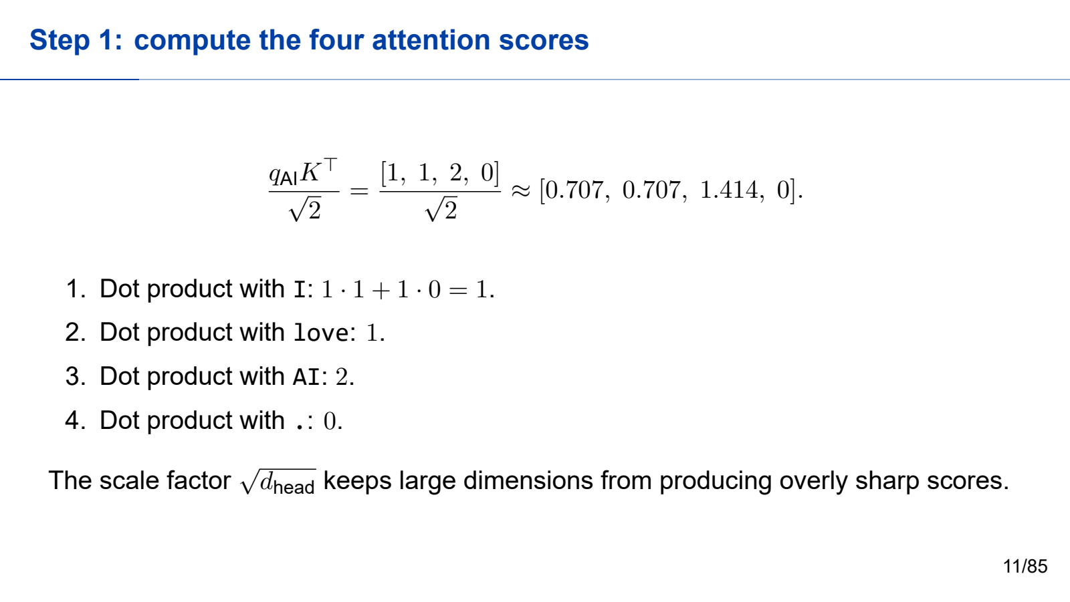
Notes:
First half: model to request. Keep the cumulative first-half teaching time within 70 minutes.
All required teaching content is visible on the slide. Use the worked steps and answer keys as written; personal examples are optional.
[Sources]
- Self-authored Beamer source: llm_inference_systems.tex
- Vaswani et al., "Attention Is All You Need," NeurIPS 2017.
- Yu et al., "Orca: A Distributed Serving System for Transformer-Based Generative Models," OSDI 2022.
- Kwon et al., "Efficient Memory Management for Large Language Model Serving with PagedAttention," SOSP 2023.
[/Sources]

Slide 12

Notes:
First half: model to request. Keep the cumulative first-half teaching time within 70 minutes.
All required teaching content is visible on the slide. Use the worked steps and answer keys as written; personal examples are optional.
[Sources]
- Self-authored Beamer source: llm_inference_systems.tex
- Vaswani et al., "Attention Is All You Need," NeurIPS 2017.
- Yu et al., "Orca: A Distributed Serving System for Transformer-Based Generative Models," OSDI 2022.
- Kwon et al., "Efficient Memory Management for Large Language Model Serving with PagedAttention," SOSP 2023.
[/Sources]

Slide 13

Notes:
First half: model to request. Keep the cumulative first-half teaching time within 70 minutes.
All required teaching content is visible on the slide. Use the worked steps and answer keys as written; personal examples are optional.
[Sources]
- Self-authored Beamer source: llm_inference_systems.tex
- Vaswani et al., "Attention Is All You Need," NeurIPS 2017.
- Yu et al., "Orca: A Distributed Serving System for Transformer-Based Generative Models," OSDI 2022.
- Kwon et al., "Efficient Memory Management for Large Language Model Serving with PagedAttention," SOSP 2023.
[/Sources]

Slide 14

Notes:
First half: model to request. Keep the cumulative first-half teaching time within 70 minutes.
All required teaching content is visible on the slide. Use the worked steps and answer keys as written; personal examples are optional.
[Sources]
- Self-authored Beamer source: llm_inference_systems.tex
- Vaswani et al., "Attention Is All You Need," NeurIPS 2017.
- Yu et al., "Orca: A Distributed Serving System for Transformer-Based Generative Models," OSDI 2022.
- Kwon et al., "Efficient Memory Management for Large Language Model Serving with PagedAttention," SOSP 2023.
[/Sources]

Slide 15

Notes:
First half: model to request. Keep the cumulative first-half teaching time within 70 minutes.
All required teaching content is visible on the slide. Use the worked steps and answer keys as written; personal examples are optional.
[Sources]
- Self-authored Beamer source: llm_inference_systems.tex
- Vaswani et al., "Attention Is All You Need," NeurIPS 2017.
- Yu et al., "Orca: A Distributed Serving System for Transformer-Based Generative Models," OSDI 2022.
- Kwon et al., "Efficient Memory Management for Large Language Model Serving with PagedAttention," SOSP 2023.
[/Sources]

Slide 16

Notes:
First half: model to request. Keep the cumulative first-half teaching time within 70 minutes.
All required teaching content is visible on the slide. Use the worked steps and answer keys as written; personal examples are optional.
[Sources]
- Self-authored Beamer source: llm_inference_systems.tex
- Vaswani et al., "Attention Is All You Need," NeurIPS 2017.
- Yu et al., "Orca: A Distributed Serving System for Transformer-Based Generative Models," OSDI 2022.
- Kwon et al., "Efficient Memory Management for Large Language Model Serving with PagedAttention," SOSP 2023.
[/Sources]

Slide 17
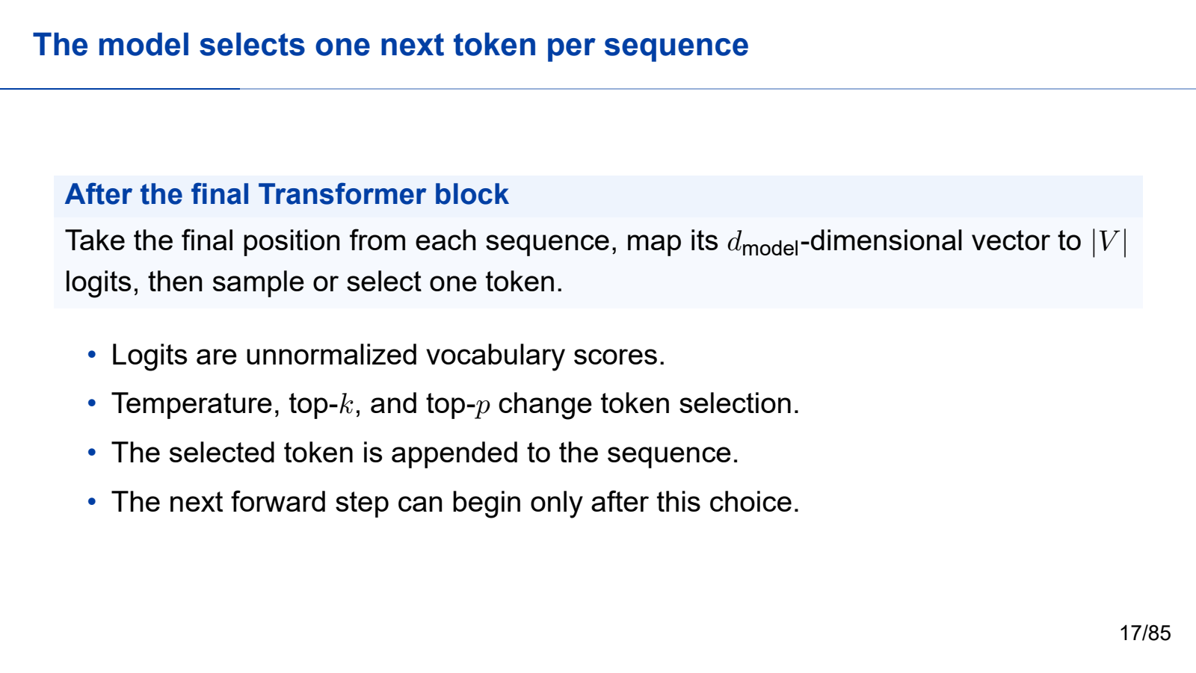
Notes:
First half: model to request. Keep the cumulative first-half teaching time within 70 minutes.
All required teaching content is visible on the slide. Use the worked steps and answer keys as written; personal examples are optional.
[Sources]
- Self-authored Beamer source: llm_inference_systems.tex
- Vaswani et al., "Attention Is All You Need," NeurIPS 2017.
- Yu et al., "Orca: A Distributed Serving System for Transformer-Based Generative Models," OSDI 2022.
- Kwon et al., "Efficient Memory Management for Large Language Model Serving with PagedAttention," SOSP 2023.
[/Sources]

Slide 18

Notes:
First half: model to request. Keep the cumulative first-half teaching time within 70 minutes.
All required teaching content is visible on the slide. Use the worked steps and answer keys as written; personal examples are optional.
[Sources]
- Self-authored Beamer source: llm_inference_systems.tex
- Vaswani et al., "Attention Is All You Need," NeurIPS 2017.
- Yu et al., "Orca: A Distributed Serving System for Transformer-Based Generative Models," OSDI 2022.
- Kwon et al., "Efficient Memory Management for Large Language Model Serving with PagedAttention," SOSP 2023.
[/Sources]

Slide 19

Notes:
First half: model to request. Keep the cumulative first-half teaching time within 70 minutes.
All required teaching content is visible on the slide. Use the worked steps and answer keys as written; personal examples are optional.
[Sources]
- Self-authored Beamer source: llm_inference_systems.tex
- Vaswani et al., "Attention Is All You Need," NeurIPS 2017.
- Yu et al., "Orca: A Distributed Serving System for Transformer-Based Generative Models," OSDI 2022.
- Kwon et al., "Efficient Memory Management for Large Language Model Serving with PagedAttention," SOSP 2023.
[/Sources]

Slide 20
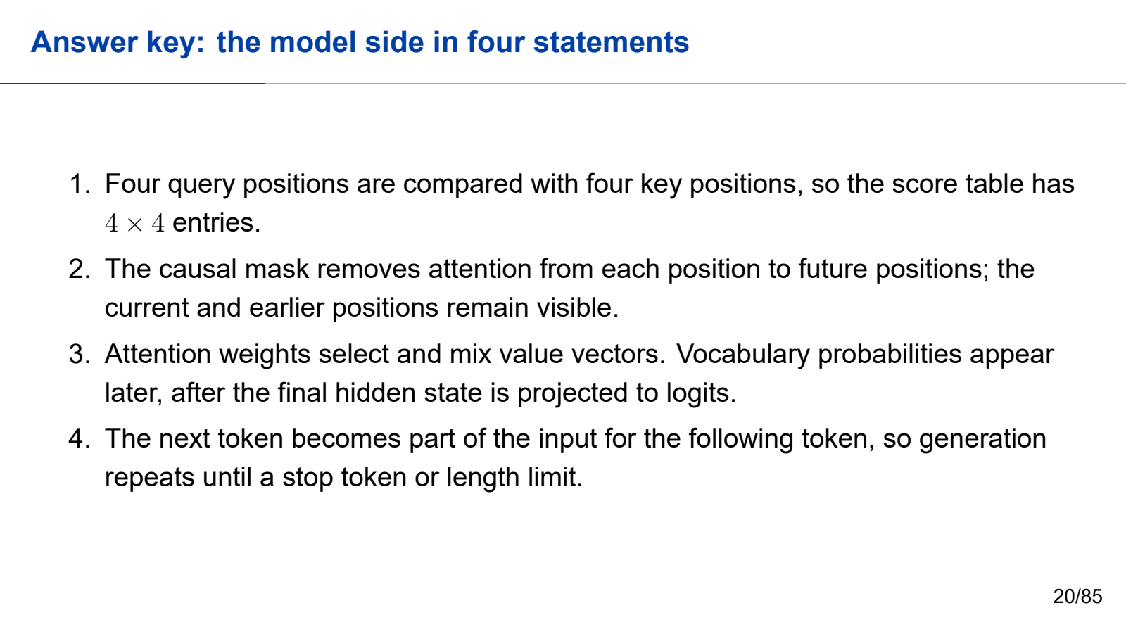
Notes:
First half: model to request. Keep the cumulative first-half teaching time within 70 minutes.
All required teaching content is visible on the slide. Use the worked steps and answer keys as written; personal examples are optional.
[Sources]
- Self-authored Beamer source: llm_inference_systems.tex
- Vaswani et al., "Attention Is All You Need," NeurIPS 2017.
- Yu et al., "Orca: A Distributed Serving System for Transformer-Based Generative Models," OSDI 2022.
- Kwon et al., "Efficient Memory Management for Large Language Model Serving with PagedAttention," SOSP 2023.
[/Sources]

Slide 21

Notes:
First half: model to request. Keep the cumulative first-half teaching time within 70 minutes.
All required teaching content is visible on the slide. Use the worked steps and answer keys as written; personal examples are optional.
[Sources]
- Self-authored Beamer source: llm_inference_systems.tex
- Vaswani et al., "Attention Is All You Need," NeurIPS 2017.
- Yu et al., "Orca: A Distributed Serving System for Transformer-Based Generative Models," OSDI 2022.
- Kwon et al., "Efficient Memory Management for Large Language Model Serving with PagedAttention," SOSP 2023.
[/Sources]

Slide 22
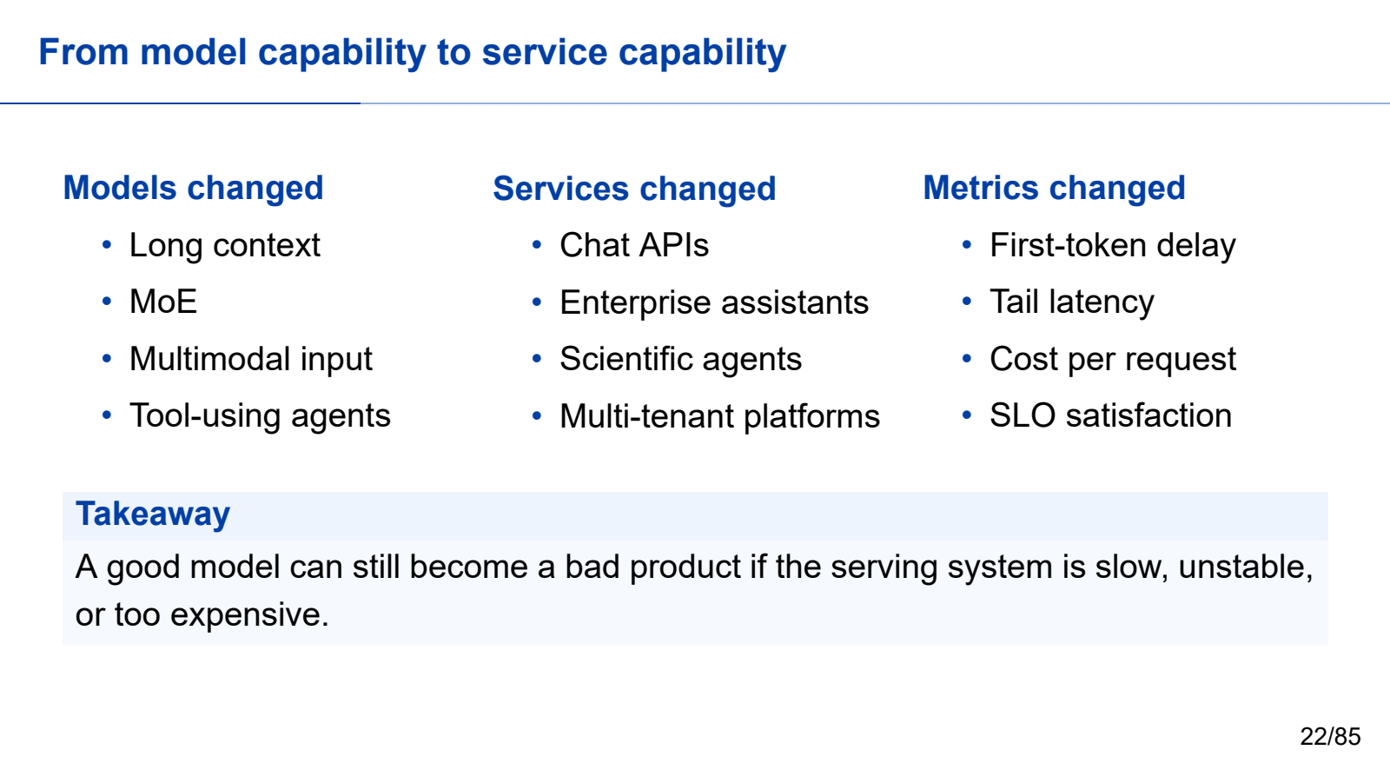
Notes:
First half: model to request. Keep the cumulative first-half teaching time within 70 minutes.
All required teaching content is visible on the slide. Use the worked steps and answer keys as written; personal examples are optional.
[Sources]
- Self-authored Beamer source: llm_inference_systems.tex
- Vaswani et al., "Attention Is All You Need," NeurIPS 2017.
- Yu et al., "Orca: A Distributed Serving System for Transformer-Based Generative Models," OSDI 2022.
- Kwon et al., "Efficient Memory Management for Large Language Model Serving with PagedAttention," SOSP 2023.
[/Sources]

Slide 23

Notes:
First half: model to request. Keep the cumulative first-half teaching time within 70 minutes.
All required teaching content is visible on the slide. Use the worked steps and answer keys as written; personal examples are optional.
[Sources]
- Self-authored Beamer source: llm_inference_systems.tex
- Vaswani et al., "Attention Is All You Need," NeurIPS 2017.
- Yu et al., "Orca: A Distributed Serving System for Transformer-Based Generative Models," OSDI 2022.
- Kwon et al., "Efficient Memory Management for Large Language Model Serving with PagedAttention," SOSP 2023.
[/Sources]

Slide 24

Notes:
First half: model to request. Keep the cumulative first-half teaching time within 70 minutes.
All required teaching content is visible on the slide. Use the worked steps and answer keys as written; personal examples are optional.
[Sources]
- Self-authored Beamer source: llm_inference_systems.tex
- Vaswani et al., "Attention Is All You Need," NeurIPS 2017.
- Yu et al., "Orca: A Distributed Serving System for Transformer-Based Generative Models," OSDI 2022.
- Kwon et al., "Efficient Memory Management for Large Language Model Serving with PagedAttention," SOSP 2023.
[/Sources]

Slide 25

Notes:
First half: model to request. Keep the cumulative first-half teaching time within 70 minutes.
All required teaching content is visible on the slide. Use the worked steps and answer keys as written; personal examples are optional.
[Sources]
- Self-authored Beamer source: llm_inference_systems.tex
- Vaswani et al., "Attention Is All You Need," NeurIPS 2017.
- Yu et al., "Orca: A Distributed Serving System for Transformer-Based Generative Models," OSDI 2022.
- Kwon et al., "Efficient Memory Management for Large Language Model Serving with PagedAttention," SOSP 2023.
[/Sources]

Slide 26
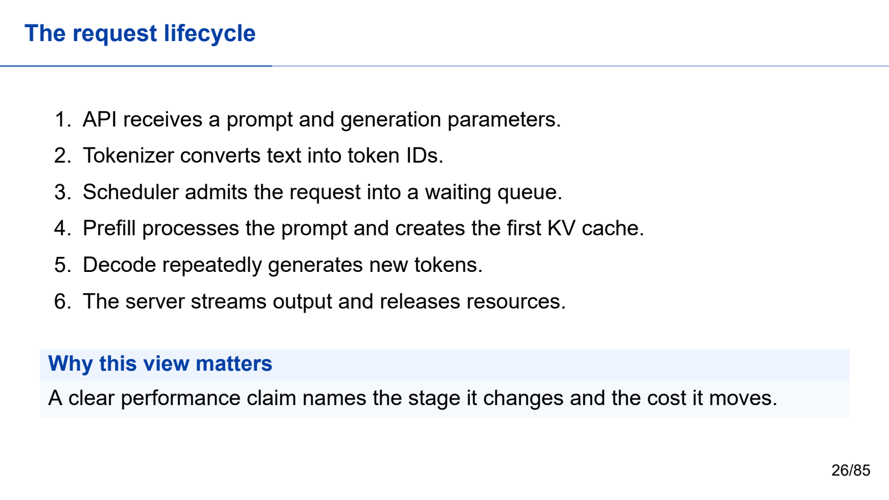
Notes:
First half: model to request. Keep the cumulative first-half teaching time within 70 minutes.
All required teaching content is visible on the slide. Use the worked steps and answer keys as written; personal examples are optional.
[Sources]
- Self-authored Beamer source: llm_inference_systems.tex
- Vaswani et al., "Attention Is All You Need," NeurIPS 2017.
- Yu et al., "Orca: A Distributed Serving System for Transformer-Based Generative Models," OSDI 2022.
- Kwon et al., "Efficient Memory Management for Large Language Model Serving with PagedAttention," SOSP 2023.
[/Sources]

Slide 27
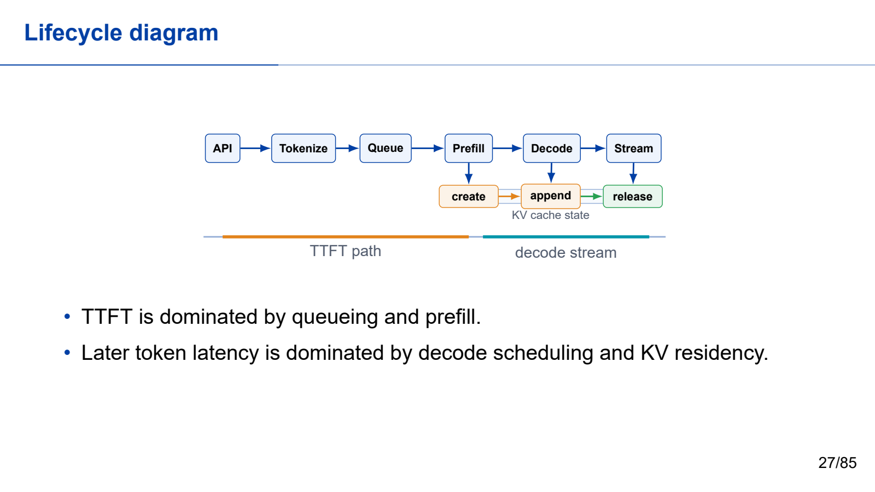
Notes:
First half: model to request. Keep the cumulative first-half teaching time within 70 minutes.
All required teaching content is visible on the slide. Use the worked steps and answer keys as written; personal examples are optional.
[Sources]
- Self-authored Beamer source: llm_inference_systems.tex
- Vaswani et al., "Attention Is All You Need," NeurIPS 2017.
- Yu et al., "Orca: A Distributed Serving System for Transformer-Based Generative Models," OSDI 2022.
- Kwon et al., "Efficient Memory Management for Large Language Model Serving with PagedAttention," SOSP 2023.
[/Sources]

Slide 28

Notes:
First half: model to request. Keep the cumulative first-half teaching time within 70 minutes.
All required teaching content is visible on the slide. Use the worked steps and answer keys as written; personal examples are optional.
[Sources]
- Self-authored Beamer source: llm_inference_systems.tex
- Vaswani et al., "Attention Is All You Need," NeurIPS 2017.
- Yu et al., "Orca: A Distributed Serving System for Transformer-Based Generative Models," OSDI 2022.
- Kwon et al., "Efficient Memory Management for Large Language Model Serving with PagedAttention," SOSP 2023.
[/Sources]

Slide 29

Notes:
First half: model to request. Keep the cumulative first-half teaching time within 70 minutes.
All required teaching content is visible on the slide. Use the worked steps and answer keys as written; personal examples are optional.
[Sources]
- Self-authored Beamer source: llm_inference_systems.tex
- Vaswani et al., "Attention Is All You Need," NeurIPS 2017.
- Yu et al., "Orca: A Distributed Serving System for Transformer-Based Generative Models," OSDI 2022.
- Kwon et al., "Efficient Memory Management for Large Language Model Serving with PagedAttention," SOSP 2023.
[/Sources]

Slide 30
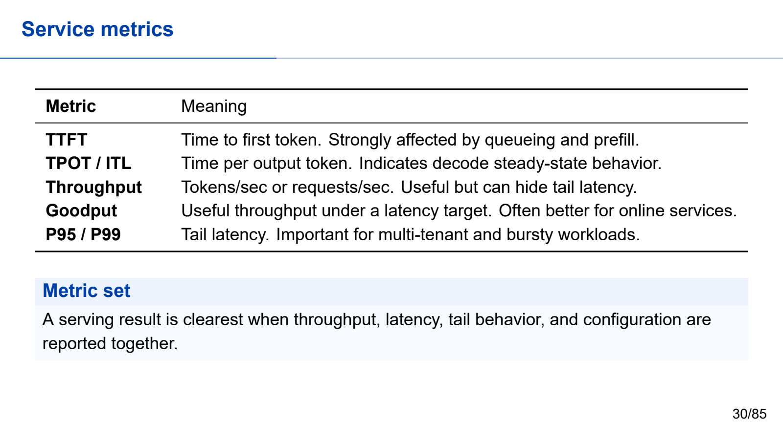
Notes:
First half: model to request. Keep the cumulative first-half teaching time within 70 minutes.
All required teaching content is visible on the slide. Use the worked steps and answer keys as written; personal examples are optional.
[Sources]
- Self-authored Beamer source: llm_inference_systems.tex
- Vaswani et al., "Attention Is All You Need," NeurIPS 2017.
- Yu et al., "Orca: A Distributed Serving System for Transformer-Based Generative Models," OSDI 2022.
- Kwon et al., "Efficient Memory Management for Large Language Model Serving with PagedAttention," SOSP 2023.
[/Sources]

Slide 31
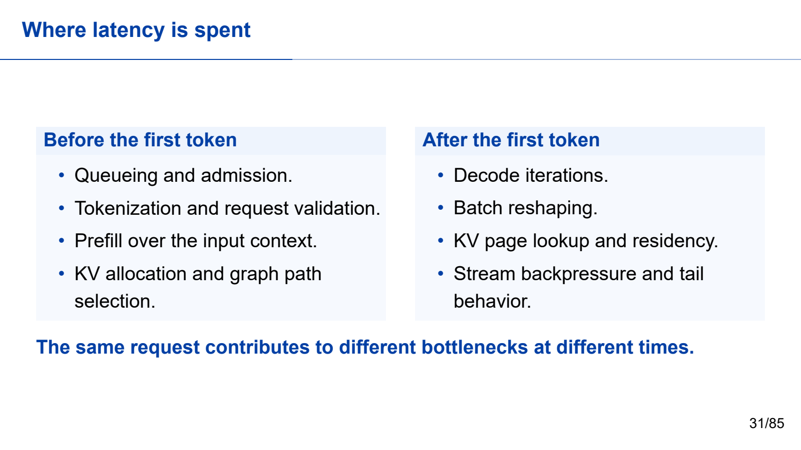
Notes:
First half: model to request. Keep the cumulative first-half teaching time within 70 minutes.
All required teaching content is visible on the slide. Use the worked steps and answer keys as written; personal examples are optional.
[Sources]
- Self-authored Beamer source: llm_inference_systems.tex
- Vaswani et al., "Attention Is All You Need," NeurIPS 2017.
- Yu et al., "Orca: A Distributed Serving System for Transformer-Based Generative Models," OSDI 2022.
- Kwon et al., "Efficient Memory Management for Large Language Model Serving with PagedAttention," SOSP 2023.
[/Sources]

Slide 32

Notes:
Ten-minute break. Resume with scheduling and KV state.
All required teaching content is visible on the slide. Use the worked steps and answer keys as written; personal examples are optional.
[Sources]
- Self-authored Beamer source: llm_inference_systems.tex
- Vaswani et al., "Attention Is All You Need," NeurIPS 2017.
- Yu et al., "Orca: A Distributed Serving System for Transformer-Based Generative Models," OSDI 2022.
- Kwon et al., "Efficient Memory Management for Large Language Model Serving with PagedAttention," SOSP 2023.
[/Sources]

Slide 33

Notes:
Second half: engine to evidence. Keep the cumulative second-half teaching time within 70 minutes.
All required teaching content is visible on the slide. Use the worked steps and answer keys as written; personal examples are optional.
[Sources]
- Self-authored Beamer source: llm_inference_systems.tex
- Vaswani et al., "Attention Is All You Need," NeurIPS 2017.
- Yu et al., "Orca: A Distributed Serving System for Transformer-Based Generative Models," OSDI 2022.
- Kwon et al., "Efficient Memory Management for Large Language Model Serving with PagedAttention," SOSP 2023.
[/Sources]

Slide 34

Notes:
Second half: engine to evidence. Keep the cumulative second-half teaching time within 70 minutes.
All required teaching content is visible on the slide. Use the worked steps and answer keys as written; personal examples are optional.
[Sources]
- Self-authored Beamer source: llm_inference_systems.tex
- Vaswani et al., "Attention Is All You Need," NeurIPS 2017.
- Yu et al., "Orca: A Distributed Serving System for Transformer-Based Generative Models," OSDI 2022.
- Kwon et al., "Efficient Memory Management for Large Language Model Serving with PagedAttention," SOSP 2023.
[/Sources]

Slide 35
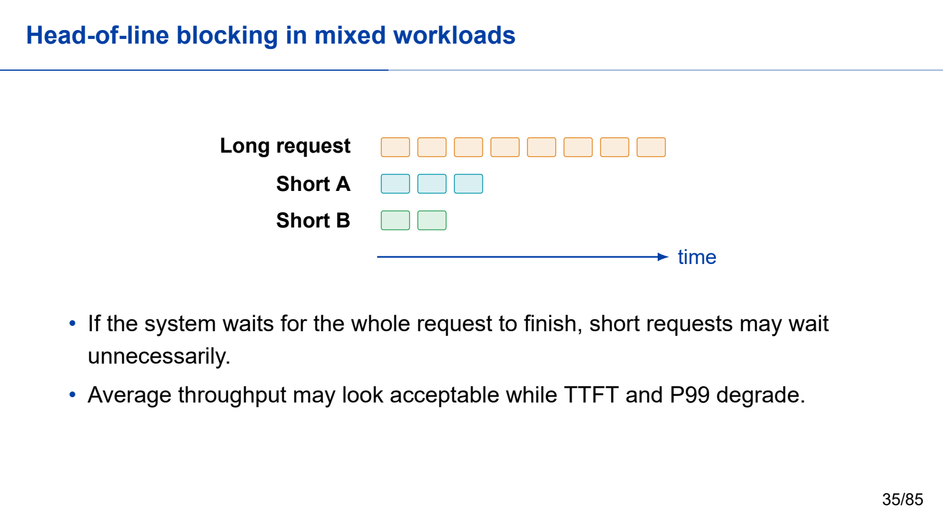
Notes:
Second half: engine to evidence. Keep the cumulative second-half teaching time within 70 minutes.
All required teaching content is visible on the slide. Use the worked steps and answer keys as written; personal examples are optional.
[Sources]
- Self-authored Beamer source: llm_inference_systems.tex
- Vaswani et al., "Attention Is All You Need," NeurIPS 2017.
- Yu et al., "Orca: A Distributed Serving System for Transformer-Based Generative Models," OSDI 2022.
- Kwon et al., "Efficient Memory Management for Large Language Model Serving with PagedAttention," SOSP 2023.
[/Sources]

Slide 36
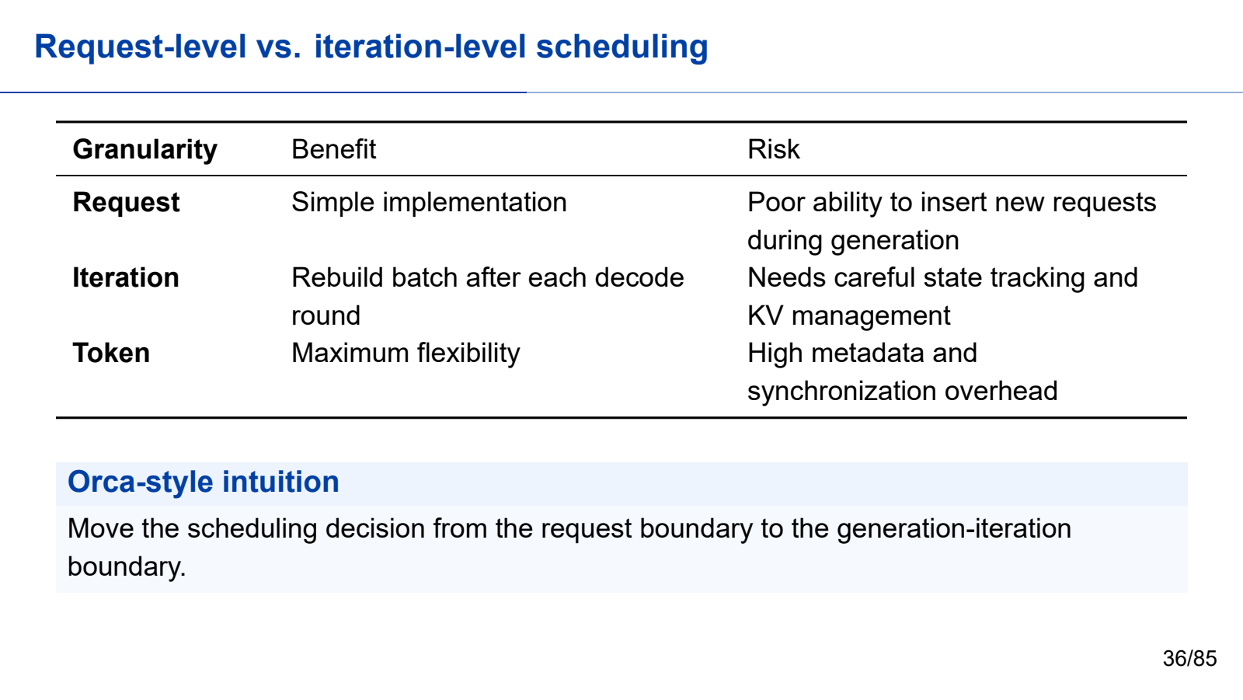
Notes:
Second half: engine to evidence. Keep the cumulative second-half teaching time within 70 minutes.
All required teaching content is visible on the slide. Use the worked steps and answer keys as written; personal examples are optional.
[Sources]
- Self-authored Beamer source: llm_inference_systems.tex
- Vaswani et al., "Attention Is All You Need," NeurIPS 2017.
- Yu et al., "Orca: A Distributed Serving System for Transformer-Based Generative Models," OSDI 2022.
- Kwon et al., "Efficient Memory Management for Large Language Model Serving with PagedAttention," SOSP 2023.
[/Sources]

Slide 37

Notes:
Second half: engine to evidence. Keep the cumulative second-half teaching time within 70 minutes.
All required teaching content is visible on the slide. Use the worked steps and answer keys as written; personal examples are optional.
[Sources]
- Self-authored Beamer source: llm_inference_systems.tex
- Vaswani et al., "Attention Is All You Need," NeurIPS 2017.
- Yu et al., "Orca: A Distributed Serving System for Transformer-Based Generative Models," OSDI 2022.
- Kwon et al., "Efficient Memory Management for Large Language Model Serving with PagedAttention," SOSP 2023.
[/Sources]

Slide 38

Notes:
Second half: engine to evidence. Keep the cumulative second-half teaching time within 70 minutes.
All required teaching content is visible on the slide. Use the worked steps and answer keys as written; personal examples are optional.
[Sources]
- Self-authored Beamer source: llm_inference_systems.tex
- Vaswani et al., "Attention Is All You Need," NeurIPS 2017.
- Yu et al., "Orca: A Distributed Serving System for Transformer-Based Generative Models," OSDI 2022.
- Kwon et al., "Efficient Memory Management for Large Language Model Serving with PagedAttention," SOSP 2023.
[/Sources]

Slide 39
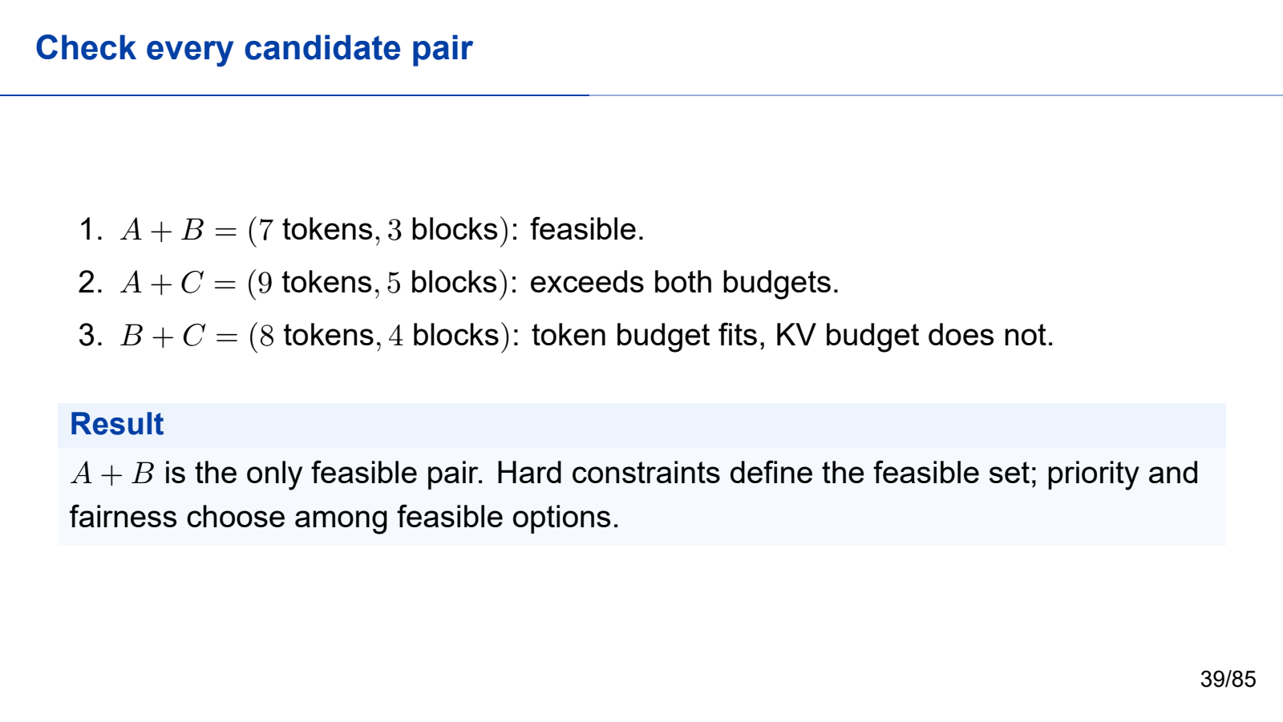
Notes:
Second half: engine to evidence. Keep the cumulative second-half teaching time within 70 minutes.
All required teaching content is visible on the slide. Use the worked steps and answer keys as written; personal examples are optional.
[Sources]
- Self-authored Beamer source: llm_inference_systems.tex
- Vaswani et al., "Attention Is All You Need," NeurIPS 2017.
- Yu et al., "Orca: A Distributed Serving System for Transformer-Based Generative Models," OSDI 2022.
- Kwon et al., "Efficient Memory Management for Large Language Model Serving with PagedAttention," SOSP 2023.
[/Sources]

Slide 40
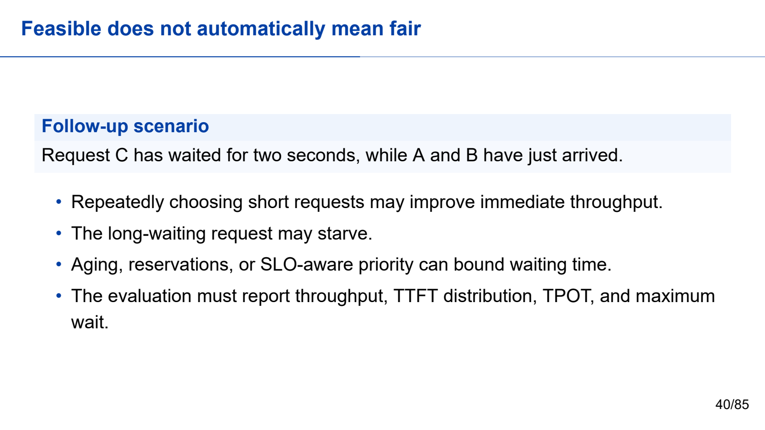
Notes:
Second half: engine to evidence. Keep the cumulative second-half teaching time within 70 minutes.
All required teaching content is visible on the slide. Use the worked steps and answer keys as written; personal examples are optional.
[Sources]
- Self-authored Beamer source: llm_inference_systems.tex
- Vaswani et al., "Attention Is All You Need," NeurIPS 2017.
- Yu et al., "Orca: A Distributed Serving System for Transformer-Based Generative Models," OSDI 2022.
- Kwon et al., "Efficient Memory Management for Large Language Model Serving with PagedAttention," SOSP 2023.
[/Sources]

Slide 41
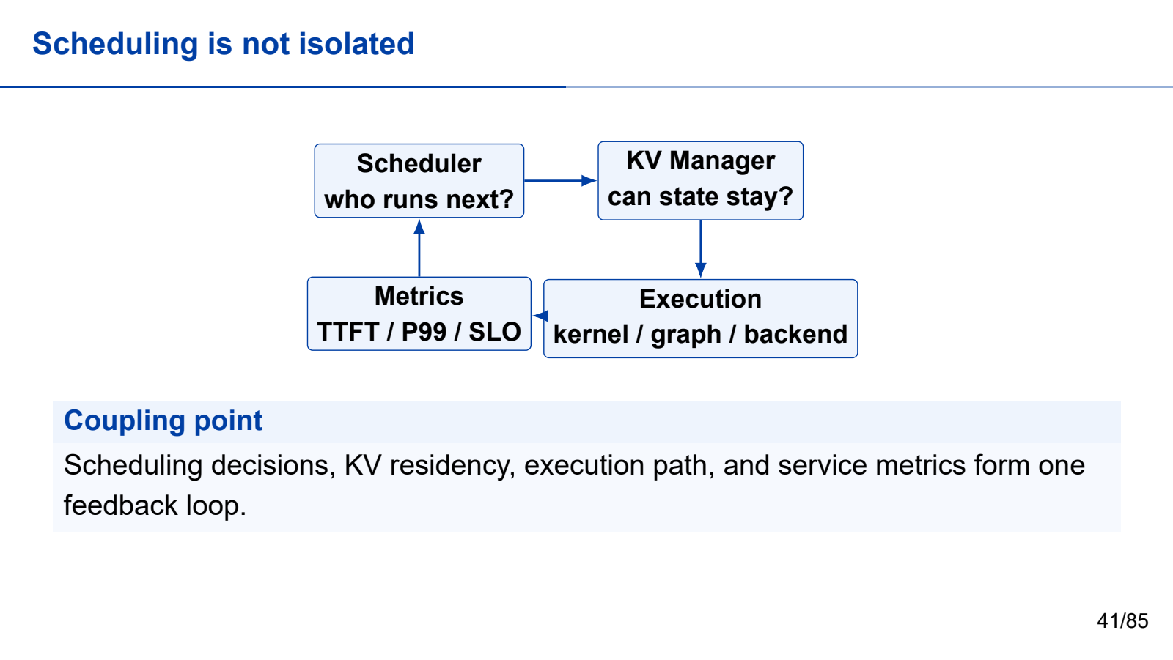
Notes:
Second half: engine to evidence. Keep the cumulative second-half teaching time within 70 minutes.
All required teaching content is visible on the slide. Use the worked steps and answer keys as written; personal examples are optional.
[Sources]
- Self-authored Beamer source: llm_inference_systems.tex
- Vaswani et al., "Attention Is All You Need," NeurIPS 2017.
- Yu et al., "Orca: A Distributed Serving System for Transformer-Based Generative Models," OSDI 2022.
- Kwon et al., "Efficient Memory Management for Large Language Model Serving with PagedAttention," SOSP 2023.
[/Sources]

Slide 42

Notes:
Second half: engine to evidence. Keep the cumulative second-half teaching time within 70 minutes.
All required teaching content is visible on the slide. Use the worked steps and answer keys as written; personal examples are optional.
[Sources]
- Self-authored Beamer source: llm_inference_systems.tex
- Vaswani et al., "Attention Is All You Need," NeurIPS 2017.
- Yu et al., "Orca: A Distributed Serving System for Transformer-Based Generative Models," OSDI 2022.
- Kwon et al., "Efficient Memory Management for Large Language Model Serving with PagedAttention," SOSP 2023.
[/Sources]

Slide 43
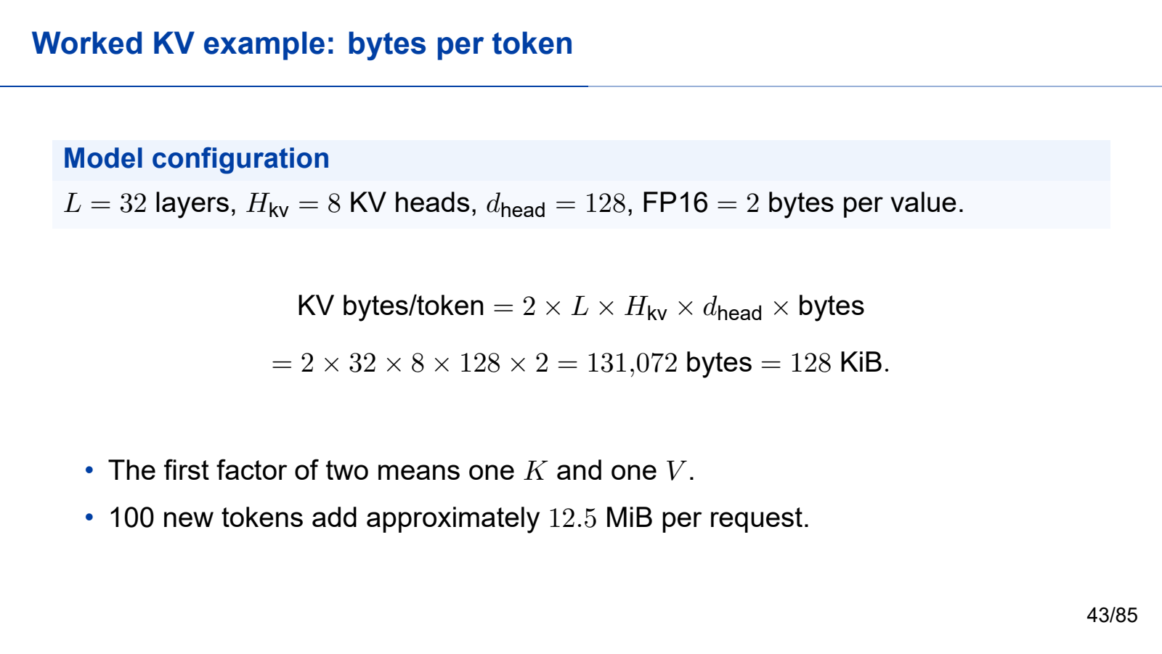
Notes:
Second half: engine to evidence. Keep the cumulative second-half teaching time within 70 minutes.
All required teaching content is visible on the slide. Use the worked steps and answer keys as written; personal examples are optional.
[Sources]
- Self-authored Beamer source: llm_inference_systems.tex
- Vaswani et al., "Attention Is All You Need," NeurIPS 2017.
- Yu et al., "Orca: A Distributed Serving System for Transformer-Based Generative Models," OSDI 2022.
- Kwon et al., "Efficient Memory Management for Large Language Model Serving with PagedAttention," SOSP 2023.
[/Sources]

Slide 44
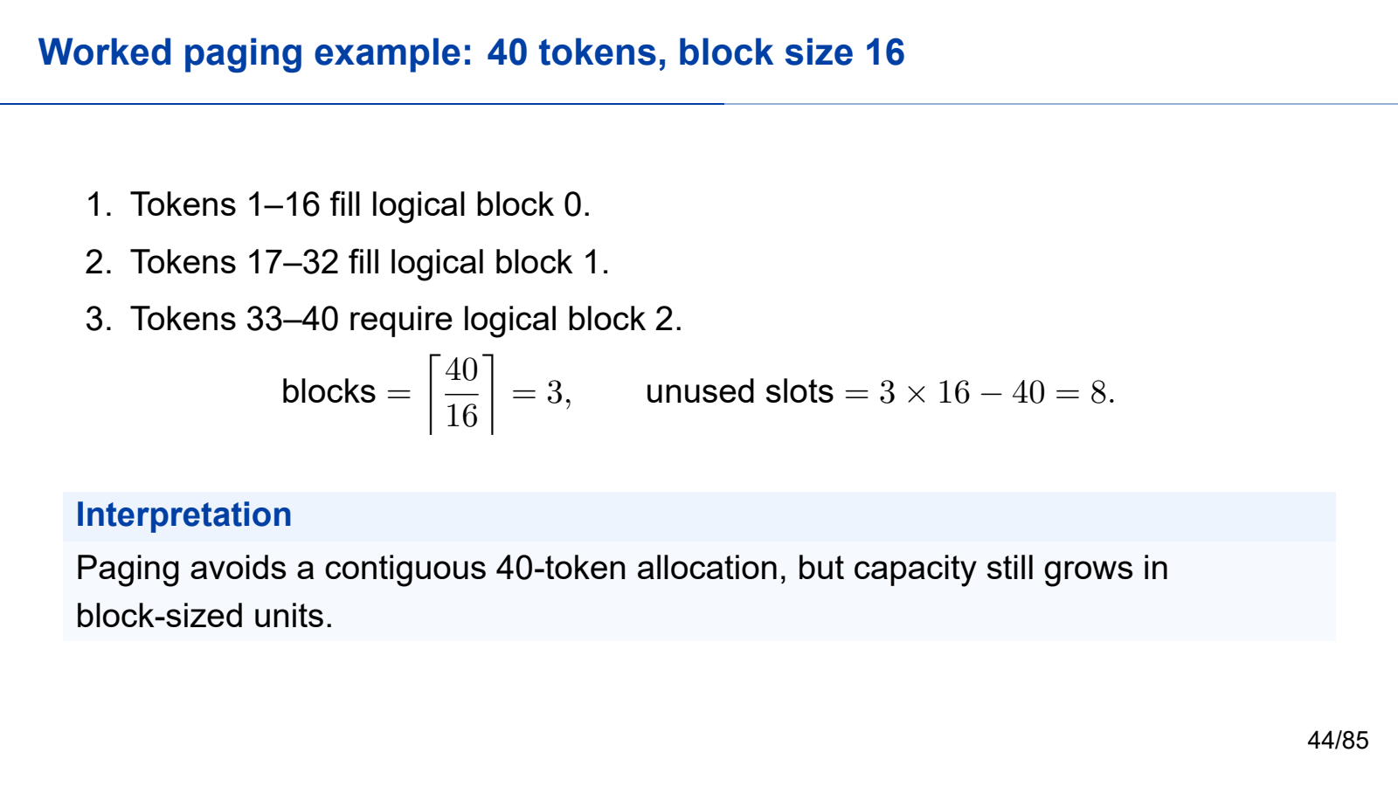
Notes:
Second half: engine to evidence. Keep the cumulative second-half teaching time within 70 minutes.
All required teaching content is visible on the slide. Use the worked steps and answer keys as written; personal examples are optional.
[Sources]
- Self-authored Beamer source: llm_inference_systems.tex
- Vaswani et al., "Attention Is All You Need," NeurIPS 2017.
- Yu et al., "Orca: A Distributed Serving System for Transformer-Based Generative Models," OSDI 2022.
- Kwon et al., "Efficient Memory Management for Large Language Model Serving with PagedAttention," SOSP 2023.
[/Sources]

Slide 45
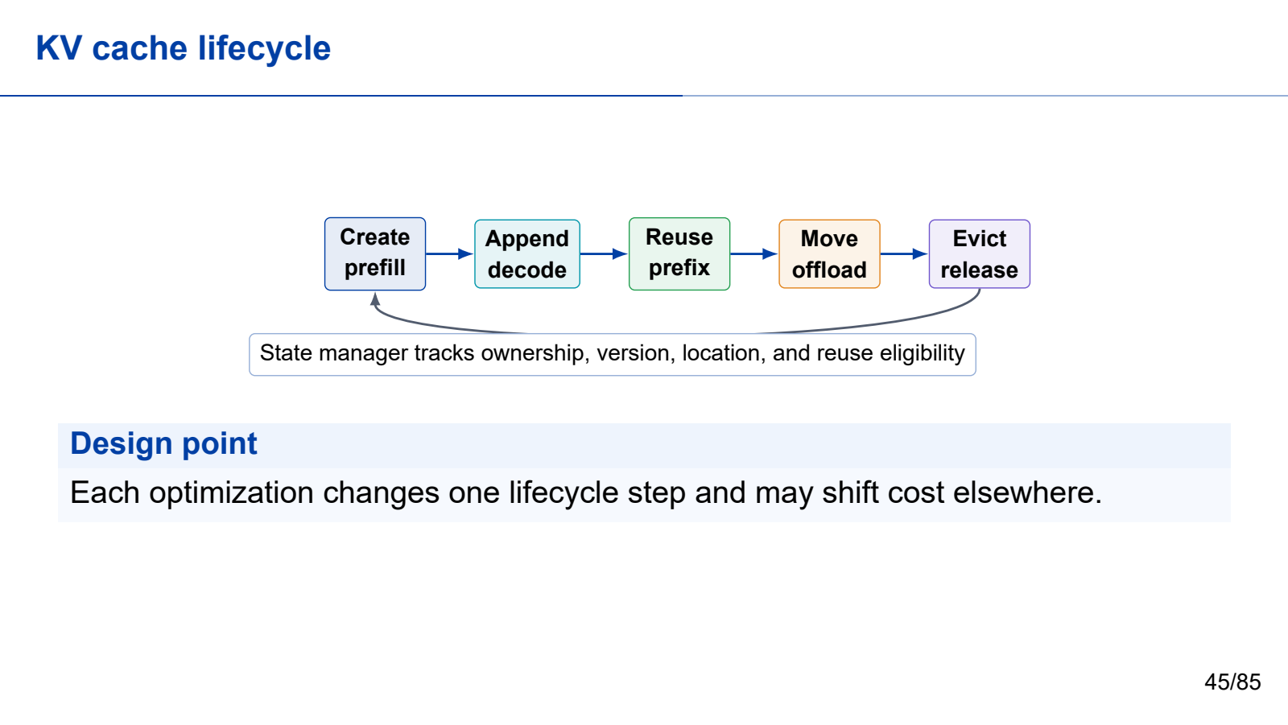
Notes:
Second half: engine to evidence. Keep the cumulative second-half teaching time within 70 minutes.
All required teaching content is visible on the slide. Use the worked steps and answer keys as written; personal examples are optional.
[Sources]
- Self-authored Beamer source: llm_inference_systems.tex
- Vaswani et al., "Attention Is All You Need," NeurIPS 2017.
- Yu et al., "Orca: A Distributed Serving System for Transformer-Based Generative Models," OSDI 2022.
- Kwon et al., "Efficient Memory Management for Large Language Model Serving with PagedAttention," SOSP 2023.
[/Sources]

Slide 46

Notes:
Second half: engine to evidence. Keep the cumulative second-half teaching time within 70 minutes.
All required teaching content is visible on the slide. Use the worked steps and answer keys as written; personal examples are optional.
[Sources]
- Self-authored Beamer source: llm_inference_systems.tex
- Vaswani et al., "Attention Is All You Need," NeurIPS 2017.
- Yu et al., "Orca: A Distributed Serving System for Transformer-Based Generative Models," OSDI 2022.
- Kwon et al., "Efficient Memory Management for Large Language Model Serving with PagedAttention," SOSP 2023.
[/Sources]

Slide 47

Notes:
Second half: engine to evidence. Keep the cumulative second-half teaching time within 70 minutes.
All required teaching content is visible on the slide. Use the worked steps and answer keys as written; personal examples are optional.
[Sources]
- Self-authored Beamer source: llm_inference_systems.tex
- Vaswani et al., "Attention Is All You Need," NeurIPS 2017.
- Yu et al., "Orca: A Distributed Serving System for Transformer-Based Generative Models," OSDI 2022.
- Kwon et al., "Efficient Memory Management for Large Language Model Serving with PagedAttention," SOSP 2023.
[/Sources]

Slide 48
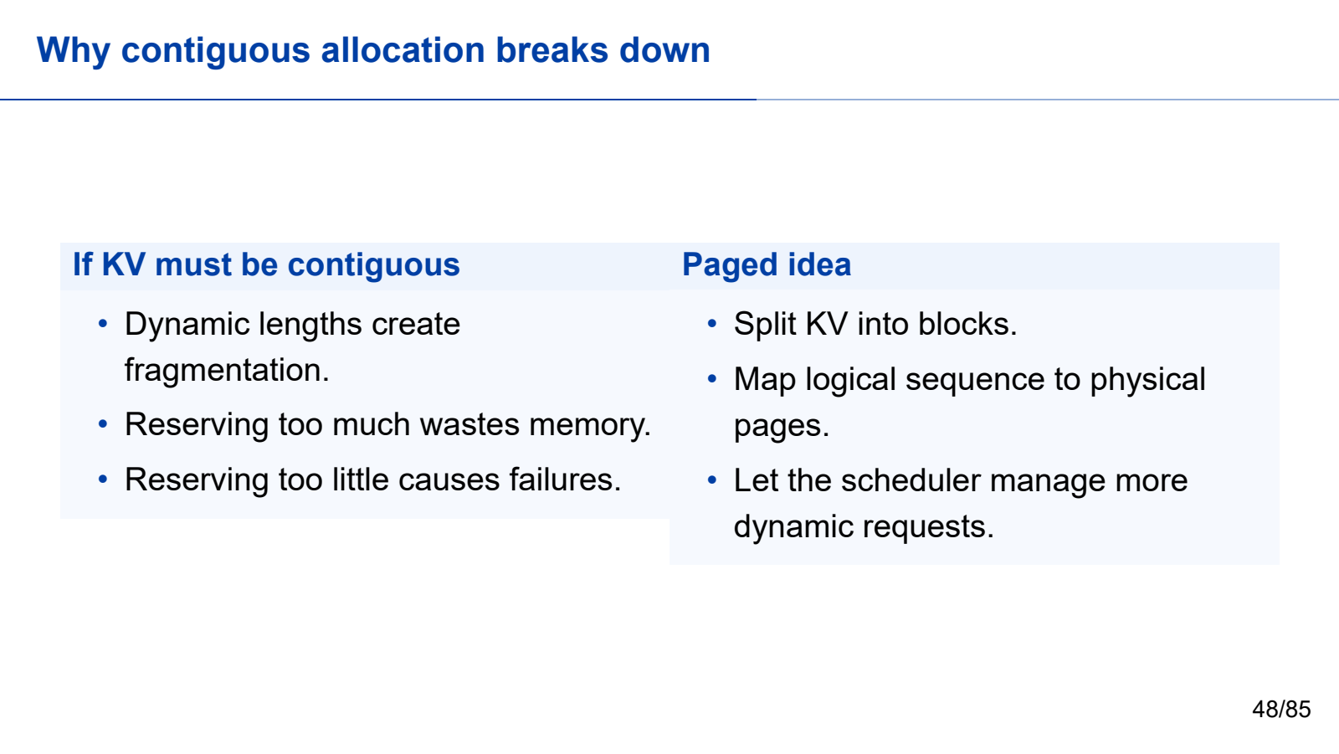
Notes:
Second half: engine to evidence. Keep the cumulative second-half teaching time within 70 minutes.
All required teaching content is visible on the slide. Use the worked steps and answer keys as written; personal examples are optional.
[Sources]
- Self-authored Beamer source: llm_inference_systems.tex
- Vaswani et al., "Attention Is All You Need," NeurIPS 2017.
- Yu et al., "Orca: A Distributed Serving System for Transformer-Based Generative Models," OSDI 2022.
- Kwon et al., "Efficient Memory Management for Large Language Model Serving with PagedAttention," SOSP 2023.
[/Sources]

Slide 49

Notes:
Second half: engine to evidence. Keep the cumulative second-half teaching time within 70 minutes.
All required teaching content is visible on the slide. Use the worked steps and answer keys as written; personal examples are optional.
[Sources]
- Self-authored Beamer source: llm_inference_systems.tex
- Vaswani et al., "Attention Is All You Need," NeurIPS 2017.
- Yu et al., "Orca: A Distributed Serving System for Transformer-Based Generative Models," OSDI 2022.
- Kwon et al., "Efficient Memory Management for Large Language Model Serving with PagedAttention," SOSP 2023.
[/Sources]

Slide 50
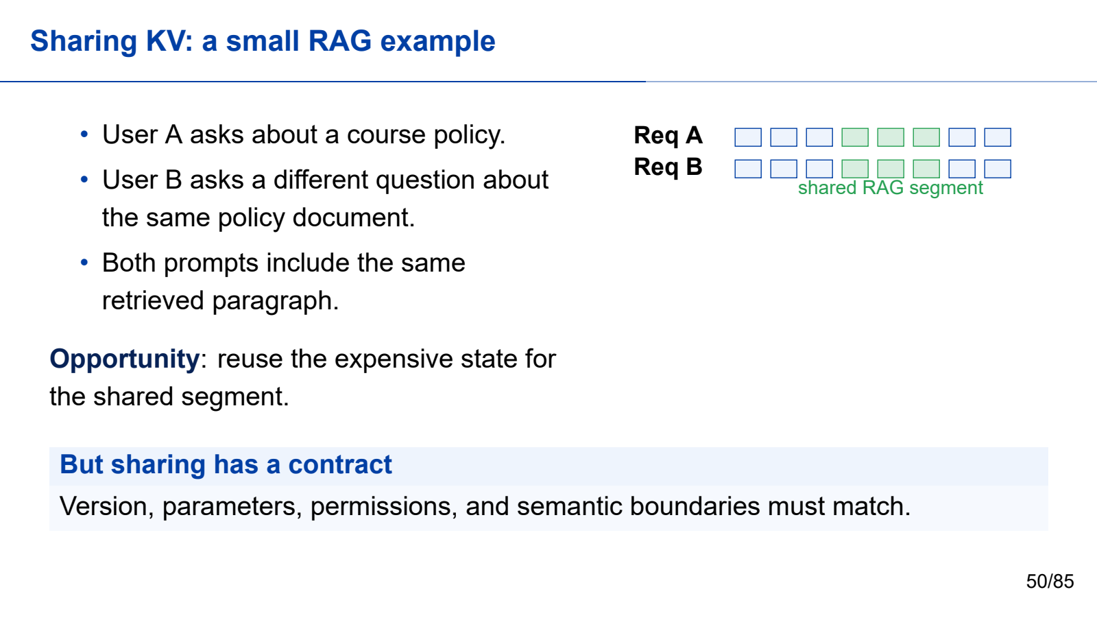
Notes:
Second half: engine to evidence. Keep the cumulative second-half teaching time within 70 minutes.
All required teaching content is visible on the slide. Use the worked steps and answer keys as written; personal examples are optional.
[Sources]
- Self-authored Beamer source: llm_inference_systems.tex
- Vaswani et al., "Attention Is All You Need," NeurIPS 2017.
- Yu et al., "Orca: A Distributed Serving System for Transformer-Based Generative Models," OSDI 2022.
- Kwon et al., "Efficient Memory Management for Large Language Model Serving with PagedAttention," SOSP 2023.
[/Sources]

Slide 51

Notes:
Second half: engine to evidence. Keep the cumulative second-half teaching time within 70 minutes.
All required teaching content is visible on the slide. Use the worked steps and answer keys as written; personal examples are optional.
[Sources]
- Self-authored Beamer source: llm_inference_systems.tex
- Vaswani et al., "Attention Is All You Need," NeurIPS 2017.
- Yu et al., "Orca: A Distributed Serving System for Transformer-Based Generative Models," OSDI 2022.
- Kwon et al., "Efficient Memory Management for Large Language Model Serving with PagedAttention," SOSP 2023.
[/Sources]

Slide 52
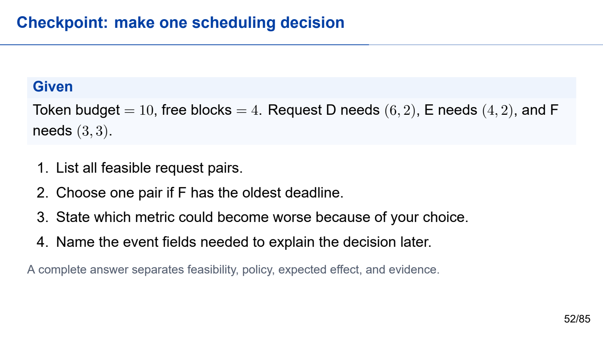
Notes:
Second half: engine to evidence. Keep the cumulative second-half teaching time within 70 minutes.
All required teaching content is visible on the slide. Use the worked steps and answer keys as written; personal examples are optional.
[Sources]
- Self-authored Beamer source: llm_inference_systems.tex
- Vaswani et al., "Attention Is All You Need," NeurIPS 2017.
- Yu et al., "Orca: A Distributed Serving System for Transformer-Based Generative Models," OSDI 2022.
- Kwon et al., "Efficient Memory Management for Large Language Model Serving with PagedAttention," SOSP 2023.
[/Sources]

Slide 53
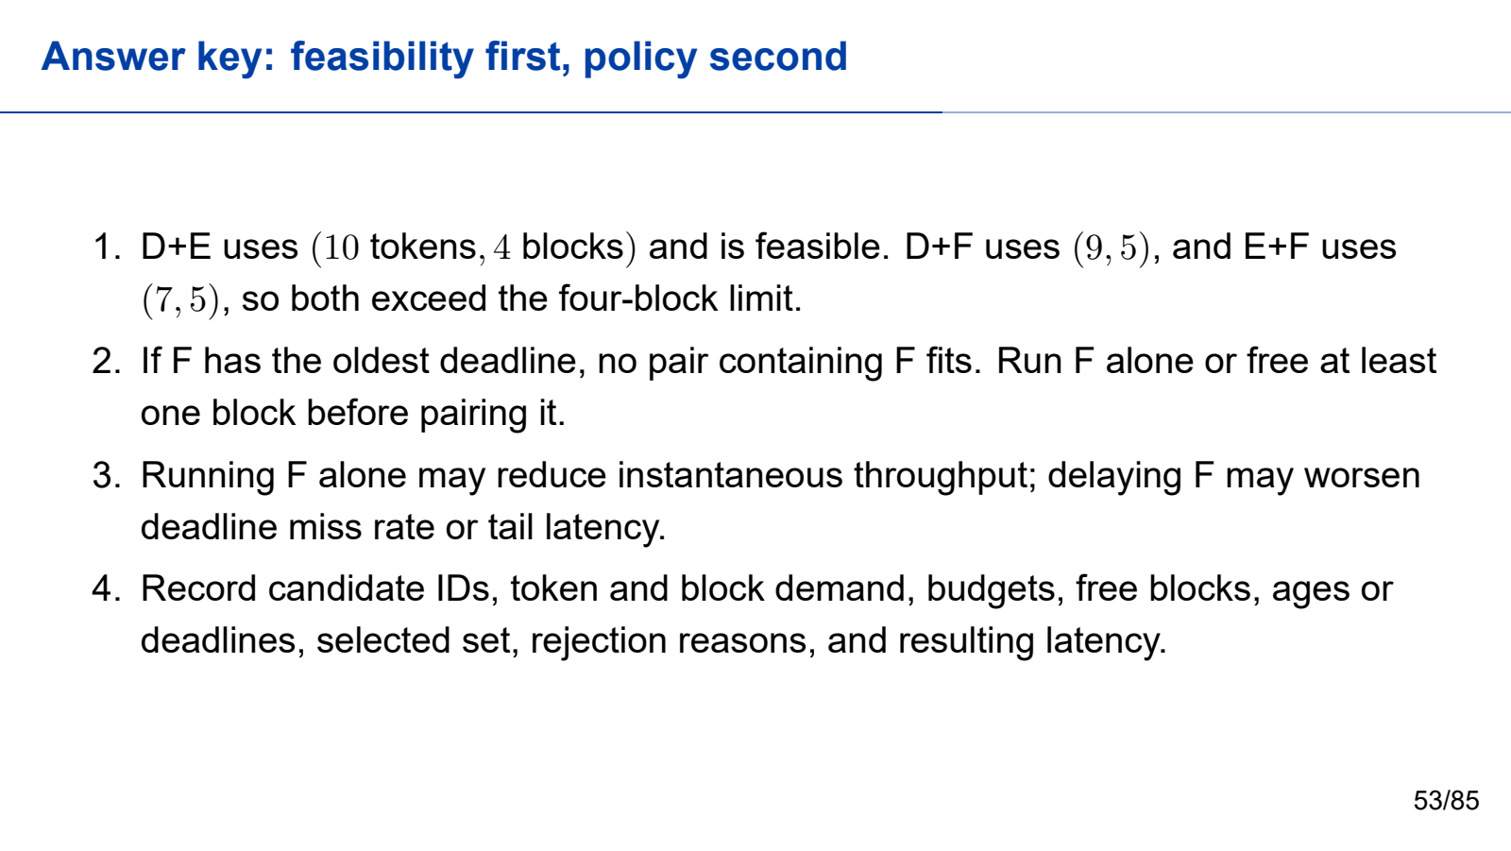
Notes:
Second half: engine to evidence. Keep the cumulative second-half teaching time within 70 minutes.
All required teaching content is visible on the slide. Use the worked steps and answer keys as written; personal examples are optional.
[Sources]
- Self-authored Beamer source: llm_inference_systems.tex
- Vaswani et al., "Attention Is All You Need," NeurIPS 2017.
- Yu et al., "Orca: A Distributed Serving System for Transformer-Based Generative Models," OSDI 2022.
- Kwon et al., "Efficient Memory Management for Large Language Model Serving with PagedAttention," SOSP 2023.
[/Sources]

Slide 54

Notes:
Second half: engine to evidence. Keep the cumulative second-half teaching time within 70 minutes.
All required teaching content is visible on the slide. Use the worked steps and answer keys as written; personal examples are optional.
[Sources]
- Self-authored Beamer source: llm_inference_systems.tex
- Vaswani et al., "Attention Is All You Need," NeurIPS 2017.
- Yu et al., "Orca: A Distributed Serving System for Transformer-Based Generative Models," OSDI 2022.
- Kwon et al., "Efficient Memory Management for Large Language Model Serving with PagedAttention," SOSP 2023.
[/Sources]

Slide 55
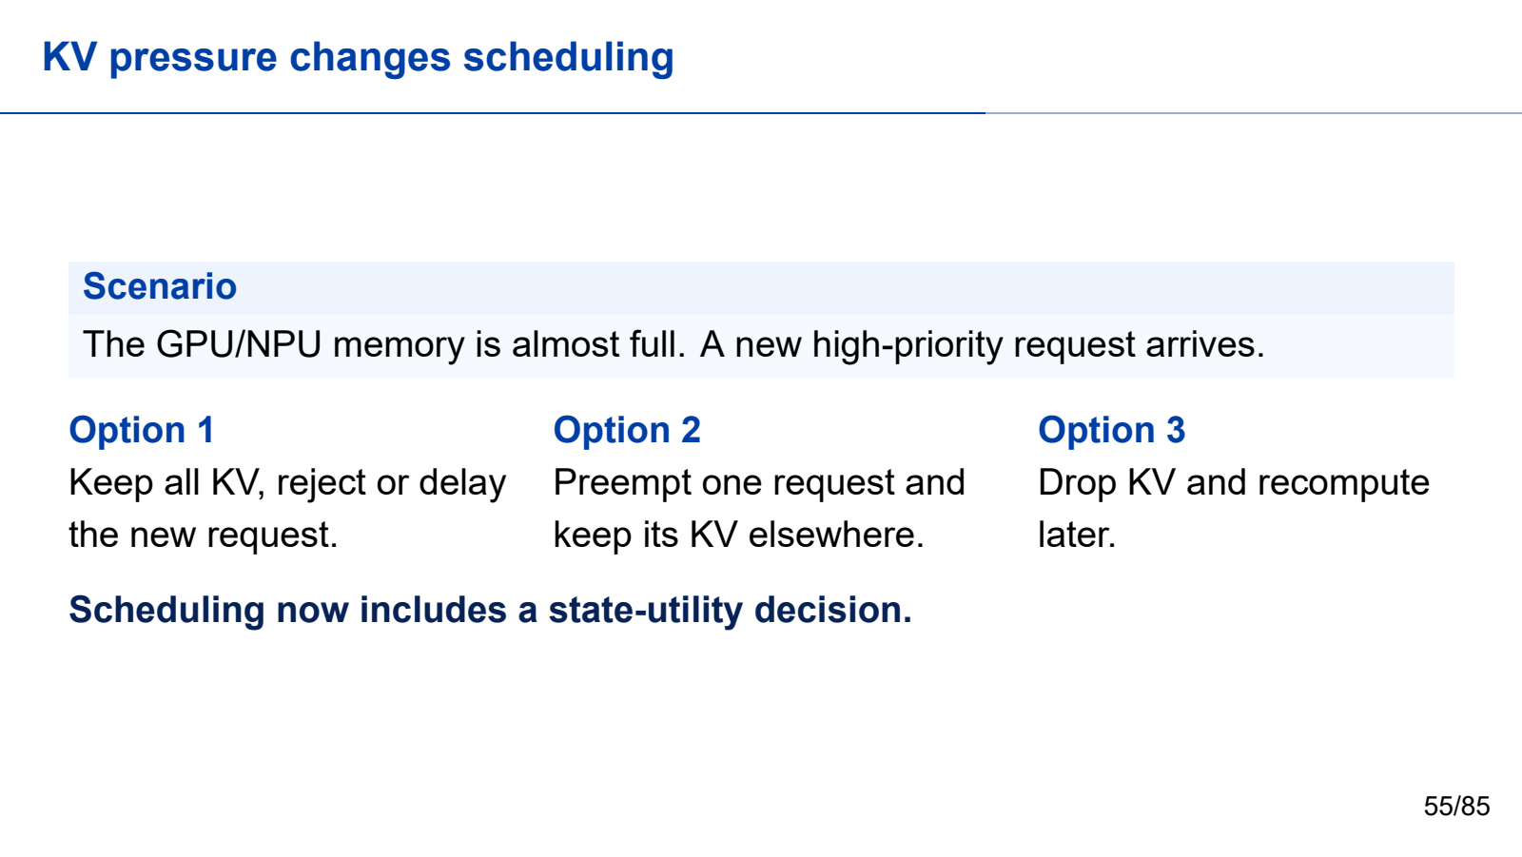
Notes:
Second half: engine to evidence. Keep the cumulative second-half teaching time within 70 minutes.
All required teaching content is visible on the slide. Use the worked steps and answer keys as written; personal examples are optional.
[Sources]
- Self-authored Beamer source: llm_inference_systems.tex
- Vaswani et al., "Attention Is All You Need," NeurIPS 2017.
- Yu et al., "Orca: A Distributed Serving System for Transformer-Based Generative Models," OSDI 2022.
- Kwon et al., "Efficient Memory Management for Large Language Model Serving with PagedAttention," SOSP 2023.
[/Sources]

Slide 56
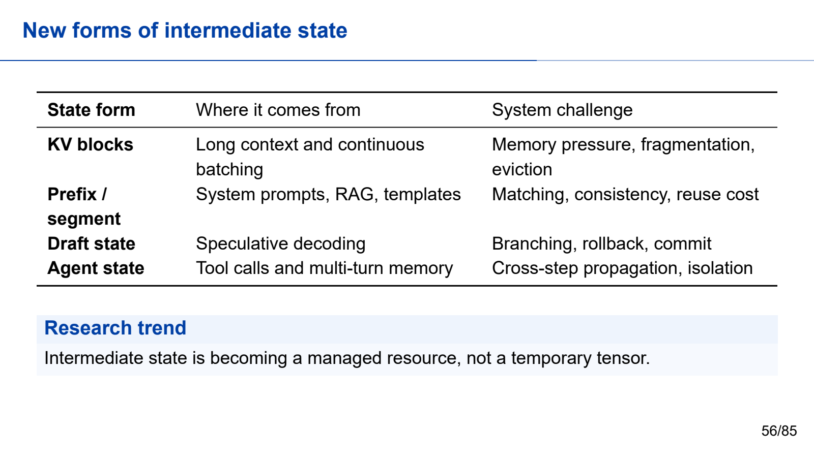
Notes:
Second half: engine to evidence. Keep the cumulative second-half teaching time within 70 minutes.
All required teaching content is visible on the slide. Use the worked steps and answer keys as written; personal examples are optional.
[Sources]
- Self-authored Beamer source: llm_inference_systems.tex
- Vaswani et al., "Attention Is All You Need," NeurIPS 2017.
- Yu et al., "Orca: A Distributed Serving System for Transformer-Based Generative Models," OSDI 2022.
- Kwon et al., "Efficient Memory Management for Large Language Model Serving with PagedAttention," SOSP 2023.
[/Sources]

Slide 57

Notes:
Second half: engine to evidence. Keep the cumulative second-half teaching time within 70 minutes.
All required teaching content is visible on the slide. Use the worked steps and answer keys as written; personal examples are optional.
[Sources]
- Self-authored Beamer source: llm_inference_systems.tex
- Vaswani et al., "Attention Is All You Need," NeurIPS 2017.
- Yu et al., "Orca: A Distributed Serving System for Transformer-Based Generative Models," OSDI 2022.
- Kwon et al., "Efficient Memory Management for Large Language Model Serving with PagedAttention," SOSP 2023.
[/Sources]

Slide 58

Notes:
Second half: engine to evidence. Keep the cumulative second-half teaching time within 70 minutes.
All required teaching content is visible on the slide. Use the worked steps and answer keys as written; personal examples are optional.
[Sources]
- Self-authored Beamer source: llm_inference_systems.tex
- Vaswani et al., "Attention Is All You Need," NeurIPS 2017.
- Yu et al., "Orca: A Distributed Serving System for Transformer-Based Generative Models," OSDI 2022.
- Kwon et al., "Efficient Memory Management for Large Language Model Serving with PagedAttention," SOSP 2023.
[/Sources]

Slide 59

Notes:
Second half: engine to evidence. Keep the cumulative second-half teaching time within 70 minutes.
All required teaching content is visible on the slide. Use the worked steps and answer keys as written; personal examples are optional.
[Sources]
- Self-authored Beamer source: llm_inference_systems.tex
- Vaswani et al., "Attention Is All You Need," NeurIPS 2017.
- Yu et al., "Orca: A Distributed Serving System for Transformer-Based Generative Models," OSDI 2022.
- Kwon et al., "Efficient Memory Management for Large Language Model Serving with PagedAttention," SOSP 2023.
[/Sources]

Slide 60
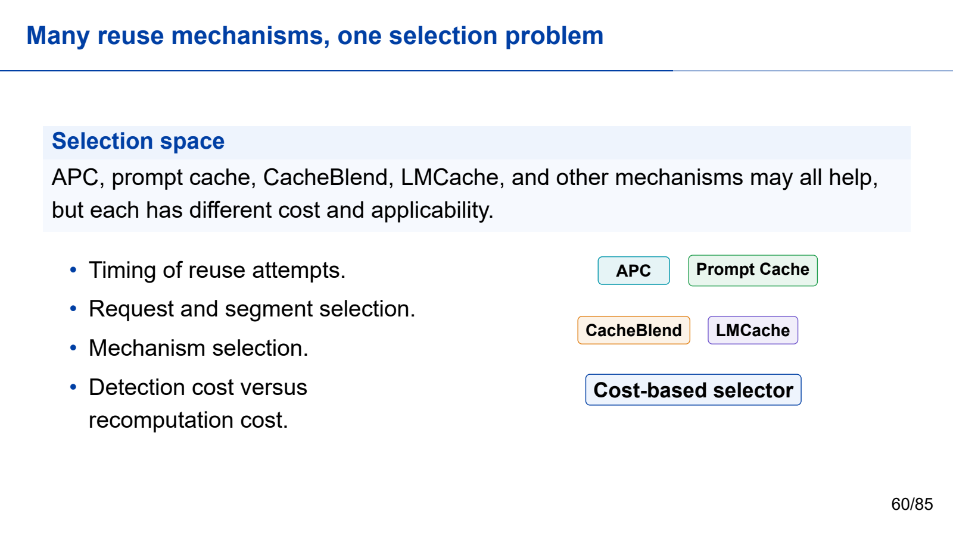
Notes:
Second half: engine to evidence. Keep the cumulative second-half teaching time within 70 minutes.
All required teaching content is visible on the slide. Use the worked steps and answer keys as written; personal examples are optional.
[Sources]
- Self-authored Beamer source: llm_inference_systems.tex
- Vaswani et al., "Attention Is All You Need," NeurIPS 2017.
- Yu et al., "Orca: A Distributed Serving System for Transformer-Based Generative Models," OSDI 2022.
- Kwon et al., "Efficient Memory Management for Large Language Model Serving with PagedAttention," SOSP 2023.
[/Sources]

Slide 61
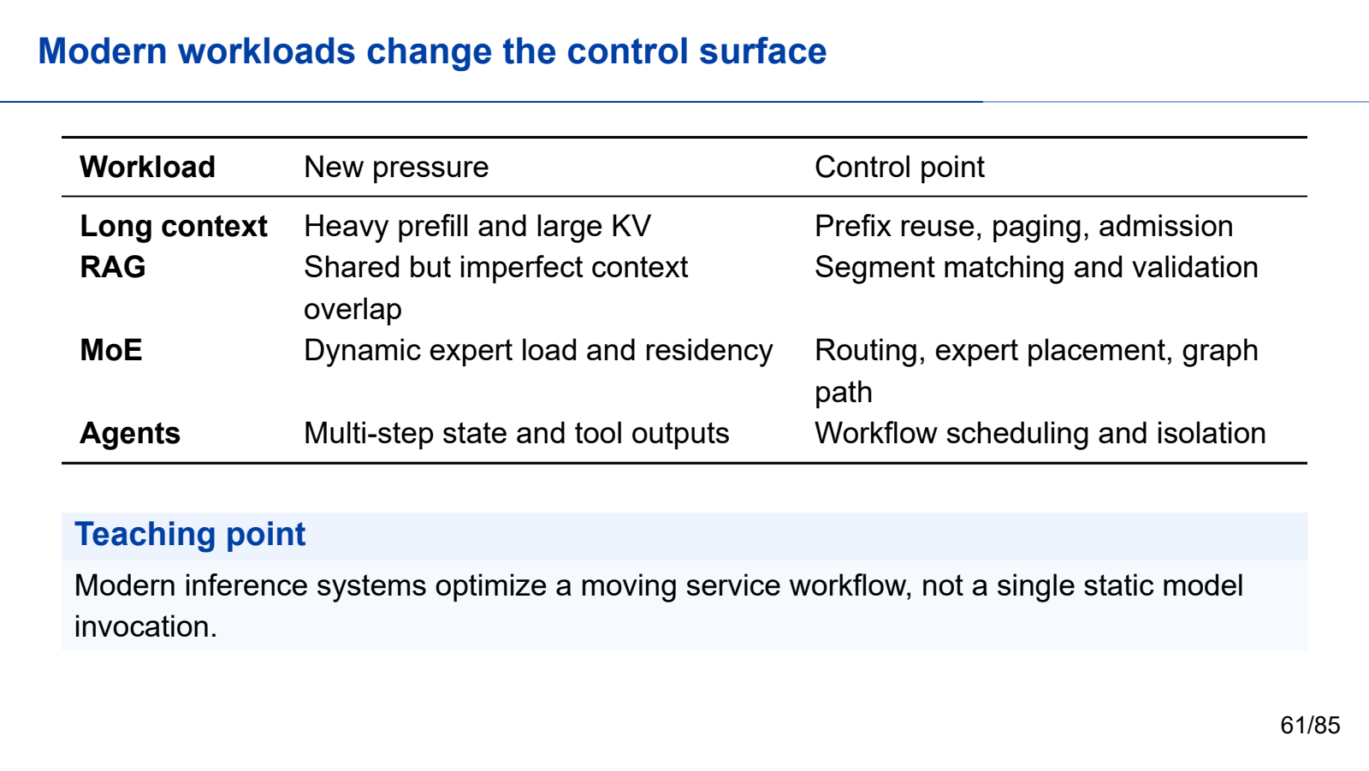
Notes:
Second half: engine to evidence. Keep the cumulative second-half teaching time within 70 minutes.
All required teaching content is visible on the slide. Use the worked steps and answer keys as written; personal examples are optional.
[Sources]
- Self-authored Beamer source: llm_inference_systems.tex
- Vaswani et al., "Attention Is All You Need," NeurIPS 2017.
- Yu et al., "Orca: A Distributed Serving System for Transformer-Based Generative Models," OSDI 2022.
- Kwon et al., "Efficient Memory Management for Large Language Model Serving with PagedAttention," SOSP 2023.
[/Sources]

Slide 62
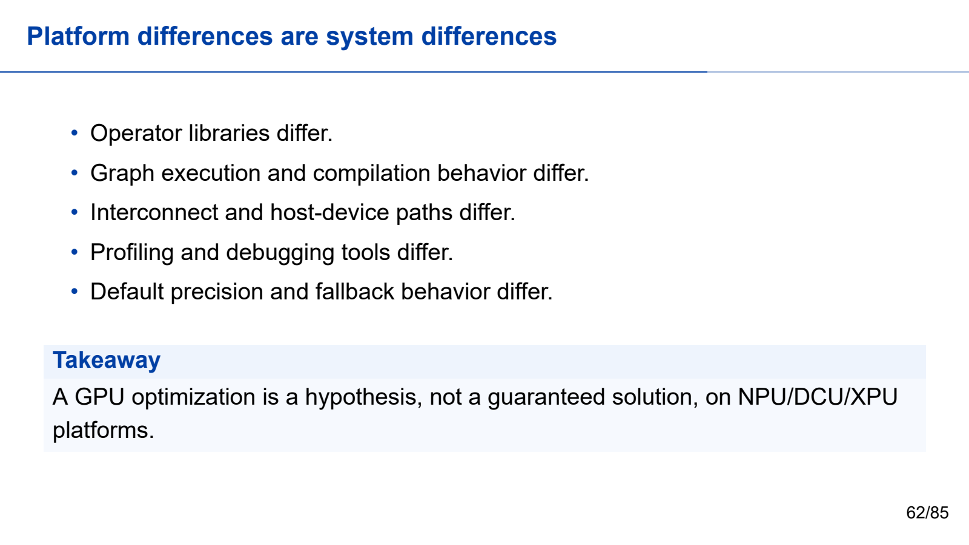
Notes:
Second half: engine to evidence. Keep the cumulative second-half teaching time within 70 minutes.
All required teaching content is visible on the slide. Use the worked steps and answer keys as written; personal examples are optional.
[Sources]
- Self-authored Beamer source: llm_inference_systems.tex
- Vaswani et al., "Attention Is All You Need," NeurIPS 2017.
- Yu et al., "Orca: A Distributed Serving System for Transformer-Based Generative Models," OSDI 2022.
- Kwon et al., "Efficient Memory Management for Large Language Model Serving with PagedAttention," SOSP 2023.
[/Sources]

Slide 63
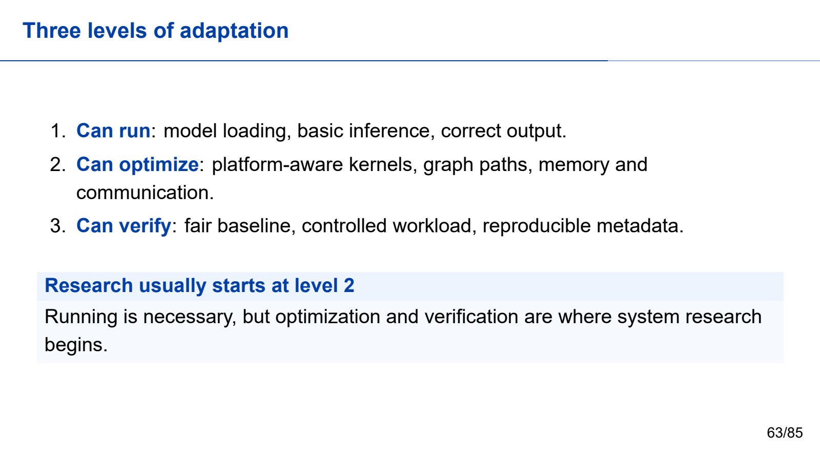
Notes:
Second half: engine to evidence. Keep the cumulative second-half teaching time within 70 minutes.
All required teaching content is visible on the slide. Use the worked steps and answer keys as written; personal examples are optional.
[Sources]
- Self-authored Beamer source: llm_inference_systems.tex
- Vaswani et al., "Attention Is All You Need," NeurIPS 2017.
- Yu et al., "Orca: A Distributed Serving System for Transformer-Based Generative Models," OSDI 2022.
- Kwon et al., "Efficient Memory Management for Large Language Model Serving with PagedAttention," SOSP 2023.
[/Sources]

Slide 64
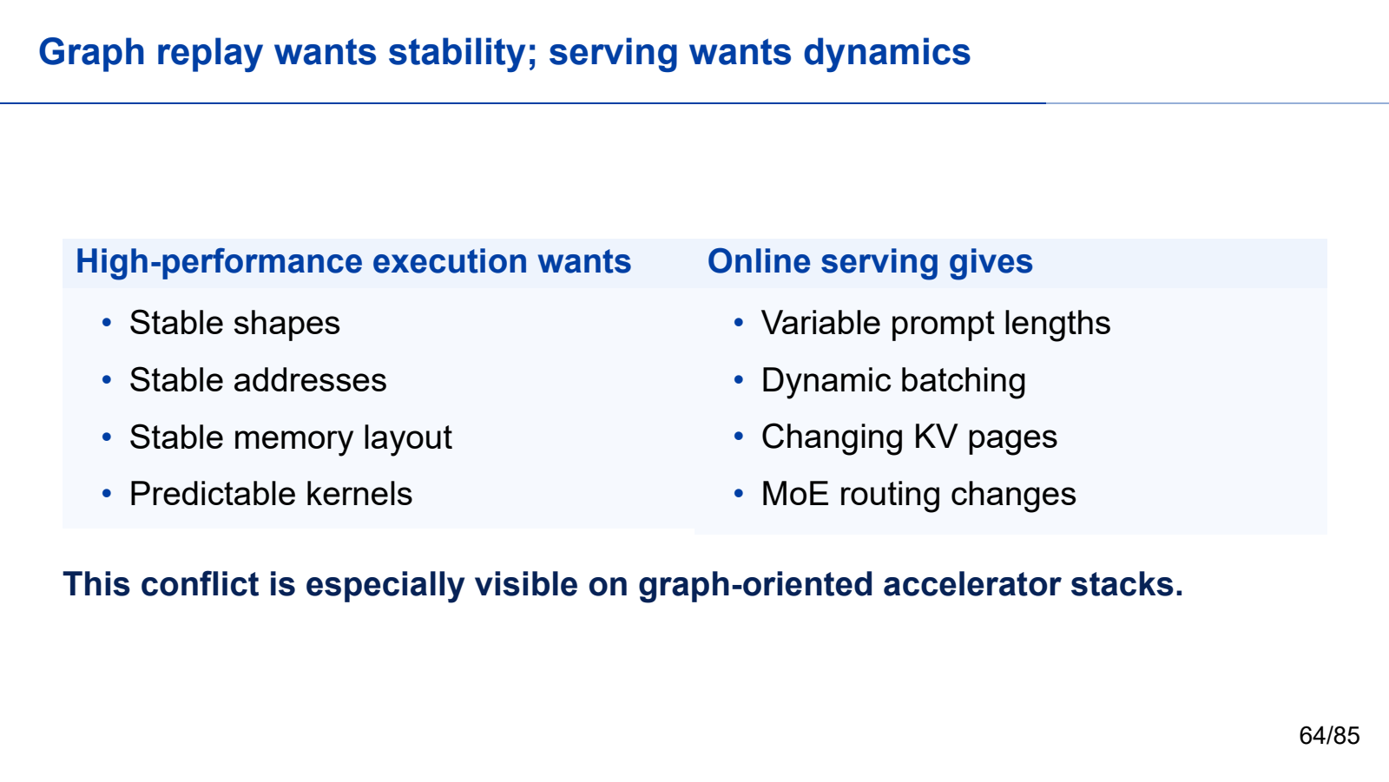
Notes:
Second half: engine to evidence. Keep the cumulative second-half teaching time within 70 minutes.
All required teaching content is visible on the slide. Use the worked steps and answer keys as written; personal examples are optional.
[Sources]
- Self-authored Beamer source: llm_inference_systems.tex
- Vaswani et al., "Attention Is All You Need," NeurIPS 2017.
- Yu et al., "Orca: A Distributed Serving System for Transformer-Based Generative Models," OSDI 2022.
- Kwon et al., "Efficient Memory Management for Large Language Model Serving with PagedAttention," SOSP 2023.
[/Sources]

Slide 65

Notes:
Second half: engine to evidence. Keep the cumulative second-half teaching time within 70 minutes.
All required teaching content is visible on the slide. Use the worked steps and answer keys as written; personal examples are optional.
[Sources]
- Self-authored Beamer source: llm_inference_systems.tex
- Vaswani et al., "Attention Is All You Need," NeurIPS 2017.
- Yu et al., "Orca: A Distributed Serving System for Transformer-Based Generative Models," OSDI 2022.
- Kwon et al., "Efficient Memory Management for Large Language Model Serving with PagedAttention," SOSP 2023.
[/Sources]

Slide 66

Notes:
Second half: engine to evidence. Keep the cumulative second-half teaching time within 70 minutes.
All required teaching content is visible on the slide. Use the worked steps and answer keys as written; personal examples are optional.
[Sources]
- Self-authored Beamer source: llm_inference_systems.tex
- Vaswani et al., "Attention Is All You Need," NeurIPS 2017.
- Yu et al., "Orca: A Distributed Serving System for Transformer-Based Generative Models," OSDI 2022.
- Kwon et al., "Efficient Memory Management for Large Language Model Serving with PagedAttention," SOSP 2023.
[/Sources]

Slide 67

Notes:
Second half: engine to evidence. Keep the cumulative second-half teaching time within 70 minutes.
All required teaching content is visible on the slide. Use the worked steps and answer keys as written; personal examples are optional.
[Sources]
- Self-authored Beamer source: llm_inference_systems.tex
- Vaswani et al., "Attention Is All You Need," NeurIPS 2017.
- Yu et al., "Orca: A Distributed Serving System for Transformer-Based Generative Models," OSDI 2022.
- Kwon et al., "Efficient Memory Management for Large Language Model Serving with PagedAttention," SOSP 2023.
[/Sources]

Slide 68
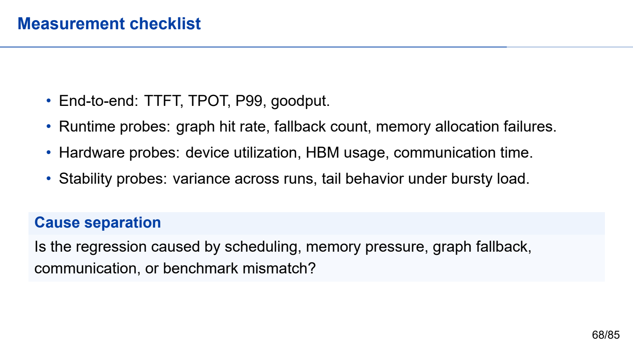
Notes:
Second half: engine to evidence. Keep the cumulative second-half teaching time within 70 minutes.
All required teaching content is visible on the slide. Use the worked steps and answer keys as written; personal examples are optional.
[Sources]
- Self-authored Beamer source: llm_inference_systems.tex
- Vaswani et al., "Attention Is All You Need," NeurIPS 2017.
- Yu et al., "Orca: A Distributed Serving System for Transformer-Based Generative Models," OSDI 2022.
- Kwon et al., "Efficient Memory Management for Large Language Model Serving with PagedAttention," SOSP 2023.
[/Sources]

Slide 69
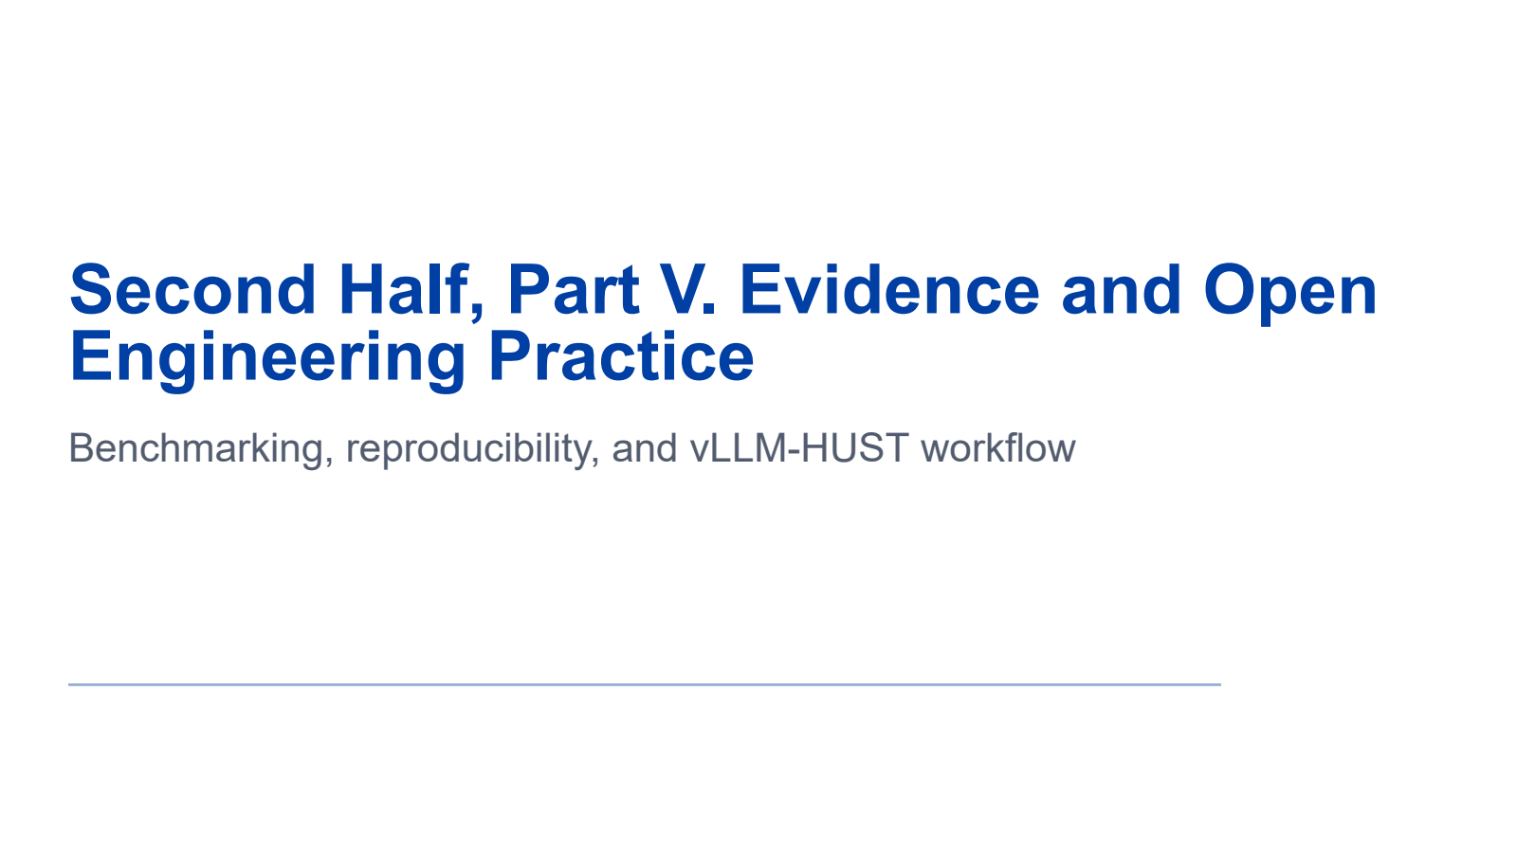
Notes:
Second half: engine to evidence. Keep the cumulative second-half teaching time within 70 minutes.
All required teaching content is visible on the slide. Use the worked steps and answer keys as written; personal examples are optional.
[Sources]
- Self-authored Beamer source: llm_inference_systems.tex
- Vaswani et al., "Attention Is All You Need," NeurIPS 2017.
- Yu et al., "Orca: A Distributed Serving System for Transformer-Based Generative Models," OSDI 2022.
- Kwon et al., "Efficient Memory Management for Large Language Model Serving with PagedAttention," SOSP 2023.
[/Sources]

Slide 70

Notes:
Second half: engine to evidence. Keep the cumulative second-half teaching time within 70 minutes.
All required teaching content is visible on the slide. Use the worked steps and answer keys as written; personal examples are optional.
[Sources]
- Self-authored Beamer source: llm_inference_systems.tex
- Vaswani et al., "Attention Is All You Need," NeurIPS 2017.
- Yu et al., "Orca: A Distributed Serving System for Transformer-Based Generative Models," OSDI 2022.
- Kwon et al., "Efficient Memory Management for Large Language Model Serving with PagedAttention," SOSP 2023.
[/Sources]

Slide 71

Notes:
Second half: engine to evidence. Keep the cumulative second-half teaching time within 70 minutes.
All required teaching content is visible on the slide. Use the worked steps and answer keys as written; personal examples are optional.
[Sources]
- Self-authored Beamer source: llm_inference_systems.tex
- Vaswani et al., "Attention Is All You Need," NeurIPS 2017.
- Yu et al., "Orca: A Distributed Serving System for Transformer-Based Generative Models," OSDI 2022.
- Kwon et al., "Efficient Memory Management for Large Language Model Serving with PagedAttention," SOSP 2023.
[/Sources]

Slide 72
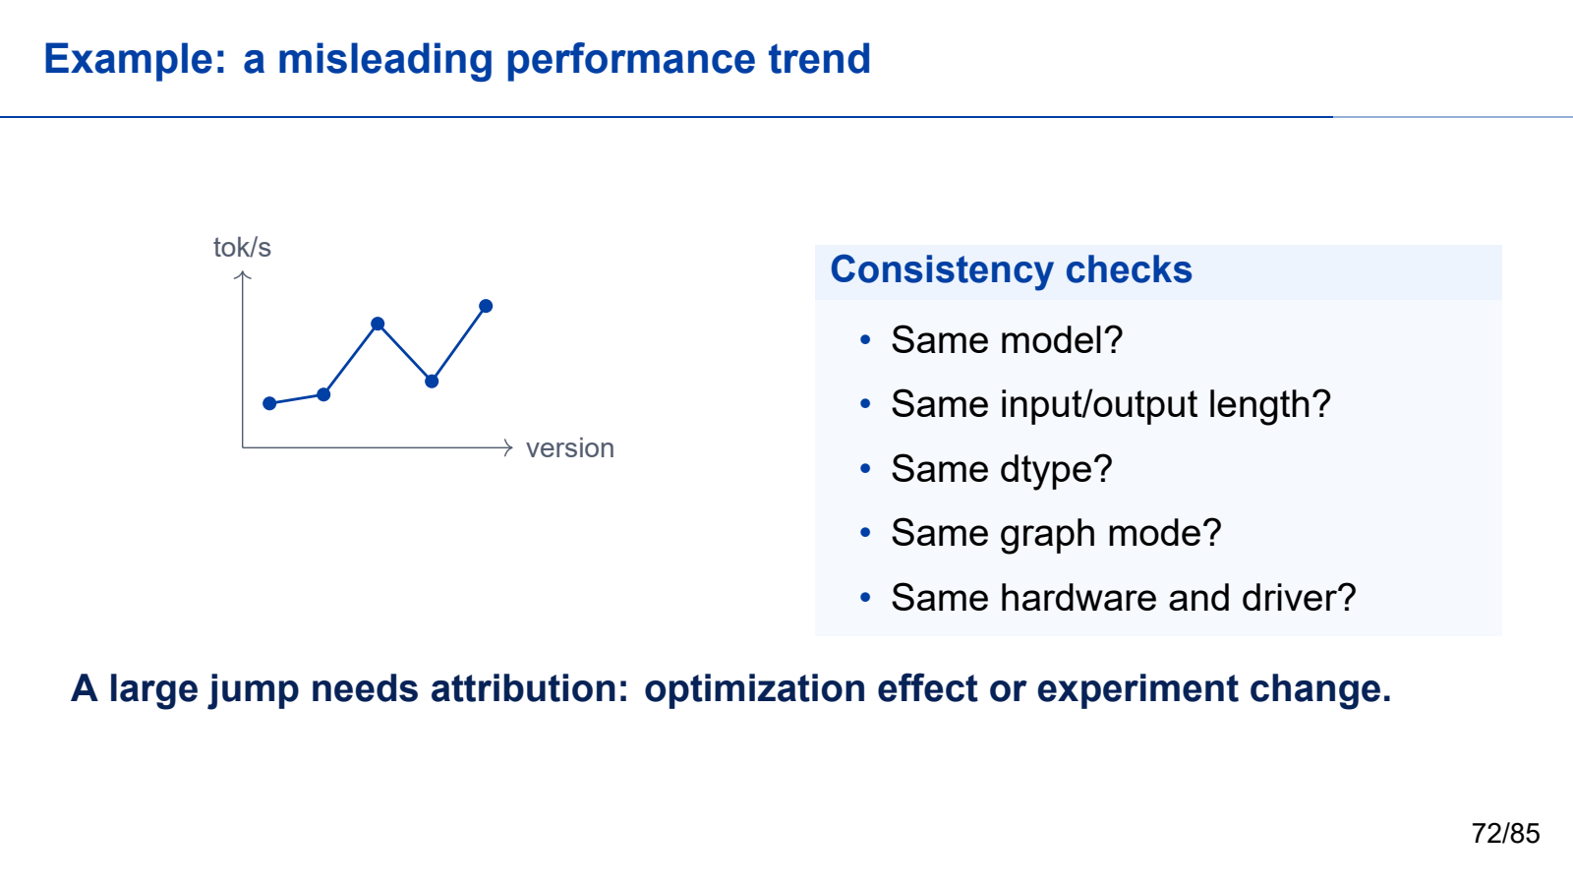
Notes:
Second half: engine to evidence. Keep the cumulative second-half teaching time within 70 minutes.
All required teaching content is visible on the slide. Use the worked steps and answer keys as written; personal examples are optional.
[Sources]
- Self-authored Beamer source: llm_inference_systems.tex
- Vaswani et al., "Attention Is All You Need," NeurIPS 2017.
- Yu et al., "Orca: A Distributed Serving System for Transformer-Based Generative Models," OSDI 2022.
- Kwon et al., "Efficient Memory Management for Large Language Model Serving with PagedAttention," SOSP 2023.
[/Sources]

Slide 73

Notes:
Second half: engine to evidence. Keep the cumulative second-half teaching time within 70 minutes.
All required teaching content is visible on the slide. Use the worked steps and answer keys as written; personal examples are optional.
[Sources]
- Self-authored Beamer source: llm_inference_systems.tex
- Vaswani et al., "Attention Is All You Need," NeurIPS 2017.
- Yu et al., "Orca: A Distributed Serving System for Transformer-Based Generative Models," OSDI 2022.
- Kwon et al., "Efficient Memory Management for Large Language Model Serving with PagedAttention," SOSP 2023.
[/Sources]

Slide 74
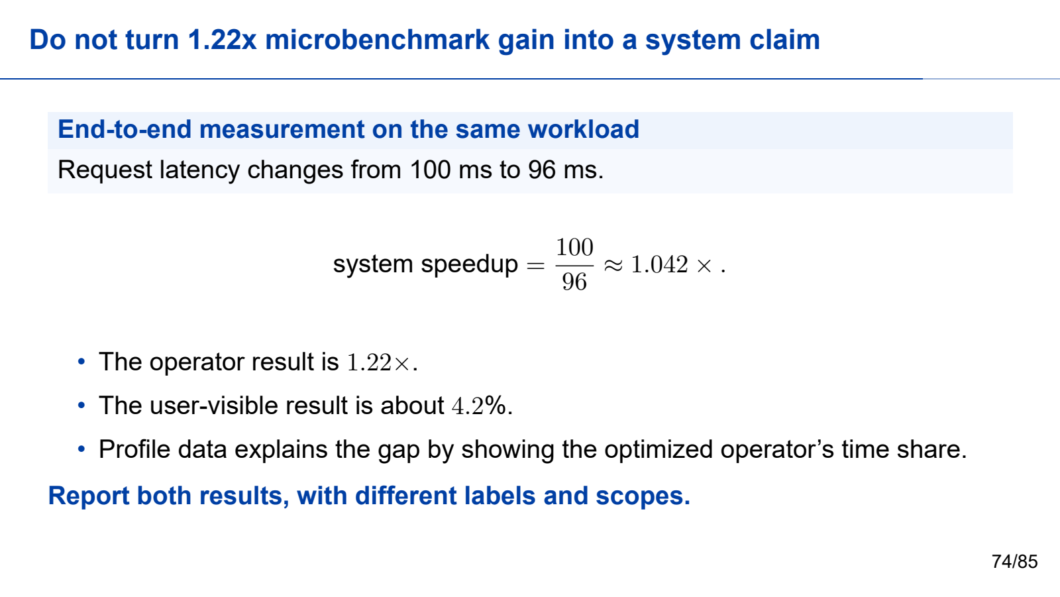
Notes:
Second half: engine to evidence. Keep the cumulative second-half teaching time within 70 minutes.
All required teaching content is visible on the slide. Use the worked steps and answer keys as written; personal examples are optional.
[Sources]
- Self-authored Beamer source: llm_inference_systems.tex
- Vaswani et al., "Attention Is All You Need," NeurIPS 2017.
- Yu et al., "Orca: A Distributed Serving System for Transformer-Based Generative Models," OSDI 2022.
- Kwon et al., "Efficient Memory Management for Large Language Model Serving with PagedAttention," SOSP 2023.
[/Sources]

Slide 75

Notes:
Second half: engine to evidence. Keep the cumulative second-half teaching time within 70 minutes.
All required teaching content is visible on the slide. Use the worked steps and answer keys as written; personal examples are optional.
[Sources]
- Self-authored Beamer source: llm_inference_systems.tex
- Vaswani et al., "Attention Is All You Need," NeurIPS 2017.
- Yu et al., "Orca: A Distributed Serving System for Transformer-Based Generative Models," OSDI 2022.
- Kwon et al., "Efficient Memory Management for Large Language Model Serving with PagedAttention," SOSP 2023.
[/Sources]

Slide 76
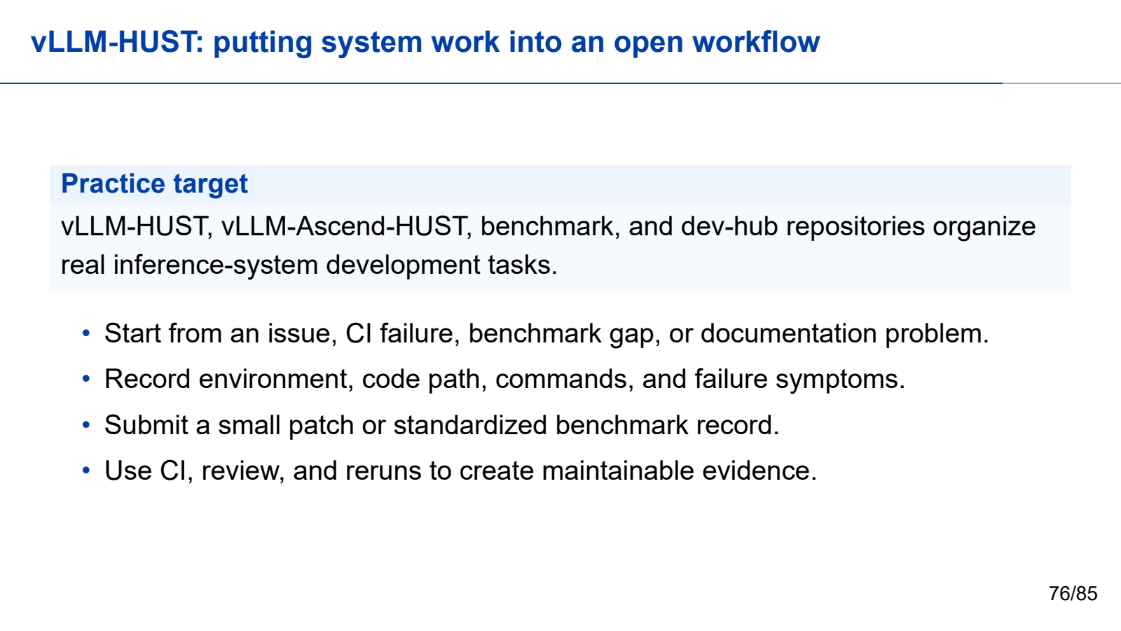
Notes:
Second half: engine to evidence. Keep the cumulative second-half teaching time within 70 minutes.
All required teaching content is visible on the slide. Use the worked steps and answer keys as written; personal examples are optional.
[Sources]
- Self-authored Beamer source: llm_inference_systems.tex
- Vaswani et al., "Attention Is All You Need," NeurIPS 2017.
- Yu et al., "Orca: A Distributed Serving System for Transformer-Based Generative Models," OSDI 2022.
- Kwon et al., "Efficient Memory Management for Large Language Model Serving with PagedAttention," SOSP 2023.
[/Sources]

Slide 77
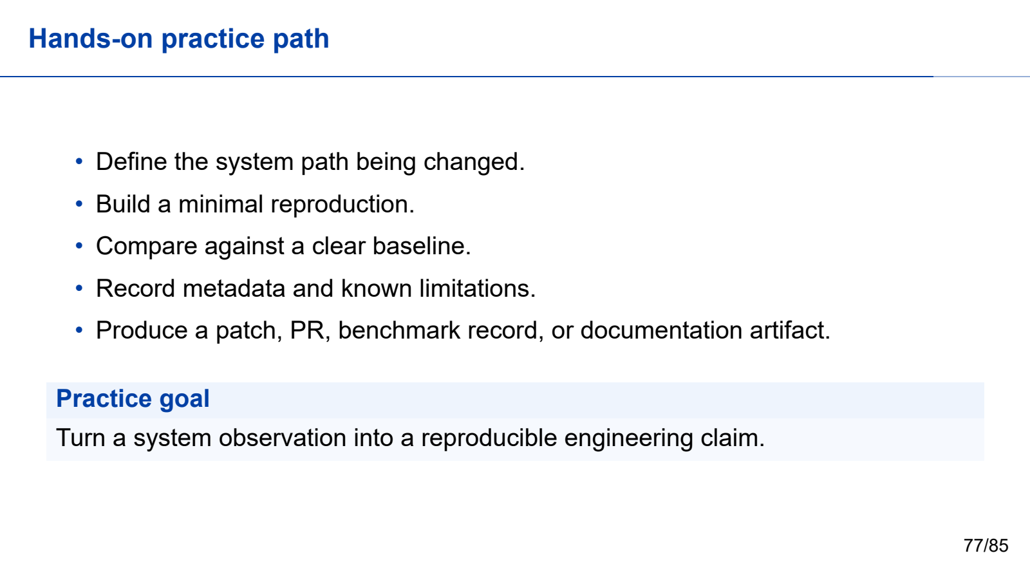
Notes:
Second half: engine to evidence. Keep the cumulative second-half teaching time within 70 minutes.
All required teaching content is visible on the slide. Use the worked steps and answer keys as written; personal examples are optional.
[Sources]
- Self-authored Beamer source: llm_inference_systems.tex
- Vaswani et al., "Attention Is All You Need," NeurIPS 2017.
- Yu et al., "Orca: A Distributed Serving System for Transformer-Based Generative Models," OSDI 2022.
- Kwon et al., "Efficient Memory Management for Large Language Model Serving with PagedAttention," SOSP 2023.
[/Sources]

Slide 78

Notes:
Second half: engine to evidence. Keep the cumulative second-half teaching time within 70 minutes.
All required teaching content is visible on the slide. Use the worked steps and answer keys as written; personal examples are optional.
[Sources]
- Self-authored Beamer source: llm_inference_systems.tex
- Vaswani et al., "Attention Is All You Need," NeurIPS 2017.
- Yu et al., "Orca: A Distributed Serving System for Transformer-Based Generative Models," OSDI 2022.
- Kwon et al., "Efficient Memory Management for Large Language Model Serving with PagedAttention," SOSP 2023.
[/Sources]

Slide 79
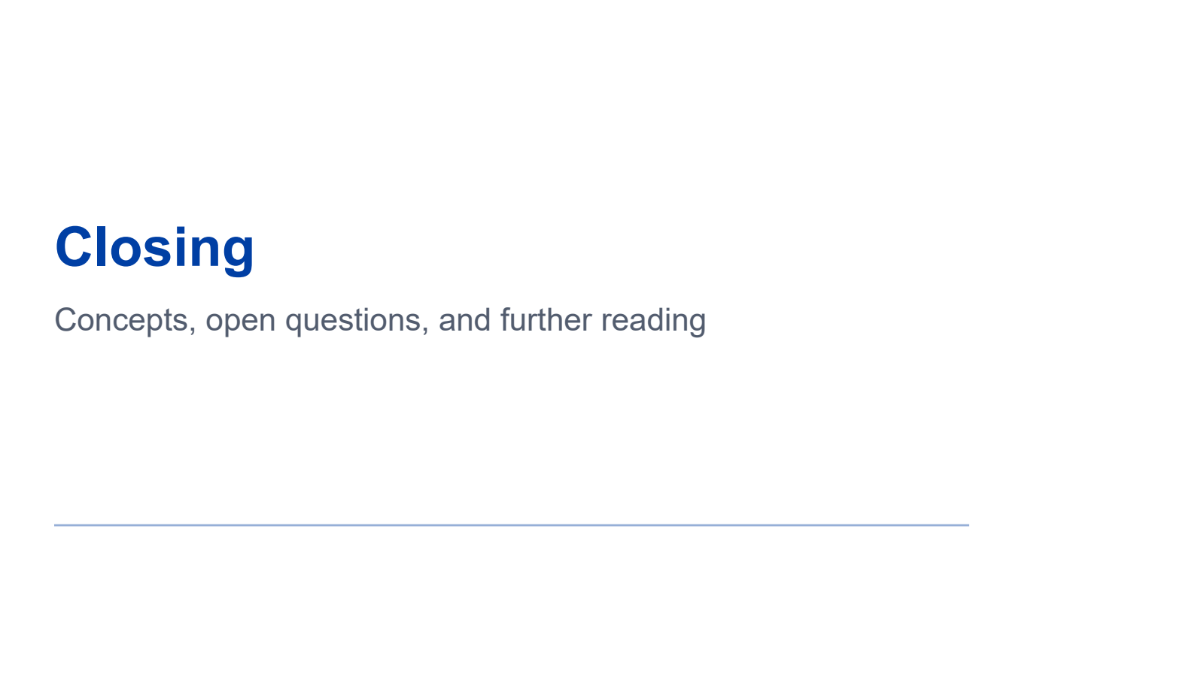
Notes:
Second half: engine to evidence. Keep the cumulative second-half teaching time within 70 minutes.
All required teaching content is visible on the slide. Use the worked steps and answer keys as written; personal examples are optional.
[Sources]
- Self-authored Beamer source: llm_inference_systems.tex
- Vaswani et al., "Attention Is All You Need," NeurIPS 2017.
- Yu et al., "Orca: A Distributed Serving System for Transformer-Based Generative Models," OSDI 2022.
- Kwon et al., "Efficient Memory Management for Large Language Model Serving with PagedAttention," SOSP 2023.
[/Sources]

Slide 80
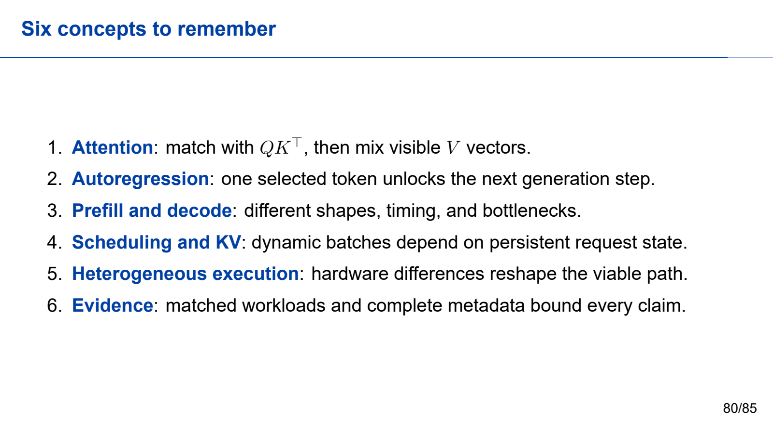
Notes:
Second half: engine to evidence. Keep the cumulative second-half teaching time within 70 minutes.
All required teaching content is visible on the slide. Use the worked steps and answer keys as written; personal examples are optional.
[Sources]
- Self-authored Beamer source: llm_inference_systems.tex
- Vaswani et al., "Attention Is All You Need," NeurIPS 2017.
- Yu et al., "Orca: A Distributed Serving System for Transformer-Based Generative Models," OSDI 2022.
- Kwon et al., "Efficient Memory Management for Large Language Model Serving with PagedAttention," SOSP 2023.
[/Sources]

Slide 81
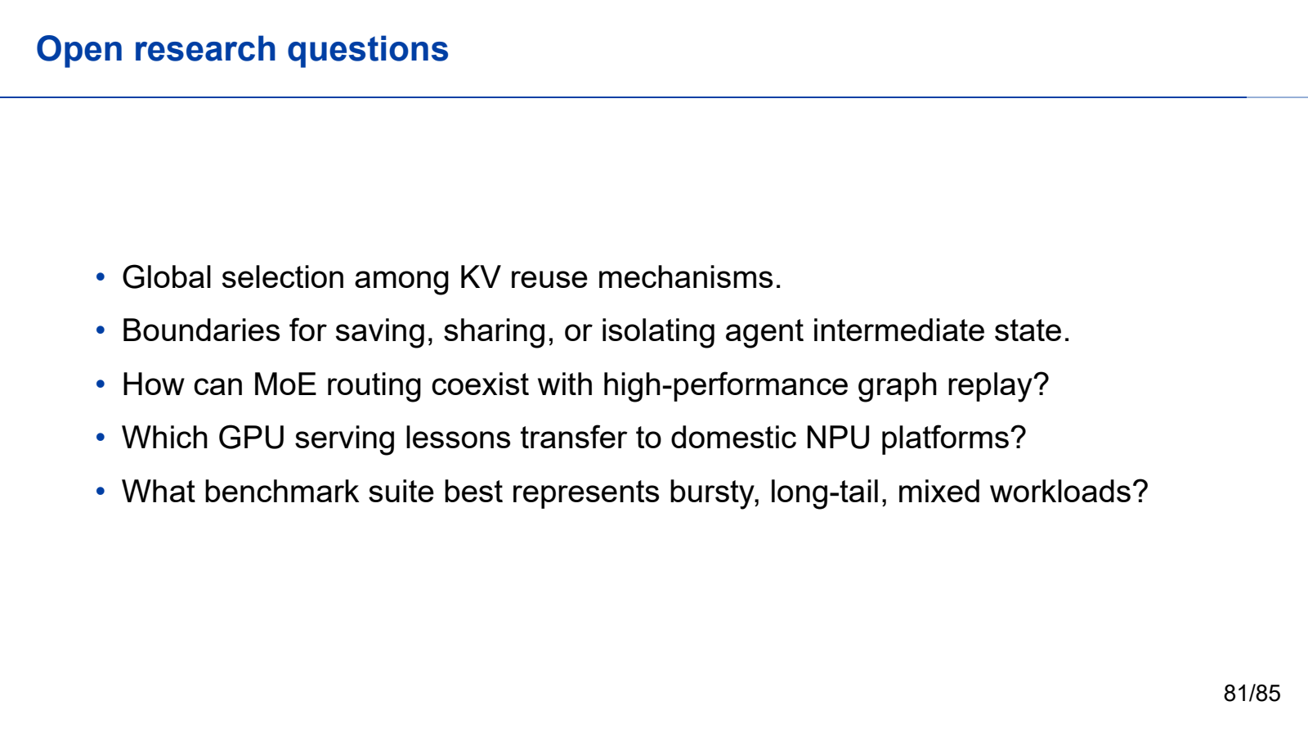
Notes:
Second half: engine to evidence. Keep the cumulative second-half teaching time within 70 minutes.
All required teaching content is visible on the slide. Use the worked steps and answer keys as written; personal examples are optional.
[Sources]
- Self-authored Beamer source: llm_inference_systems.tex
- Vaswani et al., "Attention Is All You Need," NeurIPS 2017.
- Yu et al., "Orca: A Distributed Serving System for Transformer-Based Generative Models," OSDI 2022.
- Kwon et al., "Efficient Memory Management for Large Language Model Serving with PagedAttention," SOSP 2023.
[/Sources]

Slide 82
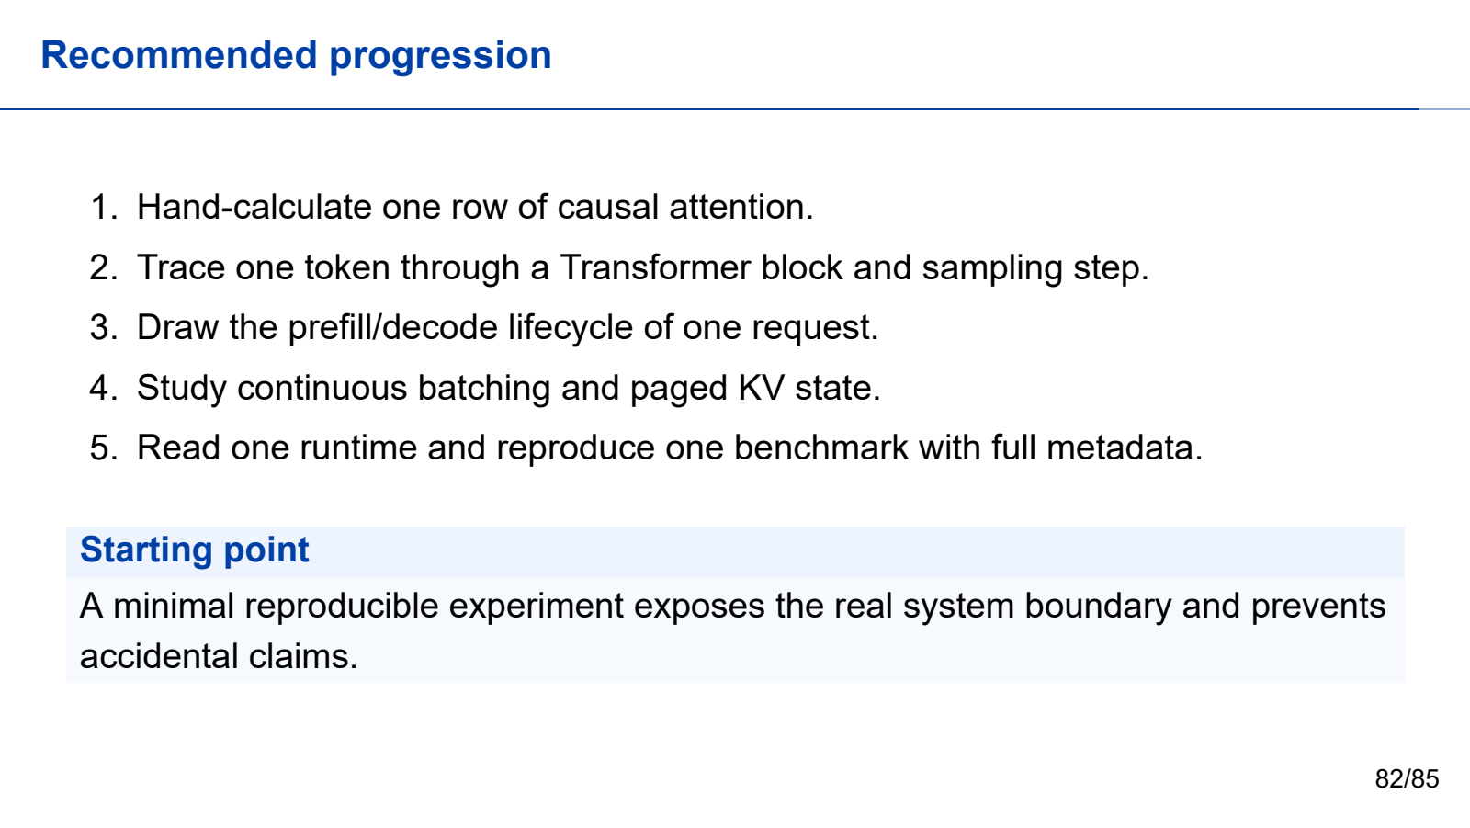
Notes:
Second half: engine to evidence. Keep the cumulative second-half teaching time within 70 minutes.
All required teaching content is visible on the slide. Use the worked steps and answer keys as written; personal examples are optional.
[Sources]
- Self-authored Beamer source: llm_inference_systems.tex
- Vaswani et al., "Attention Is All You Need," NeurIPS 2017.
- Yu et al., "Orca: A Distributed Serving System for Transformer-Based Generative Models," OSDI 2022.
- Kwon et al., "Efficient Memory Management for Large Language Model Serving with PagedAttention," SOSP 2023.
[/Sources]

Slide 83

Notes:
Second half: engine to evidence. Keep the cumulative second-half teaching time within 70 minutes.
All required teaching content is visible on the slide. Use the worked steps and answer keys as written; personal examples are optional.
[Sources]
- Self-authored Beamer source: llm_inference_systems.tex
- Vaswani et al., "Attention Is All You Need," NeurIPS 2017.
- Yu et al., "Orca: A Distributed Serving System for Transformer-Based Generative Models," OSDI 2022.
- Kwon et al., "Efficient Memory Management for Large Language Model Serving with PagedAttention," SOSP 2023.
[/Sources]

Slide 84

Notes:
Second half: engine to evidence. Keep the cumulative second-half teaching time within 70 minutes.
All required teaching content is visible on the slide. Use the worked steps and answer keys as written; personal examples are optional.
[Sources]
- Self-authored Beamer source: llm_inference_systems.tex
- Vaswani et al., "Attention Is All You Need," NeurIPS 2017.
- Yu et al., "Orca: A Distributed Serving System for Transformer-Based Generative Models," OSDI 2022.
- Kwon et al., "Efficient Memory Management for Large Language Model Serving with PagedAttention," SOSP 2023.
[/Sources]

Slide 85
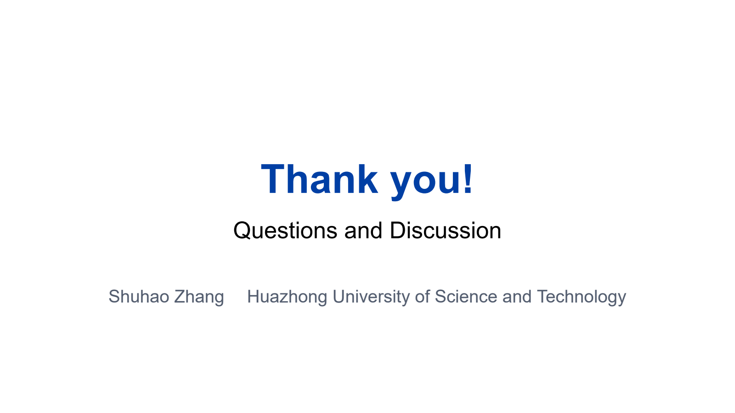
Notes:
Second half: engine to evidence. Keep the cumulative second-half teaching time within 70 minutes.
All required teaching content is visible on the slide. Use the worked steps and answer keys as written; personal examples are optional.
[Sources]
- Self-authored Beamer source: llm_inference_systems.tex
- Vaswani et al., "Attention Is All You Need," NeurIPS 2017.
- Yu et al., "Orca: A Distributed Serving System for Transformer-Based Generative Models," OSDI 2022.
- Kwon et al., "Efficient Memory Management for Large Language Model Serving with PagedAttention," SOSP 2023.
[/Sources]

