Slide 2
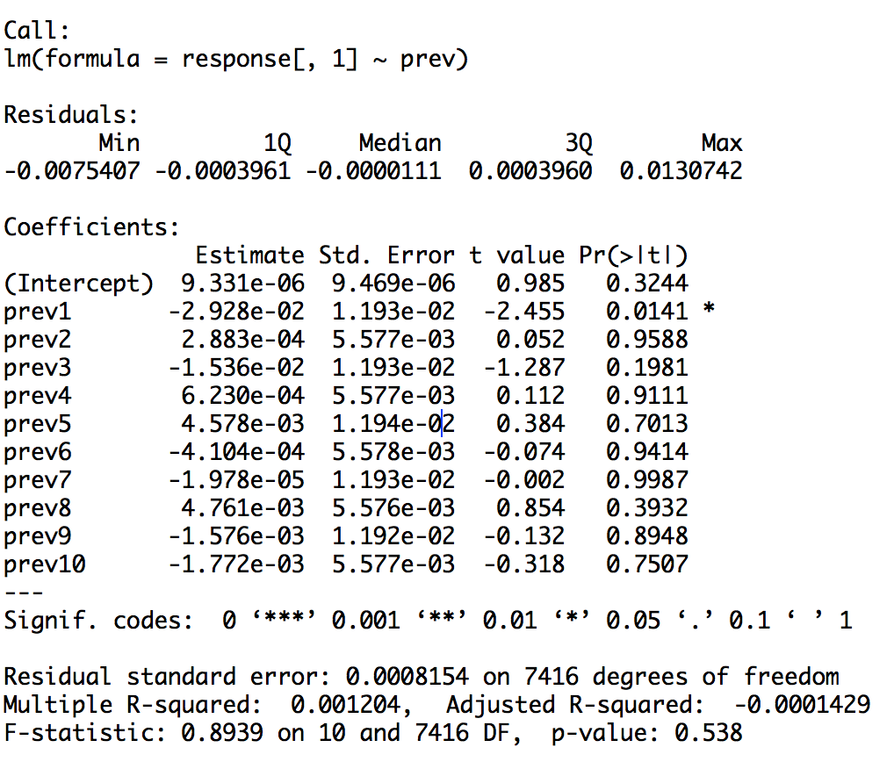
Results of Granger Casaulity of stock 74 vs stock 22

Slide 3
I borrowed this idea from Granger Causality. I chose

