Slide 1
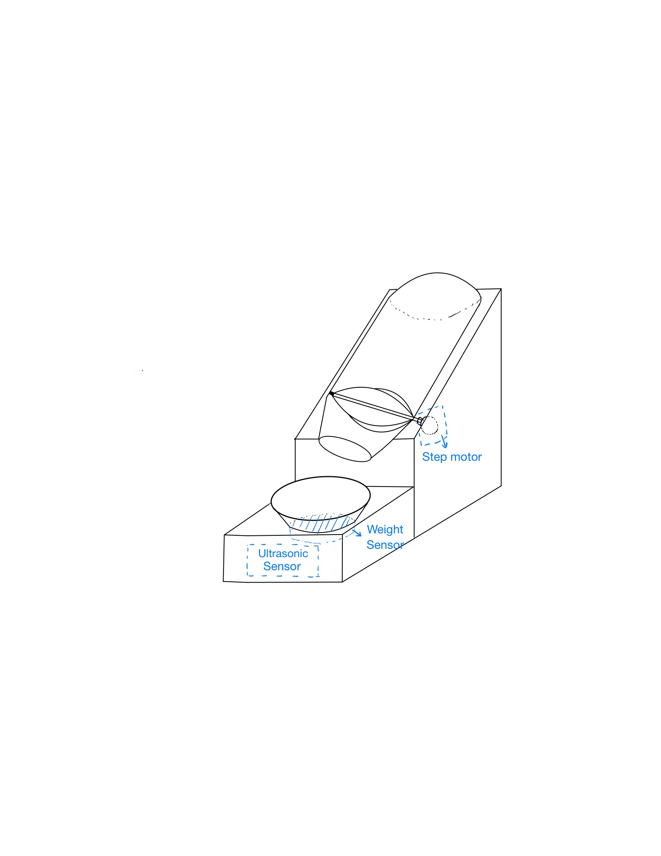
Automatic Pet Feeder
Materials
Raspberry Pi
Ultrasonic sensor
Weight sensor
Step motor
Paperboard
Large plastic bottle

Slide 2
Automatic Pet Feeder
Object
Ultrasonic sensors detect the distance from the pet, and the feeder starts working when the pet approaches.
The weight sensor detects the weight of the food in the bowl.
When the weight of food < 50g, start the motor to make the baffle turn to replenish food.
When the weight of food > 200g, the motor stops rotating.

