Slide 1
EDES 301
Glitch Camera Proposal
Oct 4, 2026
Shuken Nakamura

Slide 2

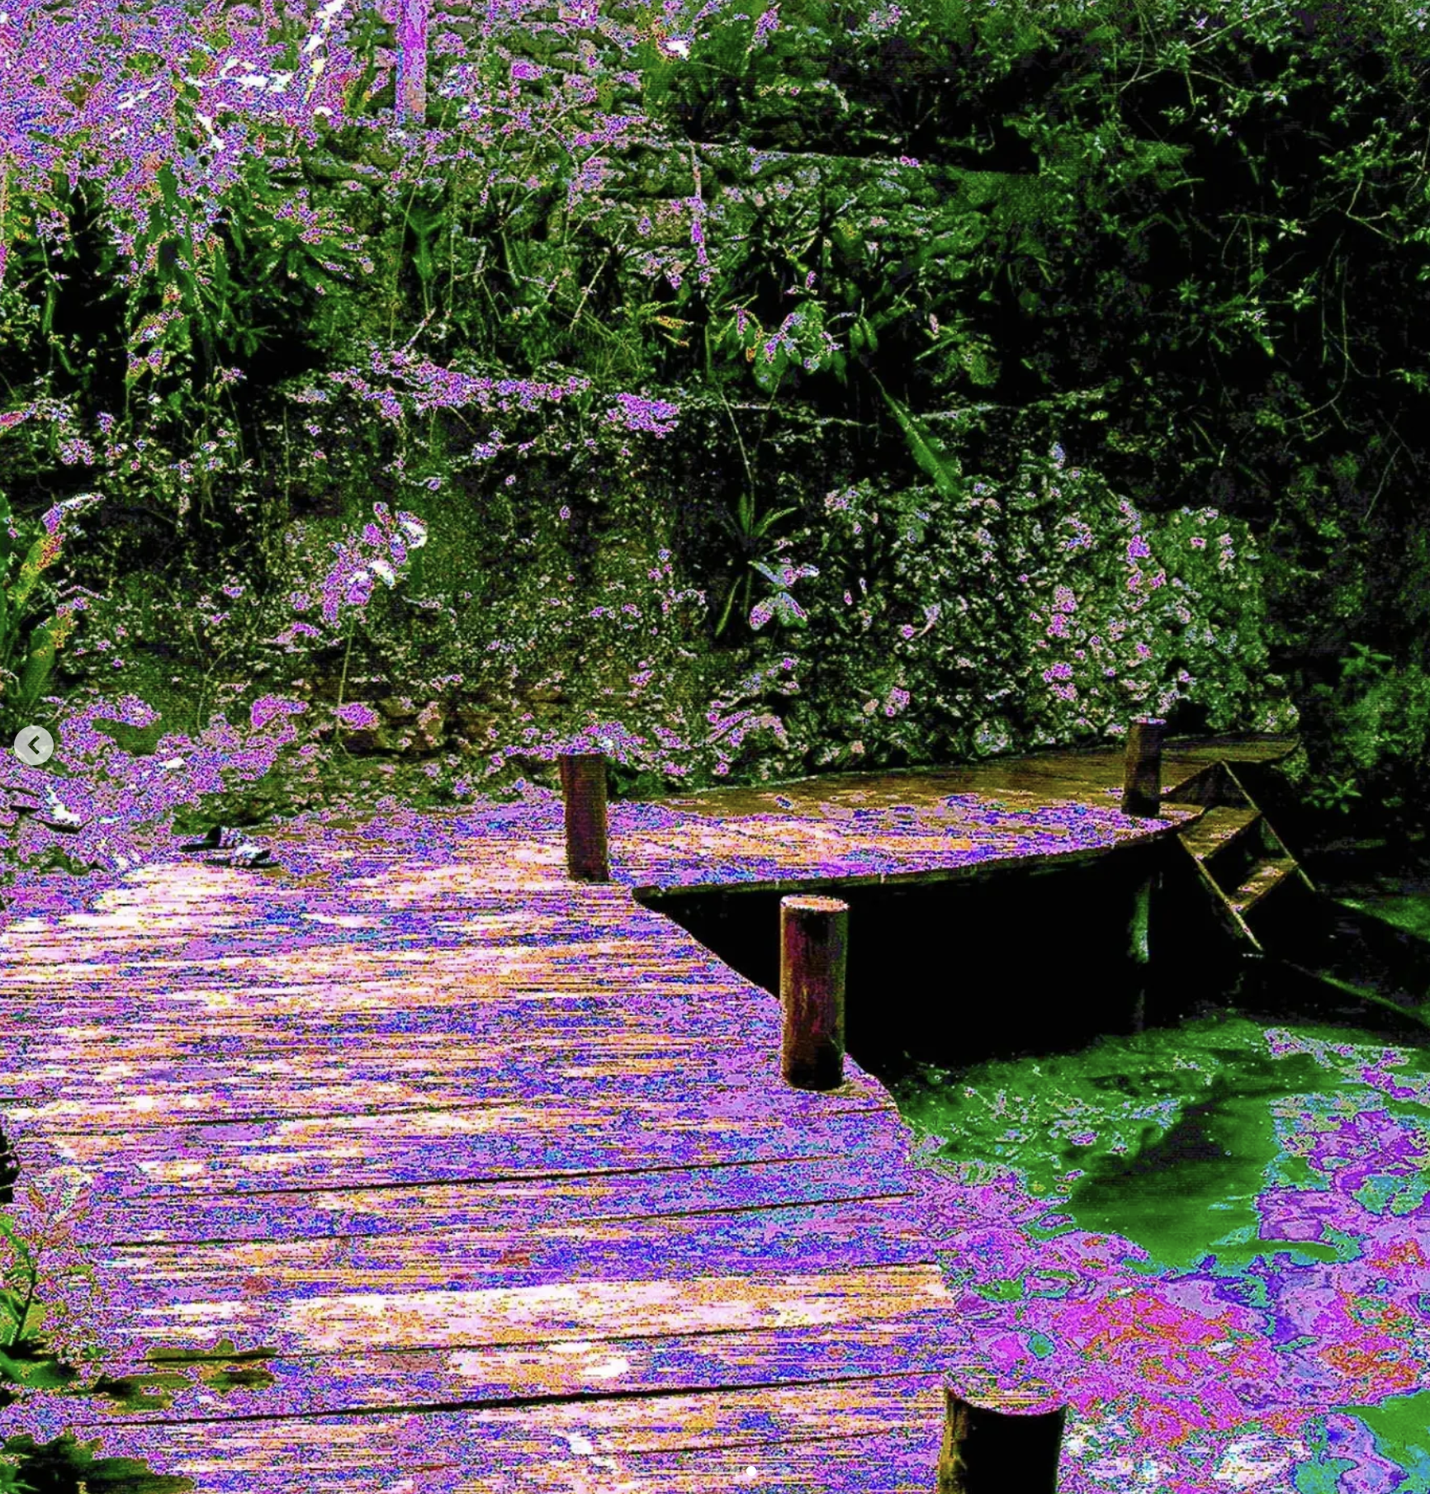
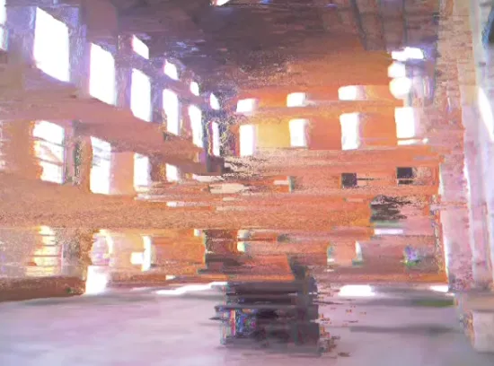
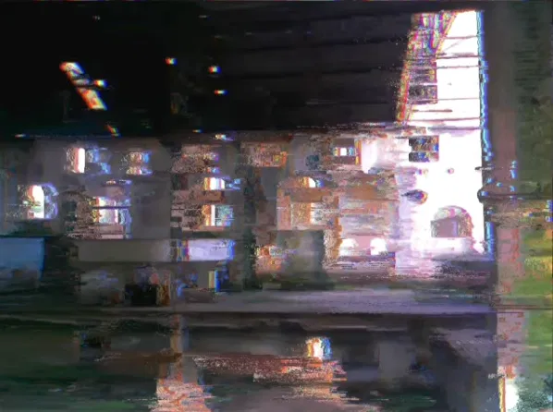
Background Information
What is being proposed?
  Circuit-Bent Cameras: Create color and quality distortions by changing the color channels of digital camera input.
  Tear/Smear Camera: Custom glitch effects that smear the lighting in a set direction
Taken experimental photography with analog (film) cameras, I want to be able to recreate the effects how different chemical processes affect film digitally. I want to combine the color effects and glitch effects are referenced. Additionally, I want to be able to change these effects using a physical nob. Thus, I am thinking of using potentiometer dials and analog stick joysticks to control the effects on the camera, rather than digital post-processing.
What improvements / additions over existing project
  Combination of existing projects
  Manual control rather than circuit-bent camera being the final
  Potential printing option?
Circuit Bending: https://www.instagram.com/rewired_optics/
Glitch Camera: https://www.instagram.com/cebolander/
https://www.reddit.com/r/raspberry_pi/comments/1t5tuu3/built_a_glitch_camera_with_raspberry_pi/
Post Process Glitch: https://github.com/makew0rld/live-glitch

Slide 3
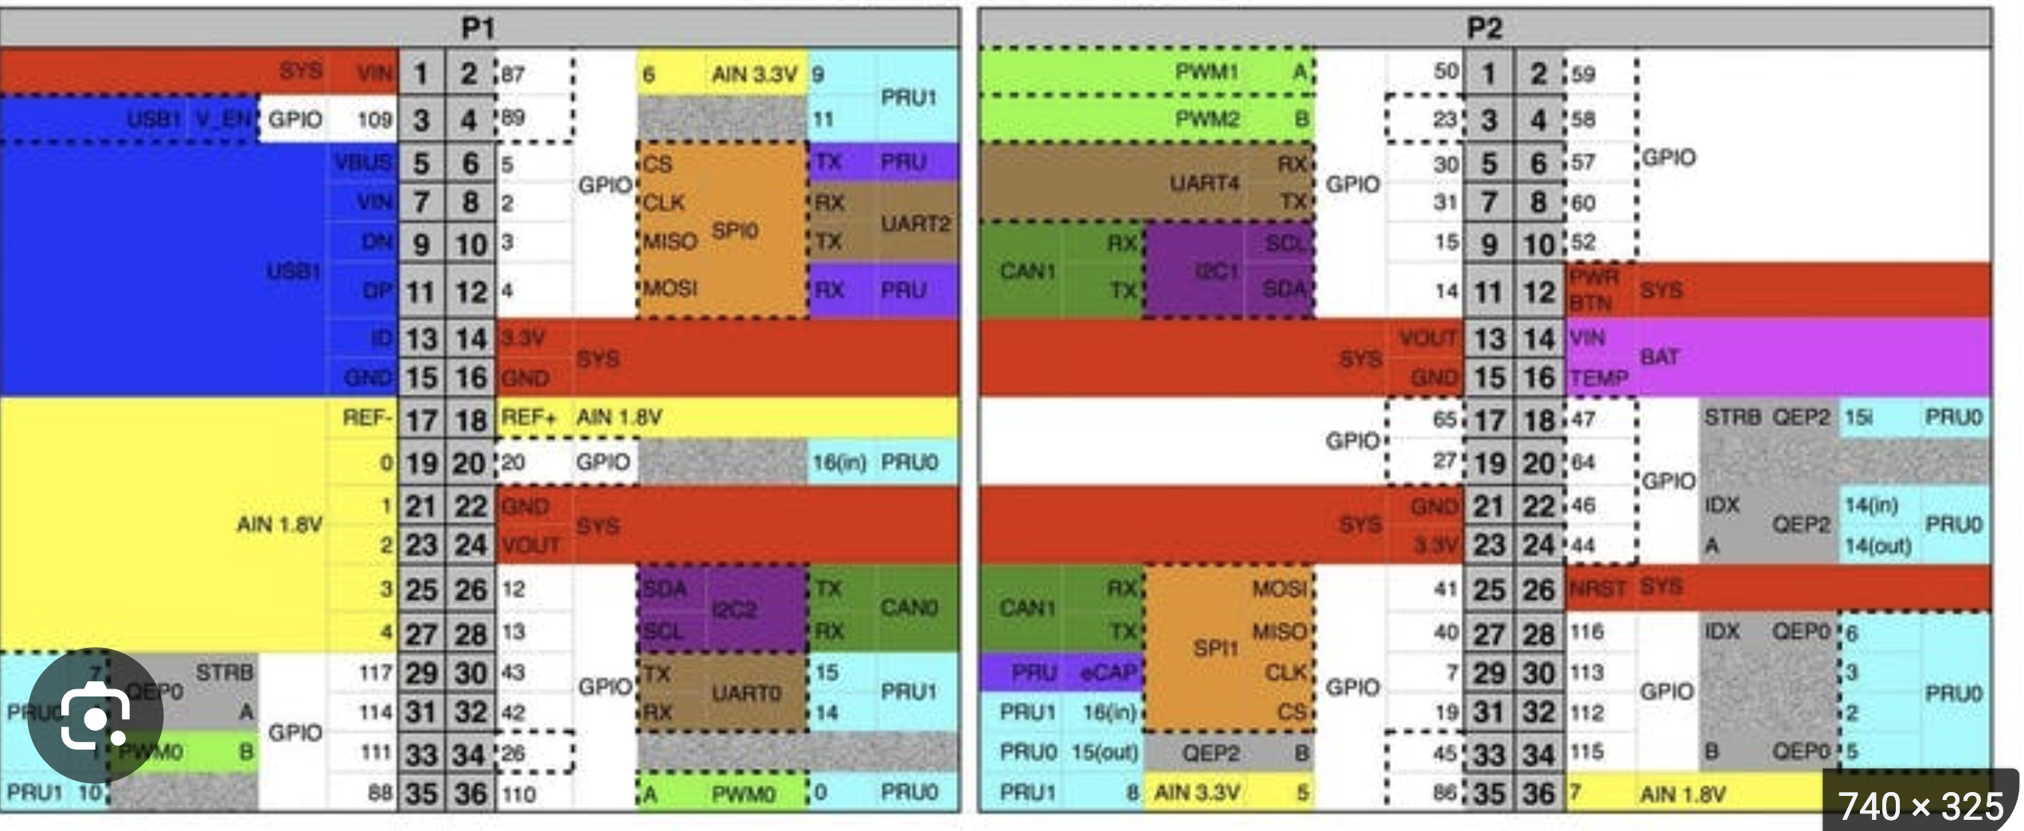
System Block Diagram
Create a System Block Diagram
Potentiometer
(Glitch)
AIN
Pocket Beagle
SPI0
Screen
IPS TFT Display
Potentiometers (3)
(Color)
GPIO
7 Segment Disp
AIN (3)
MicroSD
GPIO
LED (2)
2 Axis stick
(Direction)
AIN (2)
Buzzer
GPIO
GPIO
WMYCONGCONG Joystick
Button
GPIO
Camera
USBA
Converted
USB input
USB Camera

Slide 4
Power Block Diagram
Battery (5V)
Pocket Beagle
5V Rail
3.3V Rail
1.8 V Rail
USB Camera
Button
Potentiometers
Typically 220 mA (7)
0.5 mA (2)
Typically 10k Ohms (5)
so 1.8 mA
LEDs
2 Axis stick
Typically 20 mA (3)
10k Ohms (6)
so 1.8 mA
7 Seg Disp
Typically 20 mA (4)
Potentiometer
Typically 10k Ohms (5)
so 3.3 mA
Screen
https://www.amazon.com/Display-240x320-Raspberry-Electronic-Projects/dp/B0H6VZD3LW/
docs.arduino.cc/built-in-examples/digital/Button/
https://forum.arduino.cc/t/led-current-draw/555172
https://education.ti.com/html/eguides/stem/innovator-basic/EN/content/eg_innovsys/m_bb-datasheets/bb_ds_7seg_display.HTML
https://forum.arduino.cc/t/why-does-potentiometer-resistance-value-not-matter/223114
https://www.amazon.com/WGCD-Joystick-Breakout-Controller-Arduino/dp/B01N59MK0U
https://forums.raspberrypi.com/viewtopic.php?t=343144
30 mA (1)

Slide 5
Components / Budget
Component | EDES301 to Buy? | Cost
Joystick (ON xlsx LIST) | YES | $1.33
TFT: https://www.amazon.com/Display-240x320-Raspberry-Electronic-Projects/dp/B0H6VZD3LW/ (NOT ON LIST) | YES | $7.98
USB Camera (ON xlsx LIST) | YES | $17.99
USBA: https://www.sparkfun.com/sparkfun-usb-type-a-female-breakout.html (NOT ON LIST) | YES | $5.25
Total |  | $32.55
See Next Slide for Instructions

