Slide 1
Computer Graphics final
110550110林書愷

Slide 2
Video link
https://youtu.be/SVOqaEIBCQ0?feature=shared

Slide 3
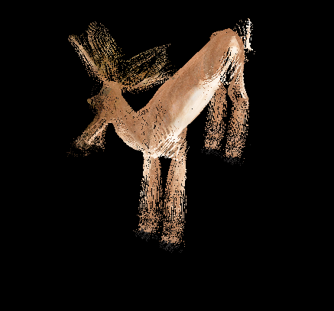
Theme: explosion
In this assignment, my main target is to make the object reaches an explosion effect
To implement this effect, I make each pixel of the object flyout from its normal and fly away as time pass

Slide 4
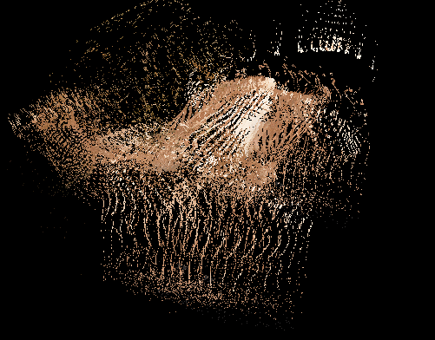
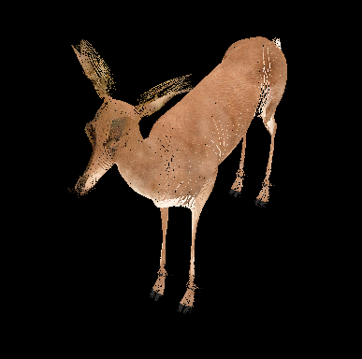
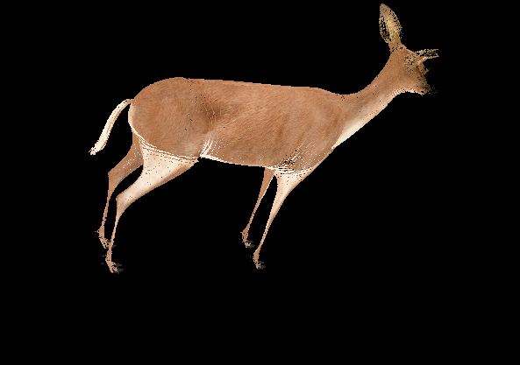
modes
Explode:
Merge:
Spin:

Slide 5
Method: geometry shader
For the input part, it will get gs_in[] array from vertex shader with view matrix, perspective matrix and texture coordinate. These are for the vertex manipulation.
For the uniform variable, time is for the scale changing and way for the pixel moving way.
For the pixel action, calculate its moving vector by getting its normal.

Slide 6
Normal calculation
First use interpolation to get the normal of each pixel based on its vertexes and sum up and average it.
Then calculate the coordinate that should be added to the original position to get the new ones.
The formula will be the normal times square of time and scale = 10.
Finally added to the gl_position to move the pixel to the target place.

Slide 7
Method: main.cpp
For the main.cpp part, besides building and passing the model and texture to the shaders, it the count the current time to decide the pixel moving distance in geometry shader
For global variables, the integer way will decide the pixel’s moving way , in or out
For isrotate is nearly same as the sample code , will decide the model is rotating and start to accumulate angle as time goes

Slide 8
Method: vertex and fragment shaders
For the vertex shader it will set gl_position of the model and pass it , texture coordinate , view matrix and perspective matrix to geometry shader
For the fragment shader it will use the texture coordinate and map to the texture map to color the object.

Slide 9
reference
Formula: https://medium.com/chenjd-xyz/using-the-geometry-shader-to-achieve-model-explosion-effect-cf6d5ec03020
Shader reference: https://www.geeks3d.com/20140625/mesh-exploder-with-geometry-shaders/

