Slide 1

Track Name- Analytics using Python Team Name- Python pro
TEAM MEMBERS
KRITI SHUKLA
AJINKYA BAM
SHUBHAM SHINDE
HITANSH WADATKAR
KRISHNA MAPARE

Slide 2
Problem Statement
Analyze customer eligibility for home loan on factors such as income, education level, dependents etc.
Key points from problem statement
How can we help banks to reduce their NPA?
How can Analytics help predict the correct set of customers for banks.
How will customer be benefited if banks correctly identify their eligibility.

Slide 3
Insights
A non-performing loan (NPA) is a bank loan that is subject to late repayment or is unlikely to be repaid by the borrower in full.
Pre-sanction and post sanction credit monitoring has a major role in reducing NPAs
Effective Scrutiny of periodical statements, discussions with the borrower, analysis of borrower’s account with the bank, discussion with co-bankers, may be helpful in identifying the credibility of the borrower.
Matt Anderson
Company Name

Slide 4
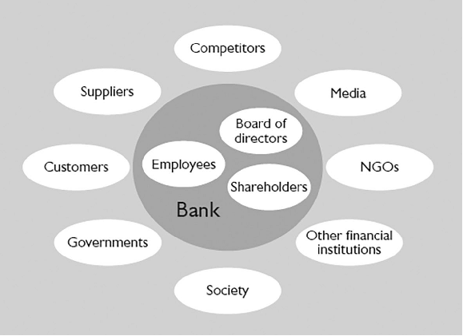
Stakeholder Map
Matt Anderson
Company Name

Slide 5
Secondary Research
Involves the summary, collation and/or synthesis of existing research.
The data set consists of data collected from various banks which includes data of costumers in different parameters such as :
1.Income
2.Education Level
3.Number of dependents
Solutions
1) To avoid the litigation process bank should go for the settlement scheme. Recovery camp should be organized on periodic basis as it saves the time and energy of the banks which they can use on the productive activities.
2) Bank can sell the NPA to asset reconstruction companies for cash.
3)Bank can take the possession of the property on which security is created.
Matt Anderson
Company Name

Slide 6
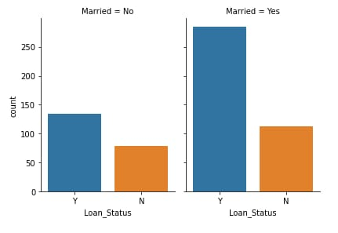
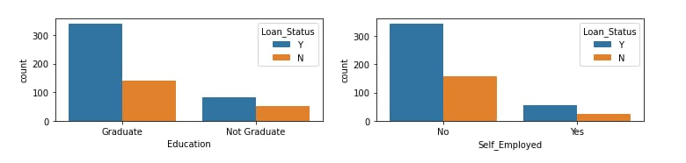
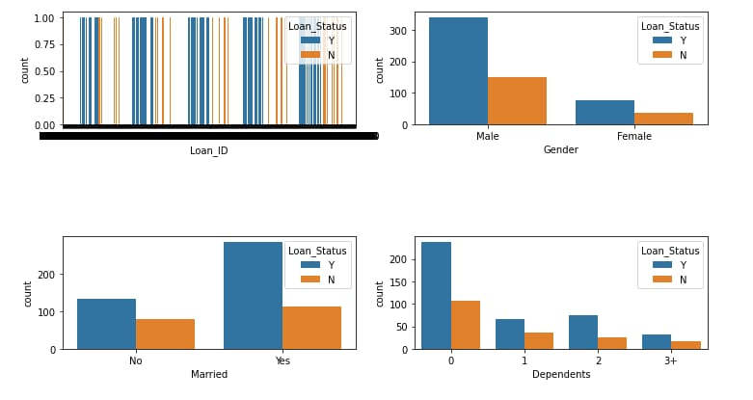
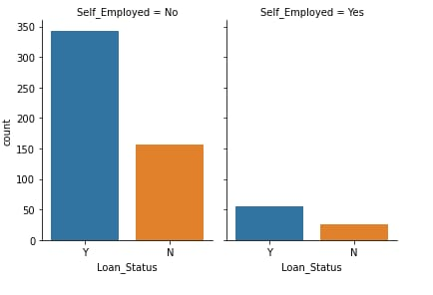

Slide 7
