Slide 1
B.Tech.(AI) Major Project I (IT448) Mid-Semester Presentation
Adaptive-Order State Transitions in Linear RNNs
for Efficient State Tracking
BY
Shashwat Chaturvedi (231AI036)
Utkarsh Shukla (231AI040)
Department of Information Technology
National Institute of Technology Karnataka, Surathkal-575025
Under the Guidance of
Anand Kumar M
Associate Professor, Department of Information Technology, NITK Surathkal
Notes:
Introduce the team and guide. One-line pitch: DeltaProduct uses the same number of Householder factors for every token; we study how many each token actually needs and let the model learn it.

Slide 2
Table of Contents
Introduction
Literature Survey
Outcome of Literature Survey
Problem Statement and Objectives
Methodology
Experimental Results
Conclusion and Future Work
Key References
Timeline of the Project
2
Notes:
Outline of the talk.

Slide 3
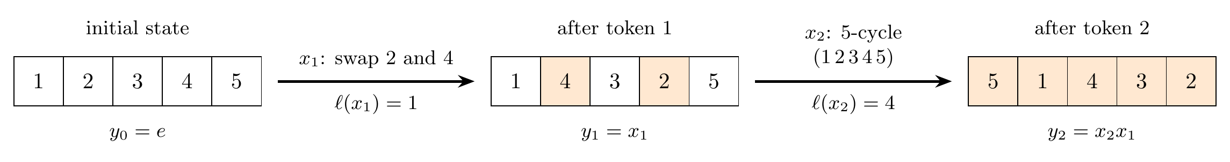
Introduction
State tracking: keeping a running summary of a sequence, e.g. where objects are after a series of moves
Linear RNNs keep a fixed-size state: linear cost, constant memory
What they can track depends on the state-transition matrix
DeltaProduct updates the memory in a few simple steps per token; each step is one Householder factor
The number of steps, n_{h}, is fixed by hand and the same for every token: more steps track harder tasks but cost more
Group word problem: each token rearranges five items; the model outputs the arrangement after every token
3
Notes:
State tracking is the ability to maintain what the sequence has done so far. Our test bed is the group word problem shown: every token is a permutation of five items and after each token the model must output the current arrangement. Linear RNNs compress the history into a fixed-size memory, and what they can track depends on how that memory is updated. DeltaProduct updates the memory with a few simple steps per token; each step is a Householder factor, which changes the memory along one direction. n_h is simply the number of these steps. It is chosen once by hand and used for every token: more steps can track harder tasks, but every token pays for them.

Slide 4
Introduction: Motivation
Tokens differ in how much work they need: swapping two items is simpler than cycling five
Efficiency
An unguessable setting
This project
A fixed n_{h} pays for the hardest token on every token
Per-token order pays the average instead
The right n_{h} depends on the whole input alphabet
Too small fails; too large wastes compute
Find how many factors each token needs
Let a learned gate choose it per token
4
Notes:
Two reasons to make the order adaptive. Efficiency: if most tokens need few factors, a fixed order wastes most of its computation. Second, and more important, the correct n_h cannot be read off the data: we show later that it depends on the algebraic structure of the whole alphabet, so adding one cheap symbol can double the cost of others.

Slide 5
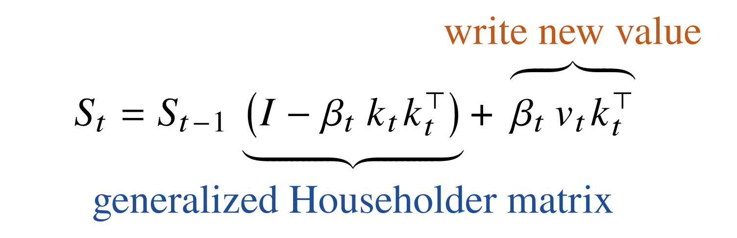
Literature Survey
Linear Attention and the Delta Rule
Key Points
Katharopoulos et al. [3]: linear attention is an RNN with a matrix-valued state, but it can only add
Schlag et al. [4] introduce the delta rule: erase the old value, then write the new one
Yang et al. [5] make the delta rule trainable at scale (DeltaNet)
The delta rule: memory update for token t
S: memory state (a matrix)
k: key, the direction updated
v: value written into memory
β: strength of the update
5
Notes:
Linear attention keeps a matrix memory S and only ever adds to it, so old associations are never removed. The delta rule fixes this. Read the equation left to right: first multiply the old memory by (I - beta k k^T), which removes what was stored along the key direction k, then add beta v k^T, which writes the new value v there. The matrix (I - beta k k^T) is a generalized Householder matrix: it changes the memory along one direction k only. beta controls how strongly. DeltaNet made this trainable at scale.

Slide 6
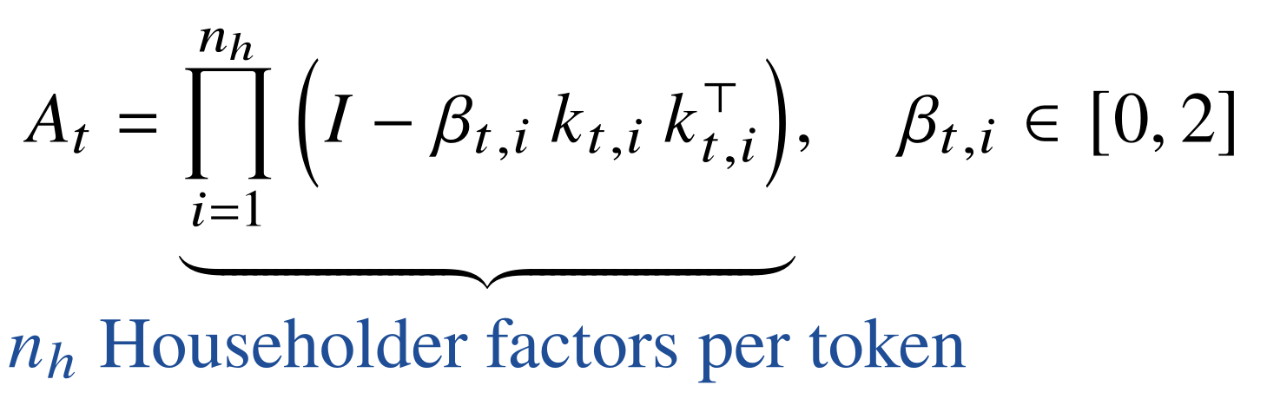
Literature Survey Contd.
Negative Eigenvalues and Householder Products
Key Points
Grazzi et al. [2]: letting β reach 2 (a reflection) lets linear RNNs solve parity
Siems et al. [1] propose DeltaProduct: n_{h} Householder factors per token, tracking groups up to S₅
n_{h} is one global setting; the paper lists per-token order as future work
DeltaProduct: the transition for token t
β = 0: identity (does nothing)
β = 1: erase along k
β = 2: reflection (a swap)
n_{h}: fixed, same for every token
6
Notes:
Grazzi et al. showed that letting beta go all the way to 2 turns the factor into a reflection, and reflections are what let these models handle parity and swaps. DeltaProduct applies n_h delta-rule steps per token, so the transition A_t is a product of n_h Householder factors. Point at the key: beta = 0 does nothing, 1 erases, 2 reflects (a swap). More factors track harder groups, up to S5. But n_h is one number fixed by hand for every token, and the paper lists per-token order as future work. That is exactly where this project starts.

Slide 7
Literature Survey Contd.
Theory of State Tracking and Representation
Key Points
Merrill et al. [6] prove that common state-space models cannot solve the S₅ word problem
Shakerinava et al. [7] find that diagonal models often fail to learn what they can represent
Howe [8] and Larson [9] relate the resources a model needs to the representation of the task
Our analysis differs: the requirement is set per token, by the group the whole alphabet generates
7
Notes:
These works explain why group word problems are the right benchmark and why Householder transitions matter. Howe and Larson are the closest related work; our difference is that the representation is fixed by the input alphabet and the requirement is defined per token, which is what allows per-token allocation.

Slide 8
Literature Survey Contd.
Adaptive Computation and Entity Tracking
Key Points
Graves [10] introduces Adaptive Computation Time: a learned halting unit plus a penalty on steps
Banino et al. [11] propose PonderNet, a probabilistic halting rule that trains more stably
Kim and Schuster [12] introduce the Boxes dataset: track box contents through text instructions
8
Notes:
ACT and PonderNet give us the monotone halting mechanism and compute penalty, but they are applied to network depth, not to the transition. Boxes is our first natural-language test: a description of seven boxes followed by move, remove and put operations.

Slide 9
Outcome of Literature Survey
Method | Transition per token | Order per token | Allocation
Linear attention [3] | Identity (additive only) | N/A | N/A
DeltaNet [5] | One Householder factor | Fixed, 1 | N/A
Negative eigenvalues [2] | Householder, β ∈ [0, 2] | Fixed | N/A
DeltaProduct [1] | n_{h} Householder factors | Fixed, global | Hand-chosen
ACT / PonderNet [10, 11] | N/A (network depth) | Variable | Learned halting
This work | ≤ n_{h} Householder factors | Variable | Learned halting
Gap: adaptive computation exists for network depth, but the number of Householder factors is always a fixed global constant
9
Notes:
Every Householder-based model fixes the number of factors globally. Adaptive computation is mature for network depth but has never been applied to the order of the transition. That is the gap.

Slide 10
Problem Statement and Objectives
Problem Statement
DeltaProduct applies the same number of Householder factors to every token. How many each token needs has not been characterised, and no mechanism allocates them per token.
Objectives
Reproduce DeltaProduct on group word problems
Characterise and verify the minimal number of factors per token
Measure per-token allocation at matched compute
Design and train a monotone halting gate with a compute budget
Evaluate trainability and reliability over repeated runs
Evaluate on natural-language entity tracking (Boxes and beyond)
10
Notes:
Six objectives. 1-5 are group word problems; 6 extends to natural language.

Slide 11
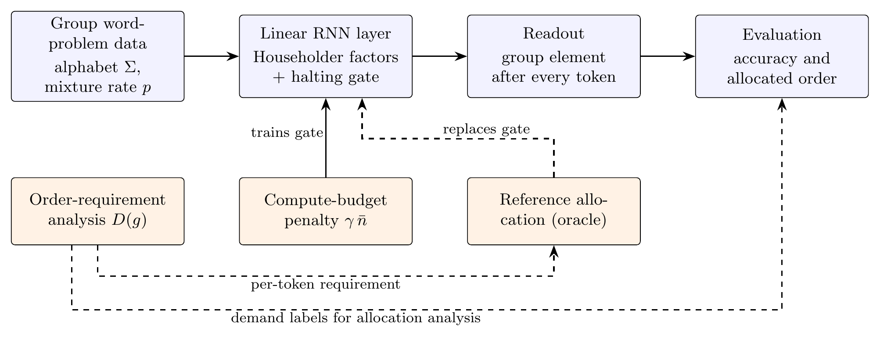
Methodology: System Overview
The order of the layer is set three ways: fixed n_{h}, a reference allocation from theory, or a learned gate
Theory (dashed) is used only for reference and evaluation, never as a training target
11
Notes:
Data generator produces word problems with controlled alphabets. One DeltaProduct layer, readout after each token. Three settings of the order: fixed n_h as baseline, the oracle reference allocation derived from our analysis, and the learned halting gate trained with a budget penalty. The theoretical labels never train the gate.

Slide 12
Methodology: How Many Factors Does a Token Need?
Rank bound: K factors can change at most K directions, so K ≥ ℓ(g), the transposition length
Parity: with β fixed at 2 only K ≡ ℓ (mod 2) is reachable, so the gate must scale β
Requirement: D(g) = min over faithful representations ρ of rank(ρ(g) − I)
Element | In S₅ | In A₅ (3-D)
Double transposition | 2 | 2
3-cycle | 2 | 2
5-cycle | 4 | 2
Factors needed per element class
Why is A₅ cheaper?
Only 5-cycles → only even rearrangements: the group A₅ (60 elements)
A₅ = the rotations of an icosahedron, a 3-D encoding
Every 3-D rotation changes 2 directions and is built from 2 mirrors
The same 5-cycle costs 4 factors in S₅ but 2 in A₅: the cost depends on the whole alphabet, not the token
12
Notes:
Each Householder factor differs from the identity by a rank-one matrix, so K factors can move at most K directions. A permutation with transposition length l needs l. With beta pinned at 2 the determinant is (-1)^K, so parity is forced; the gate must therefore scale beta rather than mask a fixed reflection. The key result: the layer may use any faithful representation. A5 is the rotation group of the icosahedron, a 3-D representation where every rotation is two reflections. So an alphabet of only 5-cycles (which generates A5) needs 2 factors, but adding one transposition makes it S5 and the same 5-cycle needs 4. Everything verified by explicit construction to about 1e-15.

Slide 13
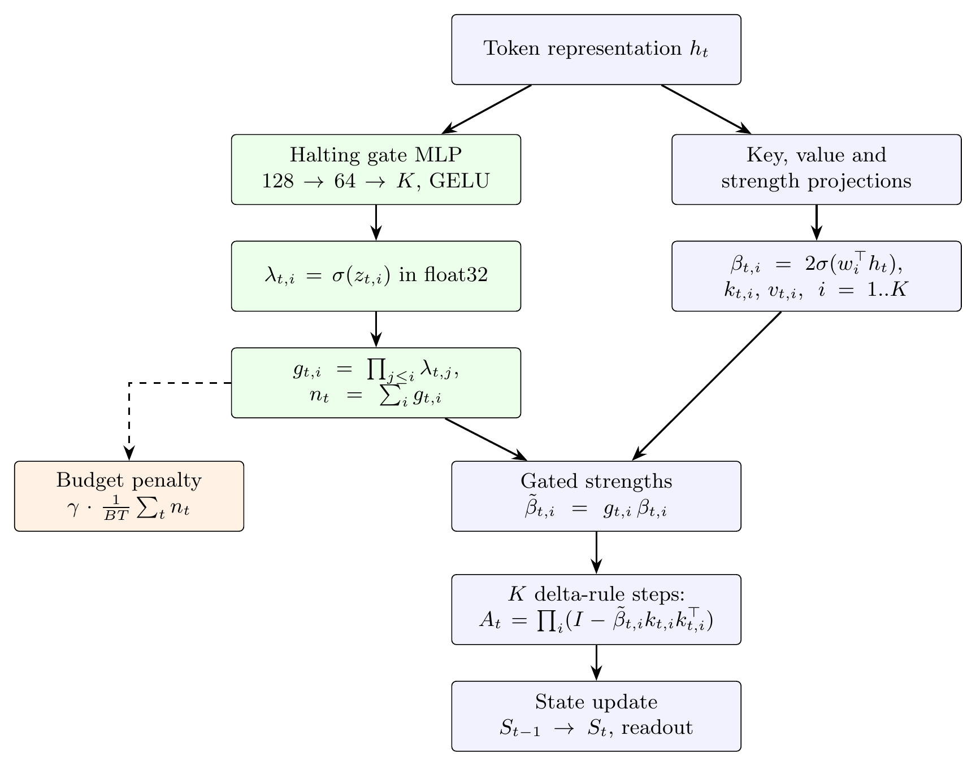
Methodology: The Adaptive-Order Layer
A small MLP reads each token and outputs K continue probabilities
Cumulative product gives monotone gates g₁ ≥ … ≥ g_{K}; order n_{t} = Σ g
Each gate scales a factor’s strength; g = 0 makes it the identity
Loss = task loss + γ · mean order, switched on after a warm-up
Gate computed in float32 so it can still receive gradient
13
Notes:
The gate is an MLP 128 -> 64 -> K. Cumulative product of sigmoids makes the gates monotone, so the effective order n_t is the number of gates still open. Following the parity result, the gate multiplies beta. The budget penalty gamma times the mean order is off for 4000 steps, then ramps over 4000 steps. The gate starts open (order 3.82). In bfloat16 a sigmoid above logit 6.2 rounds to exactly 1 with zero gradient, so the gate is evaluated in float32.

Slide 14
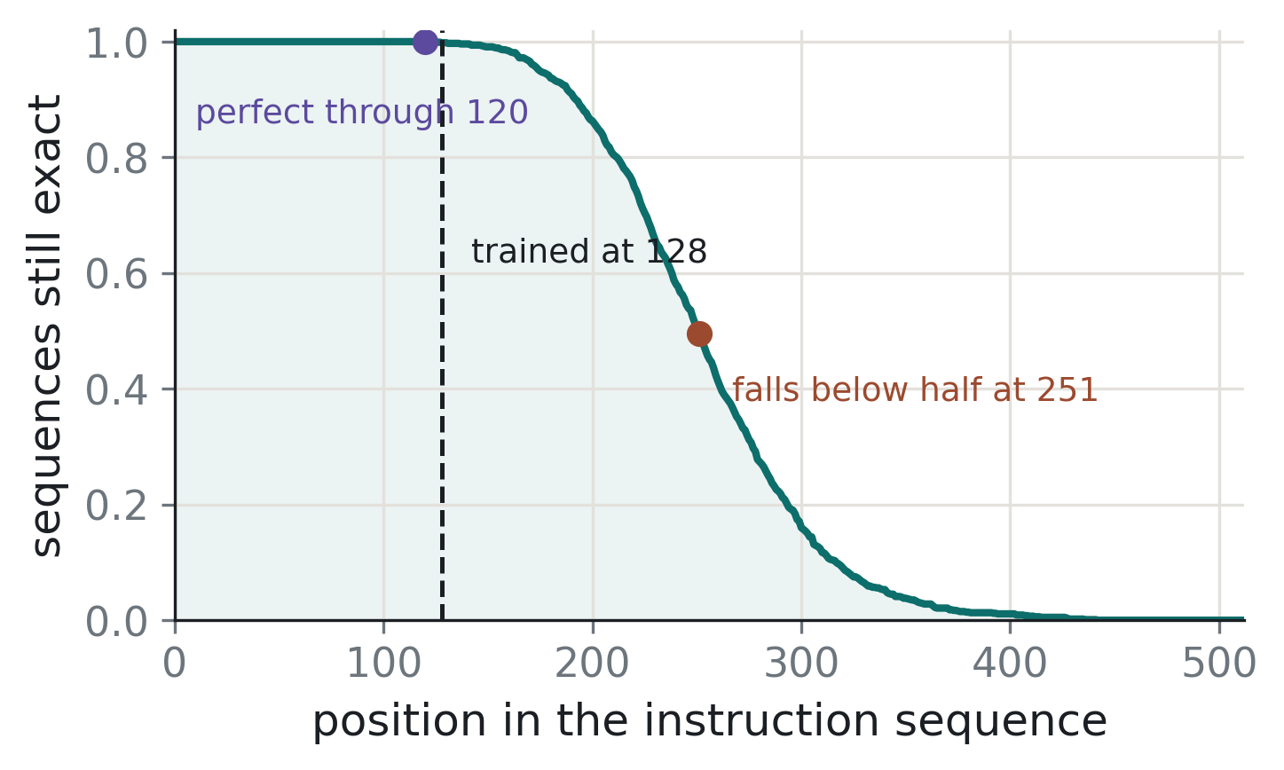
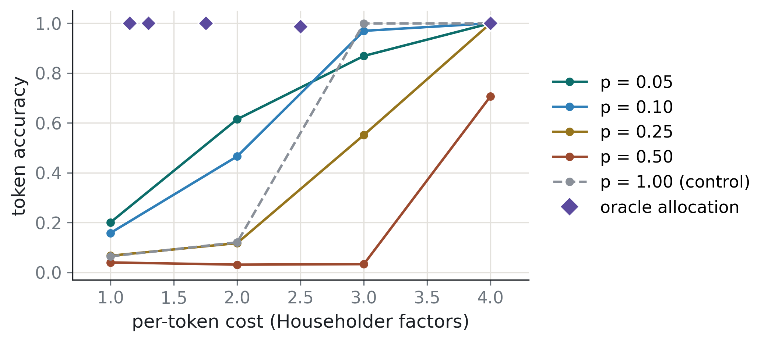
Experimental Results: Reproduction and Matched Compute
Reproduction of DeltaProduct
Per-token allocation at matched compute
S₃: 2 factors solve it, 1 factor fails (as published)
S₅: 99.8% of sequences exact at training length 128; token accuracy 0.864 at 512
Reference allocation matches 4-factor accuracy at 1.15 / 1.30 / 1.75 factors per token
Savings are in required factors; wall-clock time is unchanged so far
14
Notes:
Left: our reproduction. The curve is the fraction of sequences still fully correct up to each position; it stays near 1 up to the training length 128 and decays gradually after. Right: mixtures of transpositions (need 1) and 5-cycles (need 4). A fixed-order model needs 4 factors; the reference allocation reaches the same accuracy at 1.15, 1.30 and 1.75 factors per token, i.e. 3.5, 3.1 and 2.3 times fewer. These are single runs. Wall-clock is unchanged because the current implementation still executes every factor with zero strength.

Slide 15
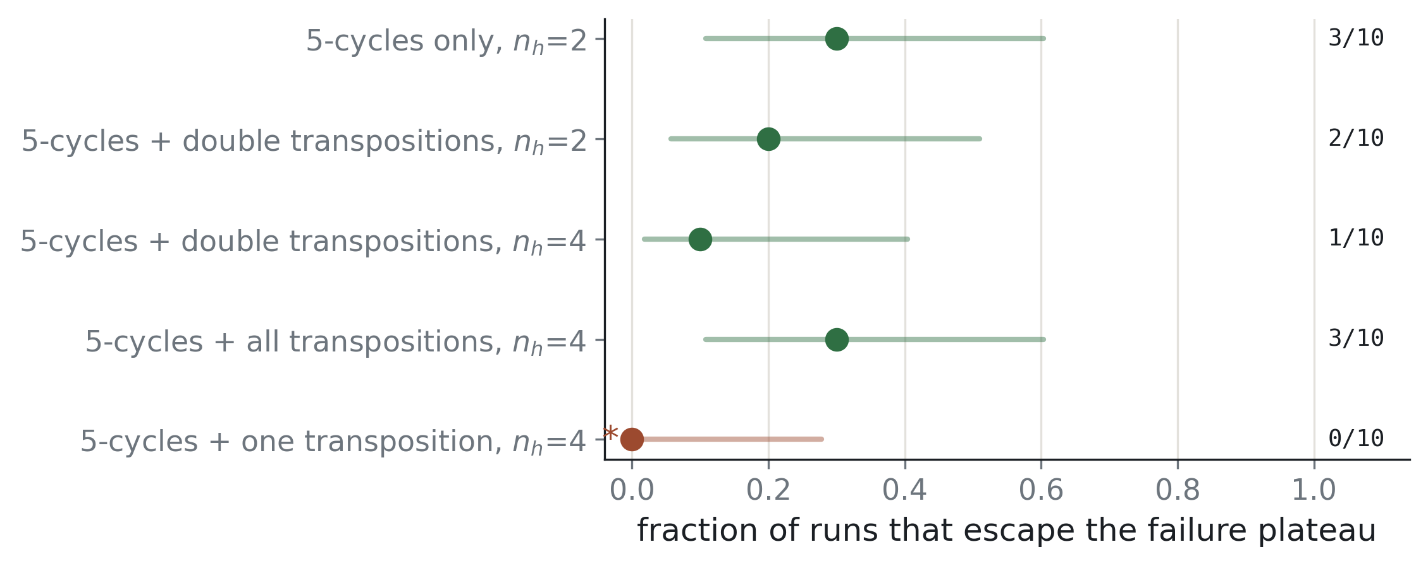
Experimental Results: Alphabet Closure
5-cycle alphabets that generate A₅ are learned with 2 factors, not 4
Training is bistable: identical runs reached 0.96 and 0.12
So results are reported as successes out of 10 runs
Fraction of 10 runs that escape the failure plateau (95% intervals)
15
Notes:
This tests that the cost depends on the alphabet. Alphabets of 5-cycles generate A5 and train with only 2 factors, which would be impossible if the cost were the transposition length 4. Training is bistable: a run either solves the task or stays near chance, and non-deterministic GPU kernels decide which, so two runs with the same seed gave 0.9598 and 0.1177. Hence we report k out of 10 with Wilson intervals. The one-transposition alphabet (96% maximum-cost tokens) is still unresolved.

Slide 16
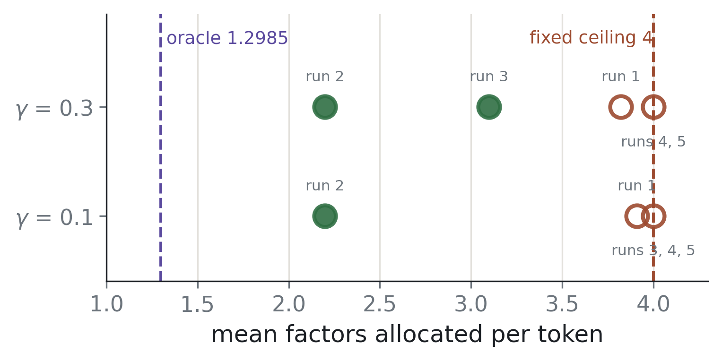
Experimental Results: The Learned Gate
3 / 10
runs recover the demand structure
2.20
factors per token at token accuracy 0.9998
Mean factors per token in each run of the learned gate
0
No supervision on the allocation; accuracy ≥ 0.998 in every run
Remaining runs keep all or nearly all factors
tokens given too few factors
16
Notes:
Trained end to end at p = 0.10 (90% transpositions, 10% 5-cycles). In 3 of 10 runs the gate separates the two classes exactly: 2 factors to every transposition and 4 to every 5-cycle, 2.20 per token at 0.9998 accuracy, better than the fixed 3-factor model (0.9696). It never under-allocates. Across all 49 learned runs, 7 recovered the structure and one earlier run reached the exact 1.30. Making this reliable is the main next step.

Slide 17
Experimental Results: The Boxes Dataset
Introduced by Kim and Schuster [12] to test entity tracking in text
Each example: a description of 7 boxes, a few operations (move, remove, put), and a query about one box
The model must write the contents of the queried box; scored by exact match
Training: at most 2 operations (78,402 examples)
Testing: 0 to 5+ operations; 3 or more are never seen in training
Example
Description: Box 0 contains the branch and the cheese, Box 1 contains the egg, Box 2 contains the disk and the tie, …
Operations: Move the tie from Box 2 to Box 1. Remove the bone from Box 6.
Query: Box 1
Answer: contains the egg and the tie.
An example in the dataset’s format
17
Notes:
This is the natural-language test, from Kim and Schuster, ACL 2023. Each example starts with a description of what is in seven boxes, then a few operations that move, remove or put objects, then a query about one box. The model must write the box's final contents, and it scores only if the whole answer is exactly right. Zero operations is pure lookup: copy from the description. Each operation is a state update, just like a token in our group task, so this is state tracking in text. Models are trained only on examples with at most two operations and tested on zero to five or more, so three or more operations checks whether the model can apply more updates than it has ever seen. The example shown is in the dataset's format; the tie moves into Box 1, so Box 1 now contains the egg and the tie.

Slide 18
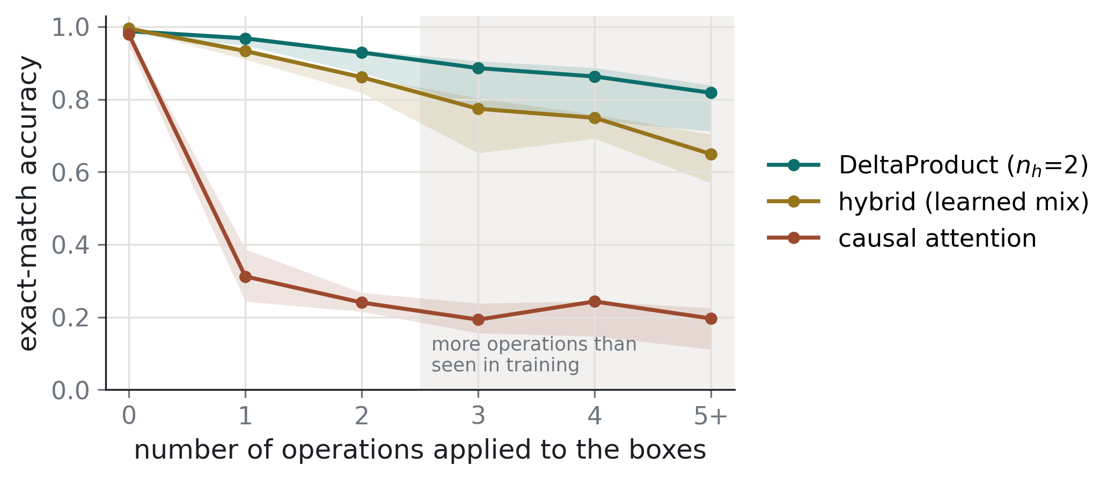
Experimental Results: Entity Tracking in Text
0.968
DeltaProduct after one operation
0.312
attention of the same size
Boxes dataset: exact-match accuracy vs number of operations (3 seeds)
Fixed order n_{h} = 2 only; adaptive order on text is next
Trained on ≤ 2 operations; still 0.818 at 5 or more
Mixing attention with DeltaProduct does not help
18
Notes:
Teammate experiment. Boxes: a description of seven boxes, then operations, then a query. All three parameter-matched models (~469k parameters) read the description correctly at 0 operations, but once one update must be applied, DeltaProduct stays at 0.968 while attention drops to 0.312. This is one small configuration trained from scratch, not a general claim about attention. The hybrid is below DeltaProduct, though it had a smaller feed-forward layer. Only n_h = 2 was tested.

Slide 19
Conclusion and Future Work
Conclusion
Future Work
A token’s cost is set by its whole alphabet, not the token
Per-token order: same accuracy with 2.3–3.5× fewer factors
Learned gate recovers the structure in 3 of 10 runs, no accuracy loss
DeltaProduct tracks state in text where attention fails
Make gate training reliable
Execute only the allocated factors for a real speedup
Alphabets needing 1, 2, 3 and 4 factors
Adaptive order on Boxes, SCONE, ProPara and NPN-Cooking
19
Notes:
Main limitations to state honestly: training success is a fraction of runs, and the savings are in required factors, not yet time, because every factor is still executed.

Slide 20
Key References
[1] J. Siems, T. Carstensen, A. Zela, F. Hutter, M. Pontil, and R. Grazzi, "DeltaProduct: Improving State-Tracking in Linear RNNs via Householder Products," in Proc. NeurIPS, 2025.
[2] R. Grazzi, J. Siems, A. Zela, J. K. H. Franke, F. Hutter, and M. Pontil, "Unlocking State-Tracking in Linear RNNs Through Negative Eigenvalues," in Proc. ICLR, 2025.
[3] A. Katharopoulos, A. Vyas, N. Pappas, and F. Fleuret, "Transformers are RNNs: Fast Autoregressive Transformers with Linear Attention," in Proc. ICML, pp. 5156–5165, 2020.
[4] I. Schlag, K. Irie, and J. Schmidhuber, "Linear Transformers Are Secretly Fast Weight Programmers," in Proc. ICML, pp. 9355–9366, 2021.
[5] S. Yang, B. Wang, Y. Zhang, Y. Shen, and Y. Kim, "Parallelizing Linear Transformers with the Delta Rule over Sequence Length," in Proc. NeurIPS, 2024.
[6] W. Merrill, J. Petty, and A. Sabharwal, "The Illusion of State in State-Space Models," in Proc. ICML, 2024.
20

Slide 21
Key References
[7] M. Shakerinava, B. Khavari, S. Ravanbakhsh, and S. Chandar, "The Expressive Limits of Diagonal SSMs for State-Tracking," in Proc. ICLR, 2026.
[8] G. L. Howe, "The Automaton Underneath: The Additive Input Pathway Is a Parasitic Attractor for State Tracking in Householder Linear RNNs," arXiv:2609.18966, 2026.
[9] S. Larson, "The Rank the Task Demands: A Causal Rank Law for Matrix Memories Trained on Group Composition," arXiv:2609.12259, 2026.
[10] A. Graves, "Adaptive Computation Time for Recurrent Neural Networks," arXiv:1603.08983, 2016.
[11] A. Banino, J. Balaguer, and C. Blundell, "PonderNet: Learning to Ponder," in 8th ICML Workshop on Automated Machine Learning, 2021.
[12] N. Kim and S. Schuster, "Entity Tracking in Language Models," in Proc. ACL, pp. 3835–3855, 2023.
21

Slide 22
Timeline of the Project
Period | Activity | Status
Jul 2026 | Problem identification and selection of the research direction | Completed
Aug 2026 | Literature survey | Completed
Sep 2026 | Reproduction; order-requirement analysis; matched-compute and closure experiments | Completed
Sep 2026 | Halting gate implementation and training; entity tracking on Boxes | Completed
Oct 2026 | Reliability of the learned gate; order sweep on Boxes | Planned
Nov 2026 | Alphabets with multiple requirement levels | Planned
Dec 2026 – Jan 2027 | Execute only the allocated factors; wall-clock measurement | Planned
Feb 2027 | High-requirement regime; replication of headline results | Planned
Mar 2027 | Adaptive order on Boxes, SCONE, ProPara and NPN-Cooking | Planned
Apr 2027 | Final report and presentation | Planned
22

