Slide 1
B.Tech.(AI) Major Project I (IT448) Progress Review, October 2026
Adaptive-Order State Transitions in Linear RNNs
for Efficient State Tracking
BY
Shashwat Chaturvedi (231AI036)
Utkarsh Shukla (231AI040)
Department of Information Technology
National Institute of Technology Karnataka, Surathkal-575025
Under the Guidance of
Anand Kumar M
Associate Professor, Department of Information Technology, NITK Surathkal
Notes:
Progress review covering the work done between the mid-semester review on 1 October and 14 October 2026.

Slide 2
Table of Contents
Progress at a Glance
Recap: The Adaptive-Order Layer
Training the Gate Reliably
Decision Rule Set in Advance
Testing the Cost Analysis on A₅
Turning the Saving into Time
Measured Speed and Accuracy
Order Matters on Real Text (Boxes)
Running Now: Restart Rule
Conclusion and Next Steps
Updated Timeline
Updates to the Mid-Semester Report
2
Notes:
The order of this review.

Slide 3
Progress at a Glance
Work done since the mid-semester review on 1 October 2026
Work | What we found | Status
Training recipe for the learned gate | Exact allocation in 13 of 20 runs (about 1 in 20 before) | Completed
Decision rule, written in advance | 13 is below the target of 15; main goal moved to measured speed | Completed
A₅ test of our cost analysis | The gate stops at 3 factors; 2 were predicted | Not confirmed
Faster inference path | 0.73–0.80 of the best 4-factor time on large inputs | Completed
Accuracy on trained models | Unchanged: token accuracy within 0.0002 | Completed
Boxes order sweep (real text) | 2 factors per token beat 1 at the same model size | Completed
Restart rule for training | Tests an early warning signal on 20 new runs | In progress
3
Notes:
Everything done since 1 October in one table. The first three rows are about training the gate, the next two about turning its saving into time without losing accuracy, then the first test on real text, and the experiment that is running now.

Slide 4
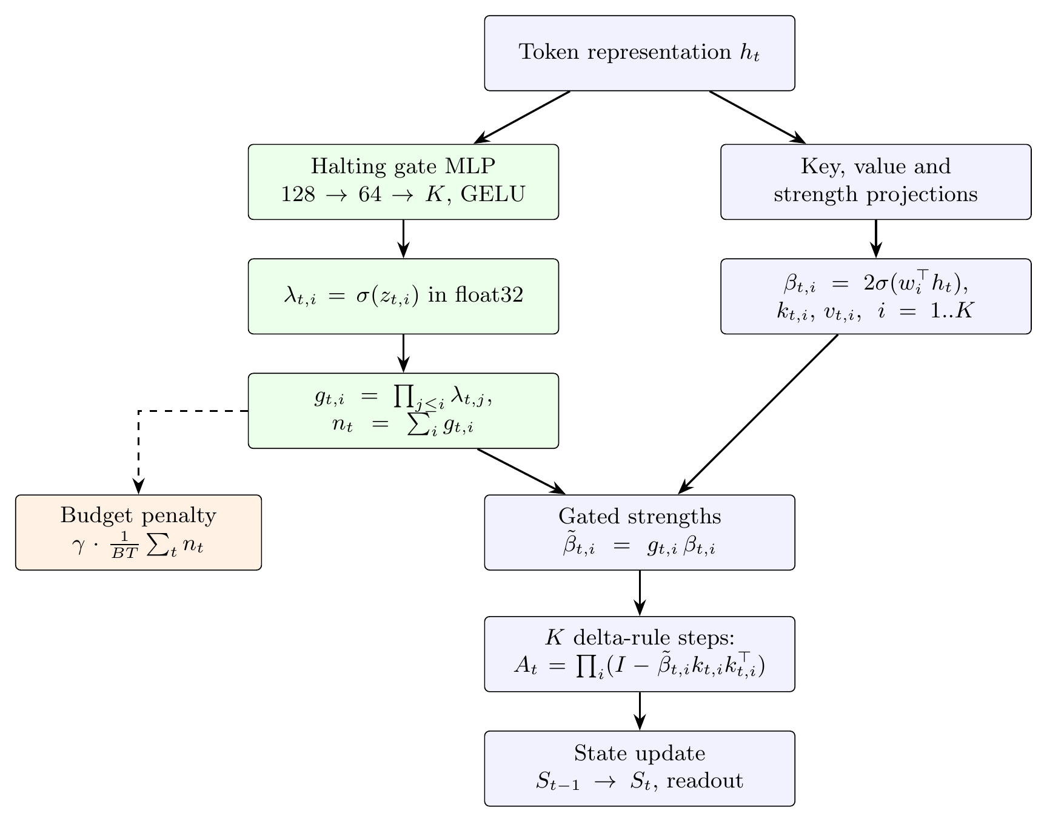
Recap: The Adaptive-Order Layer
DeltaProduct updates its memory at every token with a product of Householder factors; more factors track harder changes but cost more time
Normally the number of factors is one fixed setting for every token
Our learned gate reads each token and chooses how many of the 4 factors to use
It is trained with a penalty on the average number of factors, with no labels for the allocation
Ideal on the S₅ task: 1 factor for a swap (90% of tokens), 4 for a 5-cycle (10%), 1.30 on average
4
Notes:
A short recap for the guide. DeltaProduct updates its memory with a product of Householder factors at every token. Our gate decides per token how many to use. On the S5 task the ideal is 1 factor for swaps and 4 for 5-cycles, which averages 1.30.

Slide 5
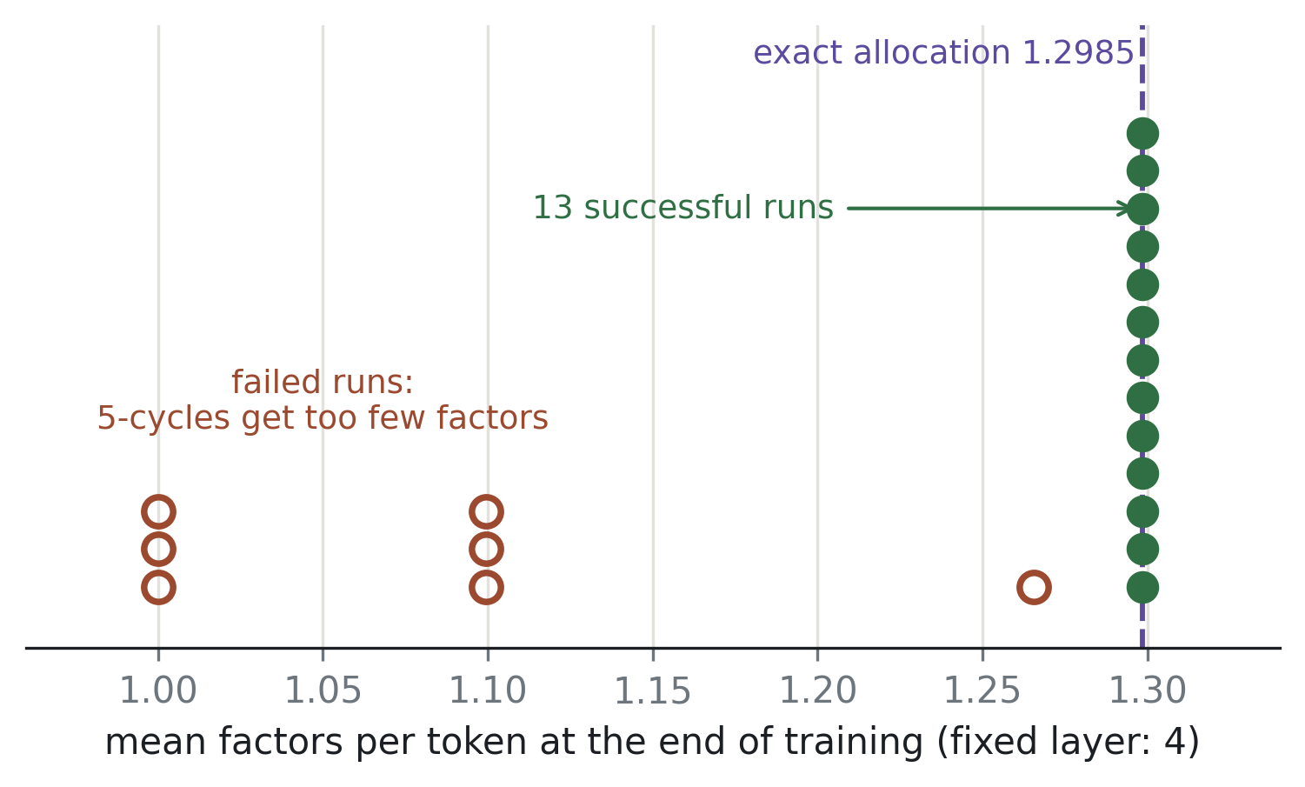
Experimental Results: Training the Gate Reliably
13 / 20
runs reach the exact allocation (about 1 in 20 before)
1.30
factors per token, token accuracy ≥ 0.9986
Mean factors per token at the end of training, in each of 20 runs (seeds 11–30)
Step 500
New recipe: on/off gates and the budget penalty from the first step, the gate starting fully open, the first factor always on
Every failed run gives 5-cycles too few factors and never learns the task
by which every failed run is already visible
5
Notes:
The main training result. With the new recipe, 13 of 20 runs find the exact allocation without supervision; before, the best setup managed about 1 in 20. All seven failures look the same and are already visible at step 500, which is the basis of the restart rule.

Slide 6
Decision Rule Set in Advance
To avoid reading the result in our favour, the success target was written down before the 20-run study
Rule (3 October)
Result (7 October)
Decision (8–11 October)
At least 15 of 20 usable runs: keep improving reliability
Fewer: change the main deliverable
13 of 20 usable runs
Below the target, so the rule was applied, not changed
Main deliverable: a measured speedup from the per-token gate at equal accuracy
13 of 20 stays the reported reliability
6
Notes:
We wrote the threshold down before the 20-run study so the result could not move the goalposts. 13 is below 15, so we applied the rule and moved the main effort to turning the gate's saving into measured time.

Slide 7
Experimental Results: Testing the Cost Analysis on A₅
Prediction: with only 5-cycles in the alphabet, each needs just 2 factors (4 when swaps are also present)
Test: the learned gate, 6 runs of 20 000 steps, penalty delayed 3 000 steps
Result: no run reached 2; the best stopped at 3 factors with accuracy 0.9994
Run | Penalty | Factors | Accuracy
11 | 0.1 | 4.00 | 0.9996
12 | 0.1 | 4.00 | 0.9997
13 | 0.1 | 3.37 | 0.9997
11 | 0.3 | 1.00 | 0.056 (collapsed)
12 | 0.3 | 4.00 | 0.9984
13 | 0.3 | 3.00 | 0.9994
What we conclude
Final factors per token and token accuracy in each run
The prediction is not confirmed for the learned gate with this recipe
A model that tracks A₅ exactly with 3 factors must use a 3-D representation (rank argument)
The gate removes factors greedily and keeps one spare
Fixed 2-factor models learn this task in 3 of 10 runs, so 2 factors are enough. The gate stops one factor short.
7
Notes:
Our analysis says the cost of a 5-cycle depends on the whole alphabet: 4 factors under S5, only 2 under A5. Fixed-order runs show 2 is enough, though rarely learned. The learned gate trimmed greedily and stopped at 3 in its best run, so the prediction is not confirmed for the gate with this recipe.

Slide 8
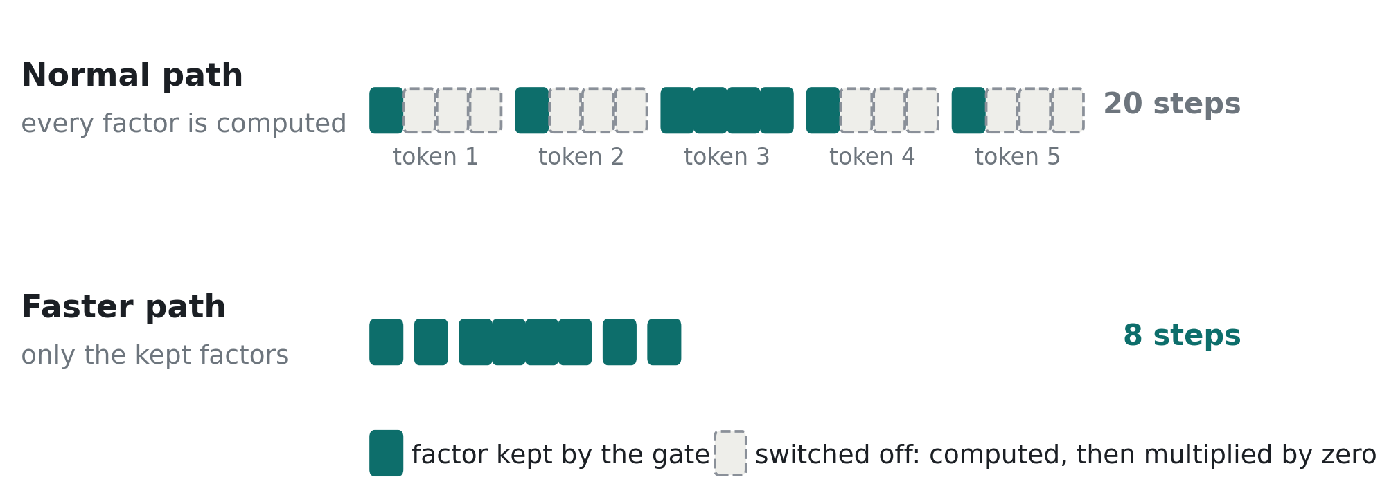
Turning the Saving into Time
The normal layer still computes all 4 factors for every token and multiplies the switched-off ones by zero, so it saves no time
Five tokens with the learned allocation: the faster path computes 8 factor steps instead of 20
Faster path: removes the switched-off factors before the recurrence and packs the remaining work of all sequences end to end (inference only)
Correctness: same output as the normal layer; both differ from an exact float64 calculation only by rounding (error 7.05e-3 against 6.57e-3)
8
Notes:
Until now the saving was only a count, because the normal layer still runs all four factors. The new path drops the switched-off factors before the recurrence and packs what is left. We checked that it gives the same output as the normal layer within bf16 rounding.

Slide 9
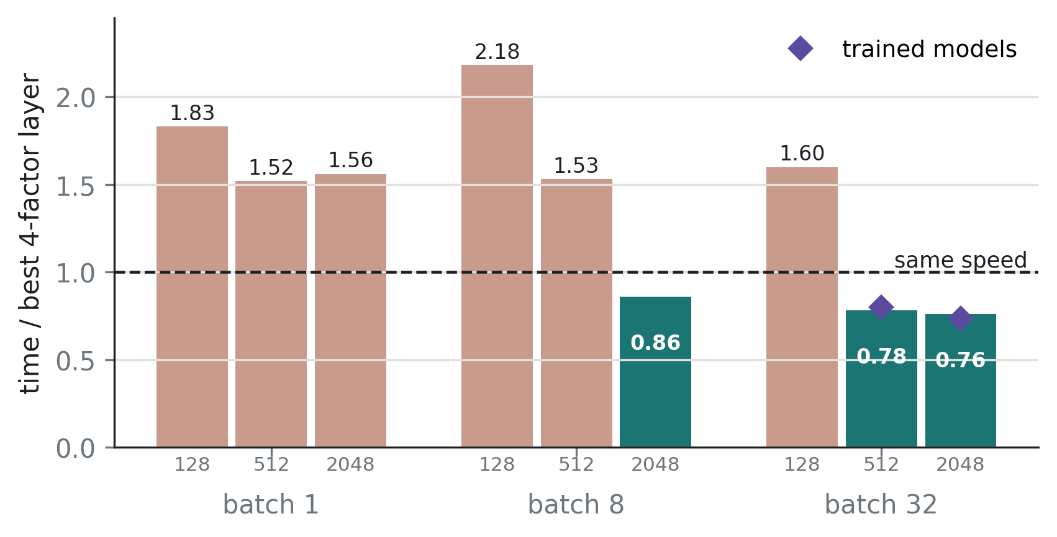
Experimental Results: Measured Inference Speed
0.73–0.80
trained models, 32 sequences of 512 and 2048 tokens
1.2–2.7×
slower on the six smaller input sizes
New path's time, gate included, divided by the faster ordinary 4-factor layer (mean of two runs)
Batch 8 × 2048 differed between the two runs (0.74 and 0.98), so it is not claimed. RTX 4050 laptop GPU.
Faster on large inputs: 0.76–0.78 at batch 32, with random weights
Slower on small inputs, where the GPU is mostly idle and packing adds a fixed cost
9
Notes:
The fair comparison: the baseline is the faster of two ordinary 4-factor layers, the original code and our version without its avoidable copying, and the new path's time includes the gate. At batch 32 it takes about three quarters of the baseline's time. On small inputs the GPU is mostly idle and the packing overhead makes it slower.

Slide 10
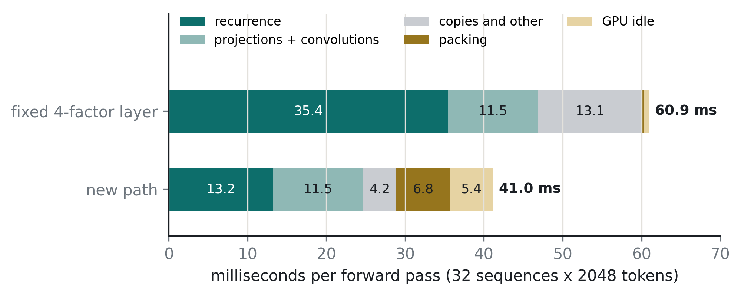
Experimental Results: Where the Time Goes
The recurrence falls from 35.4 to 13.2 ms (0.37×); the allocation predicts 0.33×
The rest is overhead: packing, the GPU waiting on the CPU, and projections still computed for all 4 factors
After removing avoidable copies from both: 56.2 ms against 39.0 ms plus 3.1 ms for the gate
One forward pass at 32 sequences × 2048 tokens, measured before avoidable copies were removed from both layers
10
Notes:
The recurrence, the expensive part, falls from 35 to 13 milliseconds, close to what the allocation predicts. The remaining gap is overhead: packing, the GPU waiting on the CPU, and projections still computed for all four factors. These are the targets for later work.

Slide 11
Experimental Results: Accuracy on Trained Models
Model | Token accuracy, normal → faster | Sequence accuracy, normal → faster | Identical predictions
Seed 12, trained | 0.9998 → 0.9996 | 0.9795 → 0.9595 | 99.95%
Seed 13, trained | 1.0000 → 0.9999 | 0.9965 → 0.9940 | 99.997%
Seed 11, did not learn the task | 0.4218 → 0.4210 | 0 → 0 | 90.0%
Models trained with the best recipe, evaluated with the normal and the faster path
What this means
On both trained models the faster path gives the same answers, and both paths are equally close to an exact float64 calculation
Sequence accuracy drops slightly because one changed token fails a whole sequence; likely cause, not yet tested: the models were trained under the normal path's exact rounding
The untrained model's 10% disagreements are all near-ties in its scores: rounding, not an error
11
Notes:
Speed matters only at equal accuracy, so we checked trained models. On both models that learned the task, token accuracy is unchanged within 0.0002 and over 99.9% of predictions are identical. Sequence accuracy drops a little because one changed token fails a whole sequence. The untrained model disagrees more, but only on near-ties.

Slide 12
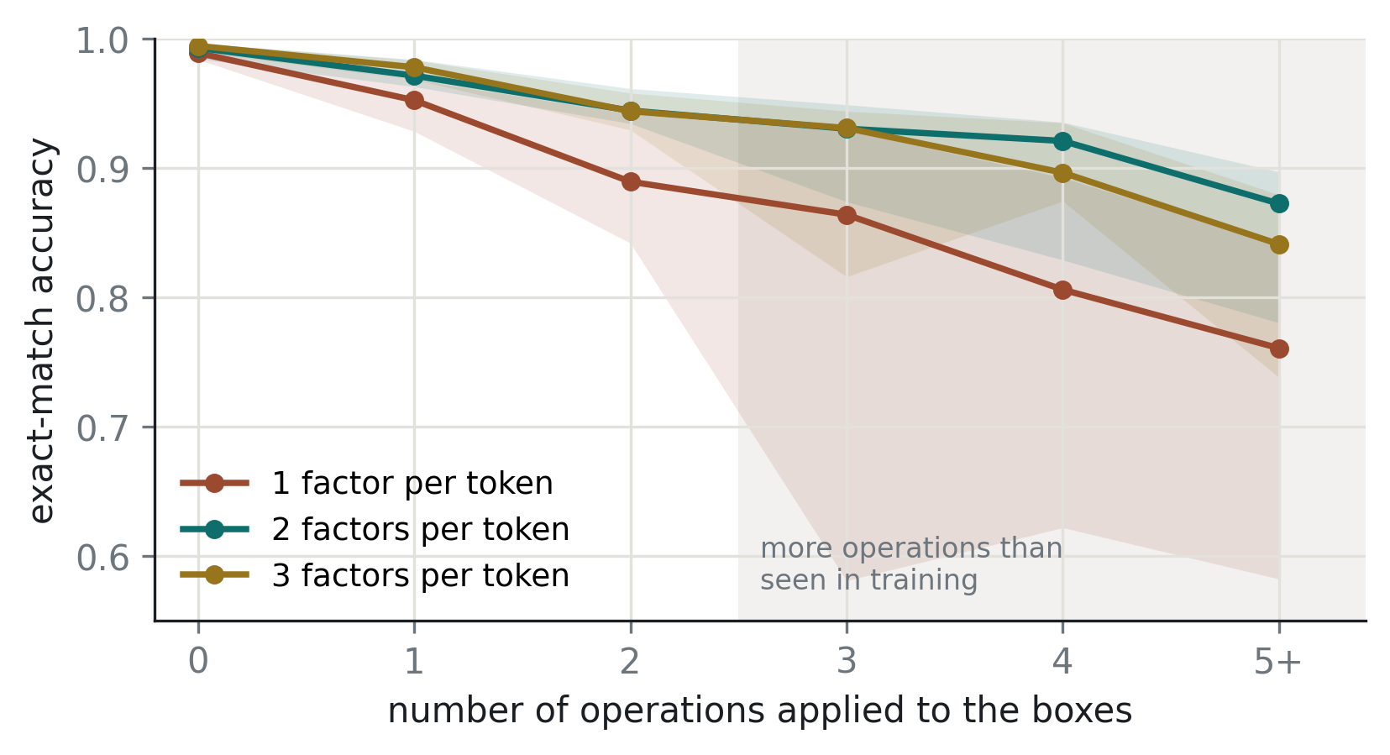
Experimental Results: Order Matters on Real Text
0.915
2 factors per token, on 3 or more operations (all 5 runs above 0.810)
0.810
1 factor per token, same model size
Boxes dataset: median exact match over 5 runs per order (shaded: lowest to highest run)
A third factor adds nothing here (0.889). Next: the learned gate on Boxes.
Same model size at every order (469,120 parameters); 16 000 steps; decision rule written before the runs
The gain is largest where the state changes most: 0.761 → 0.873 at 5 or more operations
12
Notes:
The first test on real text, using Shashwat's Boxes setup with only the number of factors changed and the model size held fixed. Two factors beat one on the harder examples in every run; three added nothing. By the rule written before the runs, the learned gate goes on Boxes next.

Slide 13
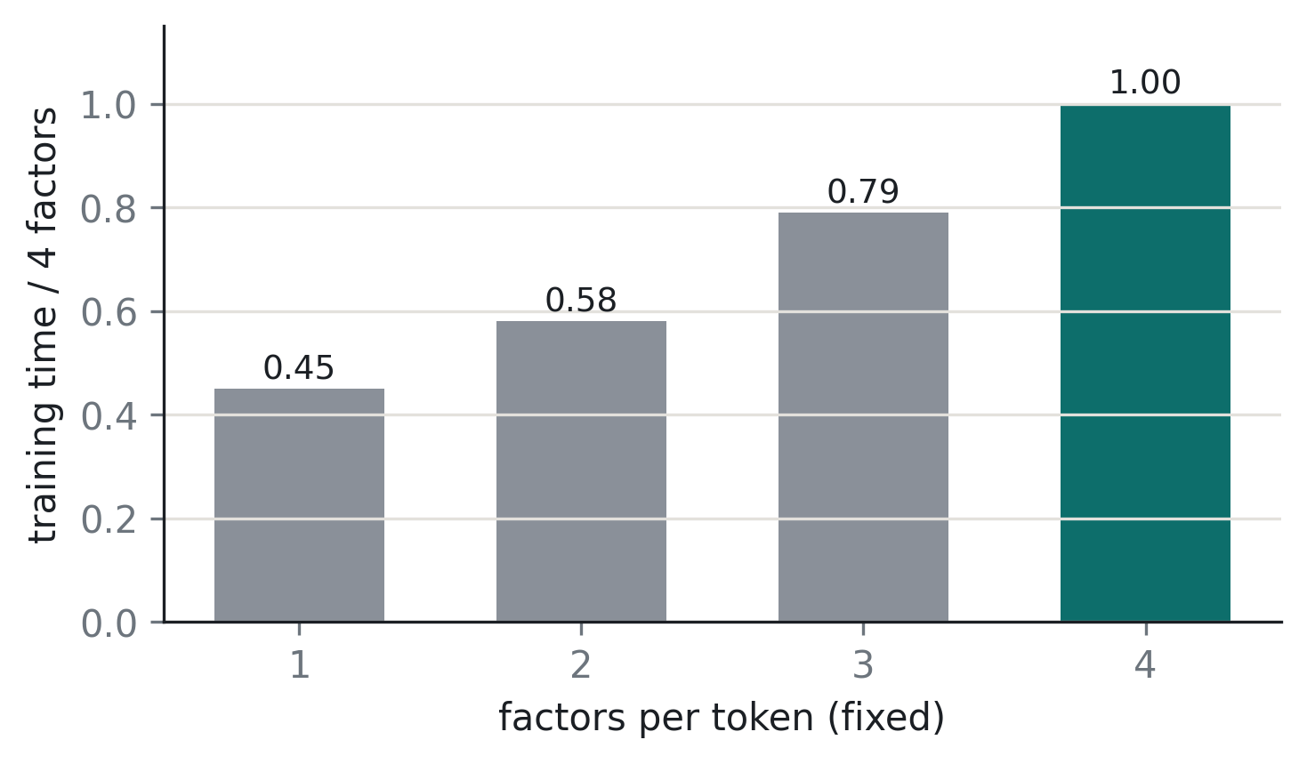
Experimental Results: Training Cost by Order
Every fixed-order training run recorded its time
1 factor trains in 0.45 of the time of 4 factors; 3 factors in 0.79
Five separate sweeps agree within 3% at 2–4 factors
These are layers built with a fixed number of factors, not the adaptive layer
Time for 20 000 training steps, relative to 4 factors
13
Notes:
These come from runs we already had: every fixed-order run recorded its training time. They are times for layers built with a fixed number of factors, not for the adaptive layer, and show what a well-chosen order can save during training.

Slide 14
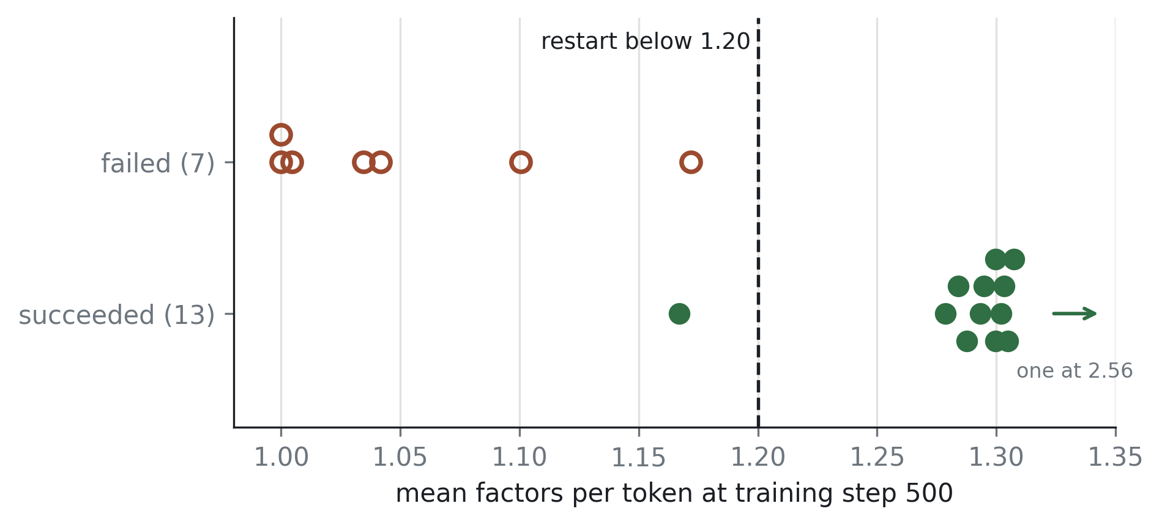
Running Now: Restart Rule for Training
7 / 7
earlier failures caught at step 500 (one success also restarted)
≈ 25 s
cost of one restart in a 16-minute run
Mean factors per token at step 500 in the earlier 20-run study (seeds 11–30)
≥ 18 / 20
A run below 1.20 at step 500 is stopped and restarted from a new seed, up to 5 attempts
Tested on 20 new seeds (31–50), so the threshold is judged on runs it has not seen
exact runs needed to adopt the rule (decided in advance)
14
Notes:
The 20-run study showed that failure is visible very early. This experiment tests whether restarting those runs makes training dependable. We wrote down the decision before running: 18 of 20 or more makes restarting the standard procedure, always reported with its restart count; 13 of 20 stays the per-run figure.

Slide 15
Conclusion and Next Steps
Conclusion so far
Next Steps
The learned gate finds the exact allocation in 13 of 20 runs, with no labels
Skipping closed factors gives 0.73–0.80 of the 4-factor time on large inputs, with accuracy unchanged
On real text, 2 factors per token beat 1 at the same model size
On A₅ the gate stops at 3 factors where 2 are enough
Restart-rule test: 20 runs, about 6 hours
The learned gate on Boxes, compared with fixed 2 and 3 factors (decision rule written first)
Reduce the faster path's overhead (packing and GPU idle time)
Revise the mid-semester report with the updates
15
Notes:
Four things to take away, and the order of the next steps: dependable training first, then the gate on Boxes where we now know the order matters, then overhead reduction, which only changes the size of the speedup.

Slide 16
Updated Timeline of the Project
Period | Activity | Status
Jul 2026 | Problem identification and selection of the research direction | Completed
Aug 2026 | Literature survey | Completed
Sep 2026 | Reproduction; order-requirement analysis; matched-compute and closure experiments | Completed
Sep 2026 | Halting gate implementation and training; entity tracking on Boxes | Completed
Oct 2026 | Reliability of the learned gate; order sweep on Boxes | Completed
Oct–Nov 2026 | Restart rule; learned gate on Boxes | In progress
Nov 2026 | Alphabets with multiple requirement levels | Planned
Dec 2026 – Jan 2027 | Execute only the allocated factors; wall-clock measurement | Done early (Oct)
Feb 2027 | High-requirement regime; replication of headline results | Planned
Mar 2027 | Adaptive order on Boxes, SCONE, ProPara and NPN-Cooking | Planned
Apr 2027 | Final report and presentation | Planned
16
Notes:
The October items are done. Executing only the allocated factors, planned for December and January, was done early because it became the main deliverable. The restart rule and the gate on Boxes are in progress.

Slide 17
Updates to the Mid-Semester Report
The report says | Updated
The learned gate never under-allocates | True of the 10-run sweep only; in the 20-run study all 7 failures give 5-cycles too few factors
The early gate runs started from an open gate | The two earliest configurations started nearly closed (mean order about 0.94); the table is relabelled
The exact allocation was reached in one run | Reached in 2 early runs, reproduced on 1 October, and now in 13 of 20 runs
The revised report will carry these changes. Full dates and details are in the accompanying progress document.
17
Notes:
Three statements in the mid-semester report have since been corrected with the October results. Saying it now is better than having it found later. The revised report will carry these changes.

