Slide 1
Conditional Normalizing Flows for Molecule Generation
Group 9
Omkar Chaudhari, Akshay Gurumoorthi, Rishabh Puri, Matthew Too

Slide 2
Motivation
Challenges in Molecular Design:
Complex chemical space makes targeted synthesis difficult.​
Existing methods like VAEs and GANs face issues with stability and validity.
Why CNFs?​
Invertible, probabilistic framework for precise property control.​
Enhanced chemical validity compared to traditional generative models.
Hybrid Approach
Advances drug discovery, catalysis, and materials science.
Efficient synthesis of chemically valid molecules with targeted properties.
Impact
​
Combines CNFs for molecule generation with quantum-level validation (e.g., RDKit, xTB).​
Ensures generated molecules are plausible and meet desired properties.
Notes:
Generating new molecules with tailored properties is a challenging task due to the vast and complex chemical space. This challenge becomes even more daunting when targeted synthesis is required."
Challenges in Molecular Design:
"Traditional generative approaches like Variational Autoencoders (VAEs) and Generative Adversarial Networks (GANs) have been used for molecular generation. However, these models often suffer from stability issues during training and struggle to guarantee the chemical validity of the molecules they generate. As a result, existing methods fall short of efficiently navigating the chemical space while ensuring that the molecules meet desired property constraints."
Why Conditional Normalizing Flows (CNFs)?
"This is where Conditional Normalizing Flows, or CNFs, provide a significant advantage. CNFs offer an invertible, probabilistic framework that allows for precise control over molecular properties during generation. Unlike traditional models, CNFs enhance chemical validity through their ability to model complex relationships while maintaining the mathematical rigor of exact likelihood computation. This makes them an ideal choice for tackling the challenges of molecular design."
Hybrid Approach:
"Our hybrid approach leverages the power of CNFs to advance key fields such as drug discovery, catalysis, and materials science. By conditioning molecular generation on quantum properties, we enable the efficient synthesis of chemically valid molecules that meet specific property requirements. This approach not only expands the possibilities in molecular design but also ensures the synthesis process remains highly targeted."
Impact:
"Finally, the impact of this work lies in combining CNFs with quantum-level validation techniques like RDKit and xTB. This ensures that the generated molecules are not only computationally plausible but also meet the desired quantum mechanical properties. In doing so, this framework bridges the gap between generative modeling and real-world applications in molecular design."

Slide 3
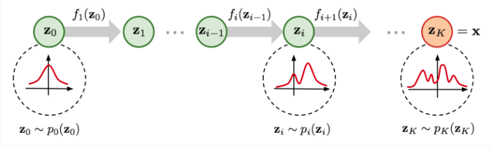
Initial Normalizing Flows
Normalizing Flows are generative models that transform a simple base distribution (e.g., Gaussian) into a complex target distribution via a sequence of invertible transformations.
Generative Direction
Key Features:
Flexible density estimation
Efficient likelihood computation
Probabilistic sampling
Normalizing Direction
https://uvadlc-notebooks.readthedocs.io/en/latest/tutorial_notebooks/tutorial11/NF_image_modeling.html
Notes:
Key Features:
"Normalizing Flows stand out for their three key features. First, they allow for flexible density estimation, enabling the model to adapt to complex data distributions. Second, they support efficient likelihood computation, as each transformation is invertible, making it possible to compute the probability density of the data exactly. Finally, they offer probabilistic sampling, allowing us to generate new data points by reversing the flow of transformations.“
Workflow Description:
"In the diagram, On the left, we start with a simple base distribution, z0z_0z0 , which is typically Gaussian. Through a series of transformations, f1,f2,…,fKf_1, we progressively refine z0p0z0 into a more complex target distribution, which corresponds to zKpKzK . This is the generative direction, moving from the base distribution to the data space.
Reversing this flow gives us the normalizing direction, where we map a complex data distribution back into a simple base distribution. This is essential for likelihood estimation during training."

Slide 4
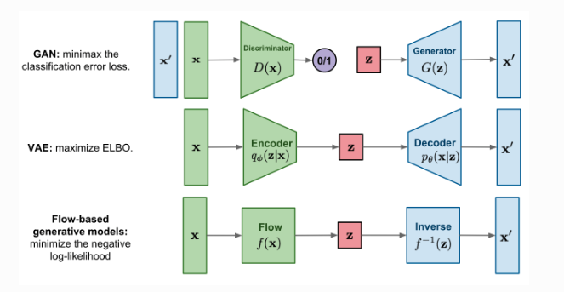
Different Generative Modeling Architectures
Normalizing Flows vs. GANs and VAEs:
Provide exact rather than approximate density estimations with bijectors
Allows final flow to produce expressive and flexible posteriors
https://uvadlc-notebooks.readthedocs.io/en/latest/tutorial_notebooks/tutorial11/NF_image_modeling.html
Notes:
GANs:
"Generative Adversarial Networks, or GANs, operate as a minimax game between a generator G(z) and a discriminator D(x). The generator creates synthetic data, and the discriminator distinguishes between real and generated samples. GANs are excellent for high-quality image synthesis but often suffer from unstable training and mode collapse."
VAEs:
"Variational Autoencoders consist of an encoder that maps data to a latent space and a decoder that reconstructs the input. By maximizing the Evidence Lower Bound (ELBO), VAEs balance reconstruction accuracy with latent space regularization. However, their outputs can lack sharpness, especially for high-resolution data."
Flow-Based Models:
"Flow-based models, like Normalizing Flows, use invertible transformations f(x) to map data to a latent space while preserving exact likelihood computation. Their flexibility and interpretability make them ideal for tasks requiring precise probabilistic modeling, such as molecular generation."
Closing:
"In summary, GANs focus on quality, VAEs on structure, and Flow-based models on exact probabilities and sampling efficiency, making them highly versatile for generative tasks."

Slide 5
MATH

Slide 6

Unconditioned Normalizing Flows
An unconditional normalizing flow transforms a base random variable $z$ (e.g., Gaussian) into a complex target variable $x$ through an invertible function $f$:
$$x=\left(f_{k}∘f_{k−1}∘⋯∘f_{1}\right)\left(z\right)=f(z)$$
Each transformation $f_{K}$ ensures invertibility, allowing the computation of the probability density of $x$ via the change of variables formula:
$$p_{X}\left(x\right)= p_{Z}\left(f^{−1}\left(x\right)\right)\left|\det\left(\frac{∂f^{−1}}{∂x}\right)\right|$$
During training with a sample $\left\{x^{(1)},x^{(2)},…,x^{(n)}\right\}$, the loss is the negative log likelihood$−log{L\left(f\right)}$. The loss is minimized to find the best mapping $\hat{f}$ to the target distribution:
$$\hat{f}=argmin_{f}\left\{−log{L\left(f\right)}\right\}=argmin_{f}\left\{−\sum_{i=1}^{n}{\left[\log{p_{Z}\left(f^{−1}\left(x^{(i)}\right)\right)+\log\left|\det\left(\frac{∂f^{−1}}{∂x^{(i)}}\right)\right| }\right]}\right\}$$

Slide 7
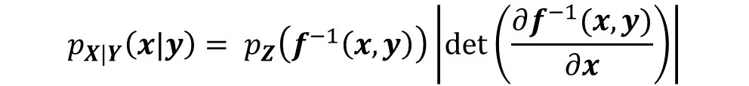
Conditioned Normalizing Flows
Conditional normalizing flows include a regression target $y$ and differ from unconditional normalizing flows in that
All distributions are made conditional
The flow $f^{−1}$ has a conditioning argument of $y$
Conditioned Invertibility:
$$x=\left(f_{k}∘f_{k−1}∘⋯∘f_{1}\right)\left(z,y\right)=f(z,y)$$
$$p_{X|Y}\left(x|y\right)= p_{Z}\left(f^{−1}\left(x,y\right)\right)\left|\det\left(\frac{∂f^{−1}(x,y)}{∂x}\right)\right|$$
Conditioned Change of Variables:
Conditioned Loss:
During training with a sample ${\left\{x^{\left(i\right)},y^{\left(i\right)}\right\}}_{i=1}^{n}$, the conditional loss is minimized.
$$\hat{f}=argmin_{f}\left\{−log{L\left(f\right)}\right\}=argmin_{f}\left\{−\sum_{i=1}^{n}{\left[\log{p_{Z}\left(f^{−1}\left(x^{(i)},y^{(i)}\right)\right)+\log\left|\det\left(\frac{∂f^{−1}(x^{\left(i\right)},y^{(i)})}{∂x^{(i)}}\right)\right| }\right]}\right\}$$

Slide 8







Masked Autoregressive Flows
Masked autoregressive flows (MAFs) are one type of conditioned normalizing flows stacked with multiple “flow layers”. Each “flow layer” contains a
Masked Autoencoder for Distribution Estimation (MADE) layer
Permutation layer
This model was used in this work.
$$f_{1}$$
$$f_{2}$$
$$f_{3}$$
$$f_{4}$$
$$f_{5}$$
$$z$$
MADE 1
PERM 1
MADE 2
PERM 2
$$x$$
Flow Layer 1
Flow Layer 2

Slide 9
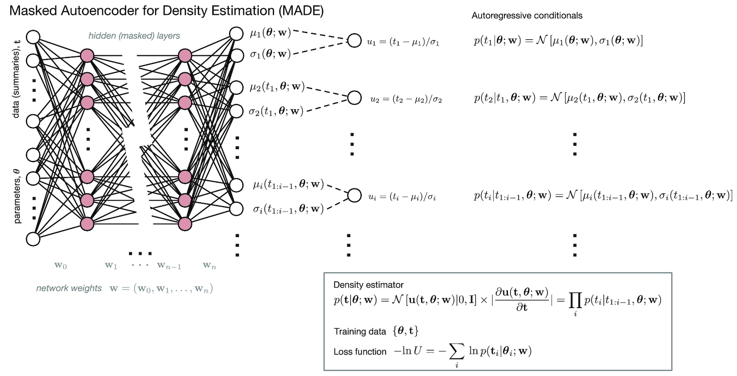
Conditioned MADE Layers
Inverse Transformation
Lower Triangular Determinant
Neural network accounts for autoregressive property with a binary mask applied to weights $W$.
$x$ to $z$ transformation occurs in a single-forward pass → $f^{−1}$ calculated without recursion → fast generation of $p_{X}\left(x\right)$!
MNRAS 000, 1–20 (2017)

Slide 10

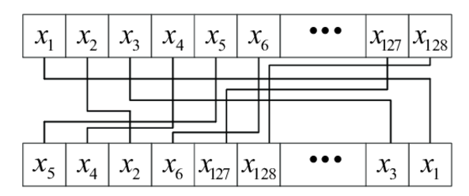
Permutation Layers
Permutation Layer: To avoid fixed ordering dependencies, a permutation π is applied:
This ensures different dimensions are modeled in varying orders across layers.
Sensors 2022, 22, 7919.

Slide 11
Data Prep and Model Building

Slide 12
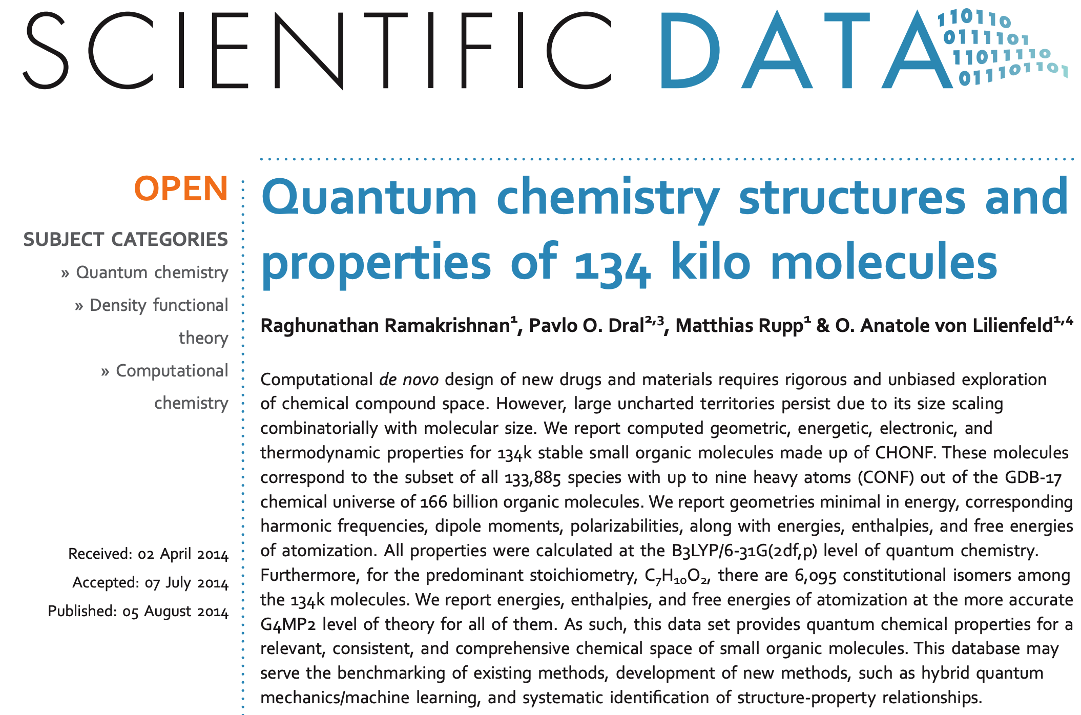
DFT Data – QM9 Dataset
Generation of Optimized Structures of more than 100,000 species of mole, based on earlier published data in QM9.
Geometry Optimization done with B3LYP based Hybrid DFT Functional, with a 6-31(G) based basis set.
Constituent atoms of the Organic Molecules were Carbon, Hydrogen, Nitrogen, Oxygen and Fluorine, Phosphorous.
Generation of QM Dataset
1 Ramakrishnan, R., Dral, P., Rupp, M. et al. Quantum chemistry structures and properties of 134 kilo molecules. Sci Data 1, 140022 (2014)

Slide 13
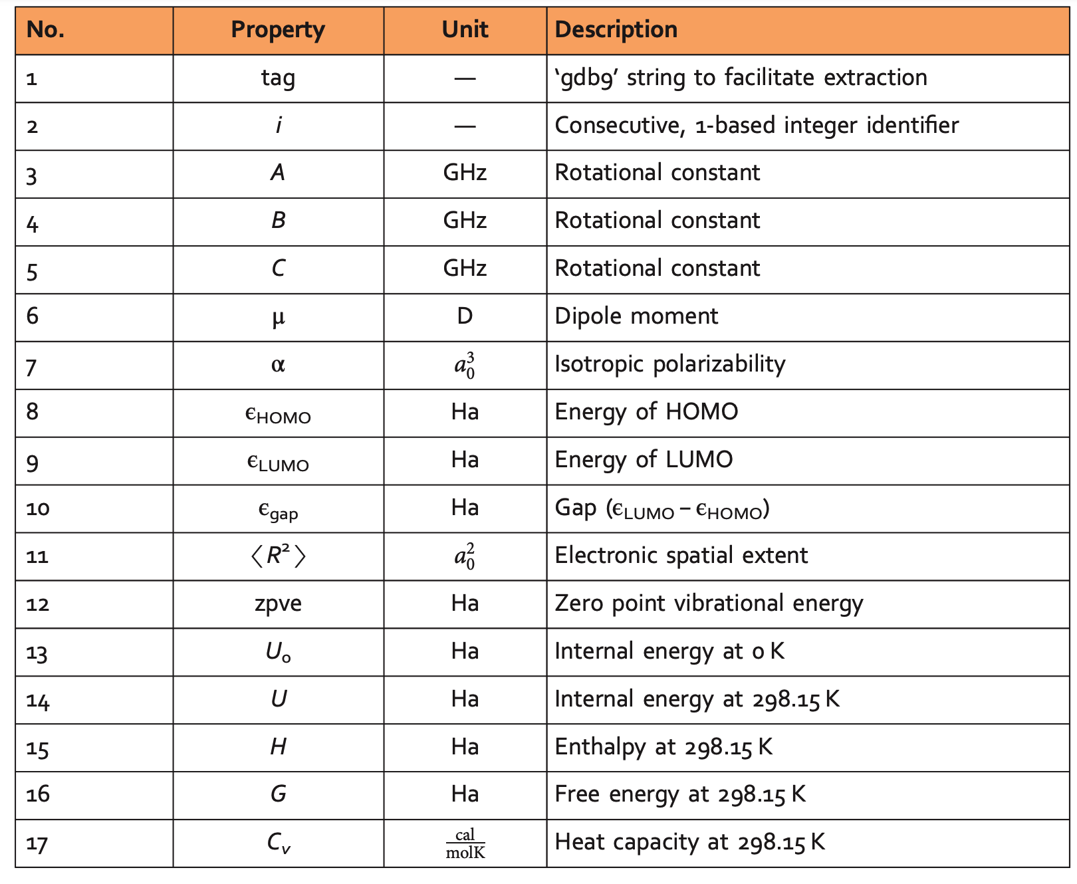
QM9 Dataset – Reported Properties
2 Ramakrishnan, R., Dral, P., Rupp, M. et al. Quantum chemistry structures and properties of 134 kilo molecules. Sci Data 1, 140022 (2014)

Slide 14
Data Preprocessing
Data Extraction
Filter Invalid Molecules
Convert to SELFIES
One-Hot Encoding
Integrate Features
Extract SMILES strings and quantum properties (e.g., dipole moments, polarizability, HOMO-LUMO gaps) from DFT data.
Remove disconnected or invalid molecules from SMILES
Transform SMILES into chemically valid SELFIES strings
Encode SELFIES into one-hot vectors with padding for uniformity
Combine encoded SELFIES with DFT properties for a comprehensive representation.

Slide 15
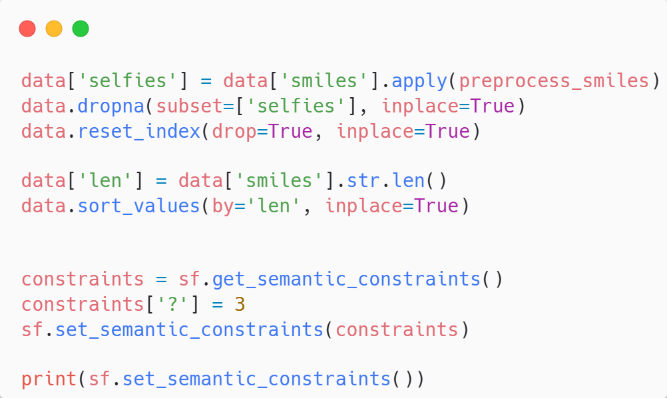
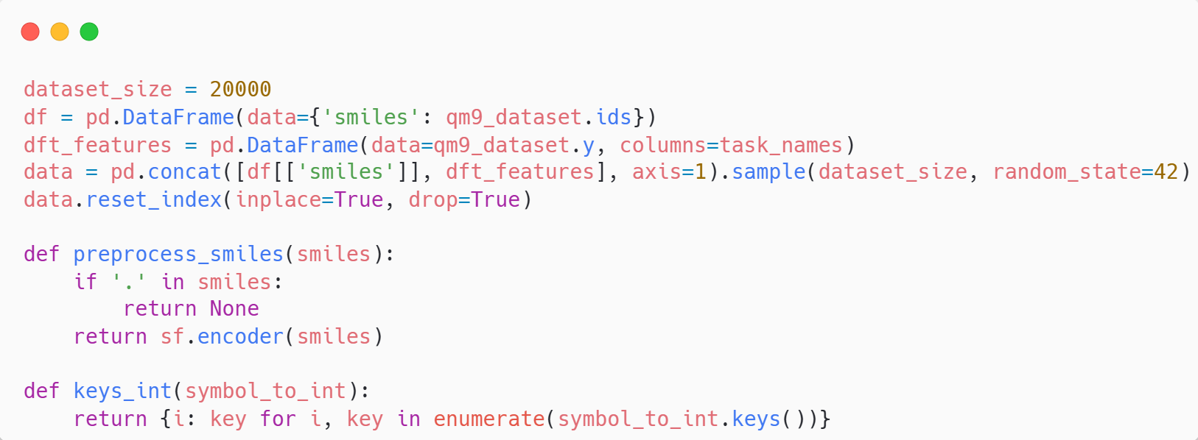
Initial Dataset Preparation
Dataset Details:
QM9 dataset used
20000 Molecules
Selfies Library used for setting bond constraints
Semantic Constraints?
Notes:
Semantic Constraints for unrecognized molecules default is 8, for generating valid molecules, constraining to 3 was done. CH3- will have 3 bonds on C

Slide 16
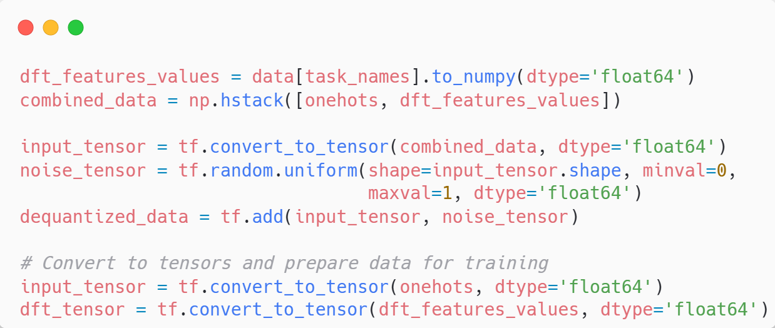
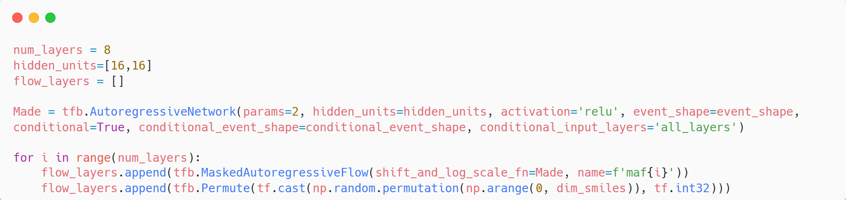
Building the Model
Architecture:
Dequantization
Model Building
Notes:
Dequantisation is needed here as well have a normalizing flow that operates on continuous data, not discrete, adding this noise allows to model to operate on our data. The permuation layers as explained before adds to the expressiveness of the model.

Slide 17
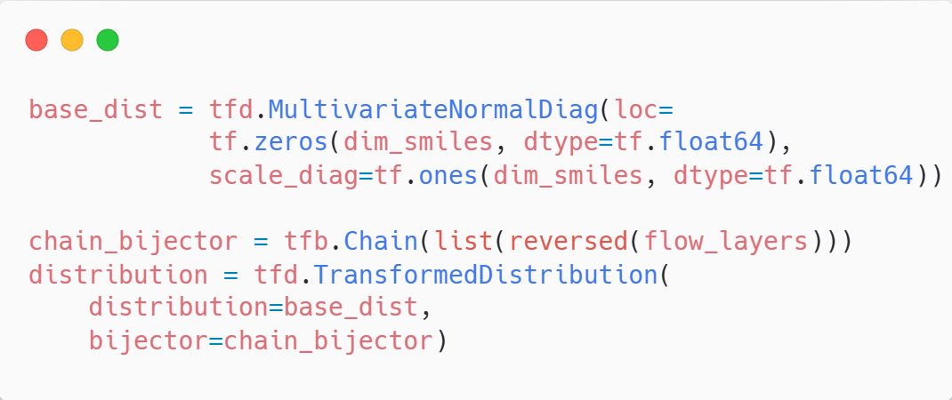
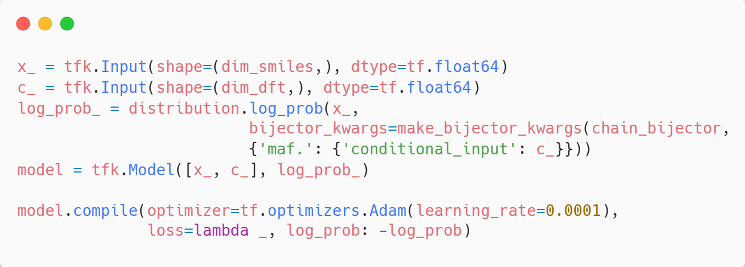
Making Bijectors, Linking Distributions
Notes:
We pass in a multivariate gaussian as the base distribution. The learning rate used here was very small, as higher ones seems to lead to high numerical instabilities.

Slide 18
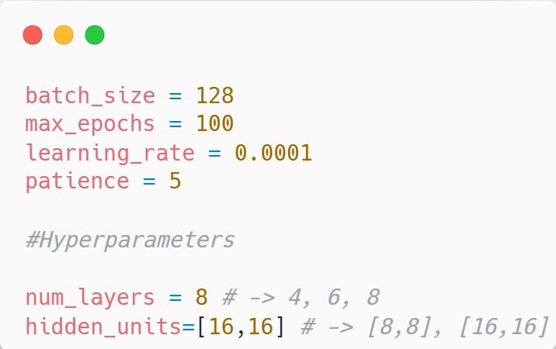
Training and Hyperparameter Tuning

Slide 19
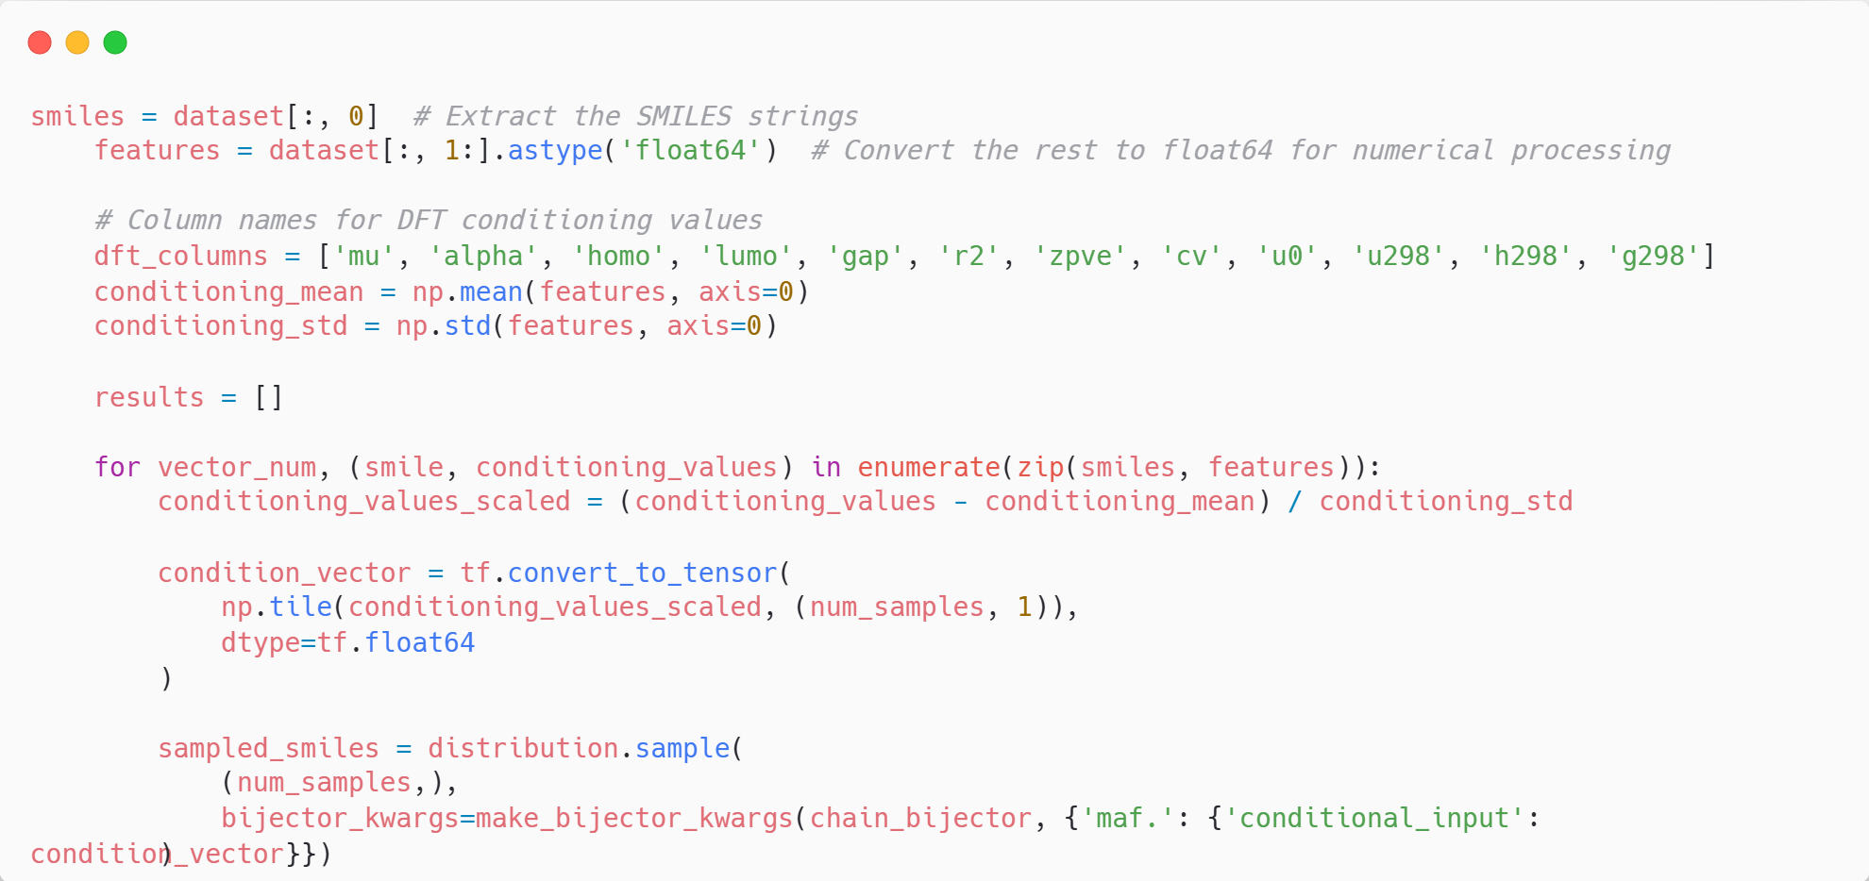
Inference
Sampling using Realistic DFT Data:
Creating the Condition Vector
Passing the condition to generate SELFIES

Slide 20
Results and Conclusion

Slide 21
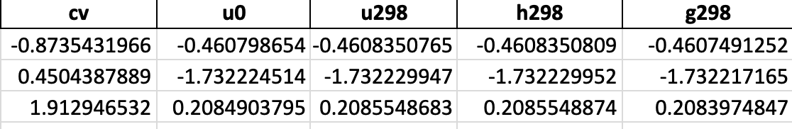
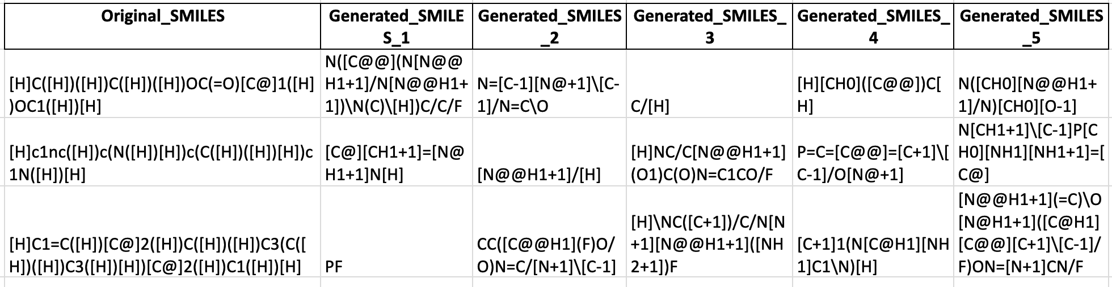
QM9 Dataset – Output from Generative Model
SMILES string of the input molecule with the corresponding properties, taken from the QM9 Dataset.
Generated Molecules, expected to have for similar molecular properties
2 Ramakrishnan, R., Dral, P., Rupp, M. et al. Quantum chemistry structures and properties of 134 kilo molecules. Sci Data 1, 140022 (2014)

Slide 22
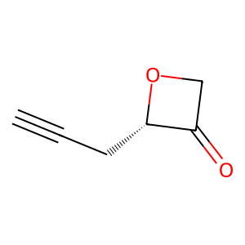
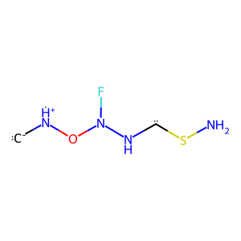
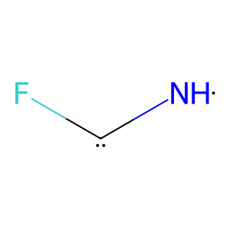
Successful Predicted Molecules – Validated at lower level of DFT theory
Dipole Moment: -0.81 Debye
Dipole Moment: -0.85 Debye
Dipole Moment: -0.89 Debye
From Dataset
Generated Molecules – Close to Target Property

Slide 23
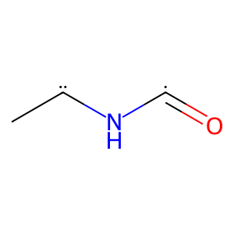
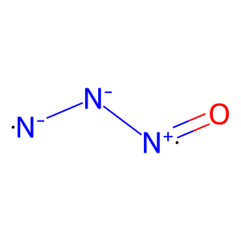
Unsuccessful Predictions
Dipole Moment: -0.81 Debye
Dipole Moment: -1.56 Debye
Dipole Moment: -2.43 Debye
From Dataset

Slide 24
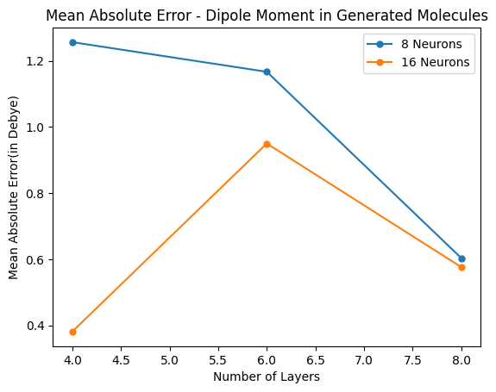
Validation Trends in Generated Molecules
We observe that, for the same number of layers in the AI Model, increase in number of neurons leads to a reduction in the mean absolute error of the dipole moment.
1 Ramakrishnan, R., Dral, P., Rupp, M. et al. Quantum chemistry structures and properties of 134 kilo molecules. Sci Data 1, 140022 (2014)

Slide 25
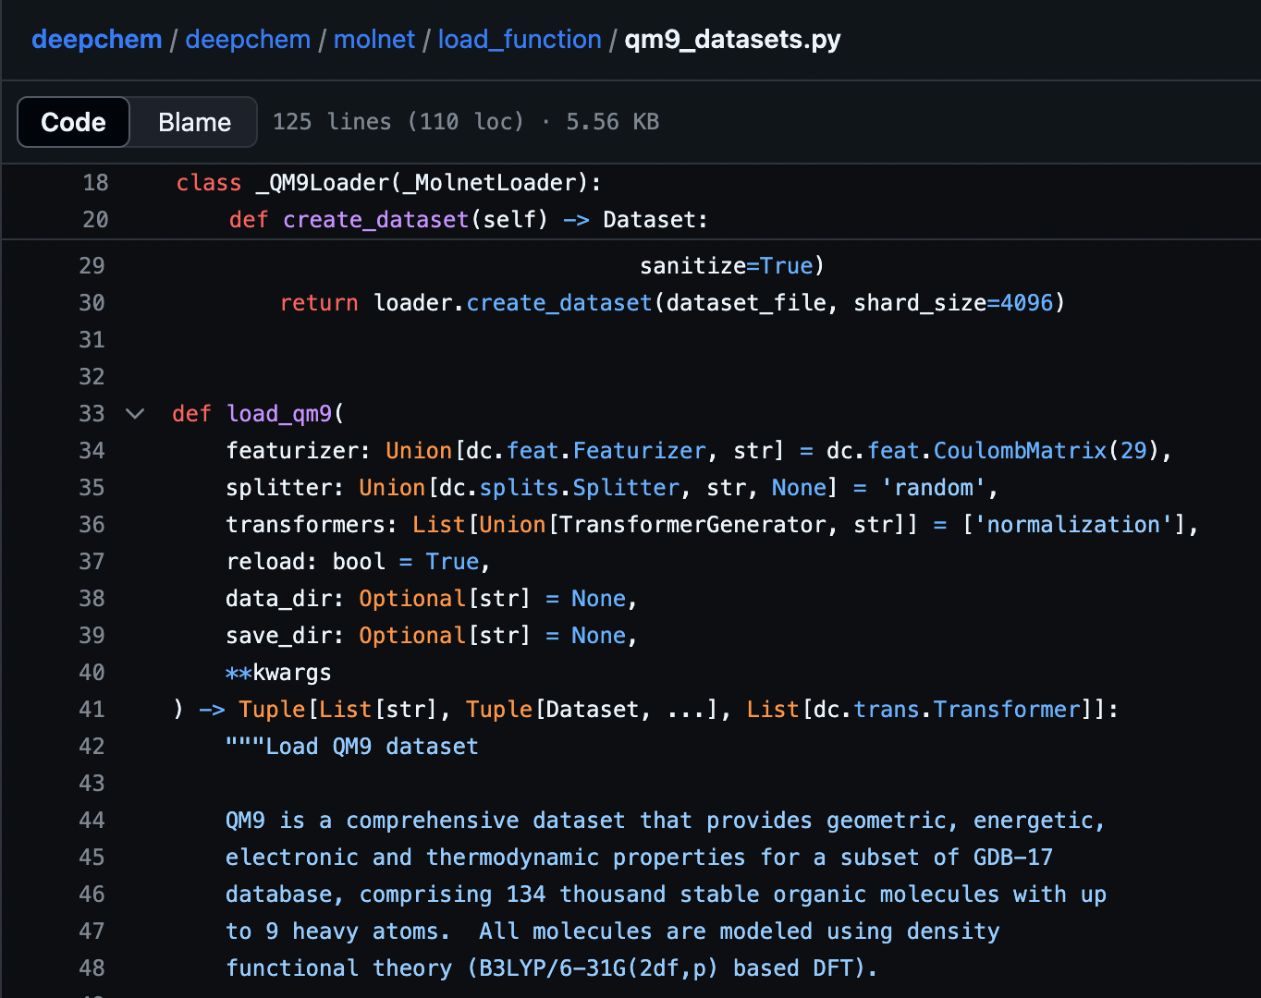
Problems and Limitations – DeepChem Library
The DeepChem Library that was used to import the molecular properties from the QM9 dataset automatically normalizes the property values.
In the run that was used to generate new molecules, this was not noticed. Therefore, the generated values of certain properties such as enthalpy, entropy, Gibbs Free Energy were not consistent with the expectation from DFT Calculations.
However, the values of these properties for generated molecules, upon verification with the original QM9 dataset were consistent in order of magnitude
1 Ramakrishnan, R., Dral, P., Rupp, M. et al. Quantum chemistry structures and properties of 134 kilo molecules. Sci Data 1, 140022 (2014)
2 Bharath Ramsundar, Peter Eastman, Patrick Walters, Vĳay Pande, Karl Leswing, & Zhenqin Wu (2019). Deep Learning for the Life Sciences. O'Reilly Media.

Slide 26
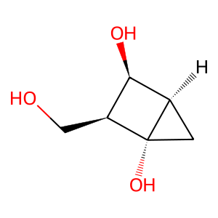
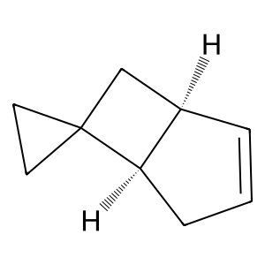
Limitations - Generation of Unphysical/Unstable Molecules
As an example, these are two generated molecules with extremely high ring-strain and conformational strain, which are unlikely to be stable.
Our present pipeline cannot distinguish between physically stable molecules and unphysical molecules.
2 Ramakrishnan, R., Dral, P., Rupp, M. et al. Quantum chemistry structures and properties of 134 kilo molecules. Sci Data 1, 140022 (2014)

Slide 27
Potential Improvements and Work
Using it on specialized datasets for specific applications
Adding physical constraints to avoid unstable structure generation.
Add weight stabilization techniques for numerical stability of the Jacobian.

Slide 28
Thank you

