Slide 1
Project FORESIGHT
Demand & Inventory Intelligence — Executive Readout
Prepared for: Head of Operations & Finance, NorthBay Living
Zidio Development · Data Science & Analytics

Slide 2
THE BRIEF
NorthBay is guessing what to stock
~60 active SKUs across Furniture, Décor, and Small Appliances, planned on spreadsheets and gut feel.
Best-sellers run out (lost sales); slow movers pile up (cash locked in markdowns).
The ask: a weekly demand forecast, an early-warning system for stockouts and overstock, and a tool the ops team can use without a data scientist in the room.

Slide 3
HEADLINE IMPACT
What FORESIGHT found, in rupees
₹5.5 Cr
₹88 L
25 of 60
Sales at risk from stockouts, next 6 weeks
Capital locked in overstock
SKUs need a reorder now
The model's weekly SKU-level forecast beats a seasonal-naive baseline by roughly a third on backtest (11.6% WAPE vs 17.5%), so the ₹ figures above are built on numbers the team can trust, not guesswork.
Recommendation: action the 25 “Reorder Now” SKUs this week; run a markdown promotion on the 2 “Markdown / Clear” SKUs to free up capital before next quarter's stock intake.

Slide 4
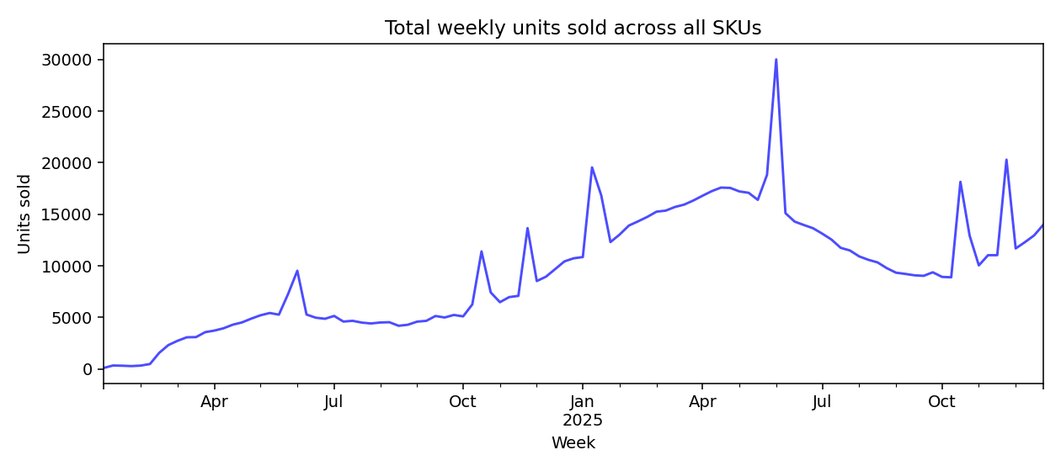
WHAT THE DATA SHOWS
Demand is seasonal and promo-driven
Demand climbs through the year and spikes sharply during promo weeks.
Promo weeks sell ~2x a normal week on average — the forecast must model this explicitly.
A naive “average of last month” approach would badly under- or over-shoot around every sale.
Source: reports/figures/01_total_weekly_demand.png — generated by src/eda.py

Slide 5
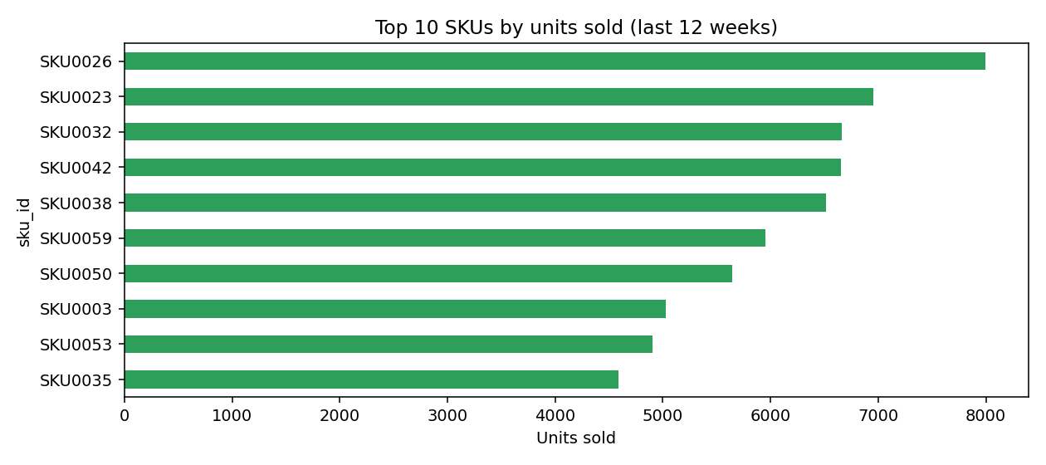
WHAT THE DATA SHOWS
A small set of SKUs drives most of the volume
The top 10 SKUs account for a large share of units sold in the last 12 weeks.
These deserve the tightest stockout monitoring — a missed reorder here is the costliest miss.
A long tail of low-volume SKUs are the natural markdown / clear candidates.

Slide 6
HOW WE BUILT IT
Forecast first proven against a baseline, honestly
Framed the metric (WAPE) and a 6-week forecast horizon before touching a model, per standard forecasting practice.
Built a seasonal-naive baseline first — the bar every model has to clear.
Trained a gradient-boosted model on lag, rolling-average, calendar, and promo features.
Validated with rolling-origin backtesting (train on the past, test on the next block, repeat) — never a single random split, and no future data ever touches a feature.
Result: 11.6% WAPE vs 17.5% for the baseline — the model wins, and we can show our work.

Slide 7
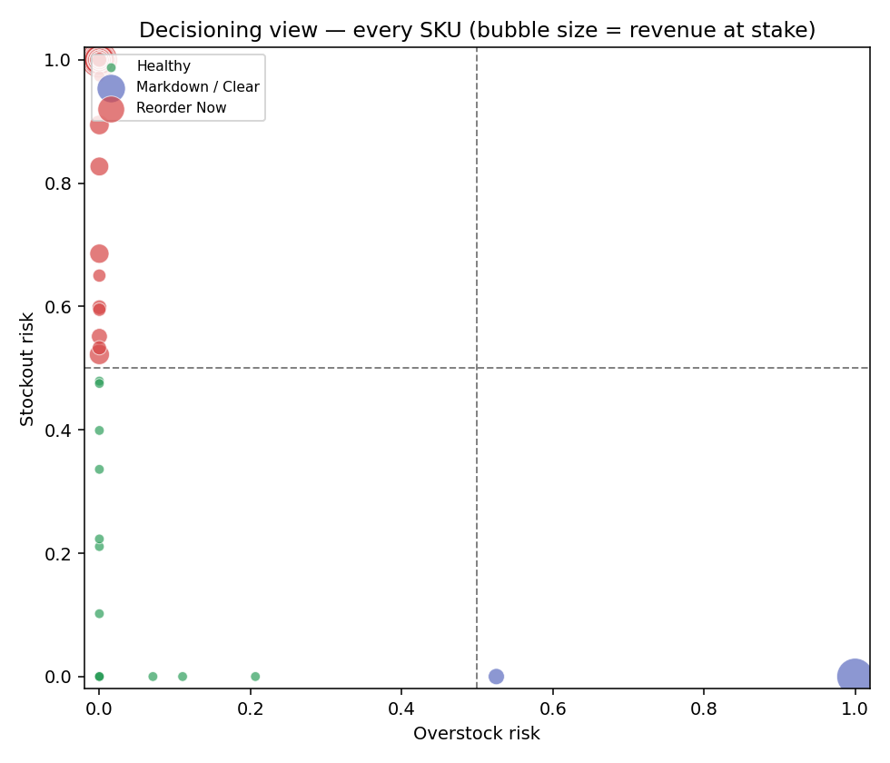
TURNING FORECASTS INTO DECISIONS
Every SKU, plotted by risk
Reorder Now: high stockout risk — raise a replenishment order.
Markdown / Clear: high overstock — promote or discount.
Watch / Volatile: high on both — review manually.
Healthy: no action needed.
Bubble size = revenue at stake. This is the view the ops team uses to triage weekly.

Slide 8
DELIVERED
What NorthBay's team gets
A reproducible data pipeline — re-runs end to end from raw extracts with one command.
A backtested, baseline-beating demand forecast for every SKU, 6 weeks out.
A transparent stockout/overstock risk score with a recommended action and rupee value per SKU.
A planning dashboard the ops team can use without a data scientist in the room.
A deployed scoring service any system can call for a forecast + risk on demand.

Slide 9
HONEST LIMITATIONS & NEXT STEPS
What this doesn't cover yet
New SKUs with under 12 weeks of history fall back to category-level patterns — flagged as lower-confidence.
The model was trained and validated on the provided extracts; a live data feed will need the same rolling-origin discipline before every retrain.
Out of scope for this engagement: live system integrations, price optimization, and automated purchase orders — FORESIGHT recommends, it does not act.
Suggested next step: pilot the “Reorder Now” list for one ordering cycle, then compare actual stockouts against this month's forecast to calibrate trust.

