Slide 1
Bikroy.com
NaJRIN SULTANA-1605042
Abrar Nadib-1605043

Slide 2
Functionality:
• Users Can Sign up.
• Users Can Sign in.
• Users Can Post a product.
• Users will get notifications if he needs to pay.
• Users will get notifications after sending his product for admin verification.
• Admin can see pending products.
• Users will get notifications when admin verifies his product.
• Users will get notifications if admin removes his.

Slide 3
• Registered Users Can report a product.
• Every admin will be notified if someone reports.
• Registered Users Can send message to each other.
•Registered users can mark a product as favorite and view the favo rite products later.
• Users can view products by category and locations.

Slide 4
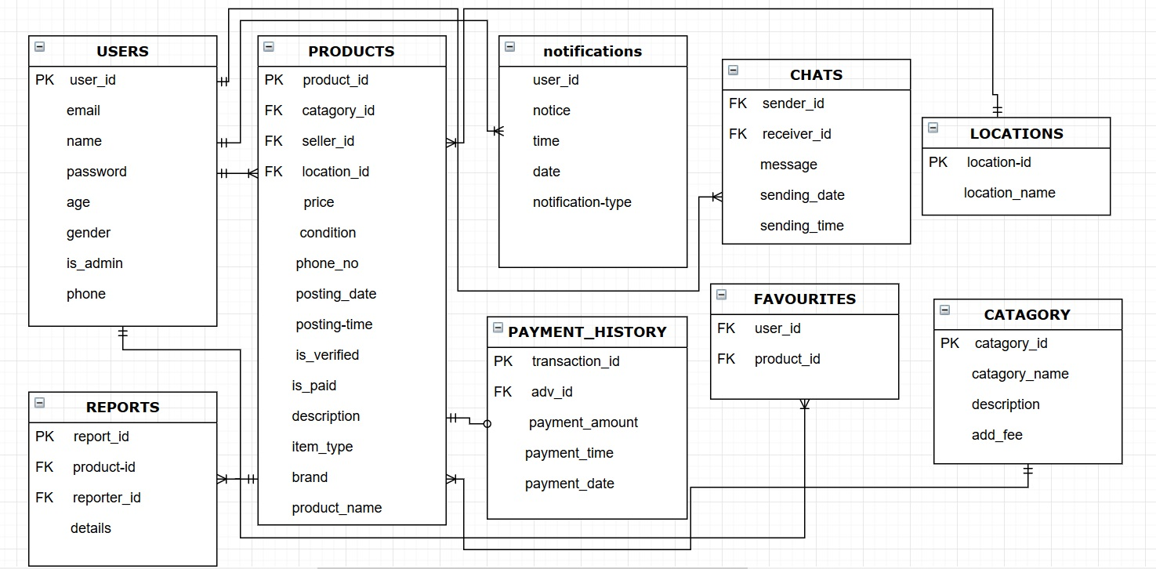
MODIFIED ERD

