Slide 1
GlobalMart Supply Chain & Business Performance Analytics
Capstone Project
Prepared by: Shuaib Shukurah Modupe
Tool: Microsoft Power BI

Slide 2
Project Overview
GlobalMart Ltd. experienced rapid growth but faced delivery delays, inventory imbalance, stagnant profit margins and limited visibility.
Objectives:
• Analyze supply chain performance
• Evaluate profitability
• Build interactive dashboards
• Provide actionable insights

Slide 3
Data Preparation
• Removed duplicates
• Checked missing values
• Corrected data types
• Standardized text values
• Created: Days to Ship, Is Late, Damaged Rate, Order Month, Order Year
• Tools: Power Query, DAX, Power BI

Slide 4
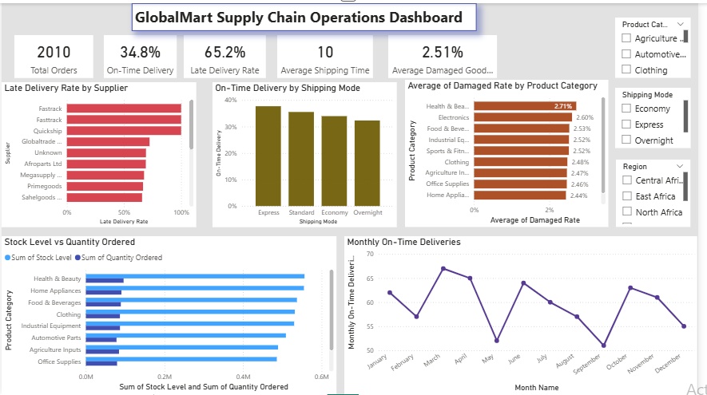
Supply Chain Operations Dashboard
Key Insights:
• Supplier delivery performance varies.
• Shipping mode affects on-time delivery.
• Damaged goods differ by category.
• Inventory optimization opportunities exist.

Slide 5
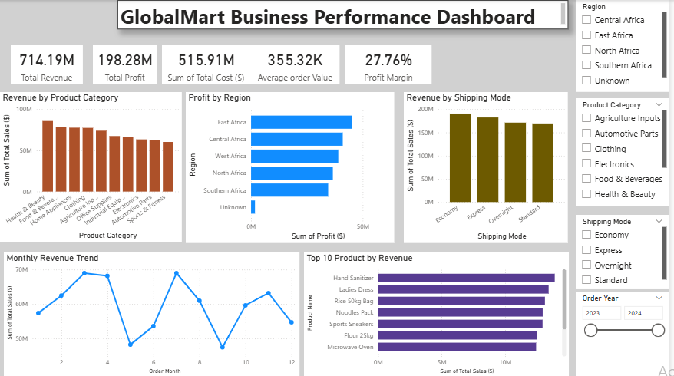
Business Performance Dashboard
Key Insights:
• Revenue varies by category.
• Regional profit differs.
• Monthly revenue trend shows performance.
• Top products drive most revenue.

Slide 6
Recommendations
• Improve supplier performance.
• Prioritize efficient shipping modes.
• Reduce damaged goods.
• Optimize inventory.
• Focus on high-performing products and regions.

Slide 7
Conclusion
The dashboards transform operational data into actionable insights that support better supply chain and business decisions.

