Slide 1
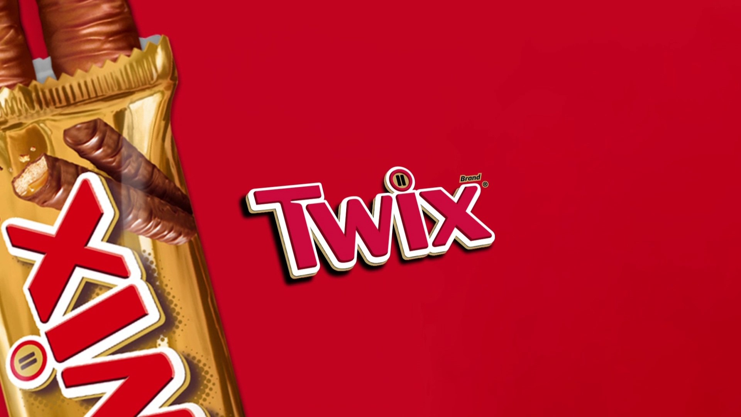
History of Twix

Slide 2
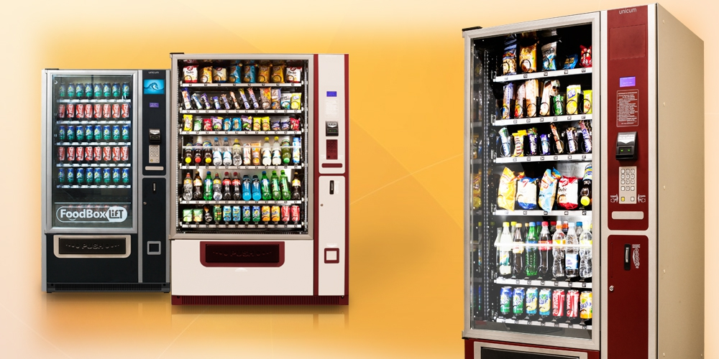
Where is it sold?
Stores
Restaurants
Vending machines

Slide 3

Production
factory import
UK (1967)
USA (1979)

Slide 4
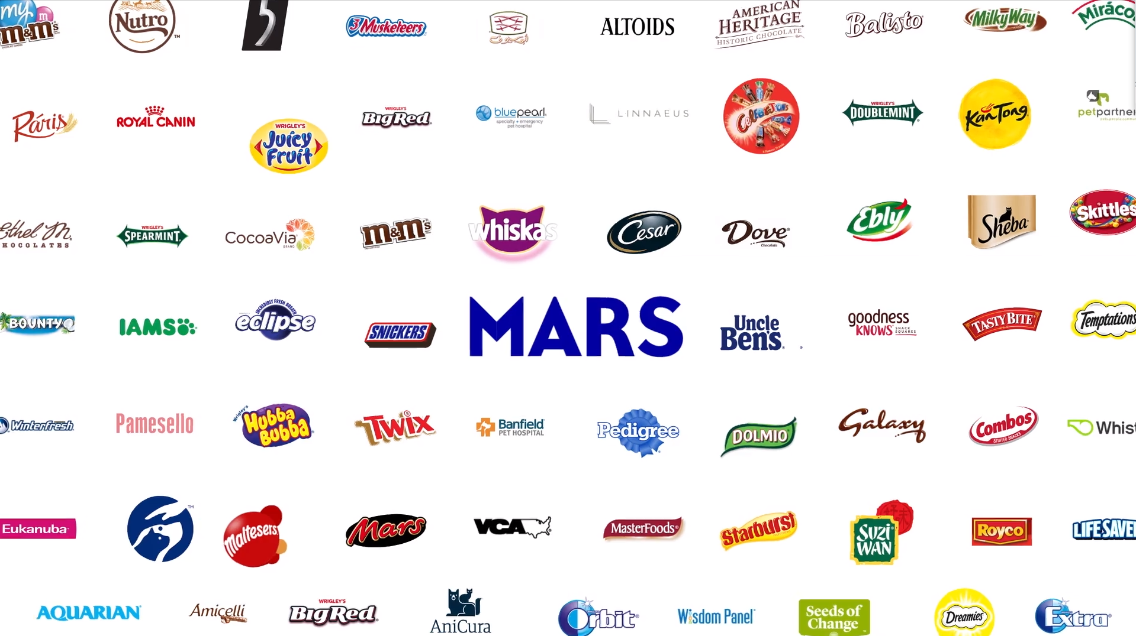
Company
Mars Incorporated Company

Slide 5
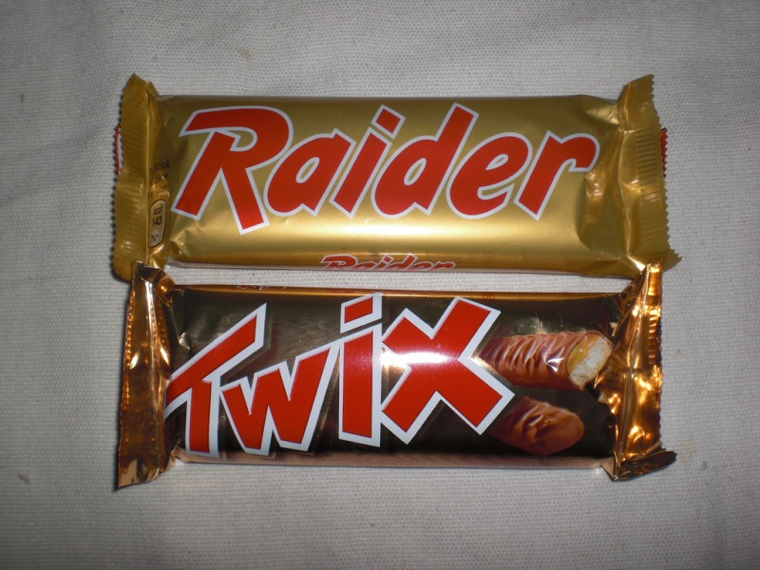
Second name
“Twix” and “Raider”

Slide 6
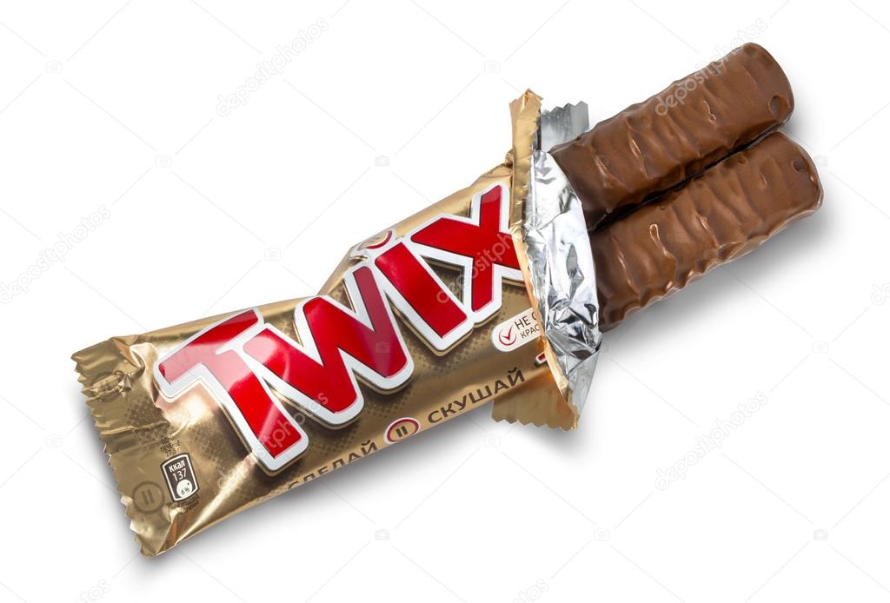
Two sticks
“Twin” and “Stick”

Slide 7
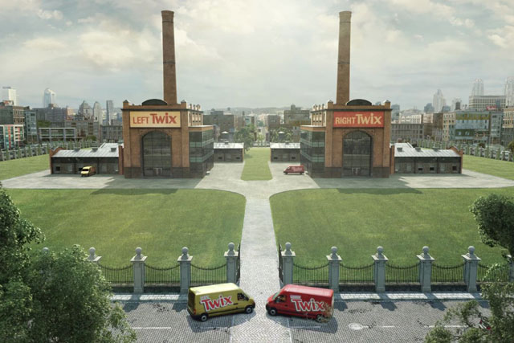
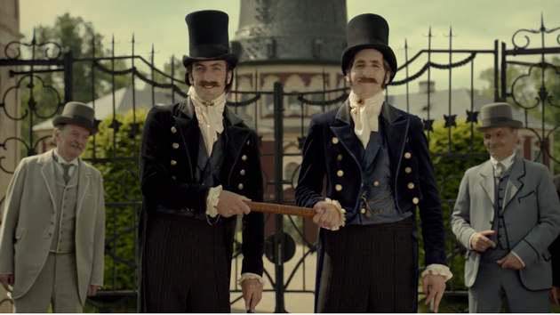
Legend
Left and right factories
Seamus Brothers

Slide 8
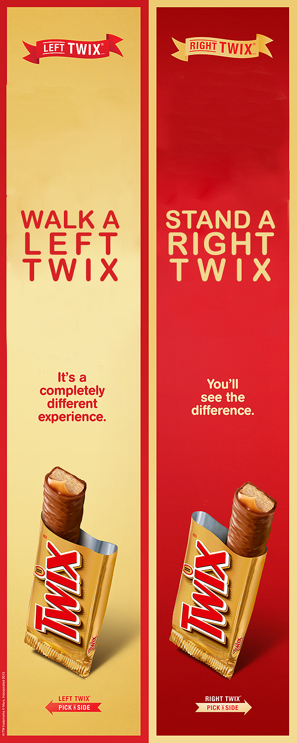
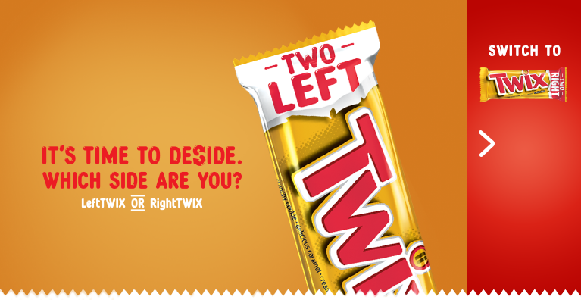
Slogan

