Slide 1


Slide 2
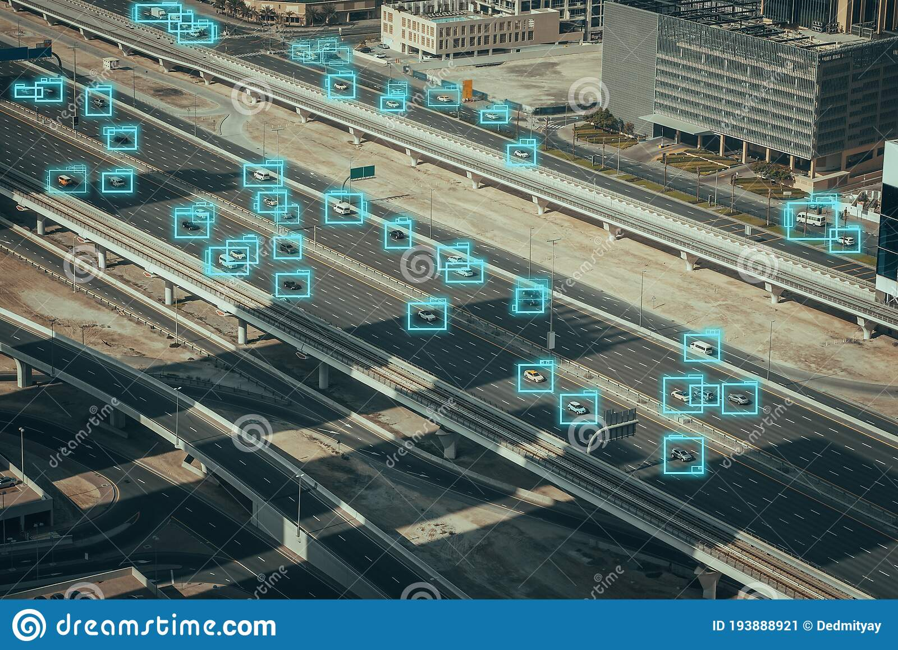
Data Mining in Traffic Control
Congestion of cars
Traffic jams

Slide 3
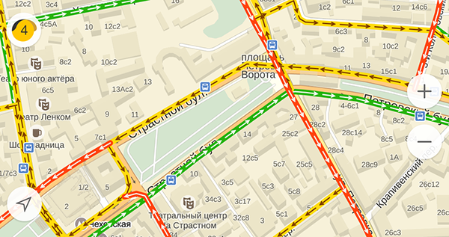
Data Mining in Traffic Control
Congestion maps
Level of congestion

Slide 4
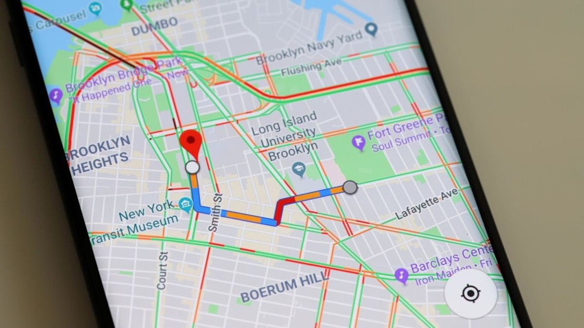
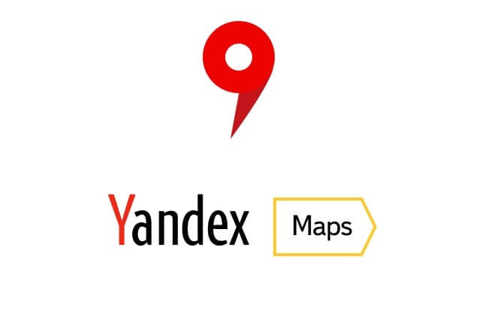

Data Mining in Traffic Control
Google maps
Yandex maps

Slide 5
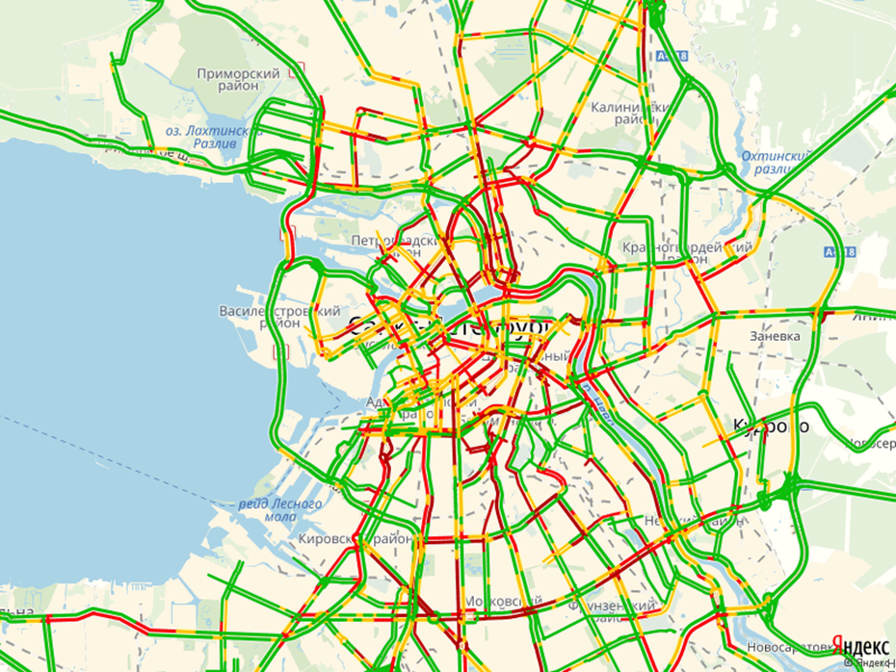
Data Mining in Traffic Control
Сolors of road congestion: red, yellow, green…

