Slide 1

SP4 Team 13
Shum Weng Sang,

Slide 2
Table of Contents:
Game Overview
Basic game description.
More detailed game description.
Framework + backbone of the program.
Challenges/ Problems the Team Encountered
Individual Work Description
Roland
Amos
Wei Qi
Ying Tzu
Samuel

Slide 3
Game Overview: What is it?
3D Simulation game, resource allocation.
Written entirely in C++ with OpenGL
Platform: PC
WASD controls, mouse click.

Slide 4
Game Overview: Game Description
The game lasts for 7 in-game days, with each day consisting of 9 hours.
Tile based.
Three main phases: Start of day, game play, End of day.
Start of day: prepare and buy masks.
Game play: watch masks sell, can buy masks at a greater cost.
End of day: Count your profits.

Slide 5
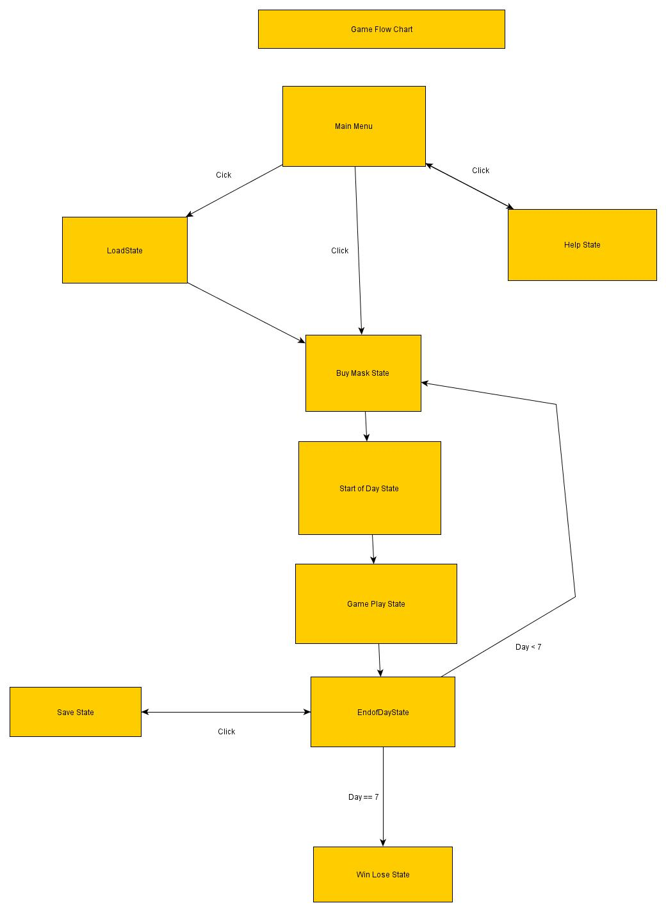
Game Overview: Framework and Backbone.
Using game states with a game state manager to control the game states.

Slide 6
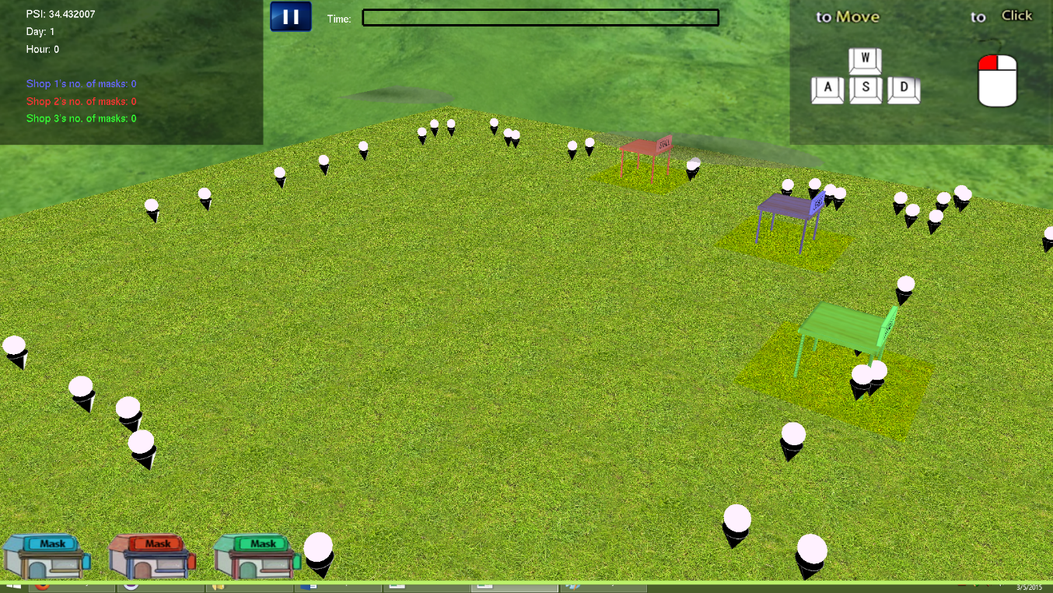
Game Overview: Challenges/Problems (Team)
Implementing a separate stack of states and state manager inside the program.
Many unhandled memory leaks.
Loading textures multiple times.

Slide 7
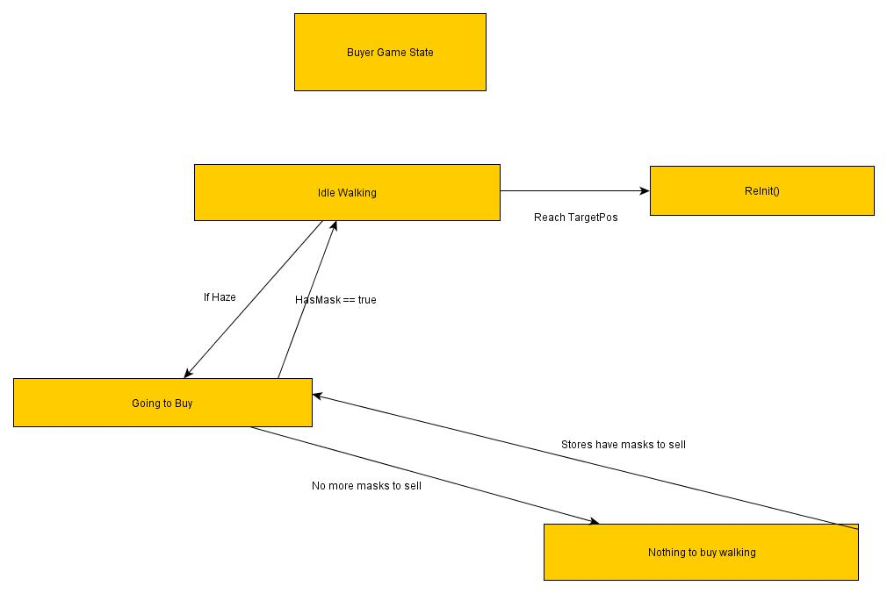
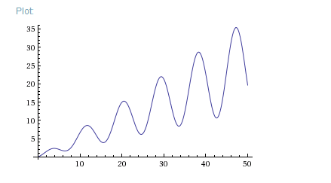
Roland
Buyer
Has a randomized personality.
Finite State Machine.
Weather
Data generated with a variation of Sine Graph.
Add in Perlin Noise.
Use data to seed random tiles on the map.
Used a recursive tree to create and render second grid.
Cellular Automata to diffuse the haze.
Highscore
Save and load highscore.

Slide 8
Wei Qi
Forecast
Algorithm based(total of 4 functions)
Uses values from Weather to 99% predict the day.
Save and Load
Save and Load from .txt files.
Buying during Gameplay
Player able to view the shop’s stock and add to it.

Slide 9
Samuel
Game State Manager and In-game State Manager
Manages a stack of states and allows changing states to and fro
In-game states are states in a game state
Eg. BuyMaskState is an in-game state in PlayState
Camera
A third-person camera that has movement, rotate and zoom functions
Mouse picking and Stall Selection
Checks the tile clicked on every time the LMB is pressed down
Uses Colour picking method to do so
Renders tiles and stalls to a unique colour scheme on every mouse click

Slide 10
YingTzu
Stall and Money system
Buttons
Game UI
Menu Background and newspaper animation
Every state button placement
Time bar

Slide 11
Amos
Sound Class
- Situational Use of sounds
Grid Class
- Drawing of grid
Win Lose Class
- Win and lose conditions
Entity Class
- Base class for all in game objects

Slide 12
Thank You

