Slide 1

DATA ANALYSIS USING SQL & PYTHON
SHUMAILA HASAN

Slide 2
Tool used
PostgreSQL → Data modelling , SQL queries, and analysis
Python (Pandas) → Data manipulation & analysis
Matplotlib & Seaborn → Data visualization
MS PowerPoint → Presentation & storytelling

Slide 3
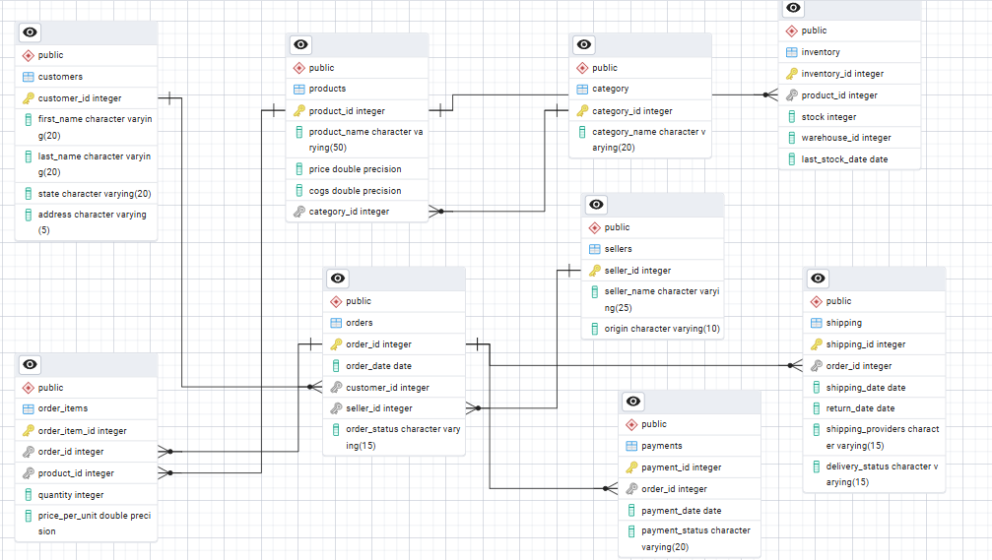
Entity Relationship Diagram

Slide 4
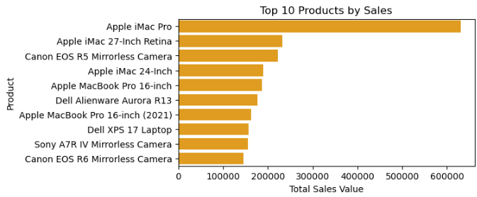
1. Top Selling Products
Apple iMac Pro has the highest sales. Apple and camera products are the main revenue drivers.”

Slide 5
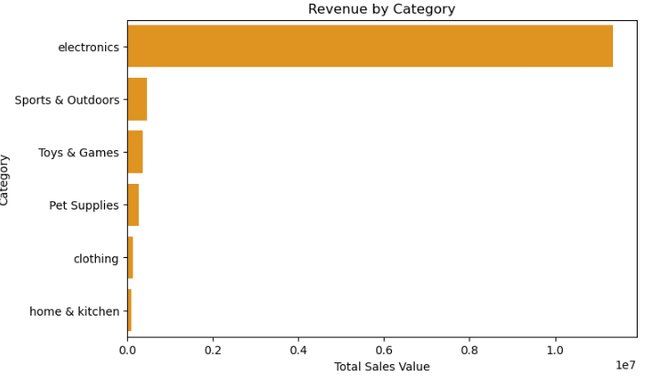
2. Revenue by Category
Electronics is the highest revenue category, far ahead of other categories like sports, toys, and clothing

Slide 6
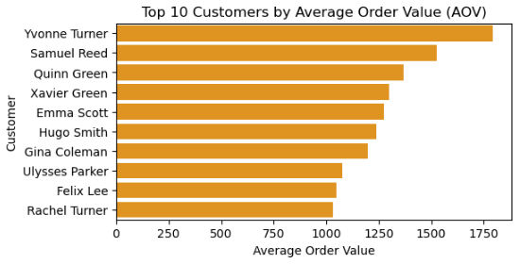
3. Average Order Value (AOV)
Yvonne Turner has the highest average order value, followed by Samuel Reed. These top customers spend more per order compared to others

Slide 7
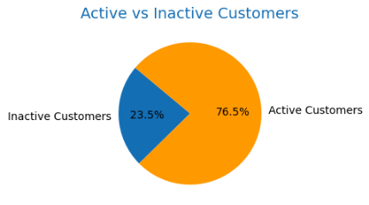
4. Customers with No Purchases
76.5% of registered customers made at least one purchase, while 24.5% created an account but never purchased.

Slide 8
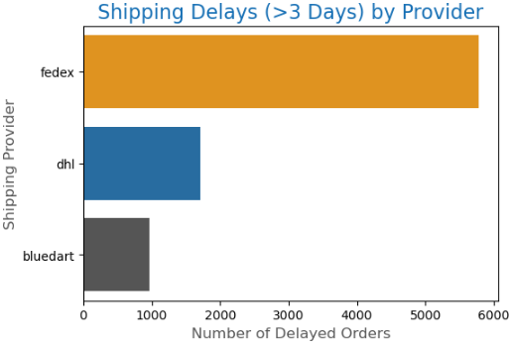
5. Shipping Delays
FedEx has the highest number of shipping delays (>3 days), far more than DHL and Bluedart.

Slide 9
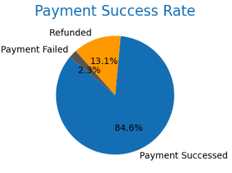
6. Payment Success Rate
Around 85% of transactions are successful, while 13% are refunded and 2% fail.

Slide 10
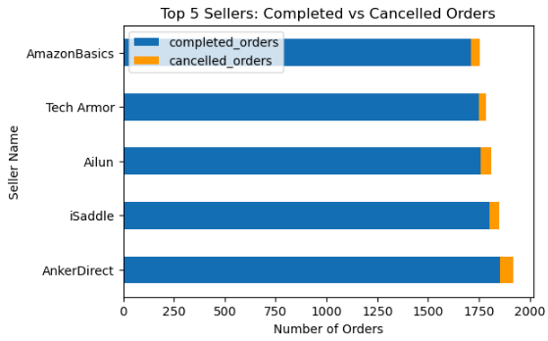
7. Top Performing Sellers
The top 5 sellers AmazonBasics, Tech Armor, Ailun, iSaddle, AnkerDirect have a high number of completed orders, showing strong performance.

Slide 11
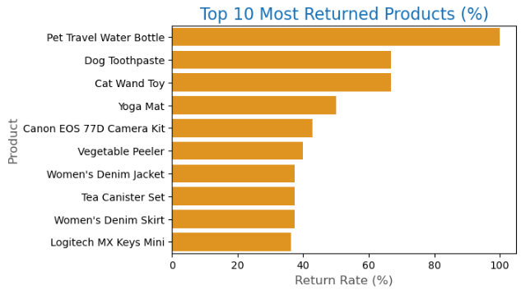
8. Most Returned Products
Pet Travel Water Bottle , Dog Toothpaste, Cat Wand Toy these are the top returned product.

Slide 12
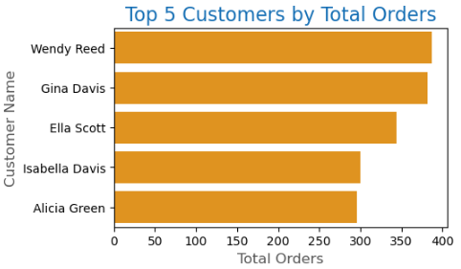
9. Top 5 Customers by Orders
Wendy Reed , Gina Davis, Ella Scott followed by Isabella Davis and Alicia Green are the top customers.

Slide 13
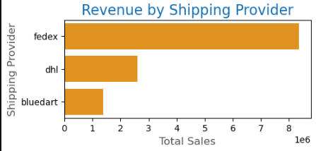
10. Revenue by Shipping Provider
Fedex ,DHL, Bluedart are the top shipping provider

Slide 14
Key Insights from Amazon Sales Analysis
Top Products
Apple iMac Pro dominates with the highest sales value.
Other Apple and Canon products are also among the top 10, showing strong demand for premium electronics.
Revenue by Category
Electronics is by far the biggest revenue generator.
Other categories (Sports, Toys, Pet Supplies, Clothing, Home & Kitchen) contribute very little in comparison.

Slide 15
Customer Value (AOV)
Yvonne Turner and Samuel Reed have the highest average order values.
High-value customers tend to spend 1.5x–2x more per order than regular customers.
Active vs Inactive Customers
~76.5% of customers are active purchasers.
~23.5% have accounts but never purchased — an opportunity for targeted marketing campaigns.
Shipping Delays
FedEx is responsible for the majority of delays (>3 days).
DHL and Bluedart perform better but still contribute to delayed orders.
Payment Success Rate
~85% of transactions succeed.
13% are refunded and ~2% fail — showing room to improve payment reliability and reduce refunds.
Top Sellers (Completed vs Cancelled Orders)
AmazonBasics and AnkerDirect are the leading sellers with high completed orders.
Cancellation rates are low but visible across all sellers, suggesting scope for better inventory & fulfillment management.

Slide 16
Recommendations Based on Analysis
Boost Electronics Category
Since Electronics drive the majority of revenue, expand premium product offerings (Apple, Canon, Sony).
Introduce bundle offers or discounts on accessories to increase cross-selling.
Engage Inactive Customers
Target the 23.5% inactive customers with email campaigns, first-purchase discounts, and loyalty points.
Improve Shipping Reliability
Address FedEx delays by reviewing contracts or shifting volume to more reliable providers (DHL, BluDart).
Introduce real-time tracking & penalty clauses for late deliveries.

Slide 17
4.Enhance Payment Success Rate
Partner with more secure gateways to reduce transaction failures.
Improve refund handling speed to retain customer trust.
5. Strengthen Top Sellers
Support high-performing sellers like AmazonBasics & AnkerDirect with better visibility and ad placements.
Reduce cancellations by improving seller inventory forecasts.
6. Focus on High-Value Customers
Reward top-spending customers with exclusive offers, early access to sales, or premium memberships.

Slide 18
Query Performance Improvement
Used window function and CTE for cleaner , efficient queries.
Avoid select * and selected only necessary column for faster execution.
Optimized joins and aggregations to improve performance on large dataset.
Replacing subqueries with joins improved query performance by ~50.19% (from 167s to 100s)

Slide 19
Thank you

