Slide 1
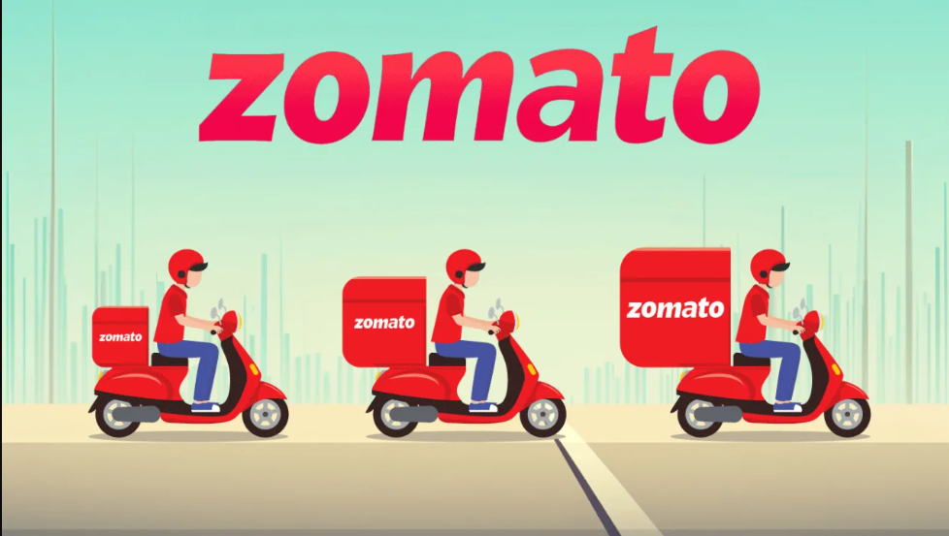
DATA ANALYSIS USING SQL AND PYTHON
SHUMAILA HASAN

Slide 2
TOOL USED
SQL (PostgreSQL) – For data modelling , data cleaning, joining, aggregation
Python (Pandas + Matplotlib) – For plotting
Jupyter Notebook – For writing + visualizing code
Presentation – Power Point

Slide 3
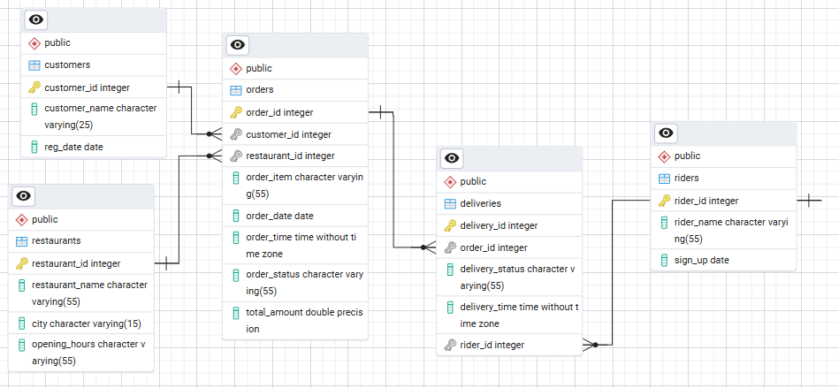
Entity Relationship Diagram – Zomato Database Structure

Slide 4
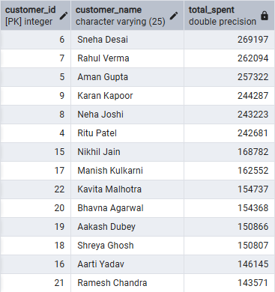
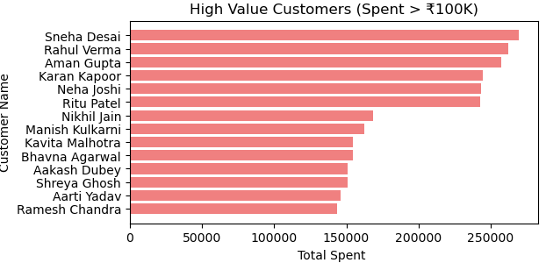
1. High Value Customers:
List the Customers who have spent more than 100K in total on food orders.
Top spenders crossing ₹100K form a key segment driving major revenue growth.

Slide 5
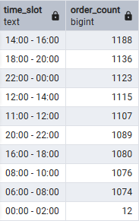
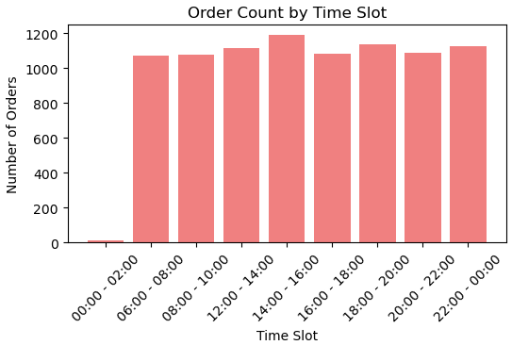
2. Popular Time slot:
Identify the time Slots during which the most orders are placed based on 2 hours interval
Afternoon hours (2–4 PM) record the highest number of orders, marking the peak demand window.

Slide 6
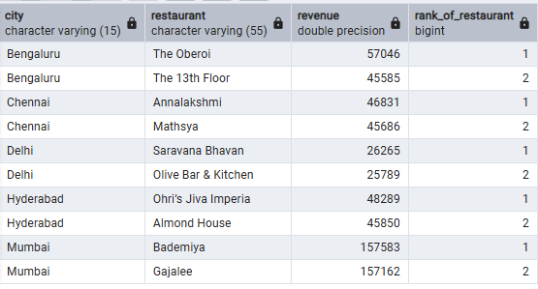
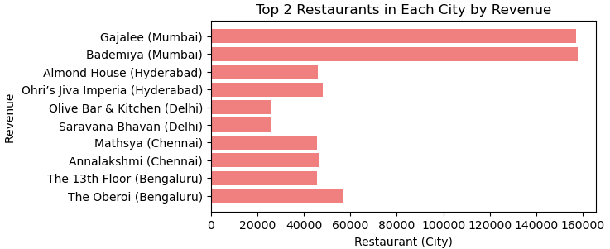
3. Restaurant Revenue Ranking:
Top 2 Restaurant in their City based on Their Highest Revenue

Slide 7
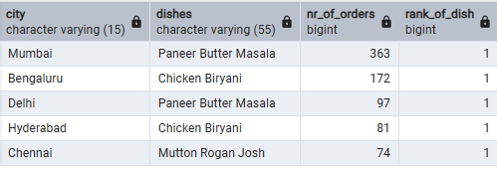
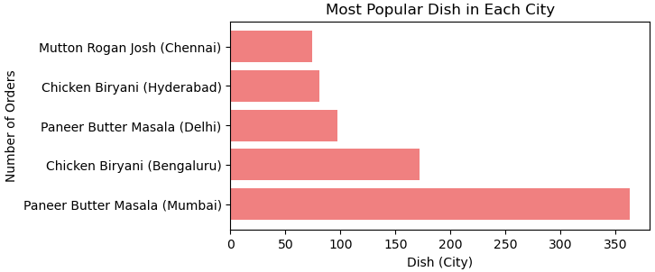
4. Most popular dish by City:
Identify the Most Popular dish in each city based on the number of orders
The most ordered dishes vary by city, highlighting localized tastes

Slide 8
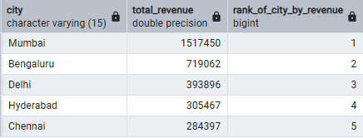
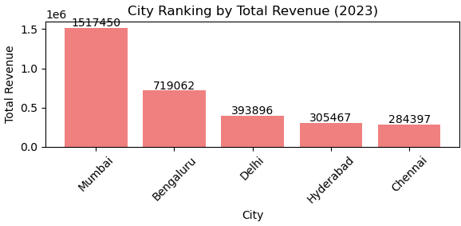
5. Rank each City based on the Total revenue
Mumbai city achieved top rank by revenue.

Slide 9
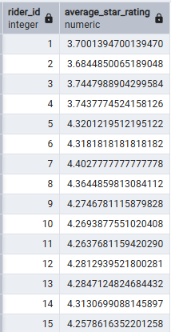
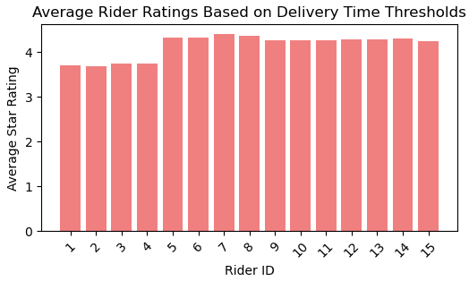
6. Rider Efficiency :
Evaluate rider efficiency by determining Average Delivery time

Slide 10
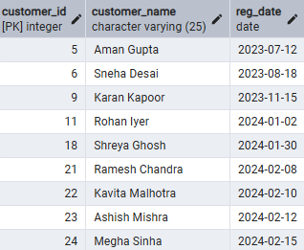
7. Customer Churn:
Customers who haven't placed an order in 2024 but did in 2023
A noticeable portion of 2023 customers did not return in 2024, requiring re-engagement strategies

Slide 11
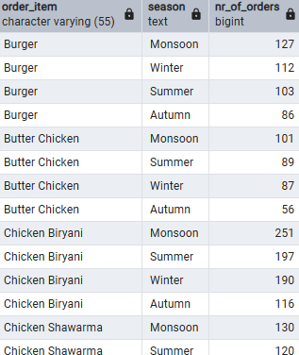
8. Order Item Popularity :
Track the Popularity of specific order items over time and identify seasonal demand spike
Monsoon drives maximum demand, with most dishes seeing higher order counts

Slide 12
Key Business Insights
Peak Ordering Hours:
Afternoon hours (2–4 PM) record the highest number of orders, marking the peak demand window.
High value customer:
Customer id 6,7,5,9,8,4 are the high value customer who spent above 200k amount
Order item popularity:
Most dishes peak in orders during monsoon, highlighting seasonal demand
Most popular dish by City:
Paneer Butter Masala , Mutton Rogan Josh, Chicken Biryani are the most popular dishes by city
City Revenue Rank :
Mumbai, Bangaluru ,Delhi, Hyderabad, Chennai are the top performing city by revenue
Rider efficiency:
Rider id 13, 17, 19,25, 23,28 received 5-star rating while some rider like rider id 1,2,3,4 is showing lower rating 3- star

Slide 13
Business Recommendations
Optimize peak-time operations (2–4 PM):
Increase delivery partner availability.
Provide special discounts for off-peak hours to balance demand.
Focus on high-value customers (> ₹100K):
Launch loyalty programs or exclusive offers.
Retain premium customers through personalized campaigns.
Reduce undelivered orders:
Track restaurants with frequent failures and improve delivery processes.
Provide training and penalties to minimize service issues.
City-specific strategy:
Prioritize top revenue-generating cities for marketing campaigns.
Target lower-performing cities with offers to increase adoption.

Slide 14
5. Leverage popular dishes per city:
1. Promote city favorites through featured deals.
2. Encourage restaurants to list similar trending items.
6.Address customer churn:
1. Identify inactive customers and run reactivation campaigns.
2. Offer personalized coupons to win back lost users.
7.Plan for seasonal spikes (Monsoon):
1. Prepare for increased demand with better inventory and rider management.
2. Highlight popular monsoon dishes with seasonal discounts.

Slide 15
Query Performance Improvements
Used window functions (RANK, DENSE_RANK) and CTEs for cleaner, efficient queries.
Avoid select * and selected only necessary columns for faster execution.
Reduced redundant subqueries and applied proper filtering for scalability.
Optimized joins and aggregations to improve performance on large datasets.

Slide 16
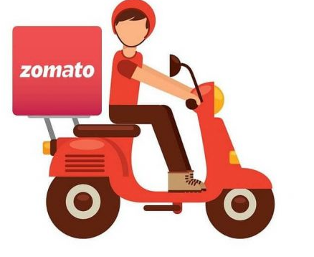
Thank you
Thank you

