Slide 2
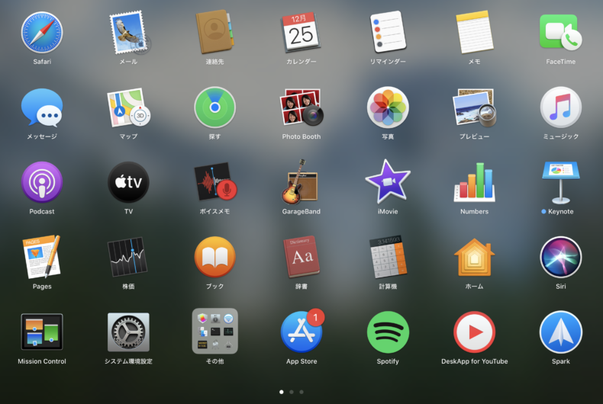
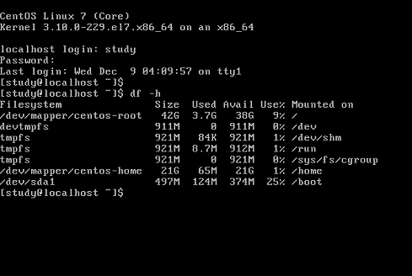
GUI vs CUI
Graphical User Interface
Character-based User Interface
Desktop screen
Command line

Slide 3
GUI vs CUI

Slide 4
1. Location and directory structure

Slide 5
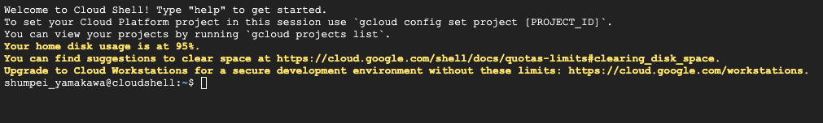
Home directory
..
You

Slide 6
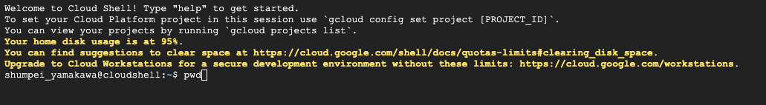
“type pwd -> enter”
Home directory
= pwd
Where am I?
..
You

Slide 7
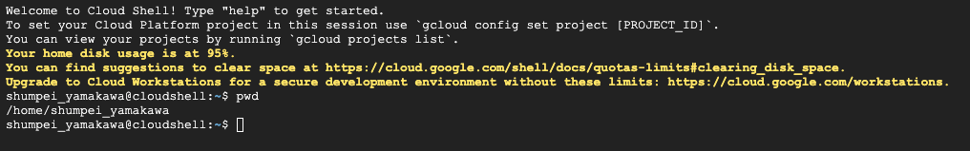
your current address
(PATH)
Home directory
= pwd
Where am I?
..
You

Slide 8
Home directory:
/home/shumpei_yamakawa
Where am I?
..
You
*the name of the directory depends on your account name

Slide 9
Home directory:
/home/shumpei_yamakawa
?
Files
(ex. text files)
..
You
*the name of the directory depends on your account name

Slide 10
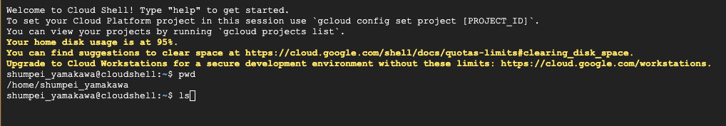
“type ls -> enter”
Home directory:
/home/shumpei_yamakawa
Files
(ex. text files)
What does this directory have?
= ls
..
You
*the name of the directory depends on your account name

Slide 11
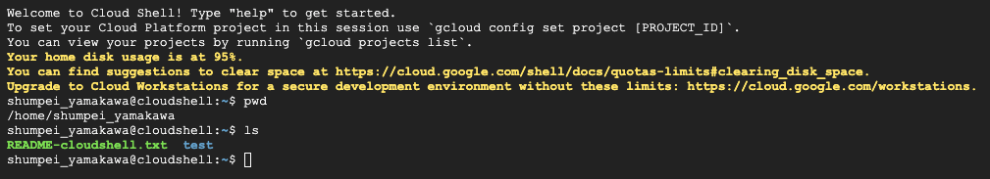
Home directory:
/home/shumpei_yamakawa
You have
“README-cloudshell.txt”
What does this directory have?
= ls
..
You

Slide 12
Home directory:
/home/shumpei_yamakawa
What does this directory have?
..
README-cloudshell.txt
You

Slide 13
Home directory:
/home/shumpei_yamakawa
What is this file?
..
README-cloudshell.txt
You

Slide 14
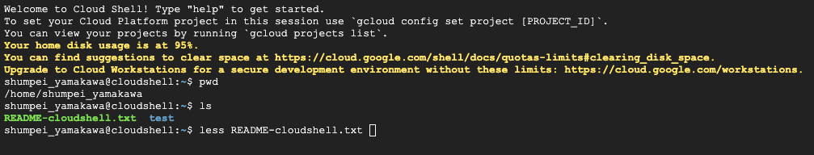
Type “less {file name}” and enter
Home directory:
/home/shumpei_yamakawa
What is this file?
= less
..
README-cloudshell.txt
You

Slide 15
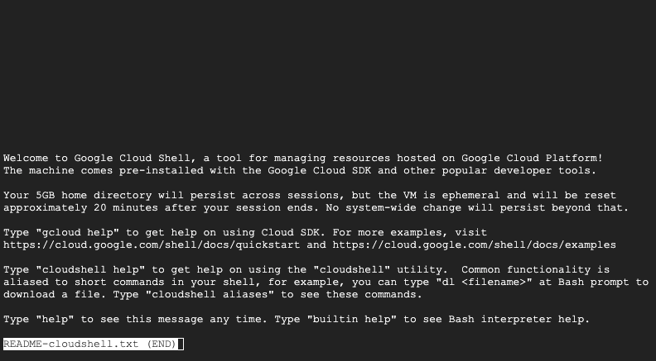
enter
README-cloudshell
.txt
What is this file?
..
You
Type “q”

Slide 16
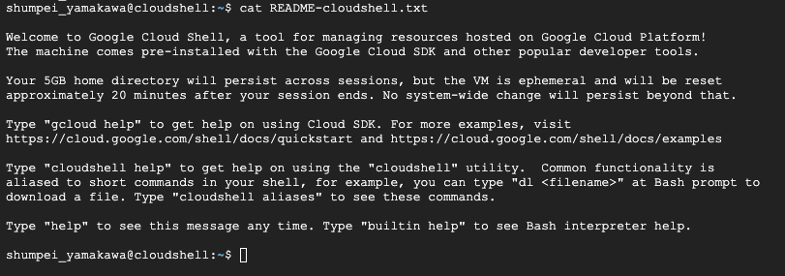
“cat” is also an option to look at the file content
Less vs cat
・less: in different output page
For big data
・cat: in standard output
For small data and to “concatenate”

Slide 17
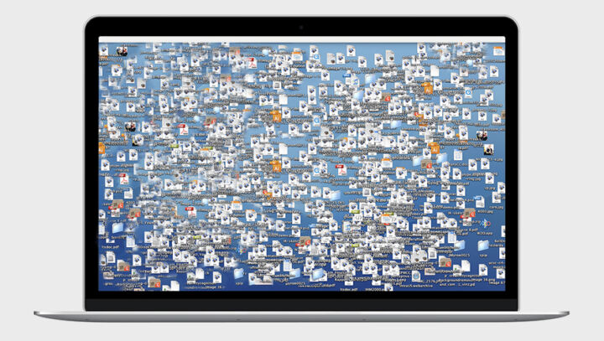
Do not stack too many files in the home directly
software
Home directory:
sequence
file
software
database
output files
software
..
…
You

Slide 18
Home directory
Hierarchical structure is ideal
New directory1
..
You

Slide 19
Home directory
Hierarchical structure is ideal
New directory1
New directory2
..
You
New directory3

Slide 20
Home directory
Hierarchical structure is ideal
2025_course
Day1
..
You
Day2

Slide 21
Home directory
Hierarchical structure is ideal
2025_course
Day1
Software
Software
Day1
..
Day1
Day1 analysis in Day1 directory
Day2
Day2
Day2

Slide 22
Home directory
Any name is okay
I want to make a directory
= mkdir
..
You

Slide 23

Check the directory by the command ls
Home directory
I want to make a directory
..
You
README-cloudshell.txt
New_directory1

Slide 24
Check the directory by the command ls
Directory or PATH that
you want to go
Home directory
I want to go to the directory
= cd
..
You
README-cloudshell.txt
New_directory1

Slide 25

Check the directory by the command ls
Home directory
..
You
New_directory1
/home/shumpei_yamakawa/
/home/shumpei_yamakawa/New_directory1

Slide 26
Exercise1
Make a new directory and move into there
..
You
Home directory
New_directory1
New_directory2
/home/shumpei_yamakawa/
/home/shumpei_yamakawa/New_directory1

Slide 27
Exercise2
Go back to the home directory
..
You
Home directory
New_directory1
New_directory2
/home/shumpei_yamakawa/
/home/shumpei_yamakawa/New_directory1

Slide 28
Exercise2
Go back to the home directory
..
You
Home directory
New_directory1
New_directory2
/home/shumpei_yamakawa/
/home/shumpei_yamakawa/New_directory1

Slide 29
cd ..
cd ..
..
You
Home directory
New_directory1
New_directory2
/home/shumpei_yamakawa/
/home/shumpei_yamakawa/New_directory1

Slide 30
cd ../..
..
You
Home directory
New_directory1
New_directory2
/home/shumpei_yamakawa/
/home/shumpei_yamakawa/New_directory1

Slide 31
cd /home/shumpe_yamakawa
..
You
Home directory
New_directory1
New_directory2
/home/shumpei_yamakawa/
/home/shumpei_yamakawa/New_directory1

Slide 32
Absolute path
../../
Relative path
/home/shumpe_yamakawa
..
You
Home directory
New_directory1
New_directory2
/home/shumpei_yamakawa/
/home/shumpei_yamakawa/New_directory1

Slide 33
2. Basic commands and specific analysis software

Slide 34
I wan to copy the file
I wan to delete the file
..
..
= cp
= rm
Download the file from url
Edit the file content
..
..
= wget
= awk
Search specific words in the file
?
Various basic commands are already prepared
..
“abc”
= grep

Slide 35
I want to make a Blast database
..
atcgtca…
= makeblastdb
Search specific sequences
agcttttaatcgtca…
..
= seqkit grep
atcgtca…
Make a phylogenic tree
..
Need to download specific software for bioinformatic analysis
= raxml

Slide 36
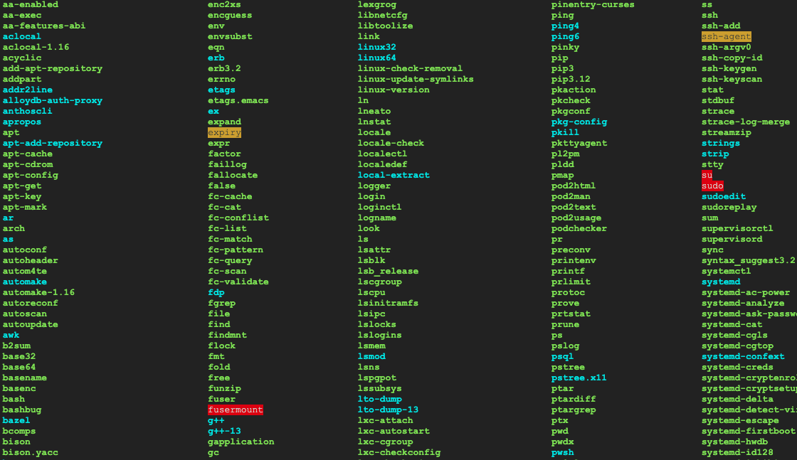
/usr/bin/
Executable files
(binary)
Files for the basic commands such as
Cat, less, makdir, pwd etc are included in this directory
..
You
/usr/bin/home/

Slide 37
/usr/bin/
Executable files
(binary)
mkdir
..
You
/usr/bin/home/

Slide 38
/usr/bin/
Executable files
(binary)
Ok, I will look for it in /usr/bin
mkdir
..
..
PC
You
/usr/bin/home/

Slide 39
/usr/bin/
Executable files
(binary)
Yes, found it. Let’s execute it
mkdir
..
..
PC
You
/usr/bin/home/

Slide 40
/usr/bin/
Executable files
(binary)
Here you go
..
..
PC
You
/usr/bin/home/

Slide 41
/usr/bin/
Executable files
(binary)
Ok, I will look for it in /usr/bin
makeblastdb
..
..
PC
You
/usr/bin/home/

Slide 42
/usr/bin/
Executable files
(binary)
No, I cannot find it…
makeblastdb
..
..
PC
You
/usr/bin/home/

Slide 43
/usr/bin/
Executable files
(binary)
..
..
blast
You
Executable file of
blast
Place the file into different directory
/usr/bin/home/
Directory A

Slide 44
/usr/bin/
Executable files
(binary)
Ok, I will look for it in /usr/bin
..
makeblastdb
..
blast
You
Executable file of
blast
/usr/bin/home/
Directory A

Slide 45
/usr/bin/
Executable files
(binary)
Ok, I will look for it in /usr/bin
..
makeblastdb
..
blast
Check in directory A, too
You
Executable file of
blast
/usr/bin/home/
Directory A

Slide 46
/usr/bin/
blast
Executable files
(binary)
Executable file of
blast
This is also possible in principle
but, the directory is for the basic command lines and may cause conflict with them…
“not recommended”
..
You
/usr/bin/home/

Slide 47
3. Installing the software

Slide 48
Installing the software
Web online
Download the software
Add a directory to PATH
Your local PC (=Cloud Shell)
..
You
Executable file of
blast
/usr/bin/home/

Slide 49
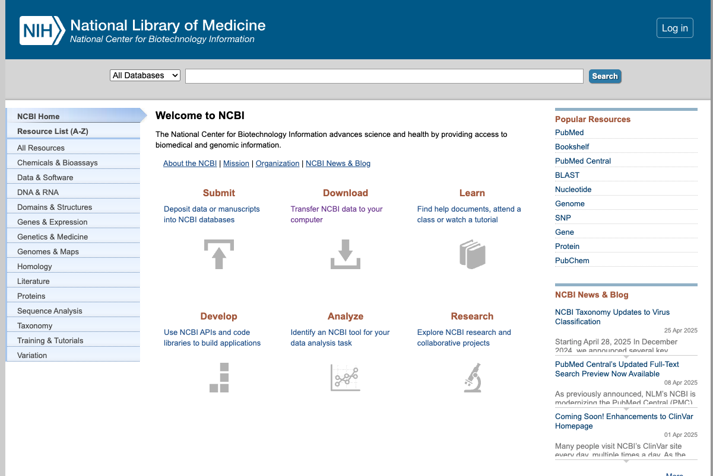
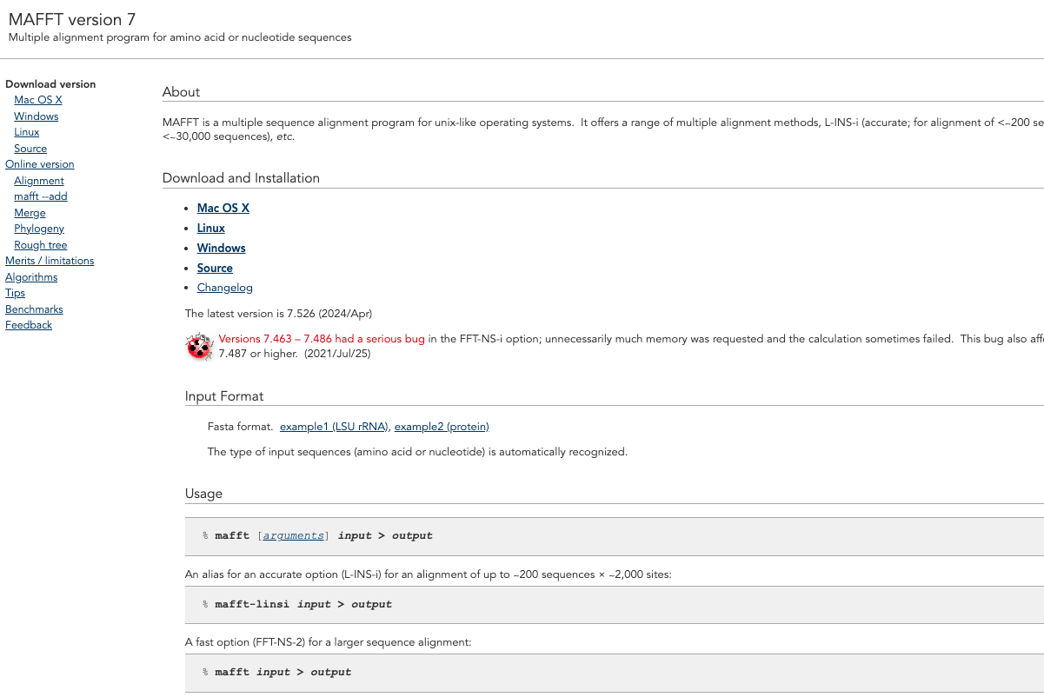
1. Download the software
Ex) NCBI provides a lot of the tools such as blast, sra-tools, and so on…
Ex) The webpage of MAFFT, an alignment tool
Go to the webpage of the software

Slide 50
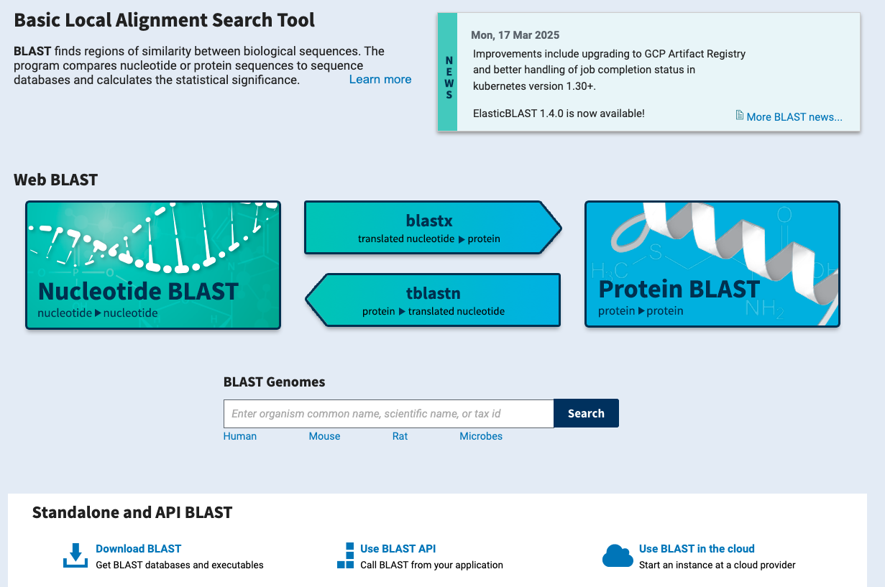
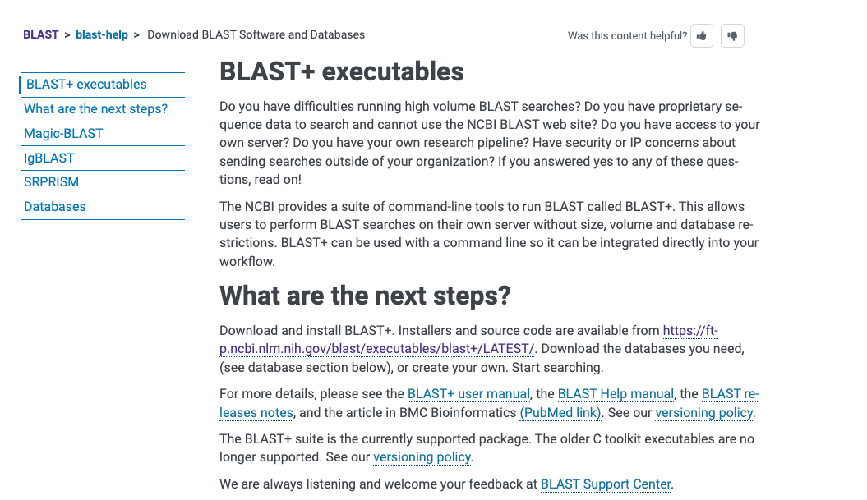
Follow the web page…

Slide 51
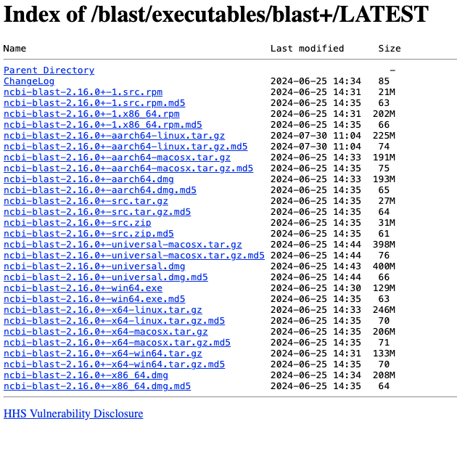
FTP
(File Transfer Protocol)

Slide 52
FTP
(File Transfer Protocol)

Slide 53
Copy link address
https://ftp.ncbi.nlm.nih.gov/blast/executables/blast+/LATEST/ncbi-blast-2.16.0+-x64-linux.tar.gz

Slide 54
Web online
wget
Install the files from web
..
You
Home directory
New_directory1
/home/shumpei_yamakawa/
/home/shumpei_yamakawa/New_directory1

Slide 55
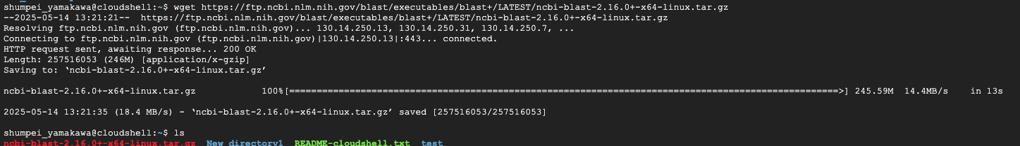
..
You
ncbi-blast-2.16.0+-x64-linux.tar.gz

Slide 56
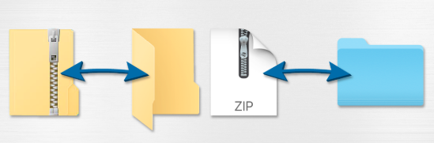
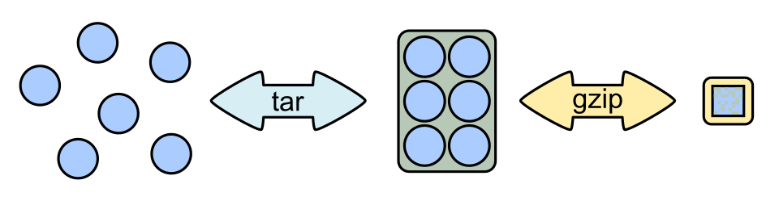
Archive and compress
archive
compress

Slide 57
tar -xvzf
Open the tar.gz. file
..
You
ncbi-blast-2.16.0+-x64-linux.tar.gz

Slide 58

ncbi-blast-2.16.0+-x64-linux
BLAST_PRIVACY
ChangeLog
..
LICENSE
ncbi_package_info
You
README
blastdb_aliastool
ncbi-blast-2.16.0+-x64-linux.tar.gz
makeblastdb
tblastn
blastp
bin
blastx
…

Slide 59
ncbi-blast-2.16.0+-x64-linux
..
You
blastdb_aliastool
makeblastdb
tblastn
blastp
bin
blastx
…
Executable files

Slide 60
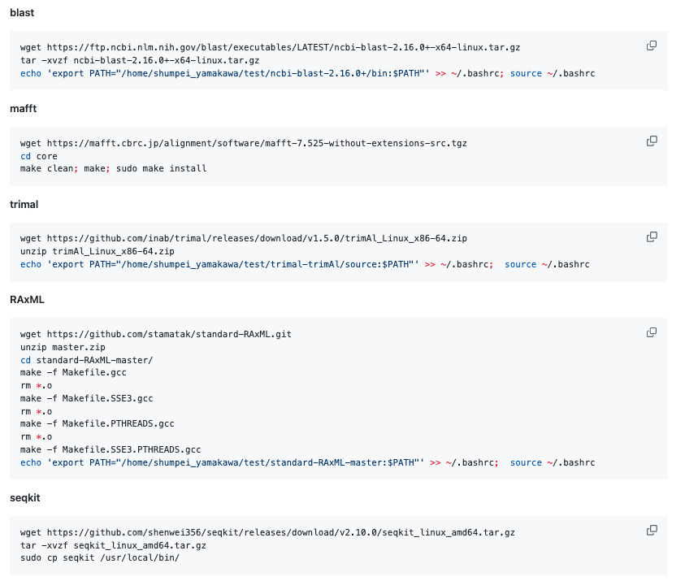
Not always so easy….

Slide 61
Installing the software
Web online
Download the software
Add a directory to PATH
Your local PC (=Cloud Shell)
..
You
Executable file of
blast
/usr/bin/home/

Slide 62
/usr/bin/
Executable files
(binary)
Ok, I will look for it in /usr/bin
..
makeblastdb
..
blast
Check in directory A, too
You
Executable file of
blast
/usr/bin/home/
Directory A

Slide 63
ncbi-blast-2.16.0+-x64-linux
..
You
blastdb_aliastool
makeblastdb
tblastn
blastp
bin
blastx
…
Executable files

Slide 64
..
makeblastdb
..
You
/home/shumpei_yamakawa/ncbi-blast-2.16.0+/bin

Slide 65
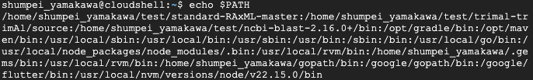
PATH: Search path for executable commands
directory A
..
PATH
/home/usr/directoryA:
/home/usr/direcotryB:
/home/usr/direcotryC:
directory B
≒ a directory list
Ex)
directory C

Slide 66
PATH: Search path for executable commands
directory A
..
PATH
/home/usr/directoryA:
/home/usr/direcotryB:
/home/usr/direcotryC:
directory B
directory C
/home/shumpei_yamakawa/ncbi-blast-2.16.0+/bin

Slide 67
PATH: Search path for executable commands
directory A
..
PATH
/home/usr/directoryA:
/home/usr/direcotryB:
/home/usr/direcotryC:
directory B
/home/shumpei_yamakawa/ncbi-blast-2.16.0+/bin
directory C
/home/shumpei_yamakawa/ncbi-blast-2.16.0+/bin

Slide 68
..
PATH
makeblastdb
..
You
makeblastdb
/home/shumpei_yamakawa/ncbi-blast-2.16.0+/bin

Slide 69
export PATH="/home/shumpei_yamakawa/test/ncbi-blast-2.16.0+/bin:$PATH"

Slide 70
PC
PATH
..
/home/usr/directoryA:
/home/usr/direcotryB:
/home/usr/direcotryC:
Set the path
PATH setting is only temporal in a session
..
/home/usr/directoryA:
/home/usr/direcotryB:
/home/usr/direcotryC:
/home/shumpei_yamakawa/ncbi-blast-2.16.0+/bin
Terminate
the session
..
/home/usr/directoryA:
/home/usr/direcotryB:
/home/usr/direcotryC:

Slide 71
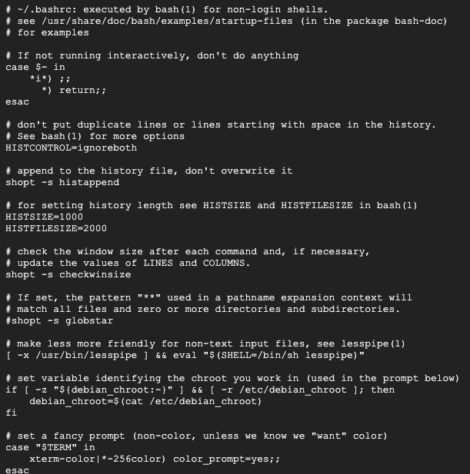
Initiate the terminal/cloud shell
.bashrc
Set the PATH etc…
PC
..
..
..
alias
PATH
…
.bashrc =
A file automatically executed whenever a Bash shell session starts

Slide 72
Initiate the terminal/cloud shell
.bashrc
Set the PATH etc…
PC
..
..
..
alias
PATH
…
Add
export PATH="/home/shumpei_yamakawa/test/ncbi-blast-2.16.0+/bin:$PATH"

Slide 73
Initiate the session
.bashrc
PC
PATH
..
..
..
Directory A
PATH
Add directory A to PATH
…
command
Directory A
PATH
PATH
..
..
..
Directory A
Terminate the session
YOU
PATH reset
Directory A

Slide 74
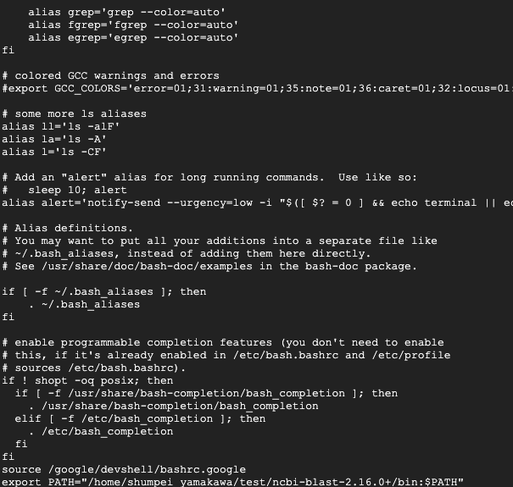
~/.bashrc
…

Slide 75
Test
Install “seqkit”

