Slide 1
UNIVERSITY ENTRANCE EXAM REVIEWER

Slide 2
The Northwest Samar State University is a public university in the Philippines located in Calbayog City with extension campus in San Jorge, Samar and the IOMD Campus Online. It is mandated to provide advanced education, higher technological, professional instruction and training in trade, fishery, agriculture, science, education, commerce, engineering, forestry, nautical courses and other related fields. It is also mandated to undertake research and extension services, and provide progressive leadership in its areas of specialization. Its main campus is in Calbayog City.

Slide 3
7 COLLEGES OR DEPARTMENTS IN NWSSU MAIN CAMPUS
COLLEGE OF AGRICULTURE AND TECHNOLOGY (CAT)
COLLEGE OF EDUCATION (CoED)
COLLEGE OF CRIMINAL JUSTICE AND SCIENCES (CCJS)

Slide 4
7 COLLEGES OR DEPARTMENTS IN NWSSU MAIN CAMPUS
COLLEGE OF COMPUTING AND INFORMATION SCIENCES (CCIS)
COLLEGE OF MANAGEMENT (COM)
COLLEGE OF ENGINEERING AND ARCHITECTURE (CEA)

Slide 5
Please remember that this is not the actual exam that you will encounter prior to your admission.

Slide 6
TIPS BEFORE THE ENTRANCE EXAM

Slide 7
Create and stick to your study plan - Know the coverage of the test. After this, create a study plan and set aside time for your review. Schedule your tasks during your most productive time.
Evaluate your strengths and weaknesses - Assess the coverage of the test and divide the subjects based on your strength and weakness. Allocate more time on your weaknesses but don’t neglect your strengths.

Slide 8
Plan your review strategy - There are various ways to study each lesson. Know your type of learning style for it will help you grasp your lessons faster.
Use relevant books only - The innumerable number of books you had since Grade 1 is overwhelming. Reviewing all of them will only consume your time and energy. Focus on more recent books but don’t forget to browse your old notes.

Slide 9
Don’t memorize — internalize - Memorization is not the best way to pass an exam; details will only vanish in no time. Thus, understand what you are reviewing.
Condition yourself for the upcoming entrance exam - It’s vital that your mind is more than ready for the exam. So, months before the exam, tell yourself, “You will ace the exam!” every single day.

Slide 10
TIPS DURING THE ENTRANCE EXAM

Slide 11
Relax: inhale, exhale - Don’t panic and try not to review your notes 10 minutes before the exam. Doing this will only worsen your state of focus.
Use the method of elimination and make educated guesses - If you can’t remember the answer, eliminate the least possible options and choose the most probable answer.

Slide 12
Read the question cautiously - Don’t jump into answering the item if you’ve only read the first 3 words. Remember; read the questions twice, if possible.
Manage time wisely - This is a common tip but it is one of the most effective ways to pass the exam. Wear your wristwatch and be cautious of the time.

Slide 13
TIPS AFTER THE ENTRANCE EXAM

Slide 14
Don’t overthink - Don’t focus on the uncertainties. Be glad that you were able to take the exam and you’ve given your best
Wait for the result patiently - It may be hours, days, or even months before you get the results. So, have a positive mindset while waiting.

Slide 15
WORD ANALOGY

Slide 16
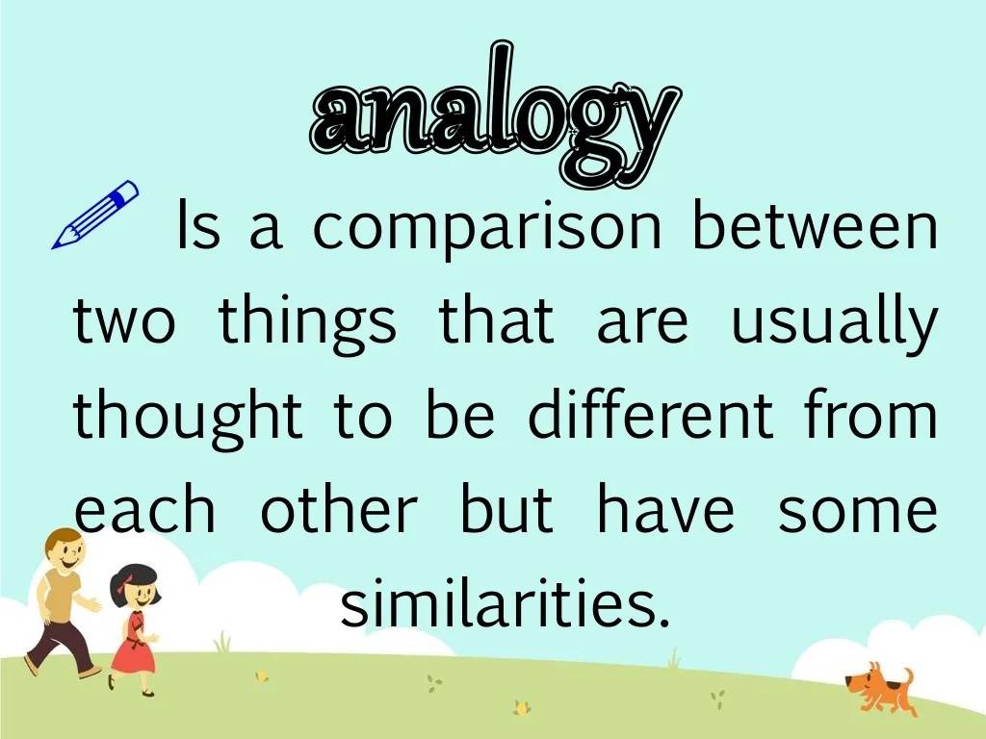

Slide 17
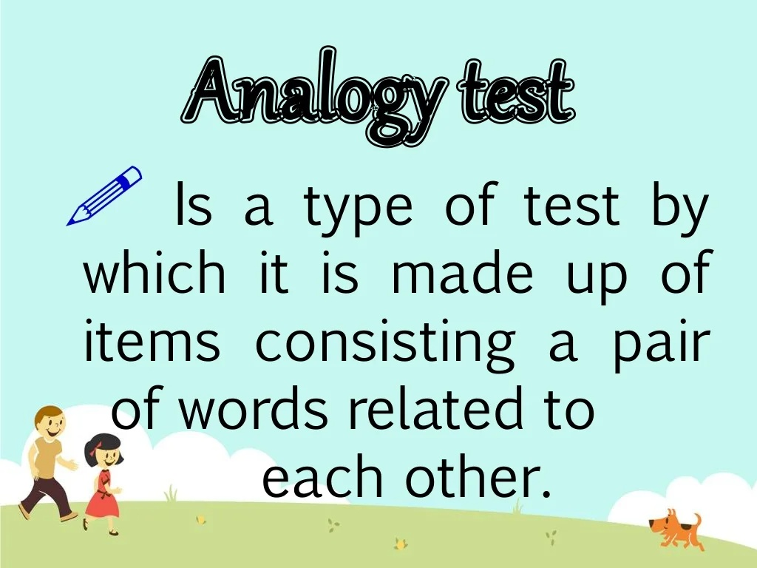

Slide 18
Single Word Analogy
_____: king :: bench : judge
a. queen b. court c. throne d. knight
Double Word Analogy
prize : contestant::
trophy: presenter b. diploma: principal c. medal: runner d. book: author e. mortgage: lender

Slide 19
Tip 1: Take note of the relationships among the words.
It is important to know the relationship among words and their particular order as shown in the next example.
petal: flower
A. hands: nail B. car: road C. monitor: computer D. daughter: mother

Slide 20
The relationship above is an example of a part to whole relationship. In the question, petal is a part of a flower. Petal is also a vital part of a flower. Among the choices, we can see that only hands and nail have the same relationship. However, the order is reversed. In hands and nail, the relationship is now whole to part. Remember, order is important. If the question is part is to whole, the answer should also be part to whole.

Slide 21
Here, the relationship is part to whole. Water is part of an
Cause and effect rain : flood virus : flu
Association: addition : addend chef : toque
Degree: hut : mansion glance : stare
Sequence: preschool : grade school engagement : marriage

Slide 22
Function: net : fishing scissors : cutting
Characteristics: cheetah : fast snow : cold
Synonym: benevolent : kind courage : bravery
Antonym: hot : cold loose : tight

Slide 23
ABSTRACT REASONING

Slide 24


Slide 25
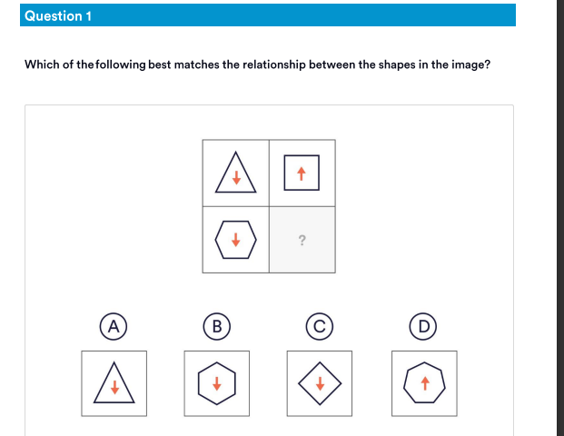

Slide 26


Slide 27
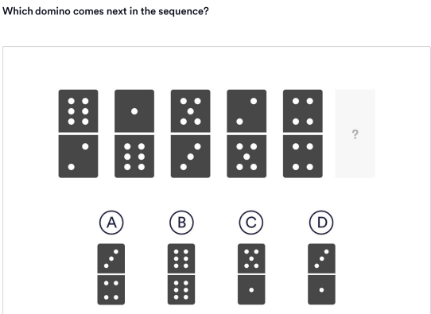

Slide 28
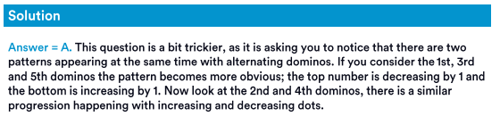

Slide 29
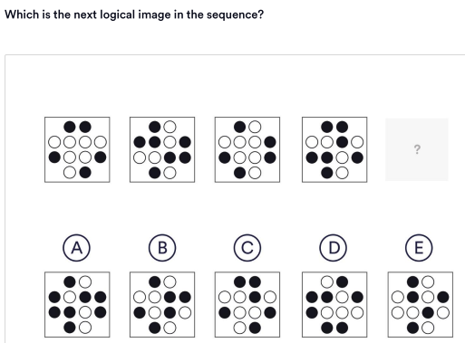

Slide 30


Slide 31
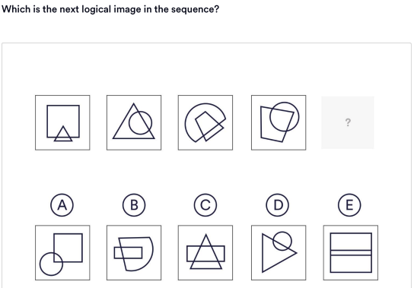

Slide 32
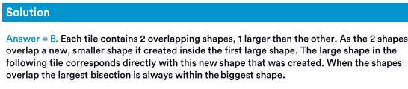

Slide 33
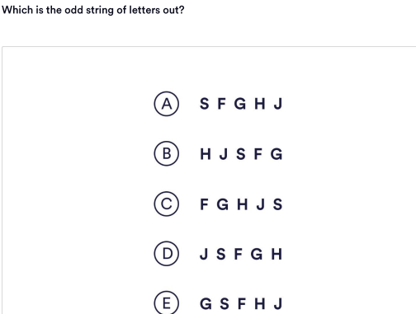

Slide 34
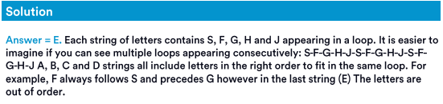

Slide 35
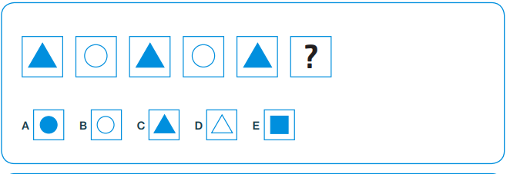

Slide 36
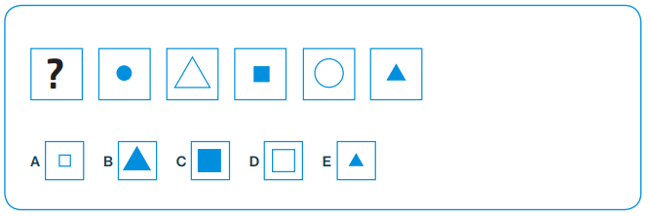

Slide 37
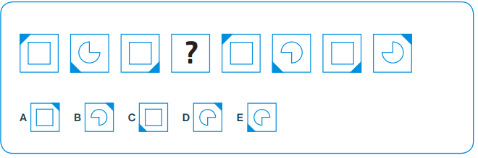

Slide 39
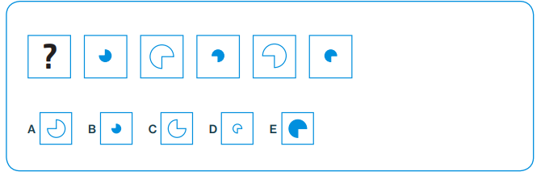

Slide 40
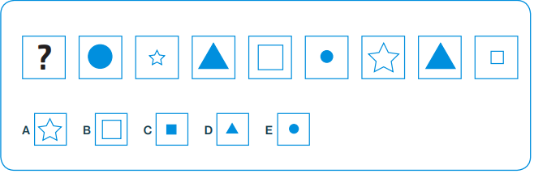

Slide 41
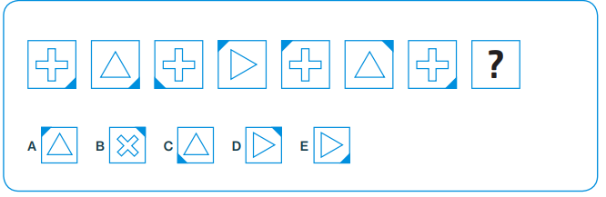

Slide 42
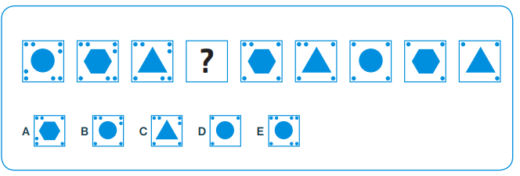

Slide 43
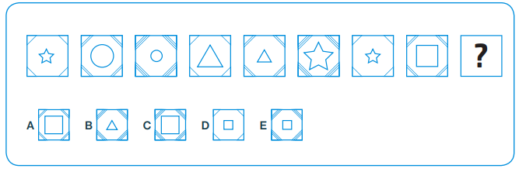

Slide 44
• Look for patterns and relationships in information.
• Practice creating diagrams which represent relationships, connections and sequences

Slide 45
1. Fill out the form as soon as possible because the quota is limited.

Slide 46
80-84% - NON BOARD COURES
85% ABOVE – BOARD COURSES

