Slide 1
Major course output
EMBRACING GLOBALIZATION

Slide 2
I. Globalization and Identity
1. Who are you?
Discuss some factors that shape who you are (e.g. sex, culture, race, etc.)
2. How do you express who you are?
Discuss expression on individual identity (e.g. traditions, beliefs, hobbies, language, clothing, etc.)
3. How are identities connected to globalization?
Discuss opportunities and/or challenges of making global connections.

Slide 3
II. Globalization and “Self” today
1. How does learning the concept of “Globalization” and its processes make you as a person of today?
Answer the question by comparing how you perceived your “old self” from your ‘self today” whom have deepen its learning about globalization
How does learning globalization helped you as a learner/contributed to you as a citizen.

Slide 4
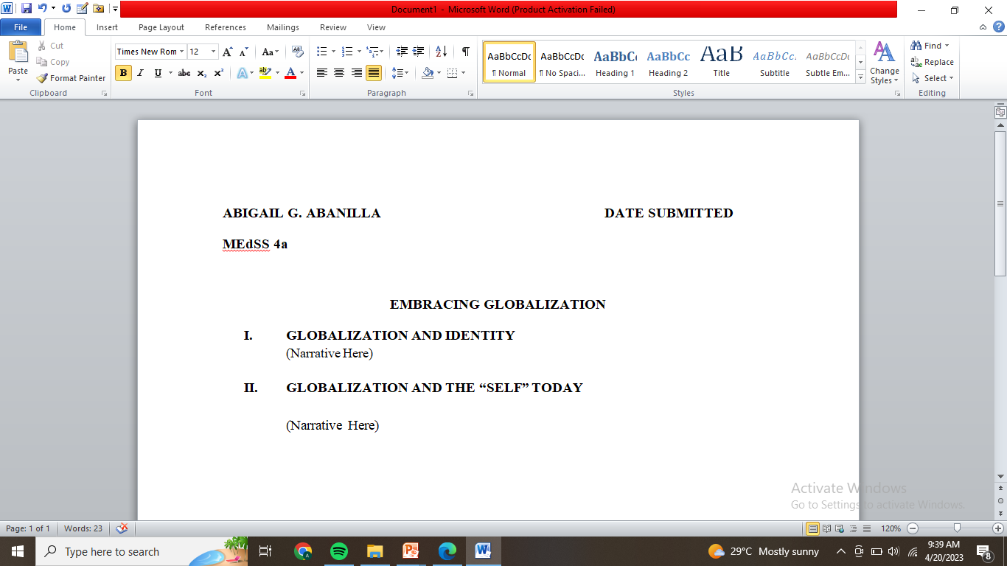
HOW TO DO IT?
Answer the questions through a narrative/essay form (not by numbers of bullets)
A4 bond paper
Arial
12 font size
Justified
BOLD (headings, title, & subtopic)
Strictly one paper used.

Slide 5
WHEN AND WHERE TO SUBMIT?
Submit your output to when you are scheduled for your Oral Examination. (Hard copy)

