Slide 1

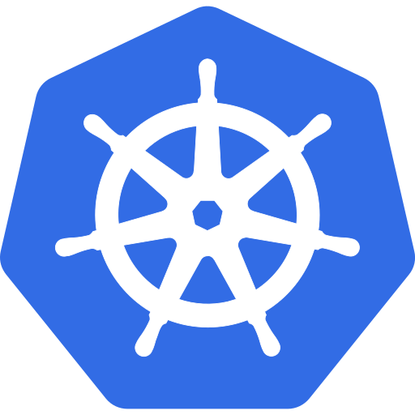



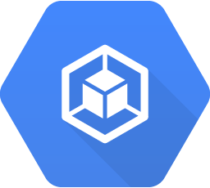


k8s-cluster
Operation suite
monitoring
monitoring
Container Engine
Logging
Monitoring
Cloud Pub/Sub

