Slide 1

Automated ILP Scheduling
Group Member: Shunjie Zhang

Slide 2

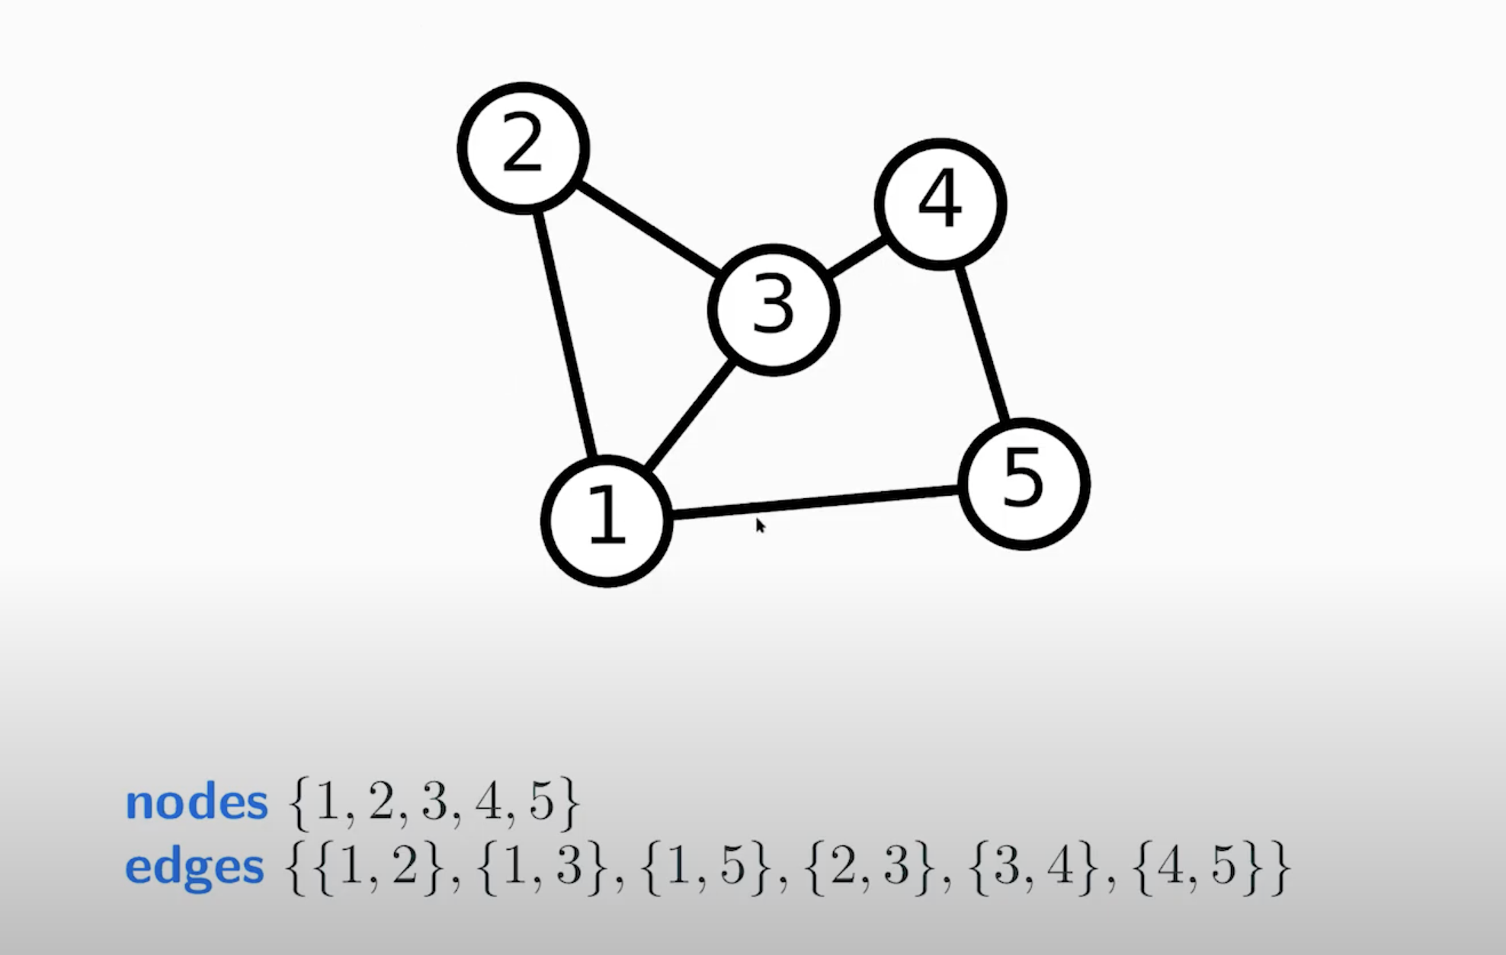
Edgelist
A network is a set of nodes connected by edges.
Figure 1

Slide 3
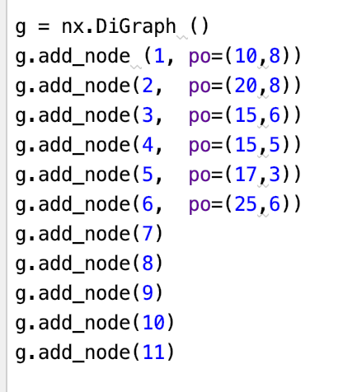
Networkx(nx)
Notes:
Using unified memory for the framebuffer array which stores each pixel RGB value for final image output, since the rendering process on GPU needs to write the result into it and CPU needs it to output the PPM image.
Except for the vec3 class which will be used both on GPU and CPU, functions of other classes are all running on the device side like camera, hittable(sphere), material, etc. So, functions in vec3.h have __host__ __device__ declaration and other classes’ functions only have __device__ declaration.

Slide 4
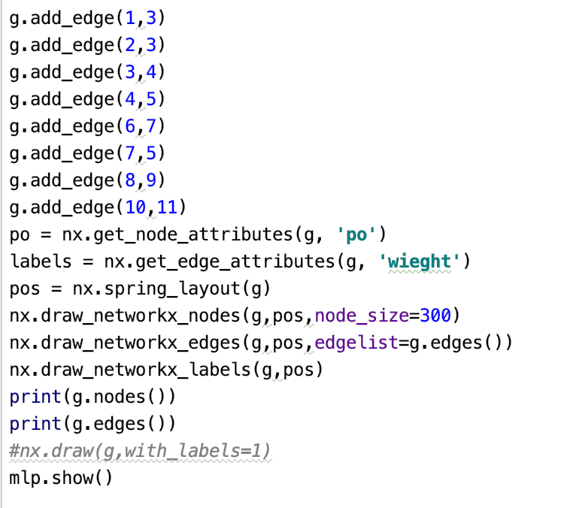
Edge
Notes:
Handing the random functions is also a trick part, because we cannot directly pass random functions in C++ to CUDA. Instead, we first need to use curand_init() to set a random state for each thread, and then pass those states to our render kernel.
The last thing to point out is replacing recursion with iteration. The common method for extracting the hit information of each object in path tracing is using the recursion. However, we find it turns out to be a problem when the recursion gets deeper. Since each thread on GPU has limited stack size compared with CPU, it causes stack overflow issues in our earliest attempts. Therefore, the recursive version of rayColor() in origin code is adapted into an iteration version.

Slide 5
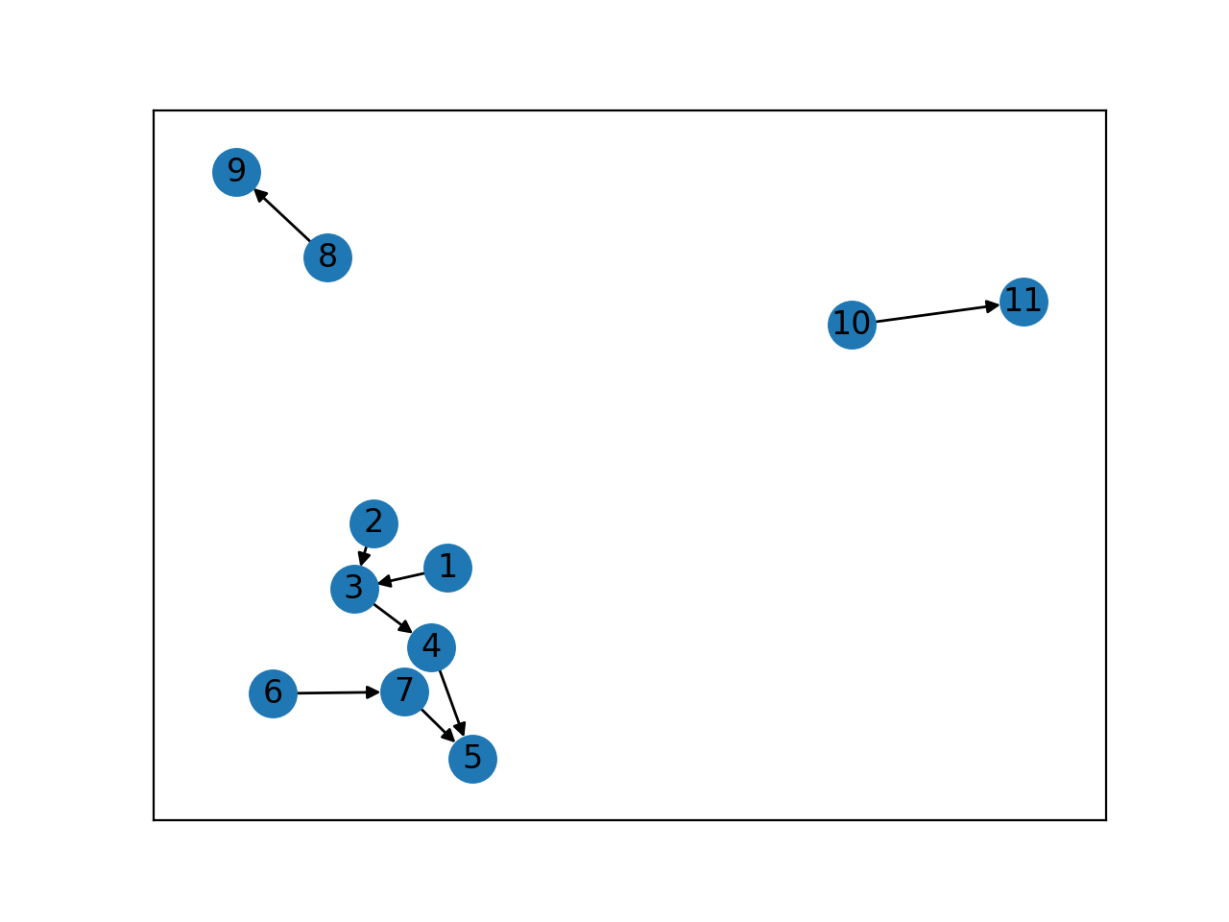
ILP scheduling

Slide 6
Thank You

