Slide 1
Quarto with Reveal.js
Brief Introduction Matt Braaksma

Slide 2
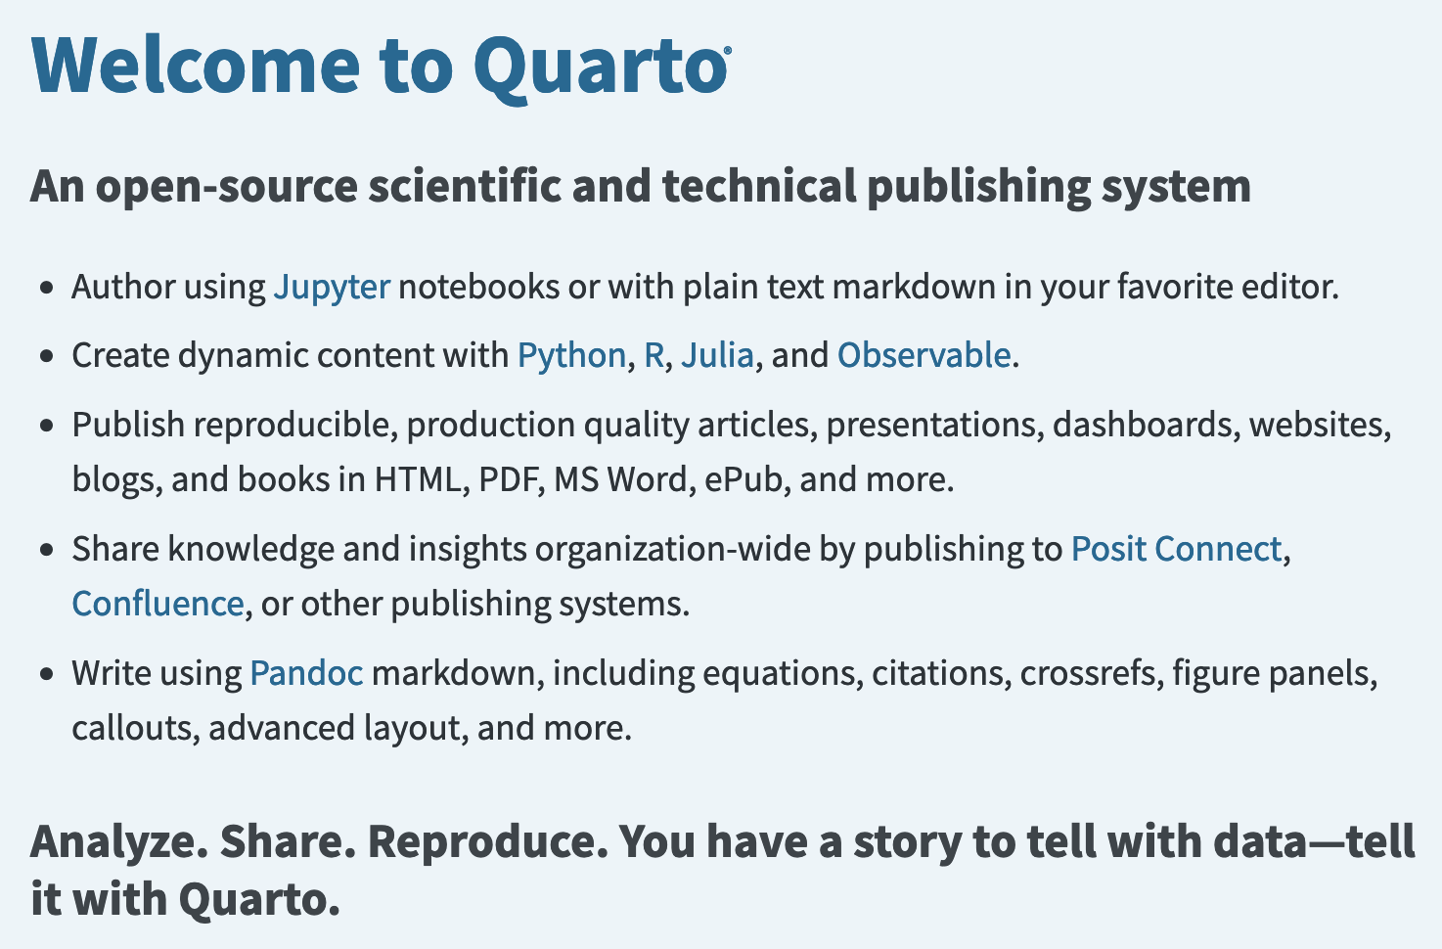
What is Quarto?

Slide 3
Quarto vs xaringan
What is the difference?
Quarto uses reveal.js to generate html slides
xaringan uses remark.js to generate html slides
Quarto has most of the features of xaringan, but more flexibility and more current development
Integration with VS Code (visual editor, preview, etc.)
Output options include html, beamer (LaTeX/PDF), pptx

Slide 4
Slide Formatting
--- title: "Habits" author: "John Doe" format: revealjs --- # In the morning ## Getting up - Turn off alarm - Get out of bed ## Breakfast - Eat eggs - Drink coffee # In the evening ## Dinner - Eat spaghetti - Drink wine ## Going to sleep - Get in bed - Count sheep

Slide 5
Header for these Slides
--- title: 'Quarto with Reveal.js' subtitle: 'Brief Introduction' format: clean-revealjs: embed-resources: true incremental: true html-math-method: katex scrollable: true code-overflow: wrap title-slide-attributes: data-background-image: UMN9_M-1line-blk.png data-background-size: 25% data-background-position: 4% 97% beamer: default pptx: default author: - name: Matt Braaksma email: braak014@umn.edu affiliations: University of Minnesota date: April 30, 2024 ---

Slide 6
Executable Code
# Import data with R library(tigris) library(ggplot2) mn_counties <- counties("MN") mn_roads <- primary_secondary_roads("MN")
. . .
# Import data with Python import pygris counties = pygris.counties(state = "MN", cb = True, cache = True)
roads = pygris.primary_secondary_roads(state = "MN", cache = True)

Slide 7
Figures
Counties
ggplot(mn_counties) + geom_sf() + theme_void()
Roads
ggplot(mn_roads) + geom_sf() + theme_void()

Slide 8
Python Code
Counties
counties.explore()
Roads
roads.explore()

Slide 9
Write Equations with LaTeX
The Wald estimator:
. . .
$${\hat{δ}}_{IV,wald}≡\frac{E_{N}\left[y_{i}|z_{i}=1\right]−E_{N}\left[y_{i}|z_{i}=0\right]}{E_{N}\left[d_{i}|z_{i}=1\right]−E_{N}\left[d_{i}|z_{i}=0\right]}$$

Slide 10
Extensions: roughnotation
Use the .rn to class to specify what elements should be highlighted.
. . .
Underline
Box
Circle
Highlight
Strike-Through
Crossed-off

Slide 11
Render to other formats
quarto render apec_seminar_quarto.qmd --to beamer quarto render apec_seminar_quarto.qmd --to pptx

Slide 12
Resources for Learning More
Quarto
Get Started with Quarto
Revealjs Guide
Revealjs Extensions
Quarto and xaringan
With Quarto Coming, is R Markdown Going Away? No. - Yihui Xie
How to transition from xaringan to Quarto revealjs - Emi Tanaka

