Slide 1
Shell Bootcamp 2024 3 Reflections for Week 1
NITYA NAND JHA
Date : 30-Aug-2024

Slide 2

About Me
Leading my life with Purpose, Loyalty, and Ambition; Committed to a positive Future.

Slide 3

My learnings from this week!

Slide 4

Learning 1 | My takeaways
Who is a professional?
An individual who is skilled and knowledgeable in their field, adhering to the standards and ethics of their profession. Example: Engineer, Doctor, Auto Driver etc.
How Does Professional Behave?
Accountability
Reliability
Integrity
Respectfulness
Adaptability

Slide 5
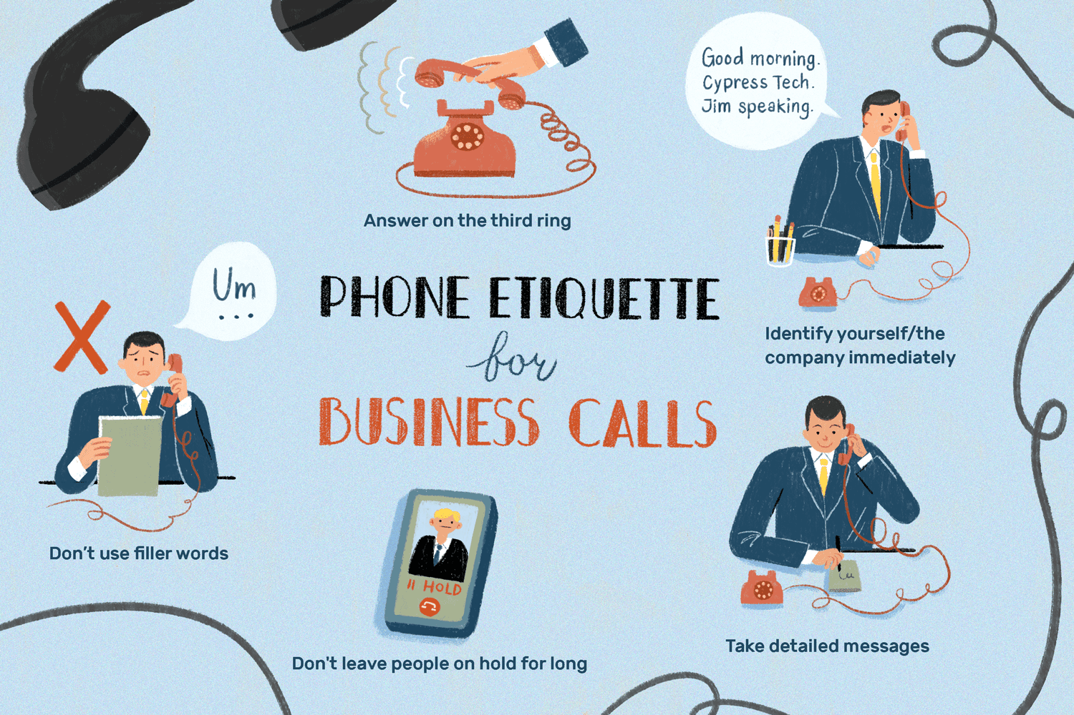
Learning 1 | My takeaways
Professional Qualities and Attributes?
Expertise
Punctuality
Appearance
Self-Discipline
Telephone Etiquette
Answering: Answer with greeting
Tone: Tone must be polite
Hold: Don't hold for long and don't move away
Ending: End with goodbye

Slide 6
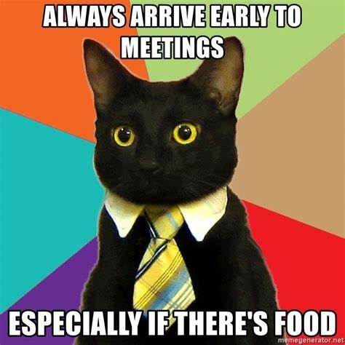
Learning 1 | My takeaways
Email Etiquette:
Subject: Don’t use block letters
One email one message
One paragraph(15-20 words) – one idea
Respond within 24 hours
Write designation in signature
Meeting Etiquette
Be Prepared and on time
Put your phone on silent
Follow-up

Slide 7

Learning 1 | My takeaways
Video Conferencing Etiquette:
Minimal background distraction
Dress as you're attending in person
Be on mute if not required
Pay attention and ask question
How do I personally see this concept implemented in the Energy sector: In the Energy sector, Professionalism involves adhering to safety regulations, maintaining technical expertise and ensuring ethical and regulatory compliance.

Slide 8
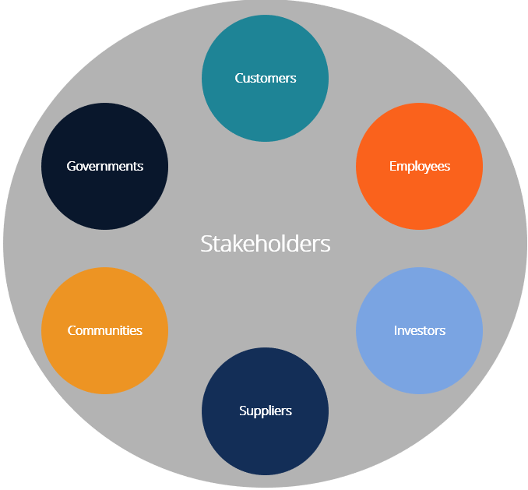
Learning 2 | My takeaways
Stakeholder Analysis
Identify the stakeholder
Understand Stakeholder
Prioritize stakeholder
Develop a communication plan
Manage and monitor stakeholder expectation
Always have power-interest graph in mind
Stakeholder expectation
Transparency
Giving everyone significant amount of say
Physical interaction is best but if it is not possible, you can have another mutually acceptable channel

Slide 9
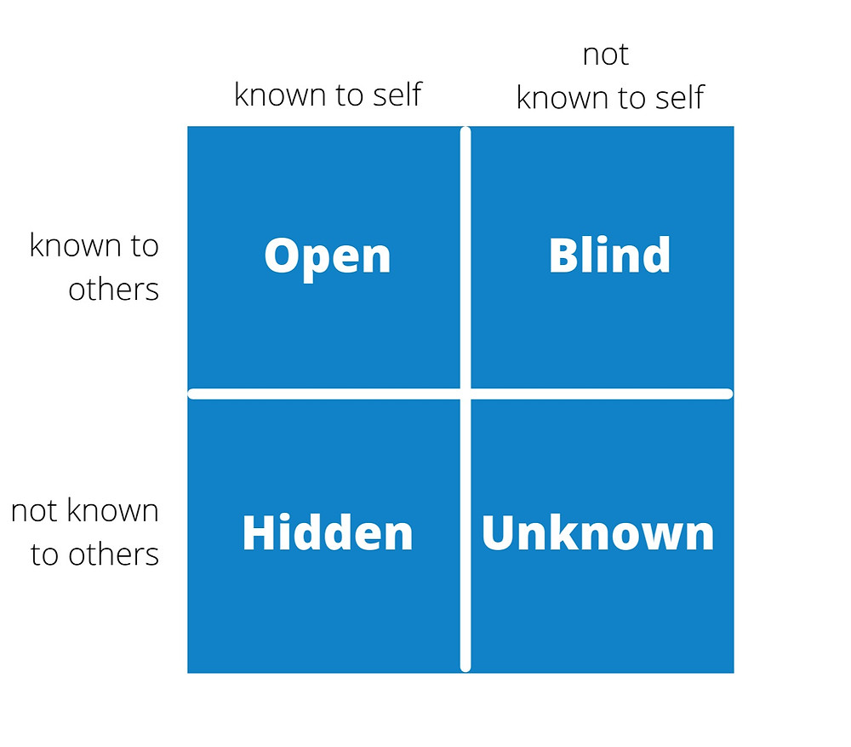
Learning 2 | My takeaways
Shell Trust Model
Credibility
Reliability
Intimacy
Self-Orientation
Always have power-interest graph in mind
Trust Enhancing Techniques
Johari Window
4 Quadrants (1- Blind Self, 2- Open Self, 3- Hidden Self, and 4- Unknown Self)
How do I personally see this concept implemented in the Energy sector: In energy sector all stakeholders are equally important.

Slide 10
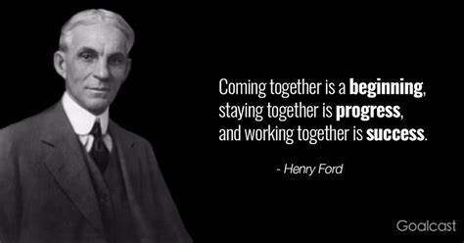
Learning 3 | My takeaways
Benefits of Teamwork
Encourages personal growth and Increases job satisfaction
Reduces stress Increases efficiency by sharing the workload
Boosts accountability and morale
Stages of Development (Tuckman Model)
Performing
Forming
Storming
Norming
Sandwich feedback method should be used

Slide 11
Learning 3 | My takeaways
5 P of Presentation
Profile, Pitch, Pace, Pause, and Practice
Logical Structure should be followed in PPT
AAB strategy should be followed for presentation
How do I personally see this concept implemented in the Energy sector: In energy sector teamwork and presentation is required to convey the idea and things to be done on time and efficiently.

Slide 12
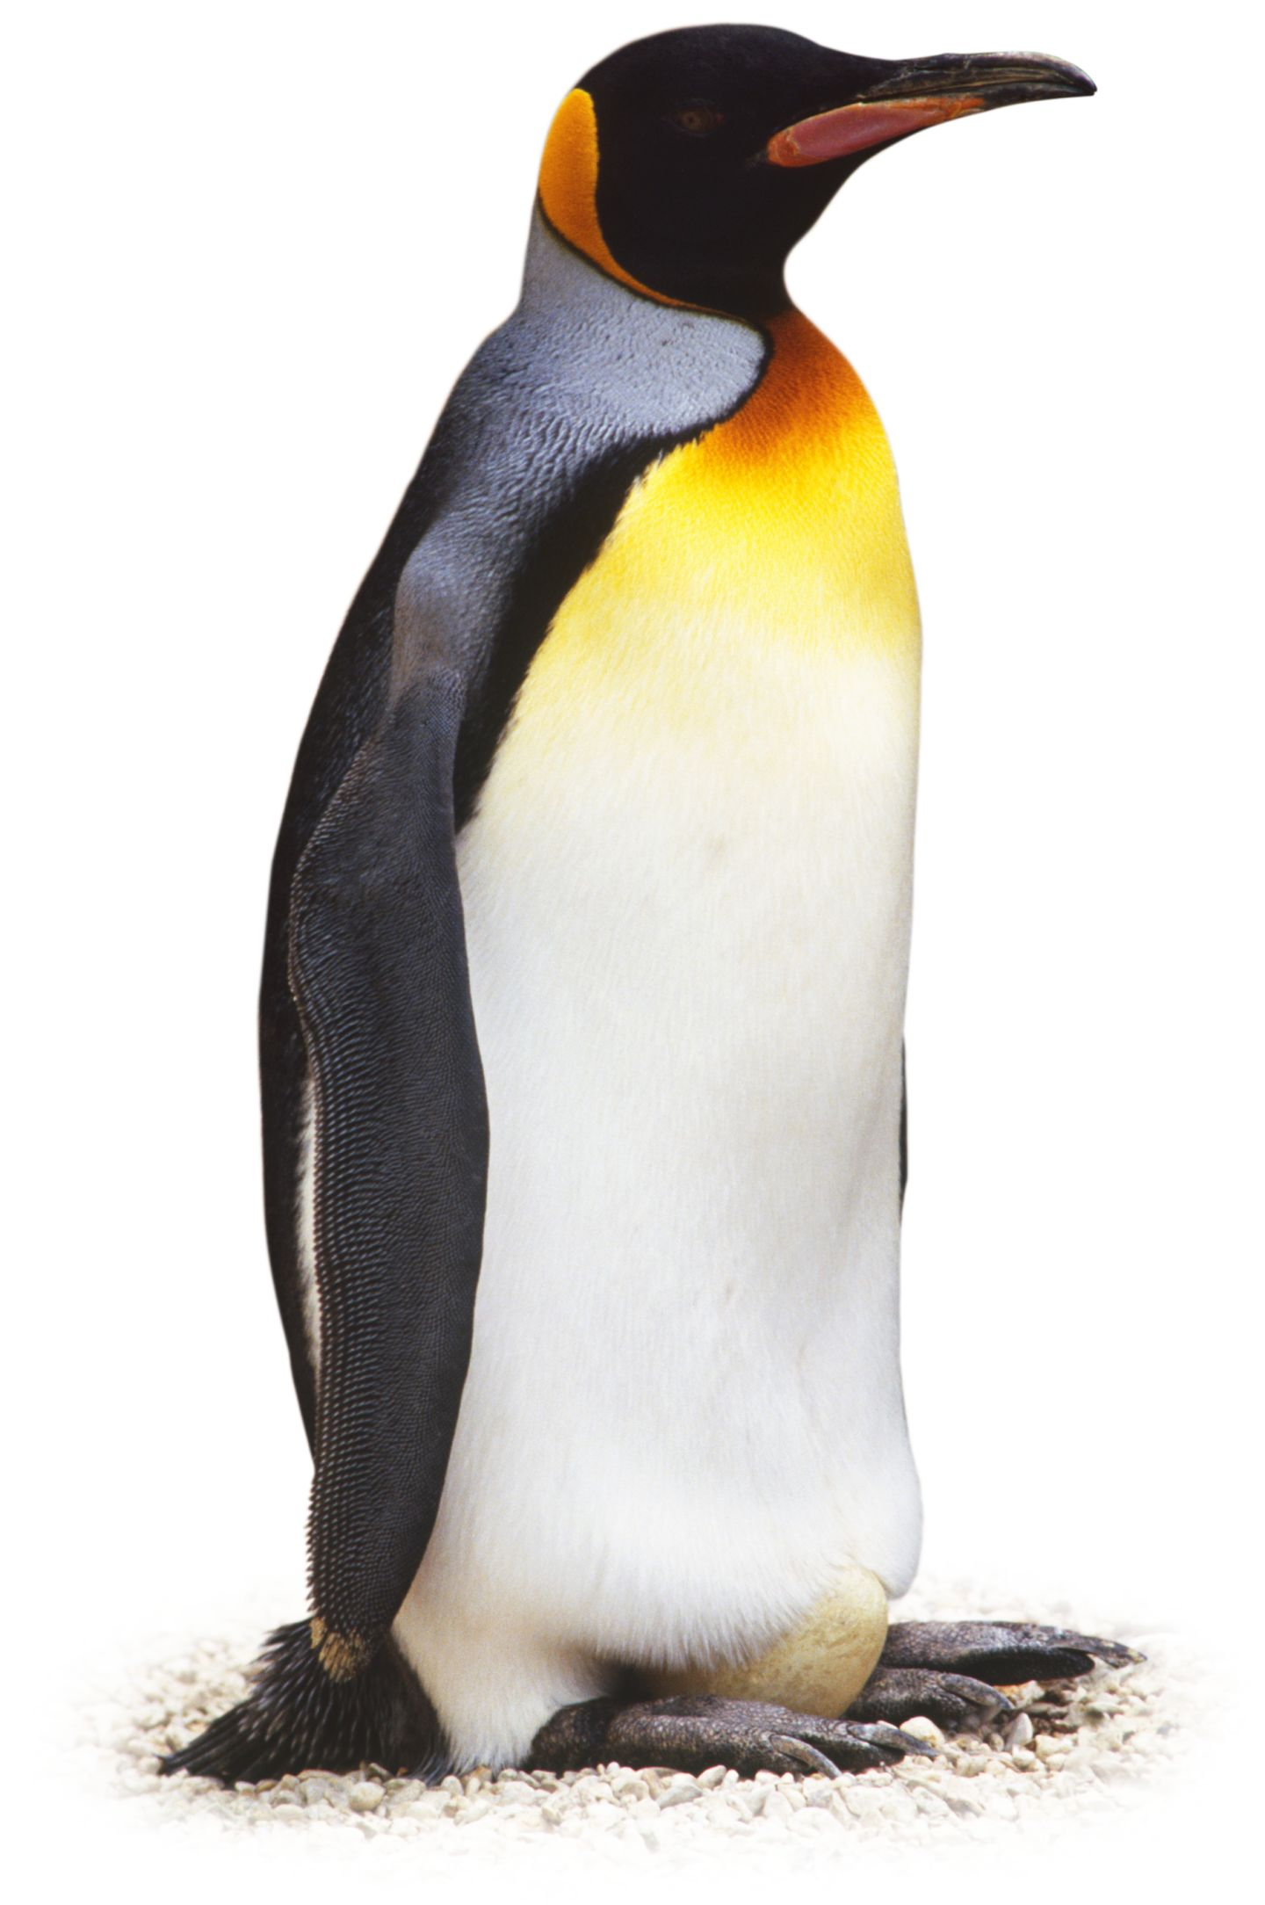
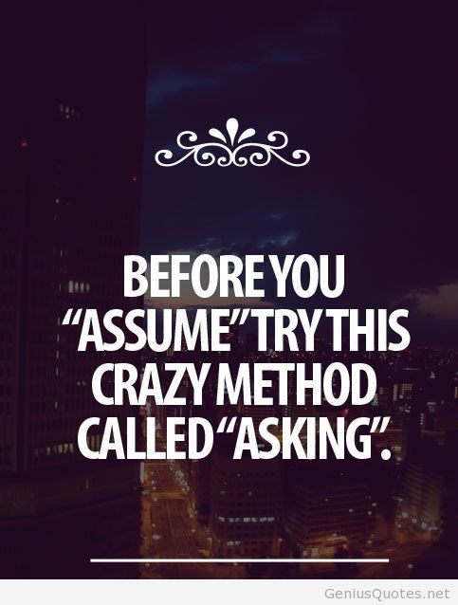
Learning 4 | My takeaways
Business Analysis
Requirement analysis (functional vs non-functional)
Requirement Elicitation and techniques
Requirement modeling (scenario based, class based, and data based)
Requirement management and its importance
Requirement management techniques (Work breakdown structure, Gannt Chart, Critical path method, waterfall model, Kanban, and Scrum)

Slide 13
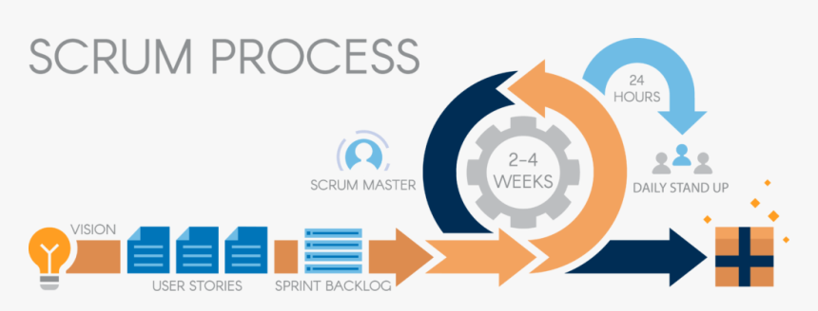
Learning 4 | My takeaways
Agile methodology(SCRUM)
A project management framework that breaks projects down into several dynamic phases, commonly known as sprints.
Scrum is an agile framework for team collaboration and problem solving, inspired by the sport of rugby
Three pillars (Transparency, Inspection and Adaptation)
Time: Sprint(2-4 weeks), Daily scrum(15 min), Planning+Review+Retrospection(2-4) hours
Benefits: Adaptability, High velocity, Continuous improvement, Sustainable pace, Faster problem resolution, customer centric, and efficient

Slide 14
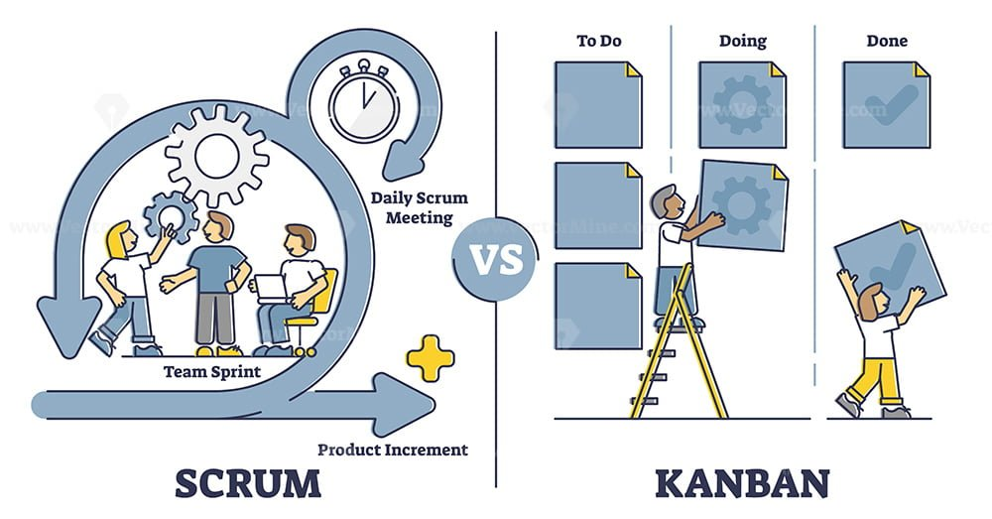
Learning 5 | My takeaways
Componenets of SCRUM
Epic
User Story
Task
Sub Task
Business Feature
Feature
Benefit Hypothesis
Acceptance Criteria
User Story
Enabler Story

Slide 15
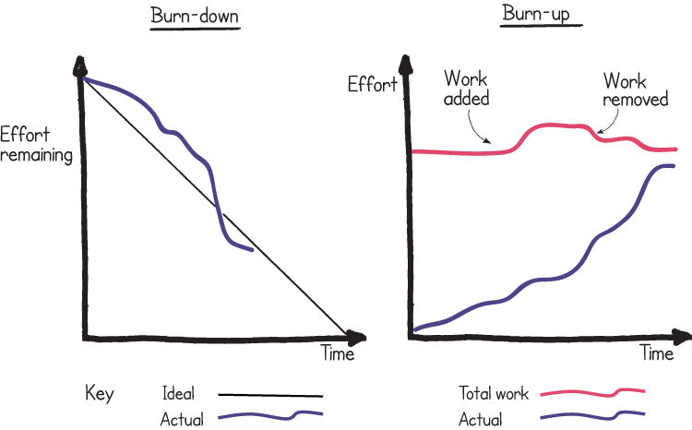
Learning 5 | My takeaways
KANBAN
The Kanban method is an approach to evolutionary and incremental systems and process change for organizations.
Story Pointing (Ready-Spint-Done)
Definition of Ready(DoR)
Definition of Done(DoD)
Estimation in Agile (Scope, Team, Cost)
Story Point Estimation
Customer Ready Stats
Team Estimates
Team Discuss

Slide 16

Relevance of learnings for my organization

Slide 17

Learning 1 | Relevance for Shell
How I feel Shell implements this learning:
Training program
Leadership by example
Performance evaluation
Clear Communication
How I feel Shell benefits from this learning:
Enhanced Reputation
Employee Satisfaction
Risk Mitigation

Slide 18
Learning 2 | Relevance for Shell
How I feel Shell implements this learning:
Stakeholder Mapping
Communcation Plan
Feedback mechanism
Collaborative platform
How I feel Shell benefits from this learning:
Improved Decision-Making
Risk mitigation
Strengthened Relationship

Slide 19
Learning 3 | Relevance for Shell
How I feel Shell implements this learning:
Team building Activities
Cross-Functional Team
Clear Roles and Responsibilities
Recognition and Reward
How I feel Shell benefits from this learning:
Increased Innovation
Higher Productivity
Employee Engagement

Slide 20
Learning 4 | Relevance for Shell
How I feel Shell implements this learning:
Agile Training
Business analysis tools
Pilot Agile Project
Continuous Feedback
How I feel Shell benefits from this learning:
Faster Time-To-market
Enhanced Flexibility
Data-Driven Decision

Slide 21
Learning 5 | Relevance for Shell
How I feel Shell implements this learning:
Cross-Functional Teams
Daily Stand-Ups
Sprint Reviews and Retrospectives
WIP Limits
Relative Estimation
How I feel Shell benefits from this learning:
Improved Efficiency
Enhanced Flexibility
Increased Transparency

Slide 22

Challenges in implementing learning

Slide 23
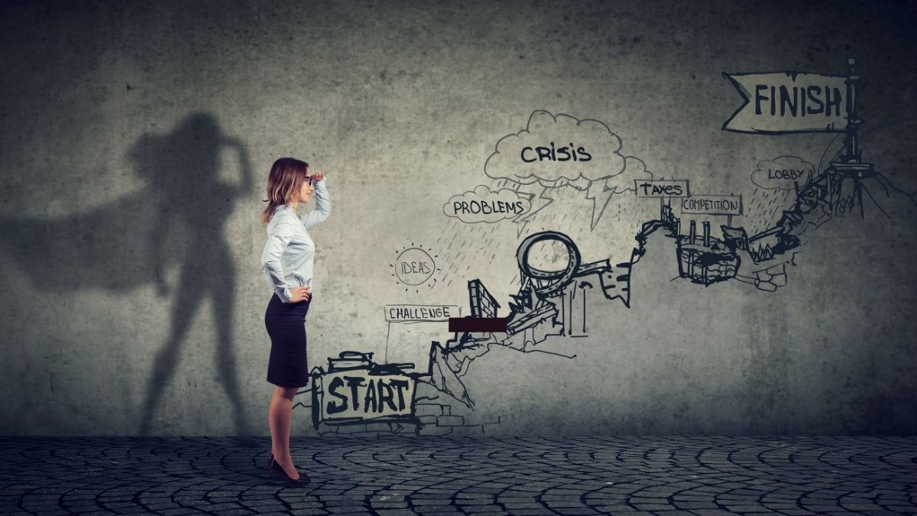
Challenge faced while implementing Learning 1
Challenge faced while implementing:
Cultural Resistance
Consistency across Regions
Measurement and Accountability
Time Constraints

Slide 24
Challenge faced while implementing Learning 2
Challenge faced while implementing:
Diverse Stakeholder interest
Communication barriers
Resource Allocation

Slide 25
Challenge faced while implementing Learning 3
Challenge faced while implementing:
Geographical Dispersion
Diverse Work Cultures leading to misunderstanding sometimes
Role Clarity Issues
Resistance to change

Slide 26
Challenge faced while implementing Learning 4
Challenge faced while implementing:
Adoption of agile suddenly
Training and Expertise
Integration with my existing knowledge
Continuous adaption

Slide 27
Challenge faced while implementing Learning 5
Challenge faced while implementing:
Consistency in Story pointing
Implementation Delays
Maintaining Discipline
Excessive Training

Slide 28

Action Plan

Slide 29
My Action Plan for this Week
Actions
Timeline
Status
Learning more about Azure DevOps
Setting up PostgreSQL and working on that
Making more friends
1 Week
Ongoing

Slide 30

Learning is also Fun!

Slide 31
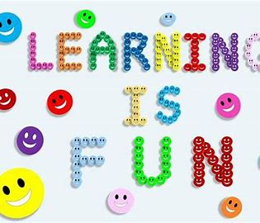
Learning is also Fun!
My learning was fun this week because of following reasons:
Roleplay
Chart making
In class presentations
Assessment
Games
Networking

Slide 32

Summary
Quick summary
Professionalism: We learned the importance of consistent behavior and clear communication, though adapting these standards globally and measuring their impact was challenging.
Stakeholder Management: Managing diverse stakeholder needs improved our collaboration but balancing conflicting interests and overcoming communication barriers required significant effort.
Teamwork: Enhancing teamwork boosted innovation and productivity but bridging geographical and cultural gaps was a challenging part of the journey.
Business Analysis and Agile: Adopting Agile practices made us more flexible yet integrating them with existing processes and ensuring proper training required a major shift.

Slide 33
Thank You

