Slide 1
Shell Bootcamp 2024 3 Reflections for Week 2
NITYA NAND JHA
Date : 30-Aug-2024

Slide 2

About Me
Leading my life with Purpose, Loyalty, and Ambition; Committed to a positive Future.

Slide 3

My learnings from this week!

Slide 4
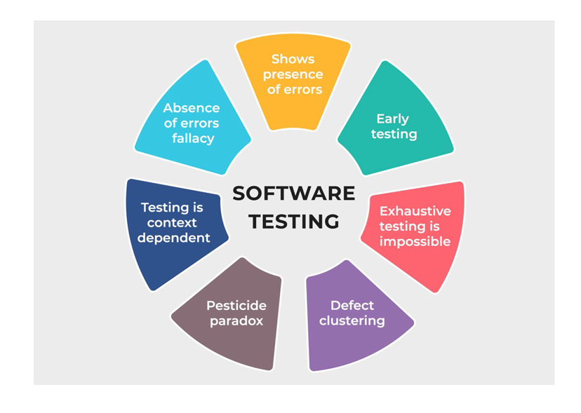
Learning 1 | My takeaways
Software Testing
Software testing is a crucial part of the software development lifecycle. It involves evaluating and verifying that a software application or product does what it’s supposed to do.
Types of Software Testing
Unit Testing
Integration Testing
Smoke Testing
Stress Testing
Regression Testing

Slide 5
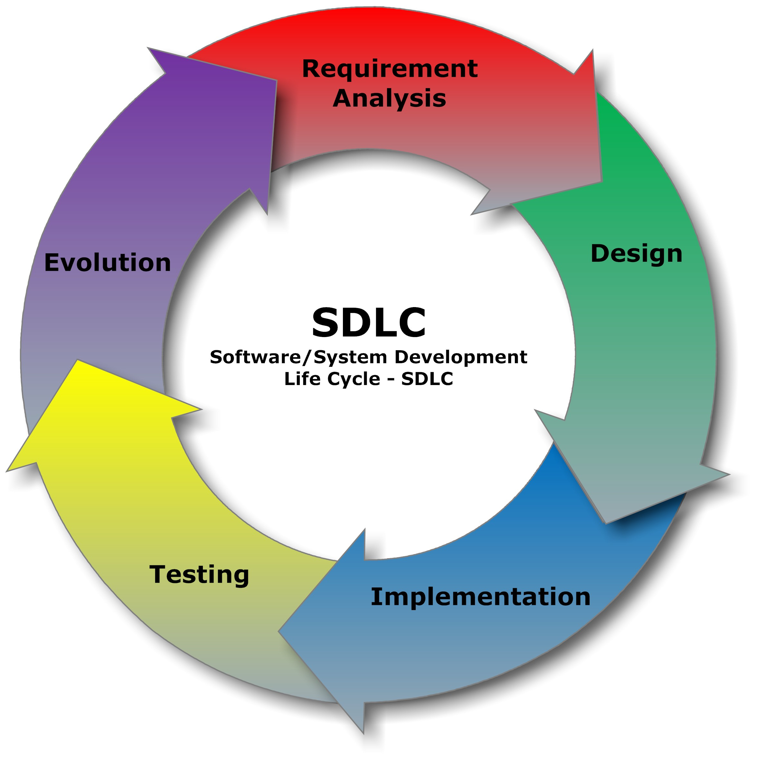
Learning 1 | My takeaways
Software Testing Life Cycle
Test Strategy
Test Plan
Test Design
Test Environment Setup
Test Execution
Defect Reporting
Test Closure

Slide 6
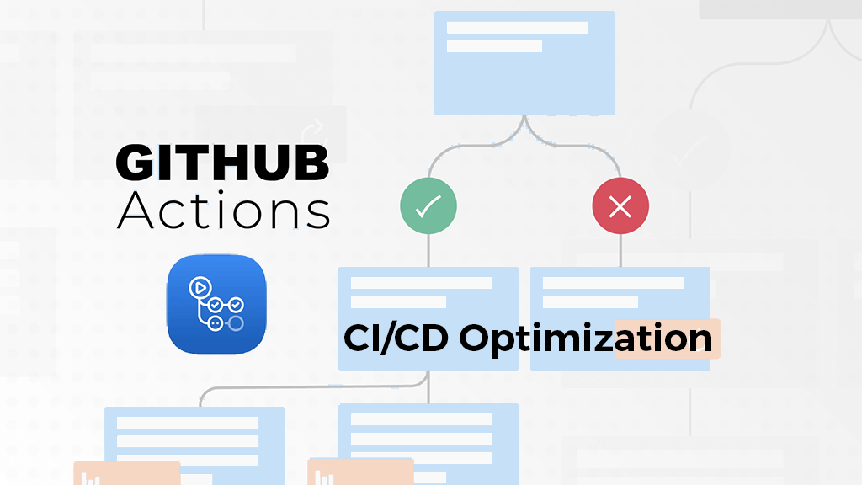
Learning 2 | My takeaways
DevOps with GitHub Actions
DevOps is a set of practices, tools, and a cultural philosophy that aims to automate and integrate the processes between software development and IT operations teams.
GitHub Actions:
Automate workflows directly in your GitHub repository.
Define custom workflows using YAML syntax.
GitHub Events:
Triggers workflows based on events (e.g., push, pull request).
Enables automated responses to repository activities.

Slide 7
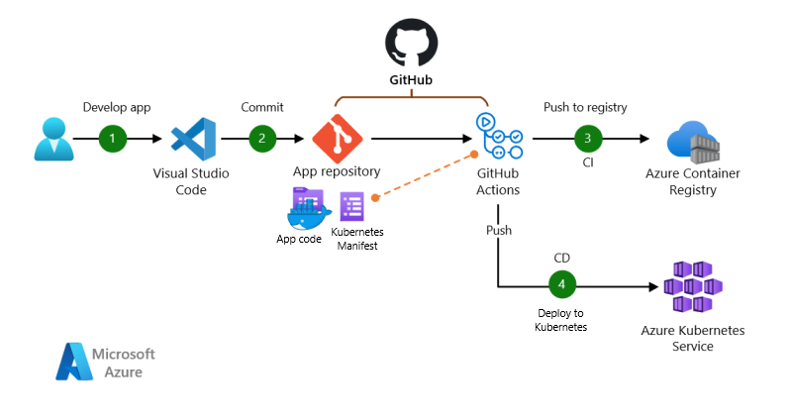
Learning 2 | My takeaways
Continuous Integration (CI):
Automatically test and integrate code changes.
Ensures code quality and reduces integration issues.
Continuous Deployment (CD):
Automatically deploy code to production.
Streamlines the release process and reduces manual intervention.
GitHub Workflow:
A series of automated steps defined in a YAML file.
Can include jobs, steps, and actions to perform tasks.

Slide 8

Learning 3 | My takeaways
Cloud Computing
Delivery of computing services (servers, storage, databases, networking, software) over the internet (“the cloud”).
Computing Models
Infrastructure as a Service (IaaS)
Platform as a Service (PaaS)
Software as a Service (SaaS)
Code as a Service
Benefits of cloud
Scalability, Cost Efficiency, Accessibility, and Flexibility

Slide 9
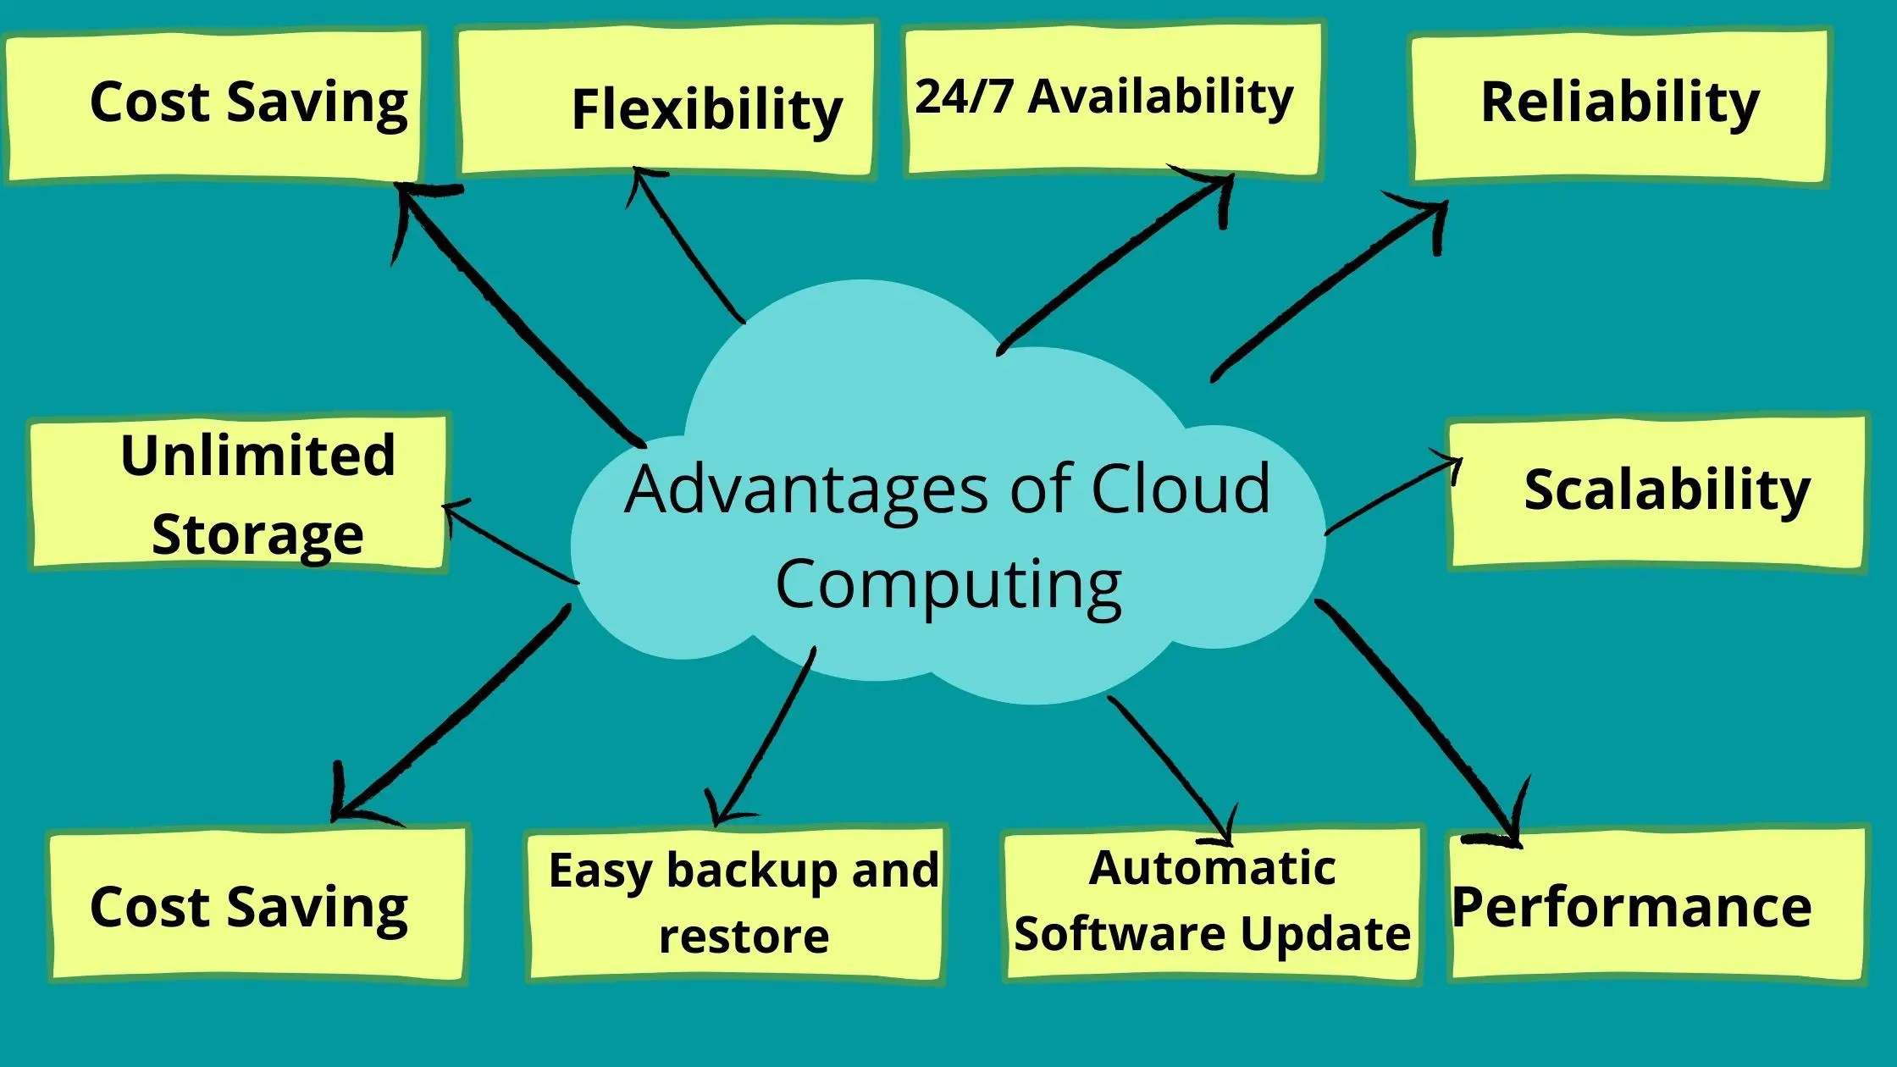
Learning 3 | My takeaways
Deployment Model
Public
Private
Hybrid
Community Cloud
Azure Cloud Services:
Virtual Machines
Azure Kubernetes Service
Blob Storage
Azure Database
Azure CDN
Azure DevOps

Slide 10
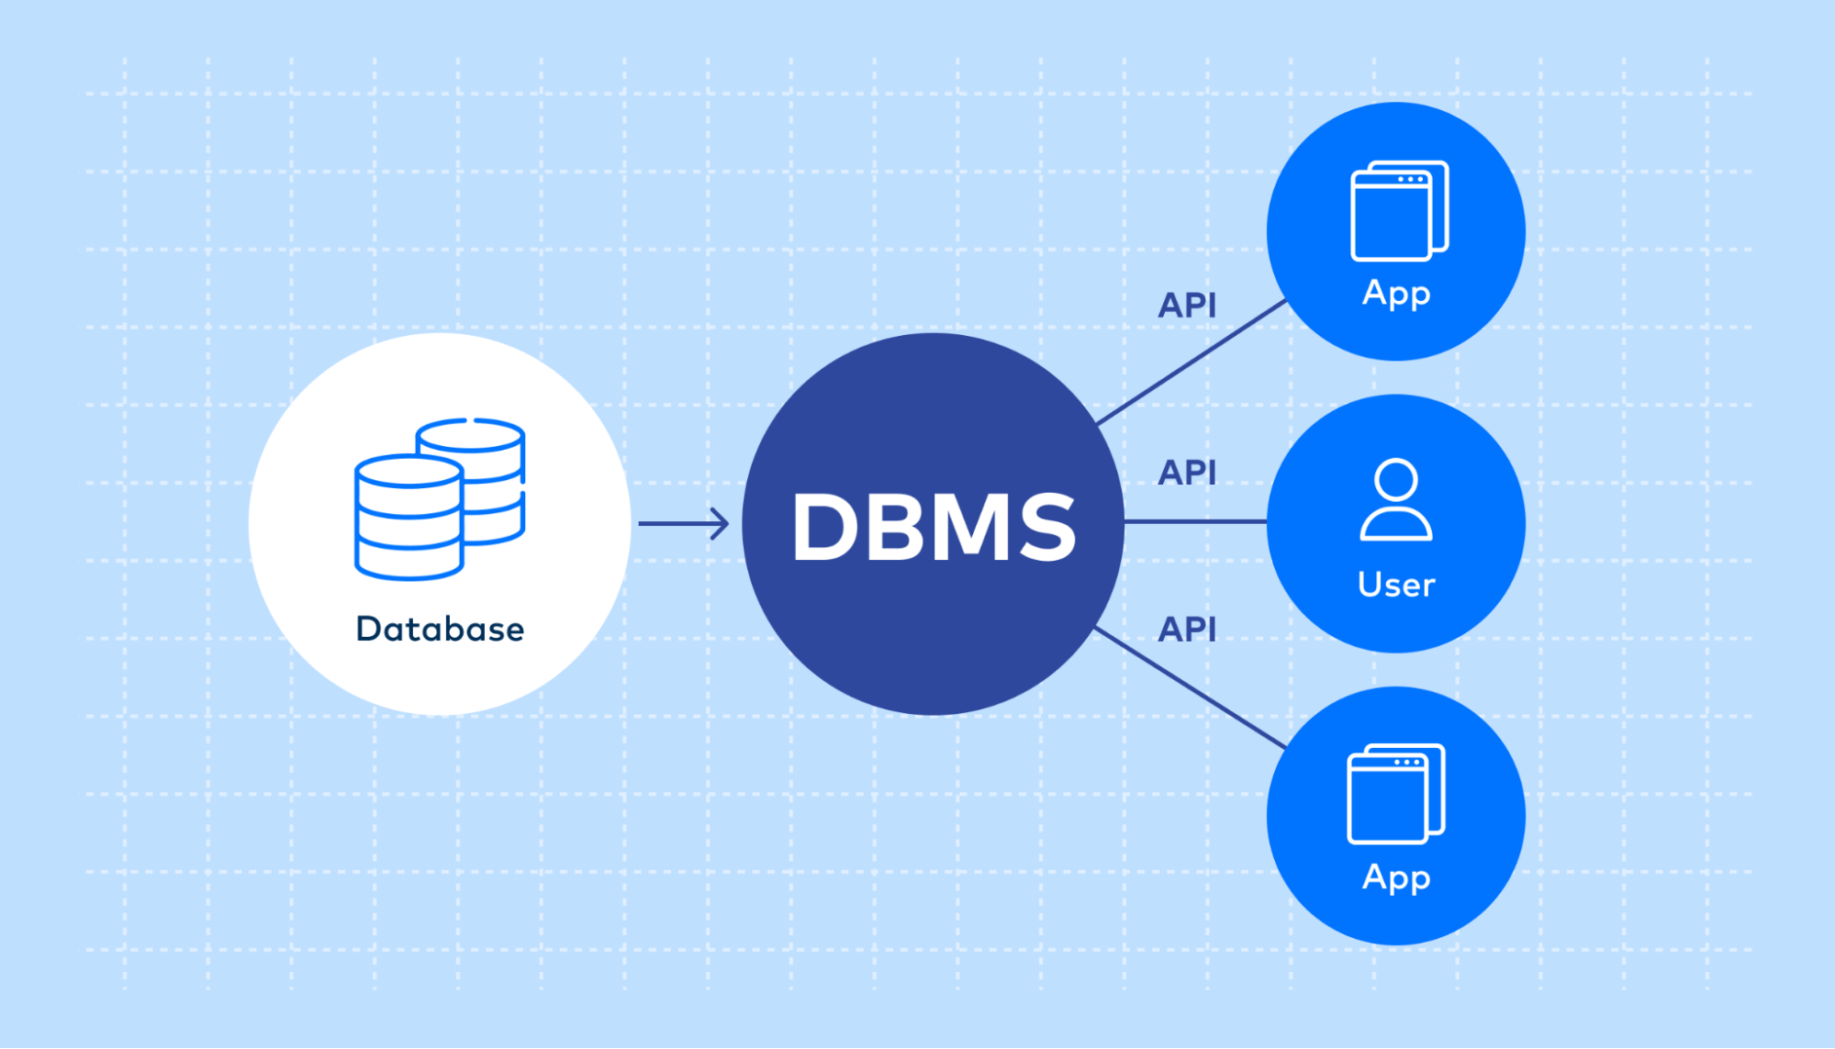
Learning 4 | My takeaways
Database
Organized collection of data, generally stored and accessed electronically.
Types: Relational, NoSQL, In-memory, Graph, etc.
Use Cases: Data storage, retrieval, and management for applications.
Relational Databases:
Type of database that stores data in tables with rows and columns.
Key Features: Structured Query Language (SQL), ACID Properties, and Normalization.

Slide 11
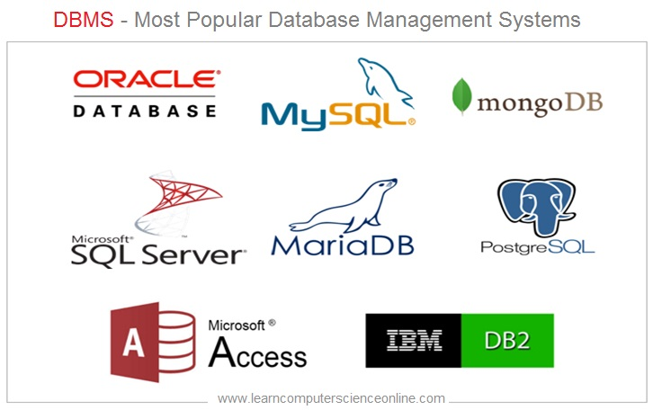
Learning 4 | My takeaways
PostgreSQL
Open-source, powerful, and advanced relational database system.
Key Features:
Extensibility
Compliance
Performance
Data Integrity
Community Support

Slide 12

Relevance of learnings for my organization

Slide 13

Learning 1 | Relevance for Shell
Software testing skills can benefit Shell by:
Ensuring Reliability: Validating software systems for accurate data processing and operational stability.
Enhancing Safety: Identifying and mitigating software bugs that could lead to operational hazards.
Improving Efficiency: Streamlining software performance to optimize energy management and resource allocation.
Compliance: Ensuring software meets industry regulations and standards.
Cost Savings: Reducing downtime.

Slide 14
Learning 2 | Relevance for Shell
GitHub Actions skills can benefit Shell by:
Automating Workflows: Streamlining repetitive tasks and processes.
Enhancing CI/CD: Improving software deployment speed and reliability.
Ensuring Code Quality: Automating testing and code reviews.
Boosting Collaboration: Facilitating better team collaboration and integration.
Efficiency: Reducing manual intervention and operational costs.

Slide 15
Learning 3 | Relevance for Shell
Cloud computing skills can benefit Shell by:
Scalability: Easily scaling resources to meet fluctuating demands.
Cost Efficiency: Reducing IT infrastructure costs through pay-as-you-go models.
Data Management: Enhancing data storage, processing, and analytics capabilities.
Innovation: Accelerating the development and deployment of new technologies.
Global Access: Enabling remote access to systems and data from anywhere.

Slide 16
Learning 4 | Relevance for Shell
DevOps skills can benefit Shell by:
Streamlining Development: Enhancing collaboration between development and operations teams.
Automating Processes: Reducing manual tasks and increasing efficiency.
Improving Reliability: Ensuring consistent and reliable software deployments.
Accelerating Delivery: Speeding up the release of new features and updates.
Enhancing Security: Integrating security practices into the development lifecycle.

Slide 17

Challenges in implementing learning

Slide 18

Challenge faced while implementing Learning 1
Challenge faced while implementing:
Understanding complex testing methodologies and tools
Keeping up with rapidly evolving technology
Maintaining attention to detail
Developing strong analytical skills
Balancing automation and manual testing
Communicating effectively with development teams

Slide 19
Challenge faced while implementing Learning 2
Challenge faced while implementing:
Understanding YAML syntax and structure
Configuring complex workflows
Integrating with various CI/CD tools
Debugging workflow errors
Managing secrets and environment variables
Keeping up with updates and new features

Slide 20
Challenge faced while implementing Learning 3
Challenge faced while implementing:
Understanding different database models (relational, NoSQL, etc.)
Learning SQL syntax and commands
Designing efficient database schemas
Managing data integrity and normalization
Optimizing query performance
Handling database security and access control
Keeping up with database technologies and updates

Slide 21
Challenge faced while implementing Learning 4
Challenge faced while implementing:
Understanding the DevOps culture and principles
Learning various automation tools and scripts
Integrating CI/CD pipelines
Managing infrastructure as code (IaC)
Ensuring security and compliance
Monitoring and logging systems
Balancing development and operations tasks

Slide 22

Action Plan

Slide 23
My Action Plan for this Week
Actions
Timeline
Status
Going to Changemakers
Learning more about Data
Making more friends
1 Week
Ongoing

Slide 24

Learning is also Fun!

Slide 25

Learning is also Fun!
My learning was fun this week because of following reasons:
Roleplay
Chart making
In class presentations
Assessment
Games
Networking

Slide 26

Summary
Quick summary
During the week, I learned essential skills in Database, DevOps, GitHub Actions, and Software Testing. I started by understanding database models and practicing SQL. Then, I moved on to grasping DevOps principles and exploring automation tools. Midweek, I configured GitHub Actions workflows and integrated CI/CD pipelines. I wrapped up by mastering software testing methodologies, balancing manual and automated tests, and finally, I reviewed and applied all the skills in a cohesive project.

Slide 27
Thank You

