Slide 1
48 trajecoties are found
intensity trj frag0 frag1
[['0.9999996', '127', '2', '1', 'C8H18N1O2Si1'], ['1.0000000', '157', '2', '1', 'C8H18N1O2Si1'], ['0.9999706', '180', '2', '1', 'C8H18N1O2Si1'], ['1.0000000', '186', '2', '1', 'C8H18N1O2Si1'], ['1.0000000', '190', '2', '1', 'C8H18N1O2Si1'], ['0.9999649', '206', '2', '1', 'C8H18N1O2Si1'], ['0.9999971', '216', '2', '1', 'C8H18N1O2Si1'], ['1.0000000', '229', '2', '1', 'C8H18N1O2Si1'], ['0.9999999', '249', '2', '1', 'C8H18N1O2Si1'], ['1.0000000', '257', '2', '1', 'C8H18N1O2Si1'], ['1.0000000', '28', '2', '1', 'C8H18N1O2Si1'], ['0.9999991', '303', '2', '1', 'C8H18N1O2Si1'], ['0.9999812', '312', '2', '1', 'C8H18N1O2Si1'], ['0.9999999', '316', '2', '1', 'C8H18N1O2Si1'], ['1.0000000', '325', '2', '1', 'C8H18N1O2Si1'], ['0.9999984', '334', '2', '1', 'C8H18N1O2Si1'], ['0.9999999', '336', '2', '1', 'C8H18N1O2Si1'], ['1.0000000', '361', '2', '1', 'C8H18N1O2Si1'], ['1.0000000', '37', '2', '1', 'C8H18N1O2Si1'], ['1.0000000', '390', '2', '1', 'C8H18N1O2Si1'], ['0.9998701', '420', '2', '1', 'C8H18N1O2Si1'], ['0.9999964', '422', '2', '1', 'C8H18N1O2Si1'], ['1.0000000', '436', '2', '1', 'C8H18N1O2Si1'], ['1.0000000', '471', '2', '1', 'C8H18N1O2Si1'], ['1.0000000', '482', '2', '1', 'C8H18N1O2Si1'], ['0.9999998', '484', '2', '1', 'C8H18N1O2Si1'], ['1.0000000', '499', '2', '1', 'C8H18N1O2Si1'], ['1.0000000', '516', '2', '1', 'C8H18N1O2Si1'], ['1.0000000', '539', '3', '1', 'C8H18N1O2Si1'], ['0.9999979', '569', '2', '1', 'C8H18N1O2Si1'], ['1.0000000', '587', '2', '1', 'C8H18N1O2Si1'], ['1.0000000', '600', '2', '1', 'C8H18N1O2Si1'], ['0.9999982', '611', '2', '1', 'C8H18N1O2Si1'], ['1.0000000', '619', '2', '1', 'C8H18N1O2Si1'], ['1.0000000', '622', '2', '1', 'C8H18N1O2Si1'], ['1.0000000', '633', '2', '1', 'C8H18N1O2Si1'], ['1.0000000', '659', '2', '1', 'C8H18N1O2Si1'], ['1.0000000', '661', '2', '1', 'C8H18N1O2Si1'], ['1.0000000', '696', '2', '1', 'C8H18N1O2Si1'], ['1.0000000', '699', '2', '1', 'C8H18N1O2Si1'], ['1.0000000', '732', '2', '1', 'C8H18N1O2Si1'], ['0.9999857', '736', '2', '1', 'C8H18N1O2Si1'], ['1.0000000', '747', '2', '1', 'C8H18N1O2Si1'], ['1.0000000', '783', '2', '1', 'C8H18N1O2Si1'], ['1.0000000', '795', '2', '1', 'C8H18N1O2Si1'], ['1.0000000', '802', '2', '1', 'C8H18N1O2Si1'], ['1.0000000', '823', '2', '1', 'C8H18N1O2Si1'], ['1.0000000', '835', '2', '1', 'C8H18N1O2Si1']]
C8H18NO2Si
188

Slide 2
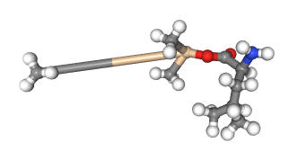
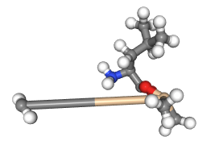
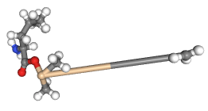
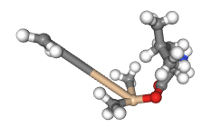
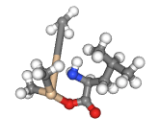
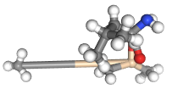
499
539
127
186
157
190

Slide 3
27 trajecoties are found
intensity trj frag0 frag1
[['0.9909237', '117', '3', '1', 'C6H12N1O1’],
['0.9999980', '161', '2', '1', 'C6H12N1O1’],
['0.9999727', '200', '2', '1', 'C6H12N1O1’],
['0.1098307', '271', '1', '1', 'C6H12N1O1'], ['0.9999935', '318', '2', '1', 'C6H12N1O1'], ['0.9999935', '322', '2', '1', 'C6H12N1O1'], ['0.9999811', '326', '2', '1', 'C6H12N1O1'], ['0.9951524', '337', '2', '1', 'C6H12N1O1'], ['1.0000000', '366', '2', '1', 'C6H12N1O1'], ['1.0000000', '367', '3', '1', 'C6H12N1O1'], ['0.9998997', '383', '2', '1', 'C6H12N1O1'], ['0.9998982', '384', '2', '1', 'C6H12N1O1'], ['1.0000000', '4', '4', '1', 'C6H12N1O1'], ['0.9999987', '459', '2', '1', 'C6H12N1O1'], ['0.9999998', '478', '3', '1', 'C6H12N1O1'], ['0.9999922', '490', '2', '1', 'C6H12N1O1'], ['0.9999924', '494', '2', '1', 'C6H12N1O1'], ['0.9997466', '507', '2', '1', 'C6H12N1O1'], ['1.0000000', '589', '2', '1', 'C6H12N1O1'], ['0.9999999', '607', '2', '1', 'C6H12N1O1'], ['0.9998728', '642', '2', '1', 'C6H12N1O1'], ['0.0099205', '649', '1', '1', 'C6H12N1O1'], ['0.9999998', '725', '2', '1', 'C6H12N1O1'], ['0.0000523', '738', '1', '1', 'C6H12N1O1'], ['0.9998189', '743', '2', '1', 'C6H12N1O1'], ['0.9999209', '752', '3', '1', 'C6H12N1O1'], ['0.9999996', '782', '4', '1', 'C6H12N1O1']]
C6H12NO
114

Slide 4
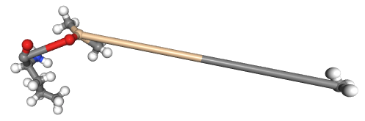
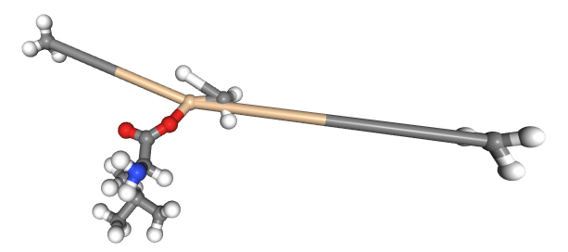
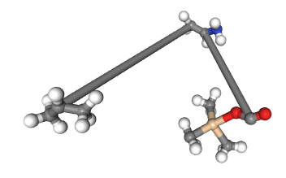
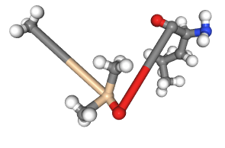
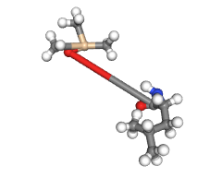
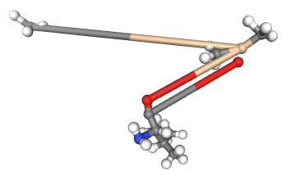
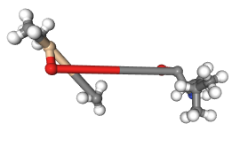
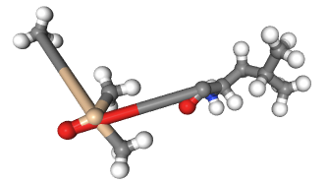
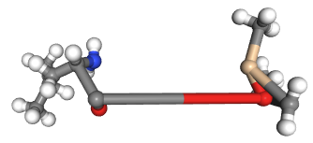
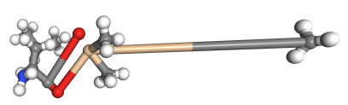
318
117
271
649
322
161
326
200
TMSO first
738
494

Slide 5
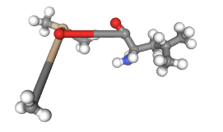
366

Slide 6
146 30 traj
86 271traj
['0.1123084', '101', '1', '1', 'C5H12N1'], ['0.9917181', '102', '2', '1', 'C5H12N1'], ['0.9894962', '104', '3', '1', 'C5H12N1'], ['0.4298811', '105', '2', '1', 'C5H12N1'], ['0.7009426', '106', '2', '1', 'C5H12N1'], ['0.7013836', '107', '2', '1', 'C5H12N1'], ['0.1207033', '112', '1', '1', 'C5H12N1'], ['0.9867119', '115', '3', '1', 'C5H12N1'], ['0.8520045', '116', '2', '1', 'C5H12N1'], ['0.9999586', '118', '2', '1', 'C5H12N1'], ['0.7678556', '121', '2', '1', 'C5H12N1'], ['0.9992352', '123', '2', '1', 'C5H12N1'], ['0.5863977', '125', '2', '1', 'C5H12N1'], ['1.0000000', '128', '2', '1', 'C5H12N1'], ['0.9999999', '129', '2', '1', 'C5H12N1'], ['0.9929819', '13', '2', '1', 'C5H12N1'], ['0.0313435', '131', '1', '1', 'C5H12N1'], ['0.0210539', '133', '1', '1', 'C5H12N1'], ['0.7466482', '136', '2', '1', 'C5H12N1'], ['0.9997363', '139', '2', '1', 'C5H12N1'], ['0.7839562', '142', '2', '1', 'C5H12N1'], ['0.9993105', '143', '2', '1', 'C5H12N1'], ['1.0000000', '144', '2', '1', 'C5H12N1'], ['1.0000000', '147', '2', '1', 'C5H12N1'], ['0.9999985', '15', '3', '1', 'C5H12N1'], ['0.9980592', '150', '2', '1', 'C5H12N1'], ['0.9999754', '151', '2', '1', 'C5H12N1'], ['0.9172700', '153', '2', '1', 'C5H12N1'], ['0.6617210', '154', '2', '1', 'C5H12N1'], ['0.9995643', '156', '4', '1', 'C5H12N1'], ['1.0000000', '16', '3', '1', 'C5H12N1'], ['0.9738567', '165', '2', '1', 'C5H12N1'], ['1.0000000', '169', '2', '1', 'C5H12N1'], ['0.0026999', '171', '1', '1', 'C5H12N1'], ['0.9790188', '172', '2', '1', 'C5H12N1'], ['1.0000000', '173', '3', '1', 'C5H12N1'], ['0.0974039', '174', '1', '1', 'C5H12N1'], ['0.0997396', '177', '1', '1', 'C5H12N1'], ['0.6167245', '18', '2', '1', 'C5H12N1'], ['0.9883460', '181', '2', '1', 'C5H12N1'], ['0.0156433', '185', '1', '1', 'C5H12N1'], ['0.9999998', '19', '3', '1', 'C5H12N1'], ['0.9999989', '191', '2', '1', 'C5H12N1'], ['0.6844377', '192', '2', '1', 'C5H12N1'], ['0.9999872', '195', '2', '1', 'C5H12N1'], ['0.9999996', '196', '2', '1', 'C5H12N1'], ['0.0691208', '197', '1', '1', 'C5H12N1'], ['0.9748258', '199', '3', '1', 'C5H12N1'], ['0.5156036', '202', '2', '1', 'C5H12N1'], ['0.2961350', '205', '1', '1', 'C5H12N1'], ['0.8123846', '208', '2', '1', 'C5H12N1'], ['0.9742230', '210', '2', '1', 'C5H12N1'], ['0.9822448', '212', '2', '1', 'C5H12N1'], ['0.5414647', '217', '2', '1', 'C5H12N1'], ['0.3766378', '218', '1', '1', 'C5H12N1'], ['0.9978089', '220', '2', '1', 'C5H12N1'], ['0.0039423', '223', '1', '1', 'C5H12N1'], ['0.9999297', '226', '3', '1', 'C5H12N1'], ['0.0512481', '227', '1', '1', 'C5H12N1'], ['0.9028520', '228', '2', '1', 'C5H12N1'], ['0.9999989', '230', '2', '1', 'C5H12N1'], ['0.8735222', '231', '2', '1', 'C5H12N1'], ['0.9999994', '233', '2', '1', 'C5H12N1'], ['0.7973886', '234', '2', '1', 'C5H12N1'], ['0.9742269', '235', '2', '1', 'C5H12N1'], ['0.9429027', '236', '2', '1', 'C5H12N1'], ['0.9999951', '237', '2', '1', 'C5H12N1'], ['0.9985071', '239', '4', '1', 'C5H12N1'], ['0.0074728', '24', '1', '1', 'C5H12N1'], ['0.9952881', '241', '2', '1', 'C5H12N1'], ['0.9992509', '242', '4', '1', 'C5H12N1'], ['0.9756746', '244', '2', '1', 'C5H12N1'], ['0.9999984', '245', '3', '1', 'C5H12N1'], ['0.0628150', '247', '1', '1', 'C5H12N1'], ['0.0576127', '256', '1', '1', 'C5H12N1'], ['1.0000000', '259', '2', '1', 'C5H12N1'], ['0.6387980', '26', '2', '1', 'C5H12N1'], ['0.5299106', '265', '2', '1', 'C5H12N1'], ['0.9999999', '267', '2', '1', 'C5H12N1'], ['0.7876702', '272', '2', '1', 'C5H12N1'], ['0.9999434', '273', '2', '1', 'C5H12N1'], ['0.4282567', '275', '2', '1', 'C5H12N1'], ['0.7233671', '277', '2', '1', 'C5H12N1'], ['0.0187968', '279', '1', '1', 'C5H12N1'], ['0.1795013', '286', '1', '1', 'C5H12N1'], ['0.0053330', '29', '1', '1', 'C5H12N1'], ['0.2913677', '290', '1', '1', 'C5H12N1'], ['1.0000000', '292', '3', '1', 'C5H12N1'], ['0.0059798', '296', '1', '1', 'C5H12N1'], ['0.9991031', '299', '3', '1', 'C5H12N1'], ['0.9999998', '300', '2', '1', 'C5H12N1'], ['0.2103561', '307', '1', '1', 'C5H12N1'], ['0.0724361', '309', '1', '1', 'C5H12N1'], ['1.0000000', '313', '4', '1', 'C5H12N1'], ['0.5823317', '320', '2', '1', 'C5H12N1'], ['0.6424326', '321', '2', '1', 'C5H12N1'], ['0.0138592', '331', '1', '1', 'C5H12N1'], ['0.0127212', '332', '1', '1', 'C5H12N1'], ['0.0037211', '335', '1', '1', 'C5H12N1'], ['0.8404065', '338', '2', '1', 'C5H12N1'], ['0.0643494', '34', '1', '1', 'C5H12N1'], ['0.0360927', '342', '1', '1', 'C5H12N1'], ['1.0000000', '343', '2', '1', 'C5H12N1'], ['0.5456727', '346', '2', '1', 'C5H12N1'], ['0.9999996', '347', '2', '1', 'C5H12N1'], ['0.9993715', '353', '2', '1', 'C5H12N1'], ['0.9999919', '358', '4', '1', 'C5H12N1'], ['0.9999965', '363', '2', '1', 'C5H12N1'], ['0.2042838', '365', '1', '1', 'C5H12N1'], ['0.9371541', '369', '2', '1', 'C5H12N1'], ['0.9999989', '370', '2', '1', 'C5H12N1'], ['0.9652136', '378', '2', '1', 'C5H12N1'], ['0.0470671', '379', '1', '1', 'C5H12N1'], ['0.0238912', '381', '1', '1', 'C5H12N1'], ['0.9999997', '382', '2', '1', 'C5H12N1'], ['0.5685747', '385', '2', '1', 'C5H12N1'], ['0.2403461', '386', '1', '1', 'C5H12N1'], ['0.0166752', '39', '1', '1', 'C5H12N1'], ['0.9848583', '395', '2', '1', 'C5H12N1'], ['0.9951898', '400', '2', '1', 'C5H12N1'], ['0.0714403', '401', '1', '1', 'C5H12N1'], ['0.7979180', '403', '2', '1', 'C5H12N1'], ['0.1182851', '41', '1', '1', 'C5H12N1'], ['0.0603559', '410', '1', '1', 'C5H12N1'], ['0.9510212', '412', '2', '1', 'C5H12N1'], ['0.1725967', '415', '1', '1', 'C5H12N1'], ['0.9999933', '417', '2', '1', 'C5H12N1'], ['0.6507695', '419', '2', '1', 'C5H12N1'], ['0.2282334', '421', '1', '1', 'C5H12N1'], ['0.9999997', '423', '3', '1', 'C5H12N1'], ['0.9480128', '426', '2', '1', 'C5H12N1'], ['0.7864300', '430', '2', '1', 'C5H12N1'], ['0.9999999', '432', '2', '1', 'C5H12N1'], ['0.5123543', '434', '2', '1', 'C5H12N1'], ['0.9723593', '437', '2', '1', 'C5H12N1'], ['0.9538530', '438', '2', '1', 'C5H12N1'], ['0.3938431', '441', '1', '1', 'C5H12N1'], ['0.5211208', '443', '2', '1', 'C5H12N1'], ['0.9929791', '445', '3', '1', 'C5H12N1'], ['0.0963426', '454', '1', '1', 'C5H12N1'], ['0.7482983', '455', '2', '1', 'C5H12N1'], ['0.9394373', '457', '2', '1', 'C5H12N1'], ['0.0341743', '464', '1', '1', 'C5H12N1'], ['0.9999842', '465', '3', '1', 'C5H12N1'], ['0.0838351', '467', '1', '1', 'C5H12N1'], ['0.7982276', '472', '2', '1', 'C5H12N1'], ['0.7724592', '479', '2', '1', 'C5H12N1'], ['0.8445546', '48', '2', '1', 'C5H12N1'], ['0.3594259', '483', '1', '1', 'C5H12N1'], ['0.1543180', '489', '1', '1', 'C5H12N1'], ['0.9999827', '491', '3', '1', 'C5H12N1'], ['0.0592436', '492', '1', '1', 'C5H12N1'], ['0.9999997', '496', '2', '1', 'C5H12N1'], ['0.1606742', '497', '1', '1', 'C5H12N1'], ['0.0024478', '498', '1', '1', 'C5H12N1'], ['0.0072538', '5', '1', '1', 'C5H12N1'], ['0.0180216', '50', '1', '1', 'C5H12N1'], ['0.0074009', '501', '1', '1', 'C5H12N1'], ['0.0175532', '503', '1', '1', 'C5H12N1'], ['1.0000000', '508', '2', '1', 'C5H12N1'], ['0.9999998', '52', '2', '1', 'C5H12N1'], ['0.1740719', '522', '1', '1', 'C5H12N1'], ['0.0028319', '523', '1', '1', 'C5H12N1'], ['0.0524132', '527', '1', '1', 'C5H12N1'], ['0.9630177', '532', '2', '1', 'C5H12N1'], ['0.9391261', '533', '2', '1', 'C5H12N1'], ['0.9079497', '534', '2', '1', 'C5H12N1'], ['0.0502290', '535', '1', '1', 'C5H12N1'], ['0.4608178', '537', '2', '1', 'C5H12N1'], ['0.8102871', '549', '2', '1', 'C5H12N1'], ['0.1423903', '552', '1', '1', 'C5H12N1'], ['0.9999969', '554', '2', '1', 'C5H12N1'], ['0.9134306', '559', '2', '1', 'C5H12N1'], ['0.9999963', '56', '3', '1', 'C5H12N1'], ['0.1083638', '561', '1', '1', 'C5H12N1'], ['0.9999999', '563', '2', '1', 'C5H12N1'], ['0.9381188', '568', '2', '1', 'C5H12N1'], ['0.3944659', '573', '1', '1', 'C5H12N1'], ['0.4437003', '580', '2', '1', 'C5H12N1'], ['0.9380603', '581', '2', '1', 'C5H12N1'], ['0.0509245', '584', '1', '1', 'C5H12N1'], ['0.9999961', '588', '4', '1', 'C5H12N1'], ['0.0445950', '592', '1', '1', 'C5H12N1'], ['0.9999032', '598', '2', '1', 'C5H12N1'], ['0.9899561', '60', '2', '1', 'C5H12N1'], ['0.6813864', '61', '2', '1', 'C5H12N1'], ['0.0077456', '610', '1', '1', 'C5H12N1'], ['0.9595556', '615', '2', '1', 'C5H12N1'], ['0.8853750', '620', '2', '1', 'C5H12N1'], ['0.9990070', '623', '4', '1', 'C5H12N1'], ['0.1167827', '629', '1', '1', 'C5H12N1'], ['0.9986612', '63', '2', '1', 'C5H12N1'], ['0.1582852', '634', '1', '1', 'C5H12N1'], ['0.0218428', '636', '1', '1', 'C5H12N1'], ['0.9999981', '644', '2', '1', 'C5H12N1'], ['0.9999983', '648', '2', '1', 'C5H12N1'], ['0.0375257', '650', '1', '1', 'C5H12N1'], ['0.4005895', '660', '1', '1', 'C5H12N1'], ['1.0000000', '664', '2', '1', 'C5H12N1'], ['0.0107382', '666', '1', '1', 'C5H12N1'], ['0.0011084', '671', '1', '1', 'C5H12N1'], ['0.0450533', '673', '1', '1', 'C5H12N1'], ['0.0232072', '676', '1', '1', 'C5H12N1'], ['0.0306033', '677', '1', '1', 'C5H12N1'], ['0.9999704', '68', '2', '1', 'C5H12N1'], ['0.8234178', '687', '2', '1', 'C5H12N1'], ['1.0000000', '688', '2', '1', 'C5H12N1'], ['0.1354156', '69', '1', '1', 'C5H12N1'], ['0.1525417', '695', '1', '1', 'C5H12N1'], ['0.9981393', '697', '2', '1', 'C5H12N1'], ['0.3715209', '698', '1', '1', 'C5H12N1'], ['0.9996913', '700', '2', '1', 'C5H12N1'], ['0.8049480', '703', '2', '1', 'C5H12N1'], ['0.9990982', '709', '2', '1', 'C5H12N1'], ['0.0947443', '710', '1', '1', 'C5H12N1'], ['0.7586092', '711', '2', '1', 'C5H12N1'], ['0.1140409', '716', '1', '1', 'C5H12N1'], ['0.1456201', '717', '1', '1', 'C5H12N1'], ['0.7942056', '720', '2', '1', 'C5H12N1'], ['0.9999999', '723', '3', '1', 'C5H12N1'], ['0.0032683', '724', '1', '1', 'C5H12N1'], ['0.1140203', '726', '1', '1', 'C5H12N1'], ['0.0503383', '727', '1', '1', 'C5H12N1'], ['0.7243513', '728', '2', '1', 'C5H12N1'], ['1.0000000', '730', '2', '1', 'C5H12N1'], ['0.1841365', '733', '1', '1', 'C5H12N1'], ['0.9855709', '734', '2', '1', 'C5H12N1'], ['0.2650799', '739', '1', '1', 'C5H12N1'], ['0.6930932', '74', '2', '1', 'C5H12N1'], ['0.9701061', '742', '2', '1', 'C5H12N1'], ['0.6951172', '744', '2', '1', 'C5H12N1'], ['0.0324273', '764', '1', '1', 'C5H12N1'], ['0.9999762', '765', '3', '1', 'C5H12N1'], ['0.5529962', '773', '2', '1', 'C5H12N1'], ['0.8127597', '775', '2', '1', 'C5H12N1'], ['0.5355547', '776', '2', '1', 'C5H12N1'], ['0.0210605', '777', '1', '1', 'C5H12N1'], ['0.9999996', '78', '2', '1', 'C5H12N1'], ['0.9999997', '781', '2', '1', 'C5H12N1'], ['0.4574753', '785', '2', '1', 'C5H12N1'], ['0.8803395', '787', '2', '1', 'C5H12N1'], ['0.7549448', '788', '2', '1', 'C5H12N1'], ['0.9999869', '791', '3', '1', 'C5H12N1'], ['0.7778904', '796', '2', '1', 'C5H12N1'], ['0.2719446', '798', '1', '1', 'C5H12N1'], ['0.4492964', '8', '2', '1', 'C5H12N1'], ['0.8649993', '805', '2', '1', 'C5H12N1'], ['0.1131727', '807', '1', '1', 'C5H12N1'], ['0.5167492', '810', '2', '1', 'C5H12N1'], ['0.8154573', '817', '2', '1', 'C5H12N1'], ['0.0819541', '82', '1', '1', 'C5H12N1'], ['0.4188442', '834', '1', '1', 'C5H12N1'], ['0.9247162', '839', '2', '1', 'C5H12N1'], ['0.0003934', '846', '1', '1', 'C5H12N1'], ['0.0013434', '848', '1', '1', 'C5H12N1'], ['0.0000047', '86', '1', '2', 'C1H3'], ['0.0000031', '86', '1', '3', 'C1H3'], ['0.0000000', '86', '2', '2', 'C1H3'], ['0.0001521', '86', '3', '1', 'C4H10'], ['0.0000068', '86', '3', '3', 'O1Si1'], ['0.9998332', '86', '4', '1', 'C2H2N1O1'], ['1.0000000', '88', '2', '1', 'C5H12N1'], ['0.7346349', '89', '2', '1', 'C5H12N1'], ['0.7325766', '9', '2', '1', 'C5H12N1'], ['0.0072234', '90', '1', '1', 'C5H12N1'], ['0.0051934', '91', '1', '1', 'C5H12N1'], ['0.9867510', '92', '2', '1', 'C5H12N1'], ['1.0000000', '93', '3', '1', 'C5H12N1'], ['0.0348872', '94', '1', '1', 'C5H12N1'], ['0.8688807', '95', '2', '1', 'C5H12N1'], ['0.9999982', '99', '3', '1', 'C5H12N1']
[['0.5091129', '140', '2', '1', 'C5H12N1O2Si1'], ['0.8926505', '160', '2', '1', 'C5H12N1O2Si1'], ['0.9999994', '162', '2', '1', 'C5H12N1O2Si1'], ['0.9999997', '2', '2', '1', 'C5H12N1O2Si1'], ['0.9743037', '215', '2', '1', 'C5H12N1O2Si1'], ['0.0091425', '266', '1', '2', 'C5H12N1O2Si1'], ['0.1430914', '294', '1', '2', 'C5H12N1O2Si1'], ['0.9999617', '298', '3', '1', 'C5H12N1O2Si1'], ['0.2424956', '315', '1', '2', 'C5H12N1O2Si1'], ['0.7531854', '357', '2', '1', 'C5H12N1O2Si1'], ['0.0005079', '373', '1', '2', 'C5H12N1O2Si1'], ['0.8084608', '402', '2', '1', 'C5H12N1O2Si1'], ['0.9999869', '409', '2', '1', 'C5H12N1O2Si1'], ['0.9846400', '439', '2', '1', 'C5H12N1O2Si1'], ['0.9992018', '521', '2', '1', 'C5H12N1O2Si1'], ['0.9960384', '591', '2', '1', 'C5H12N1O2Si1'], ['0.9997175', '627', '2', '1', 'C5H12N1O2Si1'], ['0.7136747', '637', '2', '1', 'C5H12N1O2Si1'], ['0.1707180', '647', '1', '2', 'C5H12N1O2Si1'], ['0.9975306', '672', '3', '1', 'C5H12N1O2Si1'], ['0.9832361', '678', '2', '1', 'C5H12N1O2Si1'], ['0.9999853', '7', '3', '1', 'C5H12N1O2Si1'], ['1.0000000', '706', '3', '1', 'C5H12N1O2Si1'], ['0.9999877', '713', '3', '1', 'C5H12N1O2Si1'], ['0.9999815', '758', '3', '1', 'C5H12N1O2Si1'], ['0.9999971', '766', '2', '1', 'C5H12N1O2Si1'], ['0.7327752', '81', '2', '1', 'C5H12N1O2Si1'], ['0.7662310', '829', '2', '1', 'C5H12N1O2Si1'], ['0.9652076', '844', '2', '1', 'C5H12N1O2Si1'], ['0.1671165', '849', '1', '2', 'C5H12N1O2Si1']]

Slide 7
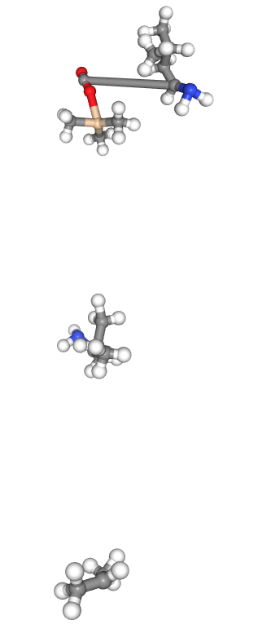
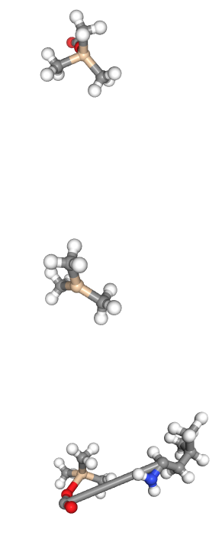
146 30 traj
101
102

