Slide 1
Network Programming with TCP
BUPT/QMUL
2018-05-02

Slide 2
Lab on TCP
Write two programs (server and client) so that the server can transfer a local file (indicate by client) to client using TCP.
  You can design the running command format, e.g.,
    ./<exefile> <server> <filename>
    The server may be specified in domain name or IP address
    The transferred file should be indicated by client’s input
    Client should rename and save the transferred content as a new file
  Each time the server sends data, following information has to be printed:
    the destination (client’s IP address and port number)
    Amount of data that has been sent by “Byte”

Slide 3

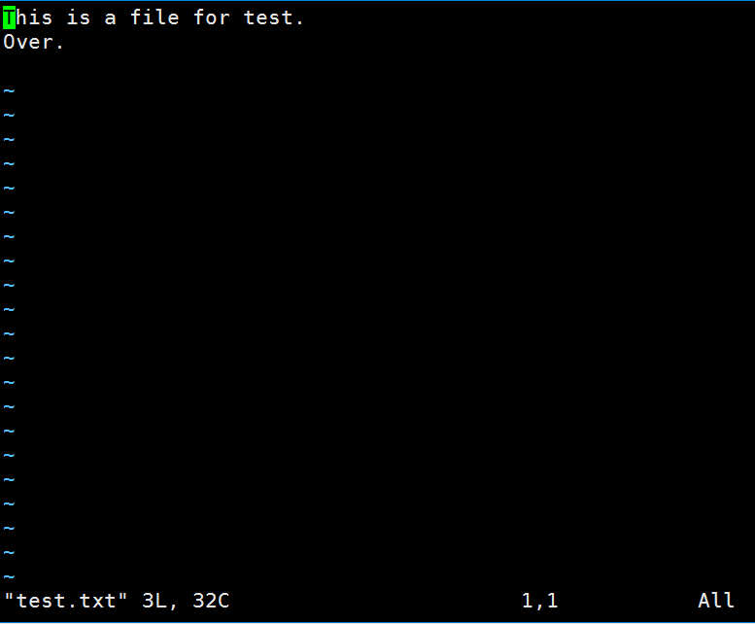
Sample Programs (1)
The file to be transferred
The content of file “test.txt”

Slide 4
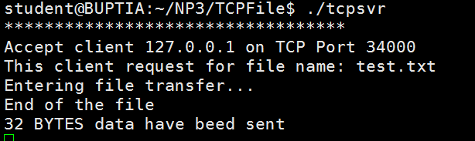
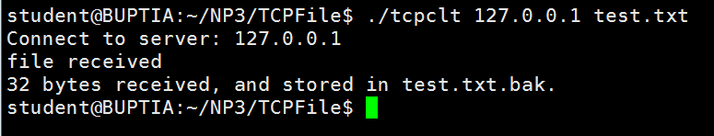
Sample Programs (2)
Step 1.
Run the server
Server sends file “test.txt” to client, and client save it as “test.txt.bak”
Step 2.
Run the client

Slide 5
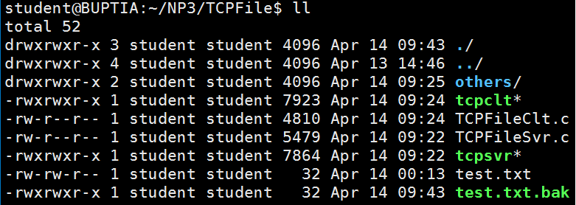
Sample Programs (3)
Same size with the original file and can be opened correctly
The new file

Slide 6
Your work
Refer to the lseek() and O_APPEND program. It reads/writes the content from a given file.
Refer to the UDP program.
Pay attention to following aspects
  Difference between UDP and TCP.
  How to judge the existence of required file and deal with it via a simplest way.
You will be asked to transfer at least two different files individually, which helps to check the validity of your program.

Slide 7
Framework of server (only for reference)
#include <xxx.h>
#include <yyy.h>
……
int main (int argc, char *argv[]){
……
sockfd = socket (xx, xx, xx); // create the socket
bind(xx, xx, xx); // bind
listen(sockfd, xx); //listen
for( ; ; ){ // Loop forever
newsockfd = accept(xx, xx, xx);//create a new socket
if ( recv (xx, xx, xx) ) { // receive the file name
fd = open(xx, xx, xx) // Judge and open the file
for(xx, xx, xx){ //loop to read the file
buffer = read(fd, xx, xx); // read content
send (newsockfd, buffer, xx); // send content
}
}
close(fd);
}
}
Useful headers
Some Parameters
Socket, bind and fault-tolerance
Listen
ACCEPT
Try to open the file
Loop until the file’s end
Read and Transfer content
Some close()

Slide 8
Framework of client (only for reference)
#include <xxx.h>
#include <yyy.h>
……
int main (int argc, char *argv[]){
……
sockfd = socket (xx, xx, xx); // Setup the socket
connect(xx, xx, xx) // Connect
send (xx, filename, xx); // send the filename indicated by argv to server
fd = open(xx, xx, xx) // Open a new file and prepare to write
for (xx; xx; xx) {
if ( recv (xx, buffer, xx) ) { // Judge whether server close the sock
buffer = write(fd, xx, xx); // write content
}
}
close(fd);
}
Useful headers
Some Parameters
Socket, connect the server
Send the file name to server
open() a new file
Receive the data
Receive and write content
close() and save the file

Slide 9
Hints
The framework is just a reference.
Server will close the socket after finishing the transmission.
Client will get a “0” from recv if the socket in server side has been closed.

