Slide 1
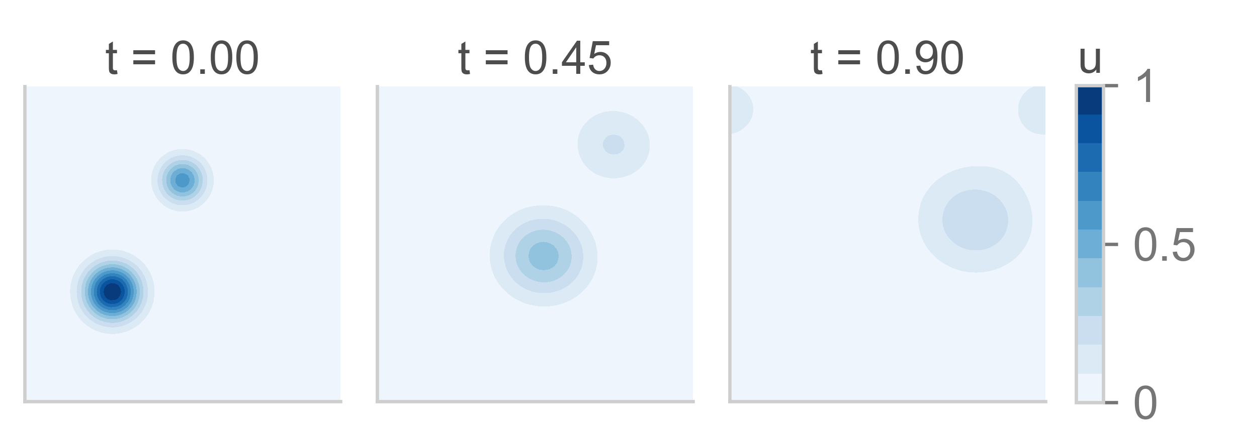
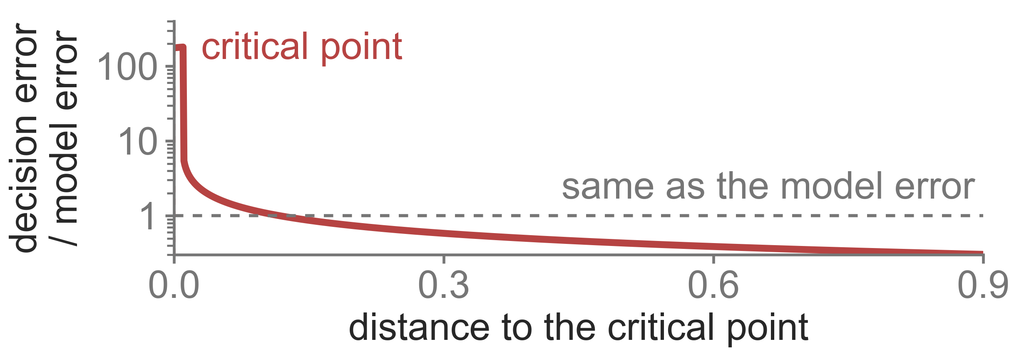
Physical AI
Its questions in science and
engineering rest on one substrate.
Learning systems that observe, model, and act on physical
systems.
The governing dynamics of physical systems
Ordinary and partial differential equations with initial
conditions, boundary conditions, and external forcing.
A. Learning to solve the dynamics
B. The model-to-decision gap
Neural operators and neural solvers that
return the solution field fast enough for
design and control, rather than a surrogate
that only predicts.
How the error of a learned model reaches a
control or optimization decision. The gap is
small over most of the state space and large
near a critical point. Regret and constraint
violation return to A as its training signal.
Computed. A two-dimensional advection-diffusion field,
solved and shown at three times.
Computed. Shift of a bistable system's equilibrium under
a fixed model error, against distance to the fold.
Tested on the same physical systems in two branches
Science: materials processing
Engineering: water and energy systems
Temperature and composition fields of a
processing step, and the process set-points
chosen from their predicted rollouts.
Urban water demand and pressure, day-ahead
electricity price, and hot-strip rolling energy, with
the pump schedules and controller actions they
set.

