Slide 1
Web Programming
Course Introduction

Slide 2
Course Information
Schedule
Every Monday, class 7-8
Every other Wednesday, class 1-2
Week 1 to 17
Location
济事楼 319
Office hours
14:00-15:00, Monday

Slide 3


Course Information
Theory
Lab & Exercise
Presentations

Slide 4
Lecturer
Dr. Shuang liang (w1-w8)
Mr. Kai Xu (w9-w17)
Associate professor, SSE, Tongji
Education
B.Sc in Computer Science, Zhejiang University
PhD in Computer Science, Nanjing Univerisity
Visit in Utrecht University, The Netherlands
Research Fellowship
The Chinese University of Hong Kong, 2009
The Hong Kong Polytechnic University, 2010-2011
The City University of Hong Kong, 2012
Contact
Office: Room 314, Jishi Building, Jiading Campus
Email: shuangliang@tongji.edu.cn
Tel: 69585491
Engineer from Alibaba
Leader
手机淘宝基础架构组，H5创新平台团队
Education
Master, Tongji University
Teaching assistant
TBA…
Please resort to TA for all programming issues.

Slide 5
Course Topics
HTML
CSS
JavaScript
DOM
Event handling
Advanced web programming
……

Slide 6
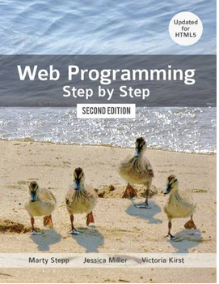
Materials
The course slides
Reference materials
Texts
Jessica Miller, Victoria Kirst, Marty Stepp, Web Programming Step by Step, 2nd edition, Step by Step Publishing, July 2012

Slide 7
Grading Policy
Class participation 10%
Please do NOT be absent for more than 5 times, otherwise you will fail.
Assignments 40%
Individual homework
Project 50%
Individual or Teamwork
Bonus 10%
For being active in class
Plagiarism is not allowed!

Slide 8
Cheating and Plagiarism
You may discuss general techniques of web development with other students
You may give or receive help understanding assignments and debugging work
You may copy examples from the lecture notes and then change them to meet the assignment requirements
You may not copy code or allow anyone to copy your code

Slide 9
Cheating and Plagiarism
Cheating:
Copying code from other students or internet sources
Copying text from other students for homework or other questions
Copying text from the internet or a book for homework or other reports

Slide 10
Course Materials
Server Samba:
\\10.60.41.1
Folder
“脚本程序设计_梁爽”
Assignments submission
To TA
To be assigned

Slide 11
Let’s start this journey!

