Slide 1
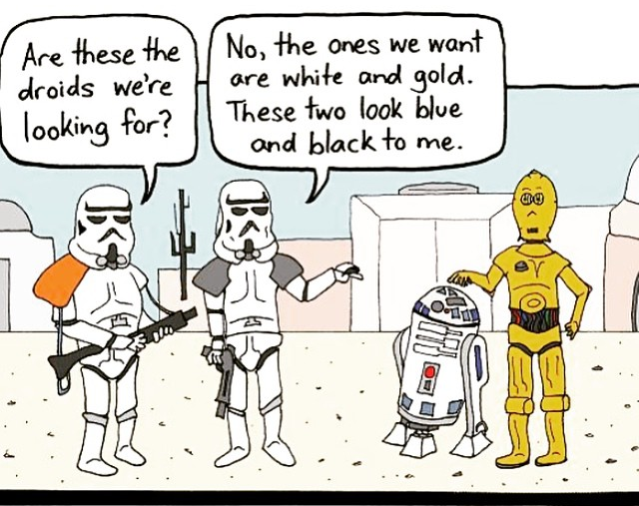
Web Programming
The Document Object Model (DOM)

Slide 2
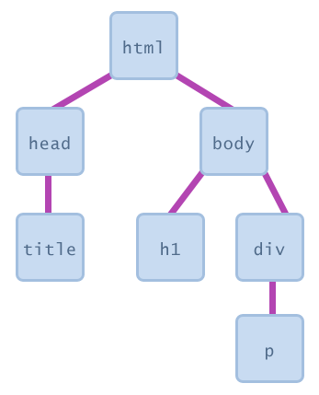
Recall: Document Object Model (DOM)
a set of JavaScript objects that represent each element on the page
each tag in a page corresponds to a JavaScript DOM object
JS code can talk to these objects to examine elements' state
e.g. see whether a box is checked
we can change state
e.g. insert some new text into a div
we can change styles
e.g. make a paragraph red

Slide 3
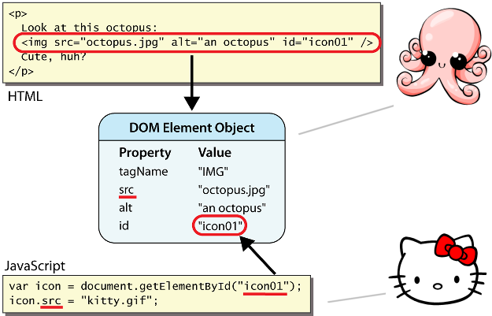
Recall: DOM element objects
access/modify the attributes of a DOM object with objectName.attributeName
most DOM object attributes have the same names as the corresponding HTML attribute
img tag's src property
a tag's href property

Slide 4
Today’s Topics
Document Object Model (DOM)
Global DOM Objects
Six global DOM objects
Unobtrusive JavaScript
Anonymous Functions
DOM Element Objects
The DOM Tree

Slide 5
The six global DOM objects
Every Javascript program can refer to the following global objects:
name | description
document | current HTML page and its content
history | list of pages the user has visited
location | URL of the current HTML page
navigator | info about the web browser you are using
screen | info about the screen area occupied by the browser
window | the browser window

Slide 6
The window object
technically, all global code and variables become part of the window object
properties:
document, history, location, name
methods:
alert, confirm, prompt (popup boxes)
setInterval, setTimeout clearInterval, clearTimeout (timers)
open, close (popping up new browser windows)
blur, focus, moveBy, moveTo, print, resizeBy, resizeTo, scrollBy, scrollTo
the entire browser window; the top-level object in DOM hierarchy

Slide 7
Popup windows with window.open
window.open("http://foo.com/bar.html", "My Foo Window",
"width=900,height=600,scrollbars=1"); JS
window.open pops up a new browser window
THIS method is the cause of all the terrible popups on the web!
some popup blocker software will prevent this method from running

Slide 8
The document object
the current web page and the elements inside it
properties:
anchors, body, cookie, domain, forms, images, links, referrer, title, URL
methods:
getElementById
getElementsByName, getElementsByTagName
querySelector, querySelectorAll
close, open, write, writeln

Slide 9
The location object
the URL of the current web page
properties:
host, hostname, href, pathname, port, protocol, search
methods:
assign, reload, replace

Slide 10
The navigator object
information about the web browser application
properties:
appName, appVersion, browserLanguage, cookieEnabled, platform, userAgent
Some web programmers examine the navigator object to see what browser is being used, and write browser-specific scripts and hacks:
if (navigator.appName === "Microsoft Internet Explorer") { ... JS
(this is poor style; you usually do not need to do this)

Slide 11
The screen object
information about the client's display screen
properties:
availHeight, availWidth, colorDepth, height, pixelDepth, width

Slide 12
The history object
the list of sites the browser has visited in this window
properties:
length
methods:
back, forward, go
sometimes the browser won't let scripts view history properties, for security

Slide 13
Today’s Topics
Document Object Model (DOM)
Global DOM Objects
Six global DOM objects
Unobtrusive JavaScript
Anonymous Functions
DOM Element Objects
The DOM Tree

Slide 14
Recall: Linking to a JavaScript file: script
<script src="filename" type="text/javascript"></script> HTML
<script src="example.js" type="text/javascript"></script> HTML
script tag should be placed in HTML page's head
script code is stored in a separate .js file
JS code can be placed directly in the HTML file's body or head (like CSS)
but this is bad style (should separate content, presentation, and behavior)

Slide 15
JavaScript in HTML body
<script type="text/javascript">
JavaScript code
</script> HTML
JS code can be embedded within your HTML page's head or body
runs as the page is loading
this is considered bad style and shouldn't be done in this course
mixes HTML content and JS scripts (bad)
can cause your page not to validate

Slide 16
Unobtrusive JavaScript
JavaScript event code seen previously was obtrusive, in the HTML; this is bad style
now we'll see how to write unobtrusive JavaScript code
HTML with no JavaScript code inside the tags
uses the JS DOM to attach and execute all JavaScript event handlers
allows separation of web site into 3 major categories:
content (HTML) - what is it?
presentation (CSS) - how does it look?
behavior (JavaScript) - how does it respond to user interaction?
Notes:
unobtrusive [ʌnəb'truːsɪv] 详细»
adj. 不唐突的；谦虚的；不引人注目的
网络释义
谦虚的 不引人注目的 不唐突的
obtrusive [əb'truːsɪv] 详细»
adj. 突出的；强迫人的；冒失的
网络释义
强迫人的 突出的 冒失的

Slide 17


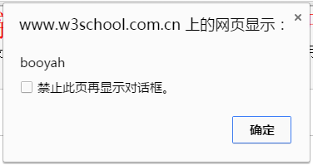
Obtrusive event handlers (bad)
<button onclick="okayClick();">OK</button> HTML
// called when OK button is clicked
function okayClick() {
alert("booyah");
} JS
output
this is bad style (HTML is cluttered with JS code)
goal: remove all JavaScript code from the HTML body

Slide 18
Attaching an event handler in JavaScript code
objectName.onevent = function; JS
<button id="ok">OK</button> HTML
var okButton = document.getElementById("ok");
okButton.onclick = okayClick; JS
it is legal to attach event handlers to elements' DOM objects in your JavaScript code
notice that you do not put parentheses after the function's name
this is better style than attaching them in the HTML
Notes:
parentheses [pə'renθəsɪz] 详细»
n. parenthesis的复数形式
网络释义
括号 圆括号 圆括弧

Slide 19
When does my code run?
<html>
<head>
<script src="myfile.js" type="text/javascript"></script>
</head>
<body> ... </body> </html> HTML
var x = 3;
function f(n) { return n + 1; }
function g(n) { return n - 1; }
x = f(x); JS
your file's JS code runs the moment the browser loads the script tag
any variables are declared immediately
any functions are declared but not called, unless your global code explicitly calls them
at this point in time, the browser has not yet read your page's body
none of the DOM objects for tags on the page have been created yet

Slide 20
A failed attempt at being unobtrusive
<html>
<head>
<script src="myfile.js" type="text/javascript"></script>
</head>
<body>
<div><button id="ok">OK</button></div> HTML
var ok = document.getElementById("ok");
ok.onclick = okayClick; // error: null JS
problem: global JS code runs the moment the script is loaded
script in head is processed before page's body has loaded
no elements are available yet or can be accessed yet via the DOM
we need a way to attach the handler after the page has loaded...

Slide 21
The window.onload event
function functionName() {
// code to initialize the page
...
}
// run this function once the page has finished loading
window.onload = functionName; //global code
we want to attach our event handlers right after the page is done loading
there is a global event called window.onload event that occurs at the moment the page body is done being loaded
if you attach a function as a handler for window.onload, it will run at that time
in window.onload handler we attach all the other handlers to run when events occur

Slide 22
An unobtrusive event handler
<!–- look, no JavaScript! -->
<button id="ok">OK</button> <!-- (1) --> HTML
// called when page loads; sets up event handlers
function pageLoad() {
var ok = document.getElementById("ok"); // (3)
ok.onclick = okayClick;
}
function okayClick() {
alert("booyah"); // (4)
}
window.onload = pageLoad; // (2) JS
output
Notes:
执行顺序见右边

Slide 23
Common unobtrusive JS errors
event names are all lowercase, not capitalized like most variables
window.onLoad = pageLoad;
window.onload = pageLoad;
you shouldn't write () when attaching the handler (if you do, it calls the function immediately, rather than setting it up to be called later)
ok.onclick = okayClick();
ok.onclick = okayClick;
related: can't directly call functions like alert; must enclose in your own function
ok.onclick = alert("booyah");
ok.onclick = okayClick;
function okayClick() { alert("booyah"); }
Notes:
our JSLint checker will catch this mistake
原因？？？related: can't directly call functions like alert; must enclose in your own function

Slide 24
Today’s Topics
Document Object Model (DOM)
Global DOM Objects
Six global DOM objects
Unobtrusive JavaScript
Anonymous Functions
DOM Element Objects
The DOM Tree

Slide 25
Anonymous functions
function(parameters) {
statements;
} JS
JavaScript allows you to declare anonymous functions
quickly creates a function without giving it a name
can be stored as a variable, attached as an event handler, etc.

Slide 26
Anonymous function example
window.onload = function() {
var ok = document.getElementById("ok");
ok.onclick = okayClick;
};
function okayClick() {
alert("booyah");
} JS
output
or the following is also legal (though harder to read and bad style):
window.onload = function() {
document.getElementById("ok").onclick = function() {
alert("booyah");
};
};
Notes:
一个匿名函数
2个匿名函数
防止出现很多不重要，且仅用过一次的小函数。
C（since2011）和matlab都支持，是很重要的编程技巧

Slide 27
Today’s Topics
Document Object Model (DOM)
Global DOM Objects
DOM Element Objects
DOM object properties
Modifying content
Adjusting styles
The DOM Tree

Slide 28
DOM object properties
<div id="main" class="foo bar">
<p>See our <a href="sale.html" id="saleslink">Sales</a> today!</p>
<img id="icon" src="images/borat.jpg" alt="Borat" />
</div> HTML
var mainDiv = document.getElementById("main");
var icon = document.getElementById("icon");
var theLink = document.getElementById("saleslink"); JS
Property | Description | Example
tagName | element's HTML tag | mainDiv.tagName is "DIV"
className | CSS classes of element | mainDiv.className is "foo bar"
innerHTML | content in element | mainDiv.innerHTML is "\n <p>See our <a hr...
src | URL target of an image | icon.src is "images/borat.jpg"
href | URL target of a link | theLink.href is "sale.html"

Slide 29

DOM properties for form controls
<input id="sid" type="text" size="7" maxlength="7" />
<input id="frosh" type="checkbox" checked="checked" /> Freshman?
HTML
var sid = document.getElementById("sid");
var frosh = document.getElementById("frosh"); JS
output
Property | Description | Example
value | the text/value chosen by the user | sid.value could be "1234567"
checked | whether a box is checked | frosh.checked is true
disabled | whether a control is disabled (boolean) | frosh.disabled is false
readOnly | whether a text box is read-only | sid.readOnly is false

Slide 30
More about form controls
<select id="captain">
<option value="kirk">James T. Kirk</option>
<option value="picard">Jean-Luc Picard</option>
<option value="cisco">Benjamin Cisco</option>
</select>
<label> <input id="trekkie" type="checkbox" /> I'm a Trekkie </label> HTML
output
when talking to a text box or select, you usually want its value
when talking to a checkbox or radio button, you probably want to know if it's checked (true/false)
Notes:
定义和用法
select 元素可创建单选或多选菜单。
<select&> 元素中的 <option> 标签用于定义列表中的可用选项。
定义和用法
<label> 标签为 input 元素定义标注（标记）。
label 元素不会向用户呈现任何特殊效果。不过，它为鼠标用户改进了可用性。如果您在 label 元素内点击文本，就会触发此控件。就是说，当用户选择该标签时，浏览器就会自动将焦点转到和标签相关的表单控件上。
<label> 标签的 for 属性应当与相关元素的 id 属性相同。

Slide 31
Today’s Topics
Document Object Model (DOM)
Global DOM Objects
DOM Element Objects
DOM object properties
Modifying content
Adjusting style
The DOM Tree

Slide 32
Modifying text inside an element
var paragraph = document.getElementById("welcome");
paragraph.innerHTML = "Welcome to our site!"; // change text on page JS
DOM element objects have the following properties:
innerHTML : text and/or HTML tags inside a node
textContent : text (no HTML tags) inside a node
simpler than innerHTML, but not supported in IE6
value : the value inside a form control
Notes:
Value一般是针对表单控件的

Slide 33

The innerHTML property
<button onclick="addText();">Click me!</button>
<span id="output">Hello </span> HTML
function addText() {
var span = document.getElementById("output");
span.innerHTML += " bro";
} JS
output
can change the text inside most elements by setting the innerHTML property

Slide 34
Abuse of innerHTML
// bad style!
var paragraph = document.getElementById("welcome");
paragraph.innerHTML =
"<p>text and <a href=\"page.html\">link</a>";
JS
innerHTML can inject arbitrary HTML content into the page
however, this is prone to bugs and errors and is considered poor style
we forbid using innerHTML to inject HTML tags; inject plain text only
Notes:
inject [ɪn'dʒekt] 详细»
vt. 注入；注射
网络释义
注射 注入 投入
(later, we'll see a better way to inject content with HTML tags in it)

Slide 35
Today’s Topics
Document Object Model (DOM)
Global DOM Objects
DOM Element Objects
DOM object properties
Modifying content
Adjusting style
The DOM Tree

Slide 36
Recall: CSS class selectors
.special { /* any element with class="special" */
font-weight: bold;
}
p.shout { /* only p elements with class="shout" */
color: red;
font-family: cursive;
} CSS
Spatula City! Spatula City!
See our spectacular spatula specials!
Today only: satisfaction guaranteed. output
applies rule to any element with class special, or a p with class shout

Slide 37
Recall: CSS ID selectors
#mission {
font-style: italic;
font-family: "Garamond", "Century Gothic", serif;
} CSS
Spatula City! Spatula City!
Our mission is to provide the most spectacular spatulas and splurge on our specials until our customers ”esplode” with splendor! output
applies style only to the paragraph that has the ID of mission
element can be specified explicitly: p#mission {
Notes:
语法
首先，ID 选择器前面有一个 # 号 - 也称为棋盘号或井号。
ID 选择器允许以一种独立于文档元素的方式来指定样式. -→ 相当于做了label？
类选择器还是 ID 选择器？
在类选择器这一章中我们曾讲解过，可以为任意多个元素指定类。前一章中类名 important 被应用到 p 和 h1 元素，而且它还可以应用到更多元素。
区别 1：只能在文档中使用一次
与类不同，在一个 HTML 文档中，ID 选择器会使用一次，而且仅一次。
区别 2：不能使用 ID 词列表
不同于类选择器，ID 选择器不能结合使用，因为 ID 属性不允许有以空格分隔的词列表。
区别 3：ID 能包含更多含义
类似于类，可以独立于元素来选择 ID。有些情况下，您知道文档中会出现某个特定 ID 值，但是并不知道它会出现在哪个元素上，所以您想声明独立的 ID 选择器。例如，您可能知道在一个给定的文档中会有一个 ID 值为 mostImportant 的元素。您不知道这个最重要的东西是一个段落、一个短语、一个列表项还是一个小节标题。您只知道每个文档都会有这么一个最重要的内容，它可能在任何元素中，而且只能出现一个。在这种情况下，可以编写如下规则：

Slide 38
Recall: CSS properties for fonts
property | description
font-family | which font will be used
font-size | how large the letters will be drawn
font-style | used to enable/disable italic style
font-weight | used to enable/disable bold style
Complete list of font properties

Slide 39
Adjusting styles with the DOM
objectName.style.propertyName = "value"; JS
<button onclick="colorIt();">Click me!</button>
<span id="fancytext">Don't forget your homework!</span> HTML
function colorIt() {
var text = document.getElementById("fancytext");
text.style.color = "#ff5500";
text.style.fontSize = "40pt";
} JS
output
Property | Description
style | lets you set any CSS style property for an element
same properties as in CSS, but with camelCasedNames
examples: backgroundColor, borderLeftWidth, fontFamily
Notes:
CamelCased详细»
网络释义
驼峰命名法 峰命名
underscores详细»
vt. 划线于…下（underscore复数）
网络释义
强调 下划线 底线
e.g. in CSS， is “font-size”

Slide 40
Common DOM styling errors
many students forget to write .style when setting styles
var clickMe = document.getElementById("clickme");
clickMe.color = "red";
clickMe.style.color = "red"; JS
style properties are capitalized likeThis, not like-this
clickMe.style.font-size = "14pt";
clickMe.style.fontSize = "14pt"; JS
style properties must be set as strings, often with units at the end
write exactly the value you would have written in the CSS, but in quotes
clickMe.style.width = 200;
clickMe.style.width = "200px";
clickMe.style.padding = "0.5em"; JS

Slide 41

Problems with reading/changing styles
<button id="clickme">Click Me</button> HTML
window.onload = function() {
document.getElementById("clickme").onclick = biggerFont;
};
function biggerFont() {
var button = document.getElementById("clickme");
var size = parseInt(button.style.fontSize);
button.style.fontSize = (size + 4) + "pt";
} JS
output
style property lets you set any CSS style for an element
problem: you cannot read existing styles with it (you can read ones you set using the DOM.style, but not ones that are set in the CSS file)
Notes:
Style 对象
Style 对象代表一个单独的样式声明。可从应用样式的文档或元素访问 Style 对象。
使用 Style 对象属性的语法：
document.getElementById("id").style.property="值"

Slide 42
Accessing elements' existing styles
window.getComputedStyle(element).propertyName JS
function biggerFont() {
// turn text yellow and make it bigger
var clickMe = document.getElementById("clickme");
var size = parseInt(window.getComputedStyle(clickMe).fontSize);
clickMe.style.fontSize = (size + 4) + "pt";
} JS
output
getComputedStyle method of global window object accesses existing styles

Slide 43
Common bug: incorrect usage of existing styles
var main = document.getElementById("main");
main.style.top = window.getComputedStyle(main).top + 100 + "px“;
// bad! JS
the above example computes e.g. "200px" + 100 + "px" , which would evaluate to "200px100px"
a corrected version:
main.style.top = parseInt(window.getComputedStyle(main).top) +
100 + "px"; // correct JS

Slide 44
Getting/setting CSS classes
function highlightField() {
// turn text yellow and make it bigger
var text = document.getElementById("text");
if (!text.className) {
text.className = "highlight";
} else if (text.className.indexOf("invalid") < 0) {
text.className += " highlight"; // awkward
}
} JS
JS DOM's className property corresponds to HTML class attribute
somewhat clunky when dealing with multiple space-separated classes as one big string
Notes:
clunky ['klʌŋkɪ] 详细»
adj. 沉重的；影响不好的
网络释义
笨拙的 笨重的
定义和用法
className 属性设置或返回元素的 class 属性。
语法
HTMLElementObject.className=classname
---------------------------------------
定义和用法
indexOf() 方法可返回某个指定的字符串值在字符串中首次出现的位置。
提示和注释
注释：indexOf() 方法对大小写敏感！
注释：如果要检索的字符串值没有出现，则该方法返回 -1。

Slide 45
Getting/setting CSS classes with classList
function highlightField() {
// turn text yellow and make it bigger
var text = document.getElementById("text");
if (!text.classList.contains("invalid")) {
text.classList.add("highlight");
}
} JS
classList collection has methods add, remove, contains, toggle to manipulate CSS classes
similar to existing className DOM property, but don't have to manually split by spaces
Notes:
classList对象在HTML5之中被加入到每一个DOM节点内,开发者可以 add,remove和 tooggle(切换，有就移除，没有则添加) 一个节点上的CSS class,开发者还可以检测给定的节点是否包含特定的CSS类。
Mozilla Firefox 是当前(2010年7月)唯一支持classList 接口的浏览器。当更多的浏览器支持classList之时，应该使用Javascript库是否包含了classList而不是自己去解析元素的class属性。

Slide 46
The keyword this
this.fieldName // access field
this.fieldName = value; // modify field
this.methodName(parameters); // call method JS
all JavaScript code actually runs inside of an object
by default, code runs in the global window object (so this === window)
all global variables and functions you declare become part of window
the this keyword refers to the current object

Slide 47
Unobtrusive styling
function okayClick() {
this.style.color = "red";
this.className = "highlighted";
} JS
.highlighted { color: red; } CSS
well-written JavaScript code should contain as little CSS as possible
use JS to set CSS classes/IDs on elements
define the styles of those classes/IDs in your CSS file
Notes:
Js尽量通过调用class或id（已在css中预先设置）来设置css格式。
一般而言，在Javascript中，this指向函数执行时的当前对象。
值得注意，该关键字在Javascript中和执行环境，而非声明，而和环境有关。

Slide 48
Today’s Topics
Document Object Model (DOM)
DOM Element Objects
Global DOM Objects
The DOM Tree

Slide 49
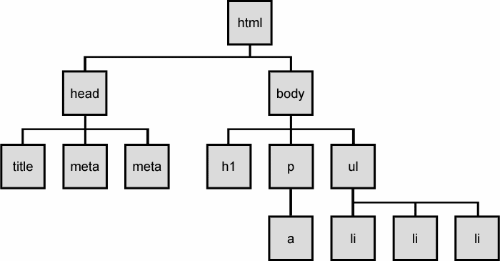
The DOM tree
The elements of a page are nested into a tree-like structure of objects
the DOM has properties and methods for traversing this tree

Slide 50

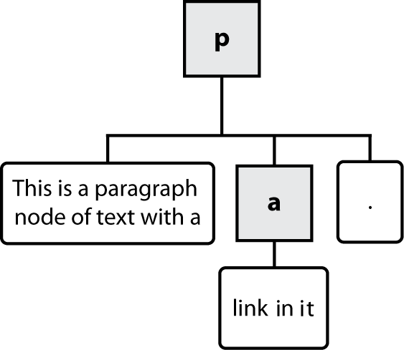


Types of DOM nodes
<p>
This is a paragraph of text with a
<a href="/path/page.html">link in it</a>.
</p> HTML
element nodes (HTML tag)
can have children and/or attributes
text nodes (text in a block element)
attribute nodes (attribute/value pair)
text/attributes are children in an element node
cannot have children or attributes
not usually shown when drawing the DOM tree

Slide 51
Traversing the DOM tree
every node's DOM object has the following properties:
name(s) | description
firstChild, lastChild | start/end of this node's list of children
childNodes | array of all this node's children
nextSibling, previousSibling | neighboring nodes with the same parent
parentNode | the element that contains this node
complete list of DOM node properties
browser incompatiblity information (IE6 sucks)
Notes:
manually

Slide 52
DOM tree traversal example
<p id="foo">This is a paragraph of text with a
<a href="/path/to/another/page.html">link</a>.</p> HTML
parentNode
This is a paragraph of text with a
firstChild
nextSibling
parentNode
parentNode
firstChild
link
p
a
lastChild
previousSibling
lastChild
.
parentNode

Slide 53
Element vs. text nodes
<div>
<p>
This is a paragraph of text with a
<a href="page.html">link</a>.
</p>
</div> HTML
Q: How many children does the div above have?
A: 3
an element node representing the <p>
two text nodes representing "\n\t" (before/after the paragraph)
Q: How many children does the paragraph have? The a tag?
A: 3 and 1
Notes:
\n 换行
\t 制表符
\r 回车

Slide 54
Complex DOM manipulation problems
How would we do each of the following in JavaScript code? Each involves modifying each one of a group of elements ...
When the Go button is clicked, reposition all the divs of class puzzle to random x/y locations.
When the user hovers over the maze boundary, turn all maze walls red.
Change every other item in the ul list with id of TAs to have a gray background.

Slide 55
Selecting groups of DOM objects
methods in document and other DOM objects (* = HTML5):
name | description
getElementsByTagName | returns array of descendents with the given tag, such as "div"
getElementsByName | returns array of descendents with the given name attribute (mostly useful for accessing form controls)
querySelector * | returns the first element that would be matched by the given CSS selector string
querySelectorAll * | returns an array of all elements that would be matched by the given CSS selector string

Slide 56
Getting all elements of a certain type
highlight all paragraphs in the document:
var allParas = document.querySelectorAll("p");
for (var i = 0; i < allParas.length; i++) {
allParas[i].style.backgroundColor = "yellow";
} JS
<body>
<p>This is the first paragraph</p>
<p>This is the second paragraph</p>
<p>You get the idea...</p>
</body> HTML
Notes:
也可以用bytag实现<p>

Slide 57
Complex selectors
highlight all paragraphs inside of the section with ID "address":
// document.getElementById("address").getElementsByTagName("p")
var addrParas = document.querySelectorAll("#address p");
for (var i = 0; i < addrParas.length; i++) {
addrParas[i].style.backgroundColor = "yellow";
} JS
<p>This won't be returned!</p>
<div id="address">
<p>1234 Street</p>
<p>Atlanta, GA</p>
</div> HTML

Slide 58
Common querySelectorAll issues
many students forget to write . or # in front of a class or id
// get all buttons with a class of "control"
var gameButtons = document.querySelectorAll("control");
var gameButtons = document.querySelectorAll(".control"); JS
querySelectorAll returns an array, not a single element; must loop over the results (document.querySelector returns just the first element that matches, if that's what you want)
// set all buttons with a class of "control" to have red text
document.querySelectorAll(".gamebutton").style.color = "red";
var gameButtons = document.querySelector(".gamebutton");
for (var i = 0; i < gameButtons.length; i++) {
gameButtons[i].style.color = "red";
}
Q: Can I still select a group of elements using querySelectorAll even if my CSS file doesn't have any style rule for that same group?
A: Yes!
Notes:
Back to slides40, just document.querySelectorAll("p");

Slide 59
Creating new nodes
name | description
document.createElement("tag") | creates and returns a new empty DOM node representing an element of that type
document.createTextNode("text") | creates and returns a text node containing given text
// create a new <h2> node
var newHeading = document.createElement("h2");
newHeading.innerHTML = "This is a heading";
newHeading.style.color = "green"; JS
merely creating a element does not add it to the page
you must add the new element as a child of an existing element on the page...

Slide 60
Modifying the DOM tree
Every DOM element object has these methods:
name | description
appendChild(node) | places given node at end of this node's child list
insertBefore(new, old) | places the given new node in this node's child list just before old child
removeChild(node) | removes given node from this node's child list
replaceChild(new, old) | replaces given child with new node
var p = document.createElement("p");
p.innerHTML = "A paragraph!";
document.getElementById("main").appendChild(p); JS
A paragraph!

Slide 61
DOM versus innerHTML hacking
Why not just code the previous example this way?
function slideClick() {
document.getElementById("main").innerHTML += "<p>A paragraph!</p>";
} JS
Imagine that the new node is more complex:
ugly: bad style on many levels (e.g. HTML code embedded within JS )
error-prone: must carefully distinguish " and '
can only add at beginning or end, not in middle of child list
function slideClick() {
document.getElementById("main").innerHTML += "<p style='color: red; " +
"margin-left: 50px;' " + "onclick='myOnClick();'>" +
"A paragraph!</p>";
} JS
Notes:
内联样式
当特殊的样式需要应用到个别元素时，就可以使用内联样式。 使用内联样式的方法是在相关的标签中使用样式属性。样式属性可以包含任何 CSS 属性。
以下实例显示出如何改变段落的颜色和左外边距。
<p style="color: red; margin-left: 20px"> This is a paragraph </p>

Slide 62
Removing a node from the page
function slideClick() {
var bullet = document.getElementById("removeme");
bullet.parentNode.removeChild(bullet);
} JS
each DOM object has a removeChild method to remove its children from the page
odd idiom: obj.parentNode.remove(obj);

Slide 63
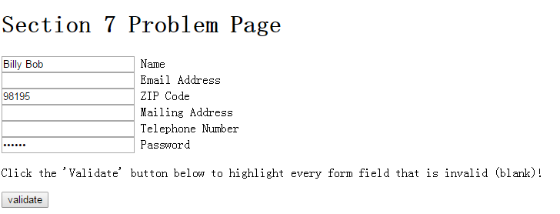
Exercise
Given the following HTML code:
<div><h1>Section 7 Problem Page</h1></div>
<div id="formtovalidate">
<div><input type="text" value="Billy Bob" /> Name</div>
<div><input type="text" value="" /> Email Address</div>
<div><input type="text" value="98195" /> ZIP Code</div>
<div><input type="text" value="" /> Mailing Address</div>
<div><input type="text" value="" /> Telephone Number</div>
<div><input type="password" value="abc123" /> Password</div>
</div>
<p>Click the 'Validate' button below to highlight every form field that is invalid (blank)!</p>
<div><button id="validate">validate</button></div> HTML

Slide 64
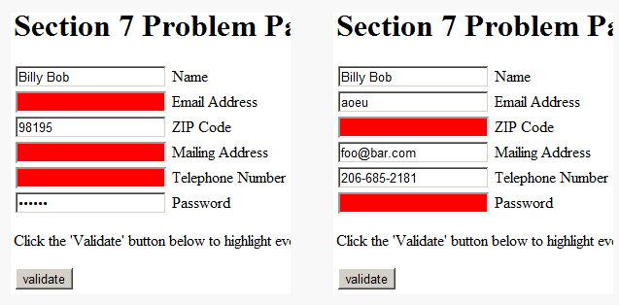
Exercise
When the “Validate” button is clicked, every input in the form that has a blank value (empty string) will be highlighted with a "red" background color.
If a text box already has the red background but is then changed to non-blank, and the Validate button is clicked again, then you should remove the red background color by setting the background to an empty string, "".
You should not modify the HTML or CSS code; write only JavaScript. Use the document.querySelectorAll taught today.
Hint: For reference, our solution
is 14 lines long (9 "substantive").

Slide 65
Thank you for your attention!

Slide 66

Event handler binding
window.onload = function() {
document.getElementById("textbox").onmouseout = booyah;
document.getElementById("submit").onclick = booyah;
}; // bound to submit button here
function booyah() { // booyah knows what object it was called on
this.value = "booyah";
} JS
output
event handlers attached unobtrusively are bound to the element
inside the handler, that element becomes this

Slide 67
The danger of global variables
var count = 0;
function incr(n) {
count += n;
}
function reset() {
count = 0;
}
incr(4);
incr(2);
console.log(count);
JS
globals can be bad; other code and other JS files can see and modify them
How many global symbols are introduced by the above code?
3 global symbols: count, incr, and reset
Notes:
如何减少全局变量，module模式：可接unobtrusive JS后。
JS debug方法：可接intro to JS后，参见webslides lab17-8.2

Slide 68
Enclosing code in a function
function everything() {
var count = 0;
function incr(n) {
count += n;
}
function reset() {
count = 0;
}
incr(4);
incr(2);
console.log(count);
}
everything();
// call the function to run the code
the above example moves all the code into a function; variables and functions declared inside another function are local to it, not global
How many global symbols are introduced by the above code?
1 global symbol: everything (can we get it down to 0?)

Slide 69
The "module pattern"
(function() {
statements;
})(); JS
wraps all of your file's code in an anonymous function that is declared and immediately called
0 global symbols will be introduced!
the variables and functions defined by your code cannot be messed with externally
Notes:
后面再加（）是马上被调用吗？

Slide 70
Module pattern example
(function() {
var count = 0;
function incr(n) {
count += n;
}
function reset() {
count = 0;
}
incr(4);
incr(2);
console.log(count);
})();
JS
How many global symbols are introduced by the above code?
0 global symbols

Slide 71
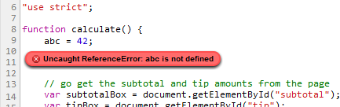
JavaScript "strict" mode
"use strict";
your code...
writing "use strict"; at the very top of your JS file turns on strict syntax checking:
shows an error if you try to assign to an undeclared variable
stops you from overwriting key JS system libraries
forbids some unsafe or error-prone language features
You should always turn on strict mode for your code in this class!

