Slide 1
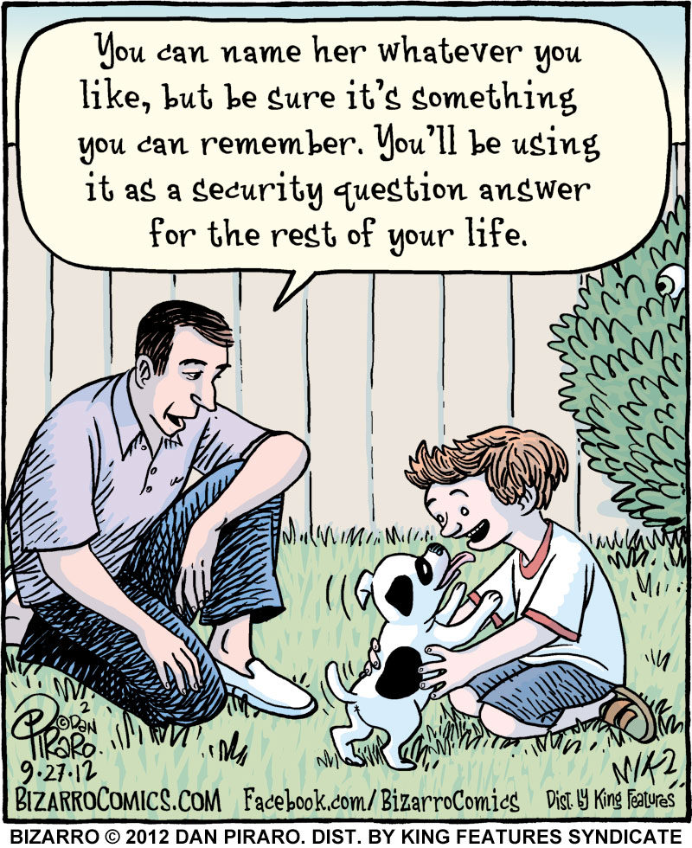
Web Programming
Events

Slide 2
Today’s Topics
Event handling
The event object
Mouse events
Keyboard the text events
Form events
Page events
Timer events
More events

Slide 3
JavaScript events
abort | blur | change | click | dblclick | error | focus
keydown | keypress | keyup | load | mousedown | mousemove | mouseout
mouseover | mouseup | reset | resize | select | submit | unload
the click event (onclick) is just one of many events that can be handled
Notes:
problem: events are tricky and have incompatibilities across browsers
reasons: fuzzy W3C event specs; IE disobeying web standards; etc.
solution: Prototype includes many event-related features and fixes

Slide 4
The event object
function name(event) {
// an event handler function ...
} JS
Event handlers can accept an optional parameter to represent the event that is occurring. Event objects have the following properties / methods:
property name | description
type | what kind of event, such as "click" or "mousedown"
target | the element on which the event occurred
timeStamp | when the event occurred
Notes:
event代表事件的状态，例如触发event对象的元素、鼠标的位置及状态、按下的键等等。 event对象只在事件发生的过程中才有效。 event的某些属性只对特定的事件有意义。比如，fromElement 和 toElement 属性只对 onmouseover 和 onmouseout 事件有意义。

Slide 5
Today’s Topics
Event handling
The event object
Mouse events
Keyboard the text events
Form events
Page events
Timer events
More events

Slide 6
Mouse events
click | user presses/releases mouse button on the element
dblclick | user presses/releases mouse button twice on the element
mousedown | user presses down mouse button on the element
mouseup | user releases mouse button on the element
clicking
mouseover | mouse cursor enters the element's box
mouseout | mouse cursor exits the element's box
mousemove | mouse cursor moves around within the element's box
movement

Slide 7
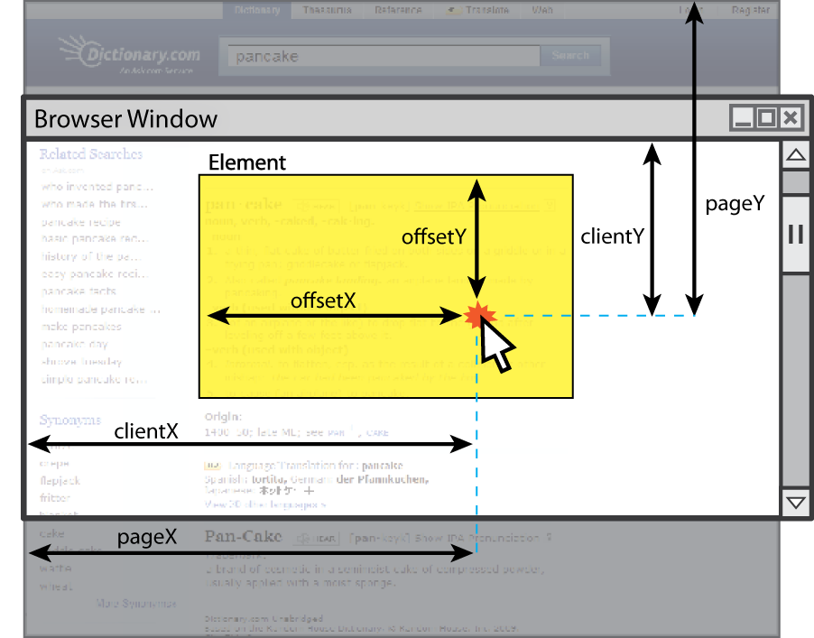
Mouse event objects
The event passed to a mouse handler has these properties:
property/method | description
clientX clientY | coordinates in browser window
screenX screenY | coordinates in screen
offsetX offsetY | coordinates in element (non-standard)
pointerX(), pointerY()* | coordinates in entire web page
button | integer representing which button was pressed (0=Left, 1=Middle, 2=Right)
* replaces non-standard properties pageX and pageY
Notes:
顾名思义，screenX是鼠标距离显示器屏幕左边框的距离，screenY是鼠标距离显示器屏幕上边框的距离。
pageX/pageY
pageX返回事件触发时鼠标相对于文档 的X坐标数值
pageY返回事件触发时鼠标相对于文档 的Y坐标数值
所谓文档可以简单的理解为浏览器中的页面内容，pageX是鼠标距离文档左侧的距离，pageY是鼠标距离文档上侧的距离，如果我们将鼠标悬停在浏览器中间，通过滚轮滚动浏览器，那么尽管没有移动鼠标的位置而pageY一直在变化，因为相对文档顶部的距离一直在变化。

Slide 8
Mouse event example
<pre id="target">Move the mouse over me!</pre> HTML
window.onload = function() {
var target = document.getElementById("target");
target.onmousemove = target.onmousedown = showCoords;
};
function showCoords(event) {
document.getElementById("target").innerHTML =
"screen : (" + event.screenX + ", " + event.screenY + ")\n"
+ "client : (" + event.clientX + ", " + event.clientY + ")\n"
+ "button : " + event.button;
} JS
screen : (333, 782)
client : (222, 460)
button : 0 output
Notes:
定义和用法
pre 元素可定义预格式化的文本。被包围在 pre 元素中的文本通常会保留空格和换行符。而文本也会呈现为等宽字体。
<pre> 标签的一个常见应用就是用来表示计算机的源代码。

Slide 9
Today’s Topics
Event handling
The event object
Mouse events
Keyboard the text events
Form events
Page events
Timer events
More events

Slide 10
Keyboard/text events
name | description
focus | this element gains keyboard focus (attention of user's keyboard)
blur | this element loses keyboard focus
keydown | user presses a key while this element has keyboard focus
keyup | user releases a key while this element has keyboard focus
keypress | user presses and releases a key while this element has keyboard focus
select | this element's text is selected or deselected
focus: the attention of the user's keyboard
given to one element at a time

Slide 11
Key event objects
property name | description
keyCode | ASCII integer value of key that was pressed (convert to char with String.fromCharCode)
altKey, ctrlKey, shiftKey | true if Alt/Ctrl/Shift key is being held
issue: if the event you attach your listener to doesn't have the focus, you won't hear the event
possible solution: attach key listener to entire page body, document, an outer element, etc.

Slide 12
Key event example
document.getElementById("textbox").onkeydown = textKeyDown;
...
function textKeyDown(event) {
var key = String.fromCharCode(event.keyCode);
if (key == 's' && event.altKey) {
alert("Save the document!");
this.value = this.value.split("").join("-");
}
} JS
each time you push down any key, even a modifier such as Alt or Ctrl, the keydown event fires
if you hold down the key, the keydown event fires repeatedly
keypress event is a bit flakier and inconsistent across browsers
Notes:
flakier详细»
薄片的
薄而易剥落的
古里古怪的（flaky的比较级）

Slide 13
Some useful key codes
keyboard key | event keyCode
Backspace | 8
Tab | 9
Enter | 13
Escape | 27
Page Up, Page Down, End, Home | 33, 34, 35, 36
Left, Up, Right, Down | 37, 38, 39, 40
Insert, Delete | 45, 46
Windows/Command | 91
F1 - F12 | 112 - 123

Slide 14
Today’s Topics
Event handling
The event object
Mouse events
Keyboard the text events
Form events
Page events
Timer events
More events

Slide 15
Form events
event name | description
submit | form is being submitted
reset | form is being reset
change | the text or state of a form control has changed

Slide 16
Today’s Topics
Event handling
The event object
Mouse events
Keyboard the text events
Form events
Page events
Timer events
More events

Slide 17
Page/window events
name | description
contextmenu | the user right-clicks to pop up a context menu
error | an error occurs when loading a document or an image
load, unload | the browser loads the page
resize | the browser window is resized
scroll | the user scrolls the viewable part of the page up/down/left/right
unload | the browser exits/leaves the page
The above can be handled on the window object

Slide 18
Today’s Topics
Event handling
The event object
Mouse events
Keyboard the text events
Form events
Page events
Timer events
More events

Slide 19
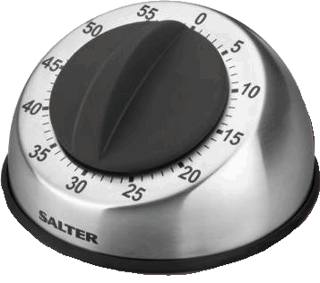
Timer events
method | description
setTimeout(function, delayMS); | arranges to call given function after given delay in ms
setInterval(function, delayMS); | arranges to call function repeatedly every delayMS ms
clearTimeout(timerID); clearInterval(timerID); | stops the given timer
both setTimeout and setInterval return an ID representing the timer
this ID can be passed to clearTimeout/Interval later to stop the timer

Slide 20

setTimeout example
<button id="clickme">Click me!</button>
<span id="output"></span> HTML
window.onload = function() {
document.getElementById("clickme").onclick = delayedMessage;
};
function delayedMessage() {
document.getElementById("output").innerHTML = "Wait for it...";
setTimeout(sayBooyah, 5000);
}
function sayBooyah() { // called when the timer goes off
document.getElementById("output").innerHTML = "BOOYAH!";
} JS
output

Slide 21
setInterval example
var timer = null; // stores ID of interval timer
function delayMsg2() {
if (timer === null) {
timer = setInterval(rudy, 1000);
} else {
clearInterval(timer);
timer = null;
}
}
function rudy() { // called each time the timer goes off
document.getElementById("output").innerHTML += " Rudy!";
} JS
Rudy！
Rudy！
Rudy！
Rudy！
Rudy！
Rudy！
Rudy！
Rudy！
output
Notes:
window.setInterval()
功能：按照指定的周期（以毫秒计）来调用函数或计算表达式。
语法：setInterval(code,millisec)
解释：code：在定时时间到时要执行的JavaScript代码串。
millisec：设定的定时时间，用毫秒数表示。
返回值：定时器的ID值，可用于clearInterval()方法停止指定的定时器。
注：setInterval()方法会不停地调用函数，直到用clearInterval()终止定时或窗口被关闭。
返回值
一个可以传递给 Window.clearInterval() 从而取消对 code 的周期性执行的值。
window.clearInterval()
功能：取消由setInterval()方法设置的定时器。
语法：clearInterval(id_of_setinterval)
解释：id_of_setinterval：由setInterval()返回的ID值。该值标识了一个setInterval定时器。
也就是：window.setInterval()返回的就是window.clearInterval的参数
定义和用法
clearInterval() 方法可取消由 setInterval() 设置的 timeout。
clearInterval() 方法的参数必须是由 setInterval() 返回的 ID 值。

Slide 22
Passing parameters to timers
function delayedMultiply() {
// 6 and 7 are passed to multiply when timer goes off
setTimeout(multiply, 2000, 6, 7);
}
function multiply(a, b) {
alert(a * b);
} JS
output
any parameters after the delay are eventually passed to the timer function
doesn't work in IE; must create an intermediate function to pass the parameters
why not just write this?
setTimeout(multiply(6 * 7), 2000); JS
Notes:
就直接调用计算了？

Slide 23
Common timer errors
many students mistakenly write () when passing the function
setTimeout(booyah(), 2000);
setTimeout(booyah, 2000);
setTimeout(multiply(num1 * num2), 2000);
setTimeout(multiply, 2000, num1, num2); JS
what does it actually do if you have the () ?
it calls the function immediately, rather than waiting the 2000ms!

Slide 24
Today’s Topics
Event handling
The event object
Mouse events
Keyboard the text events
Form events
Page events
Timer events
More events

Slide 25
Event handler binding
window.onload = function() {
document.getElementById("textbox").onmouseout = booyah;
document.getElementById("submit").onclick = booyah;
// bound to submit button here
};
function booyah() { // booyah knows what object it was called on
this.value = "booyah";
} JS
output
event handlers attached unobtrusively are bound to the element
inside the handler, that element becomes this

Slide 26
Fixing redundant code with this
<input id="huey" type="radio" name="ducks" value="Huey" /> Huey
<input id="dewey" type="radio" name="ducks" value="Dewey" /> Dewey
<input id="louie" type="radio" name="ducks" value="Louie" /> Louie HTML
function processDucks() {
if (document.getElementById("huey").checked) {
alert("Huey is checked!");
} else if (document.getElementById("dewey").checked) {
alert("Dewey is checked!");
} else {
alert("Louie is checked!");
}
alert(this.value + " is checked!");
} JS
output
if the same function is assigned to multiple elements, each gets its own bound copy

Slide 27
Multiple listeners to the same event
element.addEventListener("event", function); JS
var button = document.getElementById("mybutton");
button.addEventListener("click", func1);
// button.onclick = func1;
button.addEventListener("click", func2);
// button.onclick = func2; JS
if you assign onclick twice, the second one replaces the first
addEventListener allows multiple listeners to be called for the same event
(note that you do not include "on" in the event name!)

Slide 28
Multiple window.onload listeners
window.onload = function;
window.addEventListener("load", function); JS
it is considered bad form to directly assign to window.onload
multiple .js files could be linked to the same page, and if they all need to run code when the page loads, their window.onload statements will override each other
by calling window.addEventListener instead, all of them can run their code when the page is loaded

Slide 29
Stopping an event
event method name | description
preventDefault | stops the browser from doing its normal action on an event; for example, stops the browser from following a link when <a> tag is clicked, or stops browser from submitting a form when submit button is clicked
stopPropagation | stops the browser from showing this event to any other objects that may be listening for it
you can also return false; from your event handler to stop an event

Slide 30
Stopping an event, example
<form id="exampleform" action="http://foo.com/foo.php">...</form>
window.onload = function() {
var form = document.getElementById("exampleform");
form.onsubmit = checkData;
};
function checkData(event) {
if (document.getElementById("state").length != 2) {
alert("Error, invalid city/state."); // show error message
event.preventDefault();
return false; // stop form submission
}
} JS

Slide 31
Thank you for your attention!

