Slide 1


Slide 2
However,
I’ll be leaving
Too involved at SSRL/TSI
Own thesis falling far behind schedule
Pressure from my supervisor / family /self
Great experience at this lab
Reach me
Still on campus (Kirk Hall, Murray library)
Email gismatthew@gmail.com, meng.li@usask.ca
Phone: 306-261-0583

Slide 3
What SSRL/TSI have done
My participation
Web Mapping Projects
Immigration Project (complete)
Northern SK Project (finalizing)
Soil Science Database Project (ongoing)
Community View Project (upcoming)
Other Projects
Breast Cancer Project (LimeSurvey, Oct.)
Water Security Project (complete)

Slide 4
Transition
Bring my current work to an ordered close
Organized report on
Projects, clients (contact info)
My project progress
Dev & Product server setup
Tips & suggestion
Train the new team?
Credit: A Happy Ending -- Wrapping Up Your Current Role Before Moving On

Slide 5
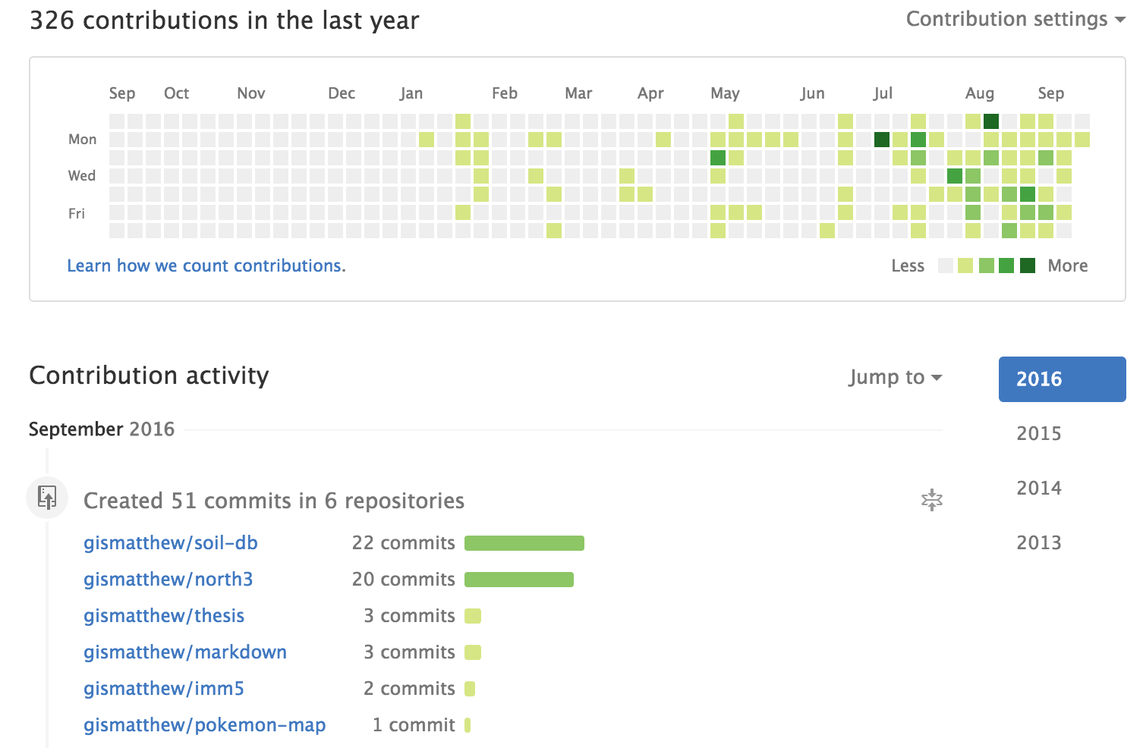
‘an ordered close’

Slide 6
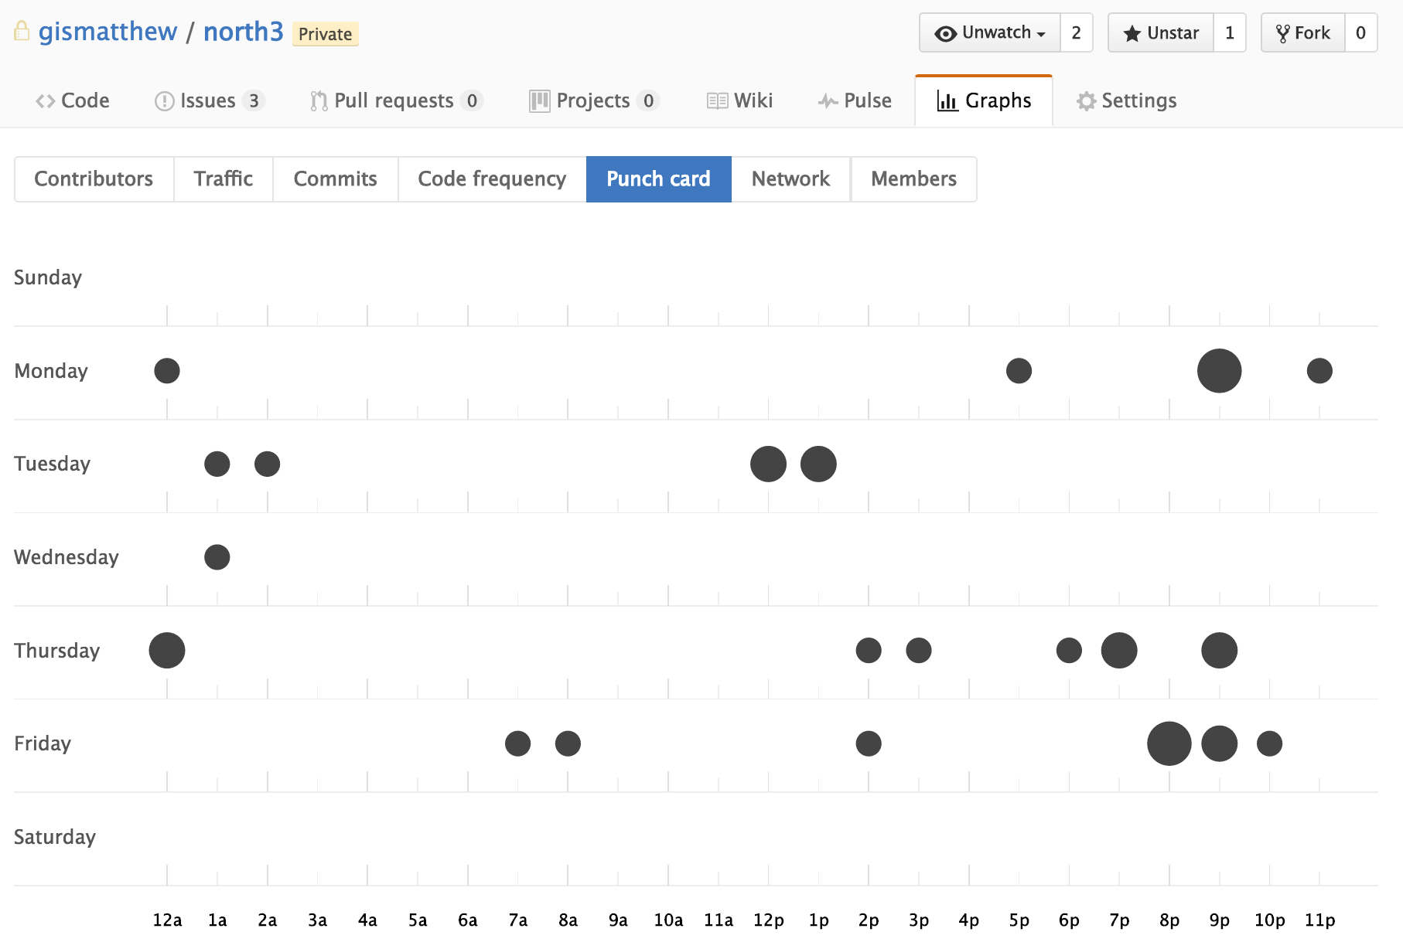
‘an ordered close’
Commits on GitHub
North3

Slide 7
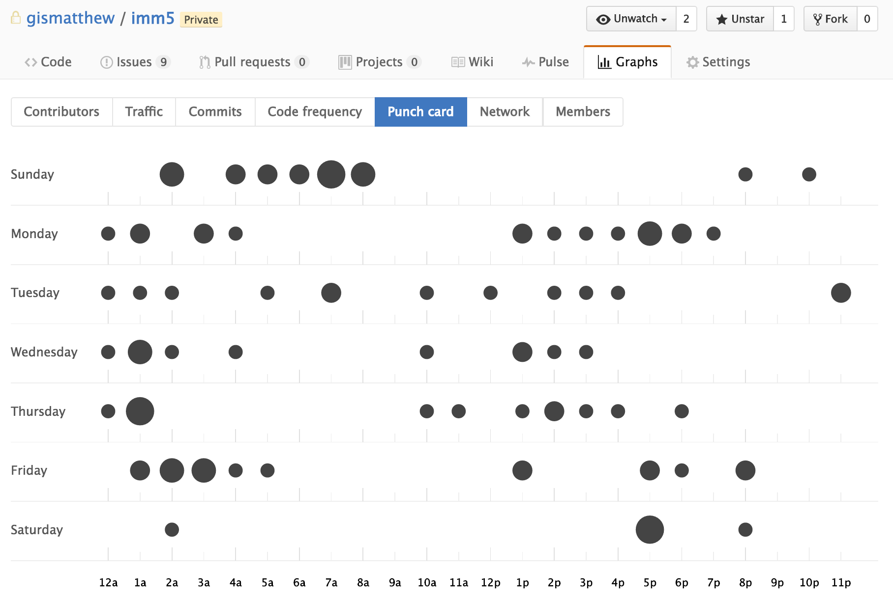
‘an ordered close’
Commits on GitHub
imm5

Slide 8
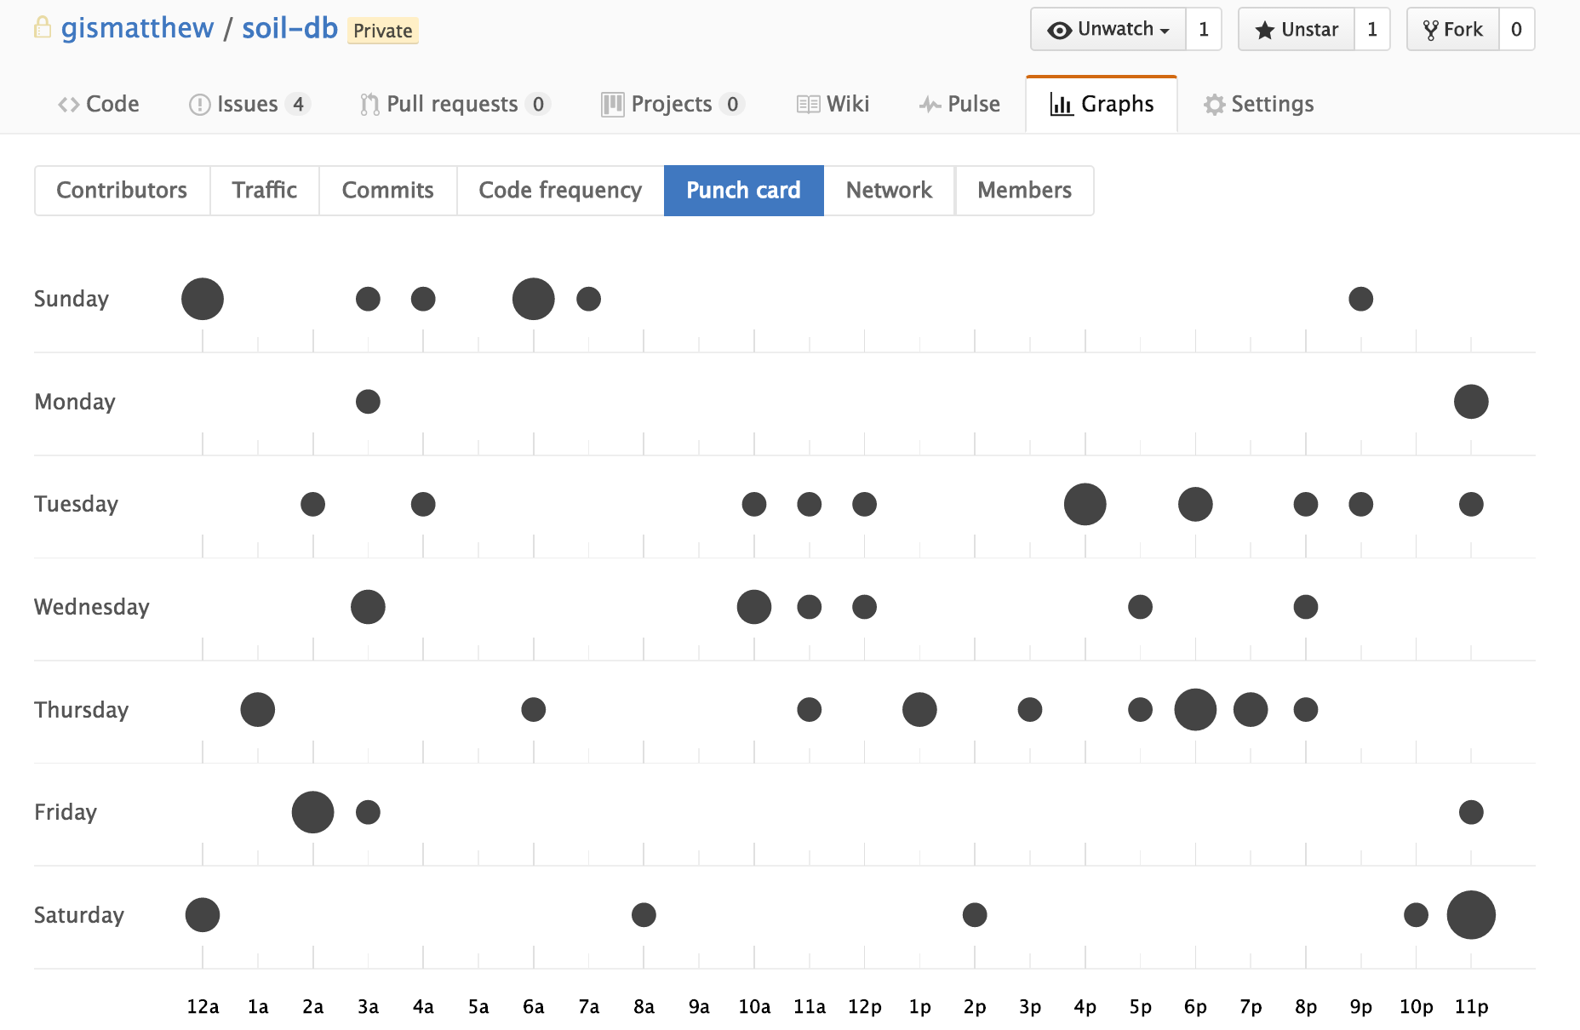
‘an ordered close’
Commits on GitHub
Soil-db

Slide 9
Immigration Project
Client:
Prof. Joseph Garcea joe.garcea@usask.ca
UofM
Immigration, Refugees and Citizenship Canada, formerly known as CIC
Project objective
Visualizing census data using maps
Keywords: multi-dimensional, scales, charts

Slide 10
Immigration Project
Output
Beautiful hand-made maps using ArcGIS
Schema/diagram as an overview of variables
Online mapping
Dev server: http://gistest.usask.ca/irw/
Product server: http://gis.usask.ca/irw/

Slide 11
Immigration Project
For the new team
Server:
gistest (dev): full access
PostGreSQL, PostGIS enabled, GDAL
ArcGIS with Python 2
My installation history: ‘matthew_work.log’
gis (product): apache_www directory
PostGreSQL, PostGIS enabled
Contact ICT for other requests

Slide 12
Immigration Project
For the new team
Source-code:
On gistest server
no version controls: ‘im’, ‘imm2’, ‘imm3’, ‘IRW’, ‘IRW2’, ‘shuo’
TODO: archive historic versions
Phase II:
https://github.com/gismatthew/imm5
JS workflow (gulp), UML, well-documented repo

Slide 13
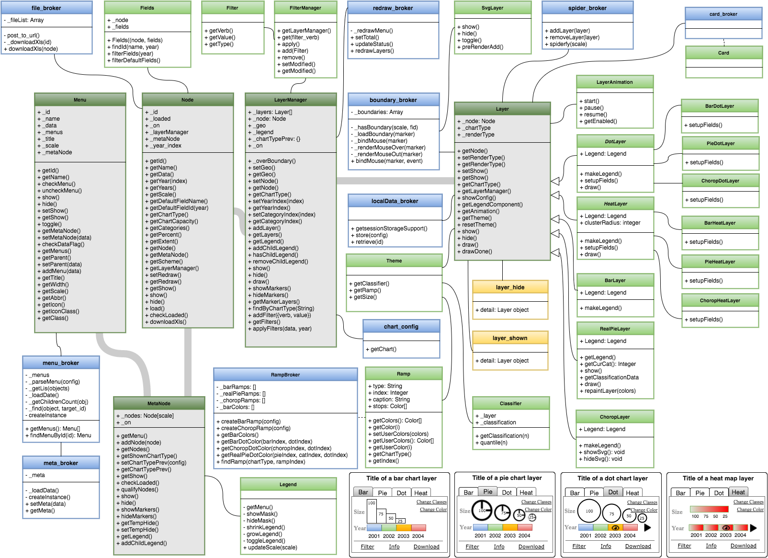
Lesson I learned from IMM
The general web mapping framework
To quickly publish census data in charts / maps
Easy to maintain/debug (modularized)
Extensible for adding new features

Slide 14
Northern SK Aboriginal Community
Client:
International Centre for Northern Governance and Development
Project objective
Visualizing census data using maps
Keywords: multi-dimensional, no scales, charts

Slide 15
Northern SK Aboriginal Community
Output
Different version, north→north2→north3
For the new team
Source-code:
https://github.com/gismatthew/north3
JS workflow (gulp), UML, well-documented repo
Deployed on gistest server
TODO: archive historic versions
Finalization: ASAP

Slide 16
Soil Science DB Project
Client
Colin Minielly’s Research Group (Derek ??)
Project objectives
Publish massive GIS data to facilitate data sharing and research collaboration of labs around the world
Key features I identified
Visualizing GIS layers (Raster, Vector)
Showing associated attribute info
Simple analysis: data query, user-defined symbology

Slide 17
Soil Science DB Project
For the new team
Source-code:
https://github.com/gismatthew/soil-db
On gis1test server http://gis1test.usask.ca/soil-db
JS workflow (gulp), UML, well-documented repo
TODO: issues on GitHub, talk to Colin
Implementation
Lots of server-side configuration
Hosting raster-tile servers and vector-tile servers
Light-weight, flexible, configurable → NodeJS

Slide 18
Soil Science DB Project
For the new team
Milestone:
Project progress report by end of this month
International partners attending workshop at USASK in Oct
Suggestions
Talk to Colin, very approachable – best project management scenario

Slide 19
Breast Cancer Project
Background
LimeSurvey
Time Sensitive: Oct
The printing function
Be able to print (un)finished survey
Add the button → Save unfinished survey to the server → query the table → generate populated pdf template

Slide 20
Water Security Project
Background
Sharing data among researchers in spatial-enabled DBMS
Implementation
ArcSDE + PostGreSQL
Use both SQL & ArcGIS to manage user privileges
Most time: grant NSIDs permissions to read and/or write access to certain tables (GIS layers)

Slide 21
Tips & Suggestions
Development
Philosophy: open source projects
Issues on GitHub to document all updates
Organize requests from email and post as issues on GH
Atom Text Editor (IDE)
Sublime → Atom
Hackable, integration with git/GitHub, markdown, plugins
Design before implementation
Always remember project objectives & key features
Discuss with clients: North→IMM→SoilDB
Paradigm: php → NodeJS

Slide 22
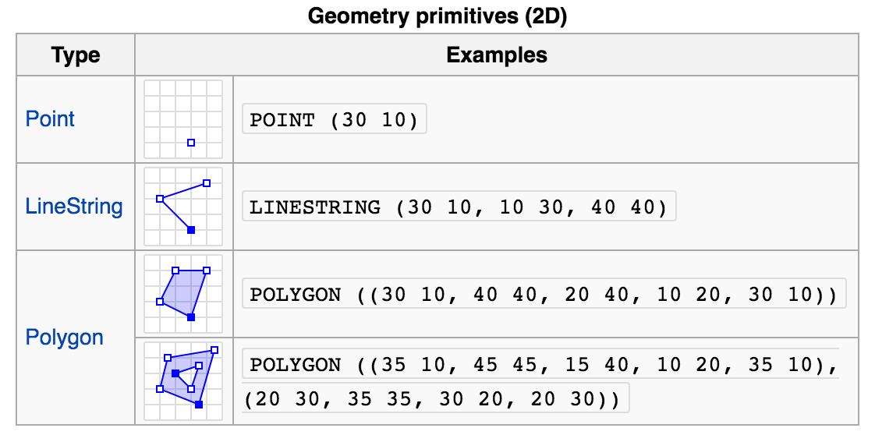
Tips & Suggestions
Design
QGIS, ArcGIS: easy to visualize
SQL support
Create geometries on the fly (WKT)
GDAL

Slide 23
Tips & Suggestions
Future of WebGIS (What I want to see)
Back-end
NodeJS server + GDAL/mapnik wrapper
Serving data, analysis
Front-end
Vector: vector tiles
Raster: UTF-grids
Charting: D3 etc
Mapping API: MapBox GL

Slide 24

Tips & Suggestions
Crash course in GIS
GEOG322 textbook
Solid theories, lots of practices
Murray Library-4th Floor
GEOG 485 (Pennsylvania State Univ)
GIS Programming and Automation: GIS modeling, Model Builder, Python
GIS For Web Developers (google for pdf copy)
Data types, common GIS file formats, projection, database, web services

Slide 25
Tips & Suggestions
Crash course in GIS
ESRI's ArcGIS tutorials
More than a tutorial. It offers everything you want to know about GIS and ArcGIS.
Lynda’s video tutorials
Up and Running with ArcGIS: "Learn how to organize, display, analyze, and map geospatial data with ArcGIS.”
ArcGIS Essential Training: "Learn to create and manage data, maps, and analytical models with ArcGIS.”
GIS on the Web: "Use Google Maps, Google Drive, Bing Maps, and other web technologies to analyze, map, and share GIS data.”
Real-World GIS: "Get solutions to real-world GIS challenges, such as collecting quality data, creating projections, and finding a GIS job."

Slide 26
Tips & Suggestions
Install ArcGIS
Windows: http://spatial.usask.ca/software/install.php
Mac / Linux: NA
Off-campus: VPN, remote desktop to a server
Install QGIS
FREE

Slide 27
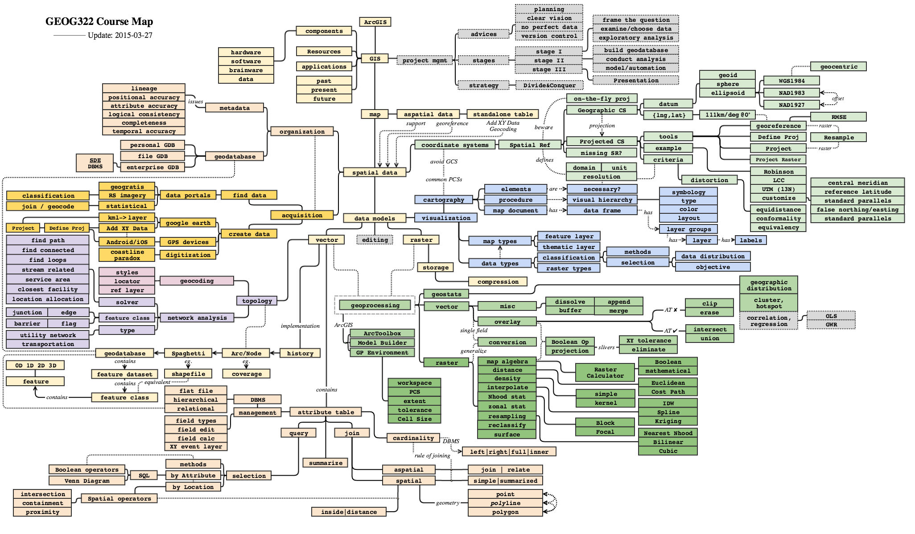
Tips & Suggestions

Slide 28
Summary
Is that all?
In good hands

Slide 29
Contact me
On campus: Kirk Hall, Murray library
Email gismatthew@gmail.com, meng.li@usask.ca
Phone: 306-261-0583
Questions?

