Slide 1
Implementation of African Soil Science Database Project
An overview
Matthew
Sep. 28, 2016

Slide 2
Disclaimer
This presentation
Will give you a big picture of soil-db prototype
Overview of soil-db project management
My design & strategy on technical implementation
Suggestions on next step
However, it won’t
Demonstrate how all technical details work, because
It involves too much boring technical details (broad & depth)
My implementation prototype may not be good enough
Appropriate dataset/steps for demo is tricky, time-consuming
Explaining why & how current prototype works > dummy data

Slide 3
Disclaimer
Expected outcome
Everyone knows his role in this project
Data-related (catalog, analysis, interpretation)
Design & Development related
Project Management
How to move on next
What part of the current design is good? Keep it.
What part is not good enough? Improve it.
What part is lacking? Implement it.

Slide 4
Before we continue,
Project: “soil-db”
Project source code:
https://github.com/gismatthew/soil-db
Matthew’s private repo
Send access request to gismatthew on GitHub or through email at gismatthew@gmail.com

Slide 5
Before we continue,
Requirement
Access: GitHub repo, server(gis1test)
Skills
GIS/WebGIS theory & practice: ArcGIS & QGIS, data models & formats & management, spatial/non-spatial analysis, ArcPy scripting, Open-source GIS tools/libraries
Server:
Windows Server setup/config, Windows command line (batch), Apache WebServer
Web/WebGIS Dev (theory & practice)
JSON, XML, PHP, Python, JavaScript, HTML, CSS
NodeJS, Git/GitHub
UX Design

Slide 6
Before we continue,
Project management (team work)
Client: needs analysis
Data: scientific investigation on data quality, source, catalogue, process/usage (classification, symbology), interpretation, knowledge-propagation
Design & Development: php, JavaScript, HTML, CSS, algorithm, software design/development/engineering skills
Management: consult Winston

Slide 7
Outline
Background:
soil-db project
GIS data on the web
Implementation
Overview
Technical Detail
Publishing vector layers, (incl. soil layer)
Server-side configuration
Front-end rendering, querying
Publishing raster layers
Server-side configuration
Front-end rendering, querying
Issues & Enhancement
Back-end: performance
Front-end: improvement
Resources
GitHub repo, related projects/tools/APIs, troubleshooting
TL;DR

Slide 8
Background: soil-db project
Main objective
Sharing massive GIS layers using WebGIS to facilitate collaboration
Back-end: publishing vector/raster layers
Front-end: rendering, query, spatial analysis
To be identified
Our team
Client
End users

Slide 9
Background: soil-db project
Main objective
Sharing massive GIS layers using WebGIS to facilitate collaboration
Back-end:
Publishing vector layers
Publishing raster layers
Front-end:
rendering:
Predefined (hard-coded) classification/rendering
user-defined classification/rendering
Attribute table display (‘Info Window’ module)
UX improvement
Query:
Query being used in rendering, but not exposed as config option for the end user
spatial analysis
To be determined, designed, and implemented
completed
next step
More on GitHub’s issues

Slide 10
Background: GIS data on the web
From Server GIS to Desktop GIS
ArcGIS Workstation→ArcGIS Desktop
The Web Era
Google Earth / Map (Pre-rendered Map Tiles + JS + CSS)
ESRI ArcGIS IMS, ArcGIS Server
Open source solutions
WebGIS Servers: Map Server, GeoServer
NodeJS-based solution (soil-db)
Small footprint & better performance (server & client)
Easy to configure/deploy (server & client)
More features (GIS formats I/O, binary vector tiles, customization)
TL;DR

Slide 11
Project Implementation
Overview
Server’s file structure
Project source-code structure

Slide 12
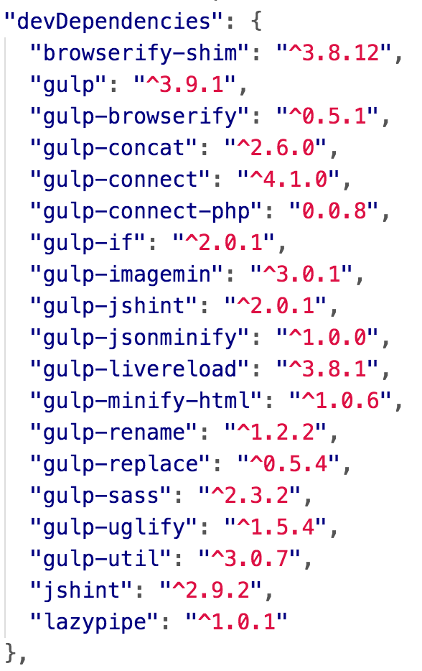
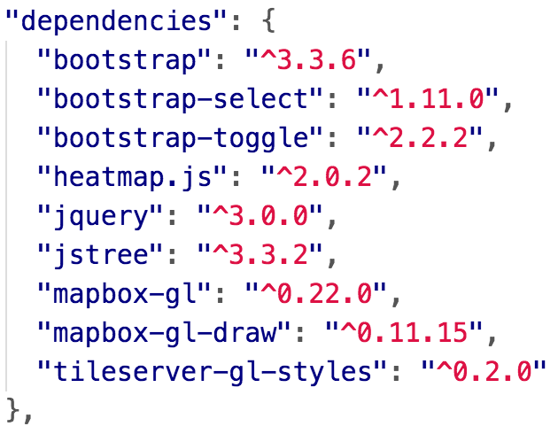
Overview
Back-end
NodeJS, PHP, GDAL/OGR
Front-end
Mapbox GL
Bootstrap+plugins
jQuery
font glyphs
SASS
NodeJS+plugins, gulp+plugins

Slide 13
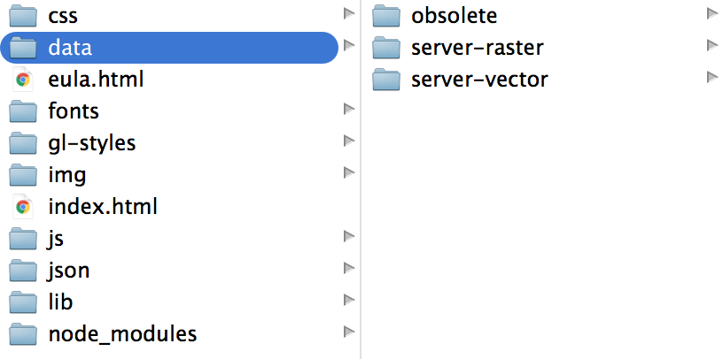
Server’s file structure
“Data” folder: responsible for publishing raster&vector GIS layers.
The rest: WebGIS project deployment

Slide 14

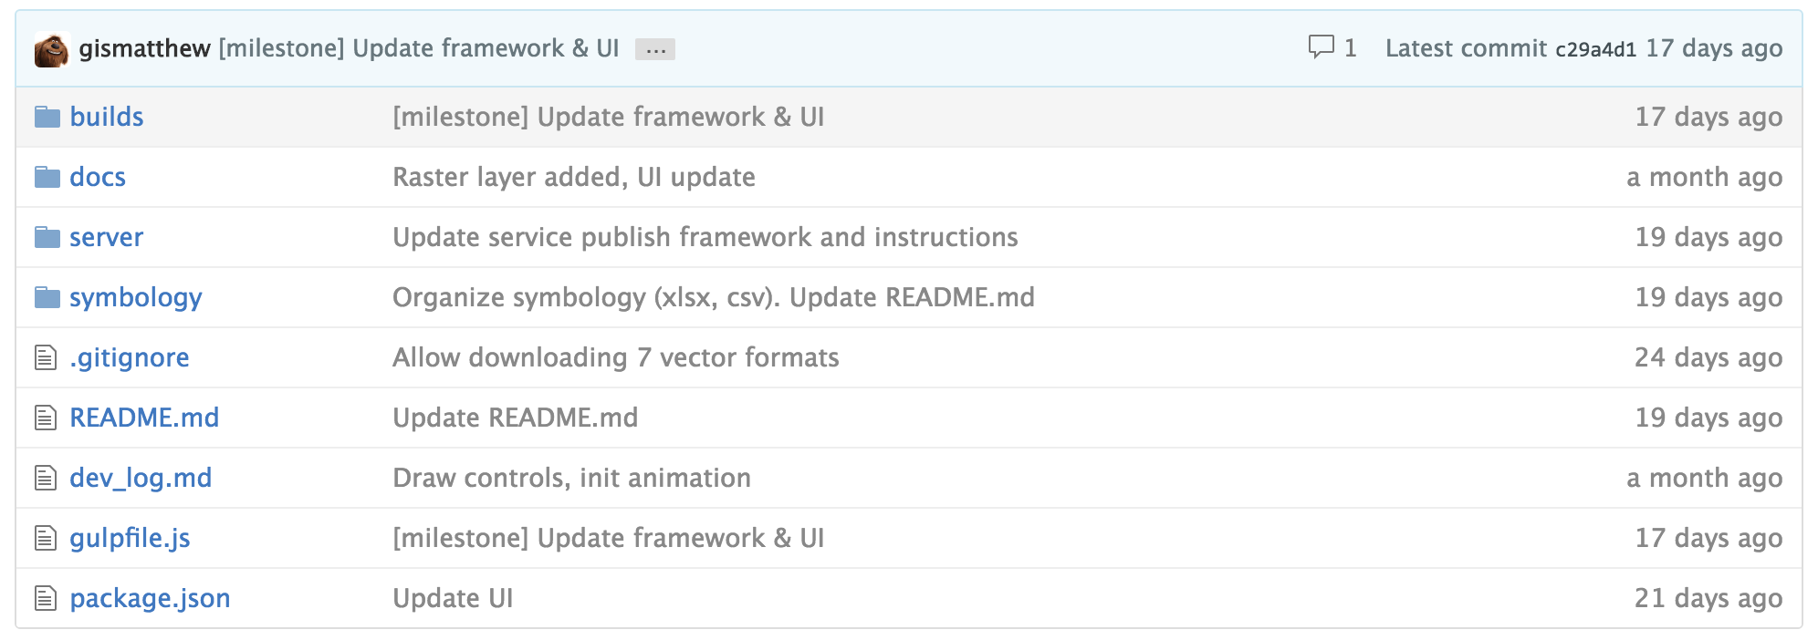
Project source code structure
WebGIS (front-end) using NodeJS
Other documentation in markdown language
Scripts for publishing vector/raster tiles
Dev notes for developers: troubleshooting, feature implementation etc
Project Documentation
Colin’s symbology design for raster layers

Slide 15
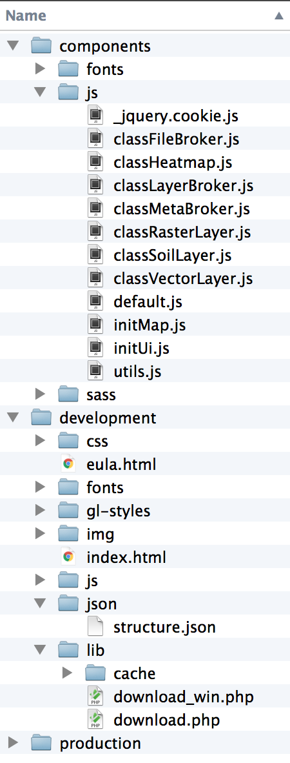
Builds directory
This folder is for project implementation (most active)
Font glyphs used in this project. Refer to: fontello.com
All JavaScript goes here. File names are self-explanatory.
classFileBroker: GIS layer downloading
classLayerBroker: GIS layer management (init, tracking)
classMetaBroker: prepare data for treeview, soil LUT
classVectorLayer: vector layer rendering, show/hide
classSoilLayer: soil layer rendering, show/hide
classRasterLayer: rasterlayer show/hide
default: default system setting/params
initMap/initUI: init map and UI with event listeners
utils: helper functions
This folder is for deploying code on developer’s machine
Minified production code goes here

Slide 16
Publishing Vector Layers
Technical Detail

Slide 17
Vector: overview
id
Deploy server instances:
One instance per ‘project’
Basemap
Project1
Project2
fields
Configuration file
fieldNames
layers
(Optional)countries
xml-writer
gdb
Mapnik XML
Layers in File GDB
livetile-bridge
Express server
cache
Web Service
url pattern
port
NodeJS
Please improve it if you can!
(maybe reverse-proxy?)

Slide 18
Vector: configuration file
project_code:
Basemap
Project1
Project2
File name | {project_code}_config.js
Designed by | Matthew
Designed Purpose | Define parameters to have easy/fine control over published vector tiles
Language | JSON
File Location | %server_project_root%/data/server-vector/
Fields | Value | Example | Meaning
id | String | "adm0" | Layer’s id to be referenced at the client-side. Should unique within one ‘project’.
fields | Array | ["NAME_ENGLI", "ISO", "NAME_FRENC”] | Real field names exposed to WebGIS.
filedNames | Array | ["Name", "ISO", "French_Name"] | Displayed field names to end user.
layers | Array | ["Benin_adm0", "BurkinaFaso_adm0", "Mali_adm0", "Niger_adm0", "Nigeria_adm0”] | One item per each country. If country info is n/a, array’s length is 1. Should be used with ‘countries’.
countries (optional) | Array | ["Benin", "BurkinaFaso", "Mali", "Niger", "Nigeria"] | Name of the countries. Should be used with ‘layers’.
gdb | String | "C:/WestAfricaFoodSecurity/BaseMaps.gdb" | Location of the File Geodatabase.

Slide 19
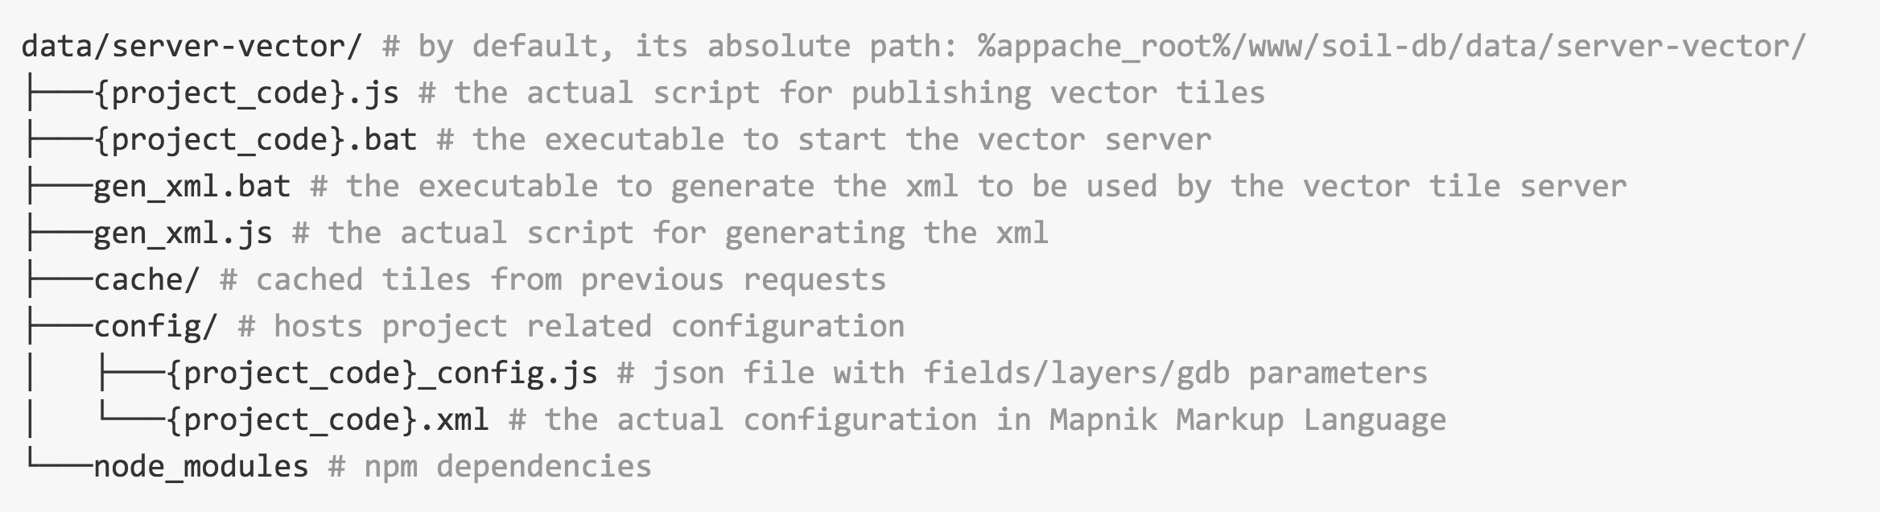
Vector: server-side config
Publishing vector tiles (by default) requires the following file structure in the project directory
Details: GitHub
project_code:
Basemap
Project1
Project2
https://github.com/gismatthew/soil-db#publish-vector-layers

Slide 20
Vector: front-end consumption
Rendering (Mapbox GL)
Mapbox GL’s style specification
www.mapbox.com/mapbox-gl-style-spec/
Query
map.queryRenderedFeatures([geometry], [parameters])
map.querySourceFeatures(sourceID, parameters)
Mapbox’s filter, simple SQL-like syntax
www.mapbox.com/mapbox-gl-style-spec/#types-filter
Spatial analysis
Potential: PHP, GDAL/OGR, Python, NodeJS

Slide 21
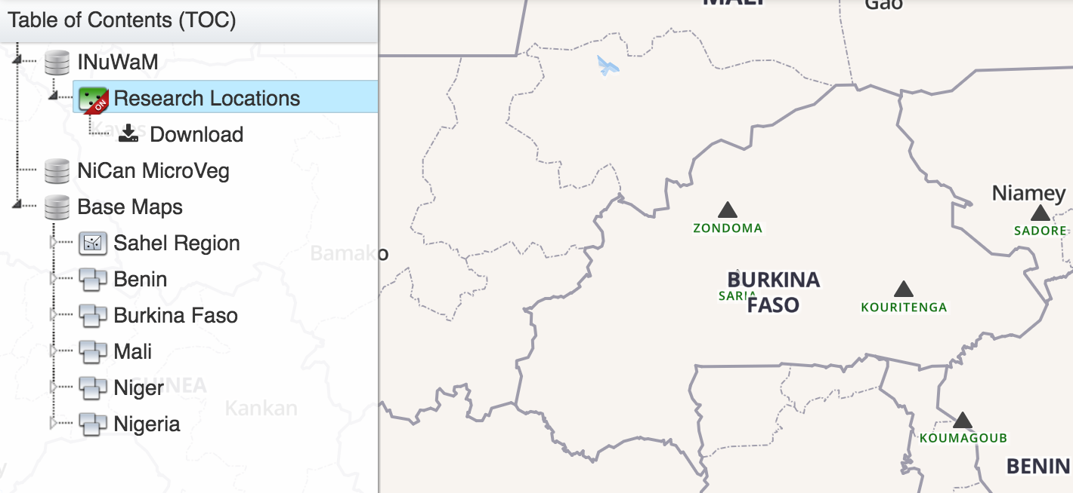
Vector: front-end consumption
Structure
Loaded from json/structure.json
Sequence of showing a vector layer
User click triggers ‘select_node.jstree’ event
If the target node is a vector layer
If it is a soil layer, create a SoilLayer instance, show it
Otherwise, create a VectorLayer instance, show it

Slide 22
Vector: front-end consumption
Styling a vector tile layer
Implemented in VectorLayer Class’s constructor.
builds/components/js/classVectorLayer.js
Soil layer is an exception
Contains 143 sub-layers (soil types, defined in meta_broker in builds/components/js/classMetaBroker.js)

Slide 23
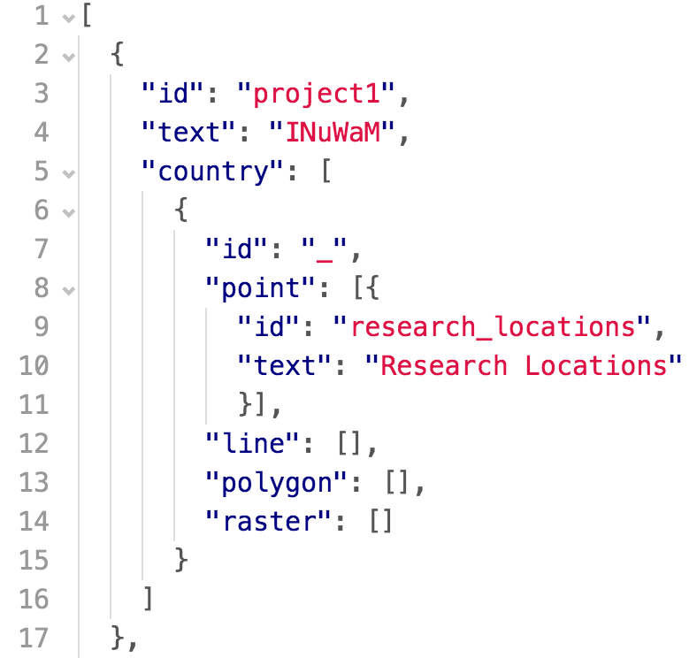
Vector: front-end consumption
Define the layer in WebGIS’s data catalogue
json/structure.json
Structure
Naming convention
id: each node has a unique id
text: displayed text (human-friendly)
country: layer group by country
Use underscore ‘_’ if country is n/a

Slide 24
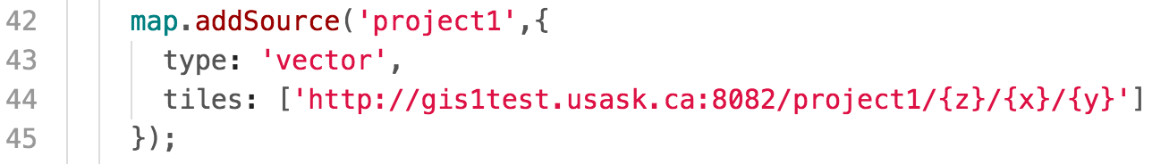
Vector: front-end consumption
Consuming the web service
Add as a source
js/initMap.js

Slide 25
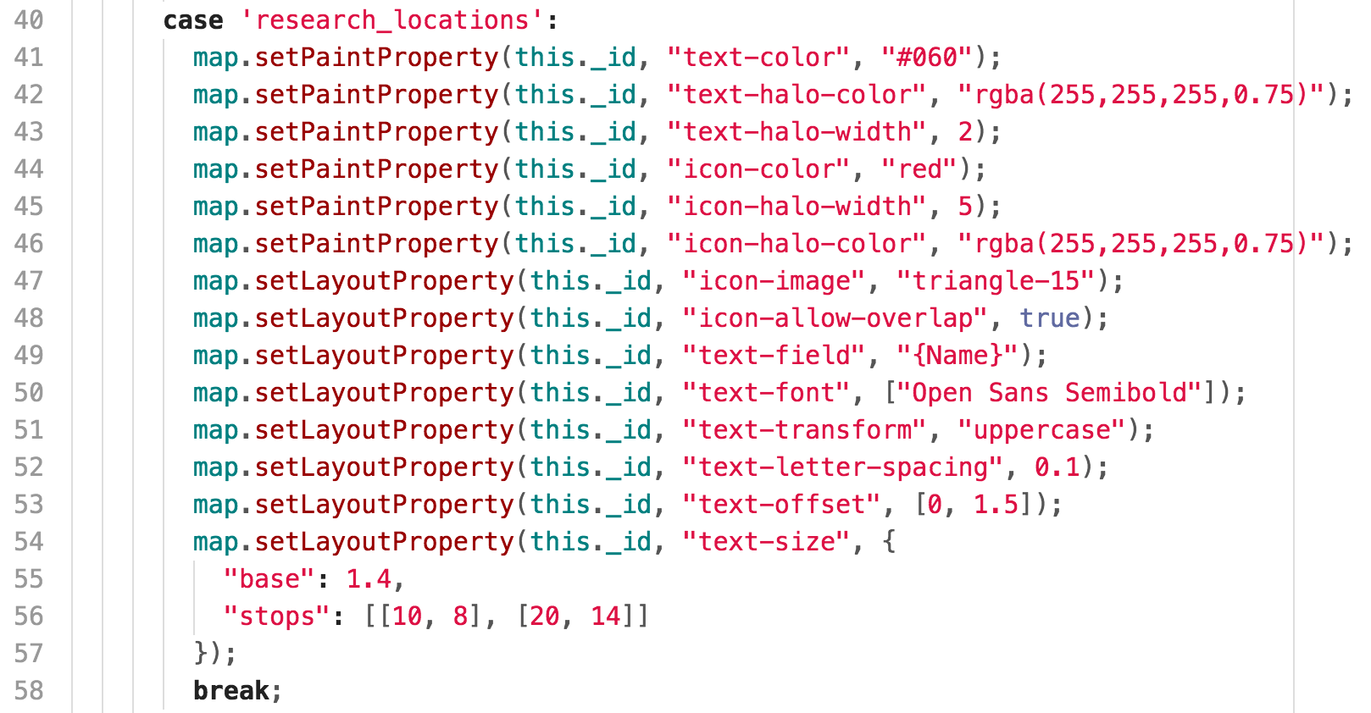
Vector: front-end consumption
The layer’s pre-defined symbology
js/classVectorLayer.js

Slide 26
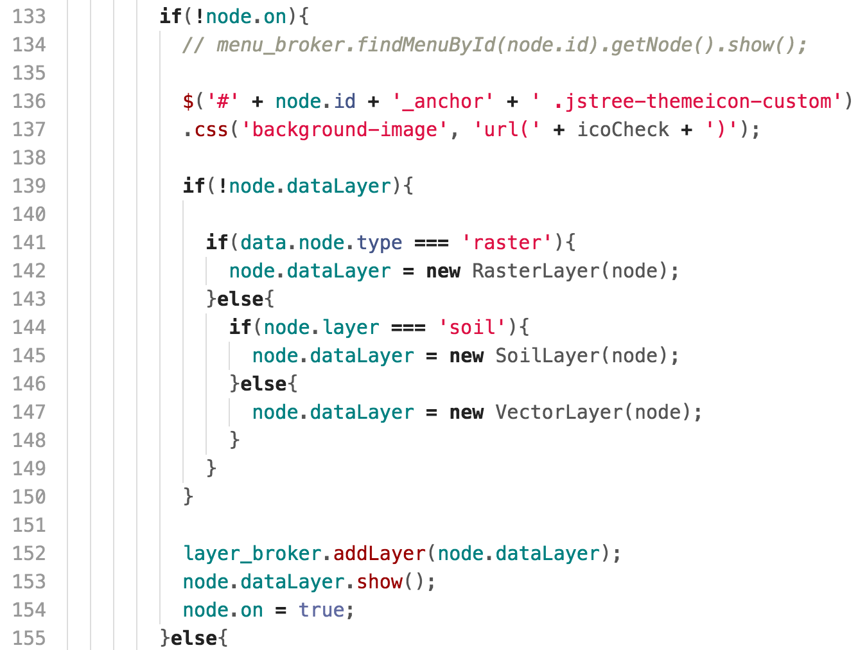
Vector: front-end consumption
Show a vector layer
js/initUI.js

Slide 27
Publishing raster Layers
Technical Detail

Slide 28
Raster: overview
Manually, or
export_raster.py
GeoTiff
Deploy server instances:
One instance per ‘project’
Basemap
Project1
Project2
Input raster
Mode=“discrete”
gen_xml_single_band.py
stops
colors
Output opacity
Mapnik XML
{project}_{country}_{layer}.xml
Output layer id
Layers in File GDB
livetile-bridge
Express server
cache
Web Service
url pattern
port
NodeJS
Please improve it if you can!
(maybe reverse-proxy?)

Slide 29
Raster: configuring xml generation
File name | gen_xml_single_band.py (Execute with gen_xml_single_band.bat)
Developed by | Matthew
Designed Purpose | Define parameters to have easy/fine control over published raster tiles
Language | PYTHON
File Location | %github_project_root%/server/raster-tile-server/
Variable | Value Type | Example | Meaning
input_dir | String | ‘..\\..\\data\\’ | Path to the ‘project’’s data directory
input_raster | String | ‘nigeria_elev.tif’ | The raster (geotiff) to be published
input_layer_id | Array | ‘elev’ | Layer’s id to be referenced at the client-side. Should unique within one ‘project’.
output_name | Array | ‘map’, ‘thumbnail’ | Name of the preview of this config.
stops | Number Array | [ 0, 190, 370, 560, 940 ] | Classification breaks
colors | Hex Array | [ '#104510', '#628234', '#cccc66', '#966530', '#61150d' ] | Colors for each classification group
output_opacity | Float |  | Opacity of the raster tiles. Should be [ 0, 1 ]

Slide 30
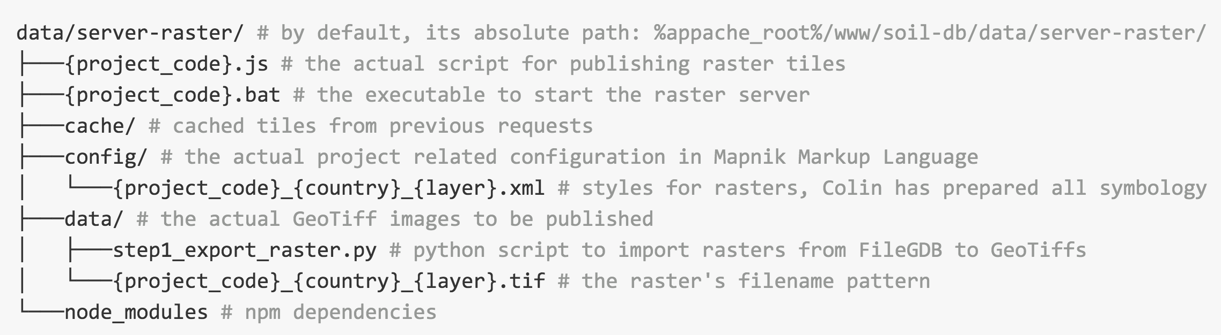
Raster: server-side config
Publishing raster tiles (by default) requires the following file structure in the project directory
Details: GitHub
project_code:
Basemap
Project1
Project2
https://github.com/gismatthew/soil-db#publish-raster-layers

Slide 31
Raster: front-end consumption
Query
UTF-GRID
https://www.mapbox.com/demo/visiblemap/
Spatial analysis
PHP, GDAL/OGR, Python, NodeJS

Slide 32
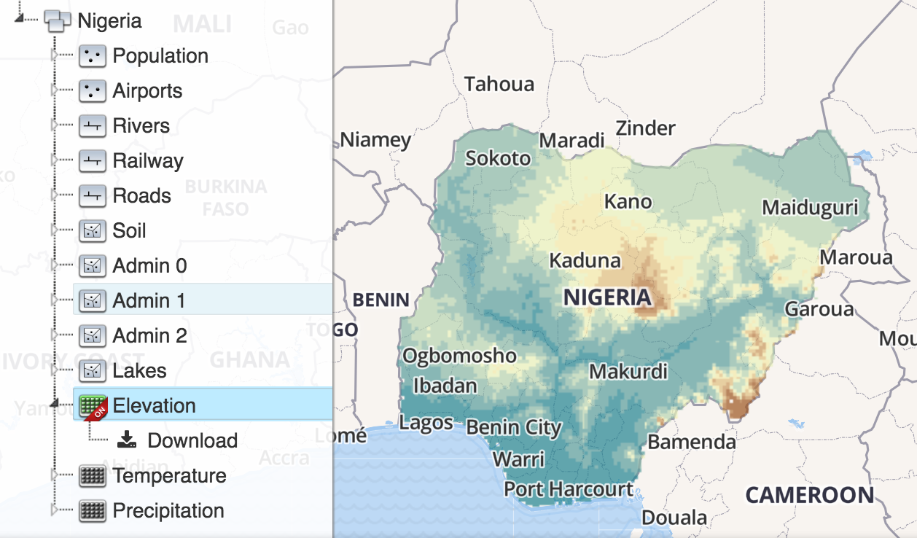
Raster: front-end consumption
Structure
Loaded from json/structure.json
Sequence of showing a raster layer
User click triggers ‘select_node.jstree’ event
If the target node is a raster layer
Create a RasterLayer instance, show it

Slide 33
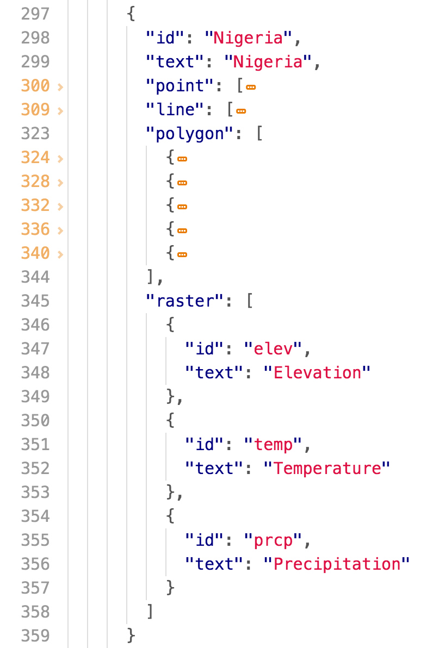
Raster: front-end consumption
Define the layer in WebGIS’s data catalogue
json/structure.json
Structure
Naming convention
id: each node has a unique id
text: displayed text (human-friendly)
country: layer group by country
Use underscore ‘_’ if country is n/a

Slide 34
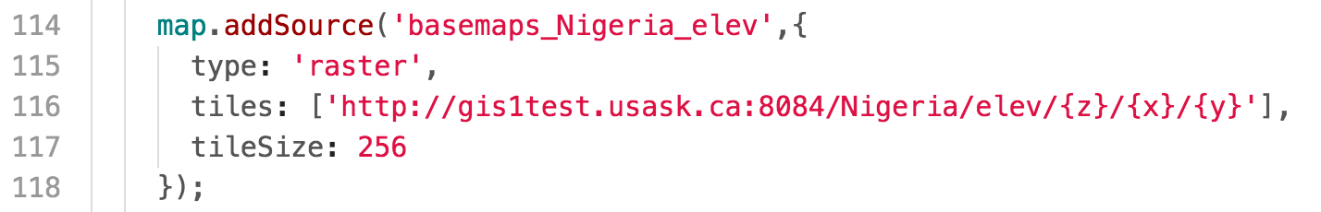
Raster: front-end consumption
Consuming the web service
Add as a source
js/initMap.js

Slide 35
Raster: front-end consumption
The layer’s pre-defined symbology
Rendered at the server
At run time if the request tile is n/a
Return a cached copy

Slide 36
Raster: front-end consumption
Show a rasterlayer
js/initUI.js

Slide 37
Issues & enhancements
Technical Detail

Slide 38
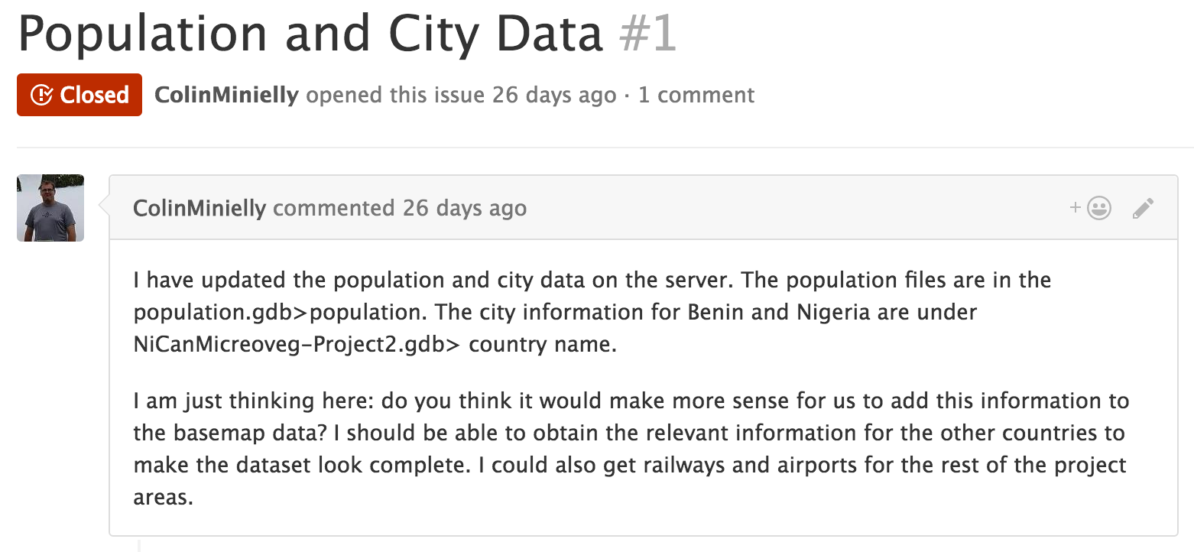
Issues & improvement
Server’s performance
Minimize no. of tile server instances
Raster: implemented (publish multiple xml configs)
Vector: implemented (single xml, but with all countries aggregated within it)
Please improve it if you can!
Read full thread on https://github.com/gismatthew/soil-db/issues/1

Slide 39
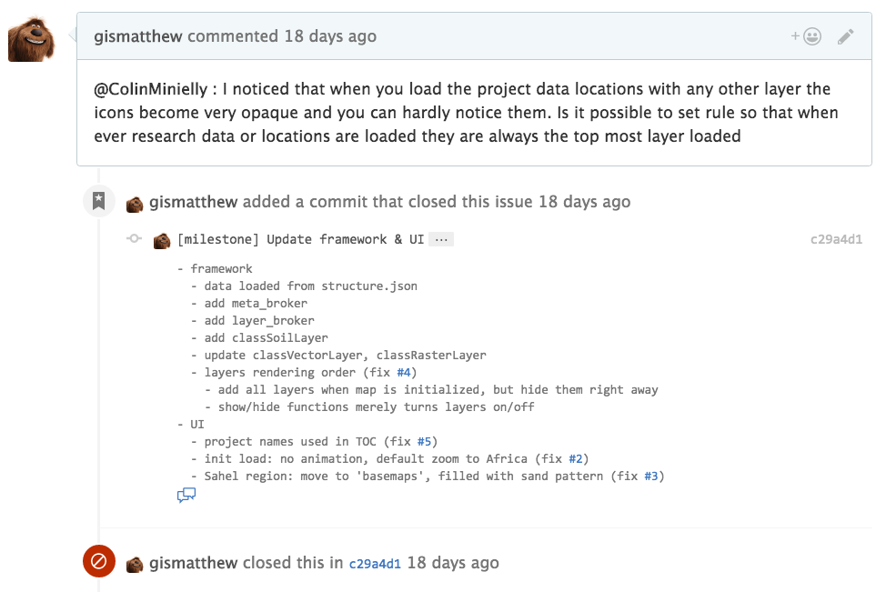
Issues & improvement
Layers’ drawing order

Slide 40
Resources
Technical Detail

Slide 41
Key Resources
Reason:
Trouble-shooting problems along the way
WebGIS: burgeoning and fast-evolving industry, performance, new features etc
List:
Key Projects/APIs (directly used in soil-db)
Awesome-vector-tiles, tileserver-gl, tileserver-gl-styles, tilelive/tilelive-bridge/tilelive-mapnik, mapbox-gl, mapnik, express, http
Trouble-shooting
http://www.google.ca/
http://stackoverflow.com/
http://gis.stackexchange.com/

Slide 42
Thank you!
Questions?
Contact Matthew
Email: gismatthew@gmail.com
Cell: 306-261-0583

