Slide 1
Meeting 09/30/2020
Shuo Zhang

Slide 2
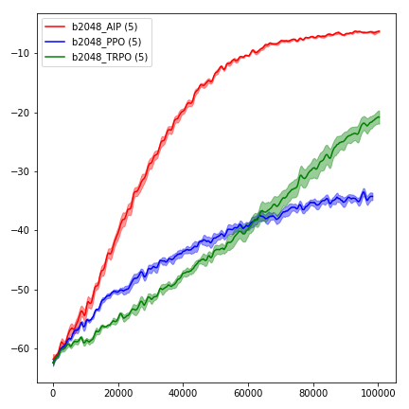
AIP (Mujoco)

Slide 3
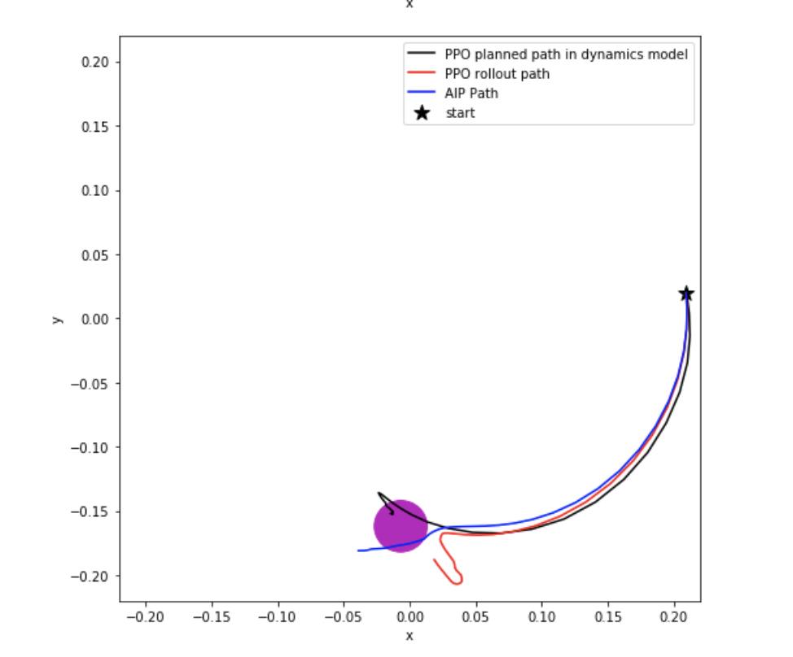
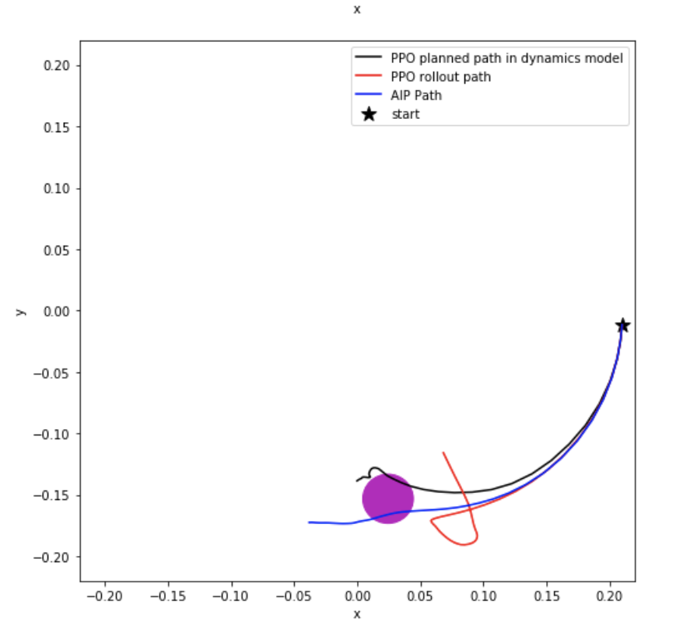
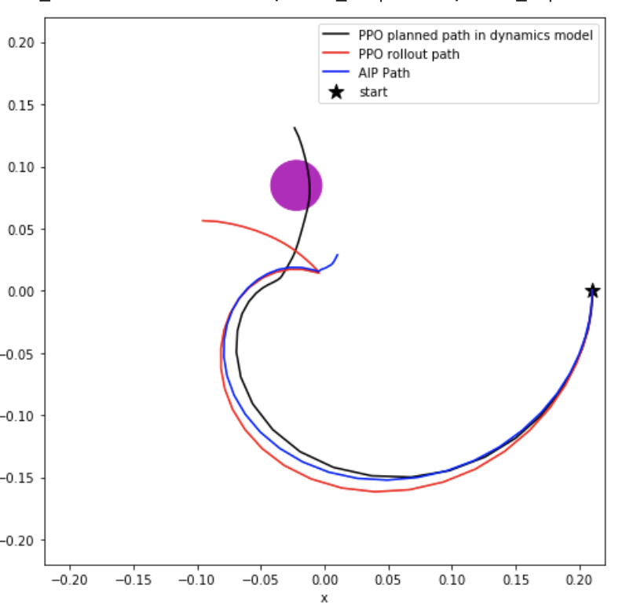
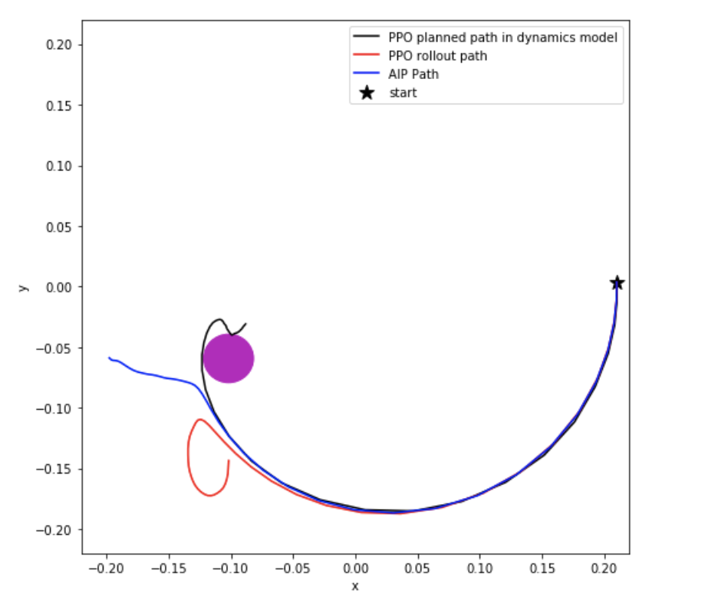
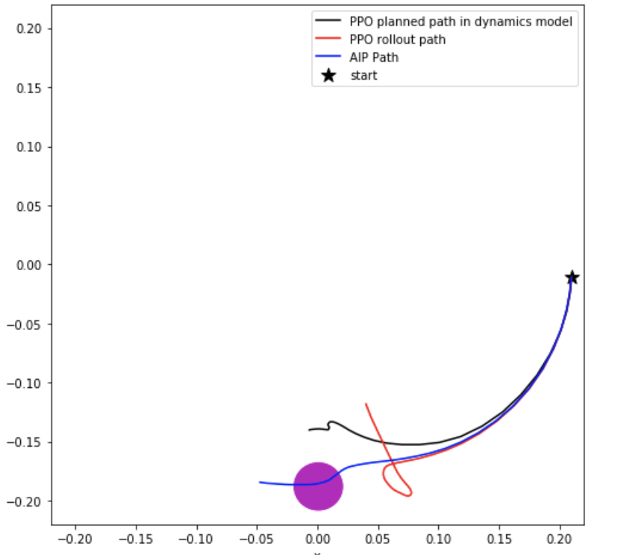
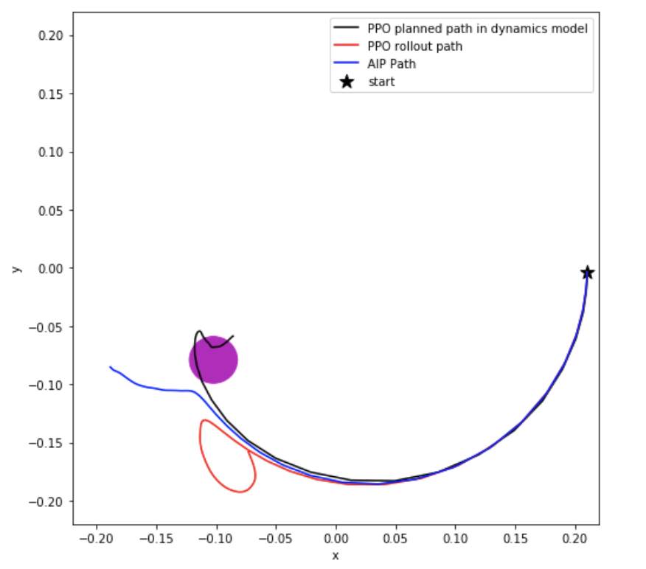
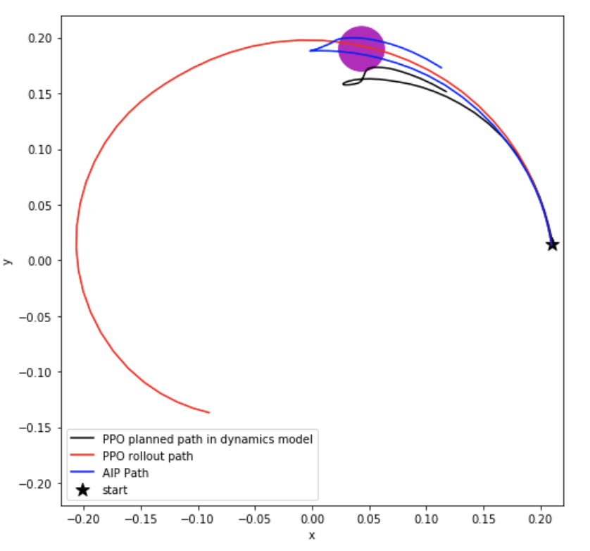

Slide 4
Questions and Plans
Next experiments: Gazebo Hand
For real hand, no automatic restart?
For Acrobot, sparse reward -1, adapt r_diff in terms of one-step Q=r+V(s’) ?

