Slide 1
Meeting 05/27/2020
Shuo Zhang

Slide 2
Mujoco/Gym Experiments
Progress
Reacher-v2:
Collect Data: Done
Learn Dynamic Model: Done
Model Evaluation: Done
Acrobot-v1;
Collect Data: Done
Currently Training: Should be over in 1 hour
Model Evaluation: Later

Slide 3
Collect Data
1 Million Steps for each task

Slide 4
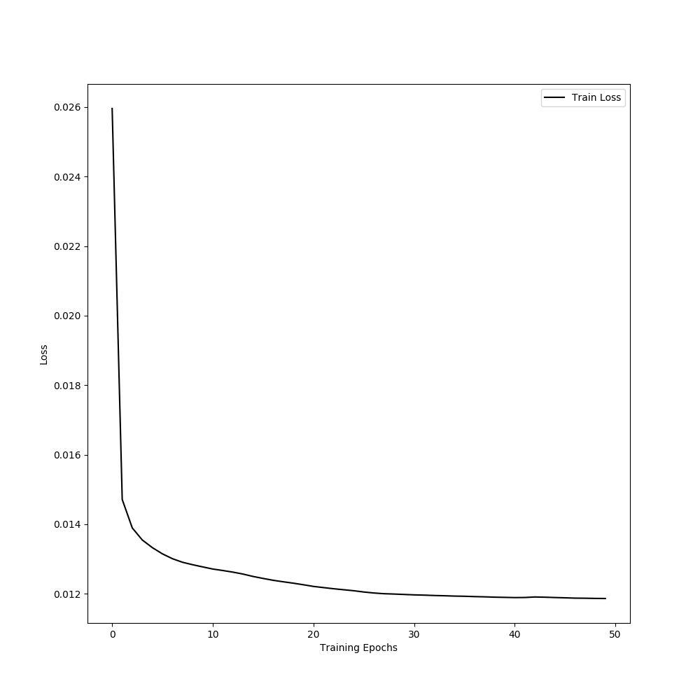
Learn Transition Model
Experimented different configs:
Learning Rate: [0.001, 0.0001]
Number of Hidden Nodes: [200, 512]
Number of Training Episodes: [20,50]
Generally, 0.0001 is better than 0.001. 20 iterations of training are good enough. Little progress from iteration 21 to iteration 50, or even from iteration 6 to iteration 50.

Slide 5
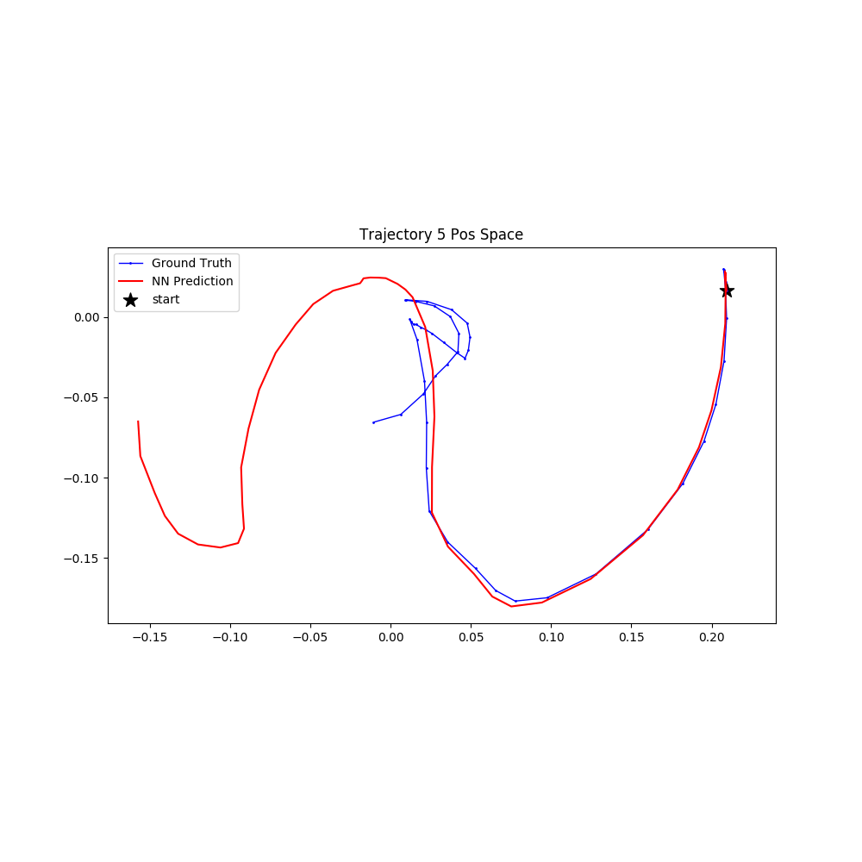
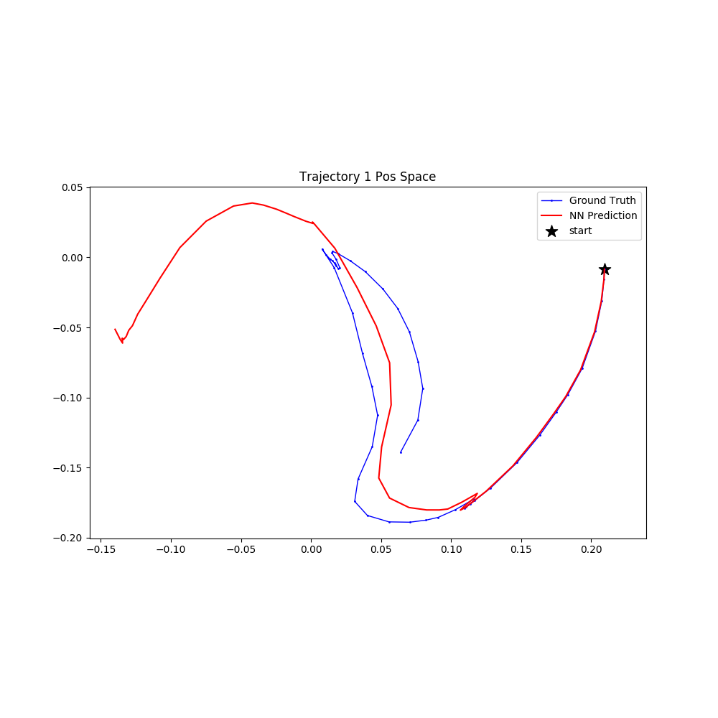
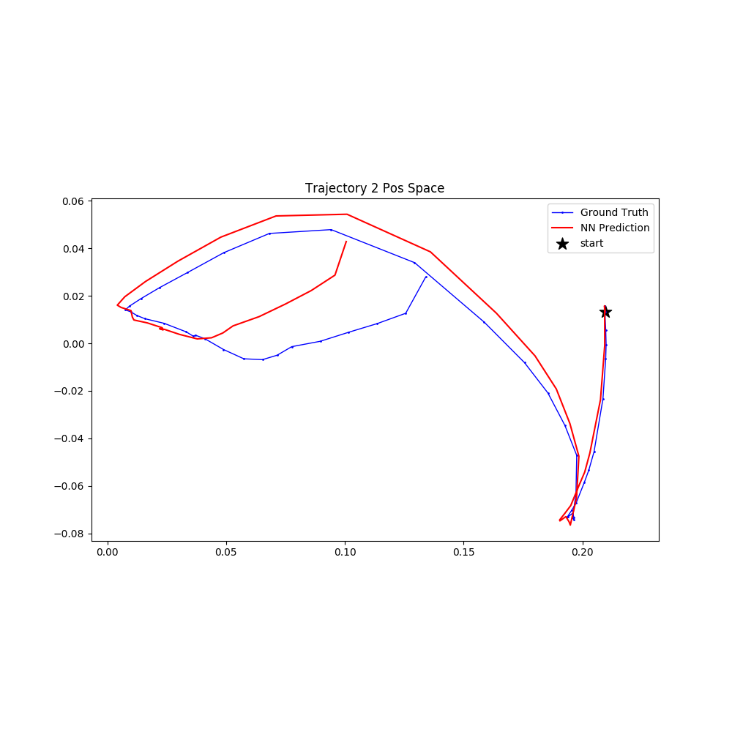
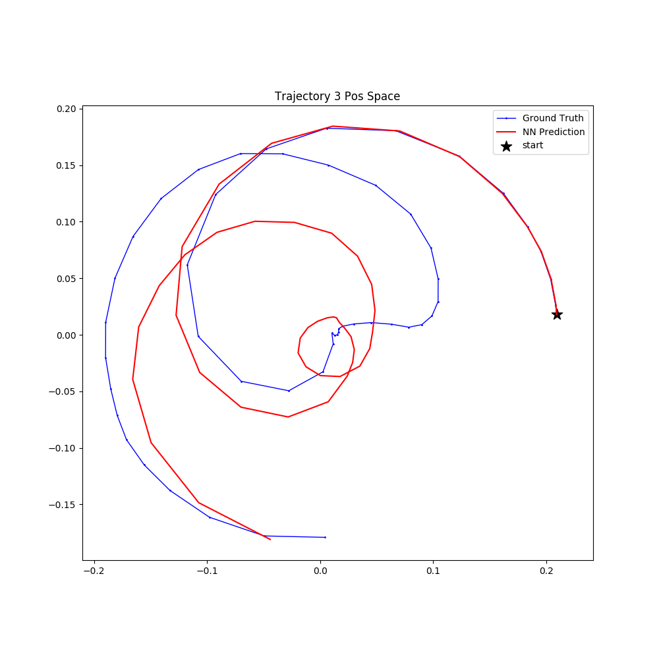
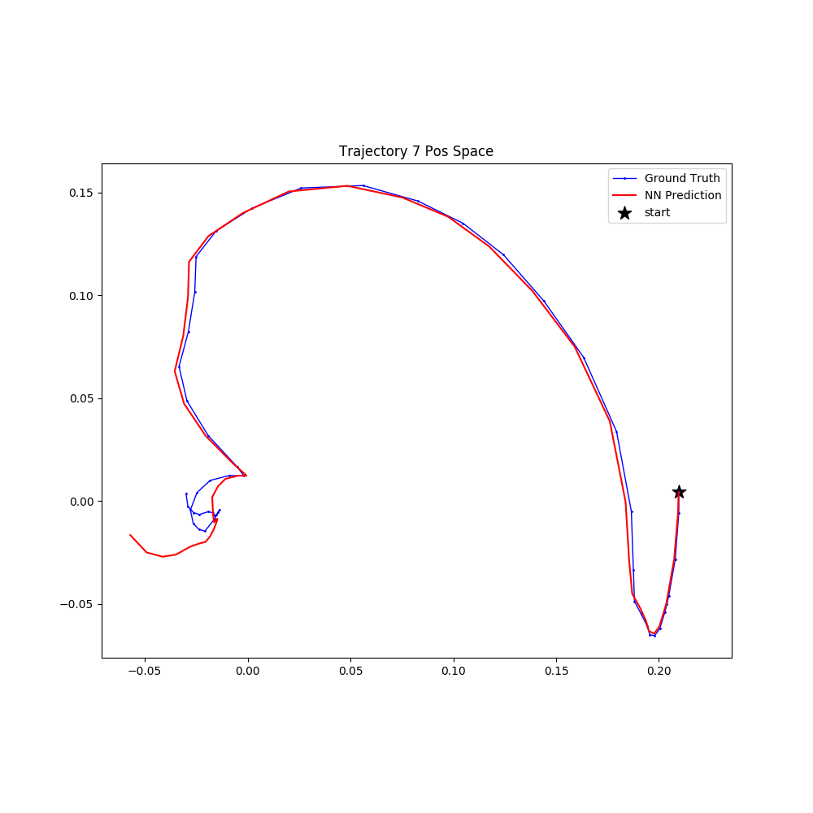
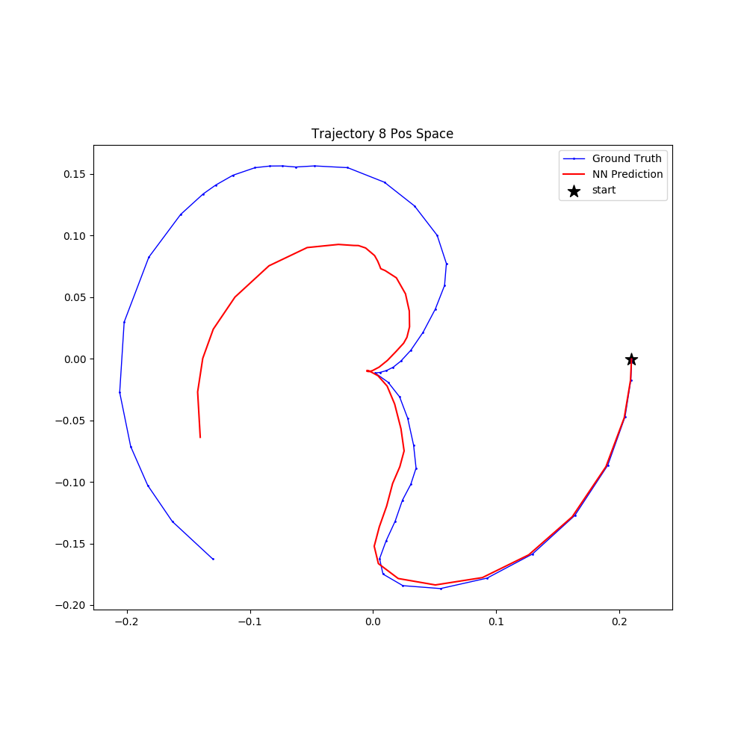
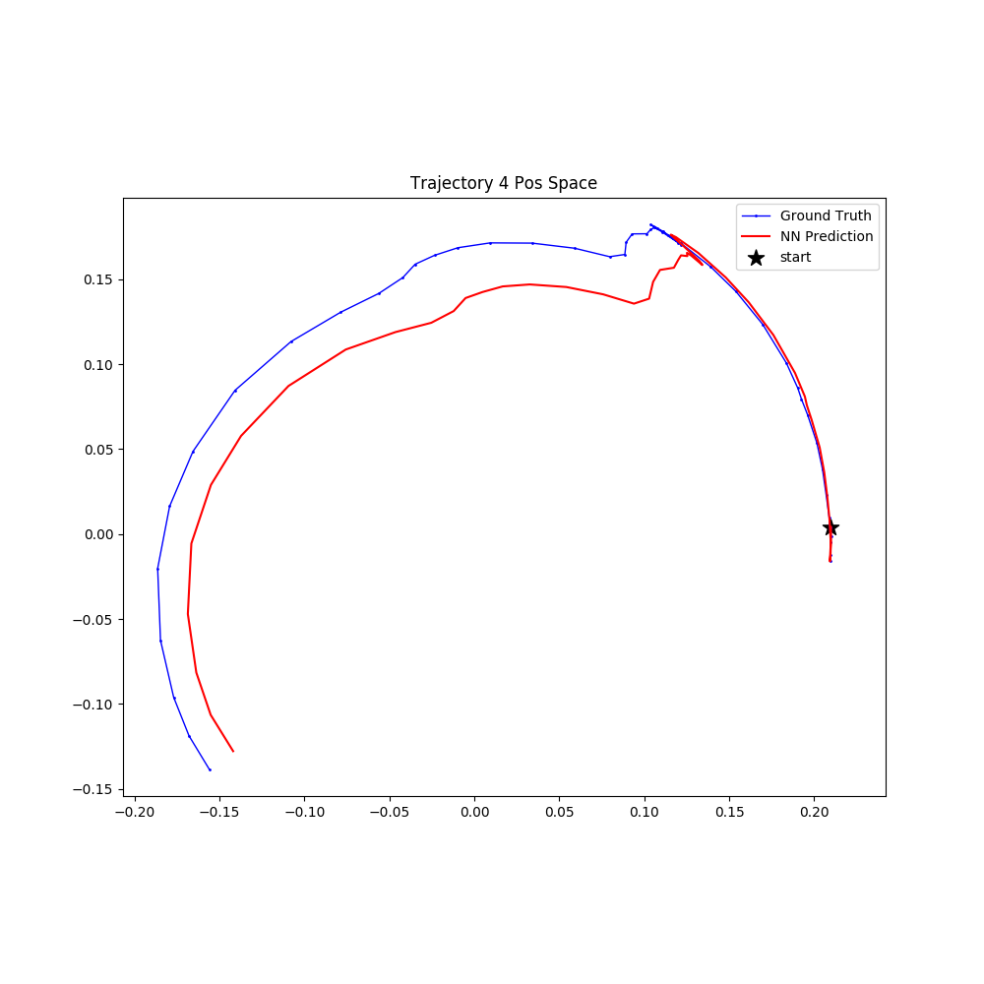
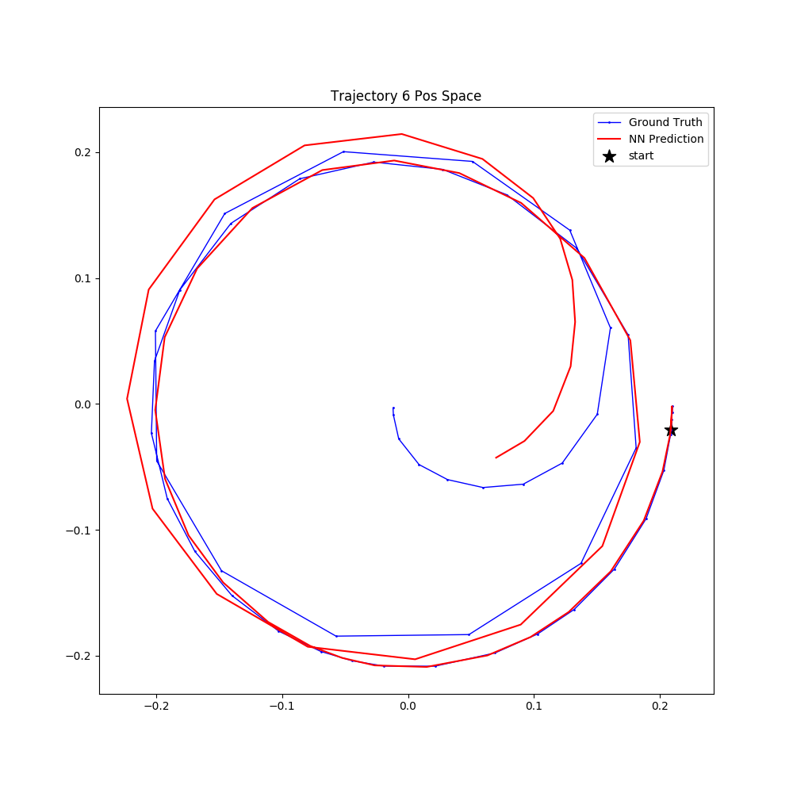
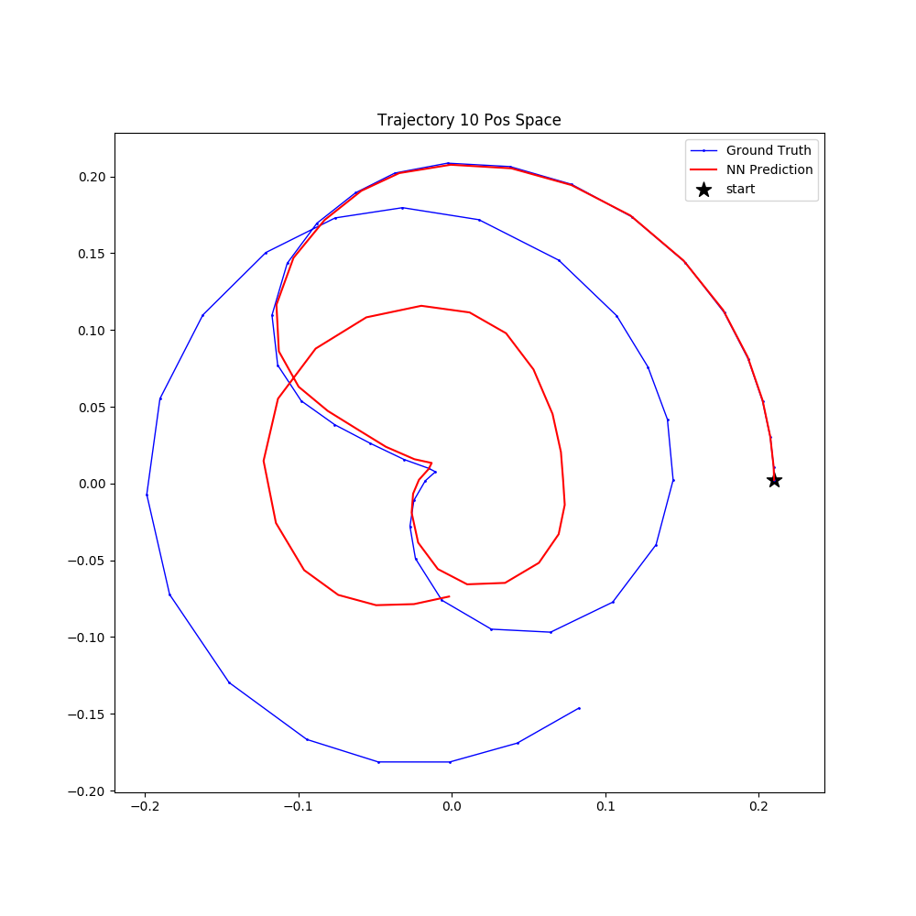
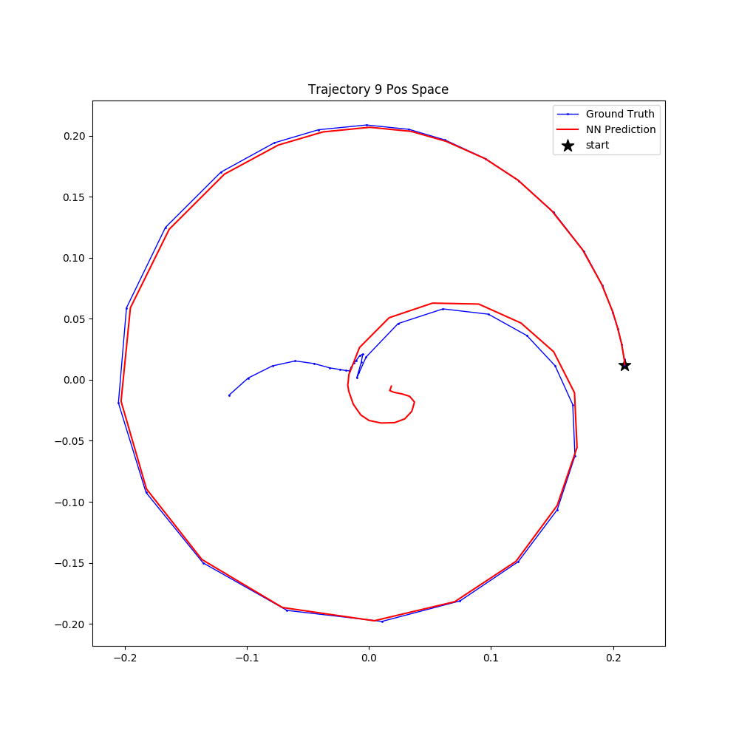
Model Evaluation: Reacher-v2
After 5 iterations of training

Slide 6
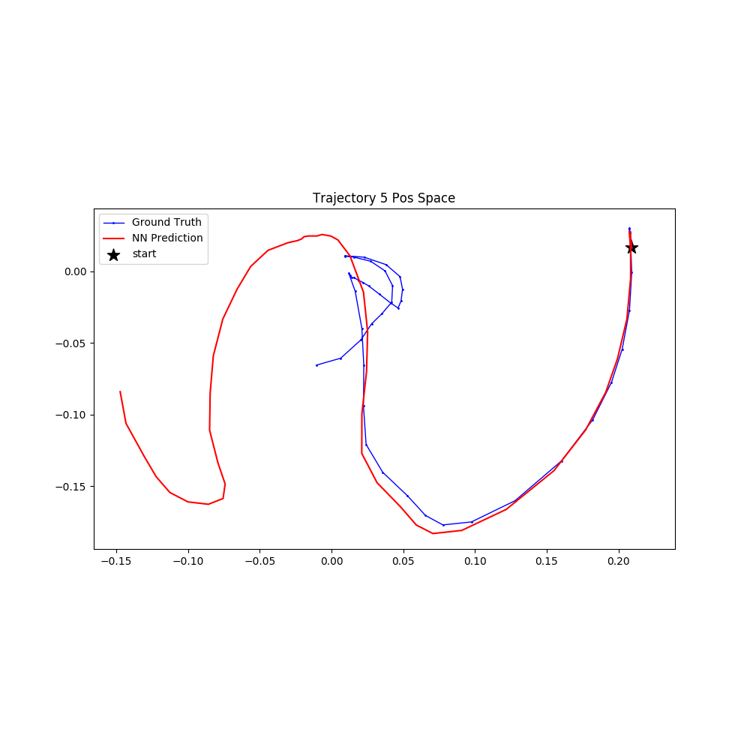
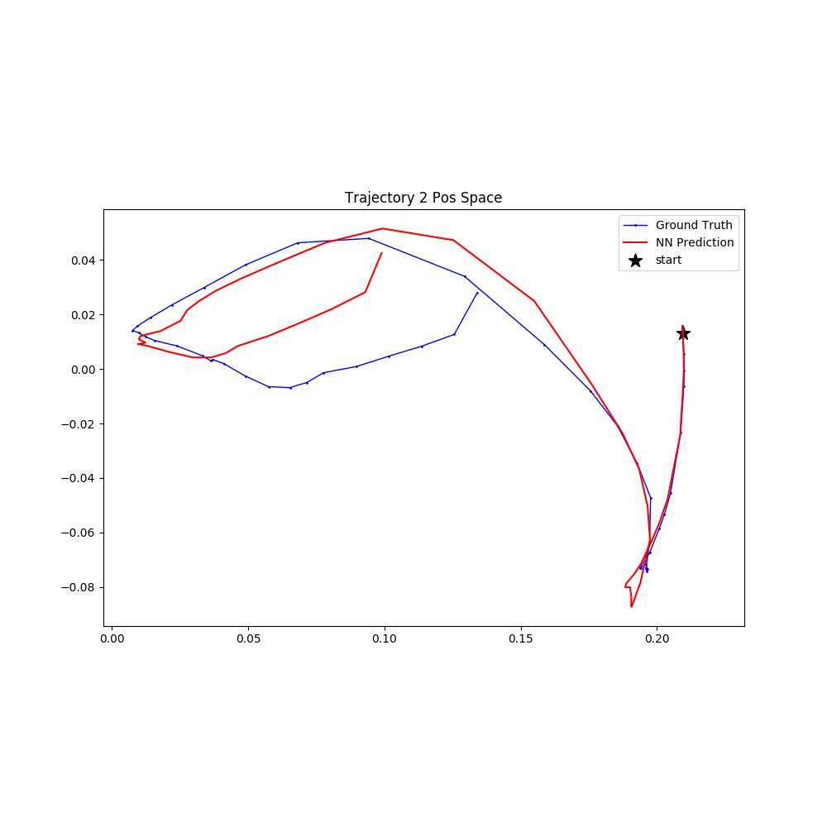
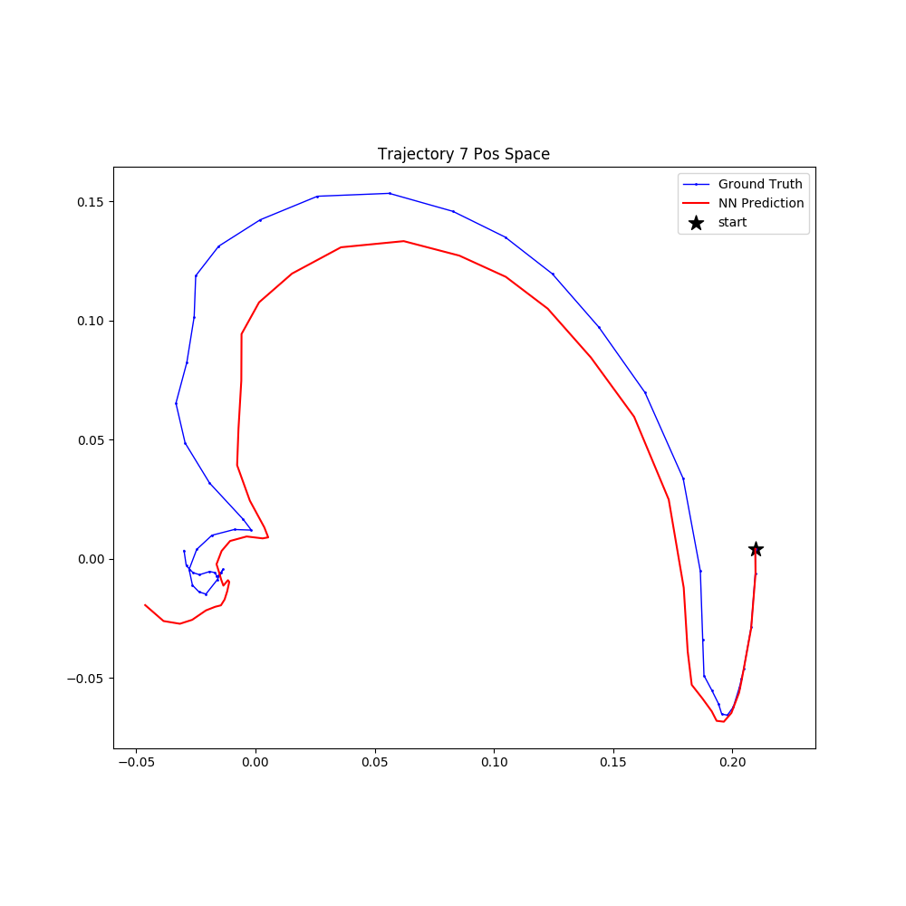
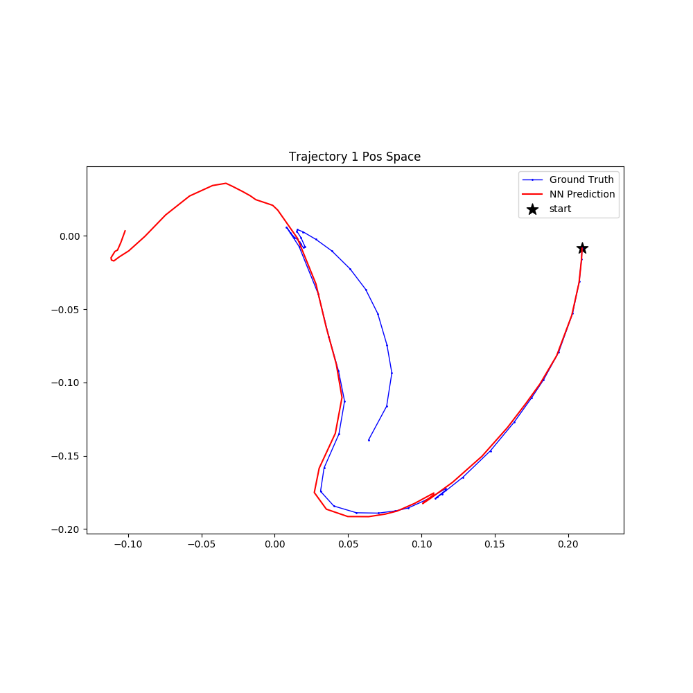
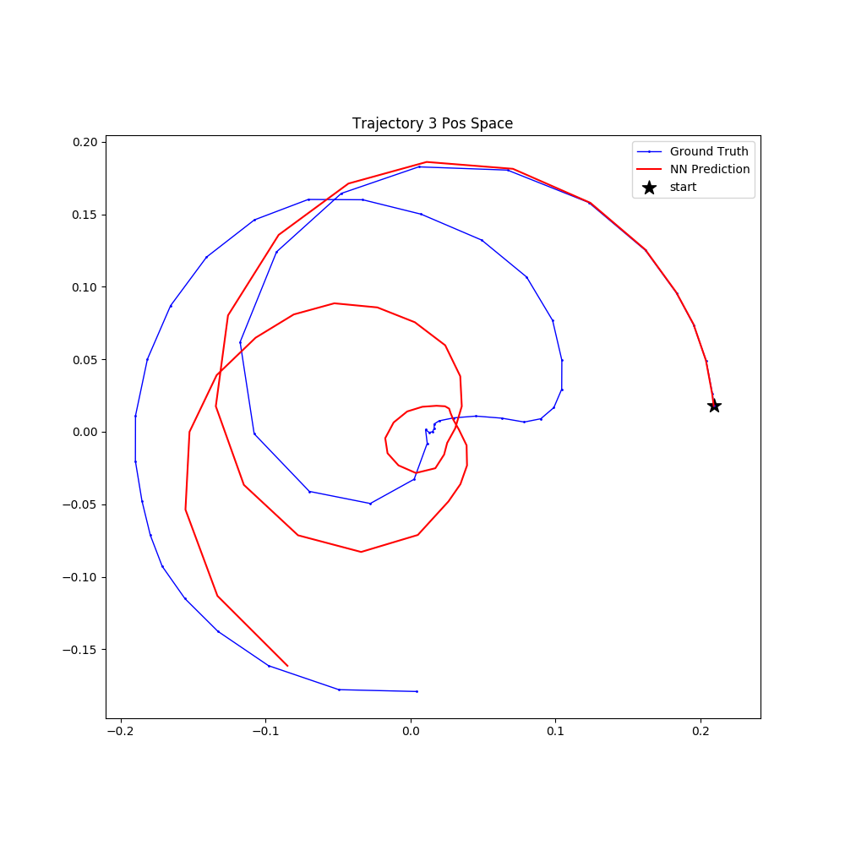
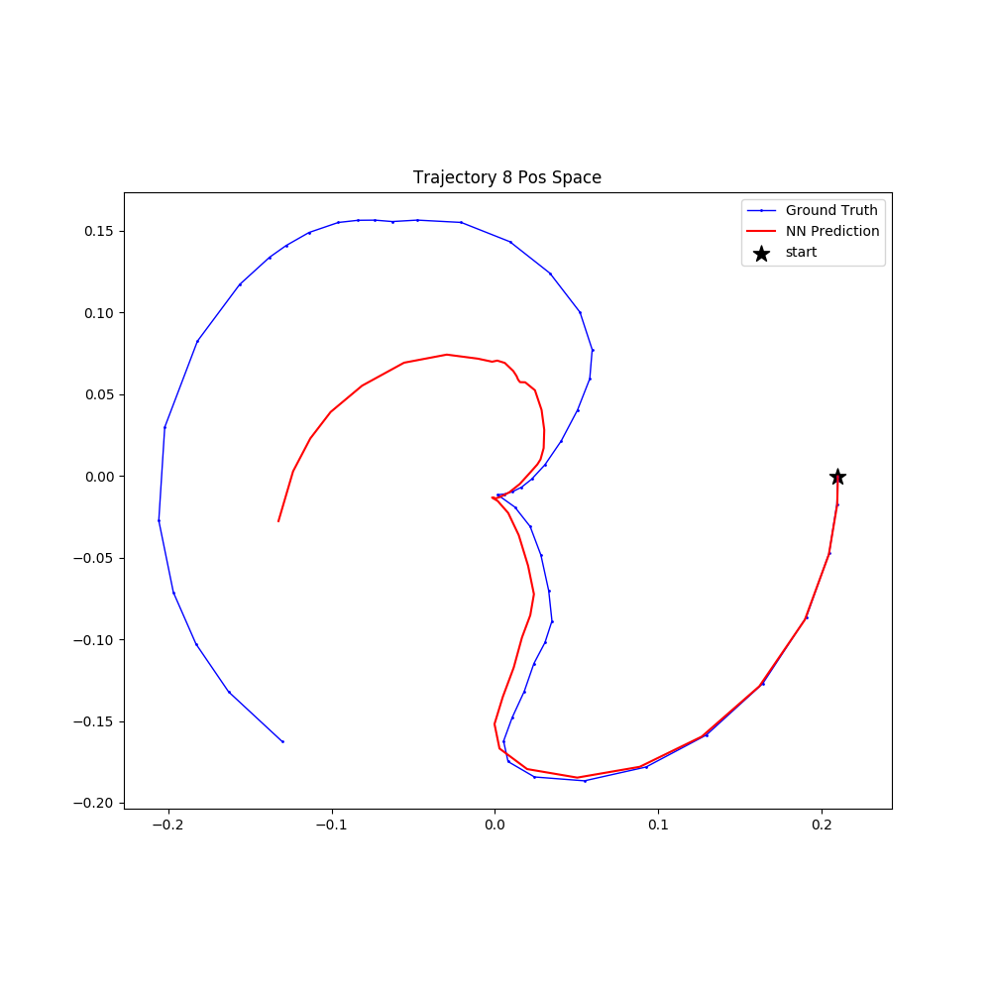
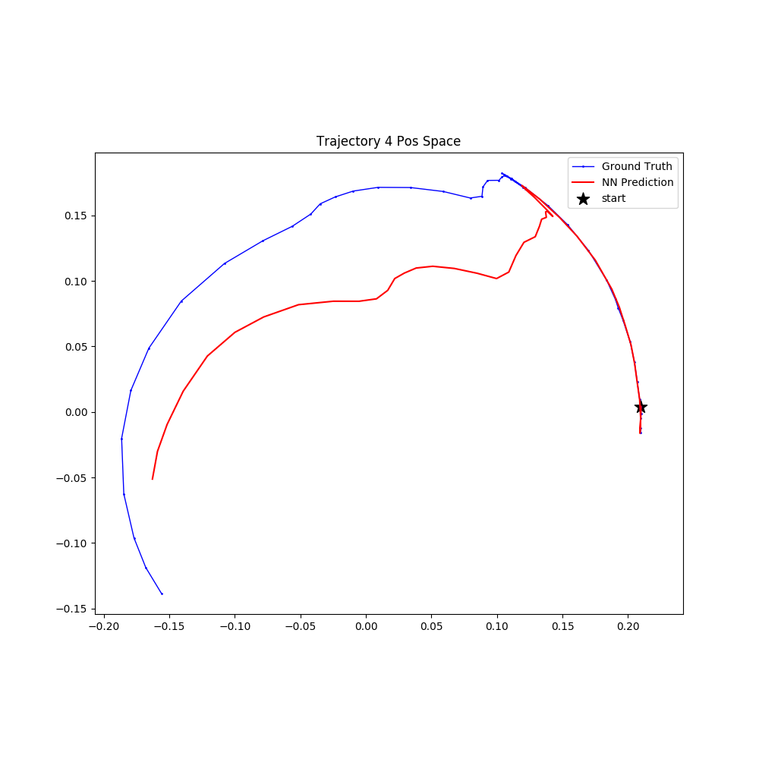
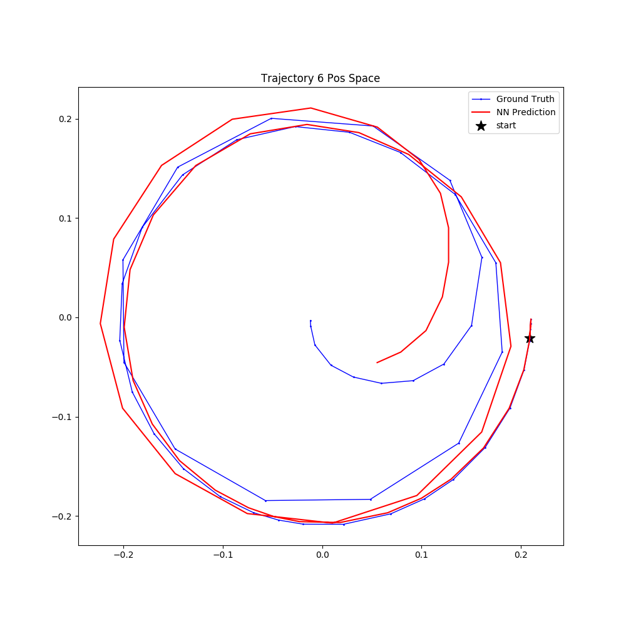
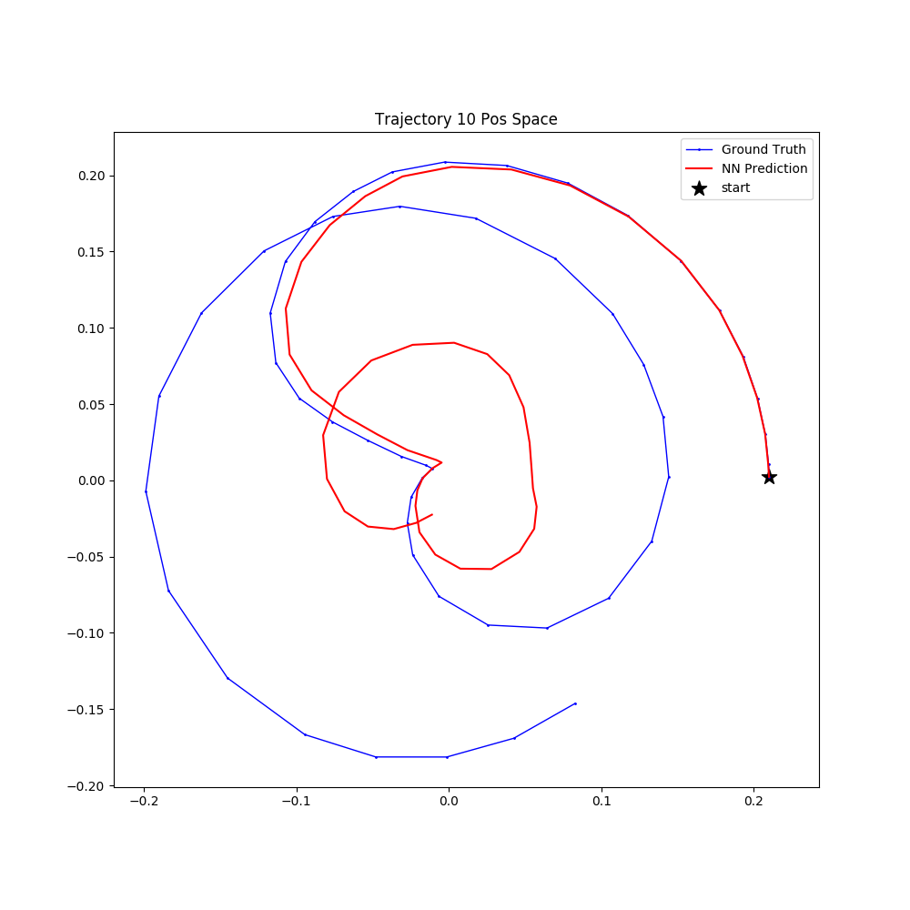
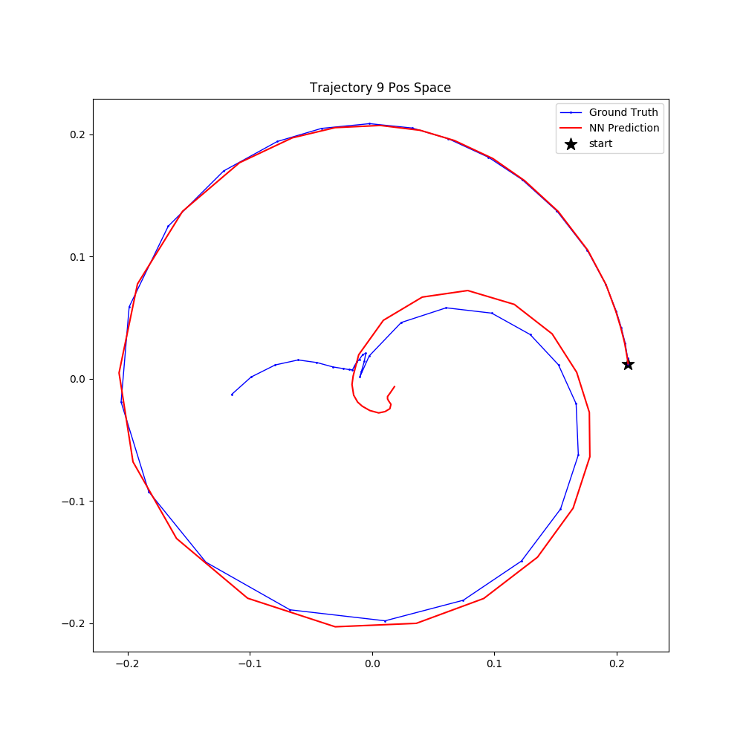
Model Evaluation: Reacher-v2
After 20 iterations of training

