Slide 1
Meeting 06/03/2020
Shuo Zhang

Slide 2
Mujoco/Gym Experiments
Progress
Reacher-v2:
Collect Data: Done
Learn Dynamic Model: Done
Model Evaluation: Done
Planning: Done
Rollout: Done
Acrobot-v1: (There is an issue)
Collect Data: Done
Currently Training: Done
Model Evaluation: Done
Planning: Done
Rollout: Done

Slide 3
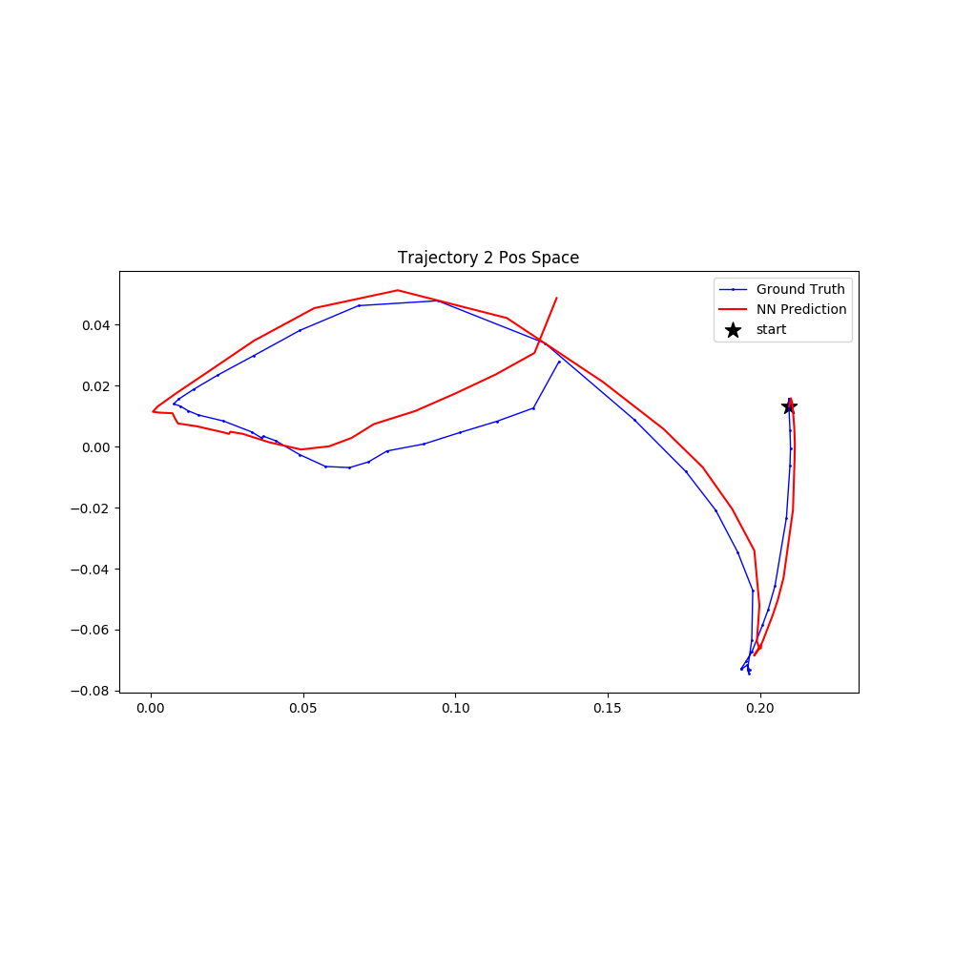
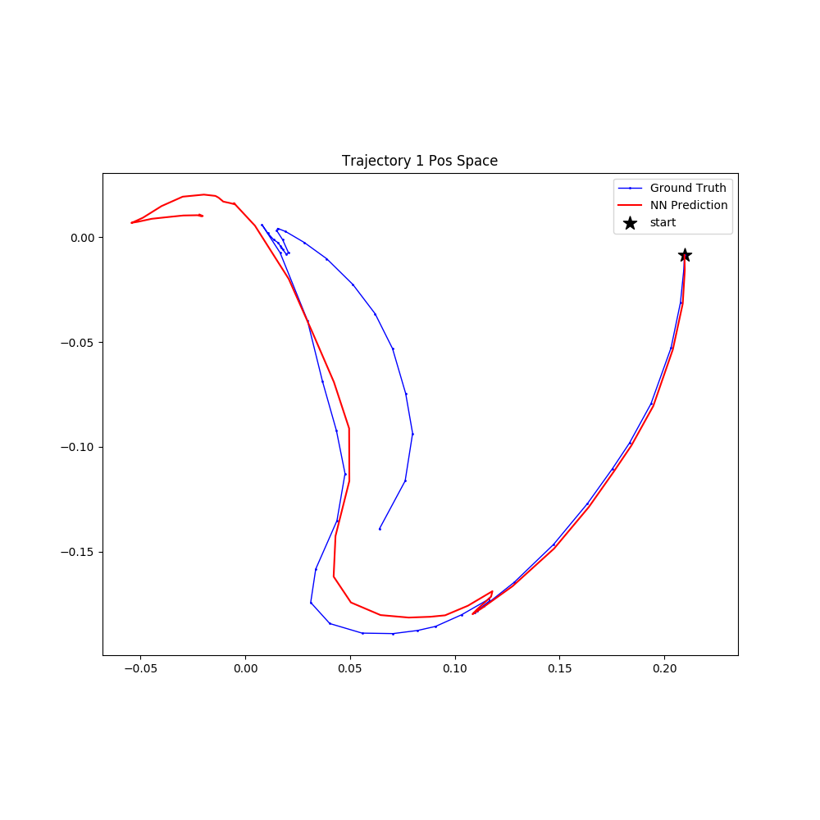
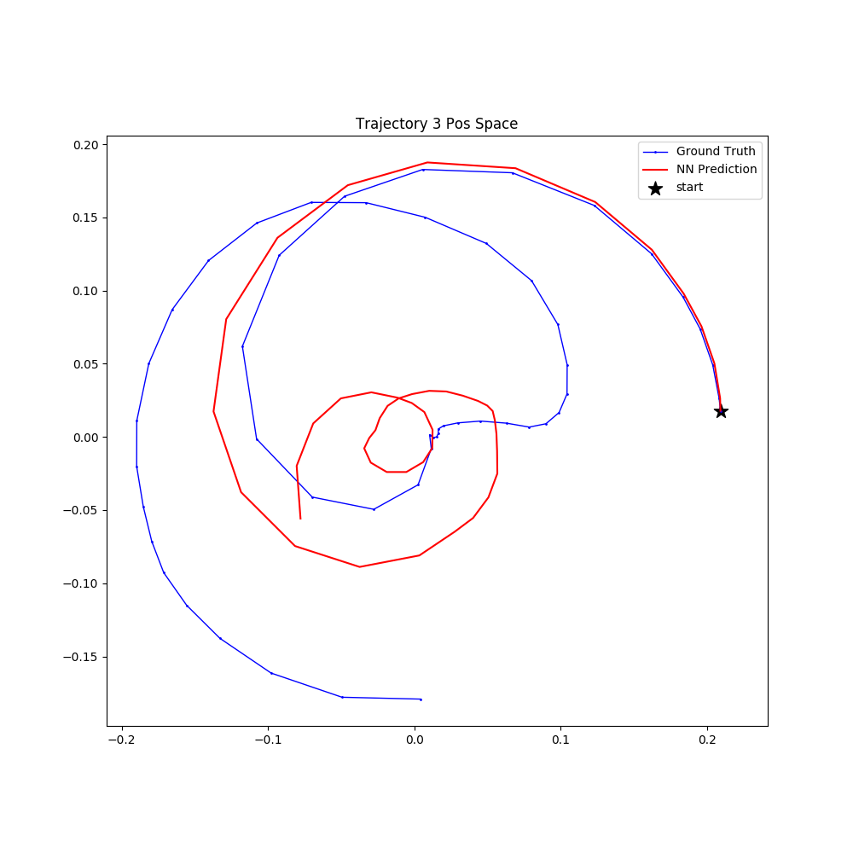
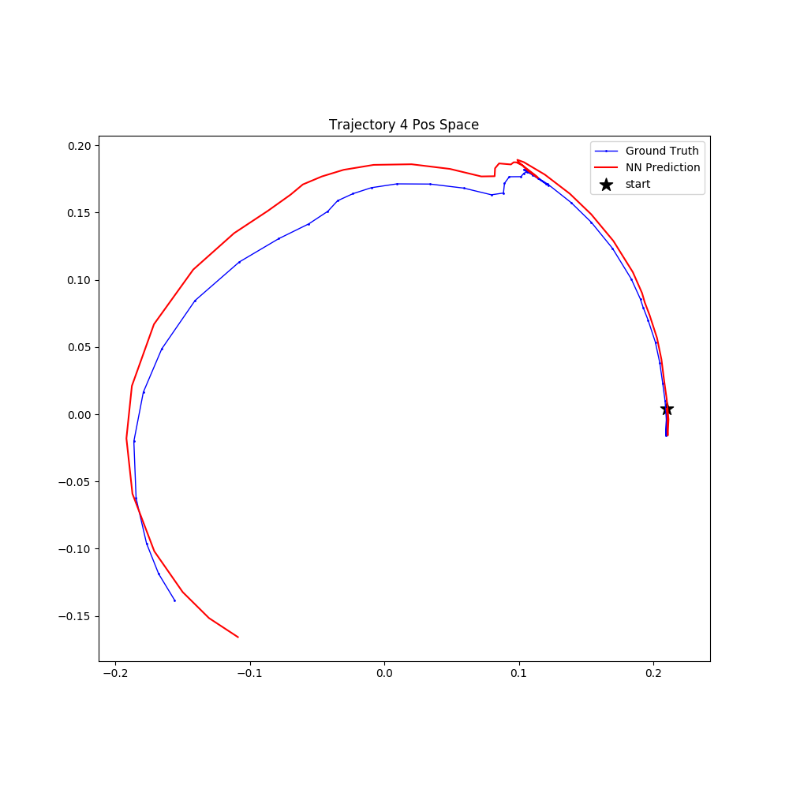
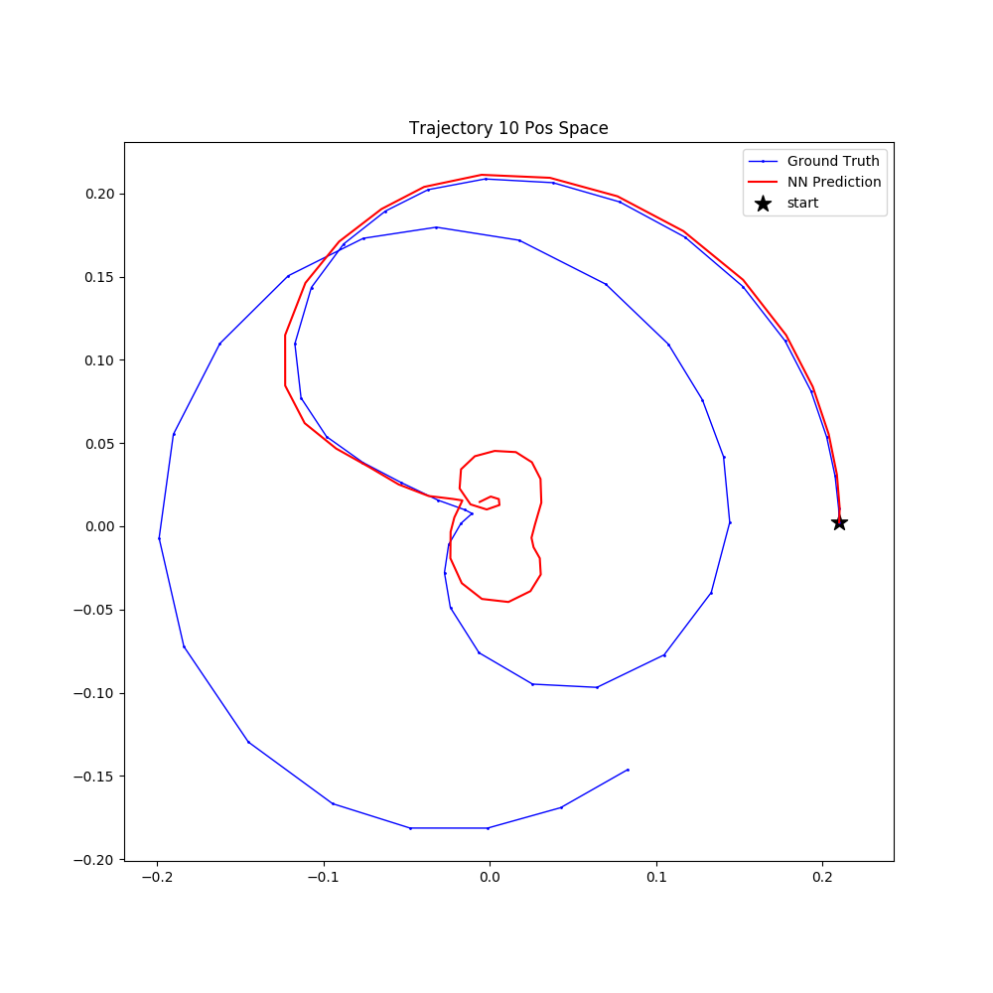
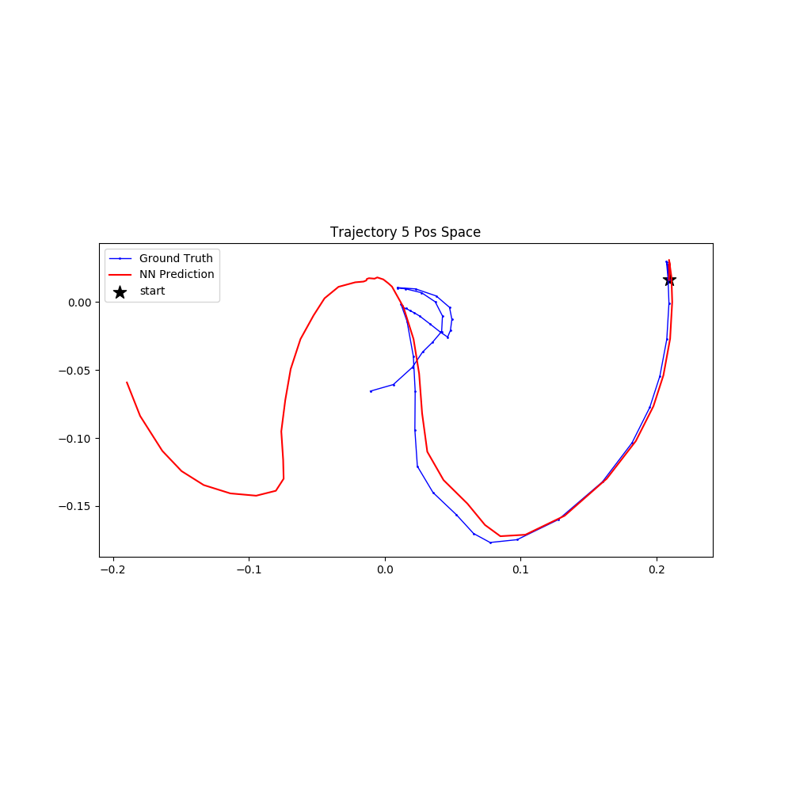
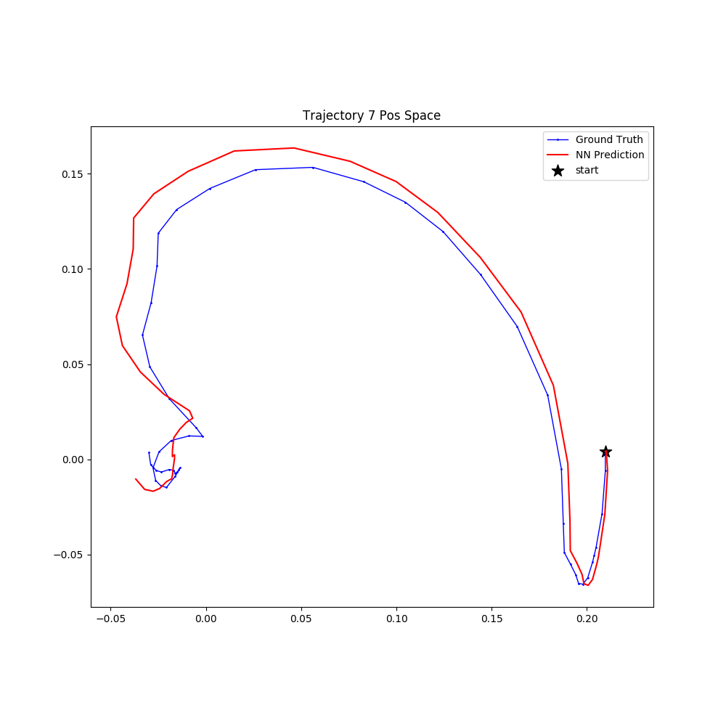
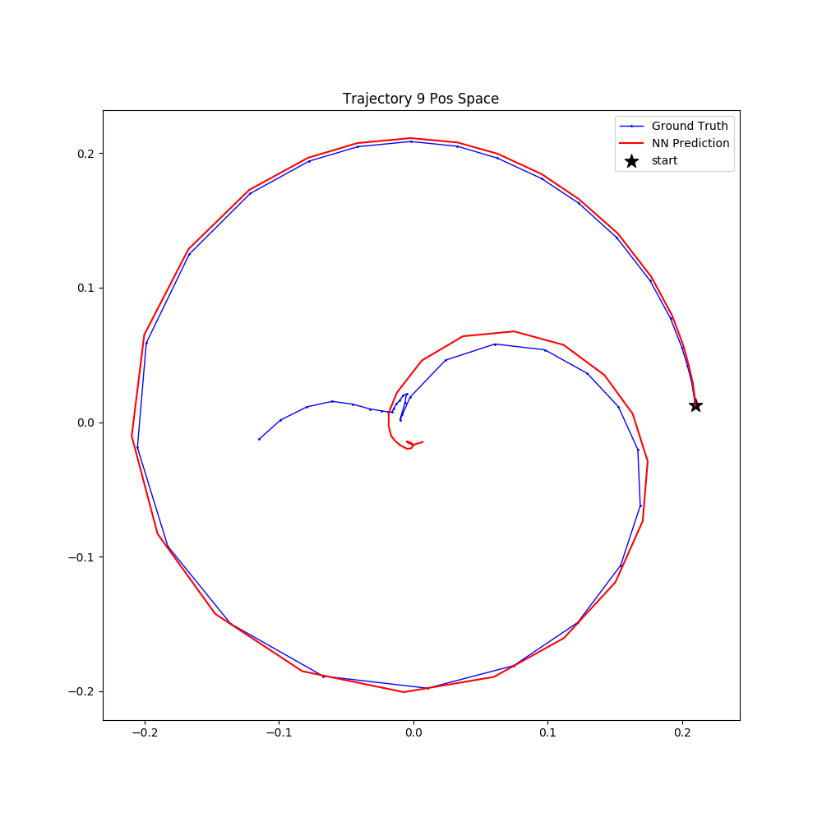
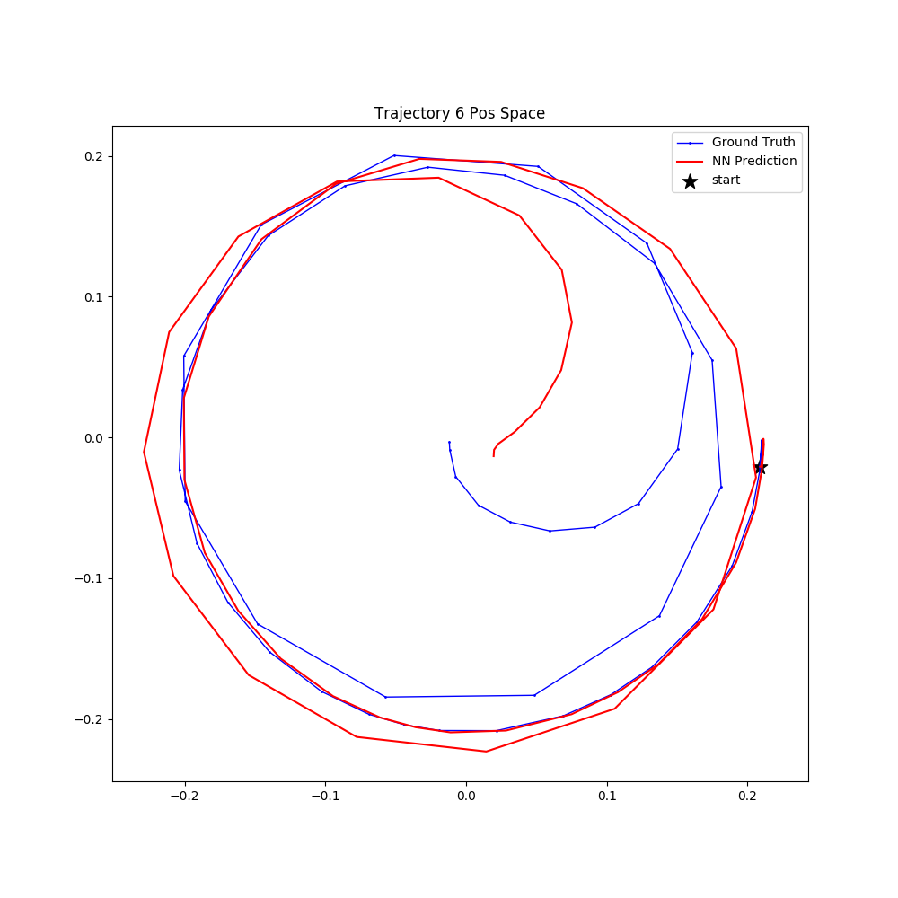
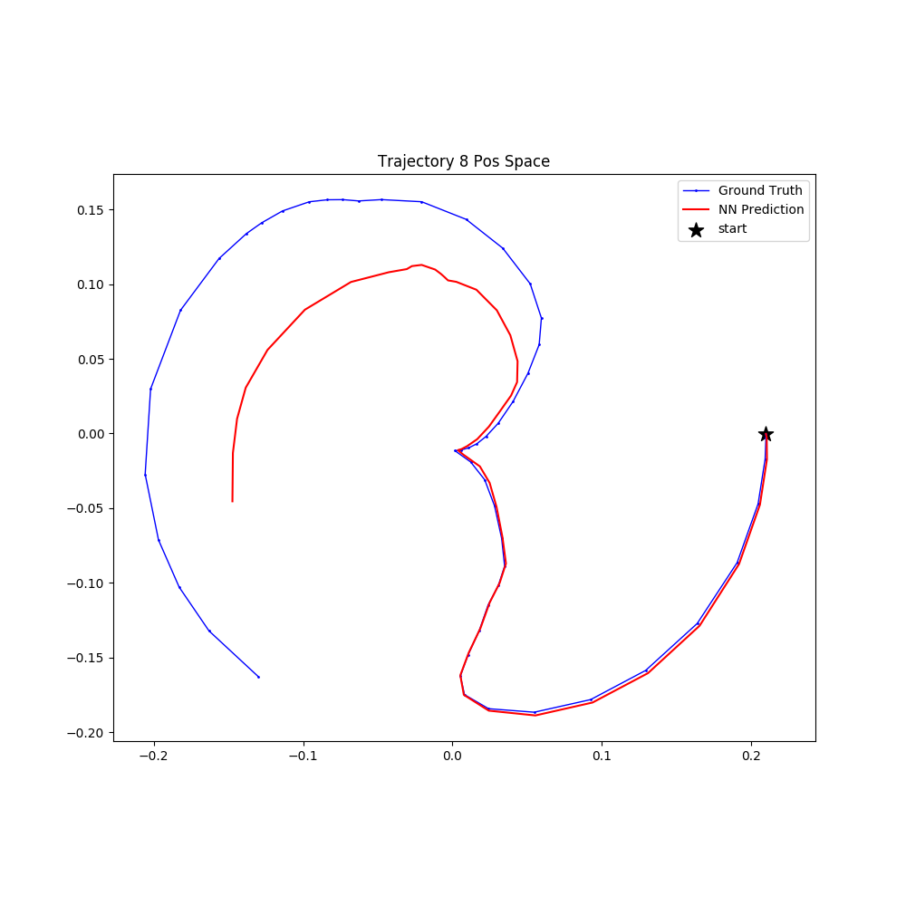
Reacher-v2: Model Evaluation

Slide 4
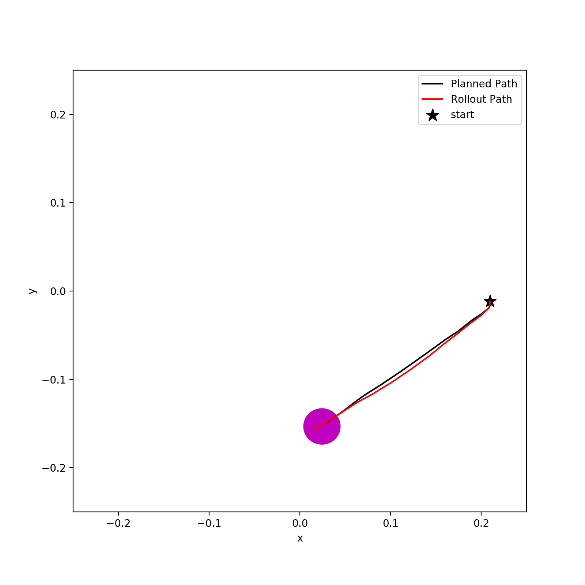
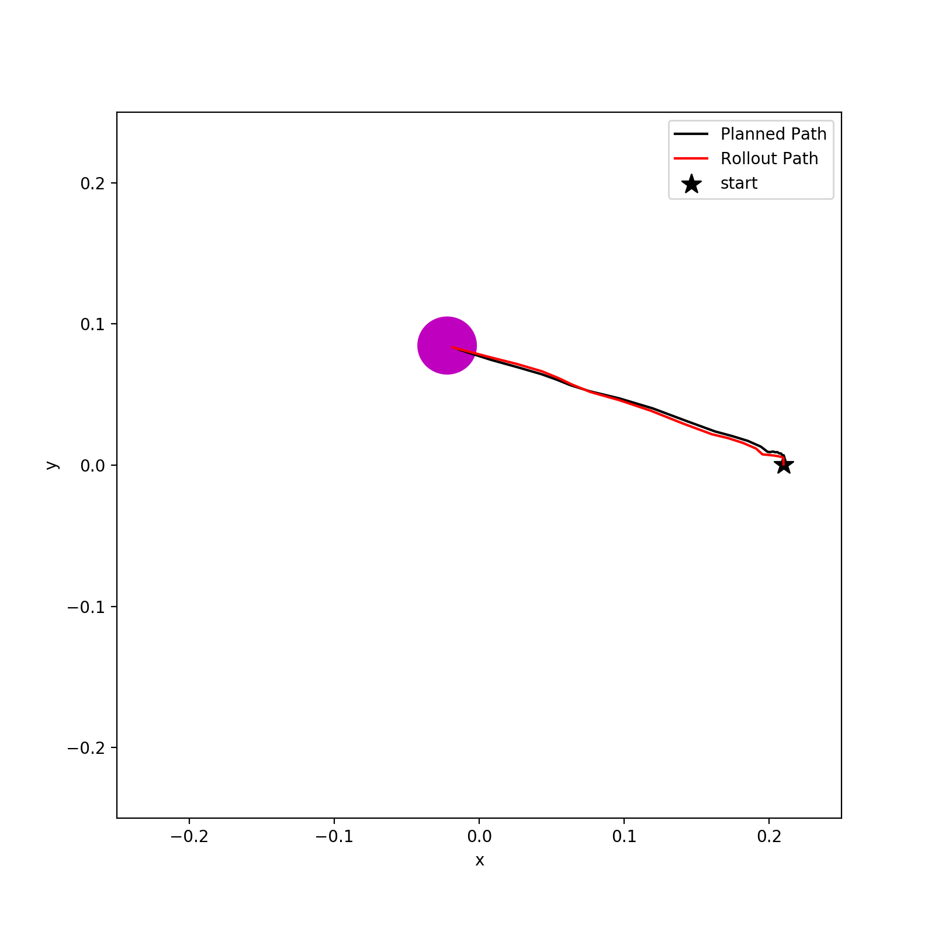
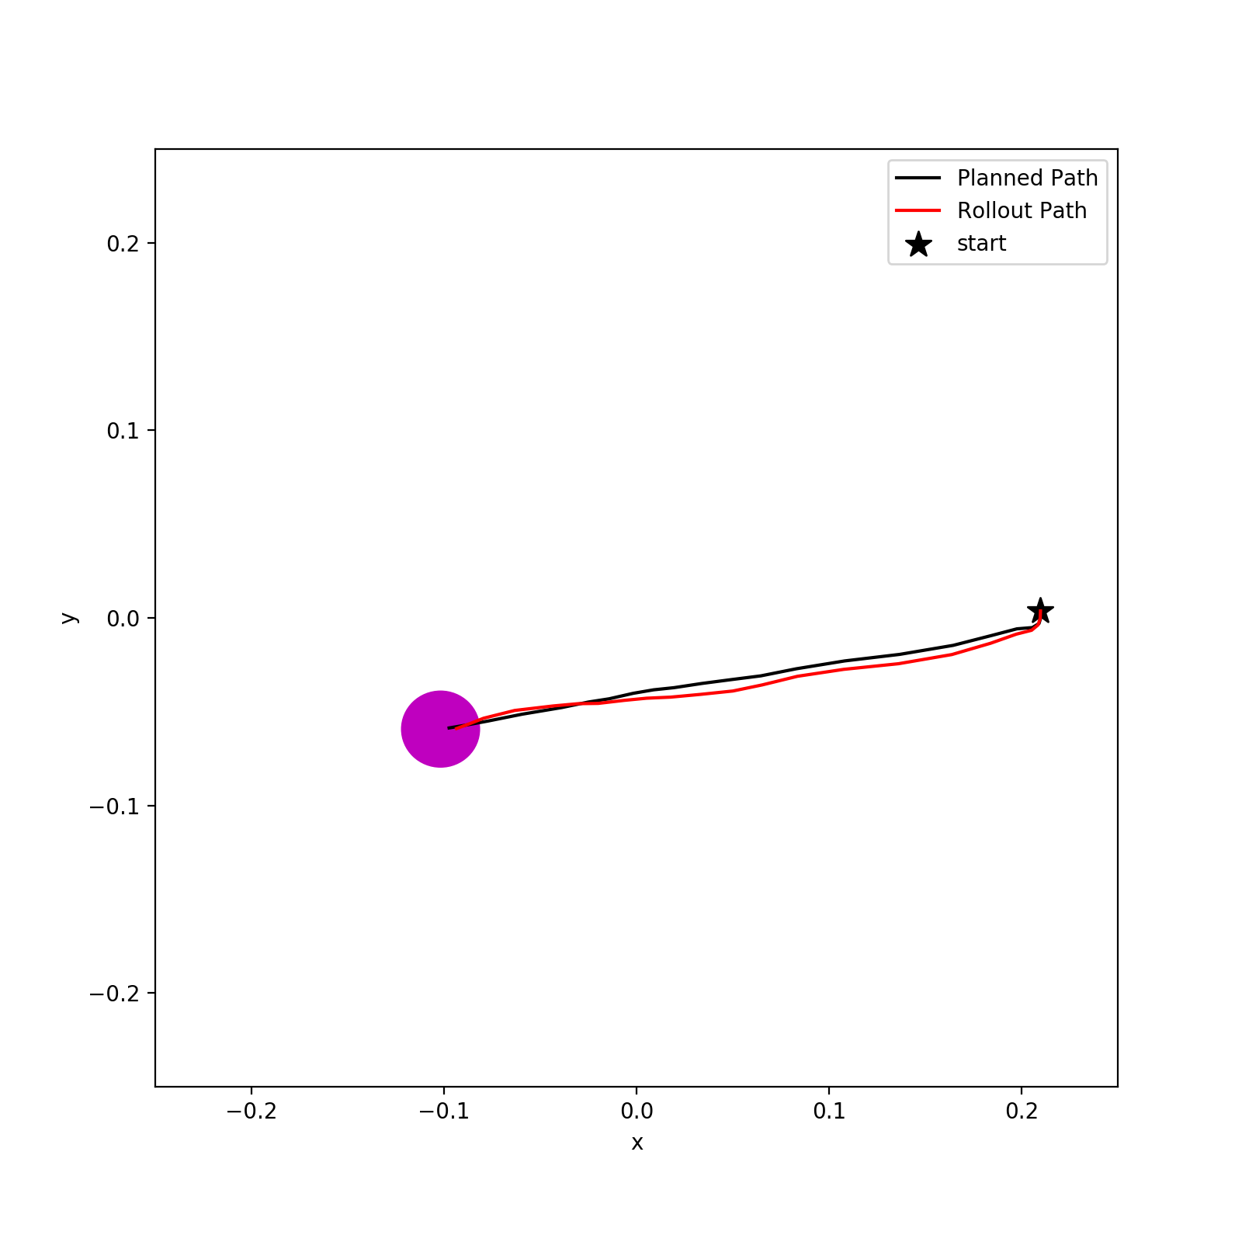
Reacher-v2: Planning+Rollout
Cost Fuction: length of path so far + distance to the goal

Slide 5
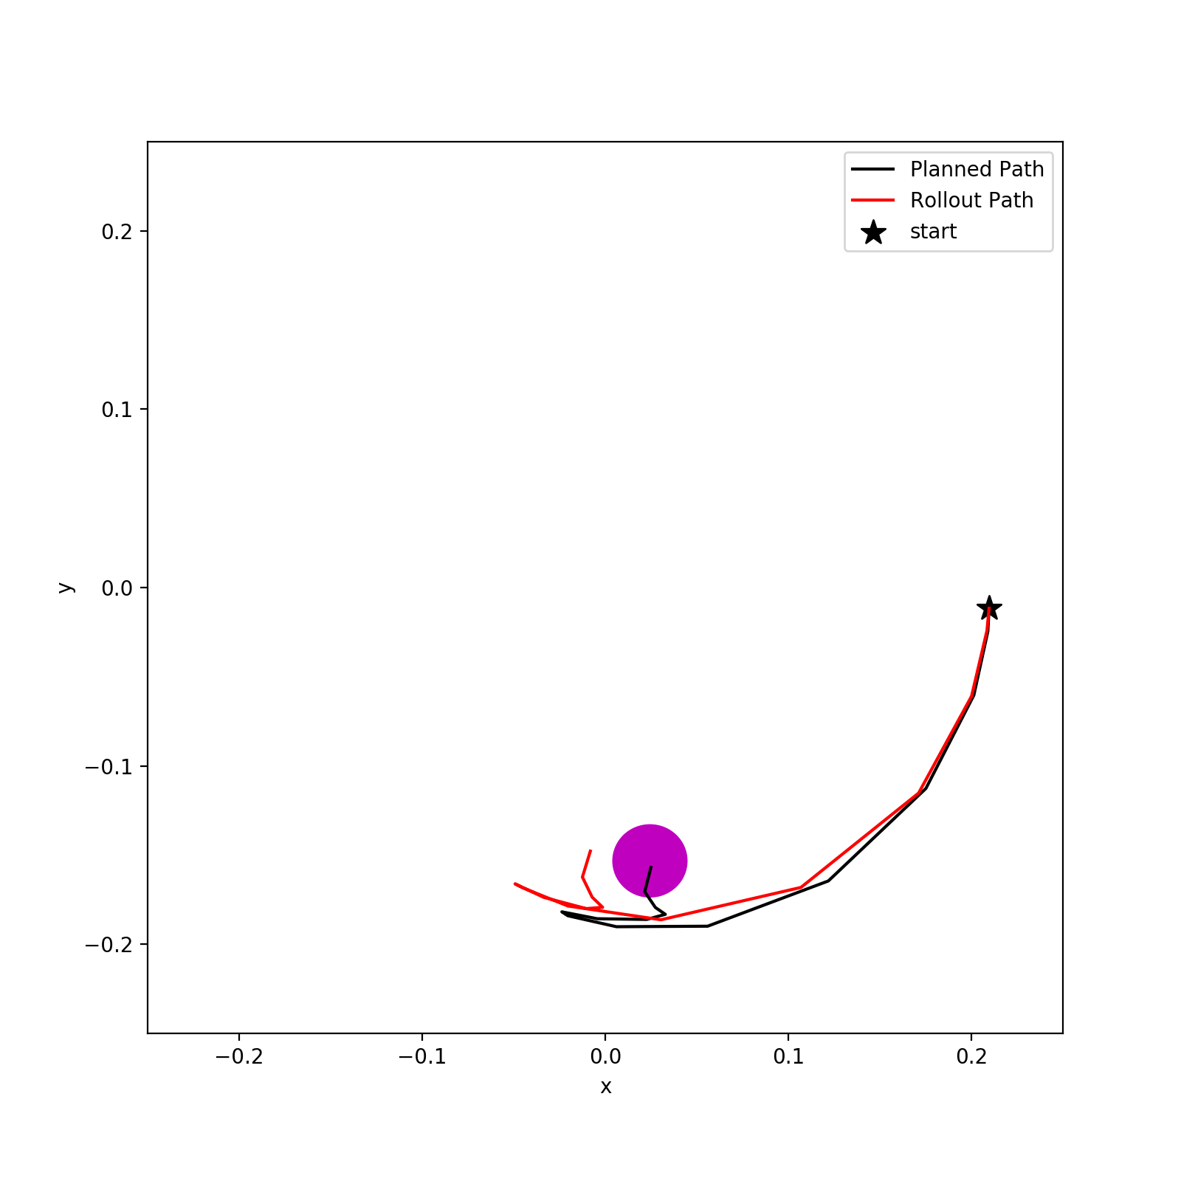
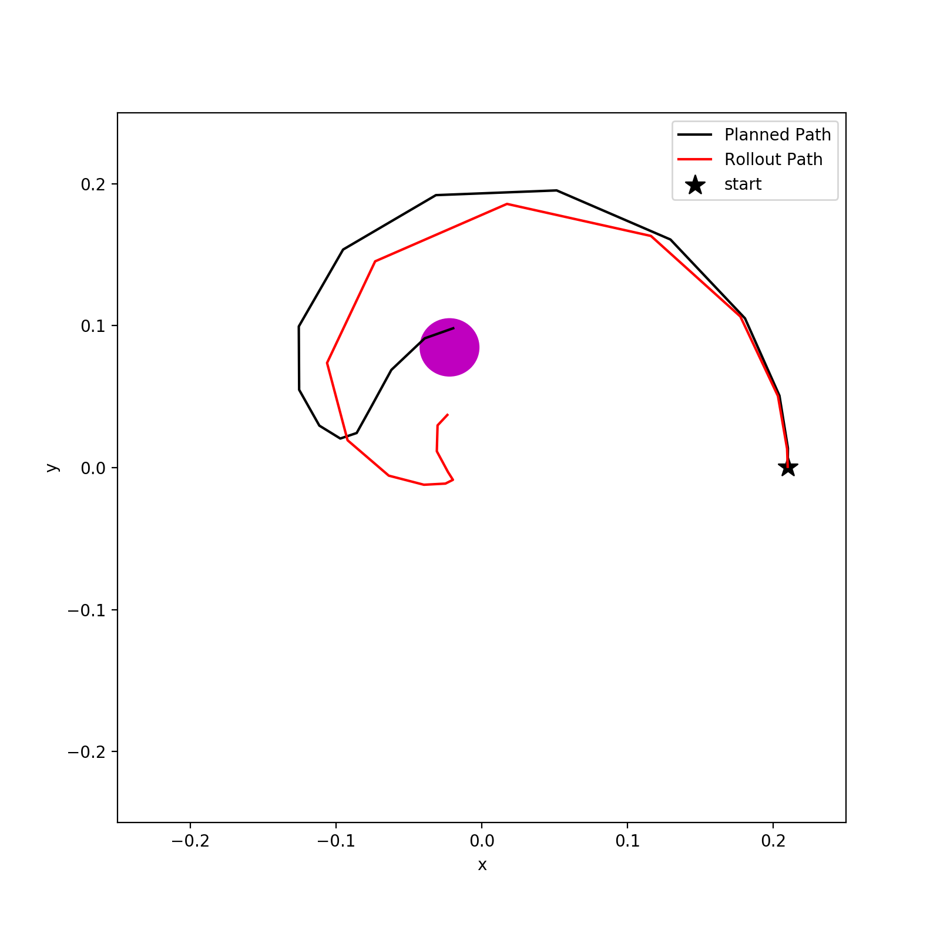
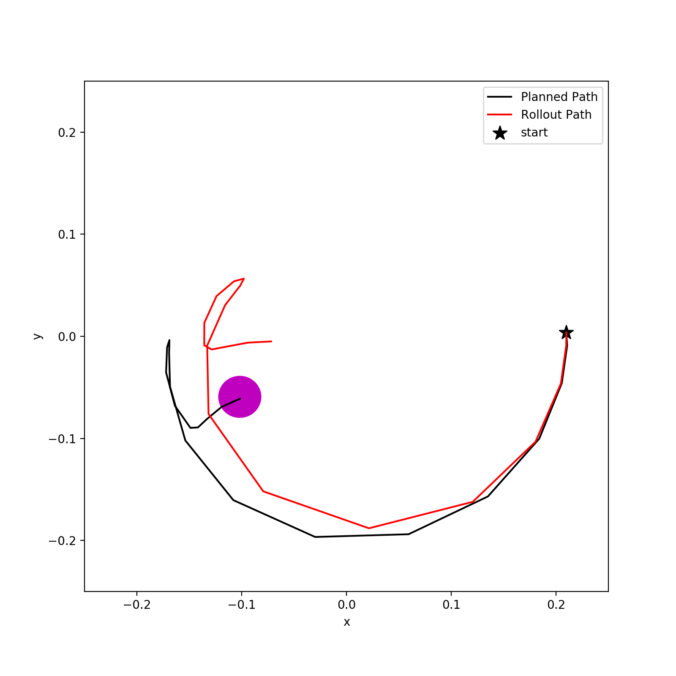
Reacher-v2: Planning+Rollout
Cost Fuction: only distance to the goal

Slide 6
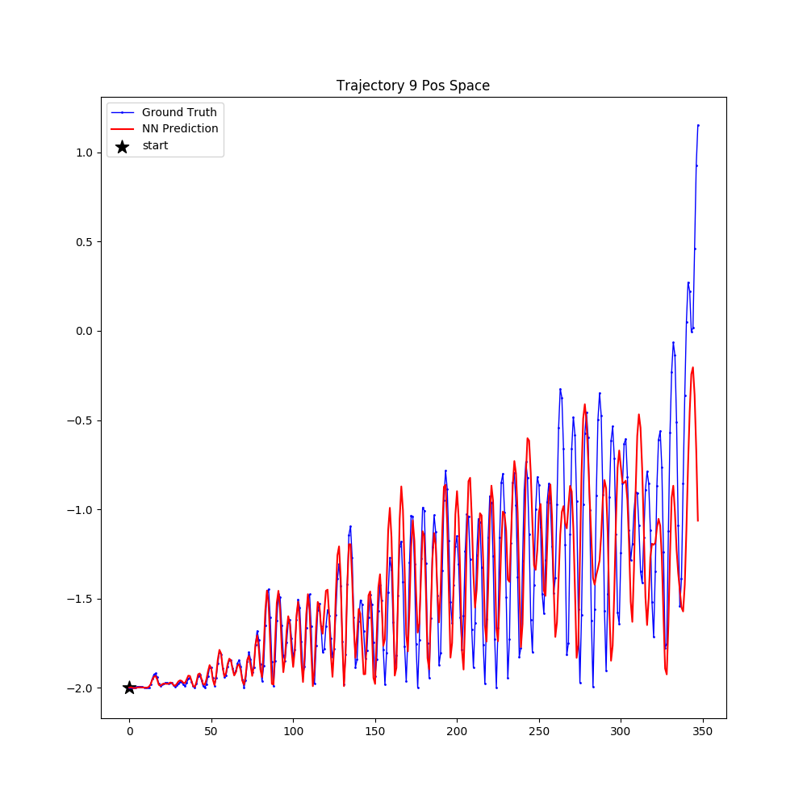
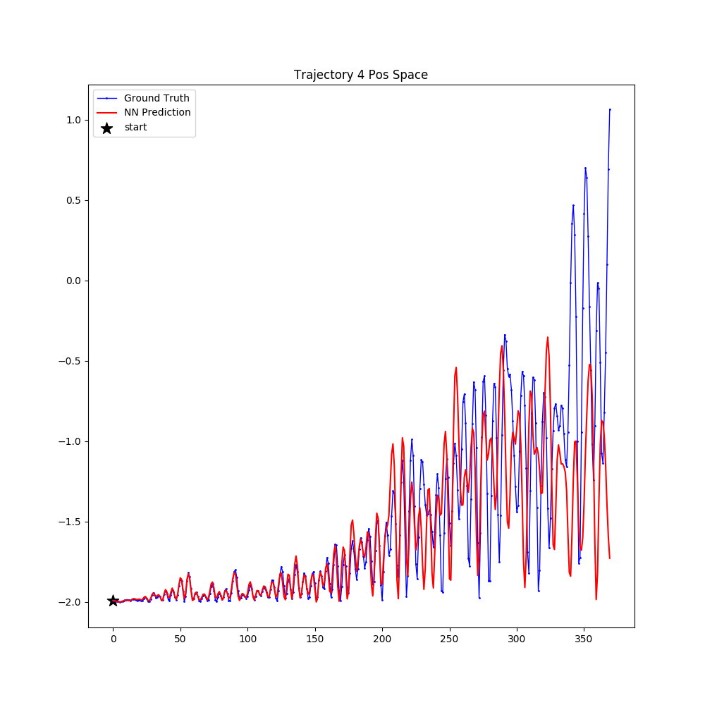
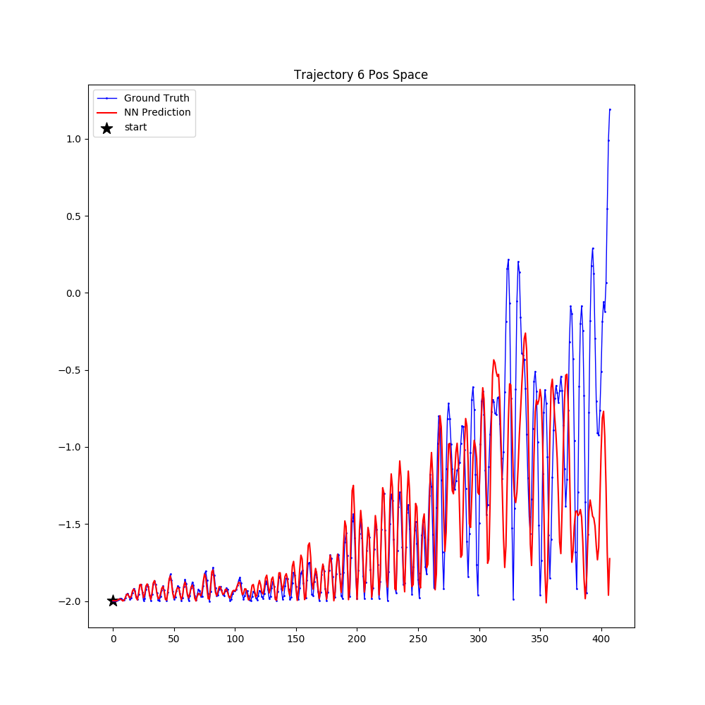
Acrobot-v1: Model Evaluation
X axis: steps
Y axis: Height (Y position) of endeffector is plotted

Slide 7
Acrobot-v1: Problem
Goal is to achieve a height higher than 1,
but for all episodes the NN model failed to predict a height higher than 1.

Slide 8
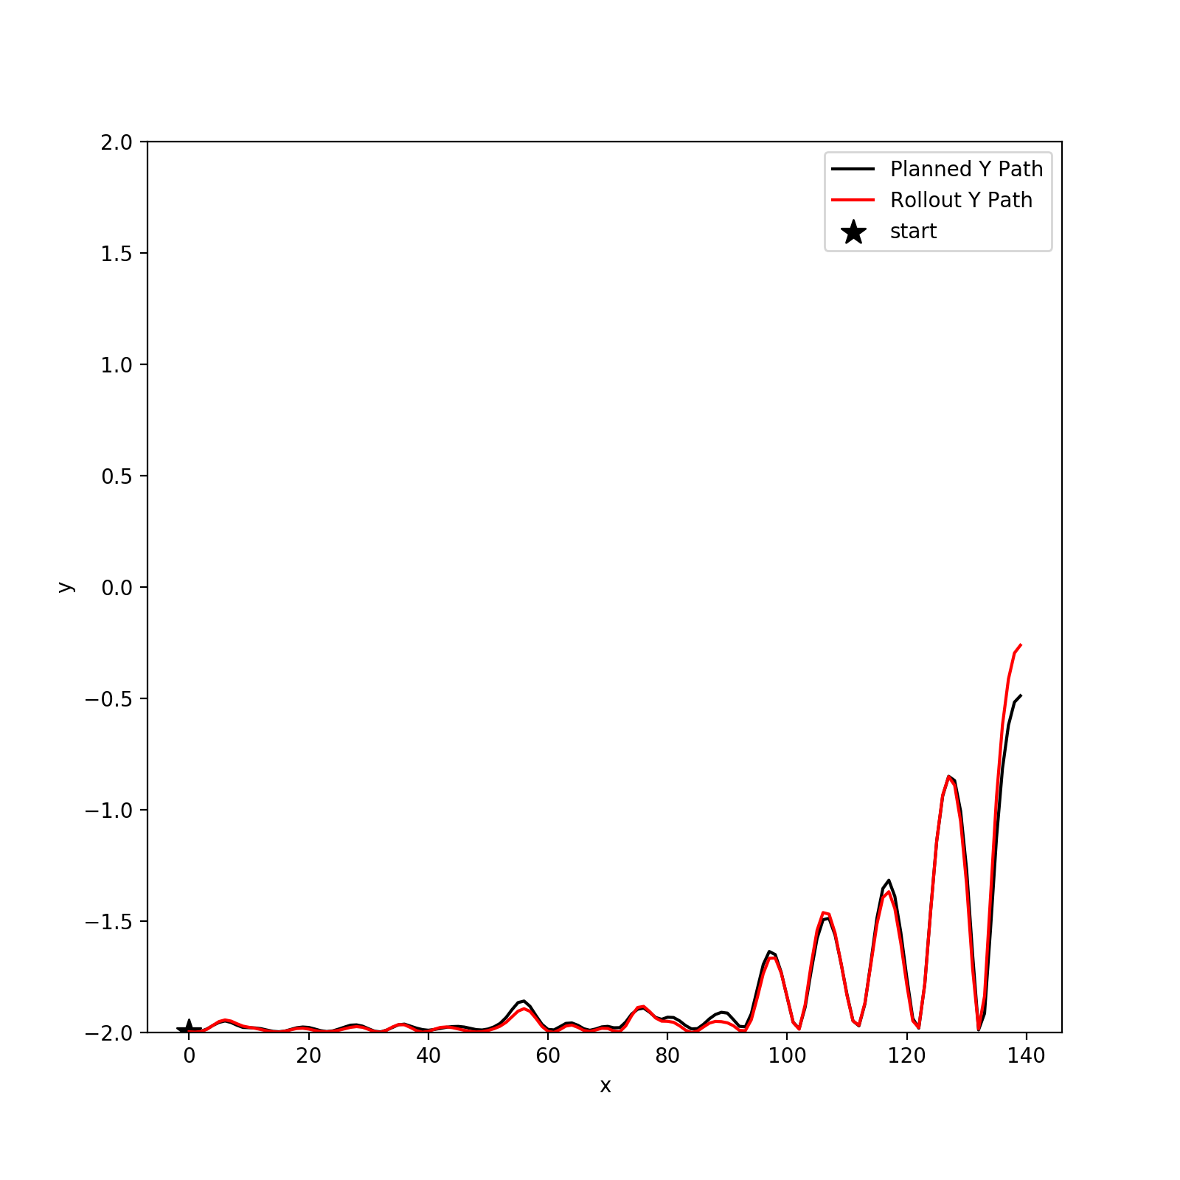
Acrobot-v1: Planning+Rollout
Goal Height: -0.5
Cost Fuction: length of height path so far + distance to the goal height

Slide 9
Acrobot-v1: Planning+Rollout
Goal Height: 1.0
Planner gave no results after a couple of hours planning.

