Slide 1
Meeting 06/20/2020
Shuo Zhang

Slide 2
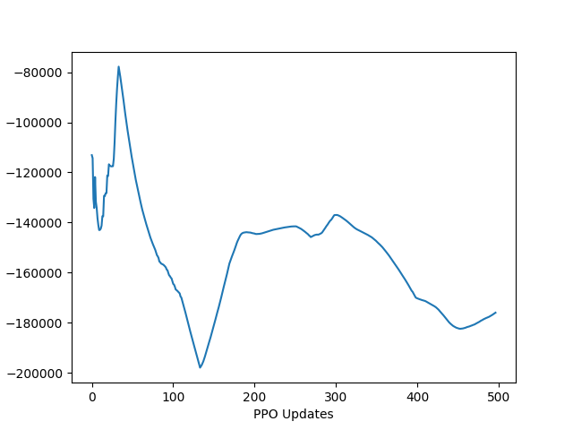
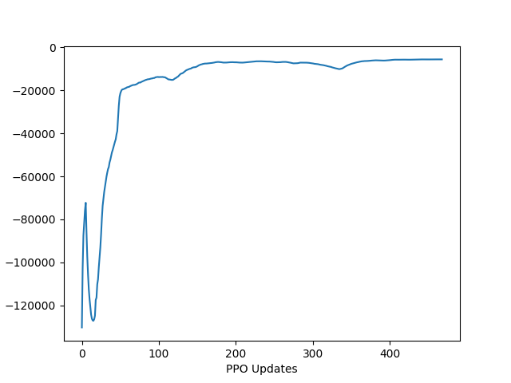
Adaptive Hand PPO: Goal Loc 7
With terminal + Control reward coefficient 1
When estimate generalized advantage,
only take entire episodes (e.g. 2000 steps or 4000 steps)
Seed 0
Seed 1
Average return over 100-episodes

Slide 3
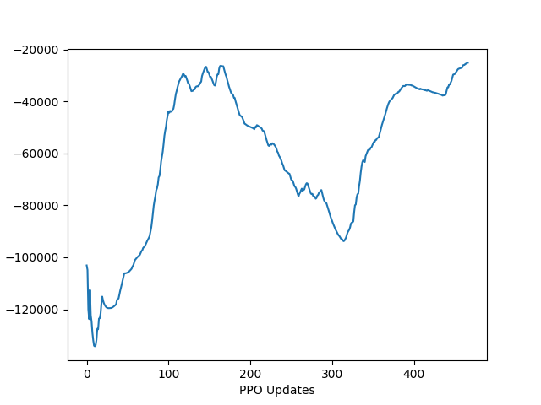
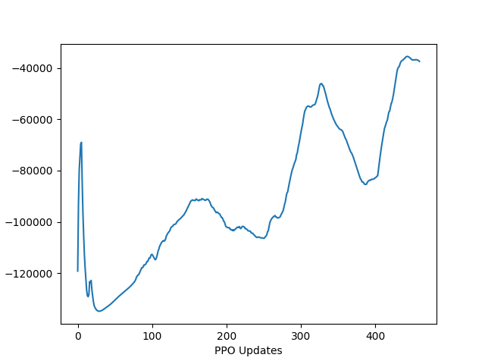
Adaptive Hand PPO: Goal Loc 8
With terminal + Control reward coefficient 1
When estimate generalized advantage,
only take entire episodes (e.g. 2000 steps or 4000 steps)
Seed 0
Seed 1
Average return over 100-episodes

Slide 4
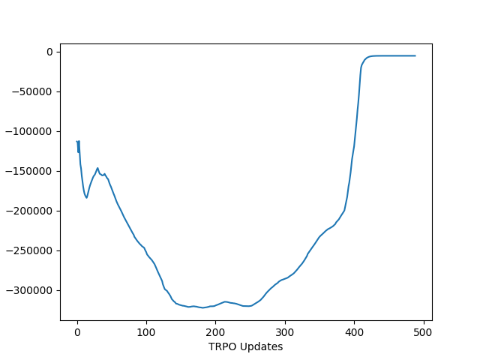
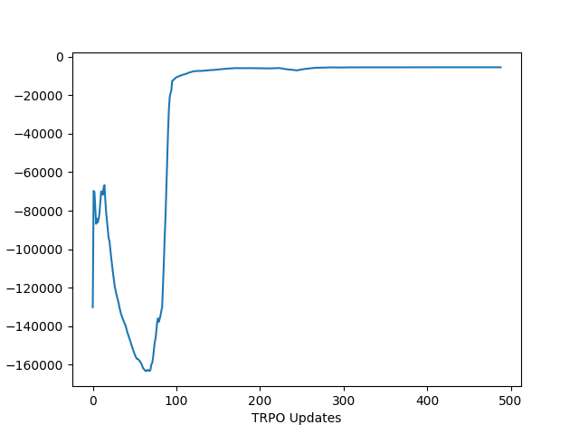
Adaptive Hand TRPO: Goal Loc 7
With terminal + Control reward coefficient 1
Seed 0
Seed 1
Average return over 100-episodes

Slide 5
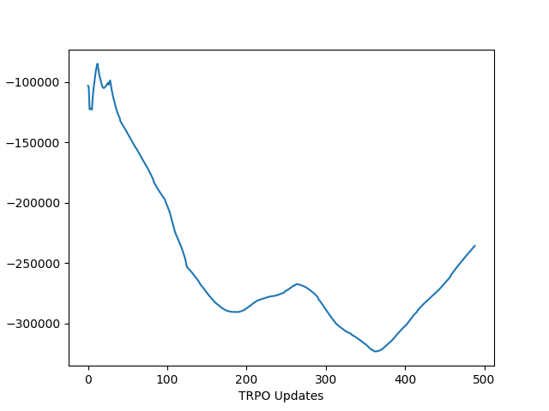
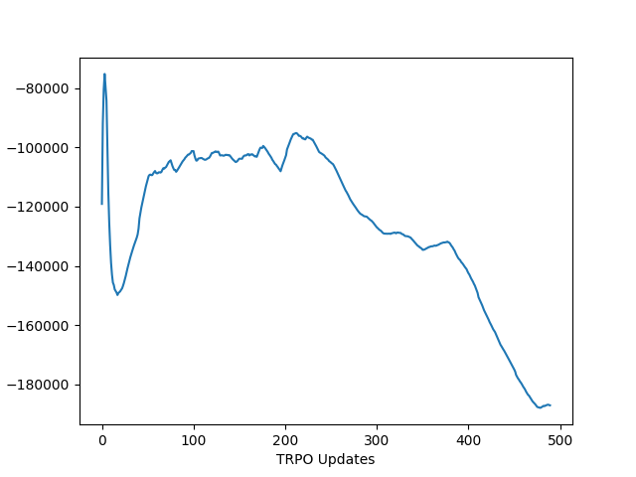
Adaptive Hand TRPO: Goal Loc 8
With terminal + Control reward coefficient 1
Seed 0
Seed 1
Average return over 100-episodes

